Slide 1
Mobile App for text recognition
1. Introduction
This is a mobile app to capture photo from camera and recognize text (English characters only) in the captured photo. The captured text is then saved into public cloud storage.
2. Technology Stack
Frontend: Java in Android Studio
Backend: Nodejs and Google Cloud (functions, Pub/Sub, Storage, Vision API)
Text Recognition: Firebase ML Kit for Android
3. Source Codes Repository
Frontend is https://github.com/samhkwest/mycrapp
Backend is https://github.com/samhkwest/ocr

Slide 2







Mobile App for text recognition
4. Data Flow
The data flow of this text recognition platform is illustrated as below:
5
Cloud Function B
Captured Image Bucket
Captured image
File of recognized text
1
Processed Image Bucket
Cloud Function A
2
4
3
Extracted text

Slide 3

Mobile App for text recognition
4. Data Flow (Cont’d)
The data flow consists of following steps:
The mobile app sends a image file captured from camera to Captured Image Bucket.
The Cloud Function A is triggered to call the Vision API to extract the text.
The extracted text is sent to a result.
The Cloud Function B saves the extracted text from the result queue to a text file.
The result file is sent to the Processed Image Bucket.
5. Frontend & Backend
The UI of the mobile app is as below:

Slide 4
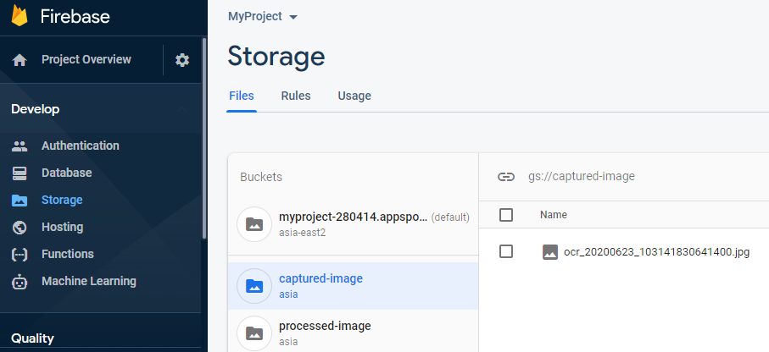
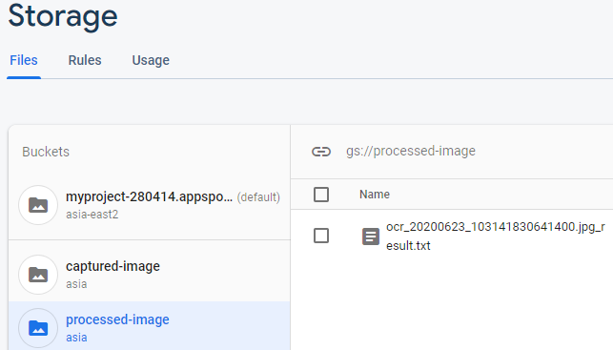
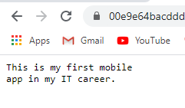
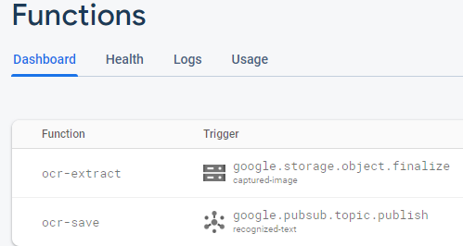
Mobile App for text recognition
5. Frontend & Backend
The Backend in google cloud platform is as below:
a) Bucket for captured image:
b) Bucket for result file (recognized text):
Open file in Google Cloud Console
c) Cloud Functions (to trigger text recognition and save result file)

