Slide 1
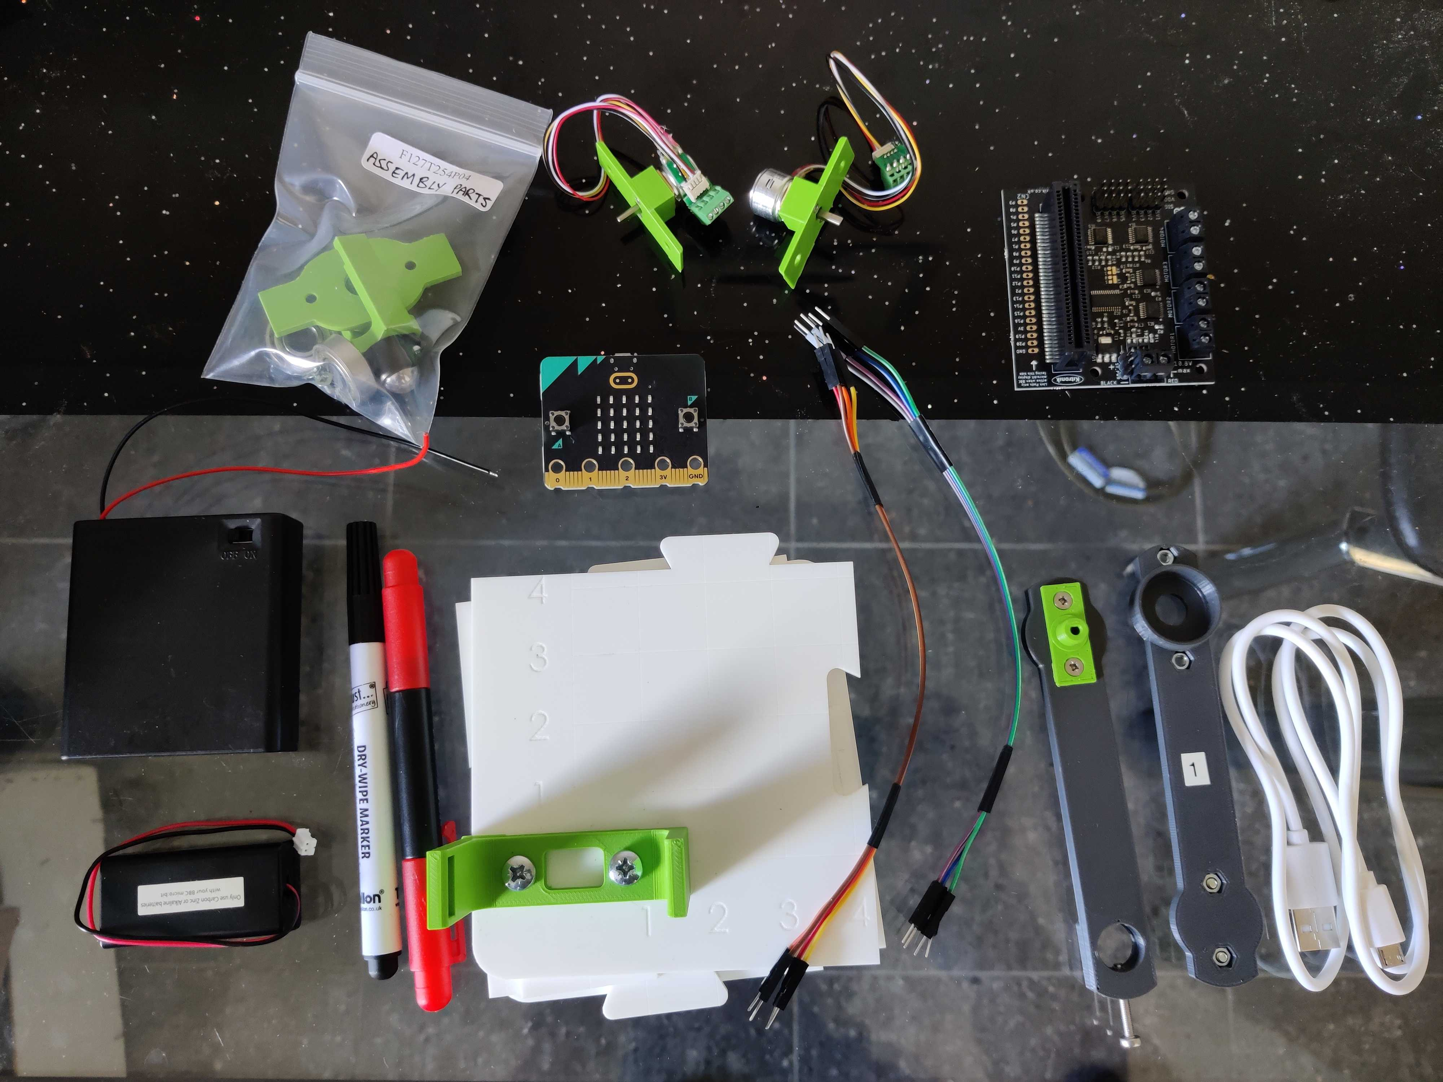
img2
2 Stepper motors
Microbit microcontroller
Bag labelled 'Assembly parts'
Kitronik robotics board
usb cable
AA 4 battery holder
whiteboard marker &
screwdriver (looks like a pen)
base board (white in color in 4 pieces)
Robot arms
2 jumper leads (4 wires each)

Slide 2
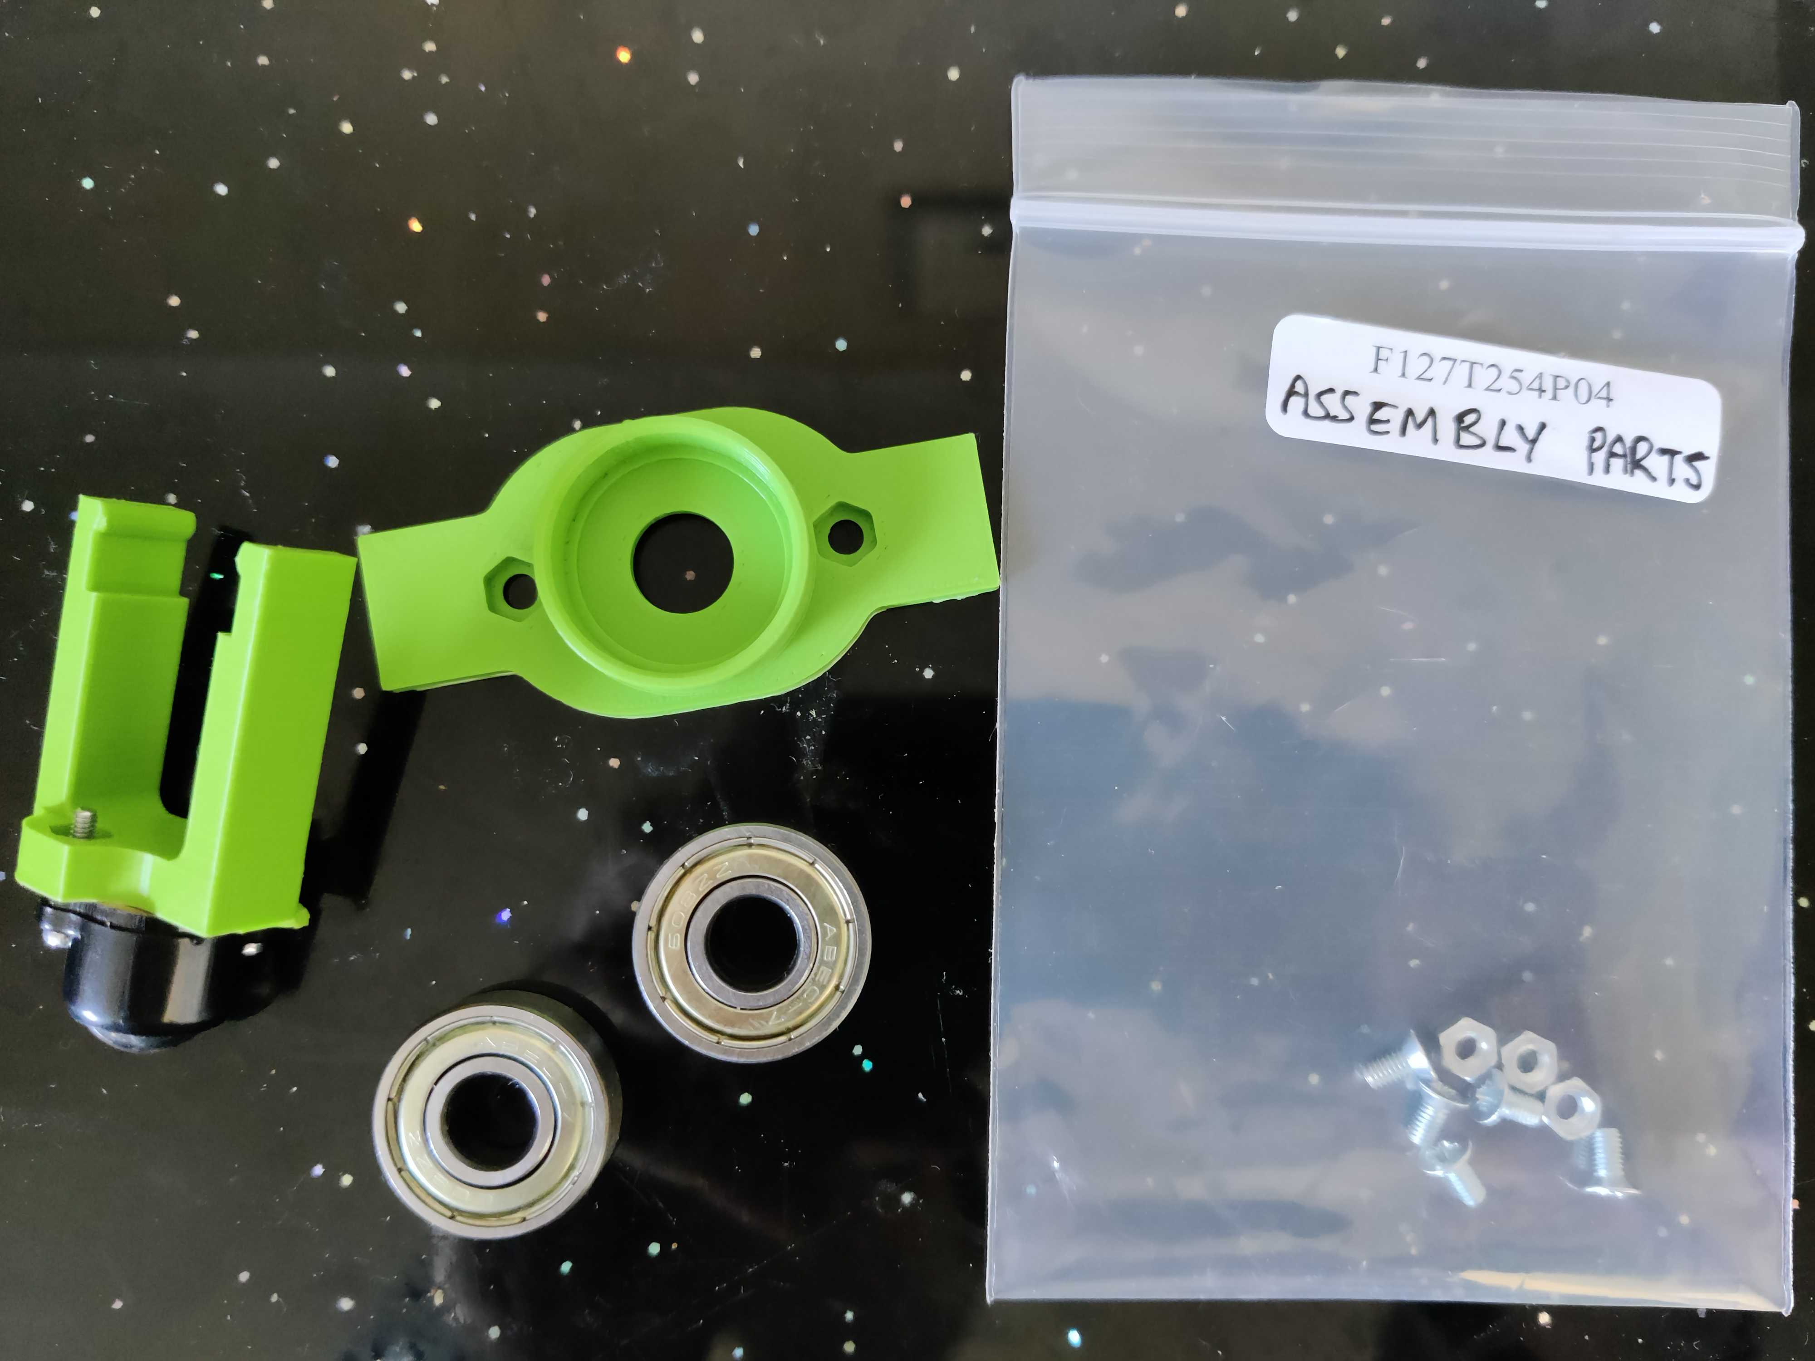
bearing holder
caster holder
screw
nut
bearings

Slide 3
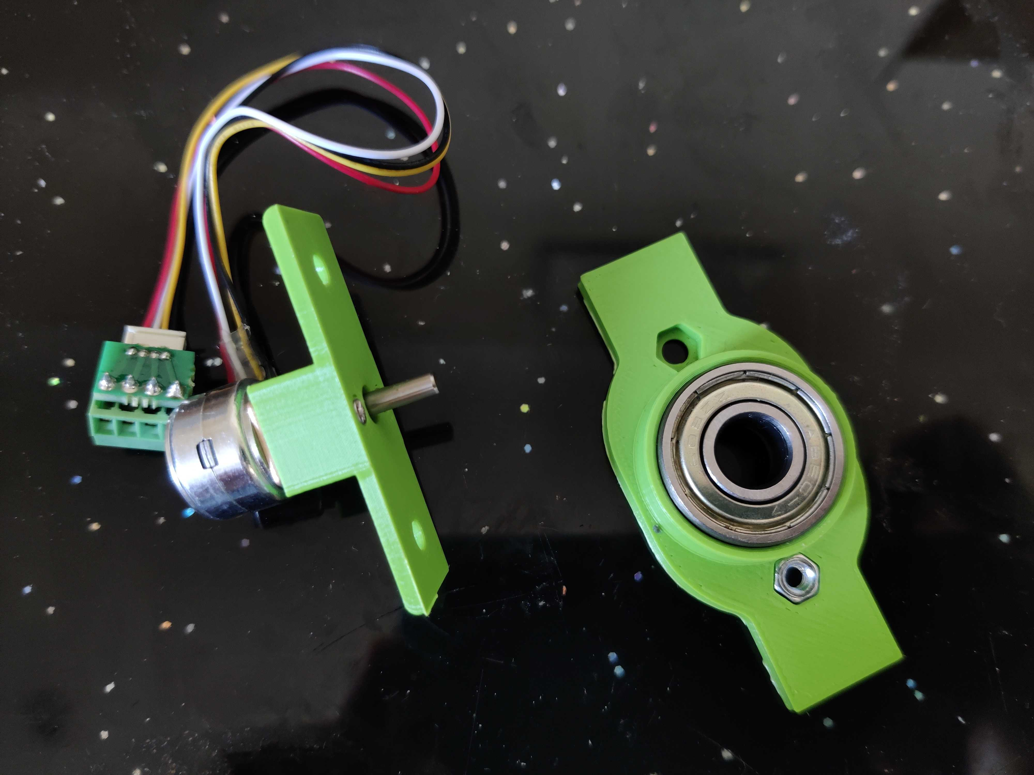
nut

Slide 4
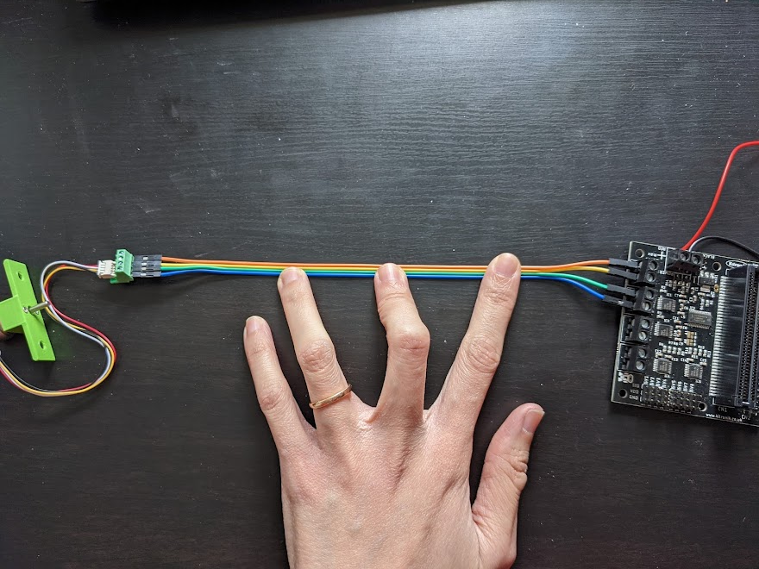
1
2
3
4
a
b
c
d

