Slide 1
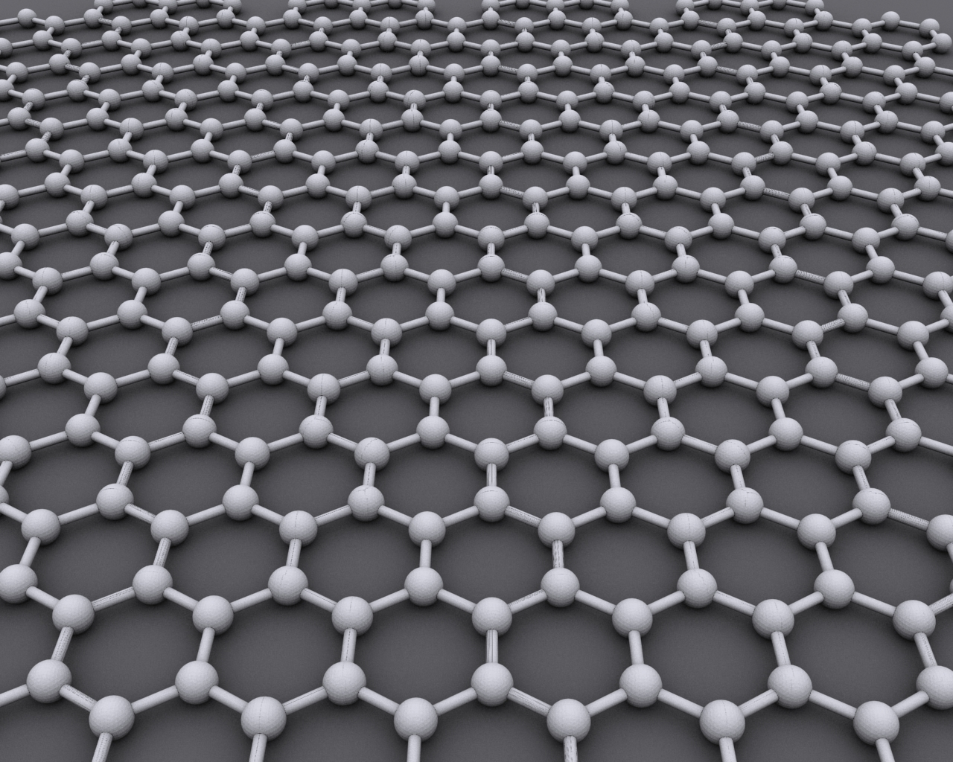
Graphing Graphene
Charles Zhang, Saavan Patel, and Sam Holladay

Slide 2
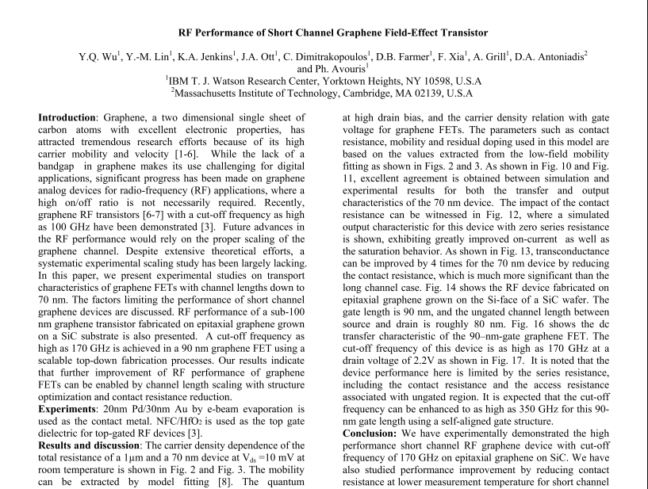

Slide 3
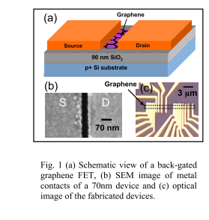
RF Measurements of graphene FETs

Slide 4
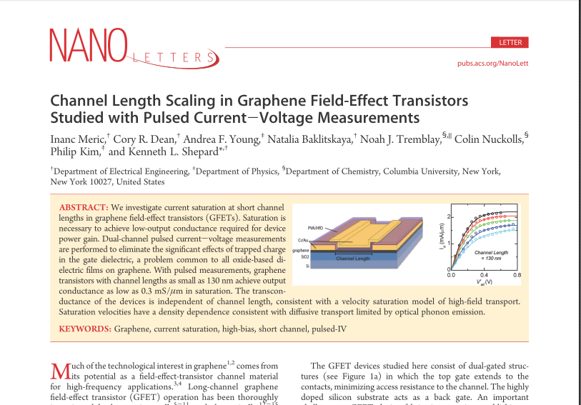

Slide 5
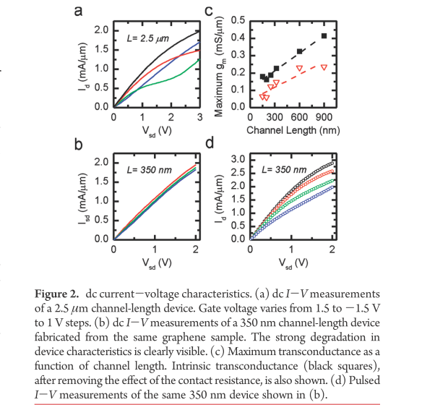
Current-voltage for various channel lengths

Slide 6
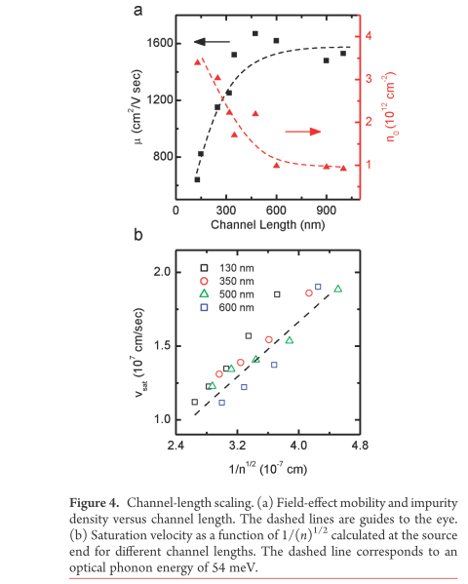
Experimental channel length scaling

Slide 7
Band structure calculation
Find eigenvalues of 6x6 Hamiltonian matrix
Using Slater Koster coefficients with first nearest neighbor approximation

Slide 8
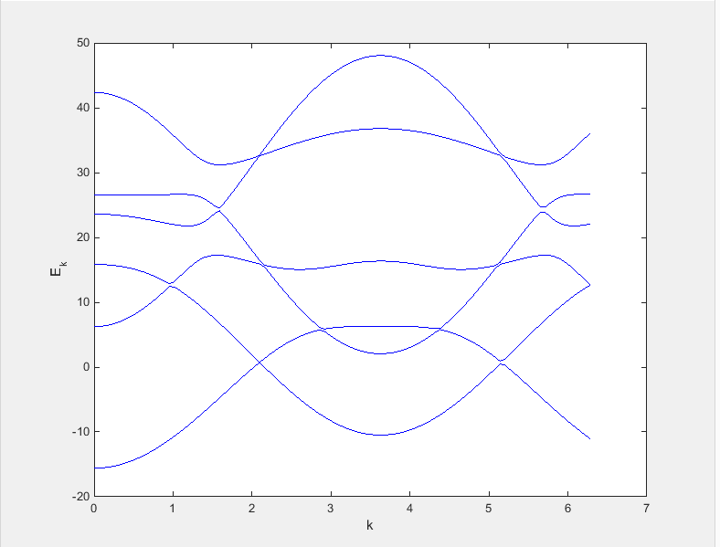
Graphene bandstructure

Slide 9
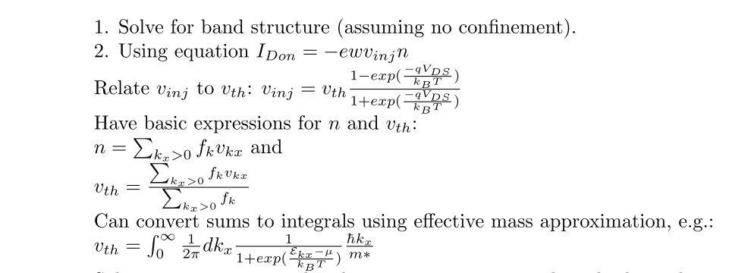
Approach

Slide 10
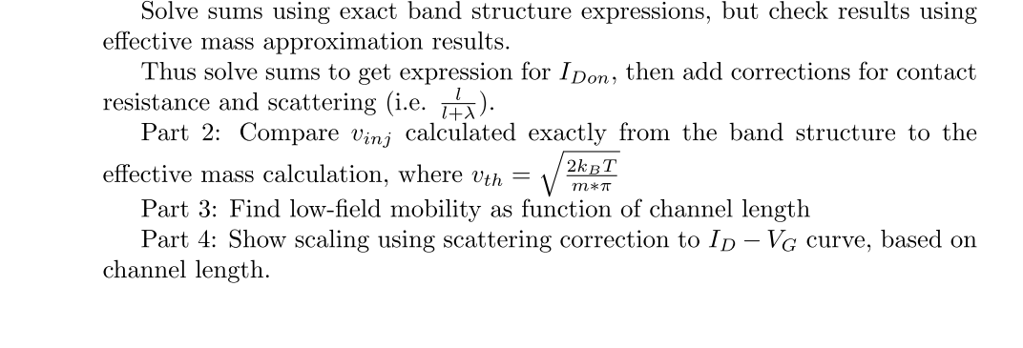
Approach

Slide 11
Questions?

