Slide 1


PORTFOLIO PROJECT
DATA ANALYTICS
Instacart Customer Analytics Dashboard
End-to-End Data Analytics Project using Python, DuckDB, SQL & Power BI
Transforming 3.4M+ transactions into executive-level business insights
Author: Abdul Samhoon | Date: 2026
Notes:
1

Slide 2




02 — CONTEXT
Business Problem & Objectives
The Challenge
Project Objectives
Online grocery platforms generate millions of daily transactions, making it difficult to extract meaningful, actionable insights from raw data.
Businesses need clarity on:
Analytical Database
Purchasing Behavior
Build a fast analytical layer using DuckDB
Analyze ordering patterns and trends
Customer purchasing behavior
Product demand patterns
Inventory planning
Customer retention
Product Performance
Executive Dashboards
Evaluate departments, aisles, and demand
Deliver interactive Power BI dashboards
Notes:
2

Slide 3

02 — FOUNDATION
Dataset & Technology Stack
3.4M+
206K
49K
Orders
Customers
Products
134
21
Aisles
Departments
Dataset Schema
Technology Stack
Five interconnected tables form the relational backbone of the analysis.
Orders
Python
Customer transactions record
Data loading & transformation
DuckDB
In-process analytical database
Departments
Table Relationships
Order Products
SQL
Business logic & analytical views
High-level categories
Line items per order
Power BI
Interactive executive dashboards
GitHub
Aisles
Products
Version control & portfolio sharing
Product aisle grouping
Catalog of items
Notes:
3

Slide 4

04 — METHODOLOGY
End-to-End Analytics Pipeline
From raw CSV files to executive-ready dashboards — a reproducible workflow built for scale and clarity.
Ingest CSV
Load with Python
Store in DuckDB
SQL Analysis
Notes:
4

Slide 5





05 — ANALYSIS
Business Questions Solved Using SQL
1
2
3
Peak Ordering Hours
Top Purchased Products
Department Performance
When do customers order most? Identified daily demand curves.
Which products drive volume? Ranked by order frequency.
Which departments perform best? Measured by revenue share.
4
Customer Segmentation
How are customers grouped? Segmented by ordering behavior.
SQL transformed raw transactional data into reusable, business-ready analytical views powering the Power BI dashboards.
Notes:
5

Slide 6
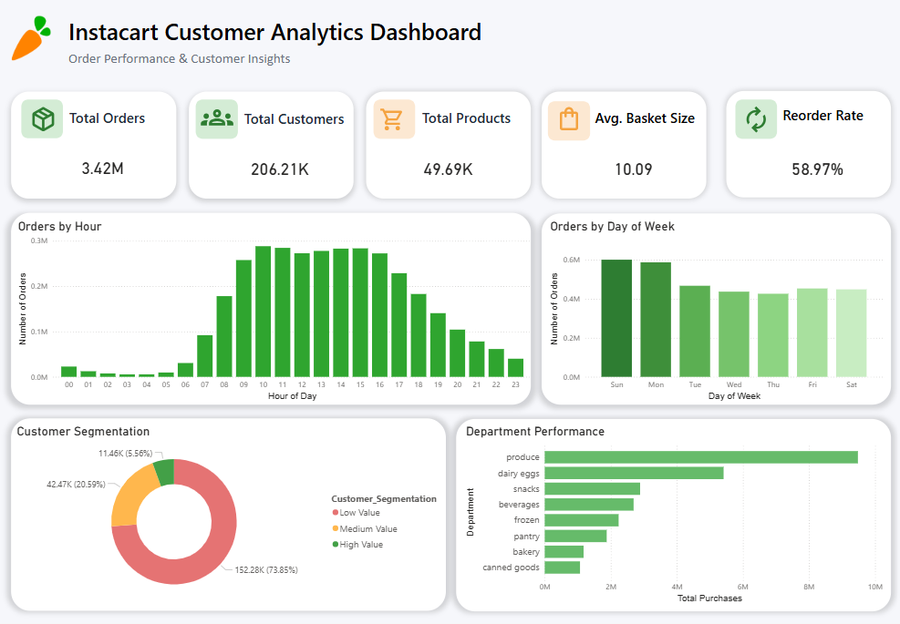
06 — DASHBOARD 1
Executive Dashboard
Dashboard Purpose
Provides an executive overview of overall business performance at a glance.
Key KPIs
Total Orders
Total Customers
Total Products
Average Basket Size
Overall Reorder Rate
Core Visuals
Orders by Hour
Orders by Day of Week
Customer Segmentation
Department Performance
Enables quick executive decision-making with real-time KPI tracking.
Notes:
6

Slide 7
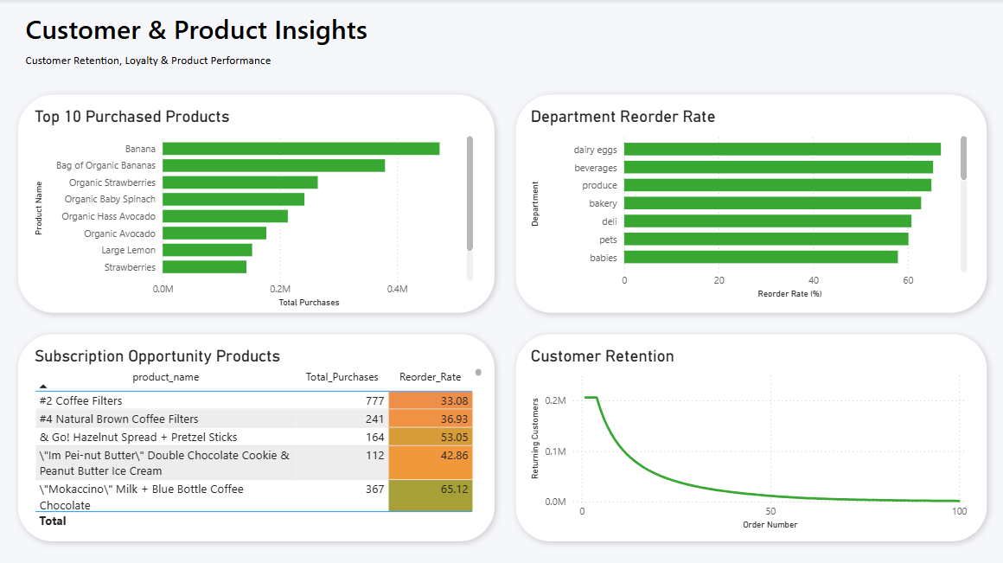
07 — DASHBOARD 2
Customer & Product Insights
Key Visuals
Business Value
Improve inventory planning
Increase customer retention
Identify recurring revenue opportunities
Support targeted marketing campaigns
Top Purchased Products
Department Reorder Rate
Subscription Opportunity Products
Customer Retention Trends
Ranked by frequency and volume
Loyalty indicators by category
Retention curves over time
High-reorder candidates flagged
Notes:
7

Slide 8
08 — TAKEAWAYS
Key Insights & Conclusion
Peak Demand Timing
High-Volume Days
Top Department
Customer demand peaks during late morning and afternoon hours.
Sundays and Mondays generate the highest order volume.
Produce is the highest-performing department by order share.
Most Purchased Product
Subscription Candidates
Retention Opportunity
Bananas are the single most purchased product across all orders.
High-reorder products are ideal candidates for subscription models.
Retention decreases over time — signaling a need for loyalty programs.
This project demonstrates a complete end-to-end analytics workflow — transforming over 3.4 million Instacart transactions into executive-level business insights using Python, DuckDB, SQL, and Power BI. It showcases practical skills in data engineering, SQL analytics, business intelligence, and dashboard design while enabling data-driven decision-making for customer behavior, product performance, and operational planning.
Thank You
Notes:
8

