Slide 1

Food Nutrition & Health Risk Analytics System
Analyzing nutritional quality and health risks using data analytics
PYTHON
PANDAS
MYSQL
POWER BI
GITHUB
Prepared by: Abdul Samhoon
Notes:
1

Slide 2


Problem, Objectives & Dataset at a Glance
Problem
Project Objectives
Consumers lack clear, data-driven insights into the nutritional quality and health risks of packaged and traditional foods.
Analyze 1,028 food items across 9 nutrients
Develop Health Risk Score & Nutrition Density
Identify healthy vs high‑risk foods
Deliver interactive Power BI dashboards
Dataset Overview
1,028 items · 9 core nutritional features · no missing values
Key features: Energy, Protein, Fat, Carbs, Free Sugar, Fibre, Cholesterol, Calcium
Notes:
2

Slide 3


Project Workflow & Feature Engineering
Data Collection
Feature Engineering
Power BI Dashboard
Ingest raw sources reproducibly
Derive metrics like Health Risk
Visualize metrics and trends
Data Cleaning
SQL Analysis
Aggregate metrics and validate
Normalize and remove errors
The pipeline enforces reproducible ETL, metric derivation, and dashboard-driven exploration. Key engineered metrics are shown below.
Health Risk Score
Nutrition Density
Composite score combining normalized Fat, Free Sugar, and Cholesterol with domain-weighted coefficients to flag high-risk items.
Ratio of beneficial nutrients (Protein, Fibre, Calcium) to energy; rewards nutrient-rich, lower-energy foods.
Validation
Checks include distribution analysis, correlation matrices, and SQL-based consistency tests.
Notes:
3

Slide 4



Top Nutrient-Dense Foods
Ranked analysis highlights traditional pulse- and grain-based preparations as nutrient-dense leaders.
Maa Chaane Ki Dal
Cracked Wheat & Green Gram Premix
Dessicated Coconut Chutney
Top nutrition density: high protein and fibre relative to energy.
Balanced macro profile with excellent micronutrient density.
Surprisingly nutrient-dense when portioned appropriately.
Notes:
4

Slide 5



Foods with Highest Health Risk Scores
Highest risk items are dominated by high free sugar and saturated fat content.
Butter Icing
Glace Icing
Mango Murabba Candy
Extremely high sugar + saturated fat → top health risk.
High free sugar concentration, low nutrient value.
Sugar-preserved fruit with concentrated free sugars and energy.
Notes:
5

Slide 6



Healthy Food Recommendations
High Protein · Low Risk
High Fibre · Low Sugar
Roast Chicken
Tandoori Chicken
Maa Chaane Ki Dal
Cracked Wheat & Green Gram
Lean protein, low added sugars — strong nutrition / low risk.
Spice-forward preparation with preserved protein profile.
Top fibre and protein—consistent low-risk performer.
Whole-grain base with sustained energy release and fibre.
Fish Tikka
Soya Roti
High protein, beneficial fats, low processed sugar.
Plant protein with high fibre and micronutrient content.
Recommendation: Prioritise whole pulses, lean proteins, and fibre-rich grains for lower health risk and improved nutrition density.
Notes:
6

Slide 7
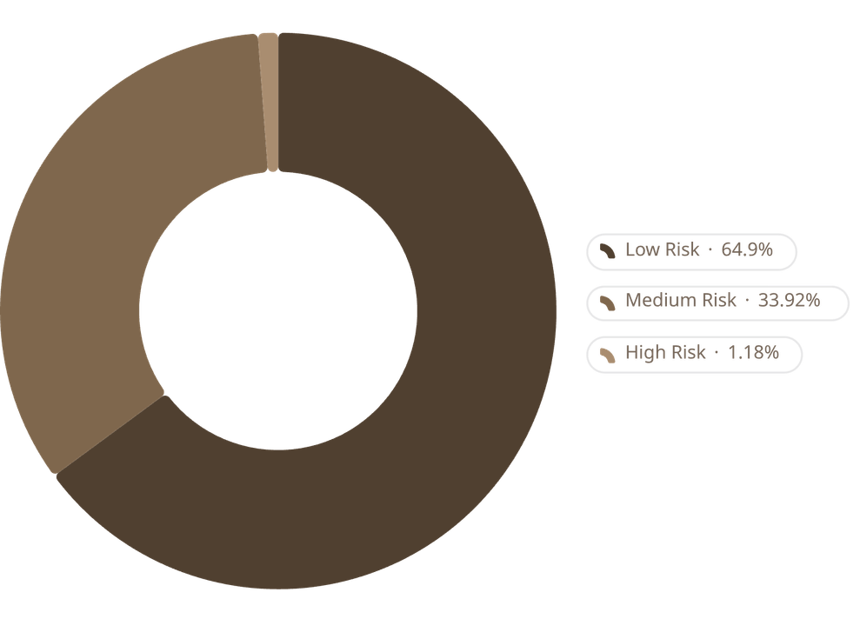



Health Risk Distribution & Leaderboard
Top Healthiest Foods
1. Maa Chaane Ki Dal
Highest Nutrition Density & low Health Risk.
2. Cracked Wheat & Green Gram Premix
Balanced macros and fibre-forward profile.
Distribution shows the majority of items classify as Low Risk.
3. Dessicated Coconut Chutney
High nutrient concentration in controlled portions.
Notes:
7

Slide 8
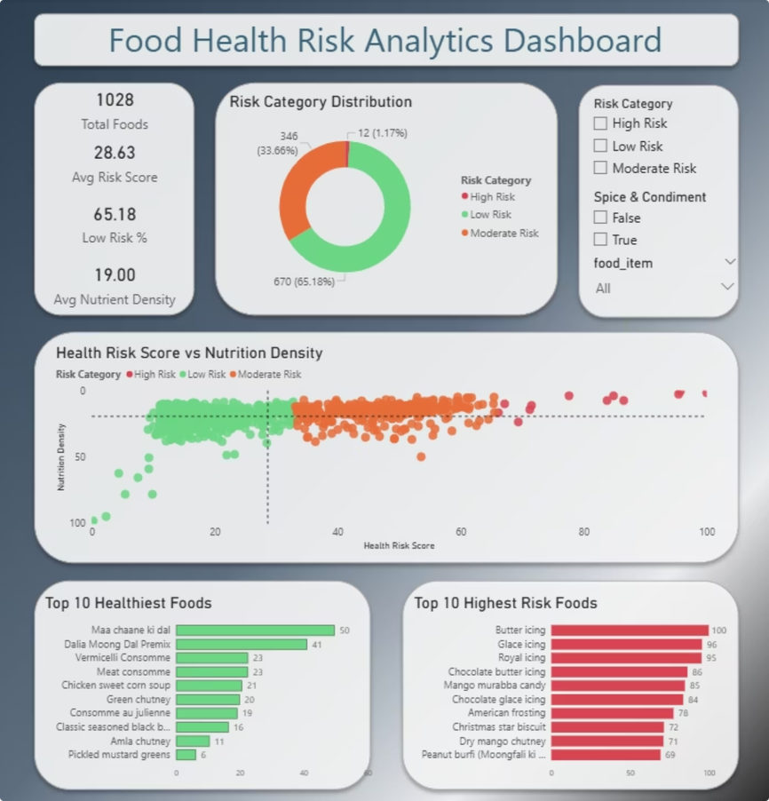
Power BI Dashboard — Interactive Showcase
KPI Cards
Interactive Filters
Key metrics: % Low Risk foods, Avg Nutrition Density, Avg Health Risk Score — at-a-glance monitoring.
Filter by category, region, serving size, and nutrient thresholds for targeted analysis.
Visuals
Risk distribution, ranked leaderboards, and nutrient correlation panels support rapid insights.
Notes:
8

Slide 9
Conclusions & Next Steps
01
02
Key Conclusions
Future Enhancements
Traditional pulse- and grain-based foods scored highest on Nutrition Density; high-sugar/fat items had the highest Health Risk Scores. 662 of 1,028 foods classified as Low Risk.
Apply machine learning for risk prediction, build personalised recommendations, integrate real-time nutrition APIs, and deploy a web-based interactive dashboard.
Notes:
9

