Slide 1
Sub-Gaussian Mean Estimation in Polynomial Time
Samuel Hopkins
Miller Fellow, UC Berkeley

Slide 2

Estimating the Mean of a Random Vector
Input: i.i.d. copies $X_{1}, …, X_{n}$ of a random vector $X$
Output: estimator $\hat{μ}$ of $μ=EX$

Slide 3
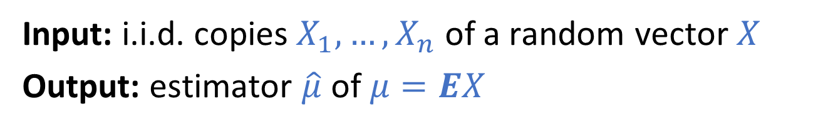
Estimating the Mean of a Random Vector
Input: i.i.d. copies $X_{1}, …, X_{n}$ of a random vector $X$
Output: estimator $\hat{μ}$ of $μ=EX$

Slide 4

Estimating the Mean of a Random Vector
Input: i.i.d. copies $X_{1}, …, X_{n}$ of a random vector $X$
Output: estimator $\hat{μ}$ of $μ=EX$
“Duh! Just use the empirical mean!”
– me, 6 months ago
“Figure out what you want from your estimator first.”
– me, now

Slide 5
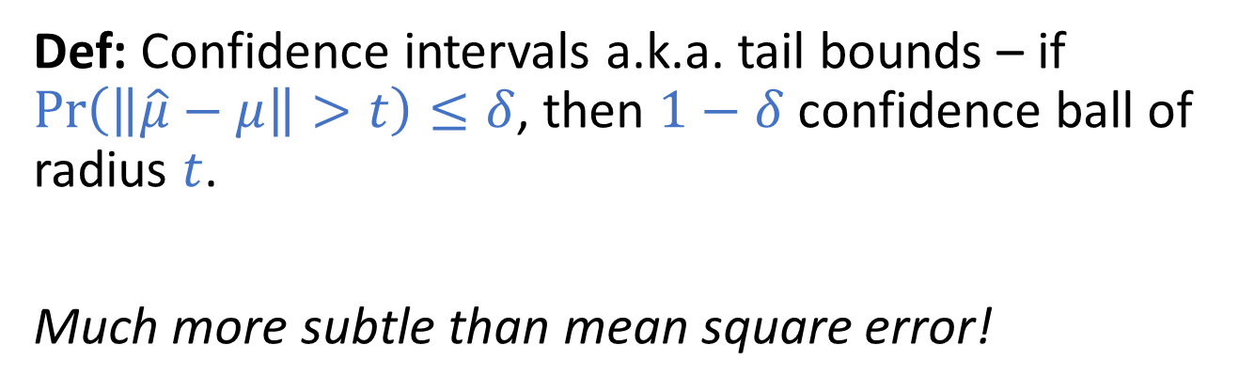
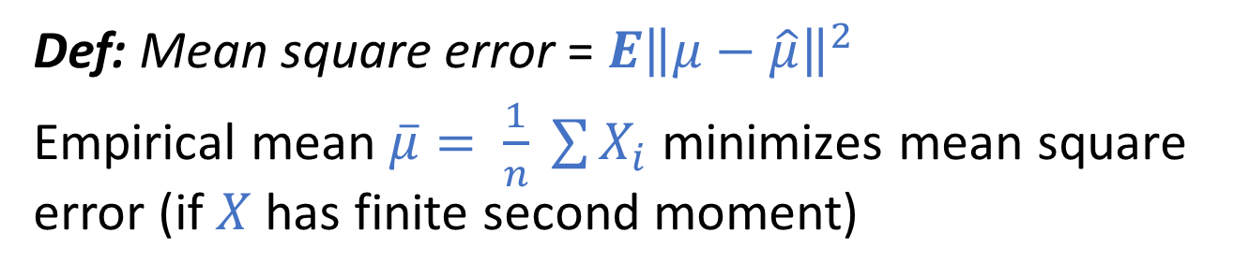
Statistics 101
Def: Mean square error = $E{\left\|μ−\hat{μ}\right\|}^{2}$
Empirical mean $\overline{μ}= \frac{1}{n} \sum{X_{i}}$ minimizes mean square error (if $X$ has finite second moment)
Def: Confidence intervals a.k.a. tail bounds – if $\operatorname{Pr}\left(\left\|\hat{μ}−μ\right\|>t\right)≤δ$, then $1−δ$ confidence ball of radius $t$.
Much more subtle than mean square error!

Slide 6
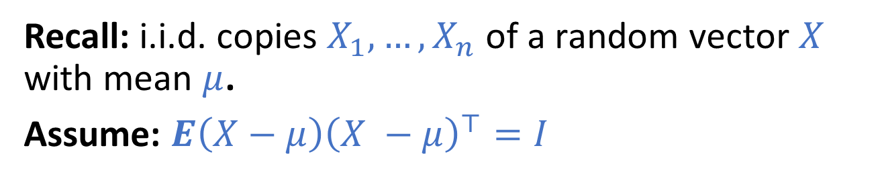
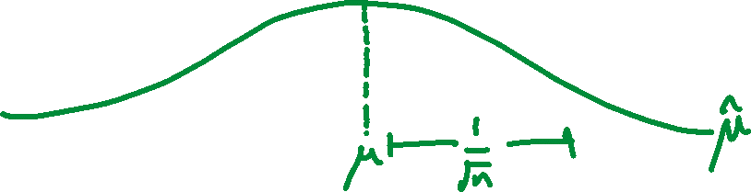
Sub-Gaussian Tails
Recall: i.i.d. copies $X_{1}, …, X_{n}$ of a random vector $X$ with mean $μ$.
Assume: $E\left(X−μ\right){\left(X −μ\right)}^{⊤}=I$
Gold Standard: $\operatorname{Pr}\left(\left\|\hat{μ}−μ\right\|>t\right)≤\exp\left(−Ω(nt^{2})\right)$

Slide 7
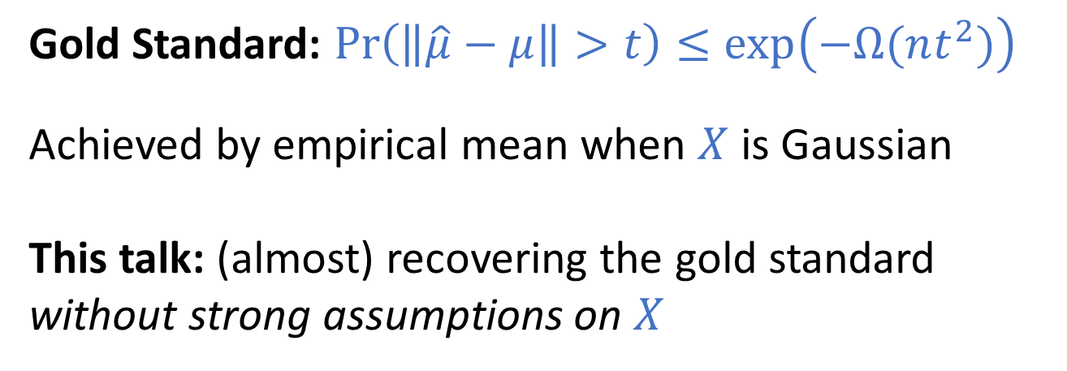

Sub-Gaussian Tails
Recall: i.i.d. copies $X_{1}, …, X_{n}$ of a random vector $X$ with mean $μ$.
Assume: $E\left(X−μ\right){\left(X −μ\right)}^{⊤}=I$
Gold Standard: $\operatorname{Pr}\left(\left\|\hat{μ}−μ\right\|>t\right)≤\exp\left(−Ω(nt^{2})\right)$
Achieved by empirical mean when $X$ is Gaussian
This talk: (almost) recovering the gold standard without strong assumptions on $X$

Slide 8
Heavy Tails
What if X isn’t (sub)-Gaussian?

Slide 9
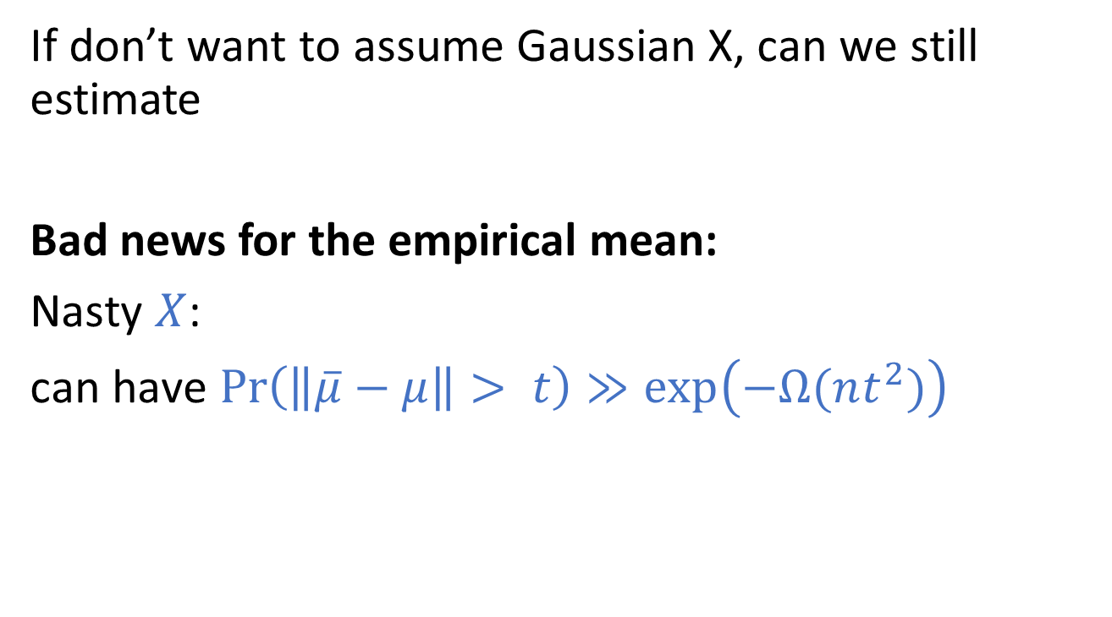
Heavy Tails and the Empirical Mean
If don’t want to assume Gaussian X, can we still estimate
Bad news for the empirical mean:
Nasty $X$:
can have $\operatorname{Pr}\left(\left\|\overline{μ}−μ\right\|> t\right)≫\exp\left(−Ω(nt^{2})\right)$

