Slide 1
Fast Spectral Algorithms from Sum-of-Squares Proofs: Tensor Decomposition and Planted Sparse Vectors
Sam Hopkins
Cornell
Tselil Schramm
UC Berkeley
Jonathan Shi
Cornell
David Steurer
Cornell

Slide 2
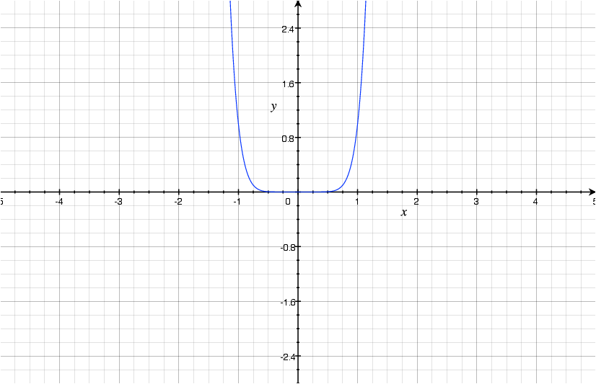
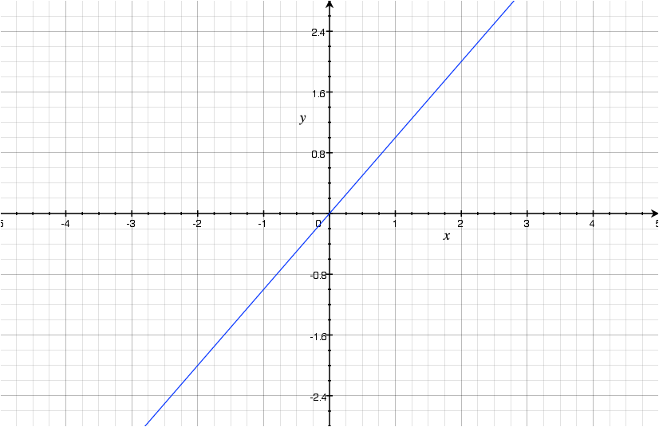



Competing Themes in Algorithms
Polynomial time
=
Efficient algorithms
versus
BUT
$$O(n)$$
$$O(n^{8})$$
Stronger convex programs
↓
better (poly-time) algorithms
↓
(which aren’t really efficient)
Notes:
Poly = efficient (for NATURAL problems)

Slide 3
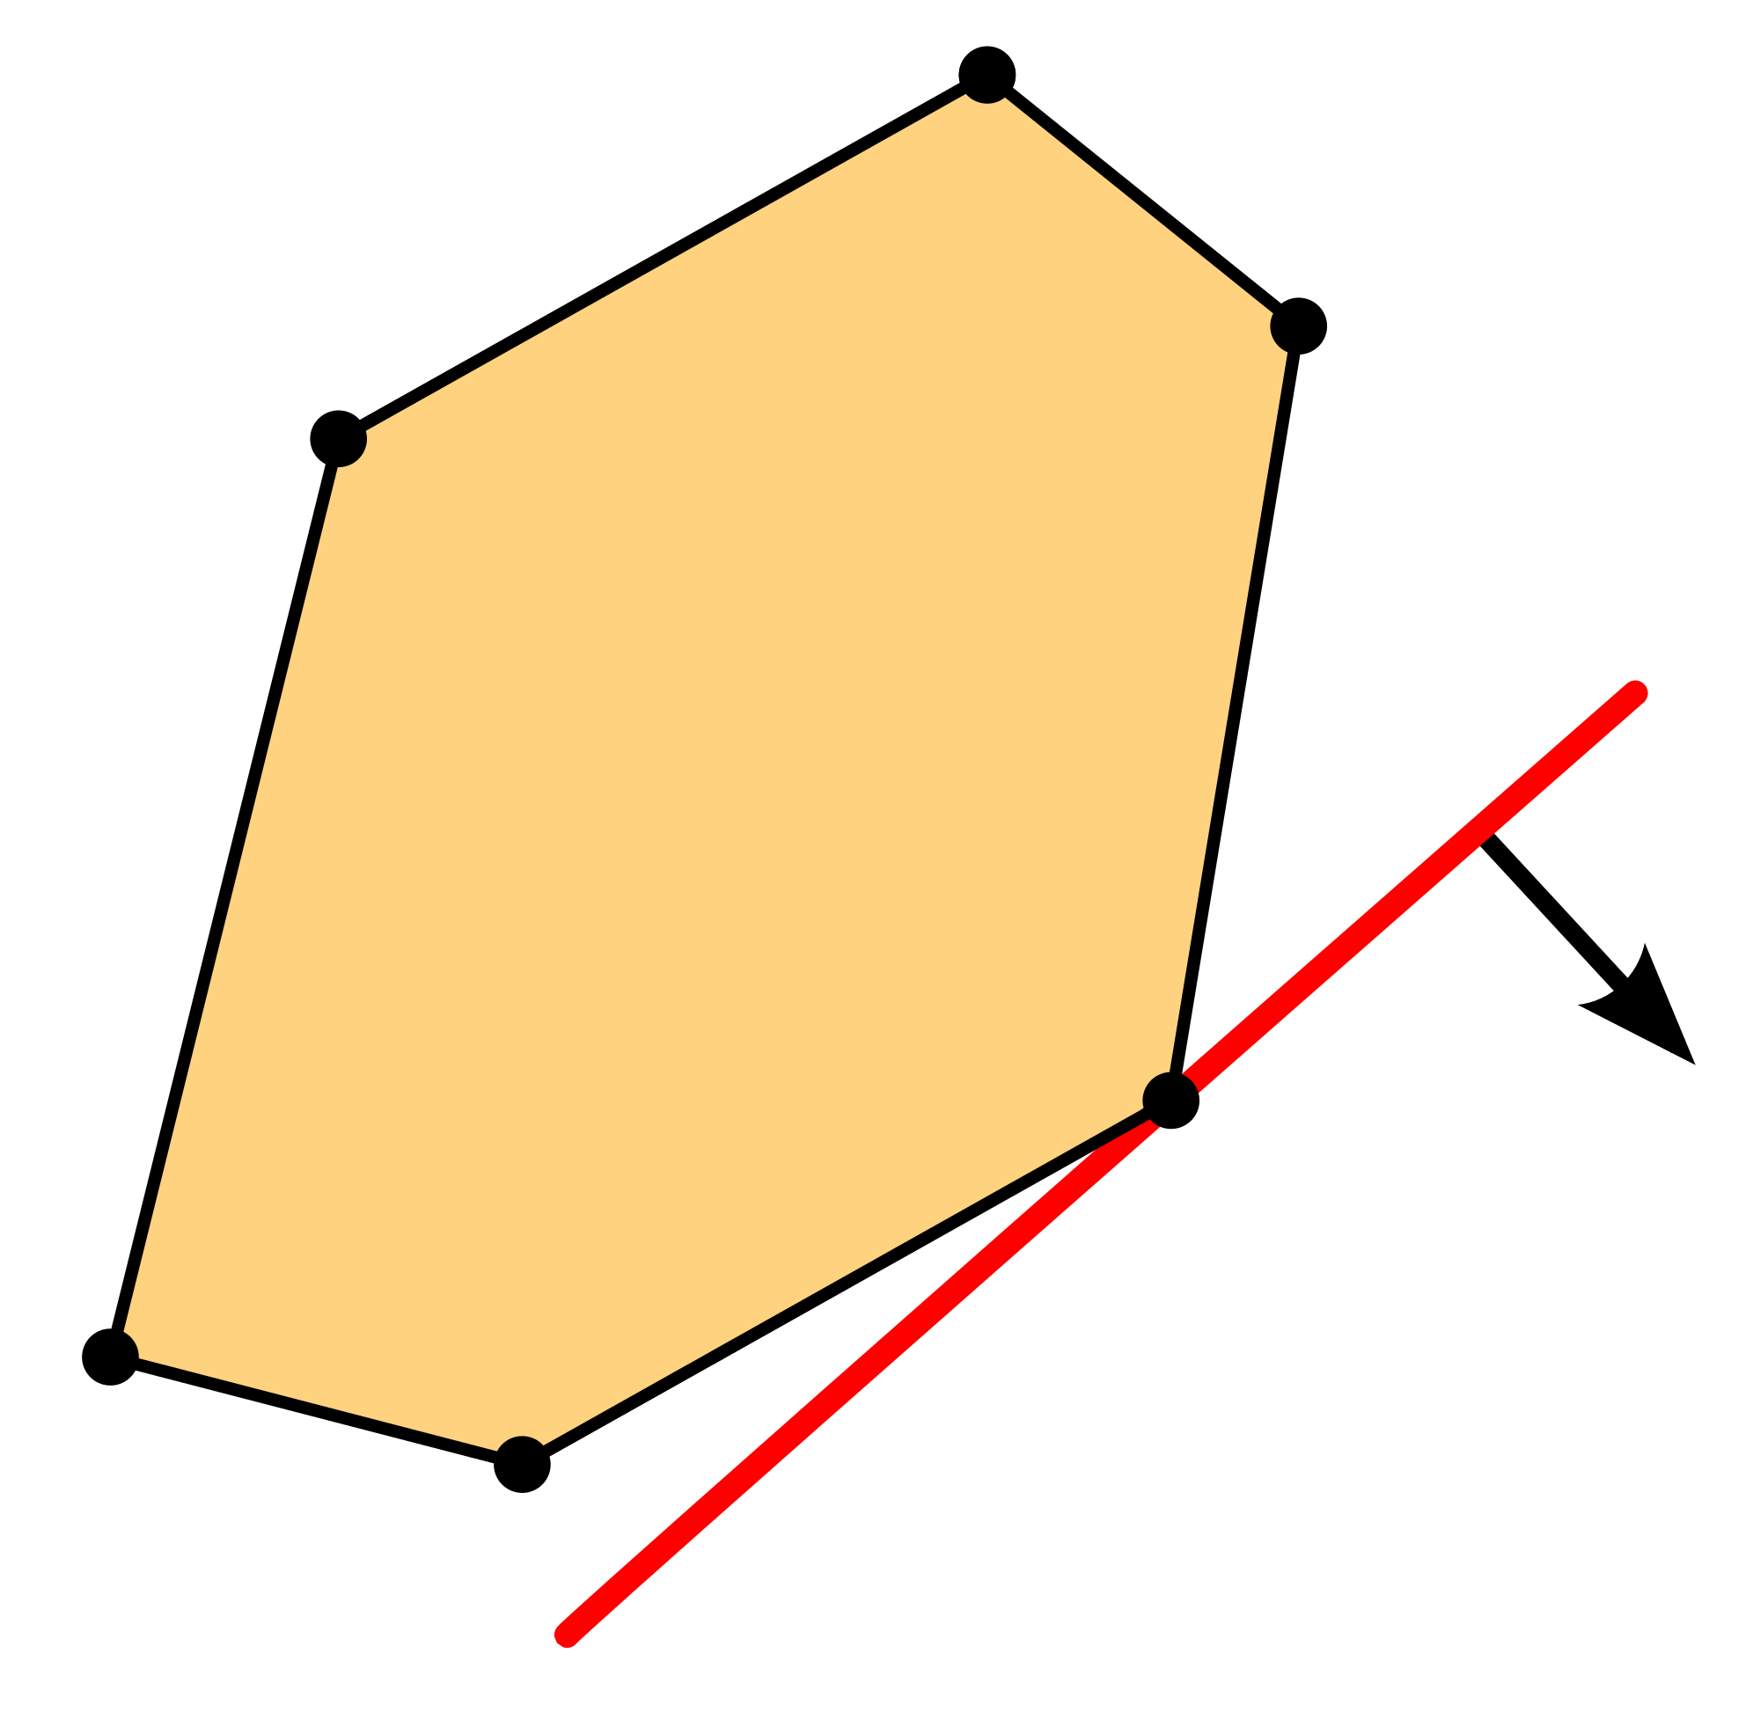
Competing Themes in Algorithms
(1) Problems in 𝒫 usually have truly efficient algorithms.
(3) Primal-Dual exploits convex relaxations without paying to solve to optimality.
BUT
Linear Programming (LP)
(2) Stronger convex programs improve output of algorithms but require more time to solve.
multiplicative weights [Plotkin-Shmoys-Tardos]
Semidefinite Programming (SDP)
matrix multiplicative weights [Arora-Kale]

Slide 4
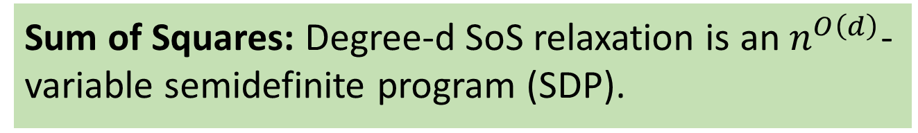
Algorithms, Hierarchies, and Running Time
Hierarchy: a sequence of increasing-strength and increasing-dimension convex relaxations of a non-convex problem.
Sherali-Adams
Lovasz-Schrijver
Lasserre/Sum-of-Squares
Sum of Squares: Degree-d SoS relaxation is an $n^{O\left(d\right)}$-variable semidefinite program (SDP).
Notes:
Algorithm will have to run in time SUBlinear in the dimension of the convex relaxation – UNLIKE previous primal-dual or MMW.

Slide 5

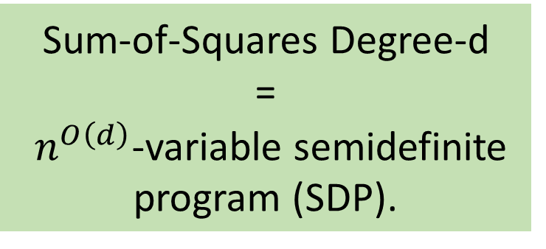





Algorithms, Hierarchies, and Running Time
HUGE, accurate SDP Relaxation
Sum-of-Squares Degree-d
=
$n^{O\left(d\right)}$-variable semidefinite program (SDP).
$$2^{n}×2^{n}$$
$$⋱$$
$$n^{4}×n^{4}$$
add variables & constraints
$$n^{3}×n^{3}$$
$$n^{2}×n^{2}$$
Hard problem
SDP Relaxation
$$n×n$$
Notes:
Algorithm will have to run in time SUBlinear in the dimension of the convex relaxation – UNLIKE previous primal-dual or MMW.

Slide 6
Algorithms, Hierarchies, and Running Time
Better approximation ratios, noise tolerance, than linear programs, semidefinite programs.
New Algorithms for:
Scheduling [Levey-Rothvoss]
Independent sets in bounded-degree graphs [Bansal, Chlamtac]
Independent sets in hypergraphs [Chlamtac, Chlamtac-Singh]
Planted problems [Barak-Kelner-Steurer, Barak-Moitra, Hopkins-Shi-Steurer, Ge-Ma, Raghavendra-Rao-Schramm, Ma-Shi-Steurer]
Unique games [Barak-Raghavendra-Steurer, Barak-Brandao-Harrow-Kelner-Steurer-Zhou]
Notes:
Add UG citations

Slide 7
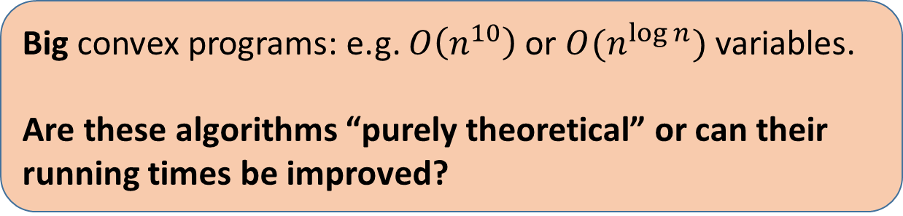
Algorithms, Hierarchies, and Running Time
Big convex programs: e.g. $O\left(n^{10}\right)$ or $O(n^{\log{n}})$ variables.
Are these algorithms “purely theoretical” or can their running times be improved?
Notes:
Algorithm will have to run in time SUBlinear in the dimension of the convex relaxation – UNLIKE previous primal-dual or MMW.

Slide 8
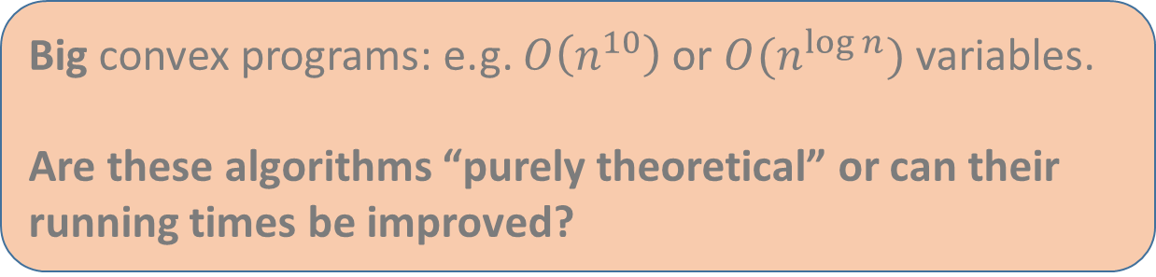
Algorithms, Hierarchies, and Running Time
Big convex programs: e.g. $O\left(n^{10}\right)$ or $O(n^{\log{n}})$ variables.
Are these algorithms “purely theoretical” or can their running times be improved?
This work: fast spectral algorithms with matching guarantees for planted problems.
Use eigenvectors of matrix polynomials
Notes:
Emphasize: spectral algs are different from usual ones

Slide 9






Algorithms, Hierarchies, and Running Time
Big convex programs: e.g. $O\left(n^{10}\right)$ or $O(n^{\log{n}})$ variables.
Are these algorithms “purely theoretical” or can their running times be improved?
This work: fast spectral algorithms with matching guarantees for planted problems.
HUGE, accurate SDP Relaxation
$$n$$
$$⋱$$
$$n$$
$$n^{3}×n^{3}$$
$$n×n$$
$$n^{2}×n^{2}$$
SDP Relaxation
Notes:
Fade background text moar

Slide 10
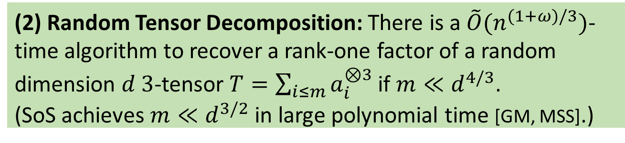
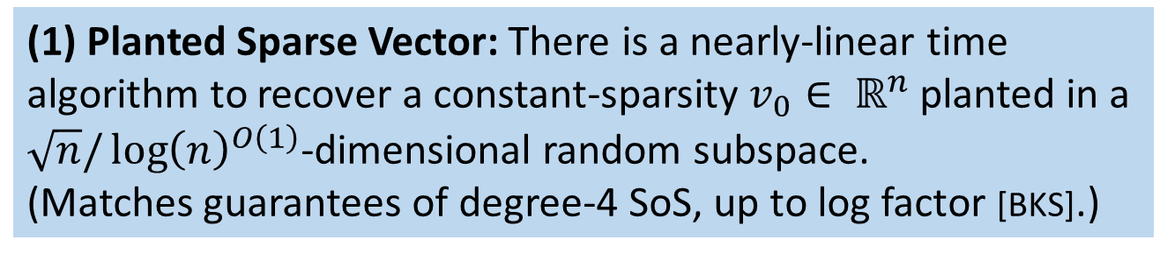
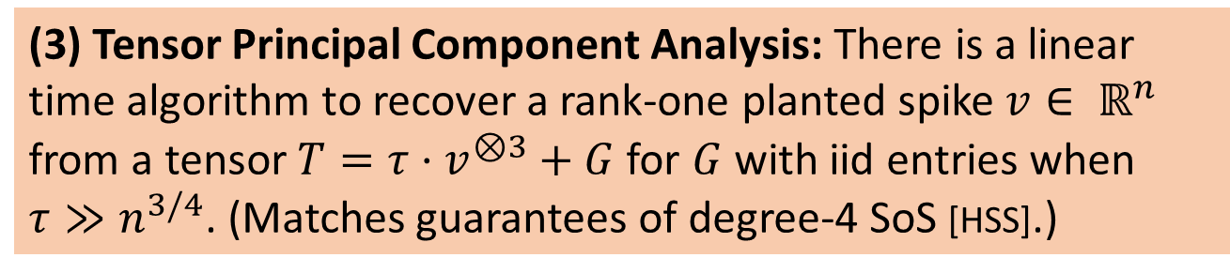
Results
(1) Planted Sparse Vector: There is a nearly-linear time algorithm to recover a constant-sparsity $v_{0}∈ ℝ^{n}$ planted in a $\sqrt{n}/{\log\left(n\right)}^{O\left(1\right)}$-dimensional random subspace. (Matches guarantees of degree-4 SoS, up to log factor [BKS].)
(2) Random Tensor Decomposition: There is a $\tilde{O}(n^{(1+ω)/3})$-time algorithm to recover a rank-one factor of a random dimension $d$ $3$-tensor $T=\sum_{i≤m}{a_{i}^{⊗3}}$ if $m≪d^{4/3}$. (SoS achieves $m≪d^{3/2}$ in large polynomial time [GM, MSS].)
(3) Tensor Principal Component Analysis: There is a linear time algorithm to recover a rank-one planted spike $v∈ ℝ^{n}$ from a tensor $T=τ⋅v^{⊗3}+G$for $G$ with iid entries when $τ≫n^{3/4}$. (Matches guarantees of degree-4 SoS [HSS].)

Slide 11
Results
(1) Planted Sparse Vector
(2) Random Tensor Decomposition
(3) Tensor Principal Component Analysis

Slide 12
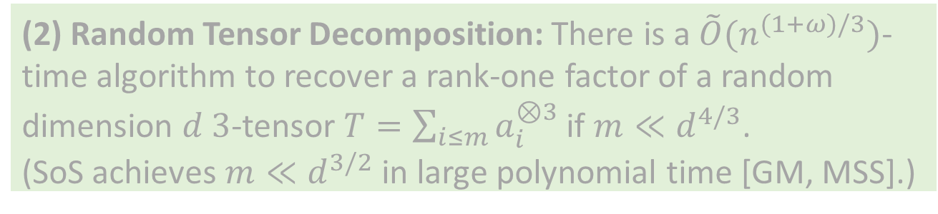
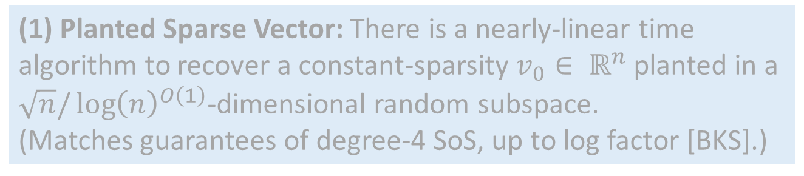
Results
(1) Planted Sparse Vector: There is a nearly-linear time algorithm to recover a constant-sparsity $v_{0}∈ ℝ^{n}$ planted in a $\sqrt{n}/{\log\left(n\right)}^{O\left(1\right)}$-dimensional random subspace. (Matches guarantees of degree-4 SoS, up to log factor [BKS].)
SoS (previous champion) has to solve large SDP (much larger than input size)
(2) Random Tensor Decomposition: There is a $\tilde{O}(n^{(1+ω)/3})$-time algorithm to recover a rank-one factor of a random dimension $d$ $3$-tensor $T=\sum_{i≤m}{a_{i}^{⊗3}}$ if $m≪d^{4/3}$. (SoS achieves $m≪d^{3/2}$ in large polynomial time [GM, MSS].)

Slide 13
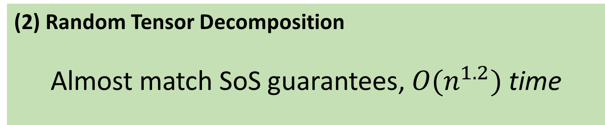
Results
Planted Sparse Vector
Match SoS guarantees, nearly-linear time
(2) Random Tensor Decomposition
Almost match SoS guarantees, $O(n^{1.2})$ time
(3) Tensor Principal Component Analysis
Match SoS guarantees, linear time
Notes:
Time guarantees are IN THE INPUT SIZE

Slide 14
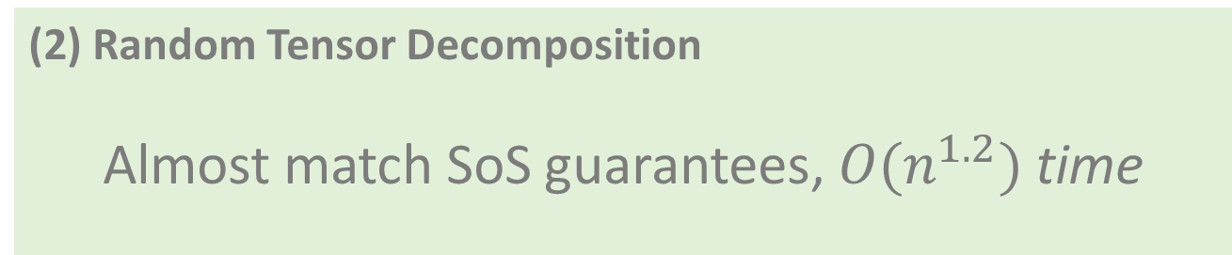
Results
Planted Sparse Vector
Match SoS guarantees, nearly-linear time
(2) Random Tensor Decomposition
Almost match SoS guarantees, $O(n^{1.2})$ time
(3) Tensor Principal Component Analysis
Match SoS guarantees, linear time

Slide 15
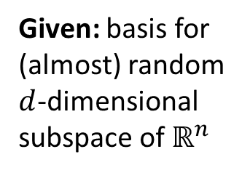
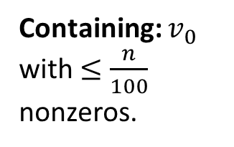









Planted Sparse Vector
Given: basis for (almost) random $d$-dimensional subspace of $ℝ^{n}$
Containing: $v_{0}$ with $≤\frac{n}{100}$ nonzeros.
Find $v_{0}$
$$d$$
$$z$$
$$y$$
$$n$$
$$n$$
$$k$$
$$x$$
$$v_{0}$$

Slide 16
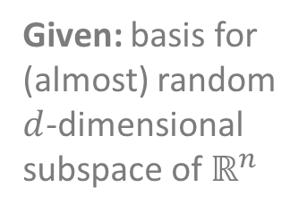
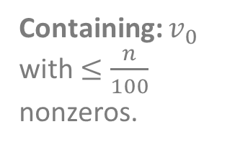






Planted Sparse Vector
Given: basis for (almost) random $d$-dimensional subspace of $ℝ^{n}$
Containing: $v_{0}$ with $≤\frac{n}{100}$ nonzeros.
Find $v_{0}$
$$d$$
$$z$$
$$y$$
$$n$$
$$n$$
$$k$$
$$x$$
$$v_{0}$$
What dimensions $d$ permit efficient algorithms?
Result: spectral algorithm matching SoS’s $d ≲\sqrt{n}$

Slide 17
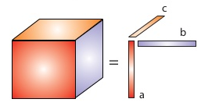
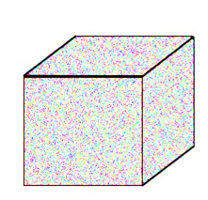
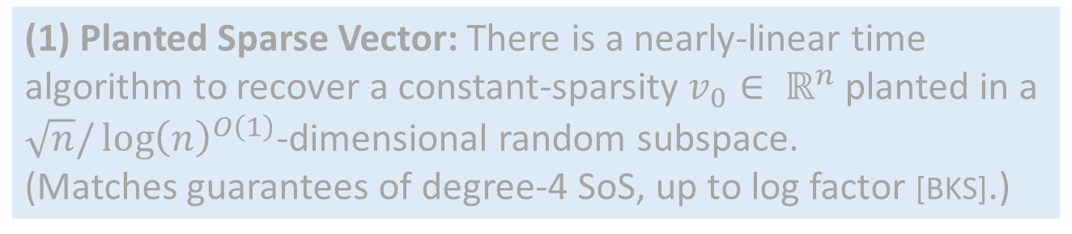

Results
(1) Planted Sparse Vector: There is a nearly-linear time algorithm to recover a constant-sparsity $v_{0}∈ ℝ^{n}$ planted in a $\sqrt{n}/{\log\left(n\right)}^{O\left(1\right)}$-dimensional random subspace. (Matches guarantees of degree-4 SoS, up to log factor [BKS].)
(2) Random Tensor Decomposition
$$+$$
(3) Tensor Principal Component Analysis
Random tensor with hidden structure

Slide 18
The Speedup Recipe
SoS algorithm (large SDP)
Spectral algorithm with big matrices
Fast spectral algorithm
Notes:
MENTION guruswami-sinop

Slide 19
The Speedup Recipe
SoS algorithm (large SDP)
Spectral algorithm with big matrices
Fast spectral algorithm
Dual certificates from SoS SDP
(variant of primal-dual)
Notes:
MENTION guruswami-sinop

Slide 20
The Speedup Recipe
Compression to small matrices
SoS algorithm (large SDP)
Spectral algorithm with big matrices
Fast spectral algorithm
Dual certificates from SoS SDP
(variant of primal-dual)
Notes:
MENTION guruswami-sinop

Slide 21
The Speedup Recipe
Compression to small matrices
Different from
— matrix multiplicative weights
[Arora-Kale]
— simpler spectral algorithms
SoS algorithm (large SDP)
Spectral algorithm with big matrices
Fast spectral algorithm
Dual certificates from SoS SDP
(variant of primal-dual)
Notes:
MENTION guruswami-sinop

Slide 22
The Speedup Recipe
Compression to small matrices
Different from
— matrix multiplicative weights
[Arora-Kale]
— simpler spectral algorithms
Not local rounding
[Guruswami-Sinop]
SoS algorithm (large SDP)
Spectral algorithm with big matrices
Fast spectral algorithm
Dual certificates from SoS SDP
(variant of primal-dual)
Notes:
MENTION guruswami-sinop

Slide 23
The Speedup Recipe
SoS algorithm (large SDP)
Spectral algorithm with big matrices
Fast spectral algorithm
Notes:
MENTION guruswami-sinop

Slide 24



The Speedup Recipe
SoS algorithm (large SDP)
Spectral algorithm with big matrices
Fast spectral algorithm
$$d^{2}$$
$$d^{2}$$
Matrix dimensions $≈$ SDP dimensions
Notes:
MENTION guruswami-sinop

Slide 25

The Speedup Recipe
SoS algorithm (large SDP)
Spectral algorithm with big matrices
Fast spectral algorithm
$$d^{2}$$
$=\left(x⊗x\right){\left(x⊗x\right)}^{⊤}+E$
signal
noise
$$d^{2}$$
Notes:
MENTION guruswami-sinop

Slide 26



The Speedup Recipe
SoS algorithm (large SDP)
Spectral algorithm with big matrices
Fast spectral algorithm
$$d^{2}$$
$=\left(x⊗x\right){\left(x⊗x\right)}^{⊤}+E$
signal
noise
$$d^{2}$$
$$d$$
Planted sparse vector
basis
$$x$$
$$≈v_{0}$$
$$n$$
Notes:
MENTION guruswami-sinop

Slide 27
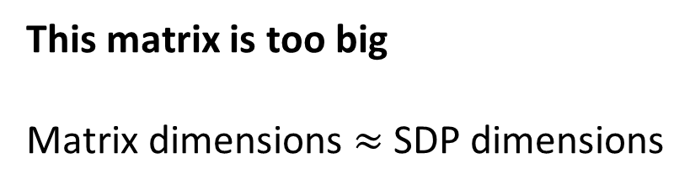
The Speedup Recipe
SoS algorithm (large SDP)
Spectral algorithm with big matrices
Fast spectral algorithm
$$d^{2}$$
This matrix is too big
Matrix dimensions $≈$ SDP dimensions
$$d^{2}$$
Notes:
MENTION guruswami-sinop

Slide 28
The Speedup Recipe
SoS algorithm (large SDP)
Spectral algorithm with big matrices
Fast spectral algorithm
Notes:
MENTION guruswami-sinop

Slide 29




The Speedup Recipe
SoS algorithm (large SDP)
Spectral algorithm with big matrices
Fast spectral algorithm
$$d^{2}$$
$$d$$
$$d^{2}$$
$$d$$
Notes:
MENTION guruswami-sinop

Slide 30

The Speedup Recipe
SoS algorithm (large SDP)
Spectral algorithm with big matrices
Fast spectral algorithm
$$d^{2}$$
$$d$$
$$d^{2}$$
$$d$$
$$\left(x⊗x\right){\left(x⊗x\right)}^{⊤}$$
redundant information
with tensor structure
Notes:
MENTION guruswami-sinop

Slide 31

The Speedup Recipe
SoS algorithm (large SDP)
Spectral algorithm with big matrices
Fast spectral algorithm
$$d^{2}$$
$$d$$
$$d^{2}$$
$$d$$
$$\left(x⊗x\right){\left(x⊗x\right)}^{⊤}$$
$$xx^{⊤}$$
redundant information
with tensor structure
Notes:
MENTION guruswami-sinop

Slide 32
The Speedup Recipe
SoS algorithm (large SDP)
Spectral algorithm with big matrices
Fast spectral algorithm
$$d^{2}$$
$$d$$
$$d^{2}$$
$$d$$
$$\left(x⊗x\right){\left(x⊗x\right)}^{⊤}$$
$$xx^{⊤}$$
Hope: preserve signal-to-noise ratio of $\left(x⊗x\right){\left(x⊗x\right)}^{⊤}+E$
Notes:
MENTION guruswami-sinop

Slide 33









Partial Trace
$$\left(x⊗x\right){\left(x⊗x\right)}^{⊤}$$
$$xx^{⊤}$$
In $d=2$ dimensions
$$d^{2}$$
$$x_{1}^{2}⋅xx^{⊤}$$
$$x_{1}x_{2}⋅xx^{⊤}$$
$$d^{2}$$
$$x_{2}x_{1}⋅xx^{⊤}$$
$$x_{2}^{2}⋅xx^{⊤}$$
Notes:
MENTION guruswami-sinop

Slide 34




Partial Trace
$$\left(x⊗x\right){\left(x⊗x\right)}^{⊤}$$
$$xx^{⊤}$$
In $d=2$ dimensions
$$d^{2}$$
$$x_{1}^{2}⋅xx^{⊤}$$
$$x_{1}x_{2}⋅xx^{⊤}$$
$$x_{1}^{2}⋅xx^{⊤}$$
$$+$$
$$x_{2}^{2}⋅xx^{⊤}$$
$$= xx^{⊤}$$
$$d^{2}$$
$$x_{2}x_{1}⋅xx^{⊤}$$
$$x_{2}^{2}⋅xx^{⊤}$$
Notes:
MENTION guruswami-sinop

Slide 35


Partial Trace
$$\left(x⊗x\right){\left(x⊗x\right)}^{⊤}+E$$
$$xx^{⊤}+ ??$$
Notes:
MENTION guruswami-sinop

Slide 36
Partial Trace
$$\left(x⊗x\right){\left(x⊗x\right)}^{⊤}+E$$
$$xx^{⊤}+ ??$$
What if the noise is as random as possible? i.i.d $±1$ entries?
Notes:
MENTION guruswami-sinop

Slide 37




Partial Trace
$$m$$
$$±1$$
$$m$$
$$≈\sqrt{m}$$
$$\left(x⊗x\right){\left(x⊗x\right)}^{⊤}+E$$
$$xx^{⊤}+ ??$$
What if the noise is as random as possible? i.i.d $±1$ entries?
Notes:
MENTION guruswami-sinop

Slide 38






Partial Trace
$$m$$
$$±1$$
$$m$$
$$≈\sqrt{m}$$
$$\left(x⊗x\right){\left(x⊗x\right)}^{⊤}+E$$
$$xx^{⊤}+ ??$$
What if the noise is as random as possible? i.i.d $±1$ entries?
$$d^{2}$$
$$d$$
$$±1$$
$$d$$
$$\frac{1}{d}⋅$$
$$d^{2}$$
Notes:
MENTION guruswami-sinop

Slide 39





Partial Trace
$$m$$
$$±1$$
$$m$$
$$≈\sqrt{m}$$
$$\left(x⊗x\right){\left(x⊗x\right)}^{⊤}+E$$
$$xx^{⊤}+ ??$$
What if the noise is as random as possible? i.i.d $±1$ entries?
$$d^{2}$$
$$±1$$
$$\frac{1}{d}⋅$$
$$±1$$
$$\frac{1}{d}⋅$$
$$+ ⋯+$$
$$\frac{1}{d}⋅$$
$$d^{2}$$
Notes:
MENTION guruswami-sinop

Slide 40

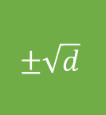

Partial Trace
$$m$$
$$±1$$
$$m$$
$$≈\sqrt{m}$$
$$\left(x⊗x\right){\left(x⊗x\right)}^{⊤}+E$$
$$xx^{⊤}+ ??$$
What if the noise is as random as possible? i.i.d $±1$ entries?
$$d^{2}$$
$$±1$$
$$\frac{1}{d}⋅$$
$$±1$$
$$\frac{1}{d}⋅$$
$$+ ⋯+$$
$$±\sqrt{d}$$
$$≈$$
$$\frac{1}{d}⋅$$
$$\frac{1}{d}⋅$$
$$d^{2}$$

Slide 41




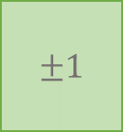
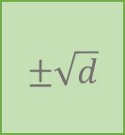



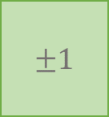
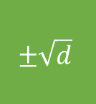
Partial Trace
$$m$$
$$±1$$
$$m$$
$$≈\sqrt{m}$$
$$\left(x⊗x\right){\left(x⊗x\right)}^{⊤}+E$$
$$xx^{⊤}+ ??$$
What if the noise is as random as possible? i.i.d $±1$ entries?
$$d^{2}$$
$$±1$$
$$\frac{1}{d}⋅$$
$$±1$$
$$\frac{1}{d}⋅$$
$$+ ⋯+$$
$$±\sqrt{d}$$
$$≈$$
$$\frac{1}{d}⋅$$
$$\frac{1}{d}⋅$$
$$d^{2}$$
$$±\sqrt{d}$$
$$\frac{1}{d}⋅$$
$$≈1$$
Notes:
MENTION guruswami-sinop

Slide 42
Partial Trace
$$m$$
$$±1$$
$$m$$
$$≈\sqrt{m}$$
$$\left(x⊗x\right){\left(x⊗x\right)}^{⊤}+E$$
$$xx^{⊤}+ ??$$
What if the noise is as random as possible? i.i.d $±1$ entries?
Conclusion: signal-to-noise ratio is preserved!
$$d^{2}$$
$$±1$$
$$\frac{1}{d}⋅$$
$$±1$$
$$\frac{1}{d}⋅$$
$$+ ⋯+$$
$$±\sqrt{d}$$
$$≈$$
$$\frac{1}{d}⋅$$
$$\frac{1}{d}⋅$$
$$d^{2}$$
$$±\sqrt{d}$$
$$\frac{1}{d}⋅$$
$$≈1$$
Notes:
MENTION guruswami-sinop

Slide 43






The Speedup Recipe
SoS algorithm (large SDP)
Spectral algorithm with big matrices
Fast spectral algorithm
$$d^{2}$$
$$d$$
$$d^{2}$$
$$d$$
$$\left(x⊗x\right){\left(x⊗x\right)}^{⊤}+E$$
$$xx^{⊤}+E′$$
Notes:
MENTION guruswami-sinop

Slide 44
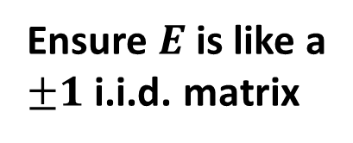
The Speedup Recipe
SoS algorithm (large SDP)
Spectral algorithm with big matrices
Fast spectral algorithm
Ensure $E$ is like a
$±1$ i.i.d. matrix
$$d^{2}$$
$$d$$
$$d^{2}$$
$$d$$
$$\left(x⊗x\right){\left(x⊗x\right)}^{⊤}+E$$
$$xx^{⊤}+E′$$
Notes:
MENTION guruswami-sinop

Slide 45
The Speedup Recipe
Avoid explicitly computing
large matrix
SoS algorithm (large SDP)
Spectral algorithm with big matrices
Fast spectral algorithm
Ensure $E$ is like a
$±1$ i.i.d. matrix
$$d^{2}$$
$$d$$
$$d^{2}$$
$$d$$
$$\left(x⊗x\right){\left(x⊗x\right)}^{⊤}+E$$
$$xx^{⊤}+E′$$
Notes:
MENTION guruswami-sinop

Slide 46
Resulting Algorithms are Simple and Spectral
Given: basis for (almost) random $d$-dimensional subspace of $ℝ^{n}$
Containing: $v_{0}$ with $≤\frac{n}{100}$ nonzeros.
Find $v_{0}$
$$d$$
$$z$$
$$y$$
$$n$$
$$n$$
$$k$$
$$x$$
$$v_{0}$$

Slide 47




Resulting Algorithms are Simple and Spectral
Given: basis for (almost) random $d$-dimensional subspace of $ℝ^{n}$
$$d$$
$$a_{1}$$
$$n$$
$$⋮$$
$$a_{n}$$

Slide 48
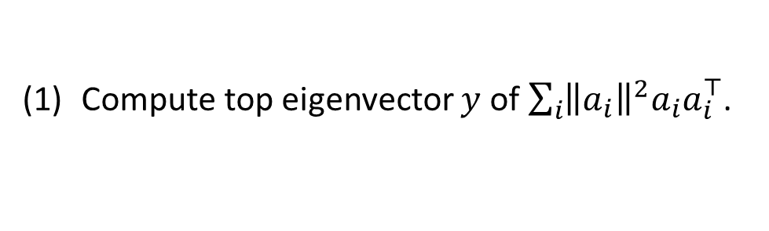
Resulting Algorithms are Simple and Spectral
Given: basis for (almost) random $d$-dimensional subspace of $ℝ^{n}$
$$d$$
Compute top eigenvector $y$ of $\sum_{i}{{\left\|a_{i}\right\|}^{2}a_{i}a_{i}^{⊤}}$.
$$a_{1}$$
$$n$$
$$⋮$$
$$a_{n}$$

Slide 49


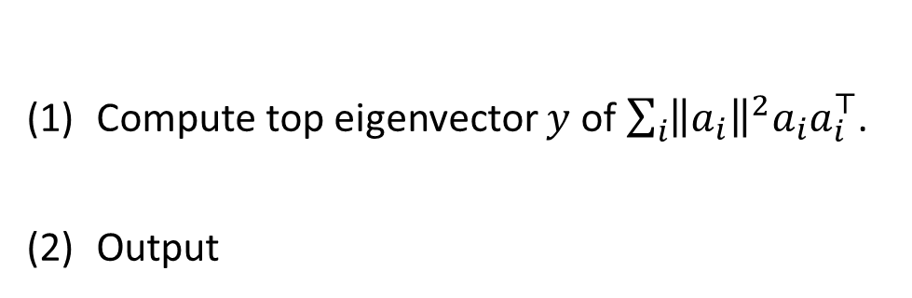
Resulting Algorithms are Simple and Spectral
Given: basis for (almost) random $d$-dimensional subspace of $ℝ^{n}$
$$d$$
Compute top eigenvector $y$ of $\sum_{i}{{\left\|a_{i}\right\|}^{2}a_{i}a_{i}^{⊤}}$.
Output
$$a_{1}$$
$$d$$
$$n$$
$$⋮$$
basis
$$y$$
$$n$$
$$a_{n}$$

Slide 50

Resulting Algorithms are Simple and Spectral
Given: basis for (almost) random $d$-dimensional subspace of $ℝ^{n}$
$$d$$
$\sum_{i}{{\left\|a_{i}\right\|}^{2}a_{i}a_{i}^{⊤}}$ is a degree-4 matrix polynomial in the input variables.
Capture the power of SoS without high dimensions
Compute top eigenvector $y$ of $\sum_{i}{{\left\|a_{i}\right\|}^{2}a_{i}a_{i}^{⊤}}$.
Output
$$a_{1}$$
$$d$$
$$n$$
$$⋮$$
basis
$$y$$
$$n$$
$$a_{n}$$

Slide 51
Conclusions
By exploiting
tensor structure in dual certificates,
randomness in inputs,
impractical SoS algorithms can become
practical spectral algorithms.
Thanks For Coming!

Slide 52
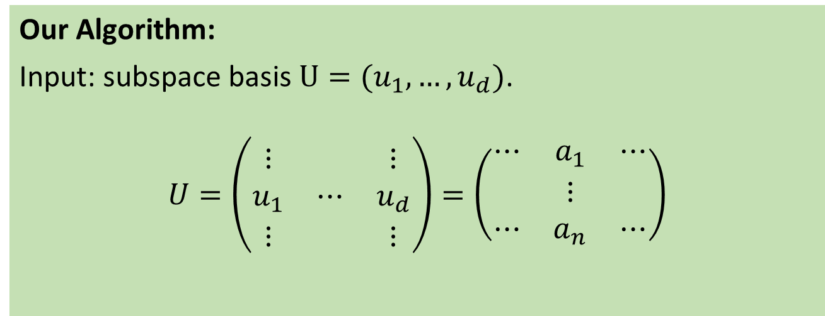
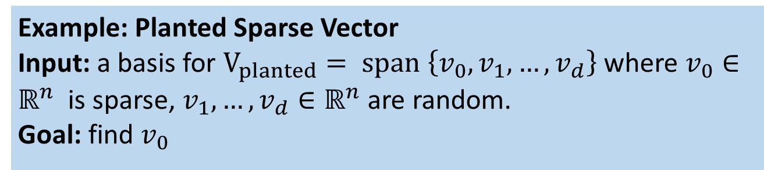
The Resulting Algorithms are Simple and Spectral
Example: Planted Sparse Vector
Input: a basis for $V_{planted}= \text{span} \left\{v_{0},v_{1},…, v_{d}\right\}$ where $v_{0}∈ℝ^{n}$ is sparse, $v_{1},…, v_{d}∈ℝ^{n}$ are random.
Goal: find $v_{0}$
Our Algorithm:
Input: subspace basis $U=(u_{1},…, u_{d})$.
$$U=\left(\begin{matrix}⋮ & & ⋮ \\ u_{1} & ⋯ & u_{d} \\ ⋮ & & ⋮\end{matrix}\right)=\left(\begin{matrix}⋯ & a_{1} & ⋯ \\ & ⋮ & \\ ⋯ & a_{n} & ⋯\end{matrix}\right)$$

Slide 53
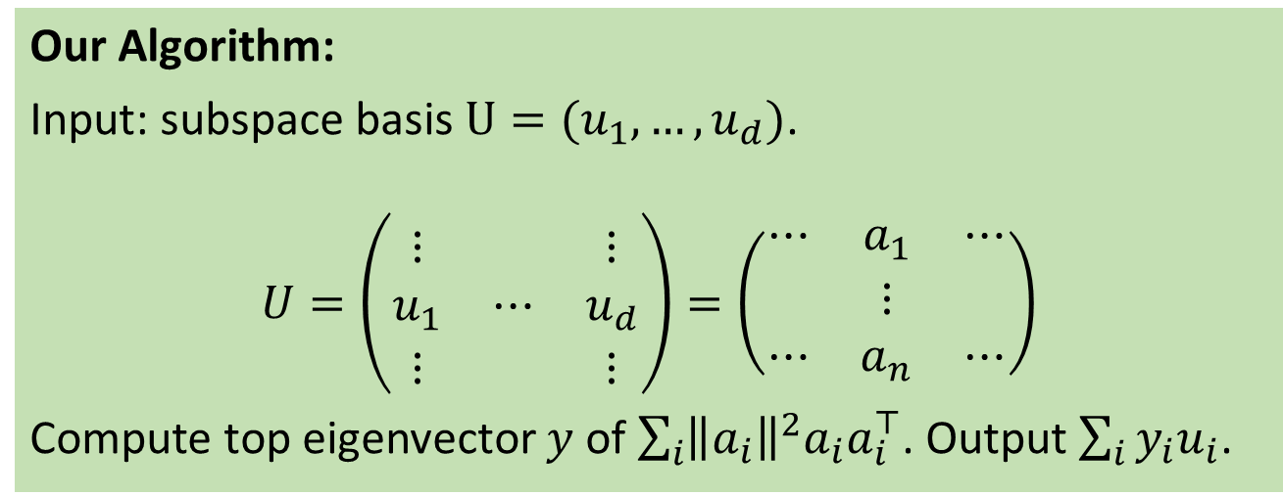
The Resulting Algorithms are Simple and Spectral
Example: Planted Sparse Vector
Input: a basis for $V_{planted}= \text{span} \left\{v_{0},v_{1},…, v_{d}\right\}$ where $v_{0}∈ℝ^{n}$ is sparse, $v_{1},…, v_{d}∈ℝ^{n}$ are random.
Goal: find $v_{0}$
Our Algorithm:
Input: subspace basis $U=(u_{1},…, u_{d})$.
$$U=\left(\begin{matrix}⋮ & & ⋮ \\ u_{1} & ⋯ & u_{d} \\ ⋮ & & ⋮\end{matrix}\right)=\left(\begin{matrix}⋯ & a_{1} & ⋯ \\ & ⋮ & \\ ⋯ & a_{n} & ⋯\end{matrix}\right)$$
Compute top eigenvector $y$ of $\sum_{i}{{\left\|a_{i}\right\|}^{2}a_{i}a_{i}^{⊤}}$. Output $\sum_{i}{y_{i}u_{i}}$.
Notes:
Replace matrices by pictures

Slide 54

The Resulting Algorithms are Simple and Spectral
Example: Planted Sparse Vector
Input: a basis for $V_{planted}= \text{span} \left\{v_{0},v_{1},…, v_{d}\right\}$ where $v_{0}∈ℝ^{n}$ is sparse, $v_{1},…, v_{d}∈ℝ^{n}$ are random.
Goal: find $v_{0}$
$\sum_{i}{{\left\|a_{i}\right\|}^{2}a_{i}a_{i}^{⊤}}$ is a degree-4 matrix polynomial in the input variables.
Capture the power of SoS without high dimensions
Our Algorithm:
Input: subspace basis $U=(u_{1},…, u_{d})$.
$$U=\left(\begin{matrix}⋮ & & ⋮ \\ u_{1} & ⋯ & u_{d} \\ ⋮ & & ⋮\end{matrix}\right)=\left(\begin{matrix}⋯ & a_{1} & ⋯ \\ & ⋮ & \\ ⋯ & a_{n} & ⋯\end{matrix}\right)$$
Compute top eigenvector $y$ of $\sum_{i}{{\left\|a_{i}\right\|}^{2}a_{i}a_{i}^{⊤}}$. Output $\sum_{i}{y_{i}u_{i}}$.

Slide 55
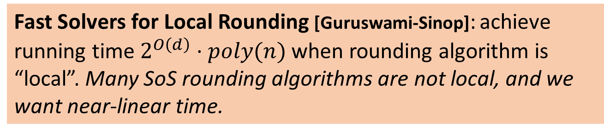
Contrast to Previous Speedup Approaches
(Matrix) Multiplicative Weights [Arora-Kale]: Cannot go faster than matrix-vector multiplication for matrices in the underlying SDP.
Fast Solvers for Local Rounding [Guruswami-Sinop]: achieve running time $2^{O\left(d\right)}⋅poly(n)$ when rounding algorithm is “local”. Many SoS rounding algorithms are not local, and we want near-linear time.
Notes:
Algorithm will have to run in time SUBlinear in the dimension of the convex relaxation – UNLIKE previous primal-dual or MMW.

Slide 56
The Speedup Recipe
Understand Spectrum of SoS Dual Certificate (avoid SDP)
(2) Reduce Dimensions via Tensor Structure in Dual Cert.

Slide 57
The Speedup Recipe
Understand Spectrum of SoS Dual Certificate (avoid SDP)
analyses of existing SoS algorithms construct dual certificates (high-dimensional matrices) but only require their existence.
compute dual certificate directly.
top eigenvector of dual can be rounded to find solution.
(2) Reduce Dimensions via Tensor Structure in Dual Cert.

Slide 58
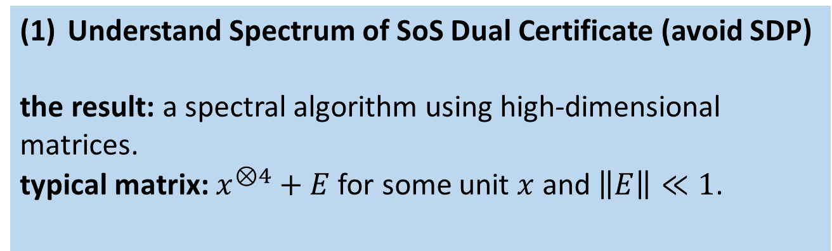
The Speedup Recipe
Understand Spectrum of SoS Dual Certificate (avoid SDP)
the result: a spectral algorithm using high-dimensional matrices.
typical matrix: $x^{⊗4}+E$ for some unit $x$ and $\left\|E\right\|≪1$.
(2) Reduce Dimensions via Tensor Structure in Dual Cert.

Slide 59
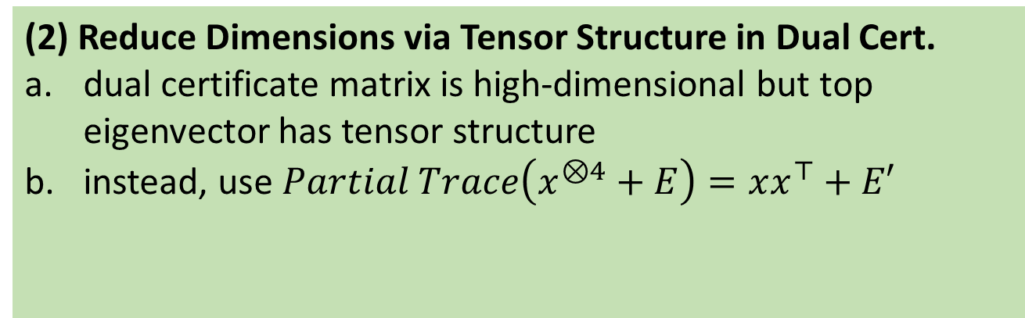
The Speedup Recipe
Understand Spectrum of SoS Dual Certificate (avoid SDP)
the result: a spectral algorithm using high-dimensional matrices.
typical matrix: $x^{⊗4}+E$ for some unit $x$ and $\left\|E\right\|≪1$.
(2) Reduce Dimensions via Tensor Structure in Dual Cert.
dual certificate matrix is high-dimensional but top eigenvector has tensor structure
instead, use $Partial Trace\left(x^{⊗4}+E\right)=xx^{⊤}+E′$

Slide 60

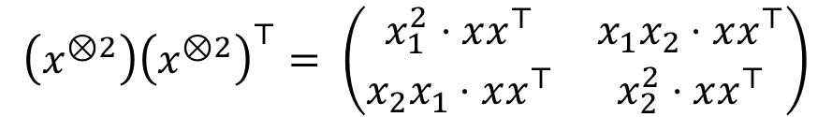
The Speedup Recipe
$$PartialTrace:\left\{d^{2}×d^{2} matrices\right\}→\left\{d×d matrices\right\}$$
Understand Spectrum of SoS Dual Certificate
the result: a spectral algorithm using high-dimensional matrices.
In 2 dimensions:
$$\left(x^{⊗2}\right){\left(x^{⊗2}\right)}^{⊤}= \left(\begin{matrix}x_{1}^{2}⋅xx^{⊤} & x_{1}x_{2}⋅xx^{⊤} \\ x_{2}x_{1}⋅xx^{⊤} & x_{2}^{2}⋅xx^{⊤}\end{matrix}\right)$$
$$x_{1}^{2}⋅xx^{⊤}+x_{2}^{2}⋅xx^{⊤}={\left|x\right|}_{2}^{2}⋅xx^{⊤}=xx^{⊤}$$
(2) Reduce Dimensions via Tensor Structure in Dual Cert.
dual certificate matrix is high-dimensional but top eigenvector has tensor structure
instead, use $Partial Trace\left(x^{⊗4}+E\right)=xx^{⊤}+E′$

Slide 61
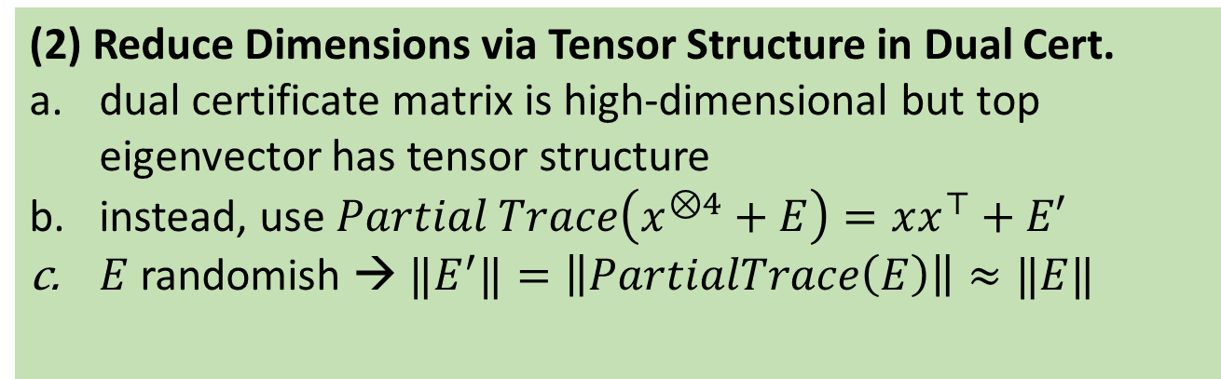
The Speedup Recipe
$$PartialTrace:\left\{d^{2}×d^{2} matrices\right\}→\left\{d×d matrices\right\}$$
Understand Spectrum of SoS Dual Certificate
the result: a spectral algorithm using high-dimensional matrices.
(2) Reduce Dimensions via Tensor Structure in Dual Cert.
dual certificate matrix is high-dimensional but top eigenvector has tensor structure
instead, use $Partial Trace\left(x^{⊗4}+E\right)=xx^{⊤}+E′$
$E$ randomish → ${‖E}^{′}‖=\left\|PartialTrace\left(E\right)\right\|≈‖E‖$

Slide 62


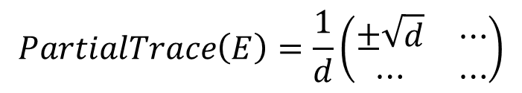

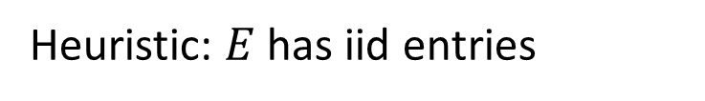
The Speedup Recipe
$$PartialTrace:\left\{d^{2}×d^{2} matrices\right\}→\left\{d×d matrices\right\}$$
Understand Spectrum of SoS Dual Certificate
the result: a spectral algorithm using high-dimensional matrices.
Heuristic: $E$ has iid entries
$$E=\frac{1}{d}\left(\begin{matrix}±1 & ⋯ \\ ⋯ & ⋯\end{matrix}\right)$$
$$PartialTrace\left(E\right)=\frac{1}{d}\left(\begin{matrix}±\sqrt{d} & ⋯ \\ ⋯ & ⋯\end{matrix}\right)$$
$$d^{2}×d^{2}$$
$$d ×d$$
(2) Reduce Dimensions via Tensor Structure in Dual Cert.
dual certificate matrix is high-dimensional but top eigenvector has tensor structure
instead, use $Partial Trace\left(x^{⊗4}+E\right)=xx^{⊤}+E′$
$E$ randomish → ${‖E}^{′}‖=\left\|PartialTrace\left(E\right)\right\|≈‖E‖$

Slide 63
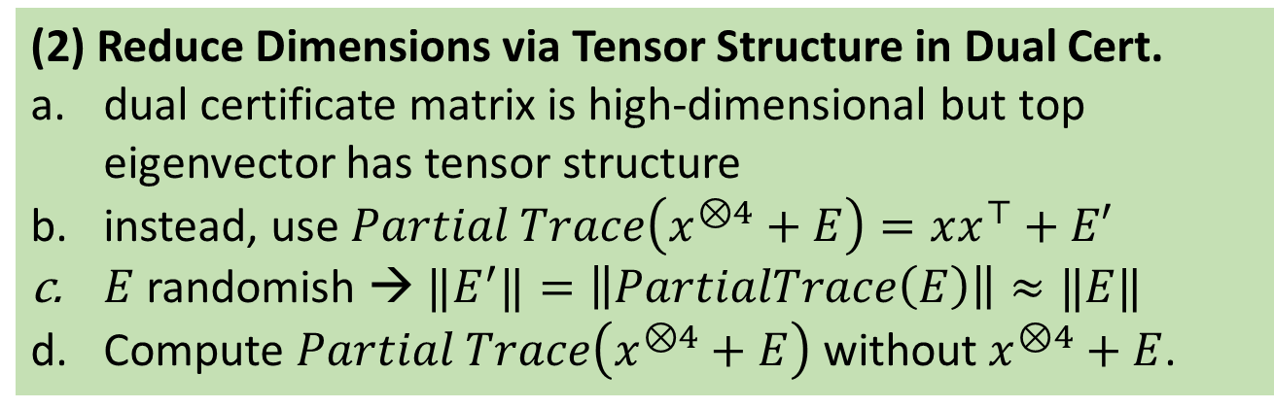
The Speedup Recipe
$$PartialTrace:\left\{d^{2}×d^{2} matrices\right\}→\left\{d×d matrices\right\}$$
Understand Spectrum of SoS Dual Certificate
the result: a spectral algorithm using high-dimensional matrices.
Heuristic: $E$ has iid entries
$$E=\frac{1}{d}\left(\begin{matrix}±1 & ⋯ \\ ⋯ & ⋯\end{matrix}\right)$$
$$PartialTrace\left(E\right)=\frac{1}{d}\left(\begin{matrix}±\sqrt{d} & ⋯ \\ ⋯ & ⋯\end{matrix}\right)$$
$$d^{2}×d^{2}$$
$$d ×d$$
(2) Reduce Dimensions via Tensor Structure in Dual Cert.
dual certificate matrix is high-dimensional but top eigenvector has tensor structure
instead, use $Partial Trace\left(x^{⊗4}+E\right)=xx^{⊤}+E′$
$E$ randomish → ${‖E}^{′}‖=\left\|PartialTrace\left(E\right)\right\|≈‖E‖$
Compute $Partial Trace\left(x^{⊗4}+E\right)$ without $x^{⊗4}+E$.

Slide 64
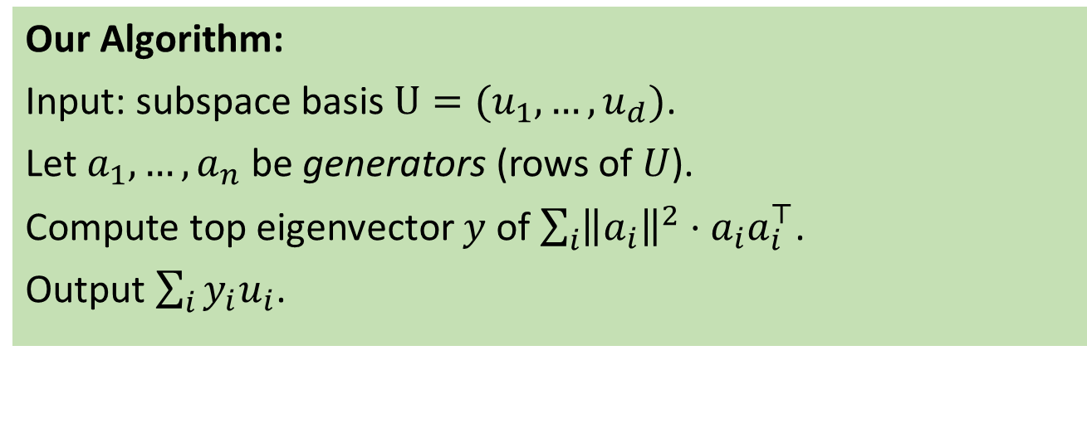
The Resulting Algorithms are Simple and Spectral
Example: Planted Sparse Vector
Input: a basis for $V_{planted}= \text{span} \left\{v_{0},v_{1},…, v_{d}\right\}$ where $v_{0}∈ℝ^{n}$ is sparse, $v_{1},…, v_{d}∈ℝ^{n}$ are random.
Goal: find $v_{0}$
Our Algorithm:
Input: subspace basis $U=(u_{1},…, u_{d})$.
Let $a_{1},…, a_{n}$ be generators (rows of $U$).
Compute top eigenvector $y$ of $\sum_{i}{{\left\|a_{i}\right\|}^{2}⋅a_{i}a_{i}^{⊤}}$.
Output $\sum_{i}{y_{i}u_{i}}$.

Slide 65
Thanks For Coming!

Slide 66
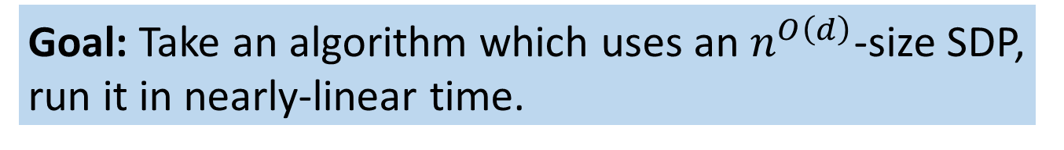
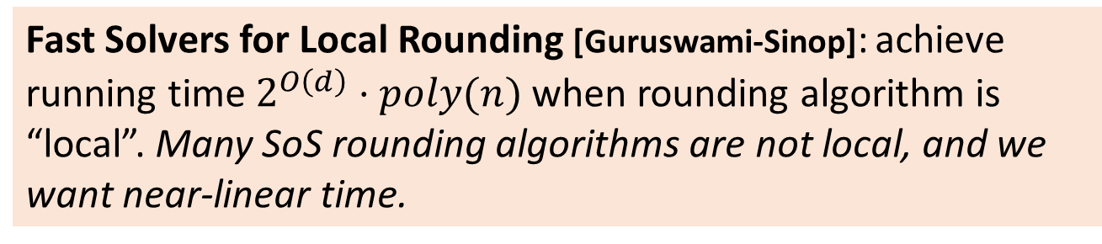
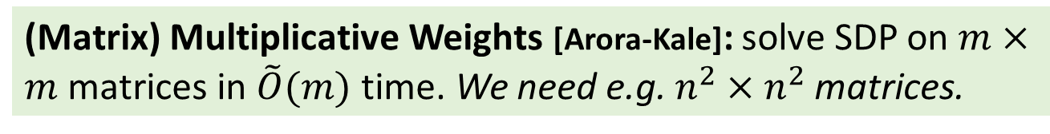
Can We Use Previous Approaches to Speeding Up Relaxation-Based Algorithms?
Goal: Take an algorithm which uses an $n^{O\left(d\right)}$-size SDP, run it in nearly-linear time.
(Matrix) Multiplicative Weights [Arora-Kale]: solve SDP on $m×m$ matrices in $\tilde{O}(m)$ time. We need e.g. $n^{2}×n^{2}$ matrices.
Fast Solvers for Local Rounding [Guruswami-Sinop]: achieve running time $2^{O\left(d\right)}⋅poly(n)$ when rounding algorithm is “local”. Many SoS rounding algorithms are not local, and we want near-linear time.
Notes:
Algorithm will have to run in time SUBlinear in the dimension of the convex relaxation – UNLIKE previous primal-dual or MMW.

Slide 67








A Benchmark Problem: Planted Sparse Vector
Input: a basis for $V_{planted}= \text{span} \left\{v_{0},v_{1},…, v_{d}\right\}$ where $v_{0}∈ℝ^{n}$has $\frac{n}{100}$ nonzeros, $v_{1},…, v_{d}∈ℝ^{n}$ are random.
Goal (recovery): find $v_{0}$
Goal (distinguishing): distinguish from a random subspace $V_{random}$
$$v_{1}$$
$$≈±\frac{1}{\sqrt{n}}$$
.
.
.
$$u_{0}$$
Random linear combinations
.
.
.
$$v_{d}$$
$$u_{d}$$
$$v_{0}$$
$$≈±\frac{10}{\sqrt{n}}$$
Notes:
Fix sparsity to n/100
More slides, fewer words
Need a visualization – maybe the spikyness picture, maybe game

Slide 68

A Benchmark Problem: Planted Sparse Vector
Input: a basis for $V_{planted}= \text{span} \left\{v_{0},v_{1},…, v_{d}\right\}$ where $v_{0}∈ℝ^{n}$has $\frac{n}{100}$ nonzeros, $v_{1},…, v_{d}∈ℝ^{n}$ are random.
Goal (recovery): find $v_{0}$
Goal (distinguishing): distinguish from a random subspace $V_{random}$
Gets harder as $d=d(n)$ grows.
Notes:
Fix sparsity to n/100
More slides, fewer words
Need a visualization – maybe the spikyness picture, maybe game

Slide 69

A Benchmark Problem: Planted Sparse Vector
Input: a basis for $V_{planted}= \text{span} \left\{v_{0},v_{1},…, v_{d}\right\}$ where $v_{0}∈ℝ^{n}$has $\frac{n}{100}$ nonzeros, $v_{1},…, v_{d}∈ℝ^{n}$ are random.
Goal (recovery): find $v_{0}$
Goal (distinguishing): distinguish from a random subspace $V_{random}$
Question: what dimension $d$ can be handled by efficient algorithms? (Poly-time in input size $nd$.)
[Spielman-Wang-Wright, Demanet-Hand, Barak-Kelner-Steurer, Qu-Sun-Wright, H-Schramm-Shi-Steurer]
Notes:
Fix sparsity to n/100
More slides, fewer words
Need a visualization – maybe the spikyness picture, maybe game

Slide 70
A Benchmark Problem: Planted Sparse Vector
Input: a basis for $V_{planted}= \text{span} \left\{v_{0},v_{1},…, v_{d}\right\}$ where $v_{0}∈ℝ^{n}$has $\frac{n}{100}$ nonzeros, $v_{1},…, v_{d}∈ℝ^{n}$ are random.
Goal (recovery): find $v_{0}$
Goal (distinguishing): distinguish from a random subspace $V_{random}$
Related to compressed sensing, dictionary learning, sparse pca, shortest codeword, small-set expansion
Notes:
Fix sparsity to n/100
More slides, fewer words
Need a visualization – maybe the spikyness picture, maybe game

Slide 71
A Benchmark Problem: Planted Sparse Vector
Input: a basis for $V_{planted}= \text{span} \left\{v_{0},v_{1},…, v_{d}\right\}$ where $v_{0}∈ℝ^{n}$has $\frac{n}{100}$ nonzeros, $v_{1},…, v_{d}∈ℝ^{n}$ are random.
Goal (recovery): find $v_{0}$
Goal (distinguishing): distinguish from a random subspace $V_{random}$
Simple problem where sum-of-squares (SoS) hierarchy beats LP, (small) SDPs, local search
Notes:
Fix sparsity to n/100
More slides, fewer words
Need a visualization – maybe the spikyness picture, maybe game

Slide 72

Previous Work (recovery version)
Authors | Subspace Dimension | Technique
[Spielman-Wang-Wright, Demanet-Hand] | $$O\left(1\right)$$ unless greater sparsity | Linear Programming
Notes:
Fix sparsity to n/100
More slides, fewer words
Need a visualization – maybe the spikyness picture, maybe game

Slide 73

Previous Work (recovery version)
Authors | Subspace Dimension | Technique
[Spielman-Wang-Wright, Demanet-Hand] | $$O\left(1\right)$$ unless greater sparsity | Linear Programming
Folklore | $$O\left(1\right)$$ unless greater sparsity | Semidefinite Programming
Notes:
Fix sparsity to n/100
More slides, fewer words
Need a visualization – maybe the spikyness picture, maybe game

Slide 74

Previous Work (recovery version)
Authors | Subspace Dimension | Technique
[Spielman-Wang-Wright, Demanet-Hand] | $$O\left(1\right)$$ unless greater sparsity | Linear Programming
Folklore | $$O\left(1\right)$$ unless greater sparsity | Semidefinite Programming
[Qu-Sun-Wright] | $$\frac{n^{1/4}}{{\left(\log{n}\right)}^{O\left(1\right)}}$$ | Alternating Minimization
Notes:
Fix sparsity to n/100
More slides, fewer words
Need a visualization – maybe the spikyness picture, maybe game

Slide 75

Previous Work (recovery version)
Authors | Subspace Dimension | Technique
[Spielman-Wang-Wright, Demanet-Hand] | $$O\left(1\right)$$ unless greater sparsity | Linear Programming
Folklore | $$O\left(1\right)$$ unless greater sparsity | Semidefinite Programming
[Qu-Sun-Wright] | $$\frac{n^{1/4}}{{\left(\log{n}\right)}^{O\left(1\right)}}$$ | Alternating Minimization
[Barak-Brandao-Harrow-Kelner-Steurer-Zhou, Barak-Kelner-Steurer] | $$\sqrt{n}$$ | SoS Hierarchy
Notes:
Fix sparsity to n/100
More slides, fewer words
Need a visualization – maybe the spikyness picture, maybe game

Slide 76
Previous Work (recovery version)
Authors | Subspace Dimension | Technique
[Spielman-Wang-Wright, Demanet-Hand] | $$O\left(1\right)$$ unless greater sparsity | Linear Programming
Folklore | $$O\left(1\right)$$ unless greater sparsity | Semidefinite Programming
[Qu-Sun-Wright] | $$\frac{n^{1/4}}{{\left(\log{n}\right)}^{O\left(1\right)}}$$ | Alternating Minimization
[Barak-Brandao-Harrow-Kelner-Steurer-Zhou, Barak-Kelner-Steurer] | $$\sqrt{n}$$ | SoS Hierarchy
All require polynomial loss in sparsity or subspace dimension or both, compared with SoS.
Notes:
Fix sparsity to n/100
More slides, fewer words
Need a visualization – maybe the spikyness picture, maybe game

Slide 77


Sum-of-Squares (and SoS-inspired) Algorithms
From now on: $d=\sqrt{n}/log{\left(n\right)}^{O\left(1\right)}$
Running Time | Distinguishing | Recovery
$$poly\left(n,d\right)$$ | [Barak-Brandao-Harrow-Kelner-Steurer-Zhou] | [Barak-Kelner-Steurer]
Notes:
Fix sparsity to n/100
More slides, fewer words
Need a visualization – maybe the spikyness picture, maybe game

Slide 78

Sum-of-Squares (and SoS-inspired) Algorithms
From now on: $d=\sqrt{n}/log{\left(n\right)}^{O\left(1\right)}$
Running Time | Distinguishing | Recovery
$$poly\left(n,d\right)$$ | [Barak-Brandao-Harrow-Kelner-Steurer-Zhou] | [Barak-Kelner-Steurer]
$$\tilde{O}(nd^{2})$$
Notes:
Fix sparsity to n/100
More slides, fewer words
Need a visualization – maybe the spikyness picture, maybe game

Slide 79

Sum-of-Squares (and SoS-inspired) Algorithms
From now on: $d=\sqrt{n}/log{\left(n\right)}^{O\left(1\right)}$
Running Time | Distinguishing | Recovery
$$poly\left(n,d\right)$$ | [Barak-Brandao-Harrow-Kelner-Steurer-Zhou] | [Barak-Kelner-Steurer]
$$\tilde{O}(nd^{2})$$ | [Barak-Brandao-Harrow-Kelner-Steurer-Zhou] (implicit)
Notes:
Fix sparsity to n/100
More slides, fewer words
Need a visualization – maybe the spikyness picture, maybe game

Slide 80

Sum-of-Squares (and SoS-inspired) Algorithms
From now on: $d=\sqrt{n}/log{\left(n\right)}^{O\left(1\right)}$
Running Time | Distinguishing | Recovery
$$poly\left(n,d\right)$$ | [Barak-Brandao-Harrow-Kelner-Steurer-Zhou] | [Barak-Kelner-Steurer]
$$\tilde{O}(nd^{2})$$ | [Barak-Brandao-Harrow-Kelner-Steurer-Zhou] (implicit) | This work
Notes:
Fix sparsity to n/100
More slides, fewer words
Need a visualization – maybe the spikyness picture, maybe game

Slide 81

Sum-of-Squares (and SoS-inspired) Algorithms
From now on: $d=\sqrt{n}/log{\left(n\right)}^{O\left(1\right)}$
Running Time | Distinguishing | Recovery
$$poly\left(n,d\right)$$ | [Barak-Brandao-Harrow-Kelner-Steurer-Zhou] | [Barak-Kelner-Steurer]
$$\tilde{O}(nd^{2})$$ | [Barak-Brandao-Harrow-Kelner-Steurer-Zhou] (implicit) | This work
Running-time barrier from dimension of convex program
Notes:
Fix sparsity to n/100
More slides, fewer words
Need a visualization – maybe the spikyness picture, maybe game

Slide 82

Sum-of-Squares (and SoS-inspired) Algorithms
From now on: $d=\sqrt{n}/log{\left(n\right)}^{O\left(1\right)}$
Running Time | Distinguishing | Recovery
$$poly\left(n,d\right)$$ | [Barak-Brandao-Harrow-Kelner-Steurer-Zhou] | [Barak-Kelner-Steurer]
$$\tilde{O}(nd^{2})$$ | [Barak-Brandao-Harrow-Kelner-Steurer-Zhou] (implicit) | This work
$\tilde{O}(nd)$ i.e. nearly-linear | This work | This work
Running-time barrier from dimension of convex program
Notes:
Fix sparsity to n/100
More slides, fewer words
Need a visualization – maybe the spikyness picture, maybe game

Slide 83


[Barak et al]’s Distinguishing Algorithm
Running Time | Distinguishing | Recovery
$$poly\left(n,d\right)$$ | [Barak-Brandao-Harrow-Kelner-Steurer-Zhou] | [Barak-Kelner-Steurer]
$$\tilde{O}(nd^{2})$$ | [Barak-Brandao-Harrow-Kelner-Steurer-Zhou] (implicit) | This work
$\tilde{O}(nd)$ i.e. nearly-linear | This work | This work
Observation: $max_{v∈V_{random}}\frac{{\left\|v\right\|}_{4}}{{\left\|v\right\|}_{2}}≪\frac{{\left\|v_{0}\right\|}_{4}}{{\left\|v_{0}\right\|}_{2}}$ for sparse $v_{0}$
[Barak et al]: $SoS_{4}\left(max_{v∈V_{random}}\frac{{\left\|v\right\|}_{4}}{{\left\|v\right\|}_{2}}\right)≪\frac{{\left\|v_{0}\right\|}_{4}}{{\left\|v_{0}\right\|}_{2}}$ for sparse $v_{0}$
SDP in $d^{2}×d^{2}$ matrices
Notes:
Fix sparsity to n/100
More slides, fewer words
Need a visualization – maybe the spikyness picture, maybe game

Slide 84




Bound $SoS_{4}$ Using Dual Certificate
$$SoS_{4}\left(max_{v∈V_{random}}\frac{{\left\|v\right\|}_{4}}{{\left\|v\right\|}_{2}}\right)≤\left\|M\left(V_{random}\right)\right\|≪\frac{{\left\|v_{0}\right\|}_{4}}{{\left\|v_{0}\right\|}_{2}}$$
Dual: $M\left(V\right)∈ℝ^{d^{2} ×d^{2}}$ so that $〈x^{⊗2}, M\left(V\right)x^{⊗2}〉={\left\|∑x_{i}u_{i}\right\|}_{4}^{4}$
(remember that $span\left\{u_{0},…, u_{d}\right\}=V$)
${\left\|∑x_{i}u_{i}\right\|}_{4}^{4}$ makes SoS the champion
High dimension → access high-degree polynomial
Notes:
Fix sparsity to n/100
More slides, fewer words
Need a visualization – maybe the spikyness picture, maybe game

Slide 85

Running Time | Distinguishing | Recovery
$$poly\left(n,d\right)$$ | [Barak-Brandao-Harrow-Kelner-Steurer-Zhou] | [Barak-Kelner-Steurer]
$$\tilde{O}(nd^{2})$$ | [Barak-Brandao-Harrow-Kelner-Steurer-Zhou] (implicit) | This work
$\tilde{O}(nd)$ i.e. nearly-linear | This work | This work
Notes:
Fix sparsity to n/100
More slides, fewer words
Need a visualization – maybe the spikyness picture, maybe game

Slide 86




Structure of the Dual Cert. $M(V)$
Computing Directly With $M\left(V\right)$
(1) $M(V)$ is explicit: matrix-vector multiply in time $O(nd^{2})$
(2) $\left\|M\left(V_{random}\right)\right\|≪\frac{{\left\|v_{0}\right\|}_{4}}{{\left\|v_{0}\right\|}_{2}}≈‖M\left(V_{planted}\right)‖$
Lemma: With high probability,
$$M\left(V_{planted}\right)=\left(y⊗y\right){\left(y⊗y\right)}^{⊤}+E,$$
where $y$ is unit, $v_{0}=\sum_{i}{y_{i}u_{i}}$, and $\left\|E\right\|≪1$.
$E$ is a random matrix depending on randomness in subspace $V_{planted}$.
Notes:
Fix sparsity to n/100
More slides, fewer words
Need a visualization – maybe the spikyness picture, maybe game

Slide 87

Running Time | Distinguishing | Recovery
$$poly\left(n,d\right)$$ | [Barak-Brandao-Harrow-Kelner-Steurer-Zhou] | [Barak-Kelner-Steurer]
$$\tilde{O}(nd^{2})$$ | [Barak-Brandao-Harrow-Kelner-Steurer-Zhou] (implicit) | This work
$\tilde{O}(nd)$ i.e. nearly-linear | This work | This work
Notes:
Fix sparsity to n/100
More slides, fewer words
Need a visualization – maybe the spikyness picture, maybe game

Slide 88



(Breaking) The Dimension Barrier
Recall: ${\left\|∑x_{i}u_{i}\right\|}_{4}^{4}$ makes SoS the champion
$M(V)$ is $d^{2}×d^{2}$ → access high-degree polynomial
High-Degree but Lower Dimension
$M\left(V_{planted}\right)=\left(y⊗y\right){\left(y⊗y\right)}^{⊤}+E$ is $d^{2}×d^{2}$
$Partial Trace\left(M\left(V_{planted}\right)\right)=yy^{⊤}+E′$ is $d×d$
$$PartialTrace:\left\{d^{2}×d^{2} matrices\right\}→\left\{d×d matrices\right\}$$
$$Partial Trace\left(\left(y⊗y\right){\left(y⊗y\right)}^{⊤}\right)=yy^{⊤}$$
$$Partial Trace\left(E\right)=E′$$
Notes:
Fix sparsity to n/100
More slides, fewer words
Need a visualization – maybe the spikyness picture, maybe game

Slide 89



(Breaking) The Dimension Barrier
High-Degree but Lower Dimension
$M\left(V_{planted}\right)=\left(y⊗y\right){\left(y⊗y\right)}^{⊤}+E$ is $d^{2}×d^{2}$
$Partial Trace\left(M\left(V_{planted}\right)\right)=yy^{⊤}+E′$ is $d×d$
Compute top eigenvector in time $\tilde{O}(nd)$?
Yes, $M(V)$ is a nice function of $V$ and $Partial Trace$ is linear
Does $\left\|E\right\|≪1$ → $\left\|E^{′}\right\|=‖PartialTrace\left(E\right)‖≪1$ ?
Yes, if $E$ is random enough.
Related: $A∈{\left\{−1,1\right\}}^{n×n}$ uniform has $\left\|A\right\|≈TrA≈\sqrt{n}$.
Notes:
Fix sparsity to n/100
More slides, fewer words
Need a visualization – maybe the spikyness picture, maybe game

Slide 90


Recovering $v_{0}$ in $\tilde{O}\left(nd\right)$ Time
Algorithm
Input: subspace basis $U=(u_{1},…, u_{d})$.
Let $a_{1},…, a_{n}$ be generators (rows of $U$).
Compute top eigenvector $y$ of $\sum_{i}{{\left\|a_{i}\right\|}^{2}⋅a_{i}a_{i}^{⊤}}$.
Output $\sum_{i}{y_{i}u_{i}}$.
The Recipe
(1) SoS algorithms (often) come with dual certificate constructions.
(2) Explicitly compute spectrum of dual certificate.
(3) Compress to lower dimensions using randomness to avoid losing information.
Notes:
Fix sparsity to n/100
More slides, fewer words
Need a visualization – maybe the spikyness picture, maybe game

