Slide 1
A Sum of Squares View on Algorithms, Complexity, and Cryptoanalysis
Sam Hopkins
Miller Fellow, UC Berkeley

Slide 2
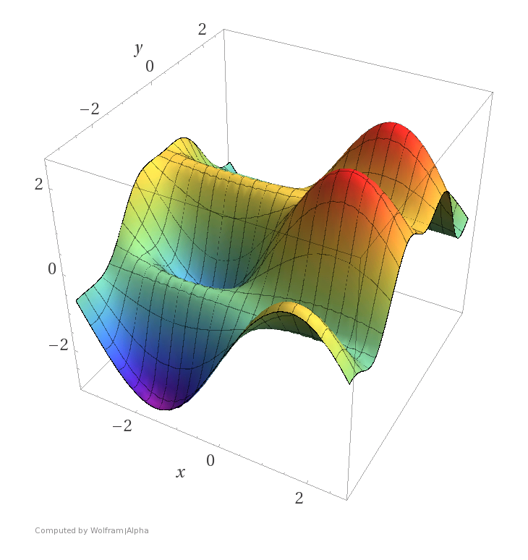
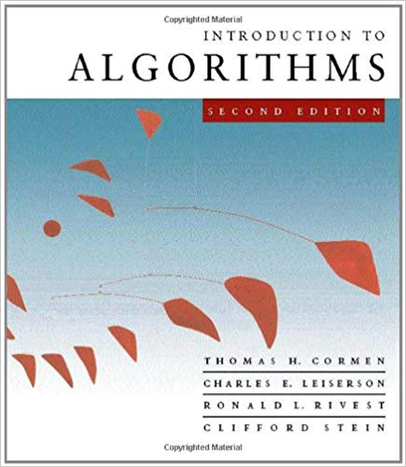



What is Sum of Squares?
Prosaic view
A family of convex relaxations for polynomial optimization problems
Glamorous view
Optimal meta-algorithm offering new lens on algorithms and complexity

Slide 3
What is Sum of Squares?
Today’s view
A language, toolkit, and set of abstractions for algorithm design with convex programming, enabling rigorous analysis of a particular set of powerful convex programs.

Slide 4
Huge Algorithmic Success
Offers best known poly-time algos for:
Constraint satisfaction
Cut problems (sparsest cut, min cut,…)
Khot’s unique games
Tensor problems (higher-order linear algebra)
Robust/heavy-tailed statistics (statistics with nasty data)
High-dimensional clustering
Matrix completion/Netflix problem
Sparse PCA, finding hidden sparse vectors
Community detection
Best separable state (detecting quantum entanglement)
The list just keeps growing!

Slide 5
Huge Algorithmic Success

Slide 6
Growing Lower Bound Success
Can prove unconditional lower bounds to support existing hardness results and/or to support hardness conjectures.
Strong lower bounds known in support of:
Feige’s random-SAT hypothesis
Planted clique
(some more exotic problems)

Slide 7
SoS and Cryptography
Cryptoanalysis: SoS is weapon of choice for designing poly-time algorithms for hard combinatorial/analytic problems. (NOT usually algebraic problems.)
Justifying assumptions: SoS lower bounds (impossibility results) are evidence for hardness against all polynomial time algorithms.

Slide 8
Starting to Enter the Crypto Scene
In 2017-18, several proposals for indistinguishability obfuscation based on blockwise 2-local or degree-2 PRGs [Lin-Tessaro, Ananth-Jain-Sahai, Agrawal, Lin-Matt]
Do blockwise 2-local PRGs exist? NO! [BBKK ‘17], attack via SoS
Do degree-2 PRGs exist? All existing proposals largely refuted [BHJKS ‘19], attack via SoS

Slide 9
Agenda
What is sum of squares?
Raghavendra’s Theorem: evidence for optimality among polynomial time algorithms (in restricted settings)
Technical Vignette: solving degree-2 equations

Slide 10
What is Sum of Squares?
Today’s view
A language, toolkit, and set of abstractions for algorithm design with convex programming, enabling rigorous analysis of a particular set of powerful convex programs.
Philosophy/Methodology
round and relax, identifiability to algorithms, “Marley’s theorem”, …
Toolkit
quadratic sampling, conditioning, global correlation, pseudocalibration, …
Language
“pseudodistribution”, “SoS proof”, …
Linear Programs
max flow, compressed sensing, …
Semidefinite Programs
max cut, Netflix problem, …
Hierarchies
Sherali-Adams, SoS

Slide 11
What is Sum of Squares?
Today’s view
A language, toolkit, and set of abstractions for algorithm design with convex programming, enabling rigorous analysis of a particular set of powerful convex programs.
Philosophy/Methodology
round and relax, identifiability to algorithms, “Marley’s theorem”, …
Toolkit
quadratic sampling, conditioning, global correlation, pseudocalibration, …
Language
“pseudodistribution”, “SoS proof”, …
Linear Programs
max flow, compressed sensing, …
Semidefinite Programs
max cut, Netflix problem, …
Hierarchies
Sherali-Adams, SoS

Slide 12




Convex Programming
Convex set
Non-convex set
Can find a point in and minimize a convex function over any sufficiently simple convex set in polynomial time.
Extremely useful in algorithm design

Slide 13
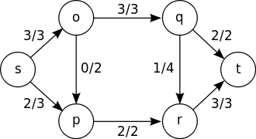
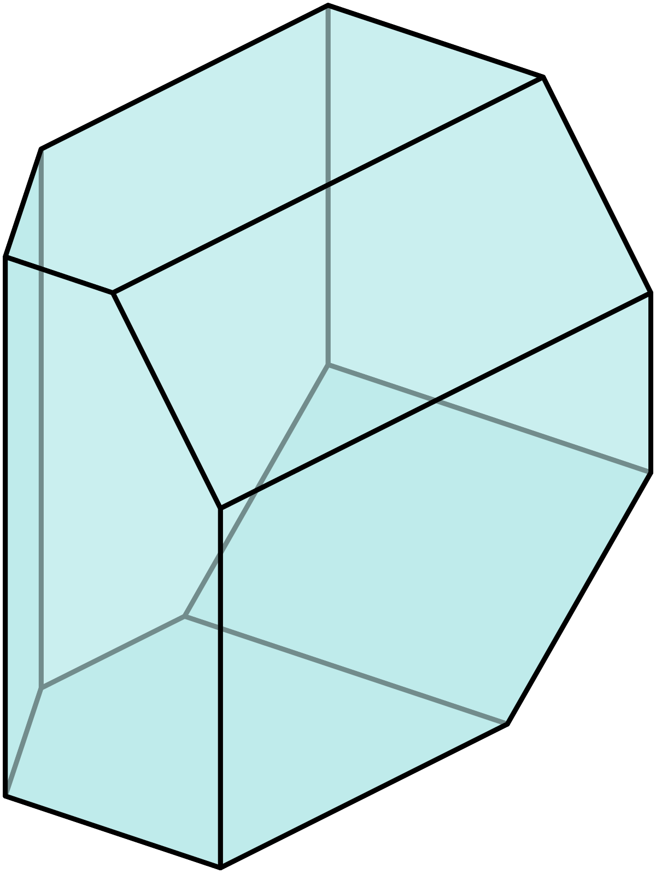
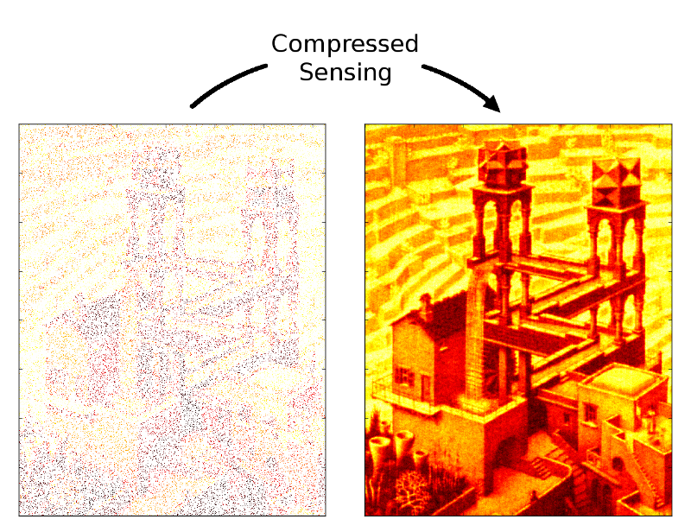


Which convex sets?
Polytopes a.k.a. LPs
Max flow
$$x∈R^{n}, Ax≥0$$
$$x=\left(x_{1},x_{2},…, x_{n}\right)$$
“Single pixel camera”

Slide 14
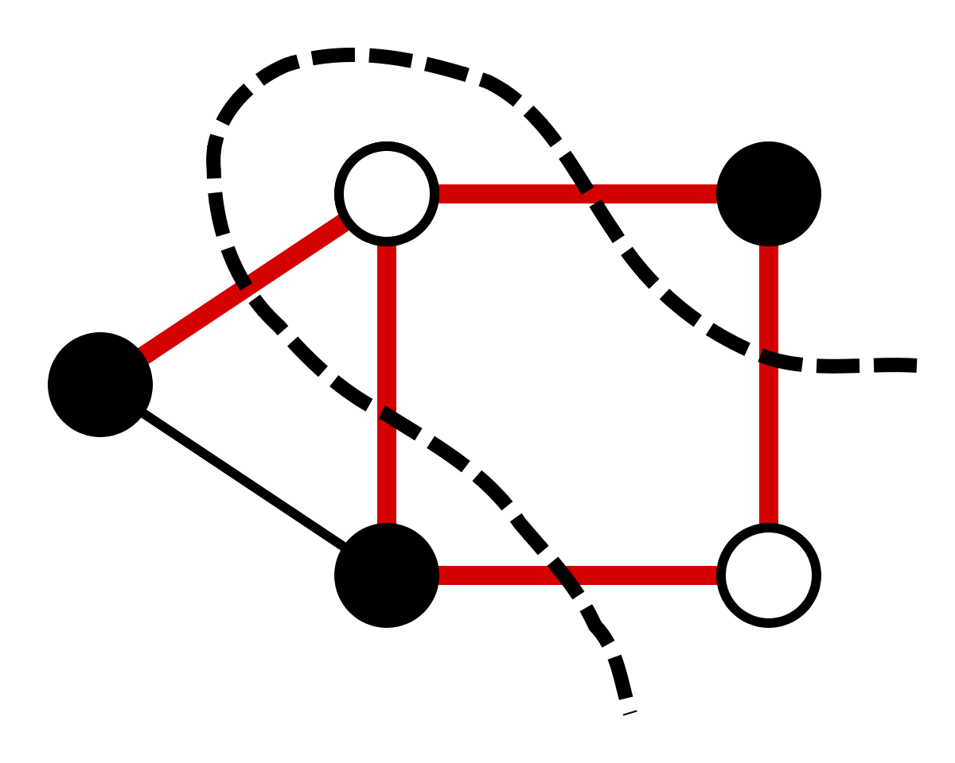
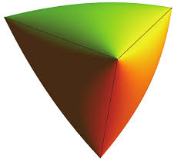

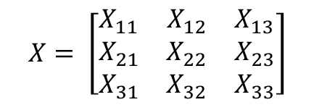
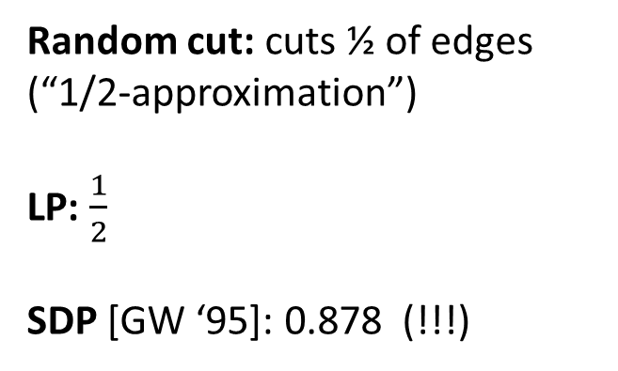
Beyond Polytopes: Semidefinite Programs (SDP)
Max Cut
Given graph G, find subset of nodes cutting most edges.
Random cut: cuts ½ of edges
(“1/2-approximation”)
LP: $\frac{1}{2}$
SDP [GW ‘95]: 0.878 (!!!)
$$X∈R^{n×n}, X≽0, Tr X=1$$
(all eigenvalues real, nonegative, sum to 1)
$$X= \left[\begin{matrix}X_{11} & X_{12} & X_{13} \\ X_{21} & X_{22} & X_{23} \\ X_{31} & X_{32} & X_{33}\end{matrix}\right]$$

Slide 15
What is Sum of Squares?
Today’s view
A language, toolkit, and set of abstractions for algorithm design with convex programming, enabling rigorous analysis of a particular set of powerful convex programs.
Philosophy/Methodology
round and relax, identifiability to algorithms, “Marley’s theorem”, …
Toolkit
quadratic sampling, conditioning, global correlation, pseudocalibration, …
Language
“pseudodistribution”, “SoS proof”, …
Linear Programs
max flow, compressed sensing, …
Semidefinite Programs
max cut, Netflix problem, …
Hierarchies
Sherali-Adams, SoS

Slide 16
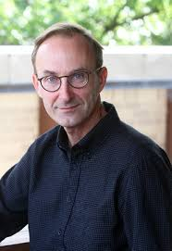


How to design LP/SDP-based algorithms
Look at your problem
Be extremely clever, invent LP/SDP relaxation
Be extremely clever, analyze your relaxation
Publish paper

Slide 17
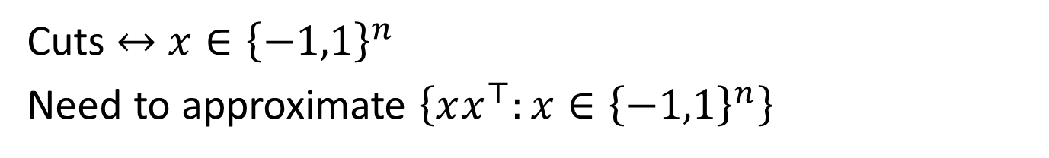
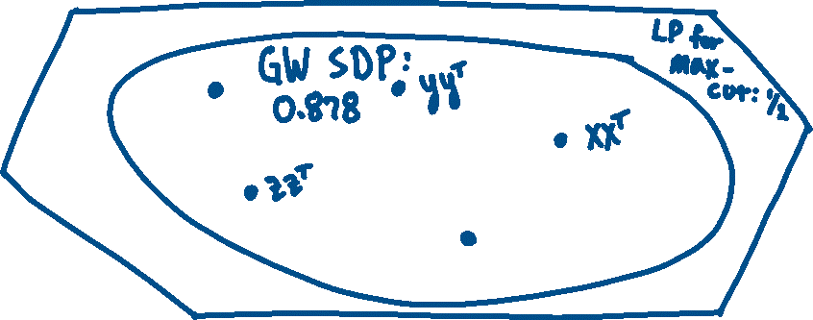
Approximating complex sets by simple ones
To approximate max-cut:
Cuts $↔$ $x∈{\left\{−1,1\right\}}^{n}$
Need to approximate $\left\{xx^{⊤}:x∈{\left\{−1,1\right\}}^{n}\right\}$

Slide 18
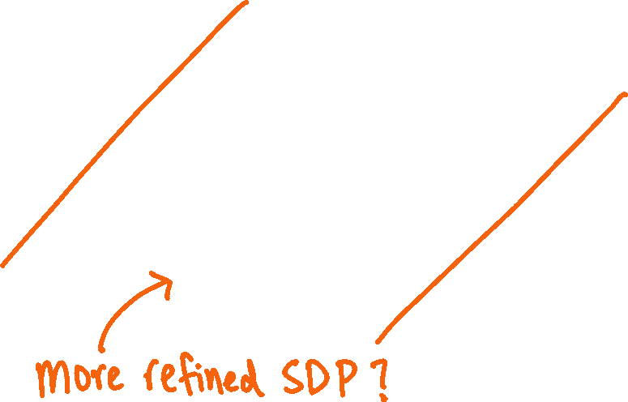

Approximating complex sets by simple ones
How would you know which constraints to add?

Slide 19
How can you explore and reason about huge design space of convex programs?

Slide 20
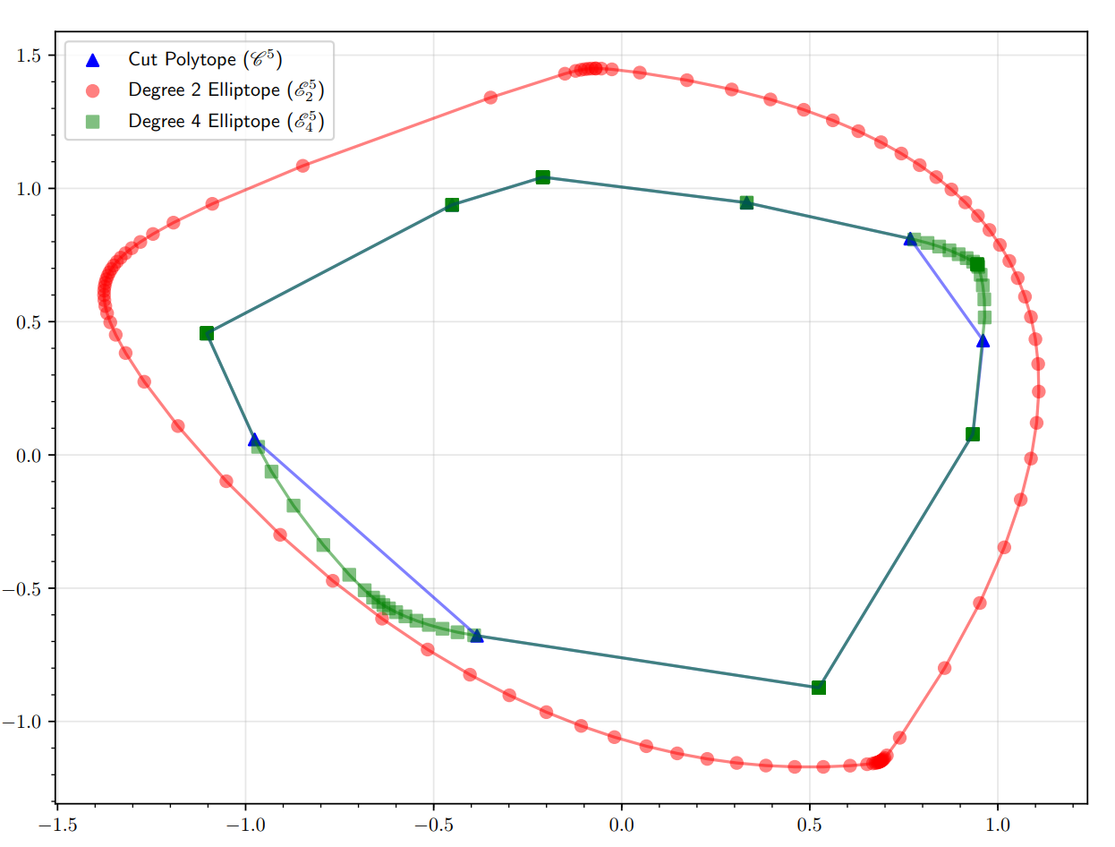
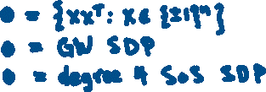
How to choose your SDP?
[Shor ‘87, Nesterov ’00, Parillo ‘00, Lasserre ’01]
SoS (prosaic): principled way to produce hierarchy of SDP approximations to nasty (nonconvex) sets.
Choose your own complexity!
And attendant running time
(And suffer the consequences/reap the rewards)
[Bandeira-Kunisky ‘18]

Slide 21
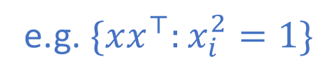
Polynomials and SoS
Given set defined by polynomial (in)equalities
e.g. $\{xx^{⊤}:x_{i}^{2}=1\}$
Degree-$d$ SoS: SDP with $≈n^{d}$ variables and constraints
increasing strength, increasing complexity
And language, toolkit to reason about them

Slide 22
What is Sum of Squares?
Today’s view
A language, toolkit, and set of abstractions for algorithm design with convex programming, enabling rigorous analysis of a particular set of powerful convex programs.
Philosophy/Methodology
round and relax, identifiability to algorithms, “Marley’s theorem”, …
Toolkit
quadratic sampling, conditioning, global correlation, pseudocalibration, …
Language
“pseudodistribution”, “SoS proof”, …
Linear Programs
max flow, compressed sensing, …
Semidefinite Programs
max cut, Netflix problem, …
Hierarchies
Sherali-Adams, SoS

Slide 23
Agenda
What is sum of squares?
Raghavendra’s Theorem (and a little beyond): evidence for optimality among polynomial time algorithms (in restricted settings)
Technical Vignette: solving degree-2 equations

Slide 24
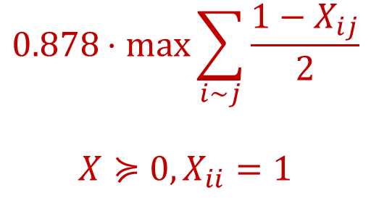
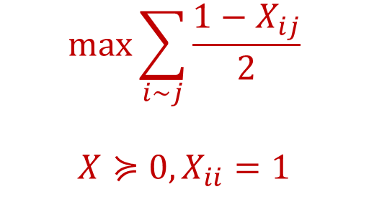
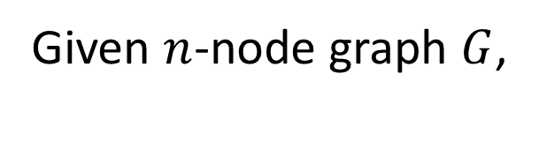
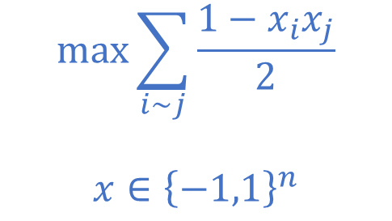
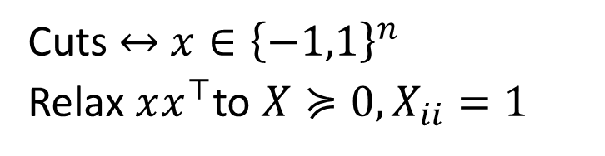


The Max Cut SDP
Given $n$-node graph $G$,
Cuts $↔$ $x∈{\left\{−1,1\right\}}^{n}$
Relax $xx^{⊤}$to $X≽0, X_{ii}=1$
$$0.878⋅\max{\sum_{i∼j}{\frac{1−X_{ij}}{2}}}$$
$$X≽0, X_{ii}=1$$
$$\max{\sum_{i∼j}{\frac{1−x_{i}x_{j}}{2}}}$$
$$x∈{\left\{−1,1\right\}}^{n}$$
$$\max{\sum_{i∼j}{\frac{1−X_{ij}}{2}}}$$
$$X≽0, X_{ii}=1$$
$$≤$$
$$≤$$
Goemans-Williamson SDP
“quadratic program”
Goemans-Williamson SDP

Slide 25
Utility of SoS
SoS of constant degree (polynomial time) captures (nearly?) every convex program and spectral method used in approximation algorithms, high-dimensional statistics, …
Constraint satisfaction, sparsest cut, max flow, LASSO, graph coloring, Netflix problem, robust statistics, …

Slide 26



Evidence for Optimality
2 kinds of evidence:
Soft:
subsumes LP, SDP, spectral algorithms
captures guarantees of best algs in wide variety of settings (caveat: not algebraic settings)
Hard:
Raghavendra’s theorem

Slide 27
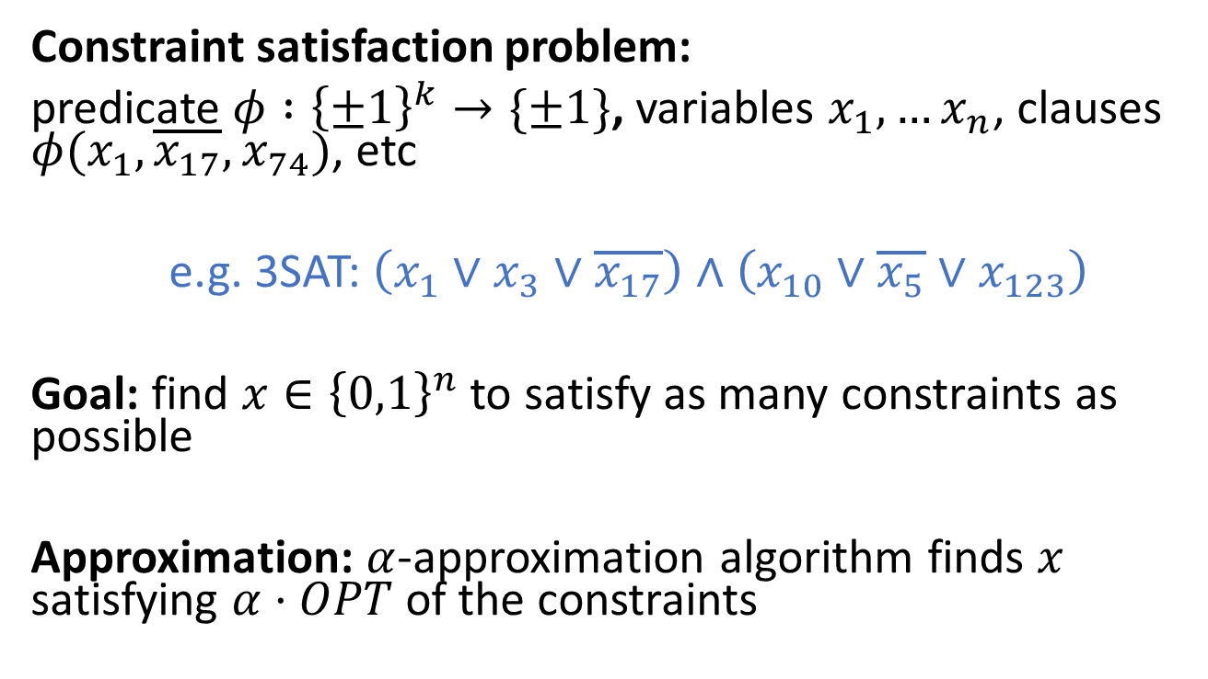
Formalizing optimality: CSPs
Constraint satisfaction problem:
predicate $φ :{\left\{±1\right\}}^{k}→\{±1\}$, variables $x_{1},…x_{n}$, clauses $φ(x_{1},\overline{x_{17}},x_{74})$, etc
e.g. 3SAT: $\left(x_{1}∨x_{3}∨\overline{x_{17}}\right)∧\left(x_{10}∨\overline{x_{5}}∨x_{123}\right)$
Goal: find $x∈{\left\{0,1\right\}}^{n}$ to satisfy as many constraints as possible
Approximation: $α$-approximation algorithm finds $x$ satisfying $α⋅OPT$ of the constraints

Slide 28
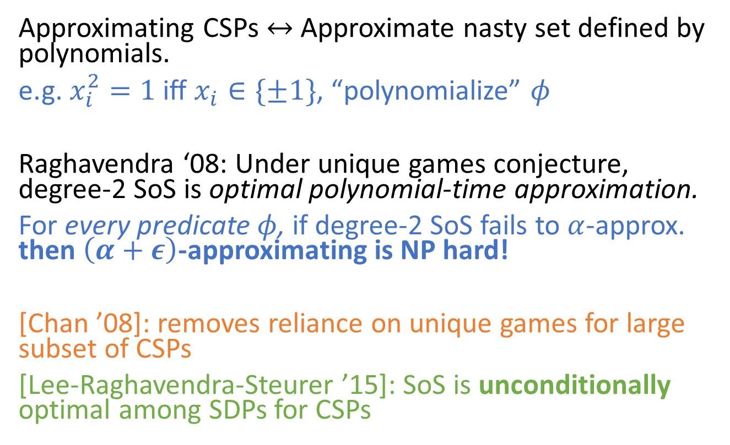
Raghavendra’s Theorem
Approximating CSPs $↔$ Approximate nasty set defined by polynomials.
e.g. $x_{i}^{2}=1$ iff $x_{i}∈\{±1\}$, “polynomialize” $φ$
Raghavendra ‘08: Under unique games conjecture, degree-2 SoS is optimal polynomial-time approximation.
For every predicate $φ$, if degree-2 SoS fails to $α$-approx. then $\left(α+ε\right)$-approximating is NP hard!
[Chan ’08]: removes reliance on unique games for large subset of CSPs
[Lee-Raghavendra-Steurer ’15]: SoS is unconditionally optimal among SDPs for CSPs

Slide 29
Agenda
What is sum of squares? (with a little advertising)
Raghavendra’s Theorem (and a little beyond): evidence for optimality among polynomial time algorithms (in restricted settings)
Technical Vignette: solving degree-2 equations

Slide 30
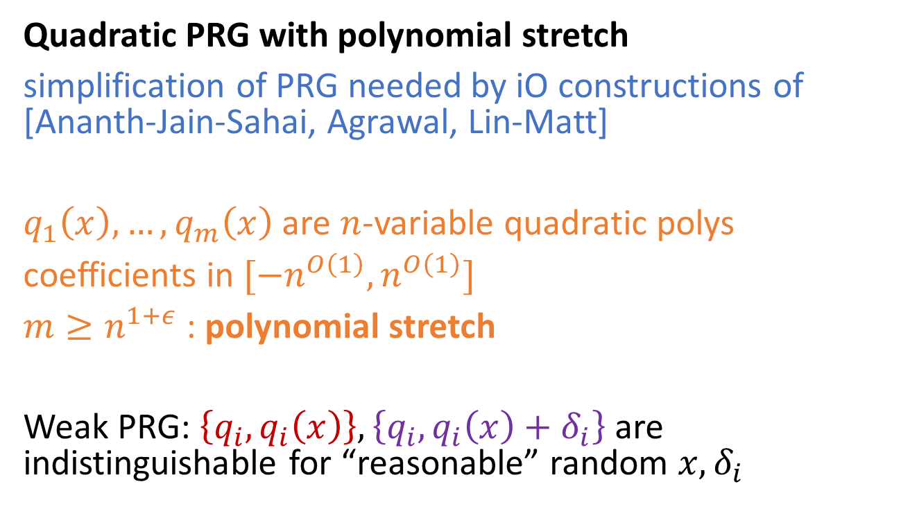
Example algorithm: solving systems of quadratic equations
Quadratic PRG with polynomial stretch
simplification of PRG needed by iO constructions of [Ananth-Jain-Sahai, Agrawal, Lin-Matt]
$q_{1}\left(x\right),…,q_{m}\left(x\right)$ are $n$-variable quadratic polys
coefficients in $[−n^{O\left(1\right)},n^{O\left(1\right)}]$
$m≥n^{1+ε}$ : polynomial stretch
Weak PRG: $\left\{q_{i}, q_{i}\left(x\right)\right\}, \left\{q_{i},q_{i}\left(x\right)+δ_{i}\right\}$ are indistinguishable for “reasonable” random $x, δ_{i}$

Slide 31
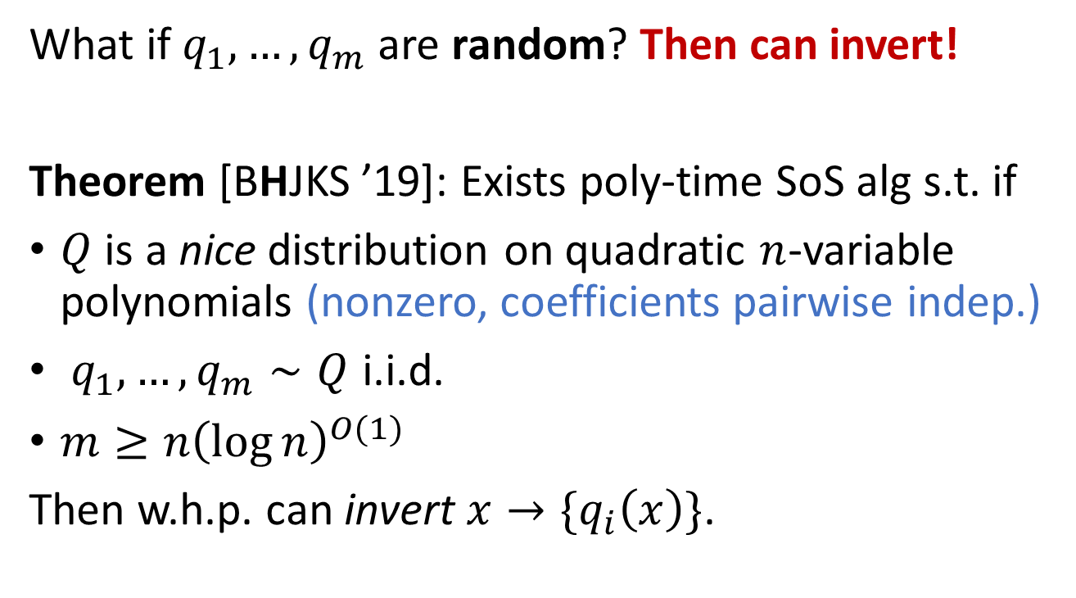
Natural candidate: random polynomials
What if $q_{1},…, q_{m}$ are random? Then can invert!
Theorem [BHJKS ’19]: Exists poly-time SoS alg s.t. if
$Q$ is a nice distribution on quadratic $n$-variable polynomials (nonzero, coefficients pairwise indep.)
$q_{1}, …, q_{m}∼Q$ i.i.d.
$m≥n{\left(\log{n}\right)}^{O(1)}$
Then w.h.p. can invert $x→\{q_{i}\left(x\right)\}$.
Can be sparse or dense!

Slide 32
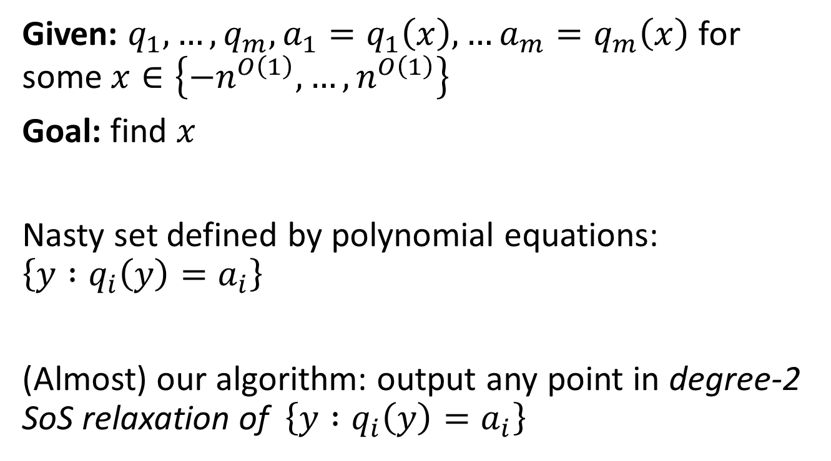
Inverting quadratic PRGs by SoS
Given: $q_{1},…, q_{m},a_{1}=q_{1}\left(x\right), …a_{m}=q_{m}\left(x\right)$ for some $x∈\left\{−n^{O\left(1\right)},…,n^{O\left(1\right)}\right\}$
Goal: find $x$
Nasty set defined by polynomial equations: $\left\{y :q_{i}\left(y\right)=a_{i}\right\}$
(Almost) our algorithm: output any point in degree-2 SoS relaxation of $\left\{y :q_{i}\left(y\right)=a_{i}\right\}$

Slide 33
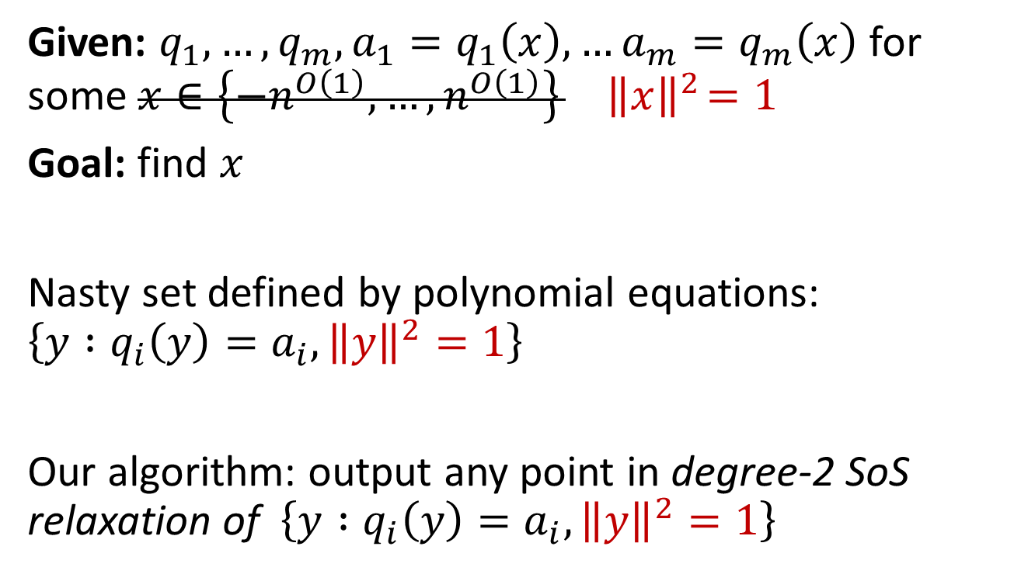
Inverting quadratic PRGs by SoS
Given: $q_{1},…, q_{m},a_{1}=q_{1}\left(x\right), …a_{m}=q_{m}\left(x\right)$ for some $x∈\left\{−n^{O\left(1\right)},…,n^{O\left(1\right)}\right\}{ \left\|x\right\|}^{2}=1$
Goal: find $x$
Nasty set defined by polynomial equations: $\left\{y :q_{i}\left(y\right)=a_{i}, {\left\|y\right\|}^{2}=1\right\}$
Our algorithm: output any point in degree-2 SoS relaxation of $\left\{y :q_{i}\left(y\right)=a_{i},{\left\|y\right\|}^{2}=1\right\}$

Slide 34
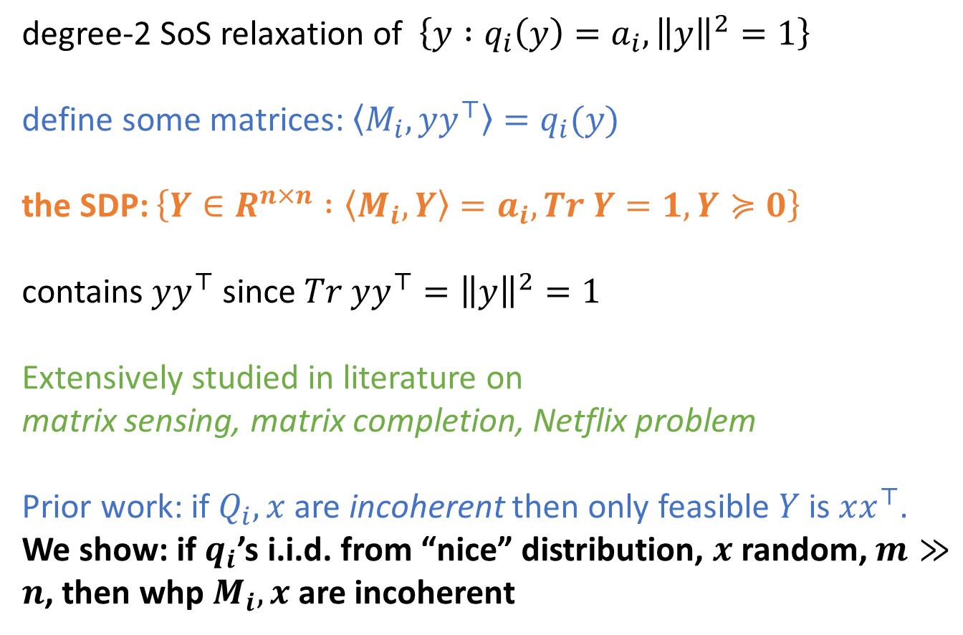
Inverting degree-2 PRGs by SoS
degree-2 SoS relaxation of $\left\{y :q_{i}\left(y\right)=a_{i},{\left\|y\right\|}^{2}=1\right\}$
define some matrices: $\left\langle M_{i},yy^{⊤}\right\rangle =q_{i}(y)$
the SDP: $\left\{Y∈R^{n×n} :\left\langle M_{i},Y\right\rangle =a_{i}, Tr Y=1, Y≽0\right\}$
contains $yy^{⊤}$ since $Tr yy^{⊤}={\left\|y\right\|}^{2}=1$
Extensively studied in literature on
matrix sensing, matrix completion, Netflix problem
Prior work: if $Q_{i},x$ are incoherent then only feasible $Y$ is $xx^{⊤}$.
We show: if $q_{i}$’s i.i.d. from “nice” distribution, $x$ random, $m≫n$, then whp $M_{i}, x$ are incoherent
[Gross ‘09, Recht-Fazel-Parillo ‘07]

Slide 35
Conclusion
Philosophy/Methodology
round and relax, identifiability to algorithms, “Marley’s theorem”, …
Toolkit
quadratic sampling, conditioning, global correlation, pseudocalibration, …
Language
“pseudodistribution”, “SoS proof”, …
Linear Programs
max flow, compressed sensing, …
Semidefinite Programs
max cut, Netflix problem, …
Hierarchies
Sherali-Adams, SoS
SoS is a powerful family of algorithms/tools with broad range of applications
Some evidence for optimality among polynomial time algorithms
Breaks existing constructions of quadratic PRGs for iO

Slide 36
Thanks!
Resources:
Barak-Steurer lecture notes:
https://www.sumofsquares.org/public/index.html
Raghavendra-Schramm-Steurer survey:
https://arxiv.org/abs/1807.11419
My thesis:
http://www.samuelbhopkins.com/thesis.pdf

Slide 37
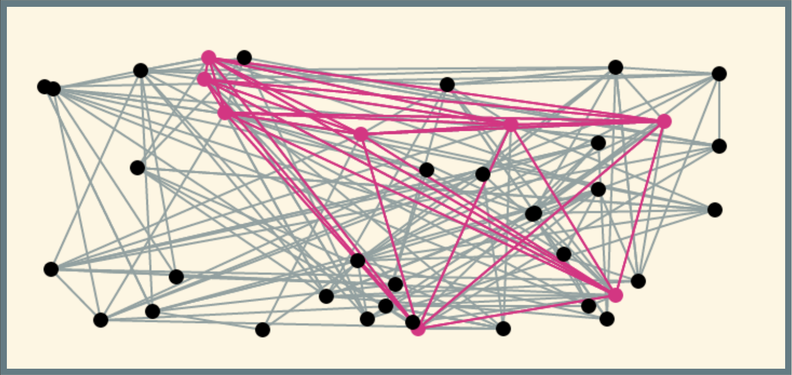
Lower Bounds
Known: lower bounds in support of major average-case complexity hypotheses
-- Feige’s hypothesis on random SAT [Grigoriev ’01, Schoenebeck ‘08]
-- planted clique [Barak-H-Kelner-Kothari-Moitra-Potechen ‘16]

Slide 38
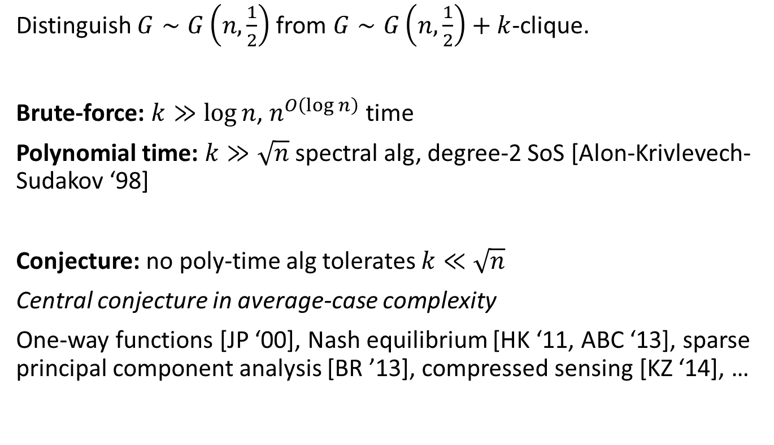
Example: Planted Clique
Distinguish $G∼G\left(n,\frac{1}{2}\right)$ from $G∼G\left(n,\frac{1}{2}\right)+k$-clique.
Brute-force: $k≫\log{n}$, $n^{O\left(\log{n}\right)}$ time
Polynomial time: $k≫\sqrt{n}$ spectral alg, degree-2 SoS [Alon-Krivlevech-Sudakov ‘98]
Conjecture: no poly-time alg tolerates $k≪\sqrt{n}$
Central conjecture in average-case complexity
One-way functions [JP ‘00], Nash equilibrium [HK ‘11, ABC ‘13], sparse principal component analysis [BR ’13], compressed sensing [KZ ‘14], …

Slide 39
Example: Planted Clique
Evidence for the planted clique conjecture?
Gadget reductions make “gadget-y instances”
What about SoS lower bounds?
(Caveat: do not know Raghavendra-style optimality for average-case problems)

Slide 40
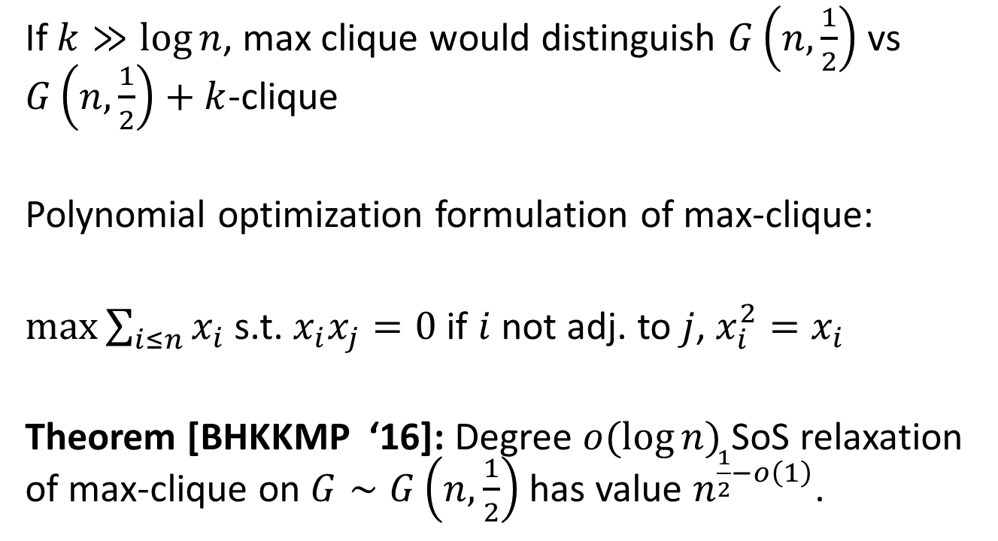
Example: Planted Clique
If $k≫\log{n}$, max clique would distinguish $G\left(n,\frac{1}{2}\right)$ vs $G\left(n,\frac{1}{2}\right)+k$-clique
Polynomial optimization formulation of max-clique:
$\max{\sum_{i≤n}{x_{i}}}$ s.t. $x_{i}x_{j}=0$ if $i$ not adj. to $j$, $x_{i}^{2}=x_{i}$
Theorem [BHKKMP ‘16]: Degree $o(\log{n})$ SoS relaxation of max-clique on $G∼G\left(n,\frac{1}{2}\right)$ has value $n^{\frac{1}{2}−o\left(1\right)}$.

Slide 41
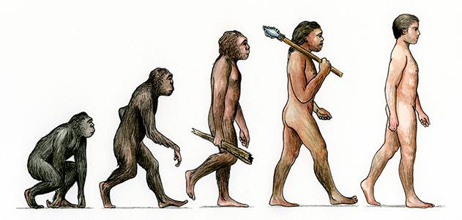
Evolution of Convex Programming
Linear programming
Max flow
Compressed sensing

Slide 42
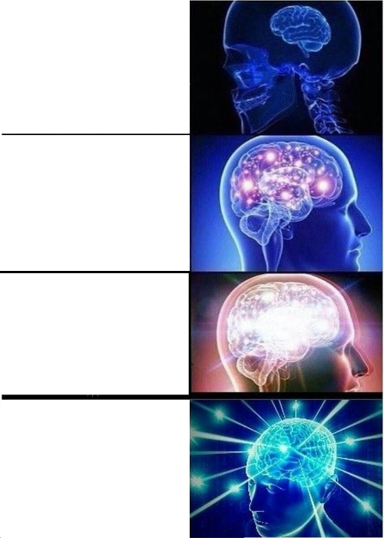
What is Sum of Squares?
A specific family of convex programs
A language, toolkit, and set of abstractions for algorithm design with convex programming
A universal meta-algorithm

Slide 43
notes
What is sum of squares?
Why is it relevant to cryptographers?
Algorithms for cryptoanalysis
Lens for hardness
Example problems
Max cut
Raghavendra theorem
Planted clique
Do an example? What problem? Tensor completion? Solving degree-2 equations?
Relation to LPs/SDPs/spectral algorithms
Language for semidefinite programming
Unification of algorithm design using small set of organizing principles
Gives recipe for algorithm design – good for cryptoanalysis
Meta-algorithms provide framework for hardness

