Slide 1
OSU HART
Michael Elliott, Samuel Hudson, Glenn Upthagrove

Slide 2
Overview for Michael Elliott:
Code run on the rocket
Data collection and interpretation from the onboard sensors
Creation and transmission of data packets to the ground station
Process packets on the receiving end

Slide 3
Rocket Sensors
GPS: location
Barometer: atmospheric pressure
Accelerometer
Magnetometer: orientation
Gyroscope: angular velocity

Slide 4
Kalman Filter
Used to eliminate noise from sensor readings
Linear quadratic estimation
Predictions based on model
Weights inputs
Goal: accurate final values

Slide 5
Transmission
Potential for high packet loss
Limited resources
Redundancy
Send data at regular interval
Goal: efficient transmission

Slide 6
Packet Design
Small packets - 20 bytes
Minimizes CPU impact
Latitude, longitude, altitude, velocity, timestamp

Slide 7
Packet Processing
Orders packets
Sanity checks
Predictive interpolation
Quadratic best fit line for position & derivative for speed
Goal: usable values from potentially sparse provided data

Slide 8
Issues
Proper testing plan
Language decisions
Code correctness
Hardware

Slide 9
Overview for Glenn Upthagrove:
Sit in the middle of the pipeline, between data collection and visualization
Collect data on ground station side
Pack data into a JSON format
Log data
Create a 3D trace of the flight path

Slide 10
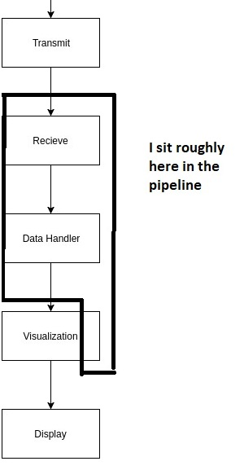
Pipeline Placement

Slide 11
Data Handling
Choice of language between C and Python
C, good for module interaction and speed, Python good for the JSON conversion
Choose to mix the two as separate processes
Data handler collects data, also spawns other processes it needs to interact with.

Slide 12
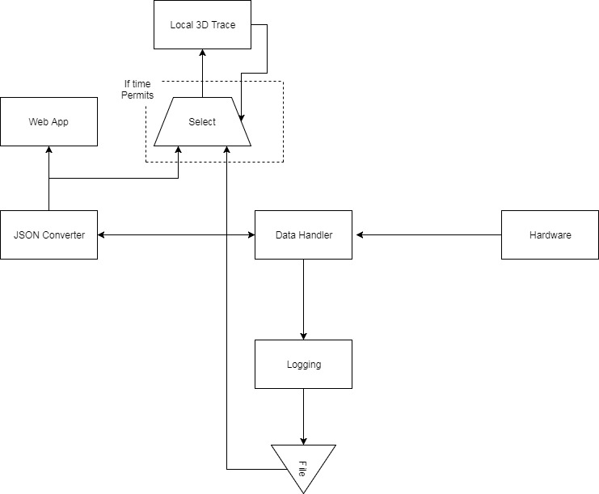
Data Handling

Slide 13
Logging
Researched JSON, YAML, and Pipe Delimited formats.
Choose JSON for readily available libraries and easy integration with other modules in the pipeline
Logging is a module spawned form the data handling module, but sits next to the pipeline.

Slide 14
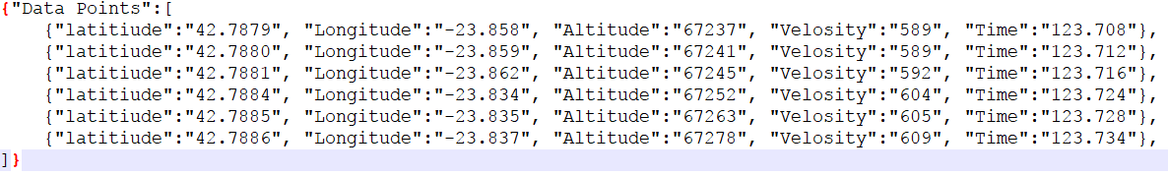
JSON

Slide 15
3D Trace
A part of the visualization.
This draws flightpath from data after collection.
If time permits, it will include a near real time mode as data is collected.
I researched OpenGL, WebGL, and Vulkan.
OpenGL was chosen for simplicity, familiarity, and wide support.

Slide 16
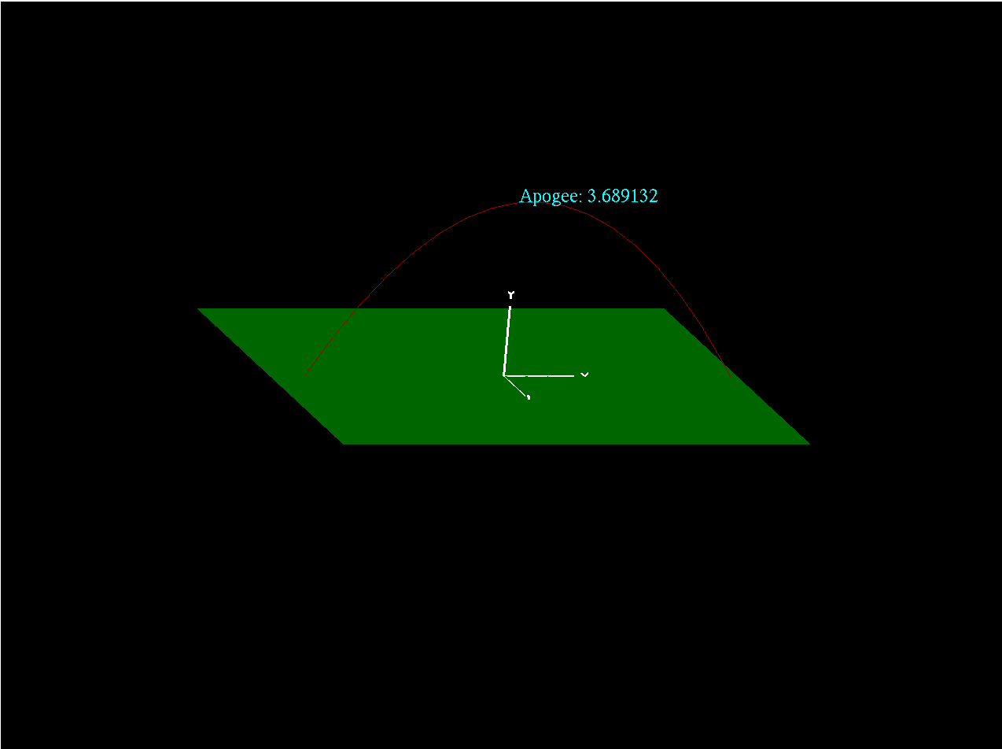
3D Trace

Slide 17
Stumbling Blocks
I missed a few meeting times.
Raspberry Pi does not like OpenGL.
Not certain of code I was and was not allowed to use for 3D trace.
The ECE team wanted pipe delimited data.
The client is a very busy person, so contact is sometimes hard.

Slide 18
Solutions and Plans
Other team members are great at catching me up.
Continue to work with it this break. Can change to WebGL or another machine for the ground station if need be.
Dr. Mike Bailey gave me express permission to use any and all of his provided code.
JSON is our best option for the rest of the pipeline, but a second logging module could easily be added to accommodate other needs.
Patience is a virtue, and emailing early is a good idea

Slide 19
Overview for Sam Hudson
Sit at the end of the pipeline, after the data handler.
Take JSON data from the data handler and push to MongoDB
Build three visualizations: Speedometer, Altitude Tracker and Trajectory plotter
Build API for other tools to interface with data.
Build web application with Flask-PyMongo & MaterializeCSS

Slide 20
Pipeline
API
Web Application
Visulizations
At this stage a the data handler will post the JSON data to MongoDB using the REST API. The REST interface will support PATCH, POST & GET for each telemetry package.
At this stage data presentation will be managed by the web application. The web application will contain five different routes: “main”, “altitude”, “speedometer”, “trajectory” and “about” these endpoints will be managed by handler functions that will be responsible for managing interactions with each page.
At this stage data will be displayed to the users in the form of three visualizations. The Speedometer, Altitude Tracker and Trajectory plotter. D3.JS will be used to render the visualizations.

Slide 21
API
Will be built using the server-side microframework Flask.
The API will support the following verbs: POST, PATCH and GET.
The API will be used by the data handler to post telemetry JSON objects to MongoDB.
The API will also be used by the visualization widgets for asynchronous calls to the database.

Slide 22
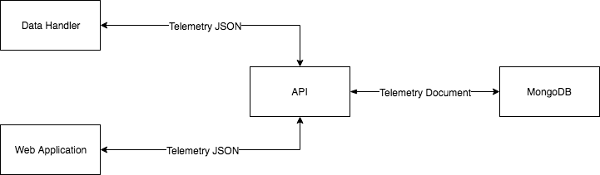
API Topology

Slide 23
Web Application - Backend
Interfaces with API to pull data from MongoDB
Renders pages for users to view
Handles five routes: “main”, “altitude”, “speedometer”, “trajectory” and “about”
Built using the Python microframework Flask

Slide 24
Web Application - Frontend
Responsible for formatting and styling web pages served to clients
Responsive web pages suitable for mobile devices
Built using the MaterializeCSS

Slide 25
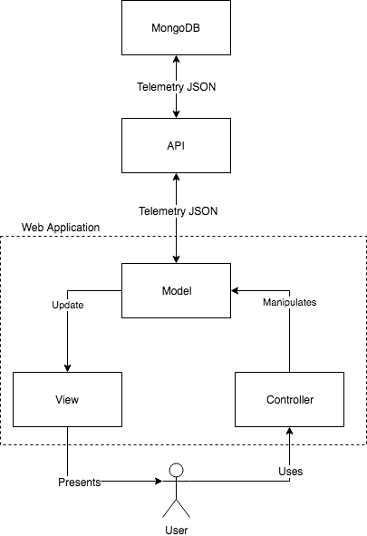
Web Application - Topology

Slide 26
Visulization
There will be 3 key visualizations
A speedometer for tracking the speed of the rocket throughout its flight
An altitude tracker used to track the rocket’s altitude in respect to the earth’s surface
Trajectory plotter which will plot an estimate of the trajectory based on existing telemetry data
Built using the JavaScript visualizations framework D3(data driven documents)

Slide 27
Issues
In the instance that packets arrive out of order a Patch call to the API will have to be made to update existing data.
Will need to ensure that we can create a local network at the ground station for users to be able to access the web application and for each module (API, web application and database) can talk to each other.

Slide 28
Summary
Components are Web API, Web Application and 3D Visualization
The web API is responsible for managing interactions with the MongoDB.
The web application is responsible for serving web pages
“main”, “altitude”, “speedometer”, “trajectory” and “about”
The 3D visualization tool to create interactive visualizations.
“speedometer”, “altitude tracker” and “trajectory plotter”

