Slide 1
OSU HART
Michael Elliott, Samuel Hudson, Glenn Upthagrove

Slide 2
Progress Overview - Michael Elliott:
Data collection and interpretation from the onboard sensors
Creation and transmission of data packets to the ground station
Process packets on the receiving end

Slide 3
Kalman Filter
Math & program structure completed
Homegrown matrix library
Waiting on hardware to be able to test

Slide 4
Transmission
Packet design and creation complete
Adding checksum
Waiting on receiver hardware

Slide 5
Issues
Code correctness
Hardware
Matrix library
Firmware

Slide 6
Progress Overview - Glenn Upthagrove:
Data logging has been completed, and can be used to log several formats of data.
Interprocess communication has been tested up to 100,000 packets per second.
The 3D trace is nearly completed for both post flight and near real time modes.
A data generator has been made that can create test data on demand and present it in several ways for various other parts of the pipeline.
Some firmware has been written to aid the ECE sub team.

Slide 7
Data Generator
The Data Generator is a necessary component for testing all other parts of the pipeline and I created it over the winter break as I knew it would be needed before anything else.
I refactored it later to allow for data to be pushed to other parts in several different ways. It can now wrote to a file, a pipe, or a fifo.
It takes in initial parameters, then creates JSON packets at a specified frequency with the data being updated with a simple quadratic and pseudo random variance.

Slide 8
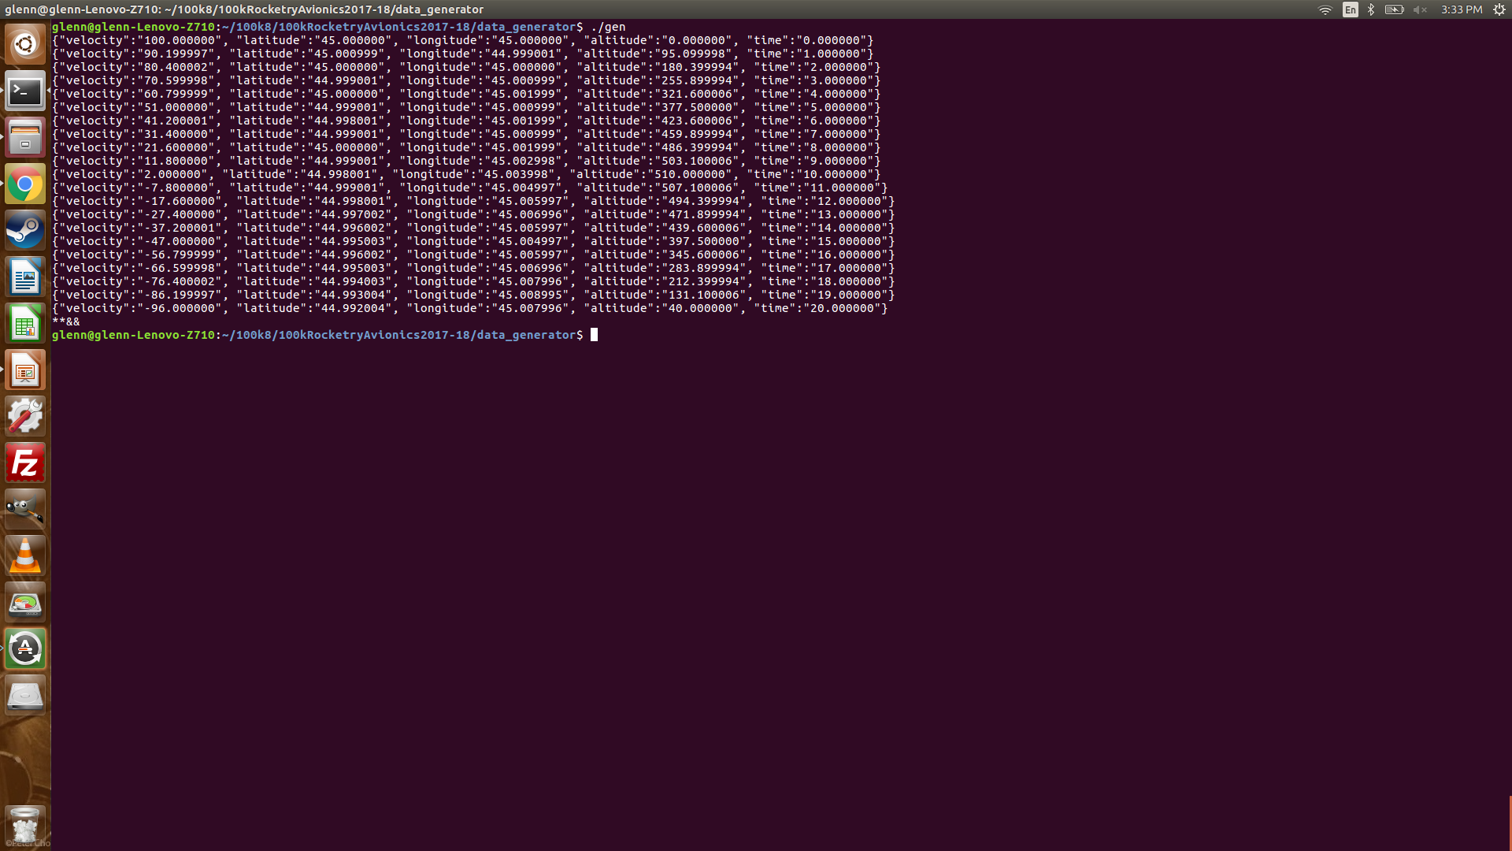
Data Generator in Action

Slide 9
Logging
The logger is a stand alone process that logs incoming string to a specified file.
It is written in this way such that it is adaptable to several circumstances.
Data can be written to a packet in several ways by an earlier portion of the pipeline and the logger will log whatever it is sent.
This allows more than one logger to be spawned and log several formats of data independently of each other.

Slide 10
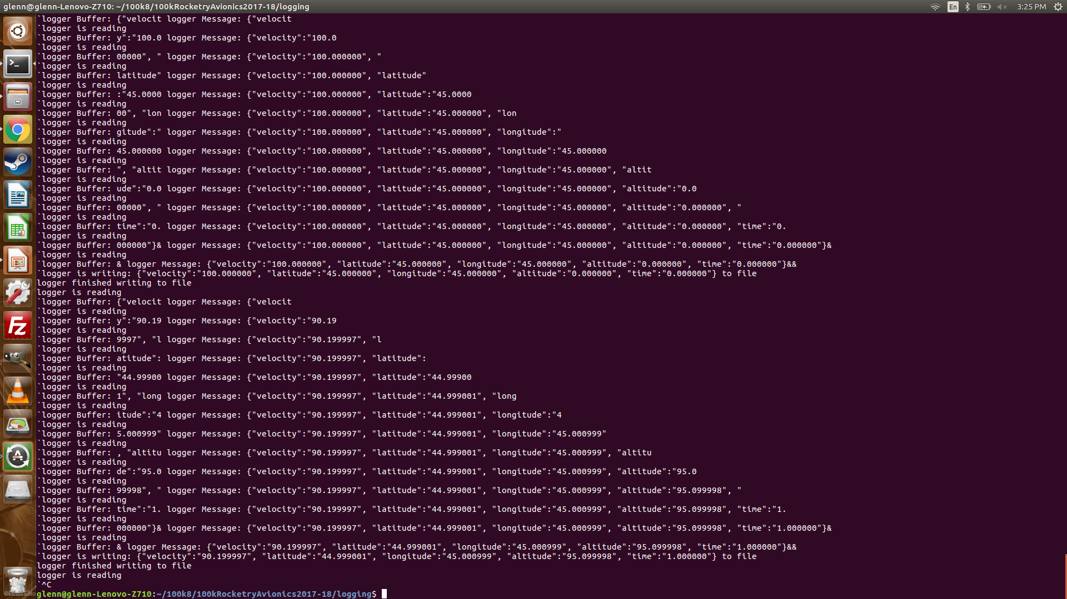
Logging in Action

Slide 11
3D Trace
The trace is nearly completed for both a post flight mode and a near real time mode. It is implemented in OpenGL.
The post flight mode reads JSON from the log file and then converts it into vertices for a line tracing the path.
NRT mode does the same conversion, but reads form a pipe every 60th of a second and updates the data set once per second.
The ground also has a map taken from the Google Static Maps API.

Slide 12
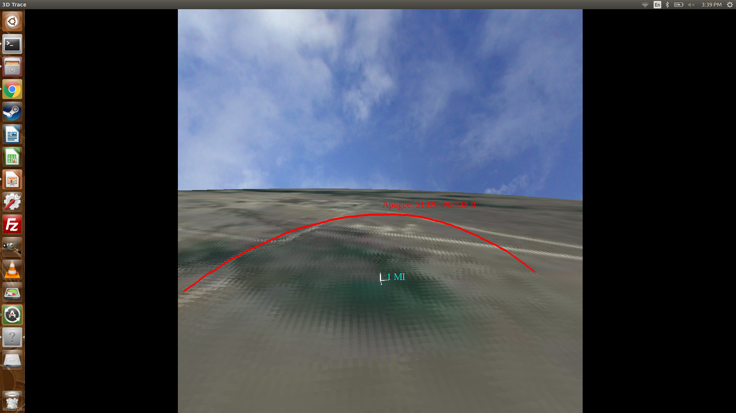
3D Trace in Action

Slide 13
Stumbling Blocks
The original plan for the trace was to multithread it, but this was not possible with OpenGL so I had to make the 60th of a second read solution.
The trace still has a longitude conversion problem and the textured plane needs to be cleaned up.
Data handling has yet to be started since I have no hardware from the ECE team to begin reading from.

Slide 14
Solutions and Plans
I am running tests to figure out where my conversion issue is. I am certain it is a simple bug.
I will remake the textured plane with triangle strips and redo the math to clean up the texture.
Once ECE gives me hardware I will work exceptionally quickly on getting data handling up and running.
I will be writting many more tests for each compnent.

Slide 15
Progress Overview - Sam Hudson
The data handler is now currently functioning and passing JSON data to the mongo database via API calls.
A docker environment has been configured to rapidly stand up each web tool container. Containers include the Web Application, Web API and MongoDB.
The web application successfully syncs with incoming telemetry from the data handler.
D3 visualizations are in progress and the speedometer is awaiting integration with the JavaScript Async function.

Slide 16
Web API
Support REST Verbs:
GET
POST
Endpoints:
/api/v1.0/telemetry_all
Supports GET
GET request to return all telemetry data
/api/v1.0/telemetry
Supports GET and POST
GETS the latest telemetry entry from the database.
POSTS telemetry JSON object to the database.

Slide 17
Web Application
The web application backend has been implemented using Flask python web framework. Currently the web application has only one route defined and that’s for the homepage.
To test integration with the web API I defined a basic function to pull data from the database via the API and display that data on the homepage.
After I confirm that data could be successfully queried I started writing the front-end in JavaScript
I then built an asynchronous function in JavaScript to poll data from the database via API request but I ran into an issue with CORS (Cross Origin Resource Sharing). I handled this by adding the dependencies flask-cors to the dependency list for this instance making cross-origin AJAX possible.

Slide 18
Database
The database has fully configured and exists stands independent of the application and API.
I ran into a configuration issue with journal sizing. Docker limits the container size and all journal files were expended beyond there 3GB limits.
I solved this issue by mounting a volume containing the journals from my host machine.

Slide 19
Visualization
The speedometer visualization has been created, currently it doesn’t interface directly with the API but this won’t be difficult to integrate.
I found a cool library for other instrumentation visualization that I may consider using after some approval.
I haven’t started working on the trajectory plotter but this is something I have a good idea on how to implement.

Slide 20
MVC
Jinja2 Templates
Base Template which stores the main layout configuration for the web application.
Child templates are used to page specific customization.

Slide 21
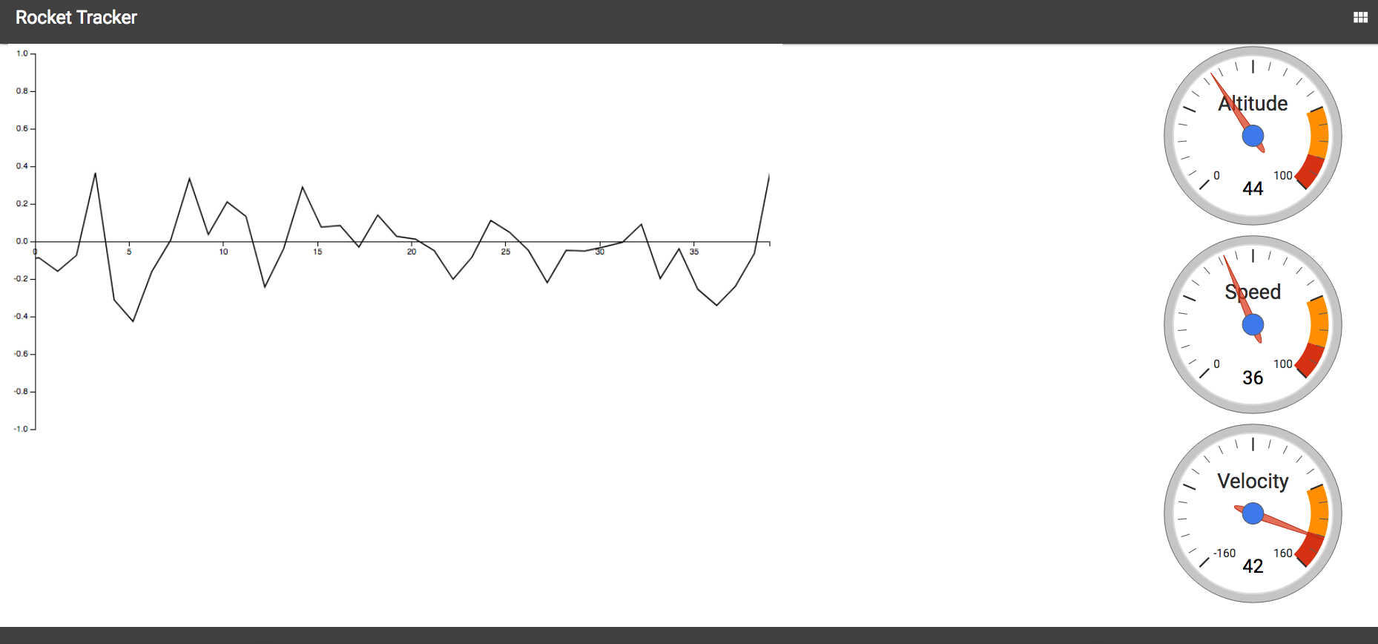
Frontend

Slide 22
The next stages of development
Integrate the trajectory plotter, altimeter and speedometer with incoming telemetry data.
Define routes for each widget.
Build an interface to navigate between pages.
Work on installing adding the web tools environment to the Raspberry Pi attached to the ground station.

