Slide 1






Plan
Plan
Introduction
Problematic
Solution
Conception
Realisation
Conclusion and perspectives
2

Slide 3
Plan
Plan
Introduction
Problematic
Solution
Conception
Realisation
Conclusion and perspectives
2

Slide 4

Introduction

Slide 5
Plan
Plan
Introduction
Problematic
Solution
Conception
Realisation
Conclusion and perspectives
2

Slide 6

Problematic
As we all know, students nowadays are under a lot of stress.
Their stress level increase tremendously especially when pressured by deadlines and in exam periods.

Slide 7
Problematic
This huge stress can lead to different bad consequences:
affects their sleep negatively,
makes them suffer from insomnia
influences their grades.

Slide 8
Problematic
This vicious cycle isn't making students live up to their potential and advancing well.
That's why it was crucial to find a solution to this non-ending loop and help students solve this issue.

Slide 9
Plan
Plan
Introduction
Problematic
Solution
Conception
Realisation
Conclusion and perspectives
2

Slide 10

Solution
As we can see, there are already several mobile applications aiming to improve sleep quality.
Unfortunately, most of these applications either requires payment , are hard to comprehend and use or old fashioned design.

Slide 11
Plan
Plan
Introduction
Problematic
Solution
Conception
Realisation
Conclusion and perspectives
2

Slide 12


















Conception
Authentification
Learn more about sleep
Uses Case
I
Improve sleep quality
Monitor sleep quality
Identify Insomnia Severity
6

Slide 13
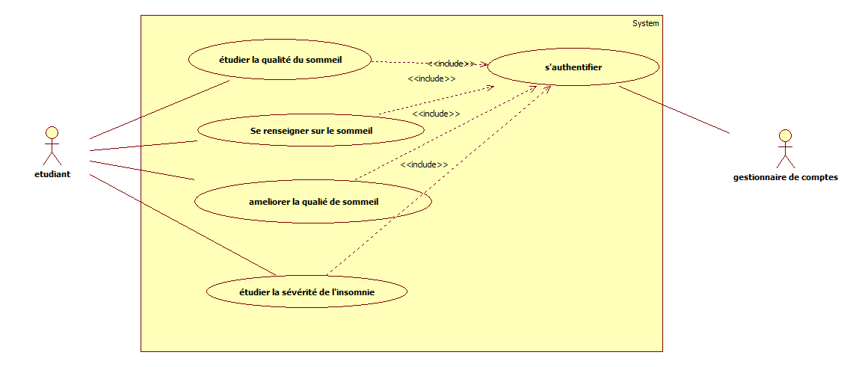
Conception

Slide 14
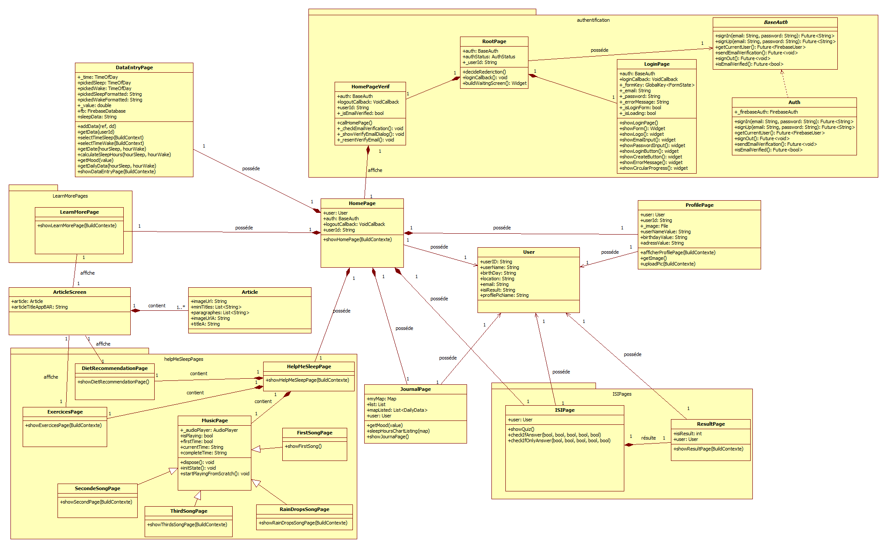
Conception

Slide 15
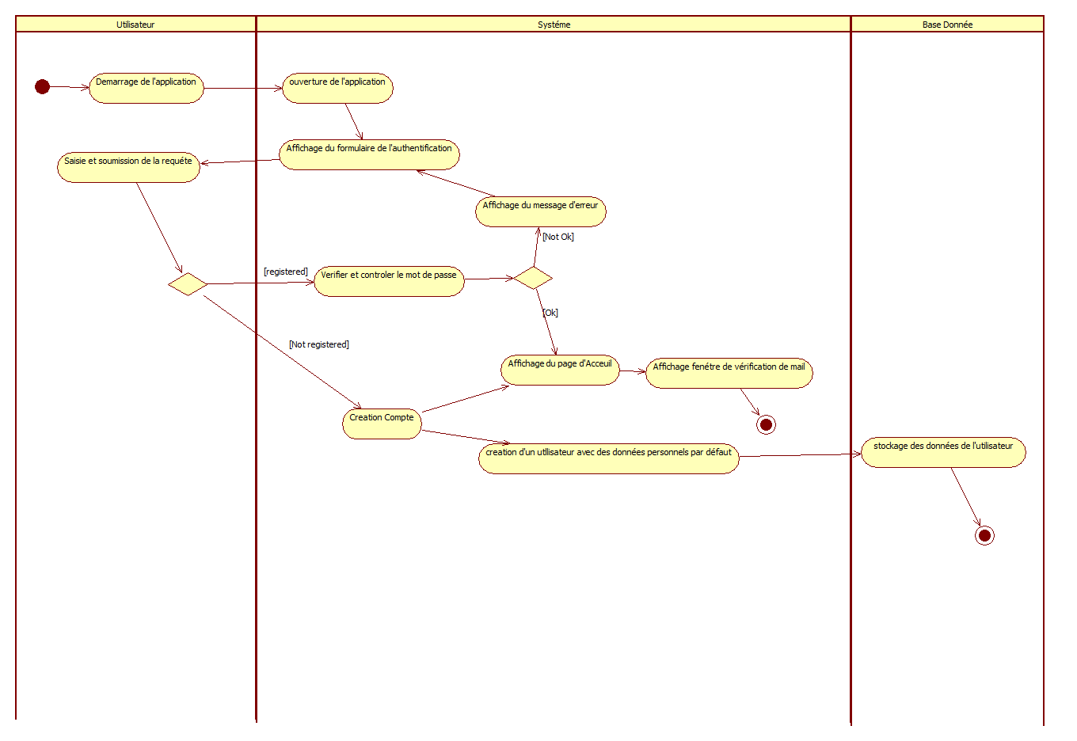
Conception
Authentification Activity Diagram

Slide 16
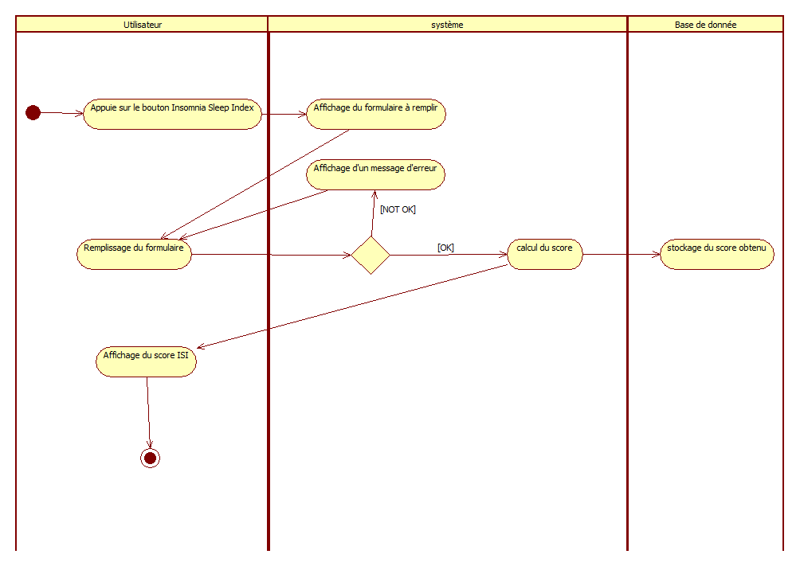
Conception
Identify Insomnia Severity Activity Diagram

Slide 17
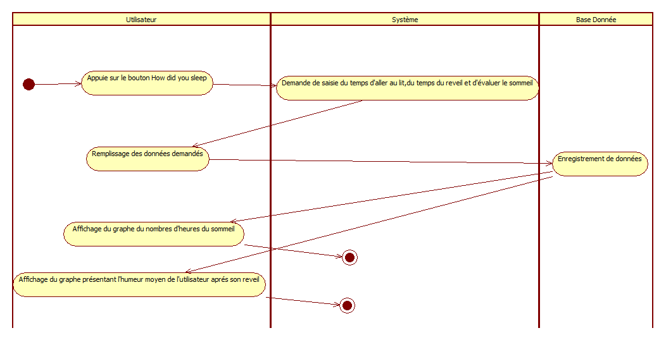
Conception
Monitor sleep quality Activity diagram

Slide 18
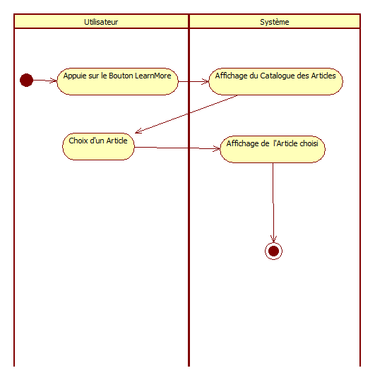
Conception
Learn more about sleep Activity diagram

Slide 19
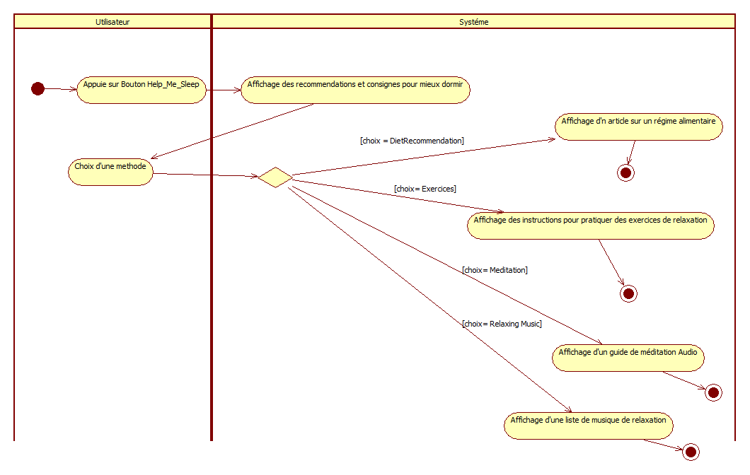
Conception
Improve sleep quality Activity diagram

Slide 20
Plan
Plan
Introduction
Problematic
Solution
Conception
Realisation
Conclusion and perspectives
2

Slide 21







Realisation
UML
Visual Studio Code
Dart
Git Bash
Tools
21

Slide 22
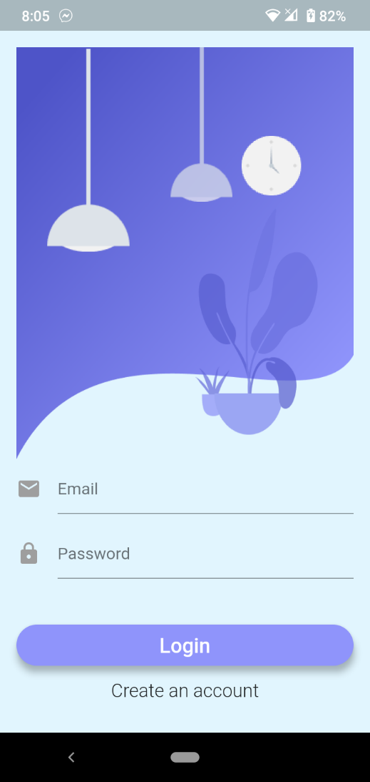
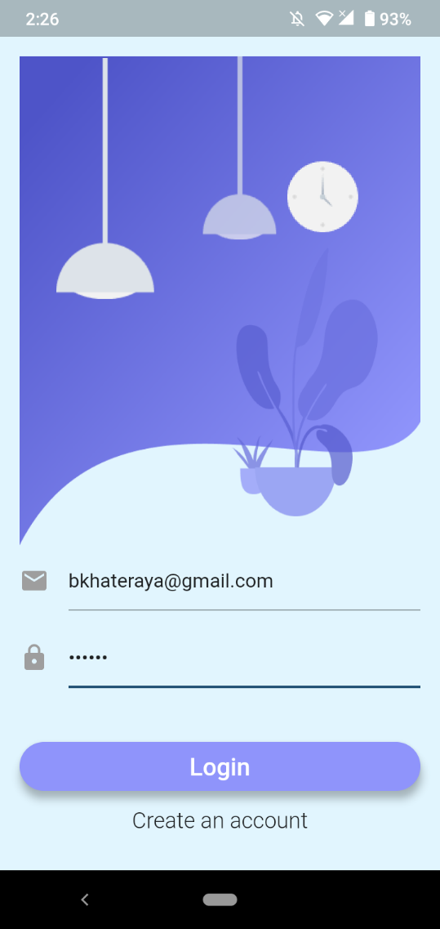
Realisation
22

Slide 23
Plan
Plan
Introduction
Problematic
Solution
Conception
Realisation
Conclusion and perspectives
2

Slide 24






Conclusion et perspectifs
Améliorer l’interface de commande
Optimiser la gestion des matériel
Ajouter des accessoires au robot Auto navigation
25

