Slide 1
-
-
LANGUAGE
LOGO
HOMEPAGE
ABOUT US
CHOOSE
GO TO MAP
RETURANT
EVENT
CHOOSE
RETAURANT
EVENT
HOT RESTAUEANTS
HOT EVENTS
RESTAURANT A
EVENT A

Slide 2
RESTURANTS
LOGO
FILTER
RESTAURANTS LIST
MAPS
INFO/TAGS
BOOK
MENU
PHOTO
INFO/TAGS
BOOK
MENU
PHOTO

Slide 3
EVENTS
LOGO
FILL EVENT ID
FILTER – FOR PUBLICK EVENTS
EVENTS LIST
MAPS
INFO/TAGS
BOOK
TYPE
PHOTOS
INFO/TAGS
BOOK
TYPE
PHOTOS

Slide 4
RESTAURANT
LOGO
AOBUT US
SLOGANS/SPECIALS/ANNOUCMENT/SPECIAL SALES
INFO
PHOTOS
BOOKING FORM
LINKS – SOCIAL MEDIA EXT …

Slide 5
EVENT
LOGO
AOBUT EVENT
SLOGANS/SPECIALS/ANNOUCMENT/SPECIAL SALES
INFO
PHOTOS
BOOKING FORM
LINKS – SOCIAL MEDIA EXT …

Slide 6
PLACE MAP
LOGO
Dance floor
STAGE
entrance

Slide 7
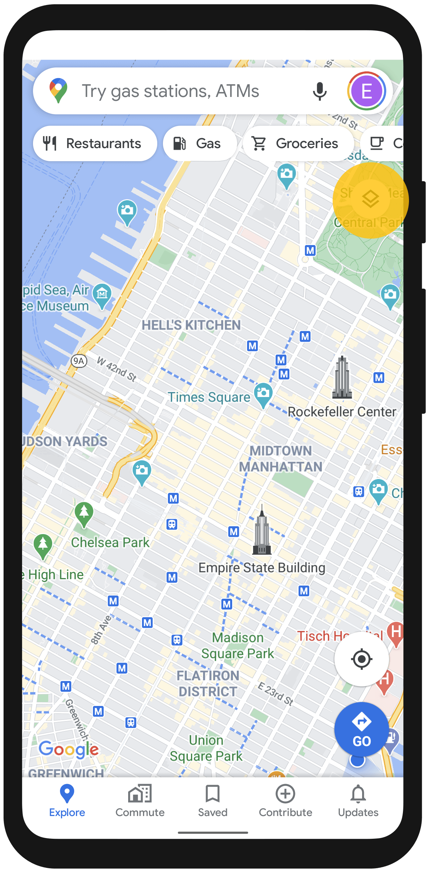
GLOBAL MAP
LOGO

