Slide 1
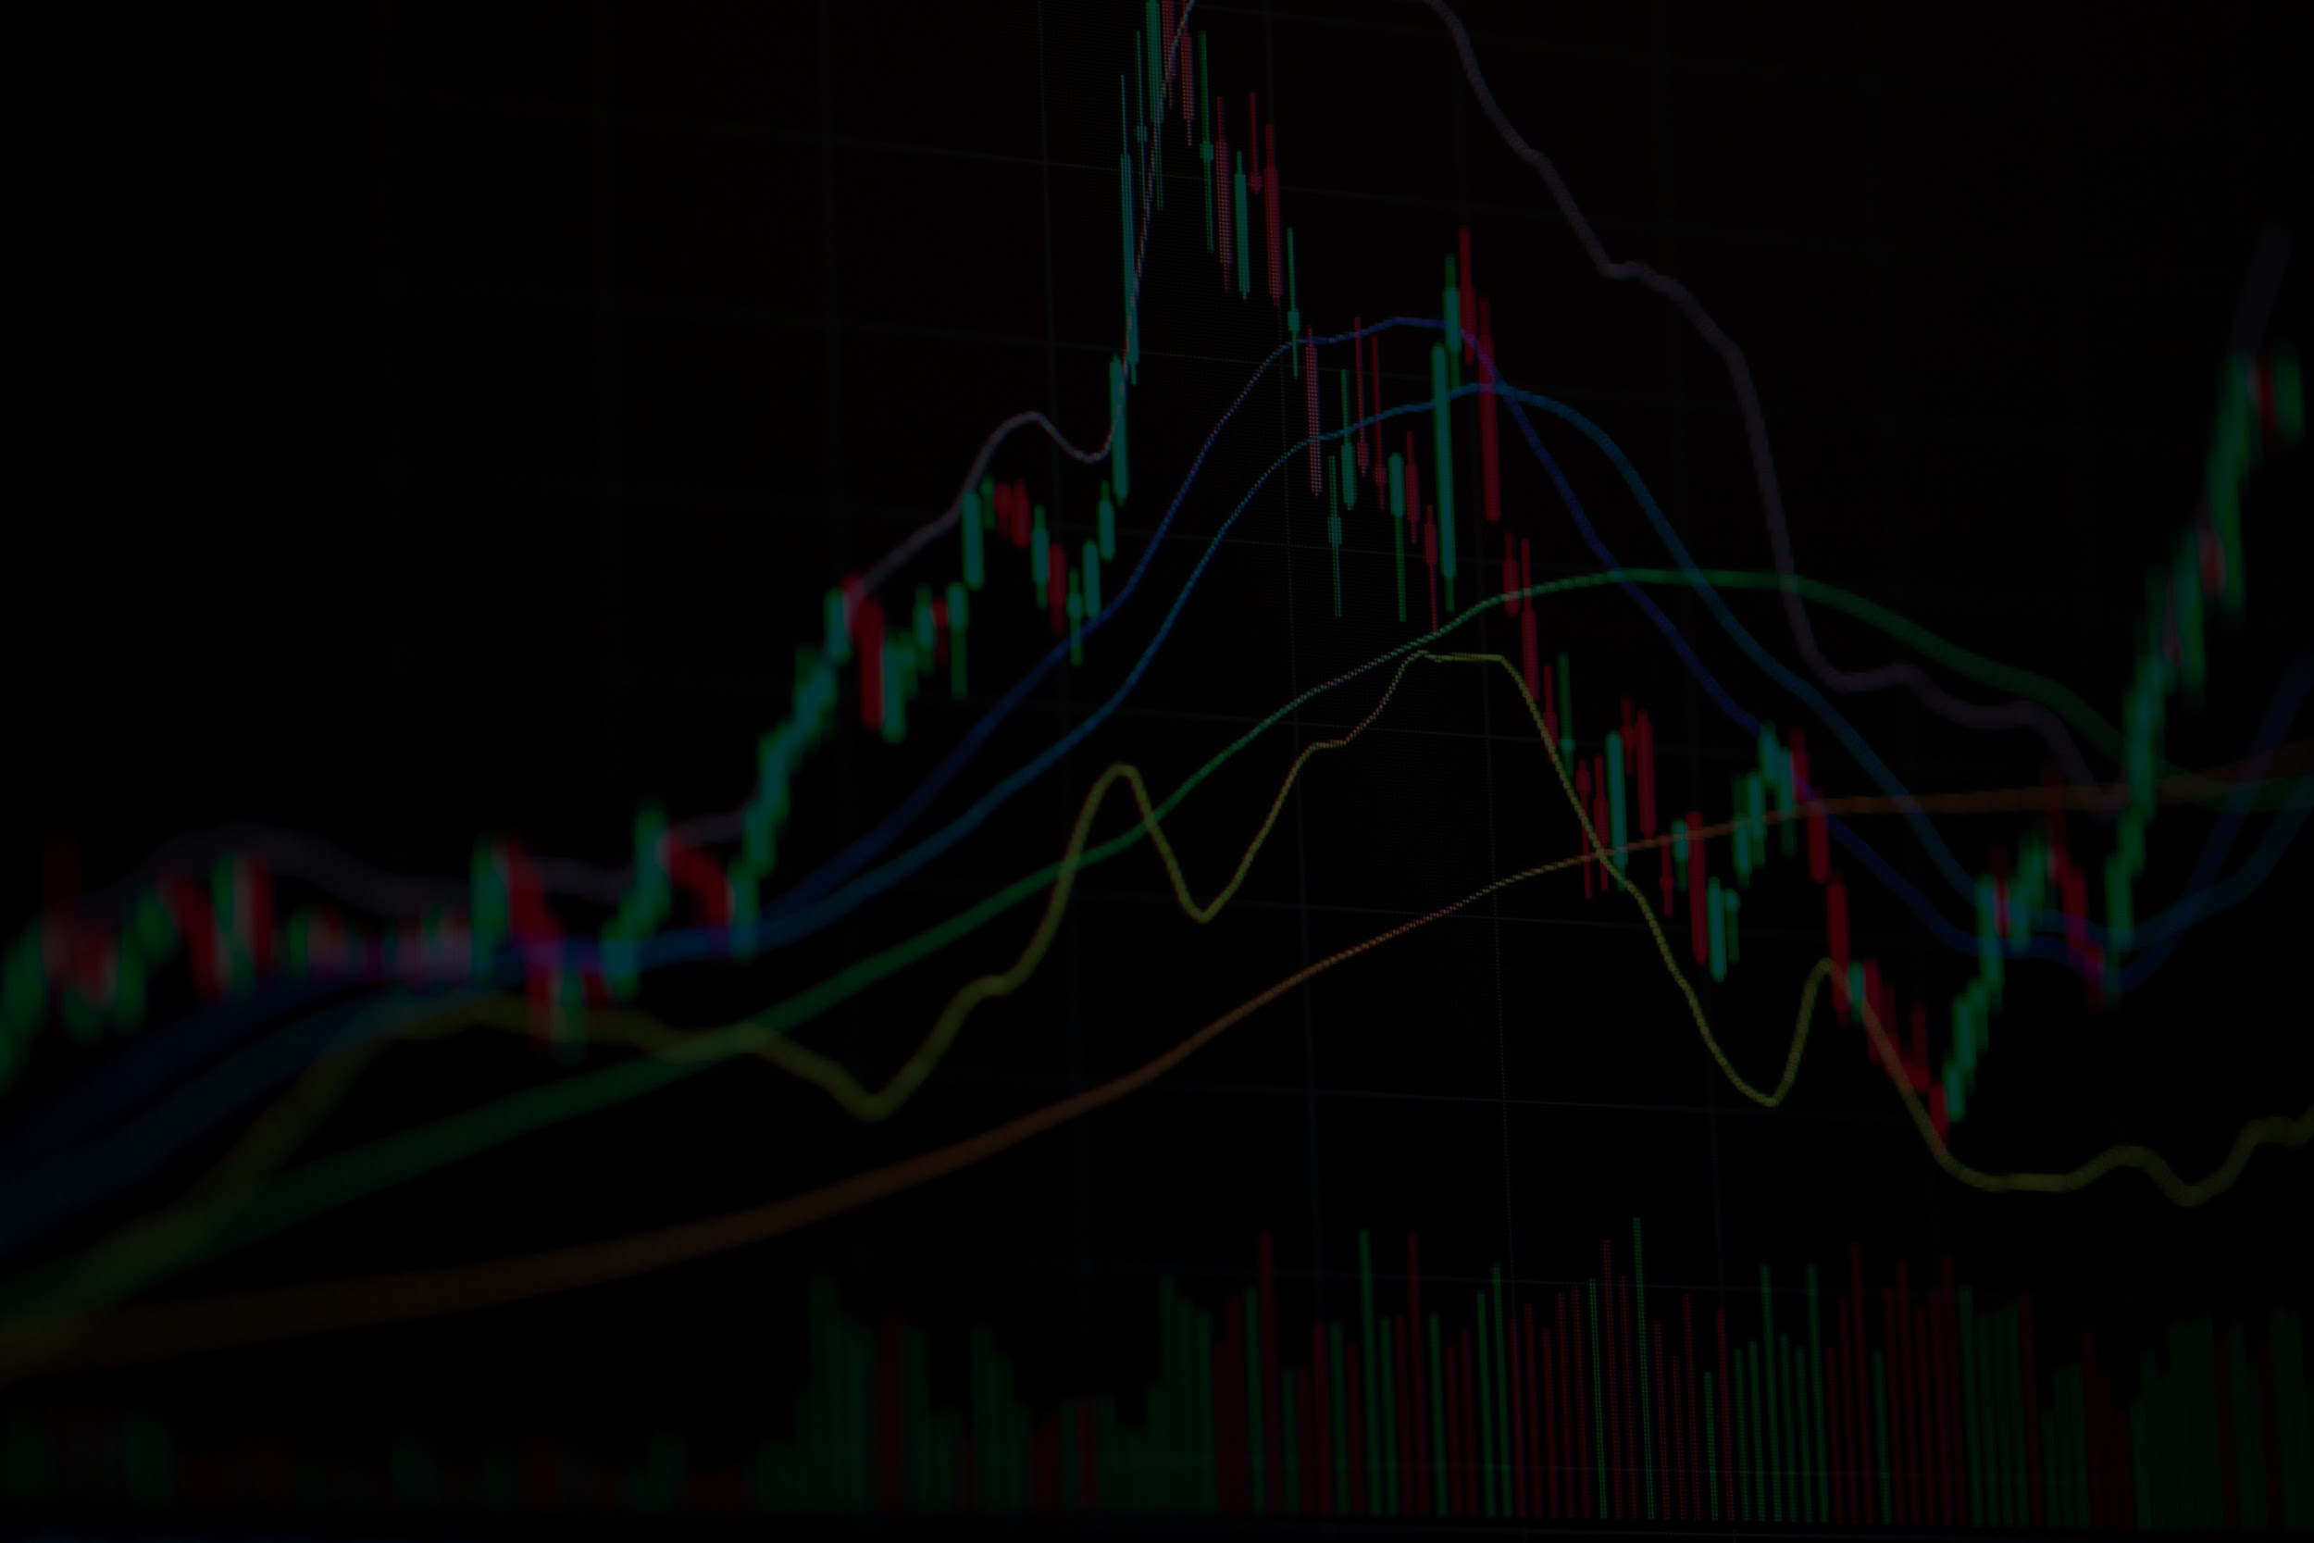
Equity Price Forecasting
Ali Mardan​ Sabayna Ali
Sami Naeem​

Slide 2
OVERVIEW
Problem: Improve asset allocation decision making by forecasting the 30-day KSE100 market returns. The problem is separated into a signal engine for mean trajectory prediction and a risk engine for variance bounds.
Hypothesis:
Extreme values represent meaningful information like market shocks and volatility spikes
Features may have high correlation
Past data can be used to predict future prices
Market regimes and events need to be accounted for to reliably model prices
Feature engineering like momentum and volatility, and lagged variables will improve the model forecasting results
⚡ Signal Engine
🛡 Risk Engine
Mean Trajectory
Variance Bounds
Captures mean price using linear and deep learning models
Models structural fat-tailed market shocks using GARCH(1,1) applied to model residuals

Slide 3
DATA & FEATURE ENGINEERING
Auto-Regressive Returns
Volatility & Drawdown
Momentum & Oscillators
Log return
One-day lagged return
Two-day lagged return
Three-day lagged return
Five-day lagged return
Ten-day lagged return
Number of trading days since highest close (past 63 trading days)
Number of trading days since highest close (past 252 trading days)
True Range
Relative Strength Index overbought indicator
Relative Strength Index oversold indicator
Moving Average Convergence Divergence histogram
Event & Holidays
Cross Market & Macro
Interest Rate Dynamics
Post-holiday indicator
International Monetary Fund event indicator
Three-day International Monetary Fund event window indicator
S&P 500 log return
Emerging Markets ETF log return
Vanguard FTSE Developed Market
ETF log return
Change in the VIX volatility index
U.S. dollar to Rupee log return
Annual GDP Growth Rate
5-day change in the Karachi Interbank Offered Rate
20-day change in the Karachi Interbank Offered Rate

Slide 4
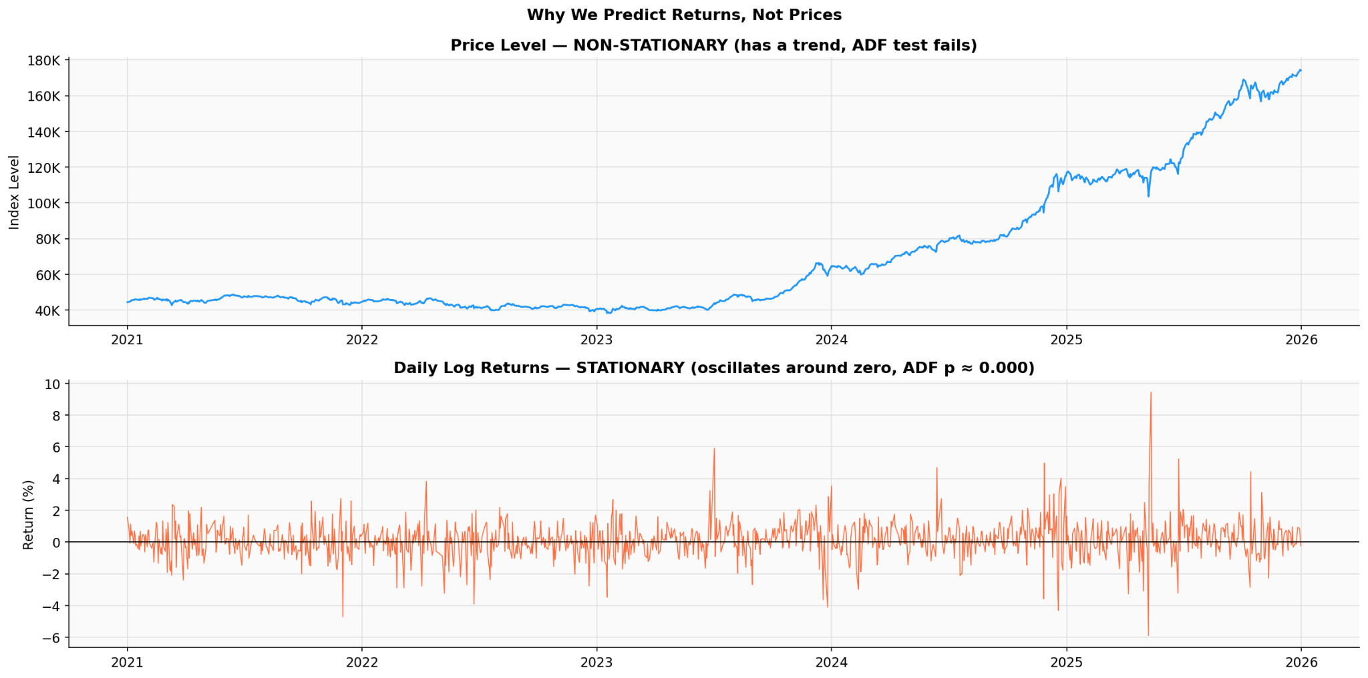
DATA PROPERTIES: Non-Stationarity
Raw prices trend upward, violating stationarity assumptions. Log-returns oscillate around zero and pass ADF test, making it suitable as model target.

Slide 5
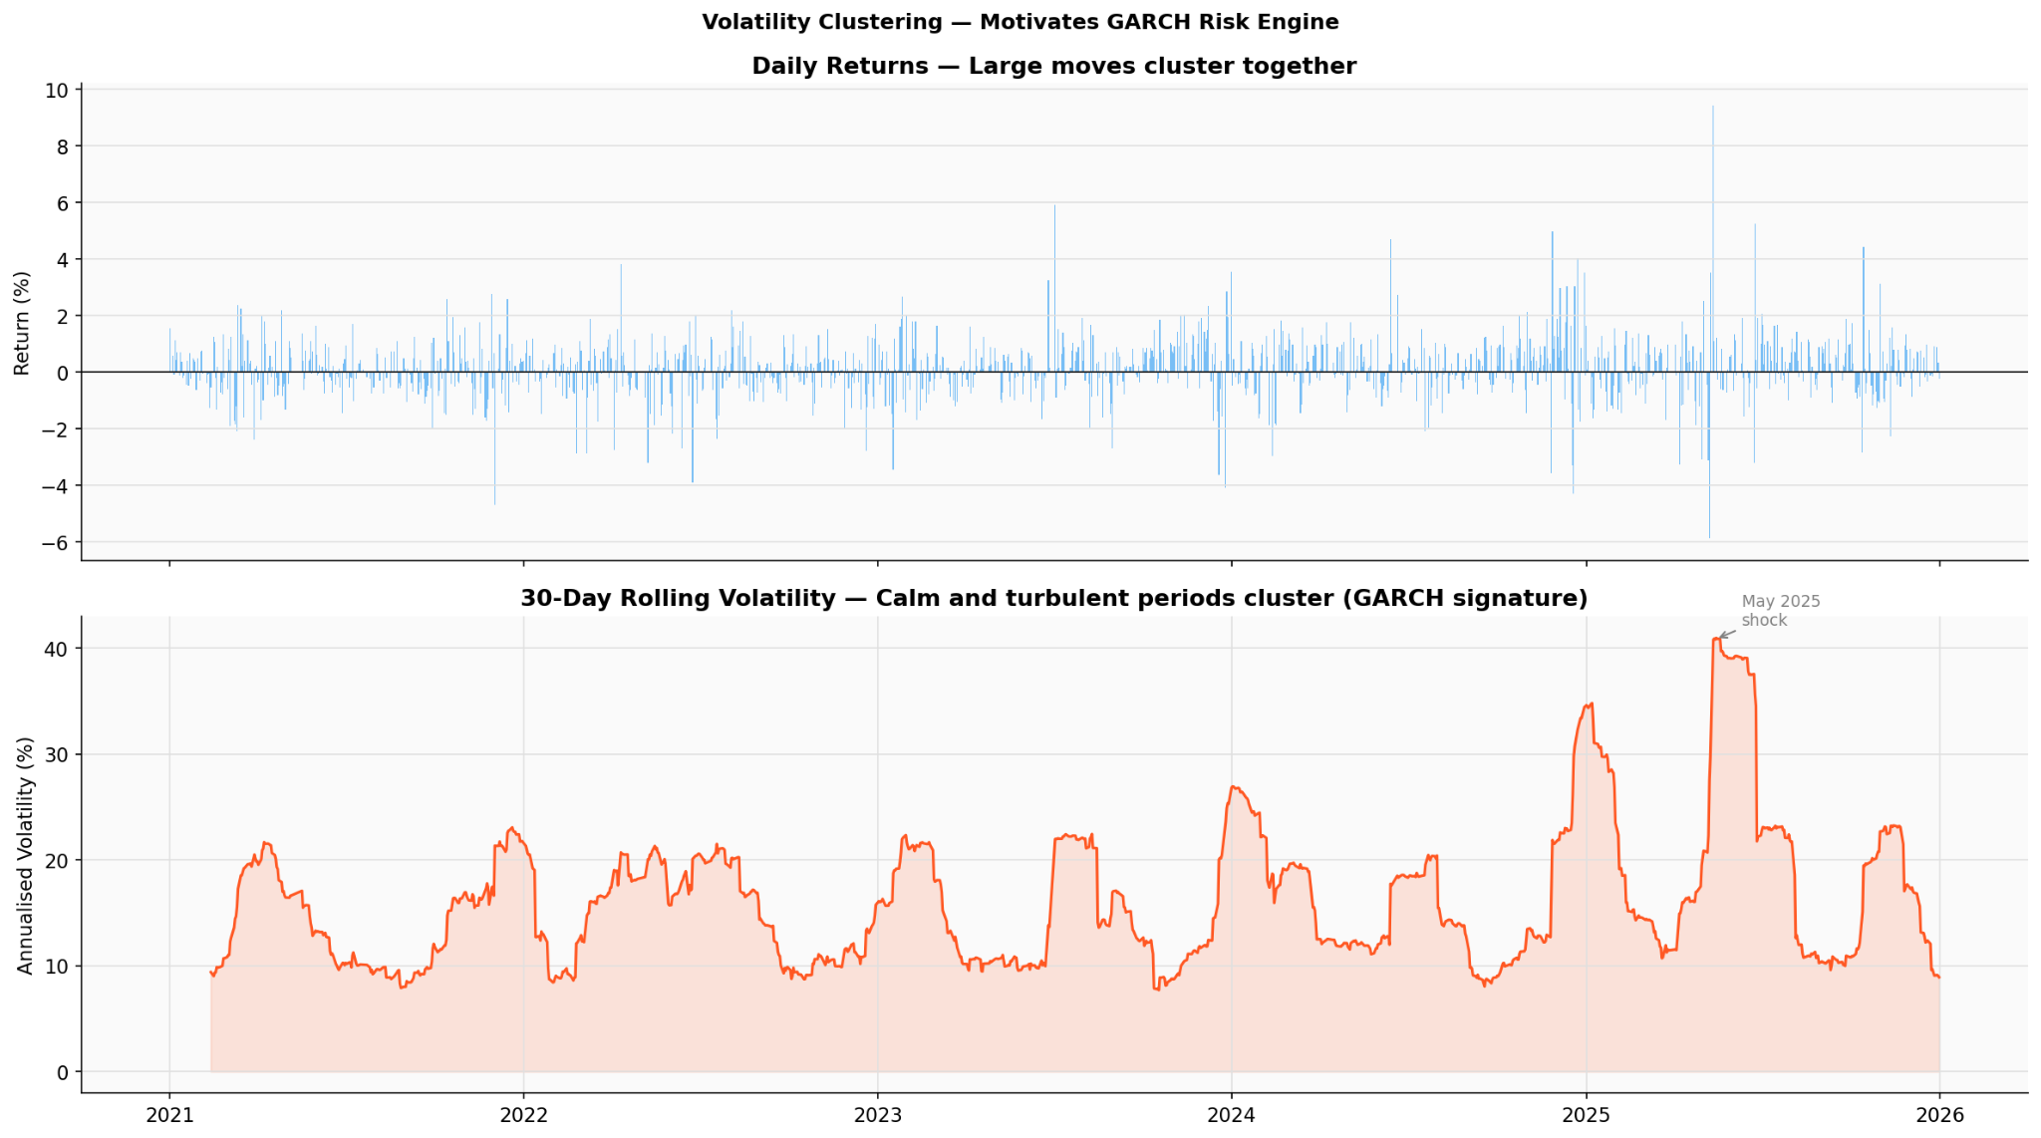
DATA PROPERTIES: Volatility Clustering
Turbulent periods cluster together and persist for weeks. GARCH(1,1) exploits this structure to model dynamic risk bounds.

Slide 6
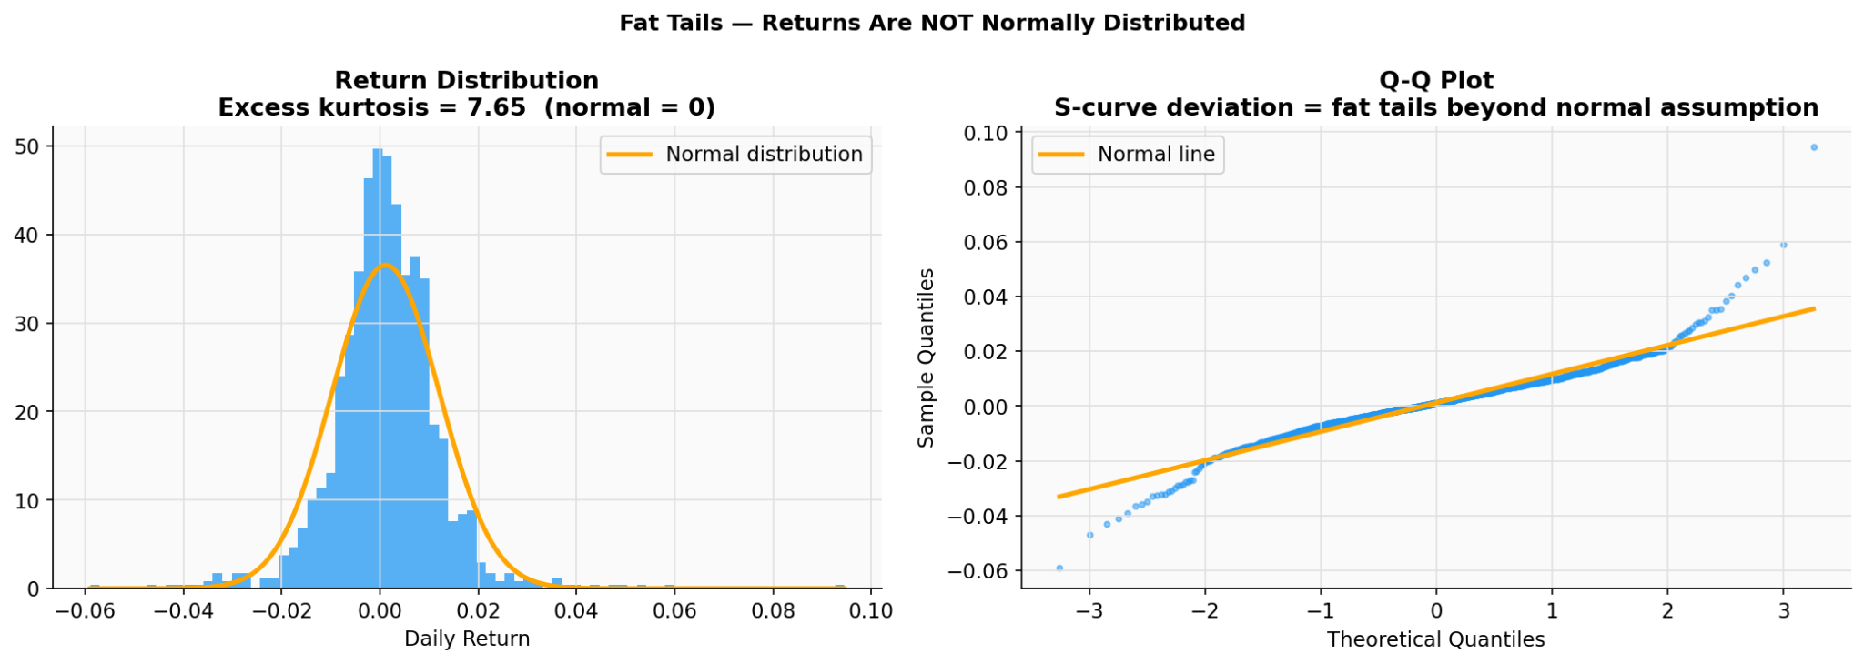
DATA PROPERTIES: Fat Tails
Excess kurtosis = 7.65 vs normal = 0. Severe shocks occur far more frequently than Gaussian models predict, motivates Student-T GARCH.

Slide 7
DATA CLEANING & TRANSFORMATIONS
〜
◼
∞
Anomaly Detection
Data Cleansing
Fat Tails
Anomalies retained since extreme readings reflect market shocks and volatility spikes
Missing rows of data dropped
VIF test used to remove features with high multicollinearity
High Correlation Pair Filtering used to remove similar features
Severe sudden shocks occur far more frequently than Gaussian models predict, requiring Student-T GARCH.
KEY TRANSFORMATION
Log-Return Sequence: yₜ = ln(Pₜ / Pₜ₋₁)
Eliminates data leakage, forces prediction of actual daily magnitude & direction, achieves stationarity.
In-Sample Training → Strict Out-of-Sample 30-Day Evaluation | No data leakage across partition boundary

Slide 8
MODEL ARCHITECTURES
SIGNAL (MEAN) ENGINE
RISK (VARIANCE) ENGINE
SARIMAX
PyTorch Mamba
TimeGPT
Mean Model Prediction Interval
GARCH(1,1)
Student-T
Captures autoregressive, trend, and external-driver effects, but less reliable for sudden regime changes
d_model=16, epochs=20
Zero-Shot & Fine-Tuned
Needs heavy regularization; highest directional accuracy
High compute overhead; native conformal bounds
Epistemic only — collapses OOS
vs
Fat-tailed aleatoric — dynamically scales
FEATURE ENGINEERING BRIDGE
1. Feed historical log-return sequences into Signal Engine architectures 2. Extract in-sample prediction residuals (errors) from Mamba/LSTM 3. Feed residuals into GARCH engine to model true structural market shocks

Slide 9
QUANTITATIVE RESULTS
Mean Engine Performance
Model | MAPE | SMAPE | MAE | RMSE | Dir. Accuracy
SARIMAX | 3.52% | 3.45% | 5641 | 6204 | 67.78%
PyTorch Mamba ★ | 2.35% | 2.32% | 3,787 | 4,305 | 53.33%
TimeGPT Zero-Shot | 2.74% | 2.70% | 4,406 | 4,952 | 43.33%
TimeGPT Fine-Tuned | 2.90% | 2.85% | 4,658 | 5,212 | 43.33%
Variance Engine — Hybrid GARCH Coverage
Model | Baseline Coverage | Hybrid Coverage | MPIW (Width) | Winkler Score
SARIMAX | 98.89% | - | 85479 | 85490
PyTorch Mamba ★ | 56.67% | 76.67% | 12,953 | 19,192
TimeGPT Zero-Shot | — | 70.00% | 14,417 | 20,796
TimeGPT Fine-Tuned | — | 60.00% | 13,372 | 21,110
★ Mamba achieves lowest MAPE (2.35%) and highest directional accuracy (53.33%) among all models

Slide 10
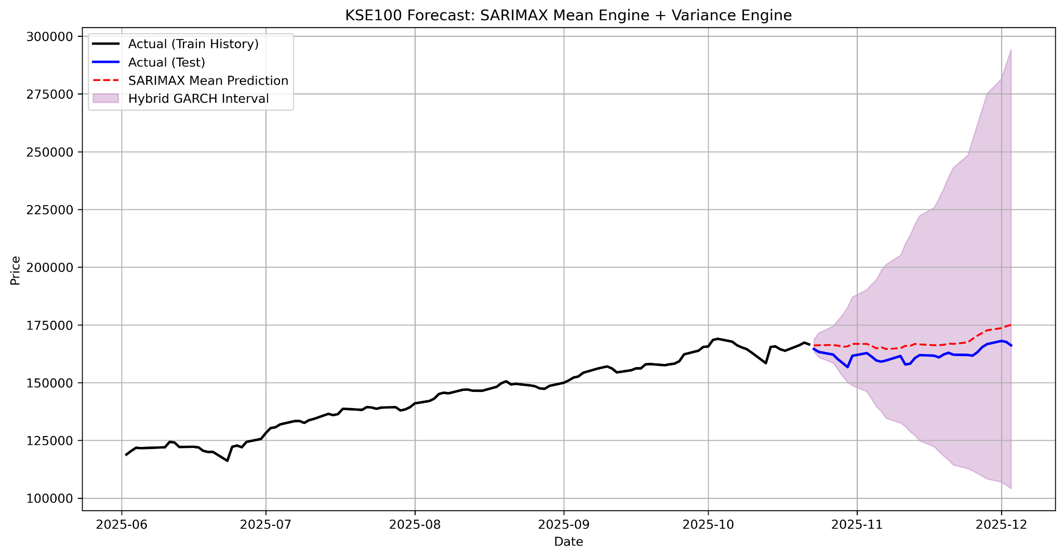
SARIMAX
Baseline Coverage: 98.89% | The model's baseline coverage is too wide making the results not very useful

Slide 11
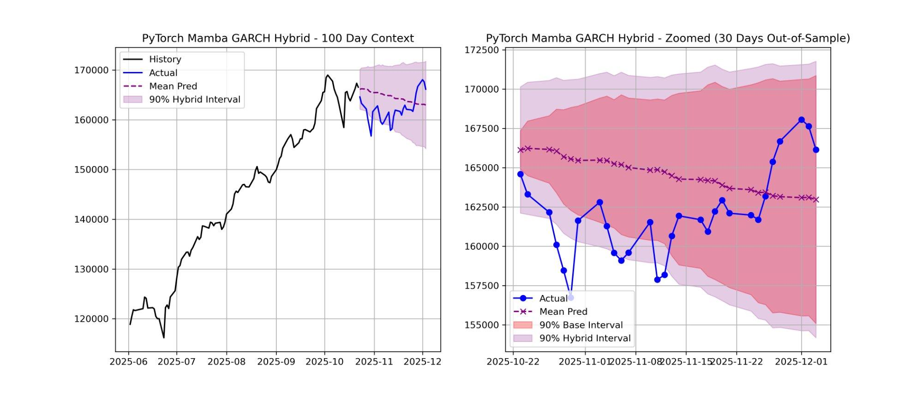
PYTORCH MAMBA — GARCH Hybrid
★ Best Model
Coverage: 76.67% | The red base interval (dropout) collapses linearly. The purple GARCH overlay correctly explodes into fat tails when sensing high residual velocity.

Slide 12
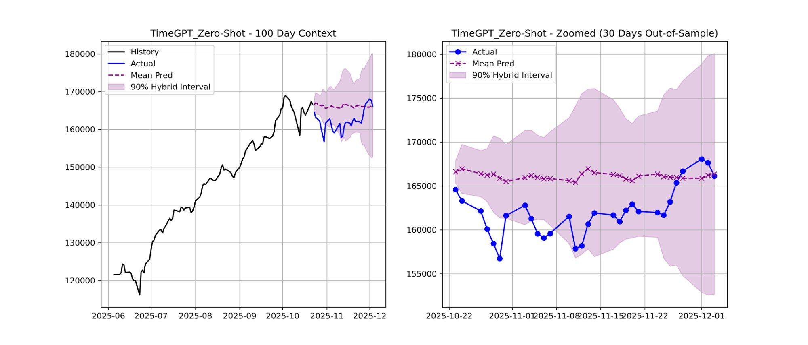
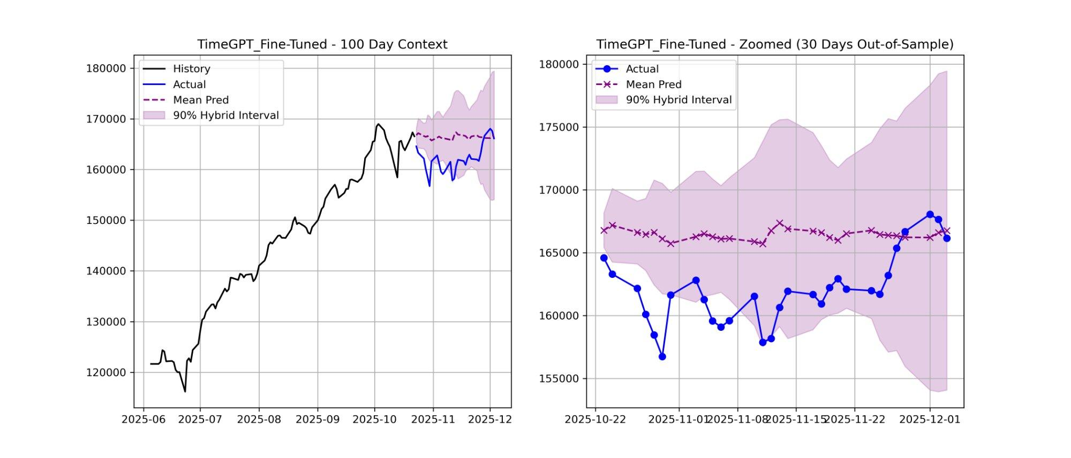
TIMEGPT — Zero-Shot vs Fine-Tuned
Zero-Shot
Fine-Tuned
Coverage:
ZS: 70.00%
why not garch
Zero-Shot outperforms Fine-Tuned on coverage (70% vs 60%) — native conformal bounds are robust without additional GARCH overlay.

Slide 13
TRADING STRATEGY & IMPLEMENTATION
CRUCIAL FINDING: MC Dropout intervals are an illusion — they collapse out-of-sample. GARCH intervals correctly capture aleatoric risk, boosting Mamba's coverage from 56.67% → 76.67%.
01 Signal: Run Mamba
02 Sizing: GARCH Lower Bound
Use Mamba SSM (or Fine-Tuned TimeGPT) as the primary forward momentum indicator. The mean trajectory provides the directional alpha signal for the trade.
Size capital allocations NOT on mean distance, but constrained by the GARCH (or TimeGPT conformal) Lower Confidence Bound — calculating maximum potential unrealized drawdown over 30 days.
Decoupled Architecture Advantage: Deep learning hyper-specializes on structural pattern matching → Statistical engine handles rigorous risk management. Each engine does what it does best.

Slide 14
FUTURE WORK & SCALING
↑ GARCH-X Integration
⚙ Hyperparameter Optimization
⬡ Multi-Asset Expansion
Upgrade the variance engine to include exogenous variables (KSE100 trading volume) to predict volatility shocks faster — GARCH-X with external regressors.
We will further tune the Student-T degrees of freedom within GARCH to push Mamba's 76.67% coverage toward the absolute 90% target via Bayesian optimization. This ensures we precisely capture those extreme fat tails without making the daily intervals unnecessarily wide.
Extend the Two-Engine (Mamba + GARCH) pipeline to other equities. Test automated paper trading to measure slippage and transaction costs on the 30-day horizon.
Coverage Target: Push hybrid Mamba+GARCH from 76.67% → 90.00% through GARCH-X and tuned Student-T ν
Two-Engine Architecture · Mamba + GARCH(1,1) · Signal × Risk Decoupled

Slide 15

THANK
YOU

Slide 16

Worked on By:
Task | Team Member
Problem Statement | Ali, Sabayna, Sami
Hypothesis | Ali, Sabayna, Sami
Exploratory Data Analysis | Ali, Sabayna, Sami
Data processing | Sami
Feature engineering | Sabayna, Sami
Models: SARIMAX | Sami
Models: Mamba | Sabayna
Models: TimeGPT | Ali
Future Work | Ali, Sabayna, Sami

