Slide 1
Intel Forge: CTI & OSINT Platform
Cyber Threat Intelligence & Open Source Intelligence Platform
Sami Ullah[BSSE-F22-E21]
Hamid Rehan[BSSE-F22-E11]
Farhan Khan[BSSE-F22-E14]
Final Year Project 2022-2026

Slide 2
Introduction
Intel Forge is an advanced Cyber Threat Intelligence (CTI) and Open Source Intelligence (OSINT) platform
Enables fast, secure, and controlled access to large-scale unstructured data repositories
Two primary search capabilities:
Face Recognition Search: AI-powered facial recognition using ArcFace/UniFace models
Text Search: Full-text search across indexed files using Quickwit search engine.
Addresses critical challenges in modern intelligence workflows
Supports organizations in threat detection, brand protection, and intelligence gathering

Slide 3
Problem Statement
Modern intelligence and cybersecurity teams face a critical challenge in searching and analyzing massive volumes of unstructured data from the surface web, dark web, and messaging platforms.
Manual investigation methods are slow, error-prone, and unable to scale for real-time threat detection and brand protection.
Existing solutions lack integration, automated multi-source data collection, and advanced search capabilities across text, images, and identities.
Organizations struggle to secure and control access to large intelligence datasets while handling growing cyber threats and impersonation risks.
This creates an urgent need for a scalable, secure CTI and OSINT platform capable of automated collection, indexing, and fast search at global scale.

Slide 4
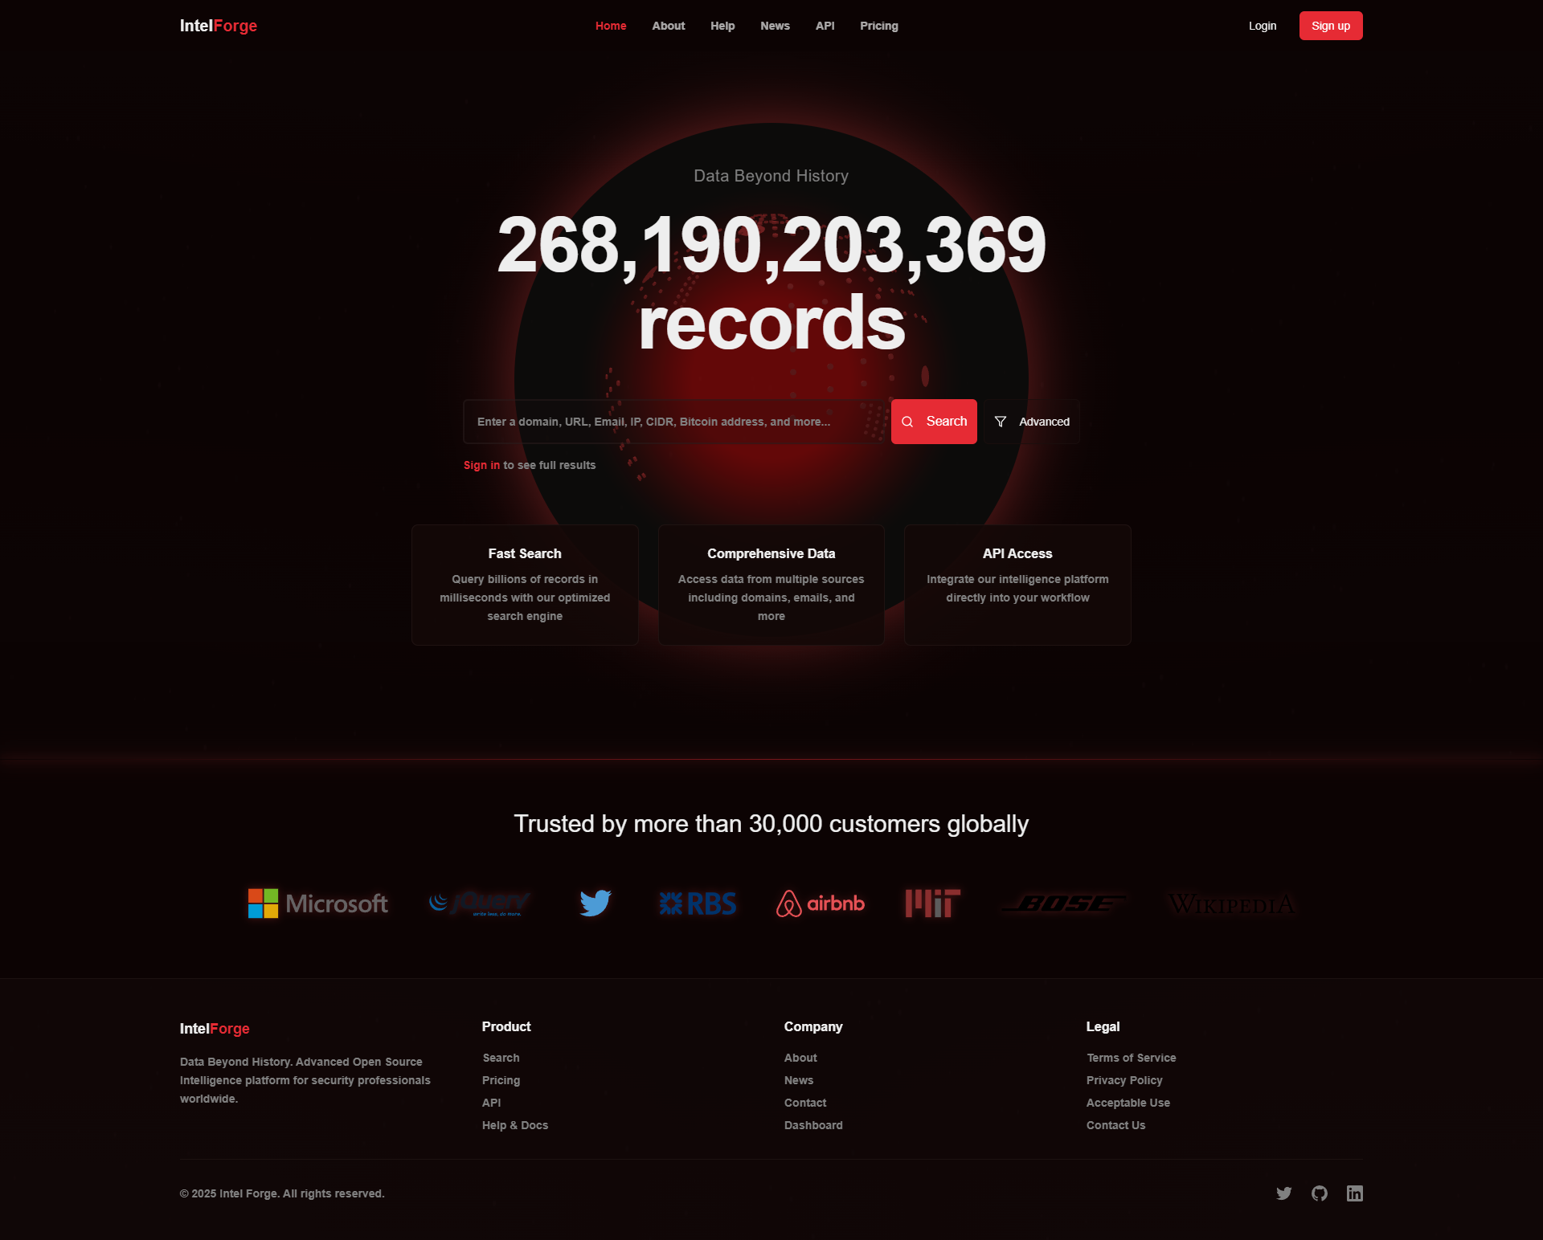
Website Interface

Slide 5
Cyber Threat Intelligence (CTI) Capabilities
Real-time monitoring of dark web sources (onion sites)
Brand mentions, leaked credentials, intellectual property
Telegram channel monitoring for threat actors
Data breaches and brand impersonation detection
Surface web scraping for public mentions
Social media monitoring and reputation management
Automated alerting system
Immediate notifications when threats are detected
Historical threat data analysis and trend identification
Comprehensive threat intelligence dashboard

Slide 6
OSINT & Brand Protection Features
OSINT Capabilities:
Automated data scraping
Multi-source aggregation
Real-time indexing
Historical data analysis
Trend identification
Brand Protection:
Brand name misuse detection
Logo infringement identification
Phishing site detection
Domain monitoring
Advanced Features:
Social media impersonation detection
Counterfeit product identification
Automated takedown requests
Image recognition for trademarks
Monitoring Sources:
Surface web (public sites)
Telegram channels
Dark web forums
Social media platforms
Marketplaces

Slide 7
Automated Data Collection Sources
Surface Web Scraping:
Public websites, forums, social media platforms
Threads profile scraping using GraphQL API
Public database scraping
RSS feed monitoring
Telegram Channels & Groups:
Real-time message and media monitoring
Automated file extraction
MTProxy support for enhanced privacy
Dark Web (Onion Network):
Tor network integration
Automated crawling of forums and marketplaces
Privacy-preserving scraping with randomized delays

Slide 8
Automatic Indexing Pipeline
File Detection & Monitoring:
File system watcher monitors /data directory
Automatic detection of new files from scrapers
File Processing:
Archive extraction (ZIP, RAR, 7Z)
Document parsing (PDF, DOCX, XLSX)
Image OCR using Tesseract
Text file indexing
Text Indexing:
Batch indexing to Quickwit (1000 lines/batch)
Duplicate detection using MD5 hash
Image & Face Indexing:
Face detection using YOLO/MTCNN
Face embeddings using ArcFace/UniFace
Vector storage in Milvus
Original images in MinIO

Slide 9
System Architecture
Hybrid Layered Architecture with MVC Pattern
Layers:
Presentation Layer: Next.js Frontend (React 19, TypeScript)
Application Layer: Next.js API Routes (Business Logic)
Data Access Layer: PostgreSQL with connection pooling
External Services: Quickwit, Milvus, MinIO, Face Recognition Service
Microservices Integration:
Face Recognition Service (Python)
Go Indexer (High-performance indexing)
Telegram Scraper (Python)
Threads Scraper (Python)
Auto-Indexer (Python)
Deployment: Docker Compose with horizontal scaling support

Slide 10
Technology Stack
Frontend:
Next.js 15
React 19
TypeScript
Tailwind CSS
Radix UI
Backend:
Next.js API Routes
Python Services
Go Services
PostgreSQL 15
Search & Storage:
Quickwit
Milvus
MinIO
AI/ML Models:
ArcFace (Face Recognition)
UniFace (Face Recognition)
YOLO (Object Detection)
Tesseract OCR
EasyOCR
Data Collection:
Telethon (Telegram)
BeautifulSoup
Selenium
Stem (Tor)
Security:
JWT Authentication
bcrypt (Password Hashing)
OWASP Top 10 Compliance

Slide 11
Search Capabilities
Text Search:
Full-text search across indexed documents
Quickwit search engine integration
Sub-2 second response times
Relevance scoring and ranking
Pagination for large result sets
Face Recognition Search:
AI-powered facial recognition
ArcFace and UniFace models
512-dimensional vector embeddings
Similarity search in Milvus
Search through millions of indexed images
Real-time face detection and matching

Slide 12
Database Design
PostgreSQL Database with 25+ Tables
Core Tables:
users, sessions, api_keys
search_index, search_index_lines
subscription_plans, user_subscriptions
security_logs, security_audit_logs
monitored_items, monitoring_alerts
Normalization:
Third Normal Form (3NF) compliance
Strategic denormalization for performance
100+ indexes for query optimization
Features:
Full-text search with TSVECTOR
JSONB for flexible data storage
Stored functions and triggers
Connection pooling and read replicas

Slide 13
Security Features
Authentication:
JWT access/refresh tokens
Two-factor authentication (2FA)
bcrypt password hashing (12 rounds)
Session management
IP lock policies
Authorization:
Role-based access control
Subscription tier enforcement
API key management
Quota management
Security Measures:
OWASP Top 10 compliance
Input validation & sanitization
SQL injection prevention
XSS & CSRF protection
Rate limiting
Headers & Policies:
Content Security Policy (CSP)
HSTS enforcement
X-Frame-Options
Security audit logging

Slide 14
User Roles & Subscription Tiers
Free Users:
50 searches per month
Basic text and face search
Blurred previews for restricted content
Starter Users:
500 searches per month
Full text search access
Surface web data access
Professional Users:
5,000 searches per month
All data sources
API access included
Priority support
Enterprise Users:
Unlimited searches
All features enabled
Custom integrations
Dedicated support & SLA

Slide 15
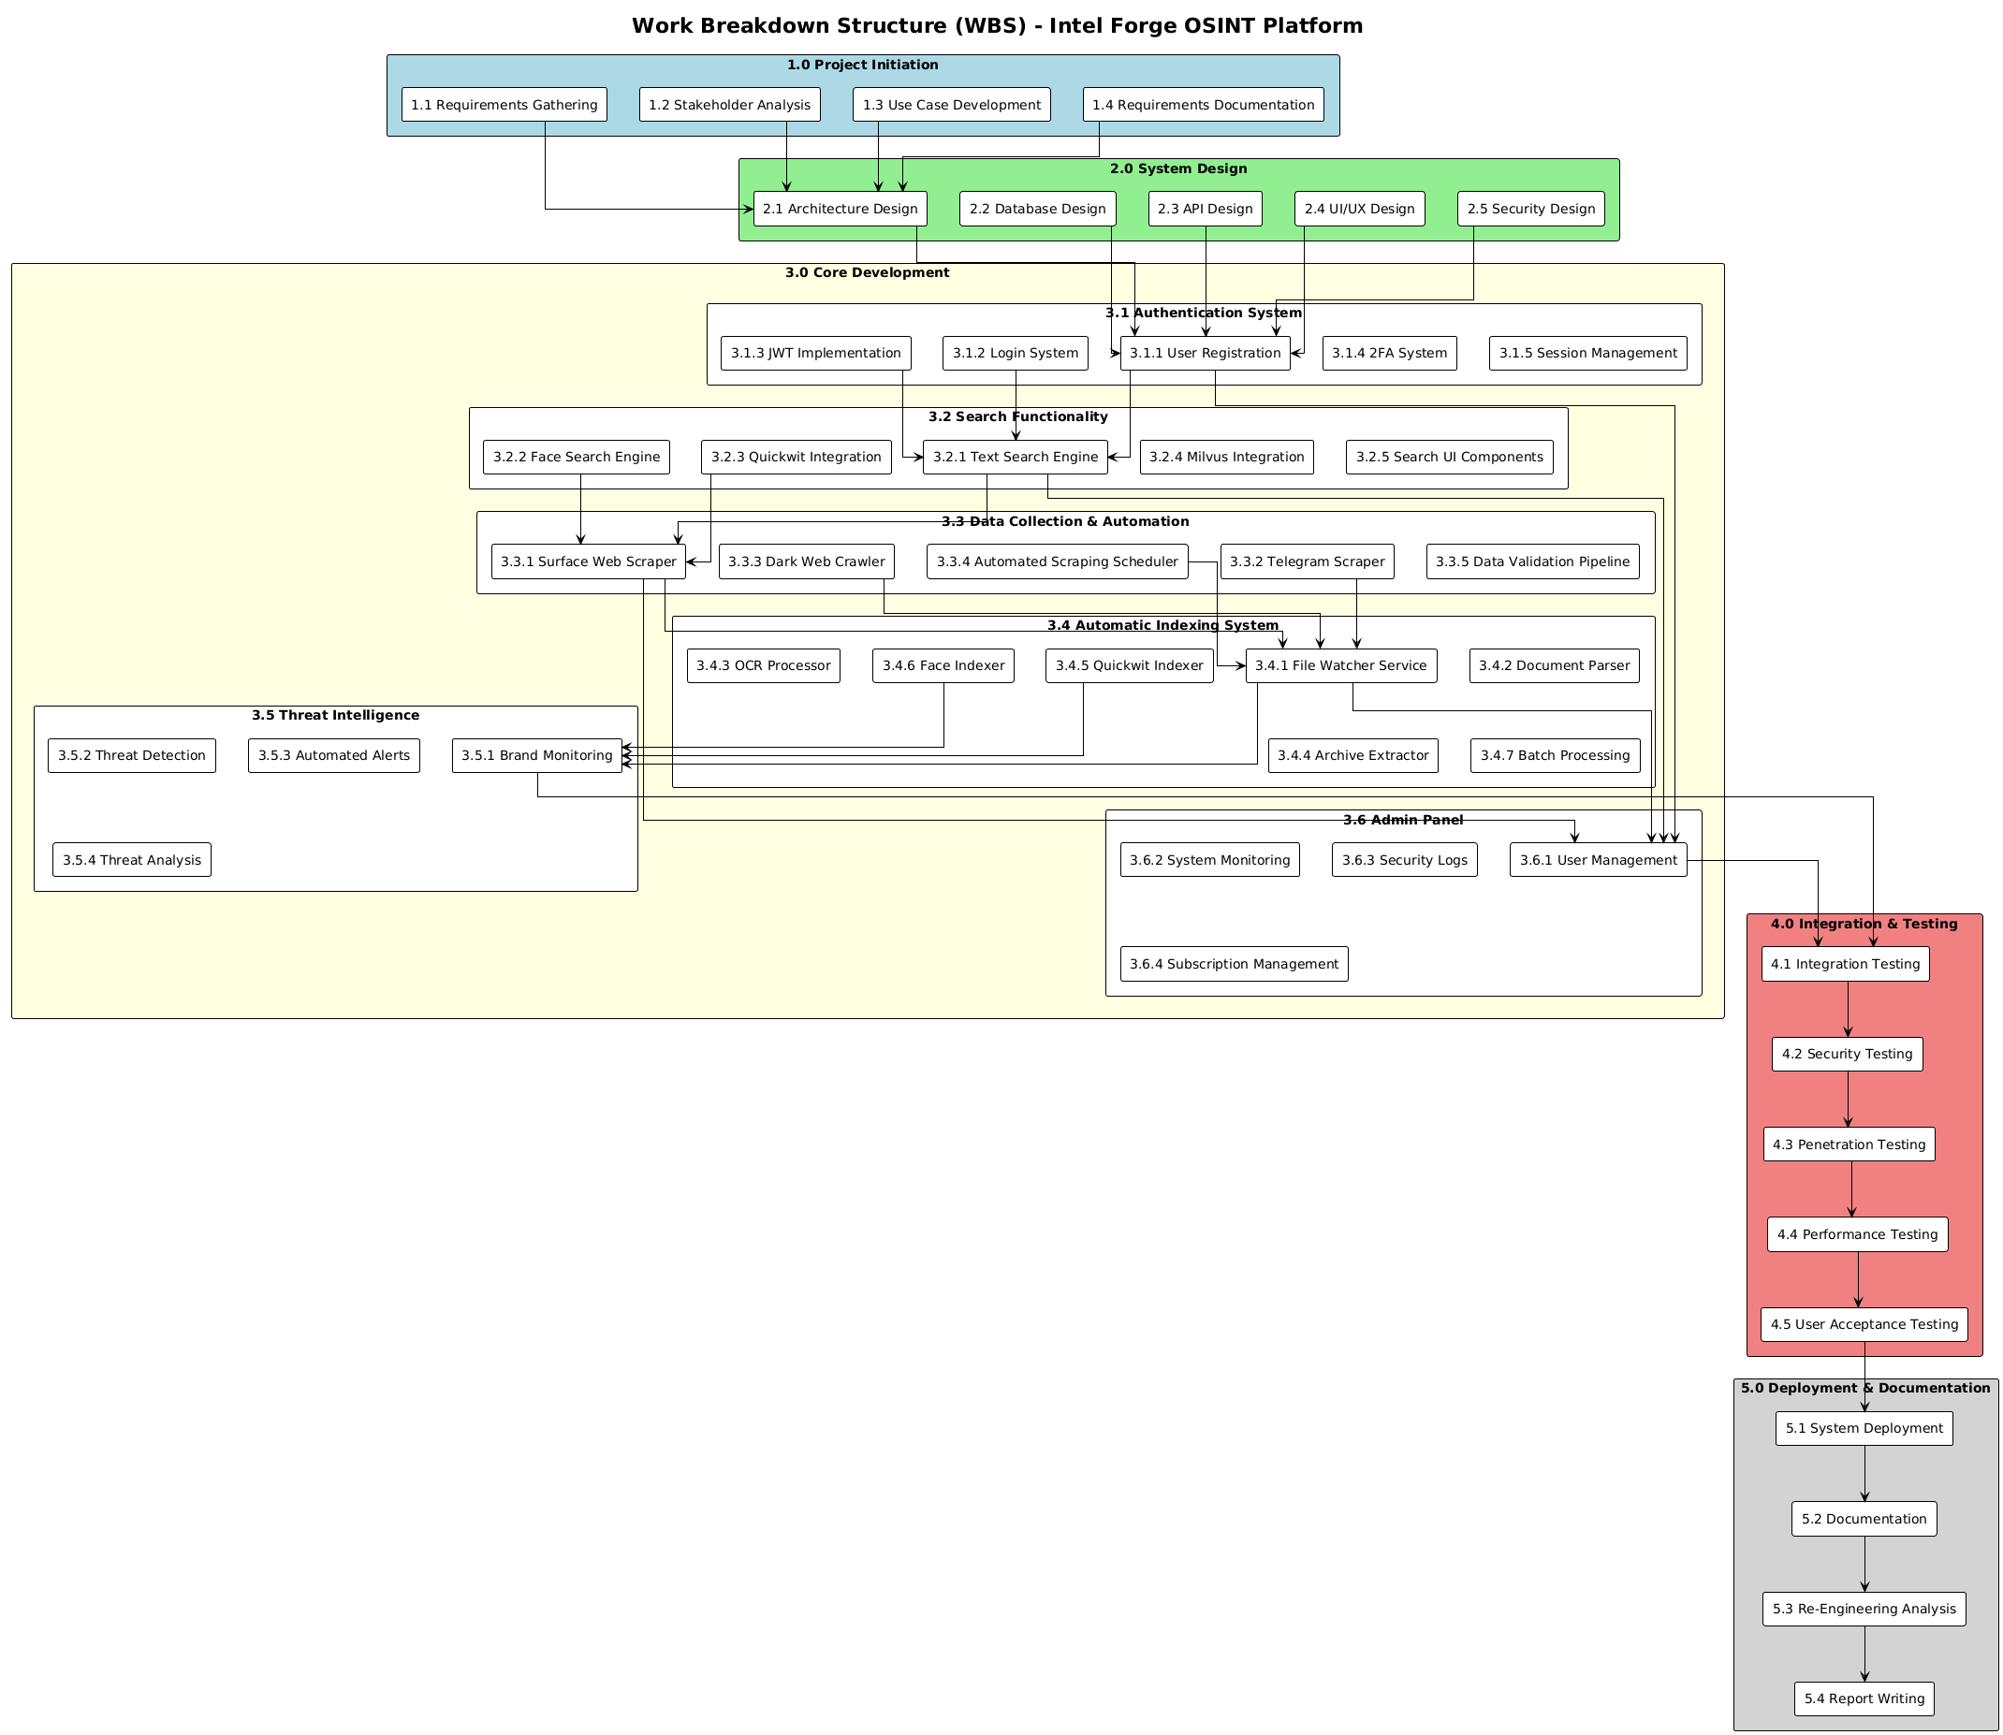
Work Break Down Diagram

Slide 16
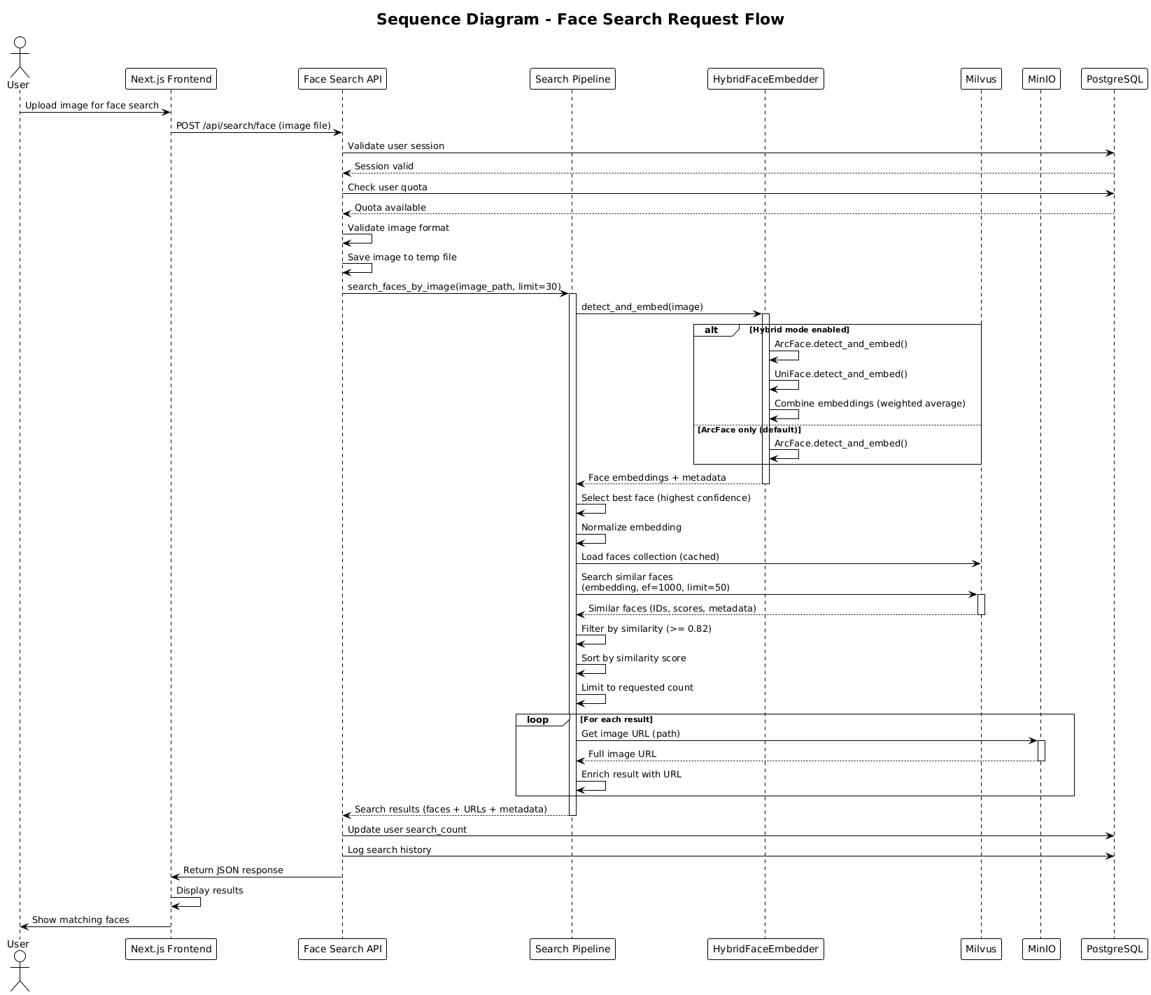
Sequence Diagram 1

Slide 17
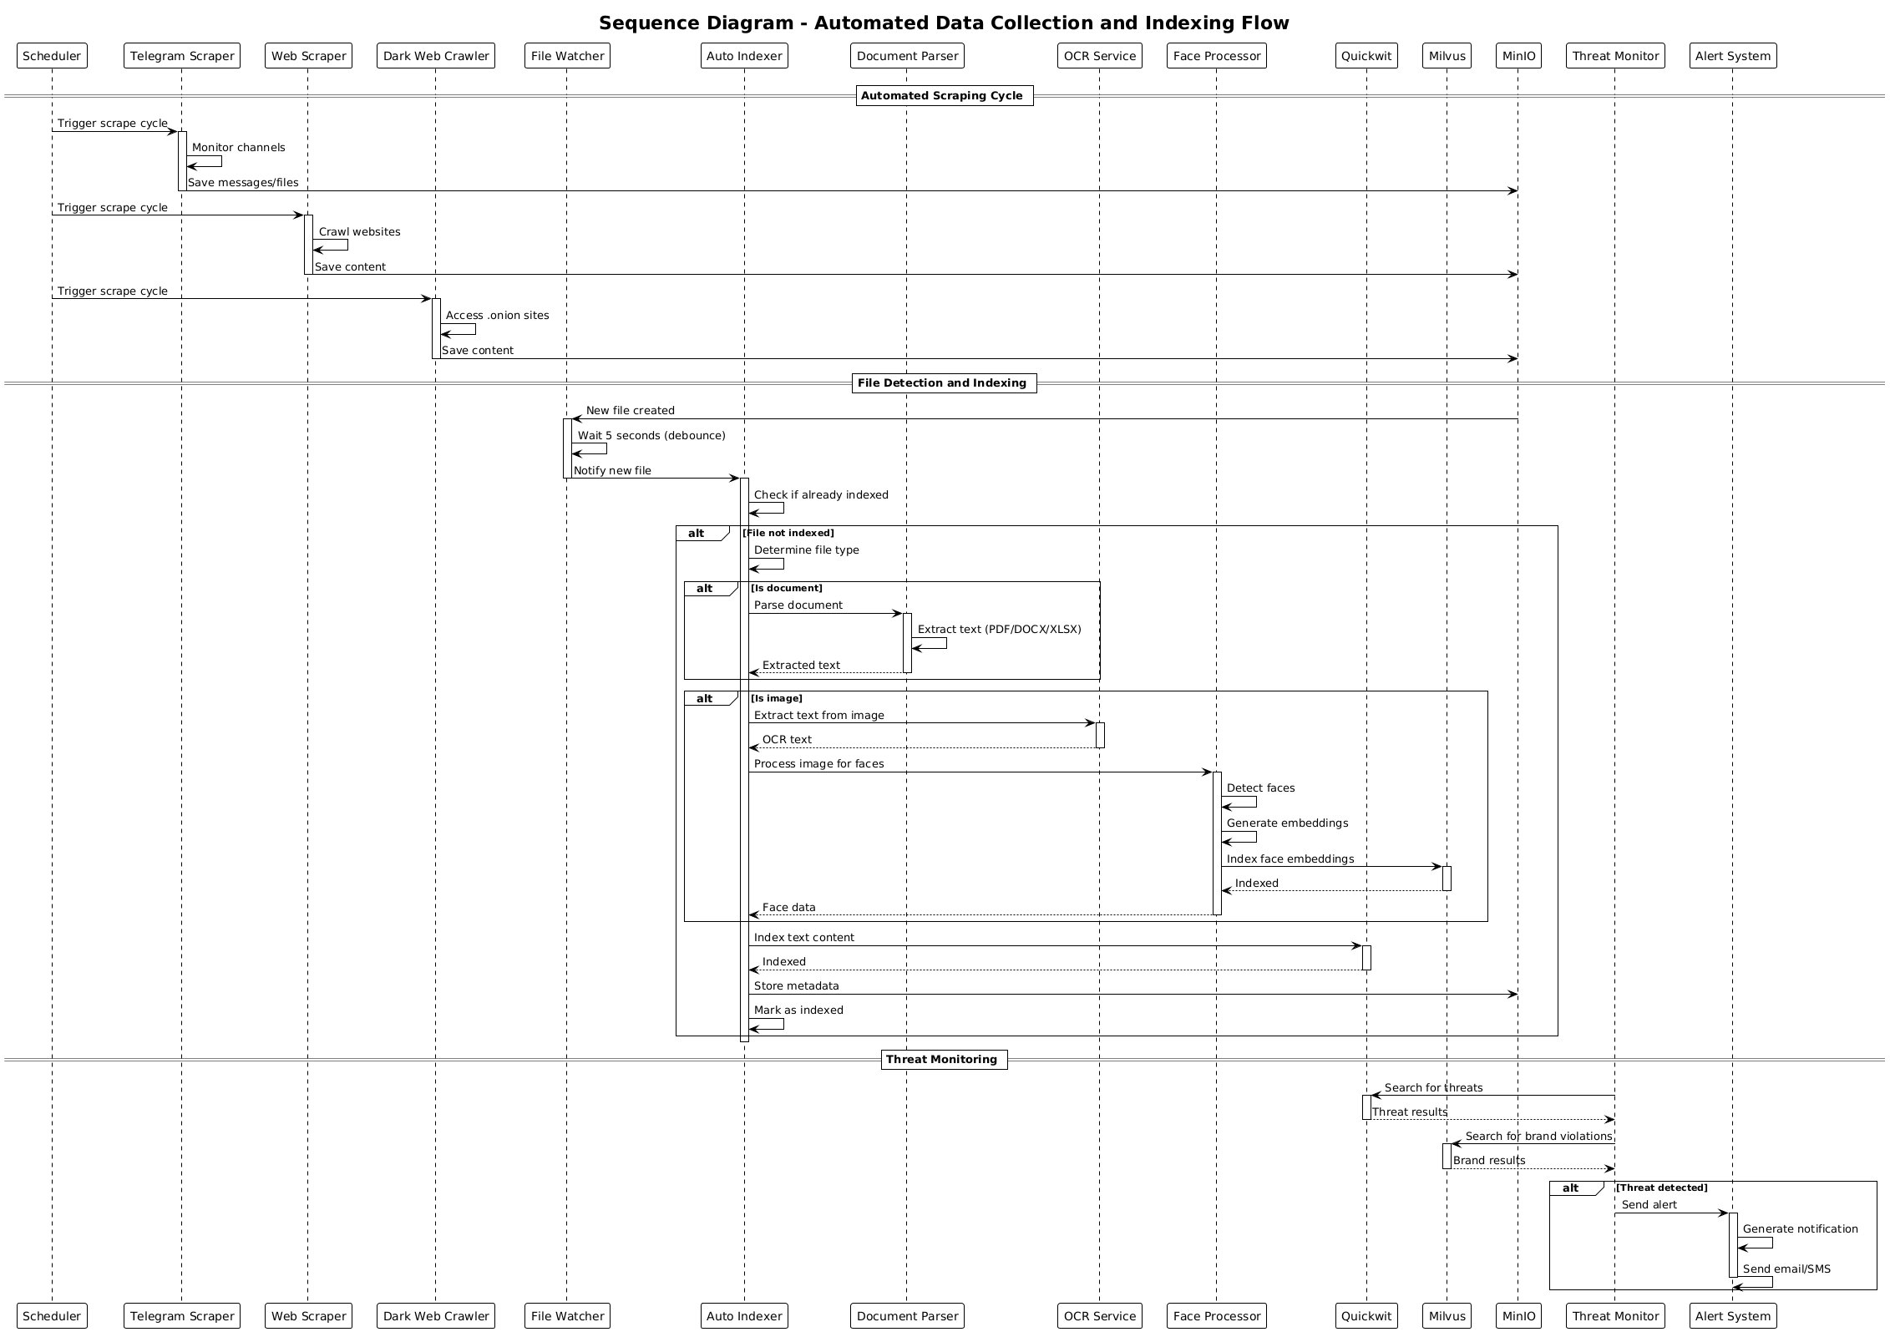
Sequence Diagram 2

Slide 18
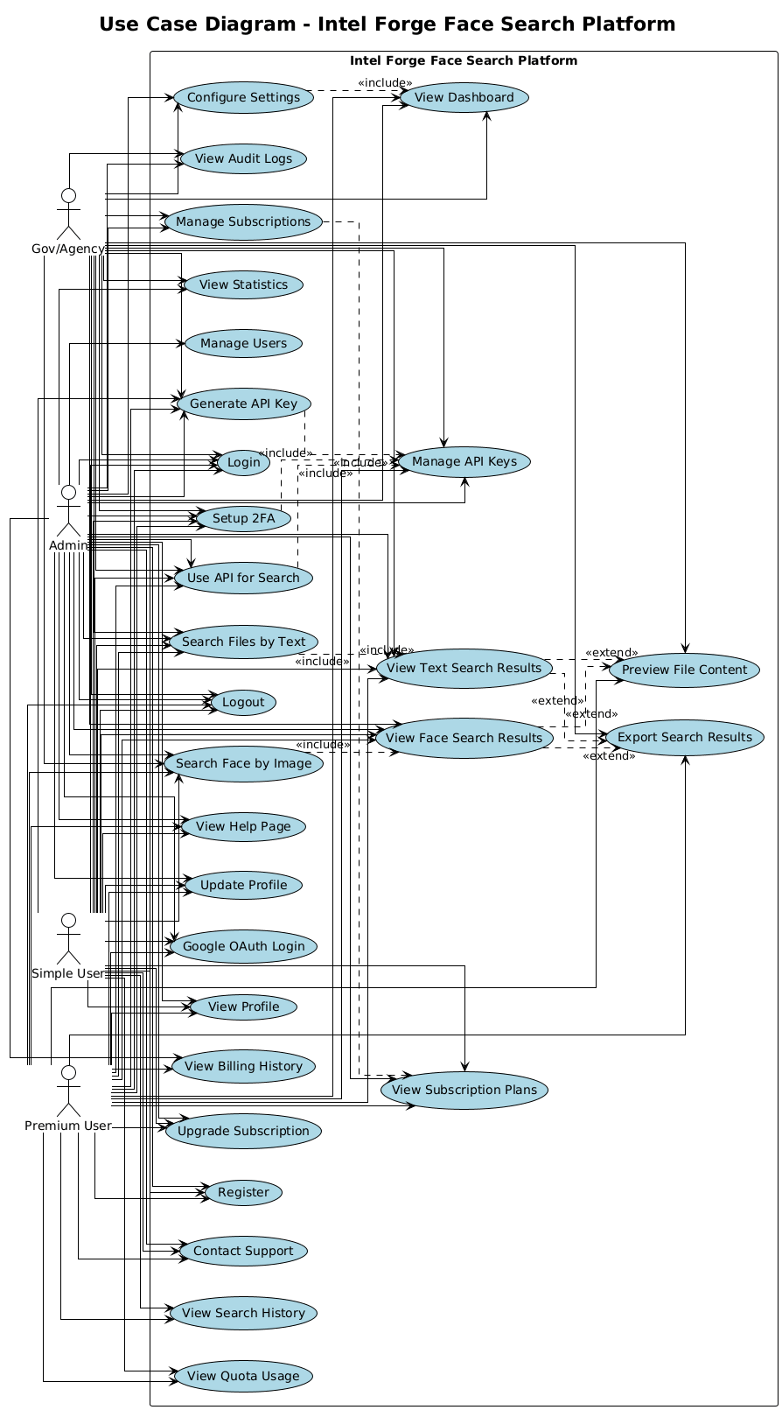
Use Case Diagram

Slide 19
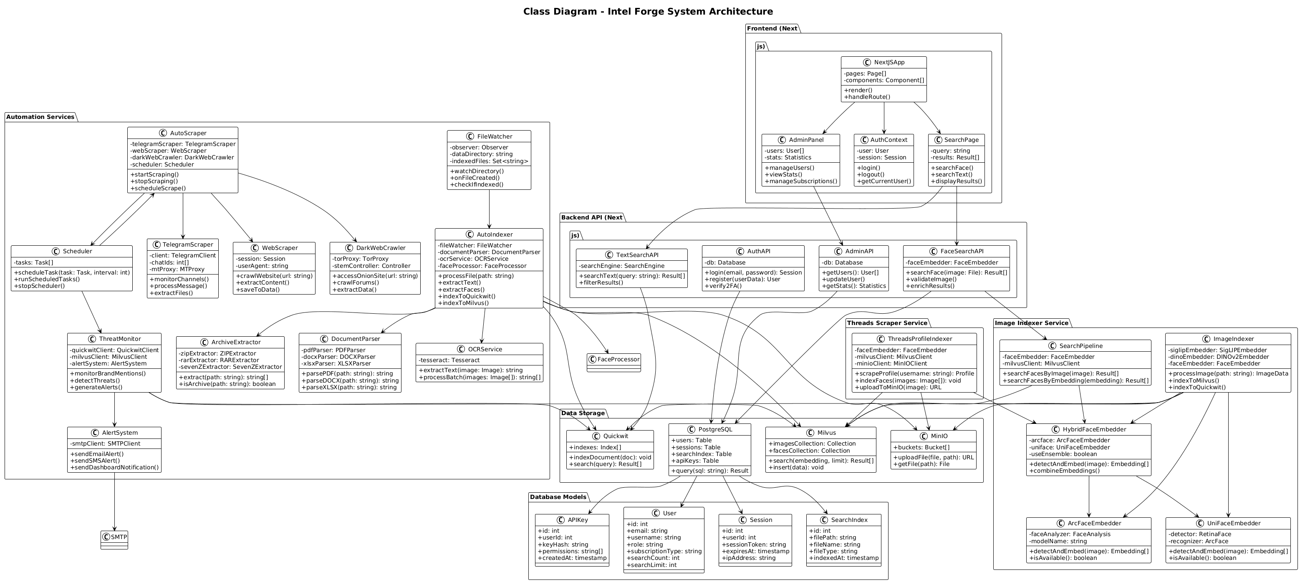
Class Diagram

Slide 20
Key Features Summary
Intelligence Gathering:
Multi-source data collection
Automated scraping
Real-time monitoring
Historical analysis
Search & Analysis:
Text search
Face recognition
Vector similarity
Relevance ranking
Security & Compliance:
Authentication & authorization
Audit logging
Data encryption
Security headers
Automation:
Auto-indexing
File processing
Threat alerting
Scheduled tasks

Slide 21
Conclusion & Future Work
Intel Forge successfully addresses critical challenges in CTI/OSINT:
Automated multi-source intelligence gathering
Scalable search across large datasets
Comprehensive threat intelligence capabilities
Enterprise-grade security and access control
Future Enhancements:
Machine learning model training capabilities
Video and audio search support
Mobile application development
Advanced analytics and visualization
Integration with external threat feeds
Multi-language support
Thank You!
Questions & Discussion

