Slide 1

HSIYC / MEDIA & PUBLICITY DEPARTMENT
THE WEBSITE / INTRODUCTION
YOUR PEOPLE.
YOUR STORIES.
OUR WORLD.
The HSIYC Media & Publicity Department
website
A creative home for the team, its activities,
its plan, and its shared vision.
EXPLORE THE WEBSITE →
PEOPLE. STORIES. POSSIBILITIES.
01 / 10
Notes:
Introduce the website as a welcoming digital home for the HSIYC Media & Publicity Department. The department logo, blue environment, teal mascot, and coral details carry the identity consistently across the experience. The button opens the live website.

Slide 2
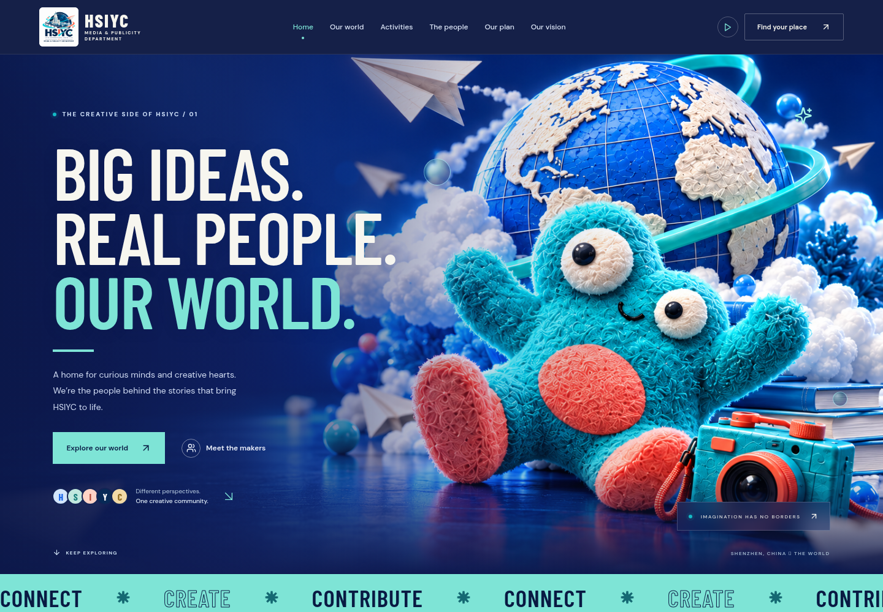
HSIYC / MEDIA & PUBLICITY DEPARTMENT
01 / PURPOSE
ONE PLACE TO GET TO KNOW THE DEPARTMENT
A CREATIVE HOME FOR THE TEAM.
01
Meet the people
Introduce the department’s roles and the
people behind the work.
02
Discover the work
Bring activities and creative ideas
together in a visual gallery.
03
Understand the direction
Explain the plan and the vision in a
clear, approachable way.
PEOPLE. STORIES. POSSIBILITIES.
02 / 10
Notes:
The homepage provides a strong first impression and directs visitors toward activities, the team, the plan, and the vision. This slide contains an actual screenshot of the current website. The site aims to make the department easy to understand; no visitor or engagement metrics are being claimed.

Slide 3
HSIYC / MEDIA & PUBLICITY DEPARTMENT
02 / VISUAL IDENTITY
THE SAME WORLD, FROM PAGE TO PRESENTATION
BOLD COLOR. FRIENDLY CHARACTER.
A recognizable visual language
Deep blue scenes create focus. Teal brings energy.
Coral adds warmth, while ivory gives the eye room to rest.
The same mascot, soft lighting, and playful shapes
connect the hero with every activity image.
Navy
#091A43
Cobalt
#1463E8
Mint
#7EE4D6
Coral
#FF765F
Ivory
#F7F6EF
PEOPLE. STORIES. POSSIBILITIES.
03 / 10
Notes:
These colors are sampled from the current website styles. The presentation uses the same imagery and palette. The website itself uses Barlow Condensed headings and DM Sans body text; this editable presentation uses Arial for compatibility across PowerPoint installations. The PDF preserves the intended appearance.

Slide 4



HSIYC / MEDIA & PUBLICITY DEPARTMENT
03 / ACTIVITIES
THREE IDEAS. ONE COHESIVE IDENTITY.
ACTIVITIES, IN FULL COLOR.
01 / CAMPUS LIFE
02 / WORKSHOPS
03 / OUR CREATIONS
Campus stories
Creative lab
Design explorations
Portraits and short stories that give
different campus voices a space.
Hands-on sessions for photography,
design, writing, and filmmaking.
A showcase of playful experiments
using the HSIYC visual identity.
CURRENT CONTENT: PROPOSED ACTIVITIES
PEOPLE. STORIES. POSSIBILITIES.
04 / 10
Notes:
These are the three proposed activities currently shown on the site, not completed events. Visitors can filter by category and open each activity for its description and takeaways. Each scene is different while preserving the same mascot, palette, materials, and lighting.

Slide 5
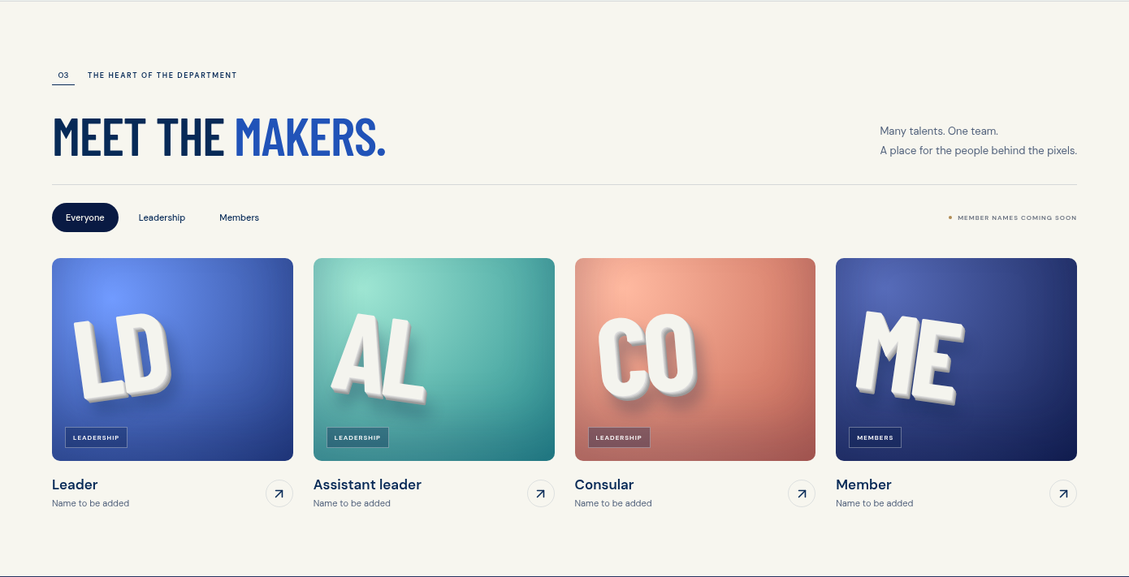
HSIYC / MEDIA & PUBLICITY DEPARTMENT
04 / PEOPLE
THE PEOPLE BEHIND THE PIXELS
A CLEAR PLACE FOR EVERY ROLE.
Leader
Direction and coordination
Assistant leader
Follow-up and team support
Consular
Guidance and feedback
Members
Ideas and creative contributions
Member names are placeholders; responsibilities are proposed.
PEOPLE. STORIES. POSSIBILITIES.
05 / 10
Notes:
The directory reflects the hierarchy supplied by the department: Leader, Assistant leader, Consular, and Members. The actual website includes filters for Everyone, Leadership, and Members, plus profile dialogs. Names still need to be supplied. Role descriptions are suggestions and should be approved by the department.

Slide 6
HSIYC / MEDIA & PUBLICITY DEPARTMENT
05 / OUR PLAN
FROM FIRST CONNECTION TO SHARED WORK
A PLAN THAT IS EASY TO FOLLOW.
Four proposed phases turn the department’s direction into practical steps.
01
02
03
04
CONNECT
EXPLORE
CREATE
CONTRIBUTE
Find our people.
Make room for ideas.
Bring stories to life.
Share. Reflect. Grow.
Welcome the team, collect
interests, and agree on a
shared direction.
Try formats, learn
together, and develop
small creative briefs.
Produce selected work
and review it for clarity,
care, and consistency.
Share approved work,
collect feedback, and plan
the next chapter.
Shared direction
Creative briefs
Reviewed work
Lessons + next steps
PEOPLE. STORIES. POSSIBILITIES.
06 / 10
Notes:
The plan is a proposed sequence, not a dated schedule or a record of completed work. Each phase can be opened on the website to see its tasks and intended output. The final phase is labeled Contribute in the website, with the title Share. Reflect. Grow.

Slide 7

HSIYC / MEDIA & PUBLICITY DEPARTMENT
06 / OUR VISION
THE PROPOSED VISION
A CAMPUS WHERE
EVERY VOICE
BELONGS.
Belonging
Make space for different cultures and perspectives.
Curiosity
Learn together, ask questions, and try new ideas.
Care
Tell thoughtful stories and credit their contributors.
PEOPLE. STORIES. POSSIBILITIES.
07 / 10
Notes:
This is the proposed vision written for the site, awaiting department confirmation. It is expressed through three values: Every voice belongs; Curiosity makes us creative; Create with care. The paired mascots and shared globe visually reinforce connection and belonging.

Slide 8
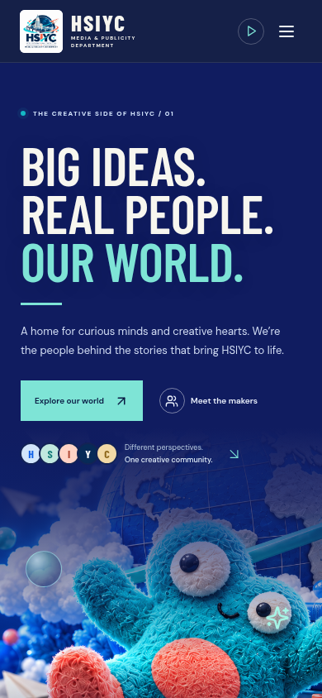
HSIYC / MEDIA & PUBLICITY DEPARTMENT
07 / THE EXPERIENCE
EXPRESSIVE, WITHOUT FEELING BUSY
MORE LIFE. LESS CLUTTER.
01
Gentle movement
Slow image motion, floating details, and scroll reveals give the
page a lively feel.
02
The visitor stays in control
Header and footer controls pause animations. Reduced-motion
preferences are respected.
03
Simple on every screen
Fewer activity cards, clearer headings, and responsive layouts
keep browsing comfortable.
PEOPLE. STORIES. POSSIBILITIES.
08 / 10
Notes:
The site uses CSS motion around still images rather than interactive 3D models. Scene animation pauses when artwork is outside the viewport. A shared motion preference controls both header and footer buttons and persists locally. The mobile screenshot is an actual capture of the site. Responsive layout, filters, dialogs, focus behavior, imagery, and reduced-motion behavior have been tested.

Slide 9
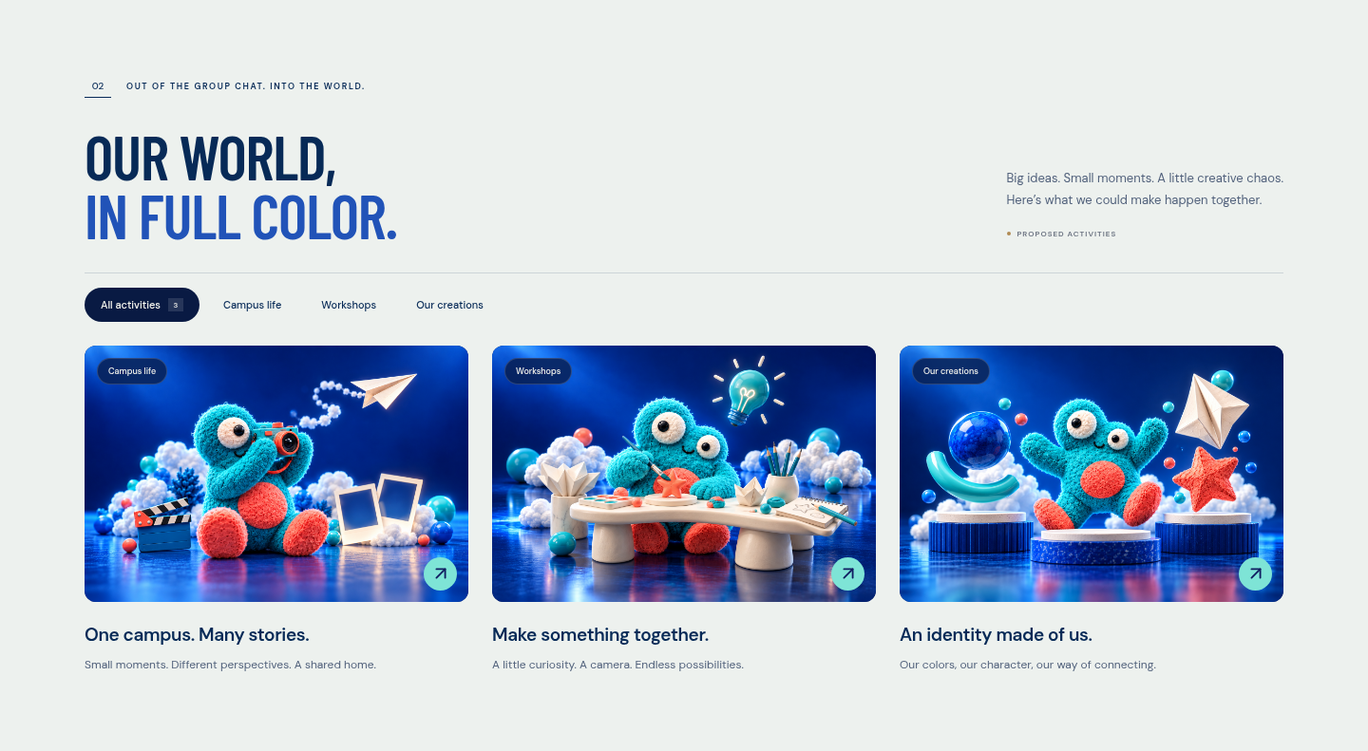
HSIYC / MEDIA & PUBLICITY DEPARTMENT
08 / A QUICK WALKTHROUGH
A SHORT PATH FROM CURIOSITY TO PARTICIPATION
DISCOVER. EXPLORE. TAKE PART.
01
Browse and filter
Choose a category or a team group.
02
Open the details
Read activity, profile, and plan
dialogs.
03
Find your place
Create and download a personal
introduction.
Introductions download locally; they are not
submitted.
PEOPLE. STORIES. POSSIBILITIES.
09 / 10
Notes:
Demonstrate a category filter, open an activity dialog, and show Find your place. The join form currently validates and downloads a draft introduction as a text file. There is no backend or connected submission service, so it does not send an application to the department. This limitation is also stated on the website.

Slide 10
HSIYC / MEDIA & PUBLICITY DEPARTMENT
09 / THE NEXT CHAPTER
THE WEBSITE IS LIVE
A SHARED SPACE.
READY TO GROW.
The design is in place.
The next step is making the content your own.
01 Add confirmed member names and profiles.
02 Approve activities, the plan, and the vision.
03 Connect an official joining/contact channel.
OPEN THE LIVE WEBSITE →
sami124-coder.github.io/Media-department-/
PEOPLE. STORIES. POSSIBILITIES.
10 / 10
Notes:
Close by opening the live site using the clickable link. The core design and interactions are published. Before treating it as the official department directory and activity plan, replace placeholder names, approve proposed content, and connect an official contact or application route. Website source: https://github.com/sami124-coder/Media-department-. Imagery: supplied HSIYC visual identity and matching generated website scenes. The department logo is an image-tool reproduction of the user-supplied reference, not the original source file. Screenshots captured from the current project.

