Slide 1
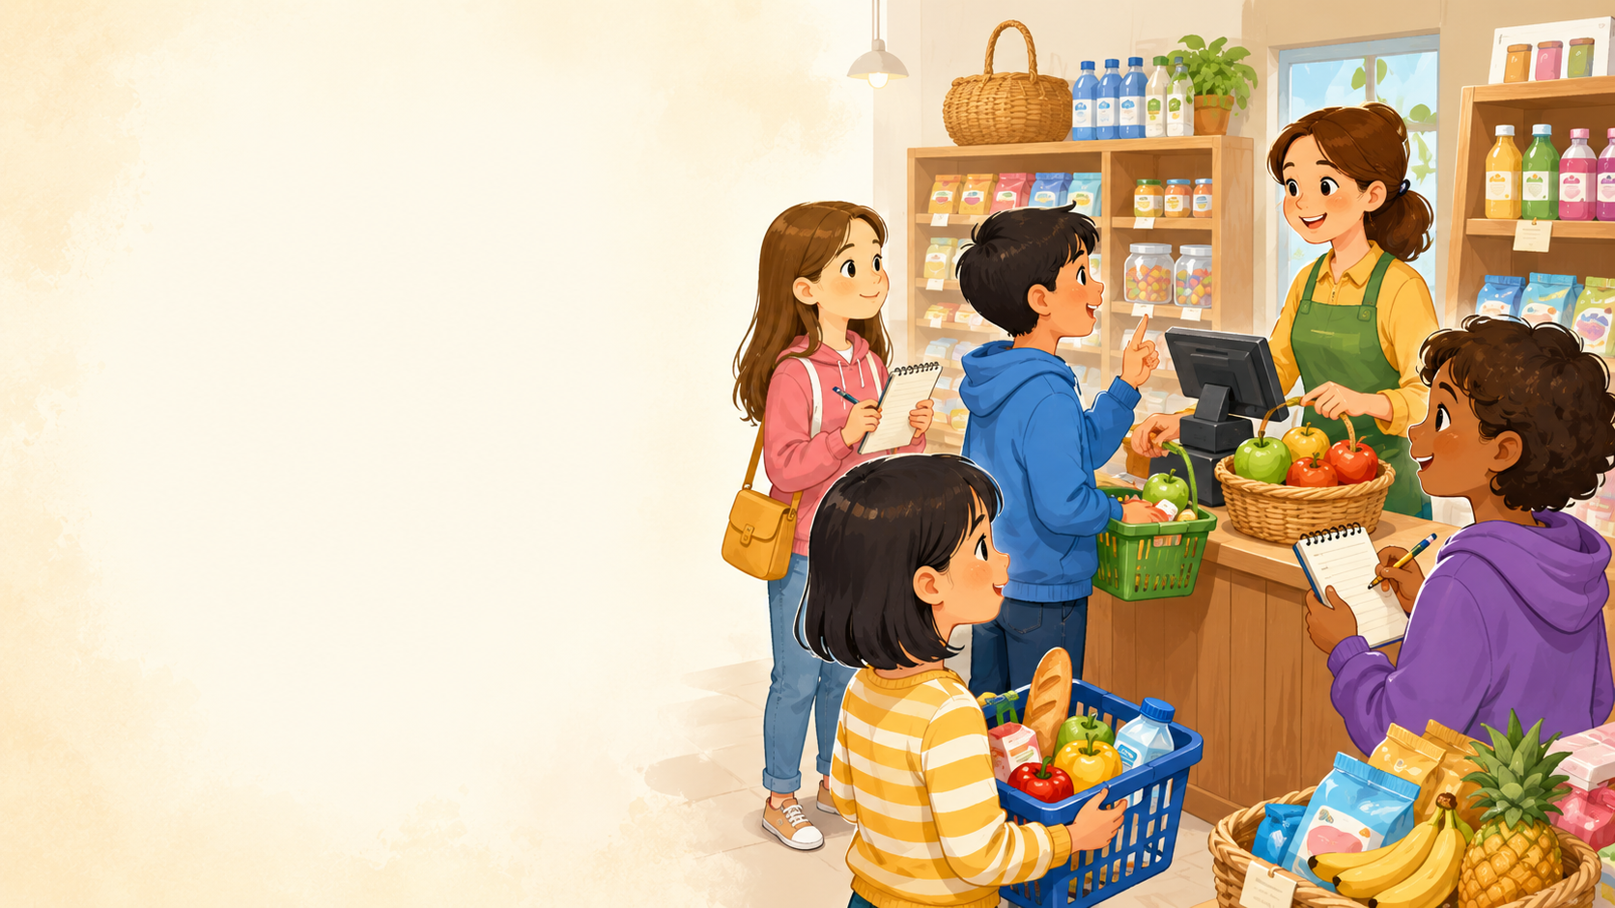
DAY 9 · 90 MINUTES
Shopping
Ask for prices and buy things politely.
⏰
I can say…
➡️
I can ask…
“I’d like a pencil, please.”
“How much is it?”
Shopping · Day 9 · Speaking & Listening
01
Notes:
Welcome students. Say: Today we will talk about daily routines. We will use simple action words, time words, and order words like first, then, after that, and finally.

Slide 2
Today’s Mission
Students learn to ask for items, prices, and quantities in a shop.
By the end of class, I can shop politely and ask for the price.
👂
Listen
🗣️
Speak
🤝
Connect
I can hear shopping words and prices in a short conversation.
I can say: I’d like a notebook, please. How much is it?
I can ask a friend: What do you want to buy?
Class promise: Use English first. Listen carefully. Say please and thank you.
Shopping · Day 9 · Speaking & Listening
02
Notes:
Ask students to repeat the mission. Use gestures: clock for time, walking fingers for routine, and two hands moving forward for order.

Slide 3
90-Minute Class Map
Use this slide to tell students what will happen today.
0–10
10–25
25–40
40–55
55–75
75–90
Quick Shop Talk
Listen & Point
Price Words
Shopping Dialogue
Speak & Survey
Show & Reflect
☀️
👂
⏰
📖
📝
⭐
warm-up items
hear items
one dollar / two yuan
find items + prices
ask friends + total
mini shop talk + exit
Teacher tip: Students should say “please” and “How much is it?” many times today.
Shopping · Day 9 · Speaking & Listening
03
Notes:
Keep this slide quick. Say: We will listen, practice routine words, ask many friends, and finish with a small presentation.

Slide 4
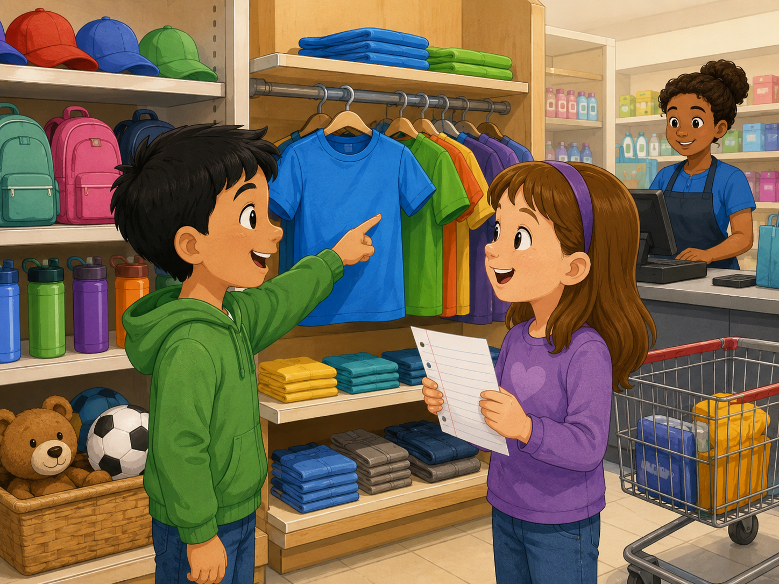
Quick Shopping Warm-up
Start speaking in the first 5 minutes.
Teacher: I’d like a pencil. What do you want to buy?
Student: I’d like _____.
Teacher: How much is it?
Student: It’s _____.
☀️
Shop
🏫
Items
New picture prompt: shopping at a store
cashier · basket
pencil · juice
Action: ask 2 classmates and remember one item.
Shopping · Day 9 · Speaking & Listening
04
Notes:
Use the picture. Model with one student. Students stand and ask two friends. Accept one action first, then push for a time.

Slide 5
Teacher Wants to Know You
Ask slowly. Students can answer with one word or a full sentence.
🛒
What do you want to buy?
🛍️
Where do you shop?
🍎
What food do you like to buy?
I want to buy _____.
I shop at the _____.
I like to buy _____.
👕
What color do you want?
💵
How much is it?
🎁
Who is it for?
I want a _____ one.
It is _____.
It is for _____.
Teacher note: Write one “class shopping” sentence on the board.
Shopping · Day 9 · Speaking & Listening
05
Notes:
Ask 2 or 3 students as a model, then students ask partners. Collect the class routines on the board.

Slide 6
How Is Your Shopping?
Students choose a feeling before saying a shopping sentence.
😊
easy
😴
hungry
⚡
busy
😎
cool
😌
expensive
Buying pencils is easy.
I want a snack.
The shop is busy.
This T-shirt is cool.
That toy is expensive.
Speak with your partner: “I’d like _____. It is _____.”
Shopping · Day 9 · Speaking & Listening
06
Notes:
Students point to a feeling first. Then they say one sentence. Encourage honest but positive answers.

Slide 7
10 Useful Shopping Words
Use gestures and quick repetition.
⏰
shop
🧥
basket
🪥
cashier
🍳
money
🏫
price
place to buy things
carry items
person who takes money
pay for things
how much it costs
🍱
buy
📚
sell
⚽
clothes
🚿
snacks
🌙
receipt
get with money
give for money
things to wear
small food
paper after paying
Mini-drill: Teacher says the word → students do the gesture.
Shopping · Day 9 · Speaking & Listening
07
Notes:
Teach each routine word with an action. Wake up = stretch, brush teeth = brushing gesture, eat breakfast = spoon gesture, go to school = walk fingers.

Slide 8
Listen & Move
When you hear the sentence, do the action.
⏰
I take a basket.
🪥
I choose a pencil.
🍳
I ask the price.
carry gesture
point gesture
question gesture
🏫
I pay money.
📚
I get a receipt.
🌙
I say thank you.
pay gesture
paper gesture
wave gesture
Challenge: Can your team do all six actions without speaking your first language?
Shopping · Day 9 · Speaking & Listening
08
Notes:
Teacher reads sentences in random order. Students do the action. Round 2 is faster. Round 3: a student leads.

Slide 9
Shopping Phrases
These phrases help students speak politely.
☀️
Excuse me,
⏰
I’d like _____.
➡️
How much is it?
start politely
ask for an item
ask the price
🏫
It is _____.
🌆
Here you are.
🌙
Thank you.
say the price
give money or item
finish politely
Repeat with rhythm: EXCUSE ME. I’D LIKE A PEN. HOW MUCH IS IT?
Shopping · Day 9 · Speaking & Listening
09
Notes:
Use call and response. Teach stress: I WAKE UP at SEVEN. THEN I eat BREAKFAST.

Slide 10
Build the Sentence
Students practice one useful pattern.
I’d like + item + please.
🧩
Item
🧩
Item
🧩
Item
pencil
notebook
juice
🧩
Item
🧩
Item
🧩
Item
sandwich
T-shirt
toy
⏰
Price
⏰
Price
⏰
Price
one dollar
two dollars
five dollars
⏰
Price
⏰
Price
⏰
Price
ten yuan
six yuan
eight yuan
Partner practice: Choose 3 items and 3 prices.
Shopping · Day 9 · Speaking & Listening
10
Notes:
Students point to an action and a time to build the sentence. Stronger students add: First, then, after that, finally.

Slide 11
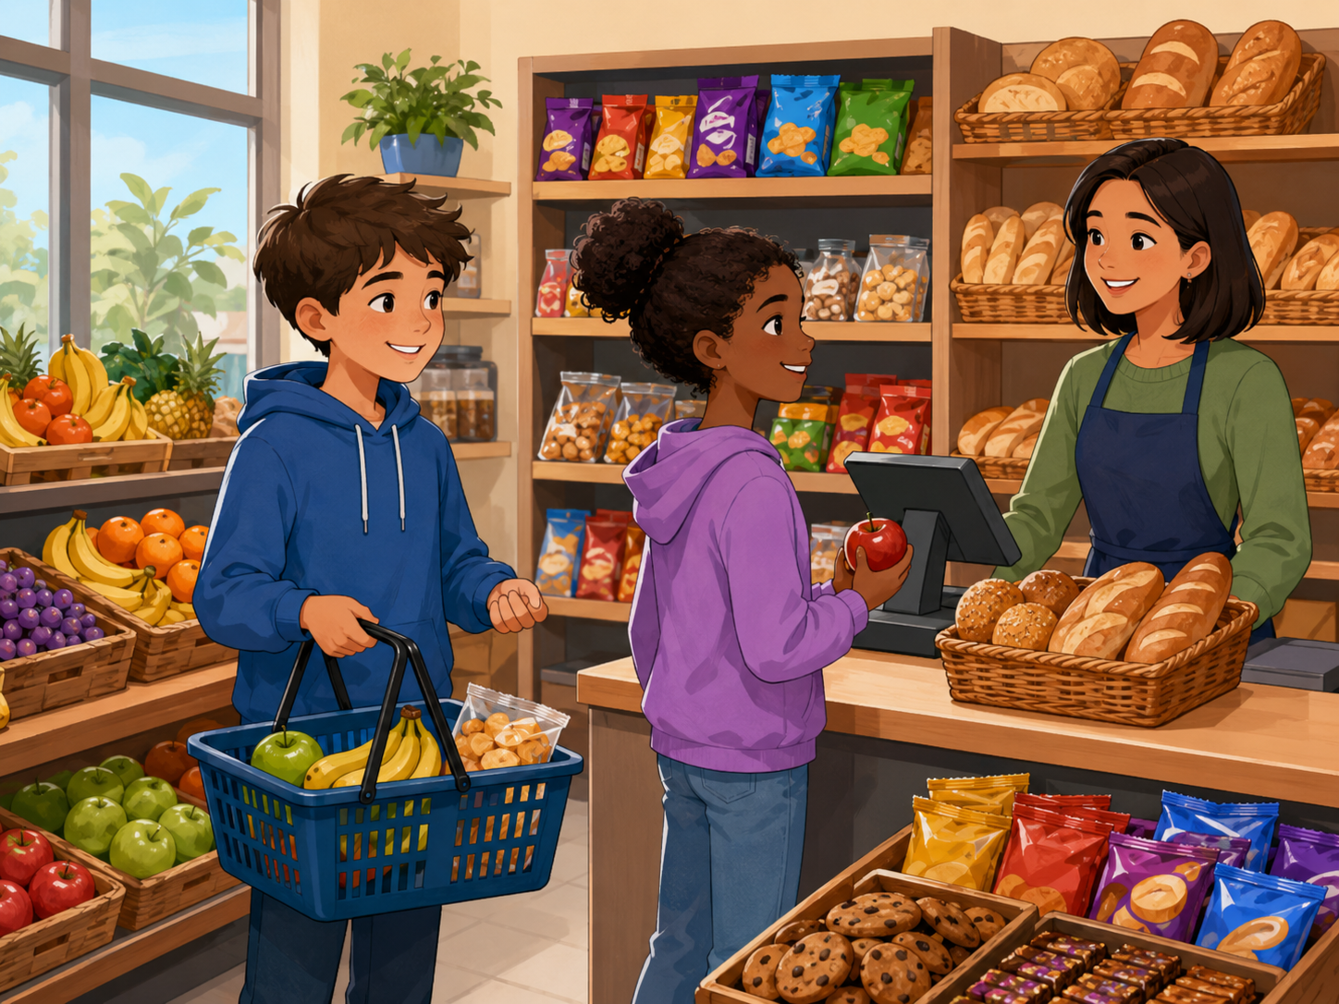
Listening 1: Alex Goes Shopping
Teacher reads. Students listen for items and prices.
Listen. Put your hand up when you hear:
⏰
I’d like a pencil, please.
🪥
How much is it?
🍳
It is one dollar.
🏫
Here you are. Thank you.
New picture prompt: shopping cards
Script is in speaker notes for the teacher.
Shopping · Day 9 · Speaking & Listening
11
Notes:
Listening script 1. Read twice. First time: students only listen. Second time: students raise their hand when they hear the key phrases. Mia: Alex, what do you do in the morning? Alex: I wake up at seven. Mia: What do you do next? Alex: I brush my teeth. Then I eat breakfast at seven thirty. Mia: What time do you go to school? Alex: I go to school at eight. Mia: Great. You have a busy morning!

Slide 12
Listening Check
Students answer with fingers: 1, 2, or 3.
👂
What does Alex buy?
🪥
What does Alex ask?
1 pencil
2 pizza
3 football
1 What time?
2 How much?
3 Where are you?
🍳
How much is the pencil?
🏫
What does Alex say at the end?
1 one dollar
2 five dollars
3 ten dollars
1 goodbye
2 thank you
3 good night
Fast correction: Say the full answer together.
Shopping · Day 9 · Speaking & Listening
12
Notes:
Students answer with fingers. Then say full answers: Alex wakes up at seven. He eats breakfast at seven thirty. He goes to school at eight.

Slide 13
Speaking Game: Shopping Chain
Students build a longer answer together.
1
2
3
4
Pick a card.
Say the item.
Partner asks price.
Give the price.
pencil / snack / toy
I’d like a pencil.
How much?
It is two dollars.
Use English only. Use gestures if you forget a word!
Shopping · Day 9 · Speaking & Listening
13
Notes:
Give each pair routine cards. Student A says an action. Student B asks what time. Student A gives a time. Then switch roles.

Slide 14
Dialogue Model
Students practice a short, safe conversation.
A: Hello. Can I help you?
B: I’d like a notebook, please.
A: How much is it?
B: It is three dollars.
A: Here you are.
B: Thank you.
Practice 3 times: slow voice → normal voice → acting voice.
Shopping · Day 9 · Speaking & Listening
14
Notes:
Model with one confident student. Then students repeat line by line. Finally pairs act it with different feelings: sleepy, happy, busy, surprised.

Slide 15
Choose a Role-play
Students make shopping useful in real conversations.
🏠
Problem 1 · School supplies
🏫
Problem 2 · Snack shop
Buy a pencil, notebook, or ruler.
Ask for juice, fruit, or a sandwich.
📚
Problem 3 · Clothes shop
🌙
Problem 4 · Toy shop
Talk about color, size, and price.
Buy a gift and say thank you.
Performance rule: everyone speaks at least one line with a price.
Shopping · Day 9 · Speaking & Listening
15
Notes:
Assign each pair one role-play. Give 3 minutes to prepare and 5-7 minutes for quick performances. Praise order words and clear time.

Slide 16
Shopping Corners
Students move, choose, and explain.
☀️
Supplies
🏫
Food
I’d like a pencil, please.
I’d like juice, please.
🌆
Clothes
🌙
Toys
I’d like a blue T-shirt.
I’d like a small toy.
Rule: Move to a corner → tell one friend your sentence → change corner.
Shopping · Day 9 · Speaking & Listening
16
Notes:
Put four picture cards in the classroom corners. Students move to a corner and tell one friend one routine sentence.

Slide 17
Mingle Survey: Ask 4 Friends
Students ask, answer, and remember prices.
Name
Item wanted
Price
Shop
Total
Ask: “What do you want to buy?” → “How much?” → Write one price.
Shopping · Day 9 · Speaking & Listening
17
Notes:
Students ask four friends and record short answers. For low-level students, allow drawing in the table. Strong students write full routine sentences.

Slide 18
Listening 2: The Busy Shop Club
Students listen for names, items, and prices.
Name
Item 1
Price
Item 2
Lily
Ben
Sara
Share answers with your partner before teacher feedback.
Shopping · Day 9 · Speaking & Listening
18
Notes:
Listening script 2. Read twice. First listen: students only listen. Second listen: students fill the table. Ben: Hi, Lily. What time do you wake up? Lily: I wake up at six thirty. Then I eat breakfast at seven. Ben: I wake up at seven. After school, I play football at four. Sara: I do homework at five. Then I read at eight. Answers: Lily - wake up/six thirty, breakfast/seven. Ben - wake up/seven, play football/four. Sara - homework/five, read/eight.

Slide 19

What Do They Buy?
Look at the picture. Choose an item and make a sentence.
⏰
He buys a pencil for one dollar.
🍳
She buys juice for two dollars.
🏫
He asks: How much is it?
📚
She says thank you at the cashier.
New picture prompt: students shopping
Pair talk: “I think he / she buys…”
Shopping · Day 9 · Speaking & Listening
19
Notes:
Use the picture as a speaking prompt. Students choose one child and make a sentence. Encourage them to point and use at with time.

Slide 20
Team Challenge: Shopping Race
A fast review game before the final speaking task.
🎭
Round 1
👂
Round 2
💬
Round 3
Teacher shows a card. Team says: I’d like _____.
Teacher says a price. Team guesses the item.
One student asks: How much? Another answers.
Scoring: 1 point for clear English · 1 point for price · 1 point for teamwork
Shopping · Day 9 · Speaking & Listening
20
Notes:
Make 2-4 teams. Keep it light and positive. Do not overcorrect. Award bonus points for students who help shy classmates speak.

Slide 21
Mini Presentation: My Shopping List
Students speak for 20–30 seconds.
Hello. My name is ____.
👀
Look up
I want to buy _____.
🗣️
Speak clearly
It is _____.
Then I want _____.
⏰
Say prices
The total is _____.
➡️
Use please
Thank you.
😊
Smile
Shopping · Day 9 · Speaking & Listening
21
Notes:
This is the final speaking task. Let students present in pairs or small groups if whole-class speaking is stressful.

Slide 22
Our Speaking Class Rules
Create a safe classroom when role-playing shopping.
🌱
Use English first.
🤝
Help your partner.
Even one word + please is okay.
Point, gesture, or whisper a word.
👂
Listen for prices.
⭐
Mistakes help us learn.
Hear “one dollar” and “How much?”
Try again with a smile.
Class chant: “Please. Price. Pay. Smile.”
Shopping · Day 9 · Speaking & Listening
22
Notes:
Have students repeat the class chant. Ask students to show thumbs up if they agree.

Slide 23
Speaking Passport: Day 9 Stamp
Self-check at the end.
Today I can…
⏰
say an item
❓
ask a friend
I’d like a pencil.
How much is it?
➡️
use polite words
✅
say the price
please and thank you
It is two dollars.
Circle one: 🙂 I can do it 😐 I need practice 🙁 I need help
Shopping · Day 9 · Speaking & Listening
23
Notes:
Students self-assess. Ask students to choose one sentence they can say today.

Slide 24
Exit Ticket
A quick closing shopping task.
💬
Say one item
⏰
Add one price
➡️
Add polite words
“I’d like a pencil.”
“It is two dollars.”
“Please and thank you.”
Teacher says goodbye using each student’s name when possible.
Shopping · Day 9 · Speaking & Listening
24
Notes:
Students must say one routine before leaving. Keep it positive and fast.

Slide 25
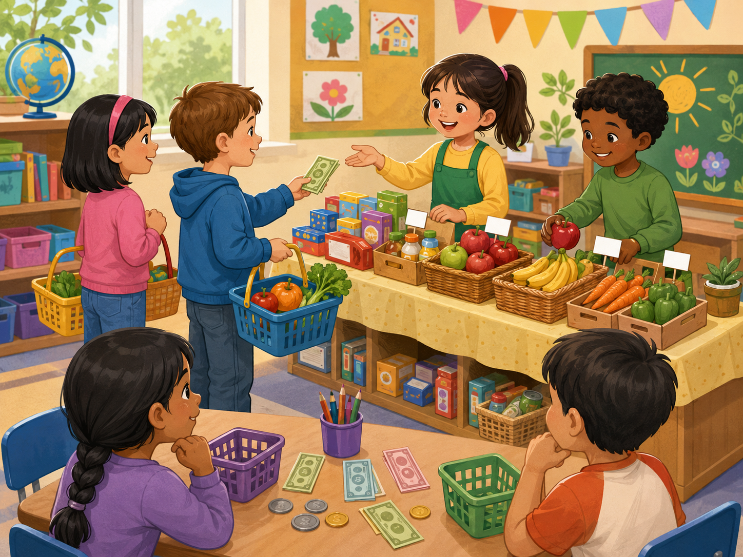
Teacher Quick Assessment
Use this to understand your students after class 9.
Student name
Can ask for item
Can say price
Can role-play
Support needed
New image: shopping speaking activity
After class, group students by confidence, price words, and dialogue control.
Shopping · Day 9 · Speaking & Listening
25
Notes:
Use this as a teacher-only slide. Identify who can answer with a time, who can order routine sentences, and who needs more listening support.

Slide 26
Printable Cards: Shop Items
Print this slide and cut into cards.
⏰
I want a pencil.
🛏️
I want a notebook.
🧥
I want an eraser.
🪥
I want a ruler.
Ask: How much?
Ask: How much?
Ask: How much?
Ask: How much?
🍳
I want juice.
🎒
I want a sandwich.
🏫
I want a T-shirt.
👋
I want a toy.
Ask: How much?
Ask: How much?
Ask: How much?
Ask: How much?
Teacher idea: Give one card to each student. They must add “please.”
Shopping · Day 9 · Speaking & Listening
26
Notes:
Print and cut. Use for pair role-plays, memory games, and classroom routines.

Slide 27
Printable Cards: Prices & Money
Students pick a card and finish the sentence.
🍱
It is one dollar.
⚽
It is two dollars.
📚
It is five dollars.
🍽️
It is ten yuan.
pay ____
pay ____
pay ____
pay ____
🚿
It is six yuan.
📖
It is eight yuan.
🧸
It is cheap.
🌙
It is expensive.
pay ____
pay ____
say why
say why
Extension: Students create one new price card.
Shopping · Day 9 · Speaking & Listening
27
Notes:
Print and cut. Students match a routine card with a time card to make a full sentence.

Slide 28
Printable Cards: Questions
Use for interviews, mingle, or small-group speaking.
⏰
Can I help you?
🍳
What would you like?
🏫
How much is it?
📚
Do you want a bag?
Answer with Yes, please
Answer with I’d like ____
Answer with It is ____
Answer with yes / no
⚽
What color do you want?
🍽️
What size do you want?
🌙
Where is the cashier?
➡️
What do you want to buy?
Answer with I want ____
Answer with small / big
Answer with over there
Answer with I want ____
Extension: Students create one new question card.
Shopping · Day 9 · Speaking & Listening
28
Notes:
Print and cut. Give each pair four cards. Students ask and answer, then swap cards with another pair.

Slide 29
Home Practice
Ask someone at home 3 questions.
Use English with family or a friend.
☀️
Question 1
🌆
Question 2
🌙
Question 3
What do you want to buy?
How much is it?
Do you like shopping?
Bring one answer to next class.
Shopping · Day 9 · Speaking & Listening
29
Notes:
This is optional homework. Students ask a family member or friend three questions and bring one answer. Keep homework oral, not writing-heavy.

