Slide 1
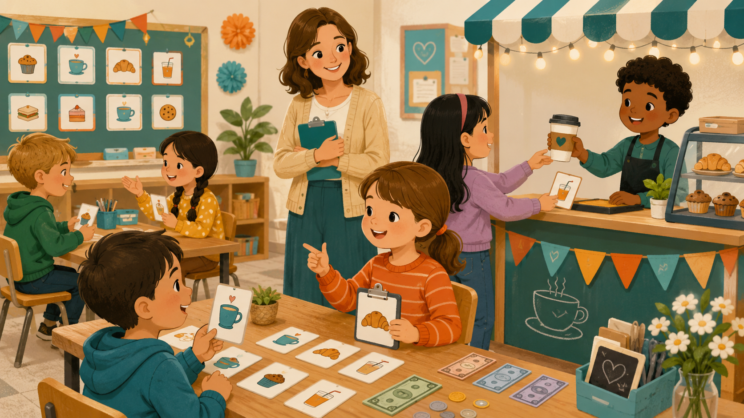
DAY 6 · 90 MINUTES
Café Role-play
Order food and drink politely.
☕
I can order…
💬
I can ask…
“I’d like a juice, please.”
“How much is it?”
Café Role-play · Day 6 · Speaking & Listening
01
Notes:
Welcome students. Say: Today we are in a café. We will order food and drinks politely, ask prices, and use role-play conversations.

Slide 2
Today’s Mission
Students learn to order food and drink politely.
By the end of class, I can order in a café and answer as a server.
👂
Listen
🗣️
Speak
🤝
Connect
I can hear café words, prices, and polite requests.
I can say: I’d like a sandwich, please.
I can ask a friend: What would you like?
Class promise: Use “please” and “thank you.” Speak clearly. Help your partner remember the words.
Café Role-play · Day 6 · Speaking & Listening
02
Notes:
Ask students to repeat the mission. Gesture: cup for drink, eating for food, money for price, and smile for polite language.

Slide 3
90-Minute Class Map
Use this slide to tell students what will happen today.
☕
Café Warm-up
👂
Listen & Point
📋
Menu Words
💵
Price Practice
🎭
Role-play Café
⭐
Show & Reflect
0–10
quick ordering
10–25
hear café words
25–40
food + drink
40–55
how much is it?
55–75
customer + server
75–90
mini performance
Teacher tip: Students should say “I’d like…” and “please” many times today.
Café Role-play · Day 6 · Speaking & Listening
03
Notes:
Keep this slide quick. Say: We will listen, practice menu words, ask prices, role-play, and finish with a small café performance.

Slide 4
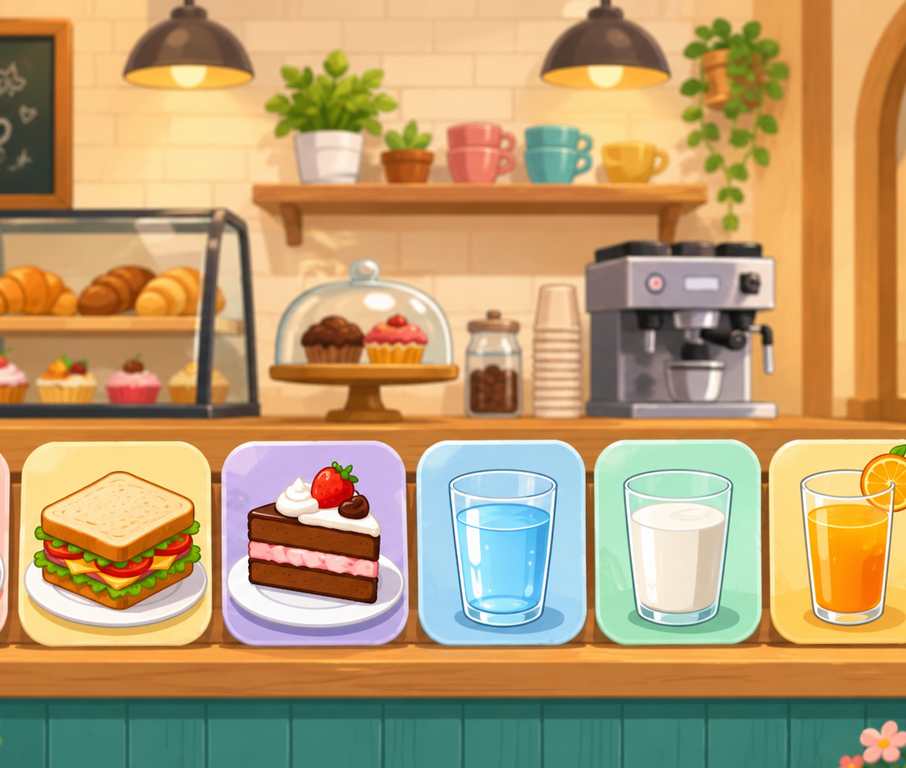
Quick Café Warm-up
Start speaking in the first 5 minutes.
Teacher: Welcome! What would you like?
Student: I’d like a _____.
Teacher: Anything else?
Student: A _____, please.
☕
Drink
🥪
Food
juice · water · tea
sandwich · cake · pizza
Action: Ask 2 classmates and remember one order.
Café Role-play · Day 6 · Speaking & Listening
04
Notes:
Use the picture. Model with one student. Students stand and ask two friends. Accept one item first, then push for please.

Slide 5
Teacher Wants to Know You
Ask slowly. Students can answer with one word or a full sentence.
☕
What drink do you like?
🥪
What food do you like?
I like _____.
I like _____.
🍰
Do you like cake?
💵
Can you ask the price?
Yes, I do. / No, I don’t.
How much is it?
🙏
Can you be polite?
🎭
Can you act as a server?
_____, please. Thank you.
What would you like?
Teacher note: Write one “class café order” on the board.
Café Role-play · Day 6 · Speaking & Listening
05
Notes:
Ask 2 or 3 students as a model, then students ask partners. Collect favorite foods and drinks on the board.

Slide 6
How Do You Feel in a Café?
Students choose a feeling before ordering.
😊
happy
😋
hungry
🥤
thirsty
😳
shy
🤩
excited
I am happy in a café.
I am hungry. I’d like food.
I am thirsty. I’d like a drink.
I can speak slowly.
Role-play is fun!
Speak with your partner: “I am _____. I’d like _____, please.”
Café Role-play · Day 6 · Speaking & Listening
06
Notes:
Students point to a feeling first. Then they order one item. Encourage shy students to use a soft but clear voice.

Slide 7
12 Useful Café Words
Use gestures and quick repetition.
☕
coffee
🥤
juice
💧
water
🥛
milk
hot drink
cold drink
simple drink
white drink
🥪
sandwich
🍕
pizza
🍰
cake
🍪
cookie
bread food
triangle food
sweet food
small sweet
🍽️
menu
💵
money
🧾
receipt
🙏
please
food list
pay for food
paper after paying
polite word
Mini-drill: Teacher says the word → students point, act, or say the word.
Café Role-play · Day 6 · Speaking & Listening
07
Notes:
Teach each café word with a gesture. Drink = sip, sandwich = two hands, money = pay, please = smile and open hand.

Slide 8
Listen & Point
When you hear the word, point to the picture or do the action.
☕
I’d like tea.
🥤
I’d like juice.
🥪
I’d like a sandwich.
sip
drink gesture
two hands
🍰
I’d like cake.
💵
How much is it?
🙏
Thank you.
eat gesture
show money
smile + nod
Challenge: Can your team do all six actions without speaking your first language?
Café Role-play · Day 6 · Speaking & Listening
08
Notes:
Teacher reads sentences in random order. Students point or do the action. Round 2 is faster. Round 3: a student leads.

Slide 9
Café Phrases
These phrases help students speak longer.
👋
Hello.
📋
What would you like?
☕
I’d like _____.
🙏
_____, please.
start politely
server asks
customer orders
be polite
💵
How much is it?
😊
Here you are.
👏
Thank you.
👋
Goodbye.
ask price
give food / money
finish politely
close the talk
Repeat with rhythm: HELLO. I’D LIKE JUICE, PLEASE. HOW MUCH IS IT?
Café Role-play · Day 6 · Speaking & Listening
09
Notes:
Use call and response. Teach stress: I’d LIKE a SANDWICH, PLEASE. HOW MUCH is it?

Slide 10
Build the Sentence
Students practice one useful pattern.
I’d like + food / drink + please.
☕
tea
🥤
juice
💧
water
🥪
a sandwich
🍕
pizza
🍰
cake
order it
order it
order it
order it
order it
order it
💵
$1
💵
$2
💵
$3
💵
$4
💵
$5
💵
$6
price
price
price
price
price
price
Partner practice: Choose 2 items and 2 prices.
Café Role-play · Day 6 · Speaking & Listening
10
Notes:
Students point to a food/drink and a price to build the sentence. Stronger students add: How much is it? It is three dollars.

Slide 11
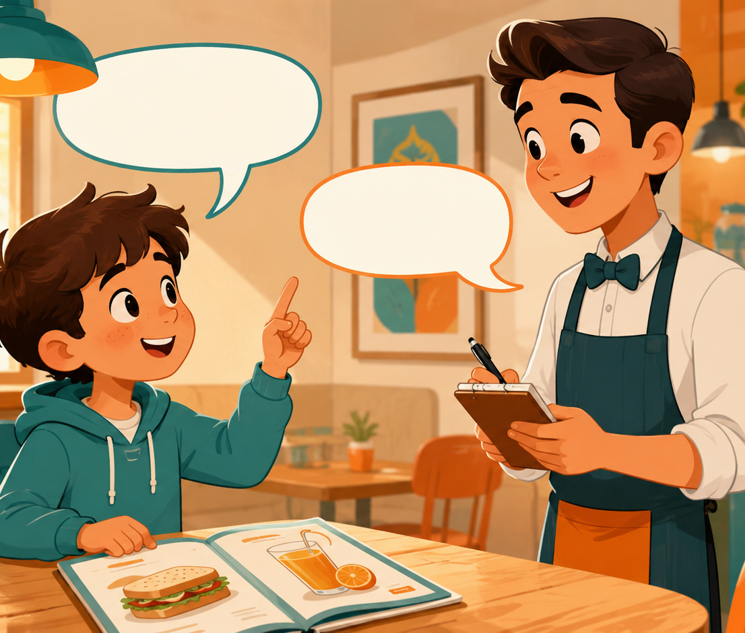
Listening 1: Maya’s Order
Teacher reads. Students listen for food, drink, and price.
☕
I’d like orange juice.
Listen and raise your hand.
🥪
A sandwich, please.
Listen and raise your hand.
💵
It is five dollars.
Listen and raise your hand.
🙏
Thank you.
Listen and raise your hand.
Script is in speaker notes for the teacher.
Café Role-play · Day 6 · Speaking & Listening
11
Notes:
Listening script 1. Read twice. First time: students only listen. Second time: students raise their hand when they hear the key phrases. Server: Hello. What would you like? Maya: I’d like orange juice, please. Server: Anything else? Maya: A sandwich, please. Server: That is five dollars. Maya: Here you are. Thank you. Server: You’re welcome.

Slide 12
Listening Check
Students answer with fingers: 1, 2, or 3.
👂
What drink does Maya order?
🥪
What food does Maya order?
1 juice
2 milk
3 water
1 pizza
2 sandwich
3 cake
💵
How much is it?
🙏
What polite words do they use?
1 five dollars
2 two dollars
3 eight dollars
1 please / thank you
2 stop
3 no
Fast correction: Say the full answer together.
Café Role-play · Day 6 · Speaking & Listening
12
Notes:
Students answer with fingers. Then say full answers: Maya orders orange juice and a sandwich. It is five dollars.

Slide 13
Speaking Game: Café Chain
Students build a longer café conversation together.
1
2
3
4
🎭
Pick a card.
🎭
Say the order.
🎭
Partner asks price.
🎭
Give the price.
juice / cake / sandwich
I’d like juice, please.
How much is it?
It is two dollars.
Use English only. Use gestures if you forget a word!
Café Role-play · Day 6 · Speaking & Listening
13
Notes:
Give each pair café cards. Student A orders an item. Student B asks price. Student A answers. Then switch roles.

Slide 14
Dialogue Model
Students practice a short, safe conversation.
A: Hello. What would you like?
B: I’d like a sandwich, please.
A: Anything to drink?
B: Orange juice, please.
A: That is five dollars.
B: Here you are. Thank you.
Practice 3 times: slow voice → normal voice → acting voice.
Café Role-play · Day 6 · Speaking & Listening
14
Notes:
Model with one confident student. Then students repeat line by line. Finally pairs act it with different feelings: hungry, thirsty, happy, shy.

Slide 15
Choose a Role-play
Students use café English in real situations.
☕
Role-play 1 · Breakfast café
🍰
Role-play 2 · Sweet snack
Order a drink and a small food.
Order cake or cookies politely.
💵
Role-play 3 · Pay the bill
😕
Role-play 4 · Problem order
Ask the price and pay.
Say: Sorry. Can I have water?
Performance rule: everyone speaks at least one polite line.
Café Role-play · Day 6 · Speaking & Listening
15
Notes:
Assign each pair one role-play. Give 3 minutes to prepare and 5-7 minutes for quick performances. Praise polite words and clear voice.

Slide 16
Café Corners
Students move, choose, and speak.
☕
Drinks
🥪
Food
🍰
Dessert
💵
Pay
I’d like juice, please.
I’d like a sandwich.
I’d like cake, please.
How much is it?
Rule: Move to a corner → tell one friend your sentence → change corner.
Café Role-play · Day 6 · Speaking & Listening
16
Notes:
Put four picture cards in the classroom corners. Students move to a corner and tell one friend one café sentence.

Slide 17
Mingle Survey: Ask 4 Friends
Students ask, answer, and remember orders.
Name
Food order
Price
Drink order
Price
Ask: “What would you like?” → “How much is it?” → Write one short answer.
Café Role-play · Day 6 · Speaking & Listening
17
Notes:
Students ask four friends and record short answers. For low-level students, allow drawing in the table. Strong students write full order sentences.

Slide 18
Listening 2: The Busy Café
Students listen for names, orders, and prices.
Name
Order 1
Price
Order 2
Lily
Ben
Sara
Share answers with your partner before teacher feedback.
Café Role-play · Day 6 · Speaking & Listening
18
Notes:
Listening script 2. Read twice. First listen: students only listen. Second listen: students fill the table. Server: Hello, Lily. What would you like? Lily: I’d like cake, please. How much is it? Server: It is three dollars. Ben: I’d like a sandwich and water, please. Server: That is four dollars. Sara: I’d like juice, please. It is two dollars? Server: Yes, two dollars. Answers: Lily - cake/three dollars. Ben - sandwich + water/four dollars. Sara - juice/two dollars.

Slide 19
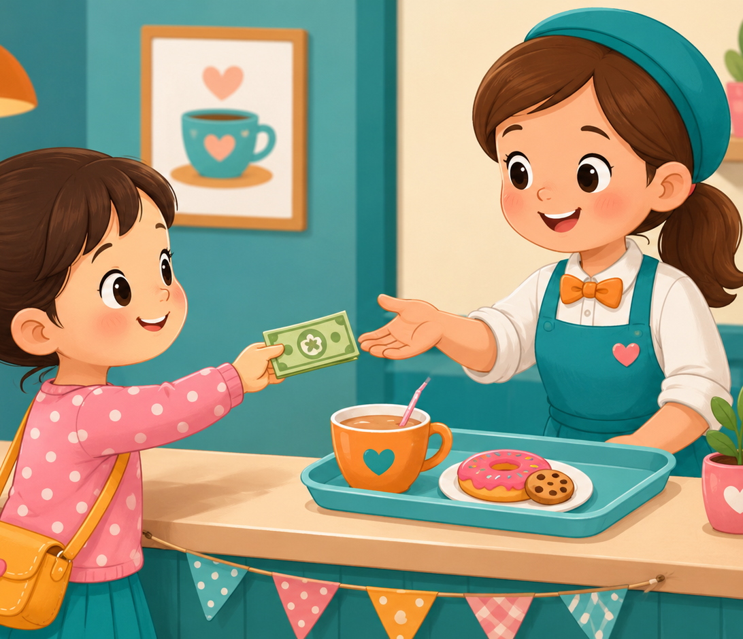
What Do They Order?
Look at the picture. Choose an item and make a sentence.
☕
She orders tea.
Pair talk: “I think she…”
🍩
She orders a donut.
Pair talk: “I think she…”
💵
She pays five dollars.
Pair talk: “I think she…”
🙏
She says thank you.
Pair talk: “I think she…”
Pair talk: “I think he / she would like…”
Café Role-play · Day 6 · Speaking & Listening
19
Notes:
Use the picture as a speaking prompt. Students choose one person and make a sentence. Encourage them to point and use would like.

Slide 20
Team Challenge: Café Race
A fast review game before the final speaking task.
🎭
Round 1
👂
Round 2
💬
Round 3
Teacher shows a card. Team says: I’d like _____.
Teacher says a price. Team asks: How much is it?
One student is server. One student is customer.
Scoring: 1 point for clear English · 1 point for polite words · 1 point for teamwork
Café Role-play · Day 6 · Speaking & Listening
20
Notes:
Make 2-4 teams. Keep it light and positive. Do not overcorrect. Award bonus points for students who help shy classmates speak.

Slide 21
Mini Presentation: My Café Order
Students speak for 20-30 seconds.
👀
Look up
Hello. My name is _____.
I am the customer.
I’d like _____, please.
I’d like _____ to drink.
How much is it?
Thank you.
🗣️
Speak clearly
🙏
Say please
💵
Ask price
😊
Smile
Café Role-play · Day 6 · Speaking & Listening
21
Notes:
This is the final speaking task. Let students present in pairs or small groups if whole-class speaking is stressful.

Slide 22
Our Speaking Class Rules
Create a safe classroom when sharing café role-plays.
🌱
Use English first.
🤝
Help your partner.
One word + please is okay.
Point, gesture, or whisper a word.
👂
Listen for the order.
⭐
Mistakes help us learn.
Hear food, drink, and price.
Try again with a smile.
Class chant: “Please. Thank you. How much? Smile.”
Café Role-play · Day 6 · Speaking & Listening
22
Notes:
Have students repeat the class chant. Ask students to show thumbs up if they agree.

Slide 23
Speaking Passport: Day 6 Stamp
Self-check at the end.
Today I can…
☕
order food or drink
❓
ask the server
I’d like juice, please.
What would you like?
💵
ask the price
✅
use polite words
How much is it?
please / thank you
Circle one: 🙂 I can do it 😐 I need practice 🙁 I need help
Café Role-play · Day 6 · Speaking & Listening
23
Notes:
Students self-assess. Ask students to choose one café sentence they can say today.

Slide 24
Exit Ticket
A quick closing café routine.
💬
Say one order
🙏
Add please
💵
Ask price
“I’d like cake.”
“I’d like cake, please.”
“How much is it?”
Teacher says goodbye using each student’s name when possible.
Café Role-play · Day 6 · Speaking & Listening
24
Notes:
Students must say one café line before leaving. Keep it positive and fast.

Slide 25
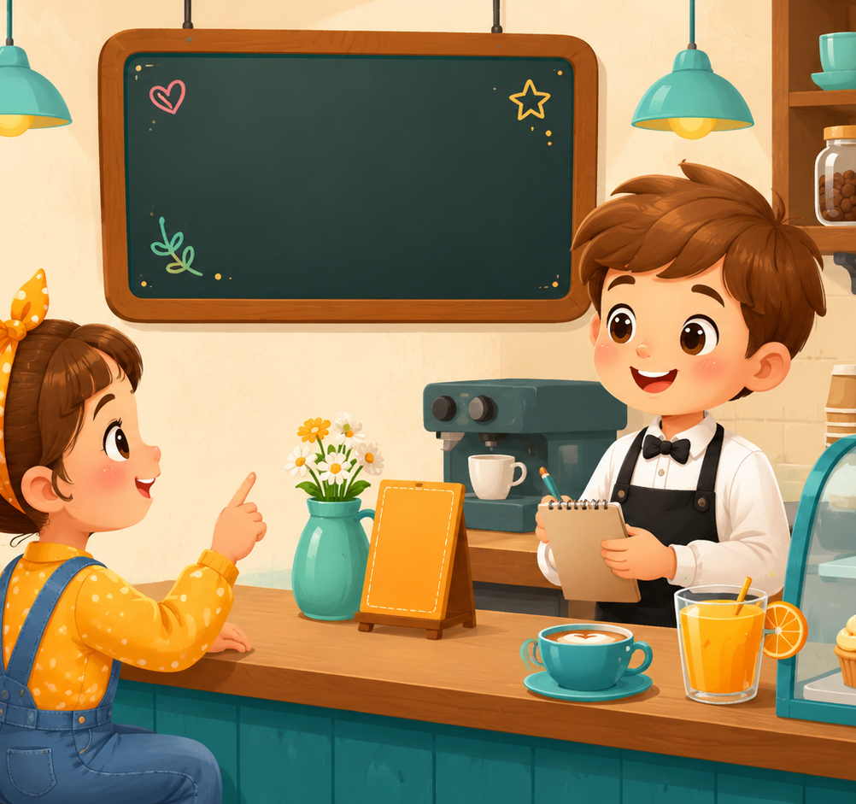
Teacher Quick Assessment
Use this to understand your students after class 6.
Student name
Can order
Can ask price
Support needed
After class, group students by confidence, polite phrases, and price control.
Café Role-play · Day 6 · Speaking & Listening
25
Notes:
Use this as a teacher-only slide. Identify who can order, who can ask price, and who needs more listening support.

Slide 26
Printable Cards: Food & Drink
Print this slide and cut into cards.
☕
tea
🥤
juice
💧
water
🥛
milk
I’d like tea.
I’d like juice.
I’d like water.
I’d like milk.
🥪
sandwich
🍕
pizza
🍰
cake
🍪
cookie
I’d like a sandwich.
I’d like pizza.
I’d like cake.
I’d like a cookie.
Teacher idea: Give one card to each student. They must add “please.”
Café Role-play · Day 6 · Speaking & Listening
26
Notes:
Print and cut. Use for pair role-plays, memory games, and café conversations.

Slide 27
Printable Cards: Server Questions
Students pick a card and ask the customer.
👋
Hello.
📋
Menu
🥤
Drink
💵
Price
What would you like?
Would you like food?
Anything to drink?
How much is it?
🧾
Bill
😊
Give item
🙏
Polite close
👋
Goodbye
That is ____ dollars.
Here you are.
Thank you.
Have a nice day!
Extension: Students create one new server question card.
Café Role-play · Day 6 · Speaking & Listening
27
Notes:
Print and cut. Students match a server card with a customer response card to make a full dialogue.

Slide 28
Printable Cards: Customer Lines
Use for interviews, mingle, or small-group speaking.
☕
I’d like _____.
🥪
Can I have _____?
🥤
Anything to drink?
💵
How much is it?
Add please.
Food request
I’d like _____.
Ask price
🧾
Here you are.
😕
Sorry?
🙏
Thank you.
⭐
It is delicious.
Give money
Ask again
Polite word
Bonus sentence
Extension: Students create one new customer line.
Café Role-play · Day 6 · Speaking & Listening
28
Notes:
Print and cut. Give each pair four cards. Students ask and answer, then swap cards with another pair.

Slide 29
Home Practice
Order politely at home or with a friend.
Use English with family or a friend.
☕
Question 1
🥪
Question 2
💵
Question 3
What would you like to drink?
What would you like to eat?
How much is it?
Bring one answer to next class.
Café Role-play · Day 6 · Speaking & Listening
29
Notes:
This is optional homework. Students ask a family member or friend three questions and bring one answer. Keep homework oral, not writing-heavy.

