Slide 1
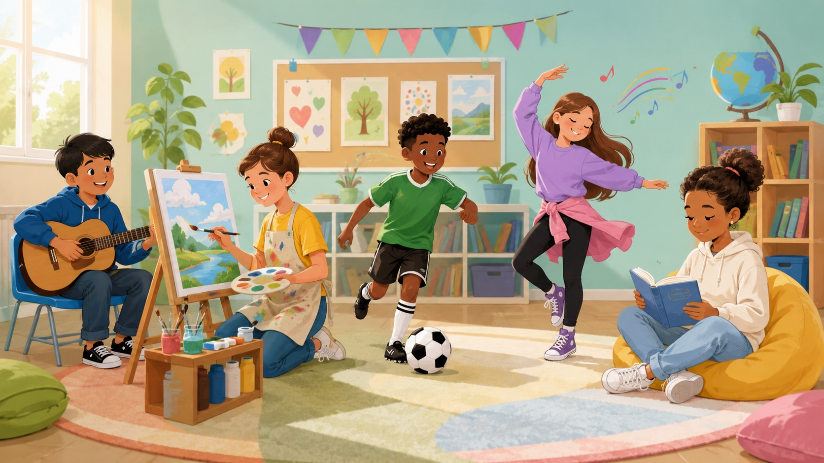
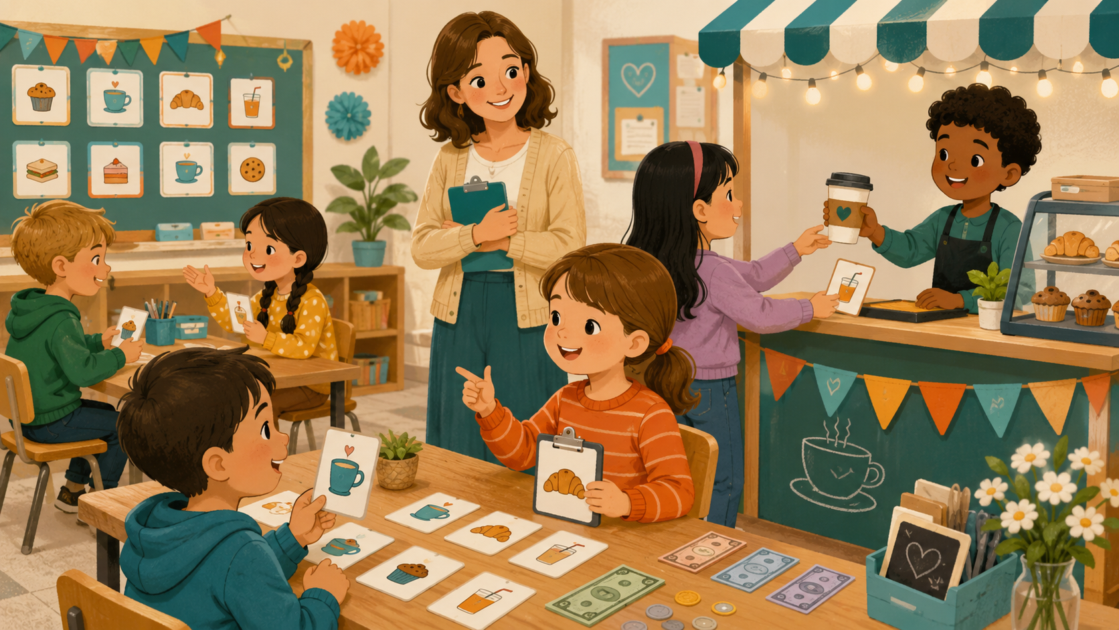
DAY 7 · 90 MINUTES
Hobbies & Abilities
Talk about hobbies and what you can do.
🎨
I can say…
💪
I can do…
“I like painting.”
“I can swim.”
Hobbies & Abilities · Day 7 · Speaking & Listening
01
Notes:
Welcome students. Say: Today we talk about hobbies and abilities. We will say what we like and what we can or can’t do yet.

Slide 2
Today’s Mission
Students learn to talk about hobbies and abilities.
By the end of class, I can say my hobbies and ask what a friend can do.
👂
Listen
🗣️
Speak
🤝
Connect
I can hear hobby words and can / can’t.
I can say: I like drawing. I can sing.
I can ask a friend: Can you dance?
Class promise: Try every sentence. Use kind words. Help your partner speak.
Hobbies & Abilities · Day 7 · Speaking & Listening
02
Notes:
Ask students to repeat the mission. Gesture: heart for like, strong arms for can, hands open for try.

Slide 3
90-Minute Class Map
Use this slide to tell students what will happen today.
☕
Hobby Warm-up
👂
Listen & Point
📋
Hobby Words
💵
Can / Can’t
🎭
Hobby Club
⭐
Show & Reflect
0–10
quick sharing
10–25
hear hobbies
25–40
12 key words
40–55
ability practice
55–75
ask + answer
75–90
mini talk
Teacher tip: Students should say “I like…” and “I can…” many times today.
Hobbies & Abilities · Day 7 · Speaking & Listening
03
Notes:
Keep this slide quick. Say: We will warm up, listen, learn hobby words, practice can/can’t, role-play, and present.

Slide 4
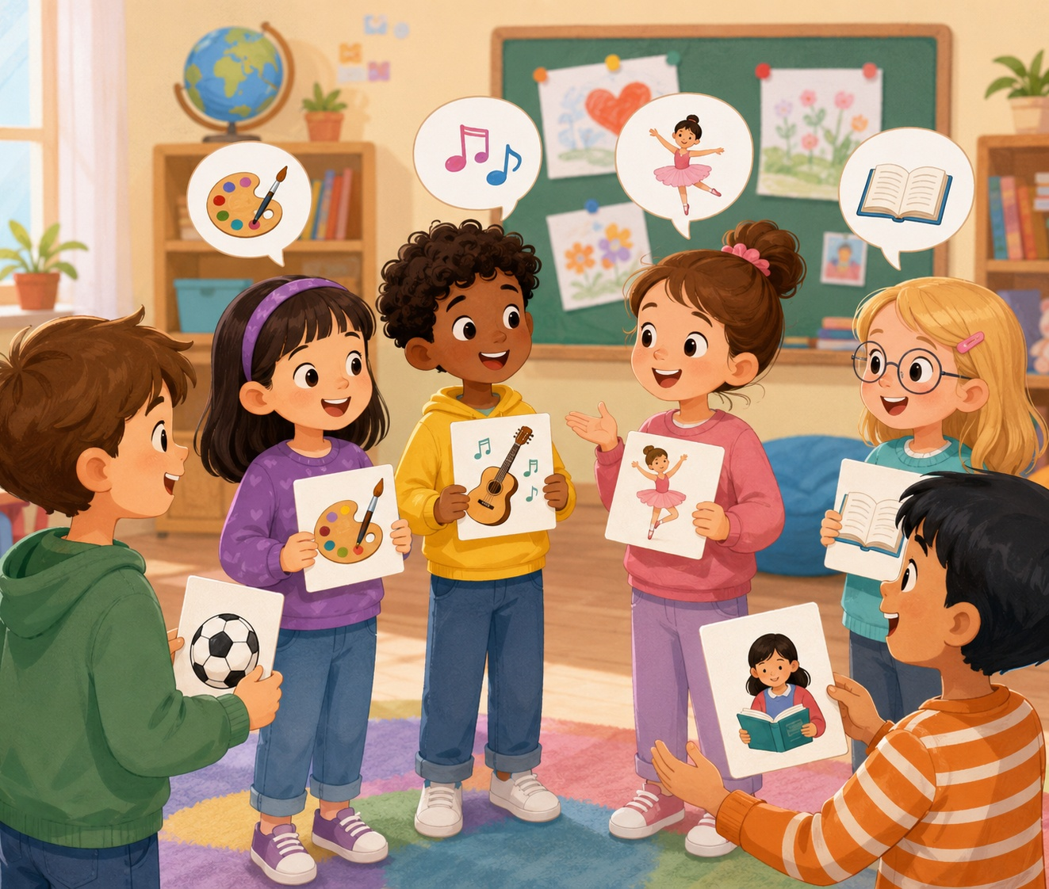
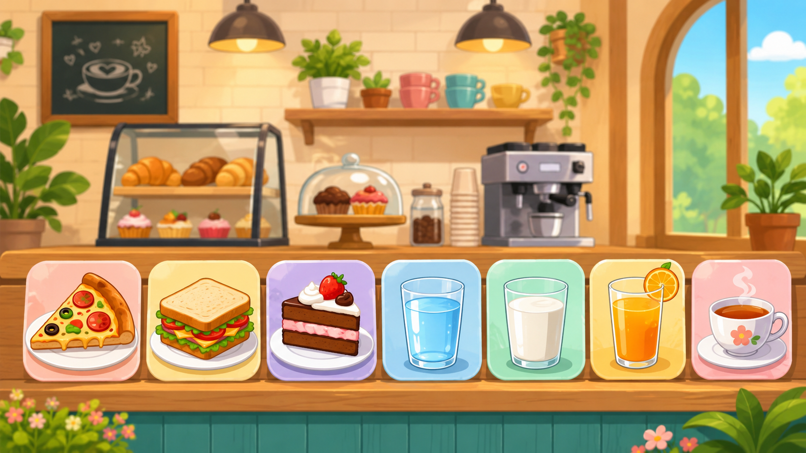
Quick Hobby Warm-up
Start speaking in the first 5 minutes.
Teacher: What do you like to do?
Student: I like _____.
Teacher: Can you _____?
Student: Yes, I can. / No, I can’t.
🎨
Creative
⚽
Active
draw · paint · sing
swim · dance · play soccer
Action: Ask 2 classmates and remember one hobby.
Hobbies & Abilities · Day 7 · Speaking & Listening
04
Notes:
Model with one student. Students stand and ask two friends. Accept one-word answers first, then push for a full sentence.

Slide 5
Teacher Wants to Know You
Ask slowly. Students can answer with one word or a full sentence.
🎨
What hobby do you like?
⚽
Do you like sports?
I like _____.
Yes, I do. / No, I don’t.
🎵
Can you sing?
🚲
Can you ride a bike?
Yes, I can. / No, I can’t.
Yes, I can.
🤝
Can you ask a friend?
⭐
Can you share proudly?
Can you _____?
I can _____.
Teacher note: Write one “class hobby list” on the board.
Hobbies & Abilities · Day 7 · Speaking & Listening
05
Notes:
Ask 2 or 3 students as a model, then students ask partners. Collect favorite hobbies on the board.

Slide 6
How Do You Feel Trying a Hobby?
Students choose a feeling before speaking.
😊
happy
💪
brave
🌟
proud
😳
shy
🤩
excited
I am happy when I draw.
I can try a new hobby.
I can do it!
I can speak slowly.
Hobbies are fun!
Speak with your partner: “I feel _____. I can _____.”
Hobbies & Abilities · Day 7 · Speaking & Listening
06
Notes:
Students point to a feeling first. Then they say one ability. Encourage shy students to speak slowly.

Slide 7
12 Useful Hobby Words
Use gestures and quick repetition.
🎨
draw
🖌️
paint
📚
read
🎤
sing
make pictures
use colors
open a book
use your voice
💃
dance
🏊
swim
⚽
play soccer
🏀
play basketball
move to music
move in water
kick a ball
bounce a ball
🎸
play guitar
🎹
play piano
🚲
ride a bike
🧑‍🍳
cook
music hobby
music skill
two wheels
make food
Mini-drill: Teacher says the word → students point, act, or say the word.
Hobbies & Abilities · Day 7 · Speaking & Listening
07
Notes:
Teach each hobby word with a gesture. Keep repetition fast and fun.

Slide 8
Listen & Point
When you hear the hobby, point to the picture or do the action.
🎨
I like drawing.
🎤
I can sing.
⚽
I play soccer.
draw gesture
sing gesture
kick gesture
💃
I can dance.
🚲
I ride a bike.
📚
I like reading.
dance move
hold handles
open book
Challenge: Can your team do all six actions without speaking your first language?
Hobbies & Abilities · Day 7 · Speaking & Listening
08
Notes:
Teacher reads sentences in random order. Students point or act. Round 2 is faster. Round 3: a student leads.

Slide 9
Hobby Phrases
These phrases help students speak longer.
👋
Hello.
❓
What do you like?
🎨
I like _____.
💪
I can _____.
start politely
ask hobby
say hobby
say ability
❓
Can you _____?
✅
Yes, I can.
❌
No, I can’t.
👏
Great job!
ask ability
positive answer
negative answer
kind words
Repeat with rhythm: I LIKE DRAWING. I CAN SWIM. CAN YOU DANCE?
Hobbies & Abilities · Day 7 · Speaking & Listening
09
Notes:
Use call and response. Teach stress: I LIKE drawing. I CAN swim. CAN you dance?

Slide 10
Build the Sentence
Students practice two useful patterns.
I like + hobby. / I can + action.
🎨
drawing
🖌️
painting
📚
reading
🎤
singing
💃
dancing
🏊
swimming
I like it.
I like it.
I like it.
I can do it.
I can do it.
I can do it.
⚽
soccer
🏀
basketball
🎸
guitar
🎹
piano
🚲
bike
🧑‍🍳
cooking
sport
sport
music
music
action
make food
Partner practice: Choose 2 hobbies and say “I like…” or “I can…”
Hobbies & Abilities · Day 7 · Speaking & Listening
10
Notes:
Students point to a hobby/action and build the sentence. Stronger students add: Can you ___?

Slide 11
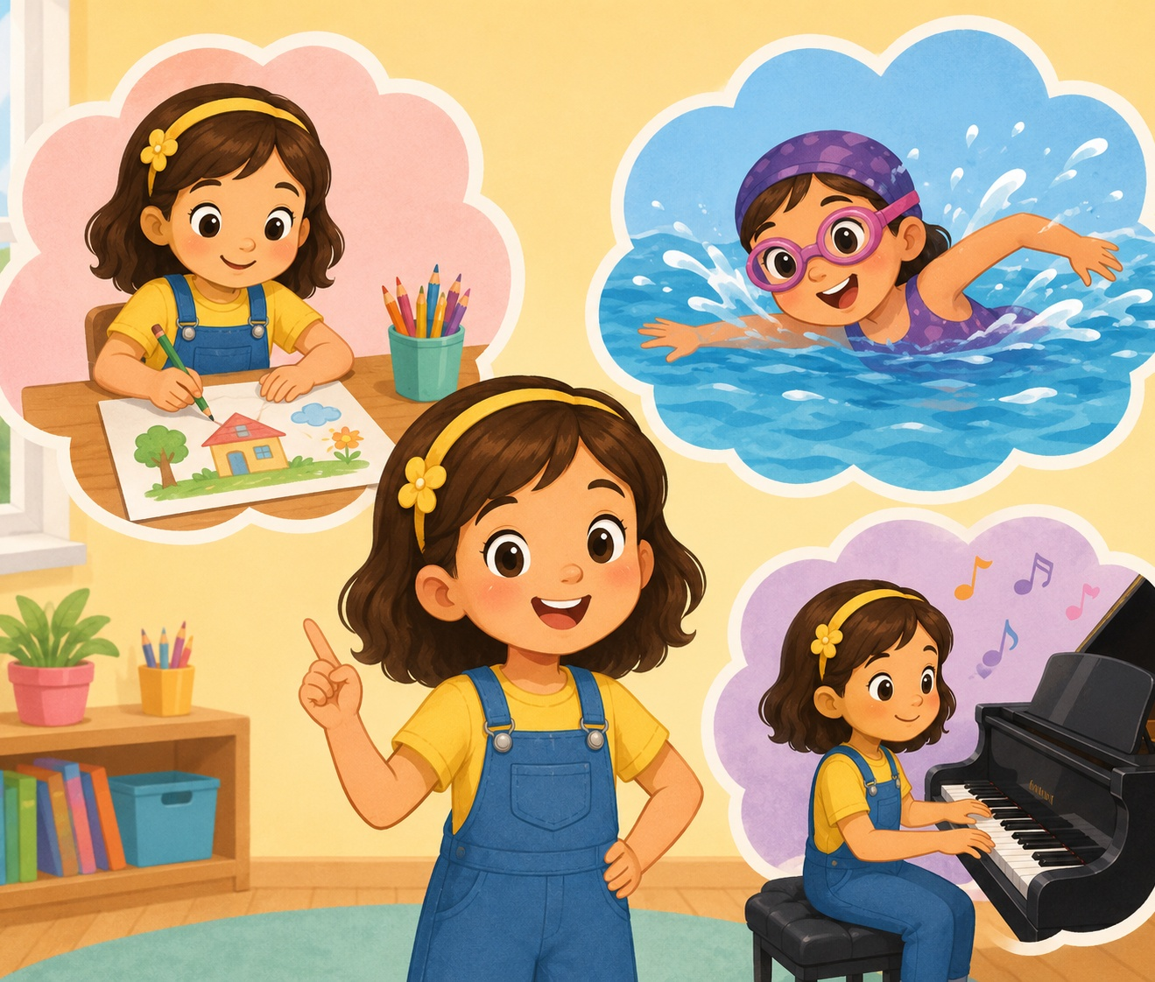
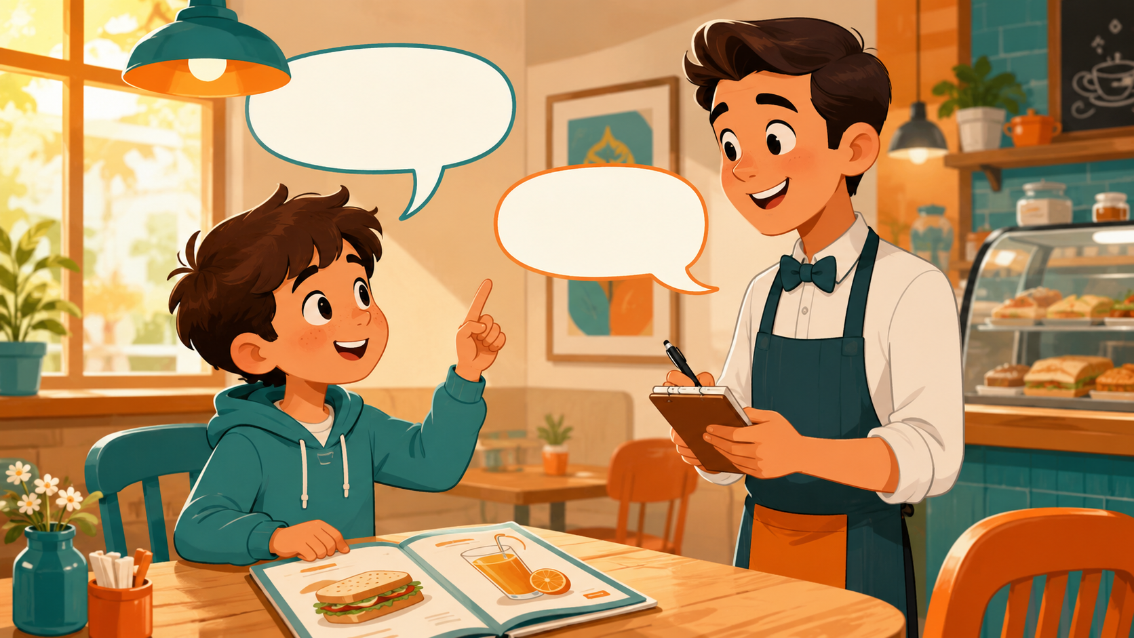
Listening 1: Maya’s Hobby
Teacher reads. Students listen for hobby, ability, and feeling.
🎨
I like painting.
Listen and raise your hand.
🎤
I can sing.
Listen and raise your hand.
❌
I can’t swim.
Listen and raise your hand.
😊
I feel happy.
Listen and raise your hand.
Script is in speaker notes for the teacher.
Hobbies & Abilities · Day 7 · Speaking & Listening
11
Notes:
Listening script 1. Read twice. Maya: Hello. I like painting. I can sing. I can’t swim yet. I feel happy when I paint. Answer: painting, sing, can’t swim, happy.

Slide 12
Listening Check
Students answer with fingers: 1, 2, or 3.
👂
What hobby does Maya like?
🥪
What can Maya do?
1 painting
2 basketball
3 cooking
1 swim
2 sing
3 ride a bike
💵
What can’t Maya do?
🙏
How does Maya feel?
1 swim
2 dance
3 read
1 happy
2 angry
3 tired
Fast correction: Say the full answer together.
Hobbies & Abilities · Day 7 · Speaking & Listening
12
Notes:
Students answer with fingers. Then say full answers together.

Slide 13
Speaking Game: Hobby Chain
Students build a longer hobby conversation together.
1
2
3
4
🎭
Pick a card.
🎭
Say your hobby.
🎭
Partner asks ability.
🎭
Give the answer.
draw / dance / soccer
I like drawing.
Can you draw?
Yes, I can. / No, I can’t.
Use English only. Use gestures if you forget a word!
Hobbies & Abilities · Day 7 · Speaking & Listening
13
Notes:
Give each pair hobby cards. Student A says a hobby. Student B asks an ability question. Then switch roles.

Slide 14
Dialogue Model
Students practice a short, safe conversation.
A: Hello. What do you like?
B: I like painting.
A: Can you paint flowers?
B: Yes, I can. Can you sing?
A: No, I can’t, but I can dance.
B: Great job!
Practice 3 times: slow voice → normal voice → acting voice.
Hobbies & Abilities · Day 7 · Speaking & Listening
14
Notes:
Model with one confident student. Then pairs repeat line by line. Finally pairs act with different feelings.

Slide 15
Choose a Role-play
Students use hobby English in real situations.
🎨
Role-play 1 · Art club
🎵
Role-play 2 · Music club
Say what you like to draw or paint.
Ask: Can you sing or play guitar?
⚽
Role-play 3 · Sports club
😕
Role-play 4 · Try again
Say one sport you can play.
Say: I can’t yet, but I can try.
Performance rule: everyone speaks at least one “I can” line.
Hobbies & Abilities · Day 7 · Speaking & Listening
15
Notes:
Assign each pair one role-play. Give 3 minutes to prepare and 5-7 minutes for quick performances.

Slide 16
Hobby Corners
Students move, choose, and speak.
🎨
Art
🎵
Music
⚽
Sports
📚
Quiet hobbies
I like drawing.
I can sing.
I can play soccer.
I like reading.
Rule: Move to a corner → tell one friend your sentence → change corner.
Hobbies & Abilities · Day 7 · Speaking & Listening
16
Notes:
Put four picture cards in the classroom corners. Students move to a corner and tell one friend one sentence.

Slide 17
Mingle Survey: Ask 4 Friends
Students ask, answer, and remember abilities.
Name
Hobby
Can do?
Question
Answer
Ask: “What do you like?” → “Can you _____?” → Write one short answer.
Hobbies & Abilities · Day 7 · Speaking & Listening
17
Notes:
Students ask four friends and record short answers. For low-level students, allow drawing in the table.

Slide 18
Listening 2: Hobby Club
Students listen for names, hobbies, and abilities.
Name
Hobby
Can do?
Can’t do
Lily
Ben
Sara
Share answers with your partner before teacher feedback.
Hobbies & Abilities · Day 7 · Speaking & Listening
18
Notes:
Listening script 2. Lily likes dance and can dance, but can’t play guitar. Ben likes soccer and can play soccer, but can’t swim. Sara likes reading and can ride a bike, but can’t cook.

Slide 19
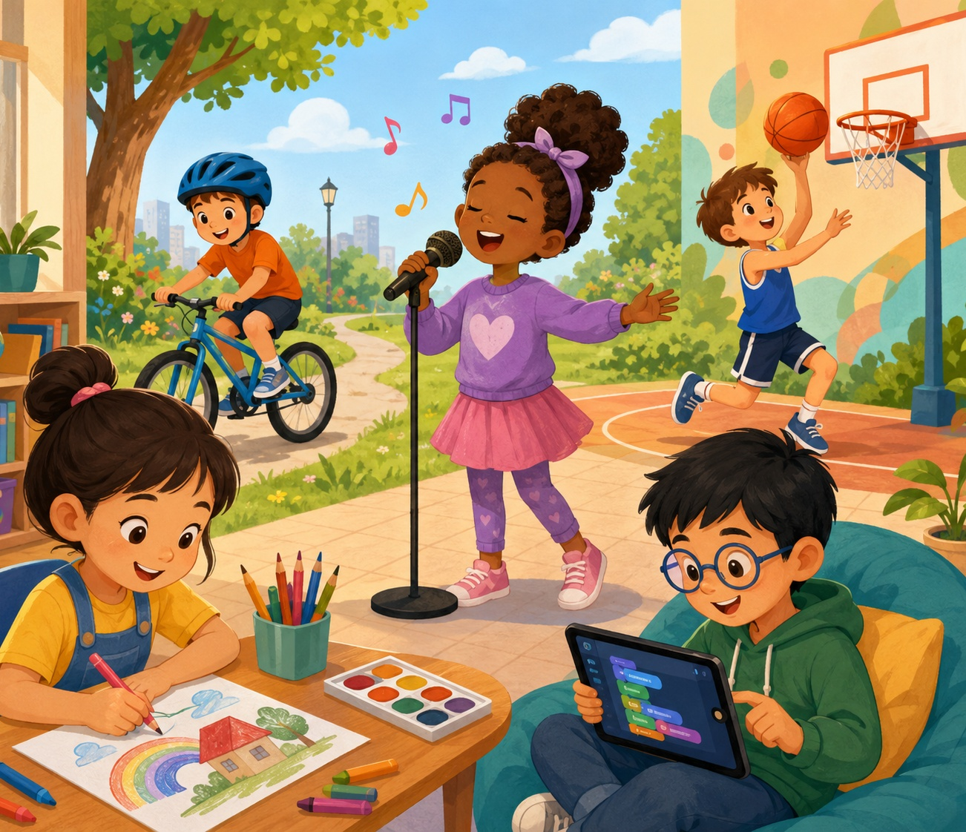
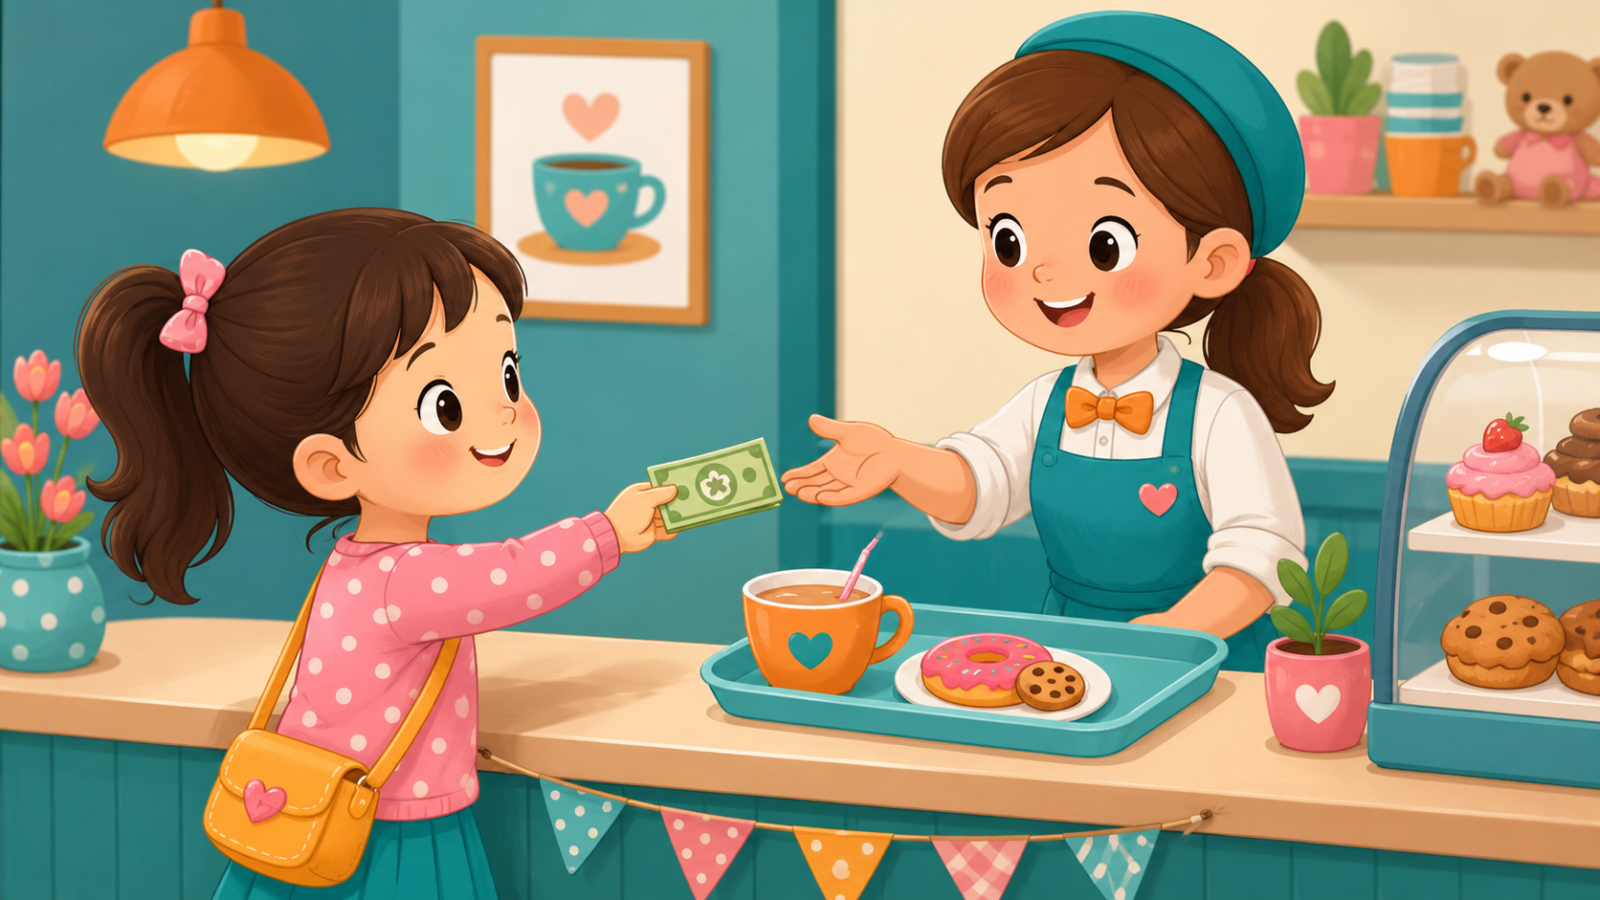
What Can They Do?
Look at the picture. Choose one child and make a sentence.
🎸
He can play guitar.
Pair talk: “I think he…”
🖌️
She likes painting.
Pair talk: “I think she…”
⚽
He can play soccer.
Pair talk: “I think he…”
📚
She likes reading.
Pair talk: “I think she…”
Pair talk: “I think he / she can…”
Hobbies & Abilities · Day 7 · Speaking & Listening
19
Notes:
Use the picture as a speaking prompt. Students choose one child and make a sentence with can or likes.

Slide 20
Team Challenge: Hobby Race
A fast review game before the final speaking task.
🎭
Round 1
👂
Round 2
💬
Round 3
Teacher shows a card. Team says: I like _____.
Teacher says an action. Team asks: Can you _____?
One student asks. One student answers.
Scoring: 1 point for clear English · 1 point for “can / can’t” · 1 point for teamwork
Hobbies & Abilities · Day 7 · Speaking & Listening
20
Notes:
Make 2-4 teams. Keep it positive. Award bonus points for helping shy classmates speak.

Slide 21
Mini Presentation: My Hobby & Ability
Students speak for 20-30 seconds.
👀
Look up
Hello. My name is _____.
I like _____.
I can _____.
I can’t _____ yet.
My favorite hobby is _____.
Thank you.
🗣️
Speak clearly
🙏
Use “can”
💵
Say one hobby
😊
Smile
Hobbies & Abilities · Day 7 · Speaking & Listening
21
Notes:
This is the final speaking task. Let students present in pairs or small groups if whole-class speaking is stressful.

Slide 22
Our Speaking Class Rules
Create a safe classroom when sharing hobbies and abilities.
🌱
Use English first.
🤝
Help your partner.
One word + action is okay.
Point, gesture, or whisper a word.
👂
Listen for can / can’t.
⭐
Mistakes help us learn.
Hear hobbies and abilities.
Try again with a smile.
Class chant: “I like it. I can try. Great job!”
Hobbies & Abilities · Day 7 · Speaking & Listening
22
Notes:
Have students repeat the class chant. Ask students to show thumbs up if they agree.

Slide 23
Speaking Passport: Day 7 Stamp
Self-check at the end.
Today I can…
☕
say my hobby
❓
ask an ability
I like painting.
Can you swim?
💵
answer with can
✅
encourage friends
Yes, I can. / No, I can’t.
Great job! Keep trying!
Circle one: 🙂 I can do it 😐 I need practice 🙁 I need help
Hobbies & Abilities · Day 7 · Speaking & Listening
23
Notes:
Students self-assess. Ask students to choose one sentence they can say today.

Slide 24
Exit Ticket
A quick closing hobby routine.
💬
Say one hobby
🙏
Say one ability
💵
Ask a friend
“I like drawing.”
“I can swim.”
“Can you dance?”
Teacher says goodbye using each student’s name when possible.
Hobbies & Abilities · Day 7 · Speaking & Listening
24
Notes:
Students must say one hobby line before leaving. Keep it positive and fast.

Slide 25
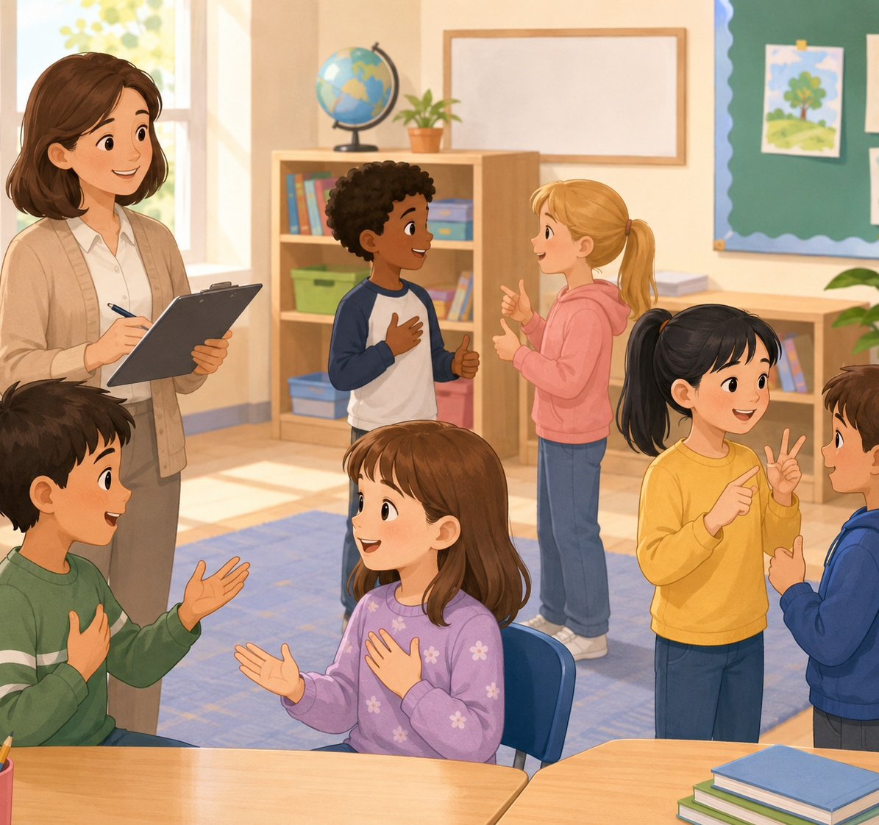
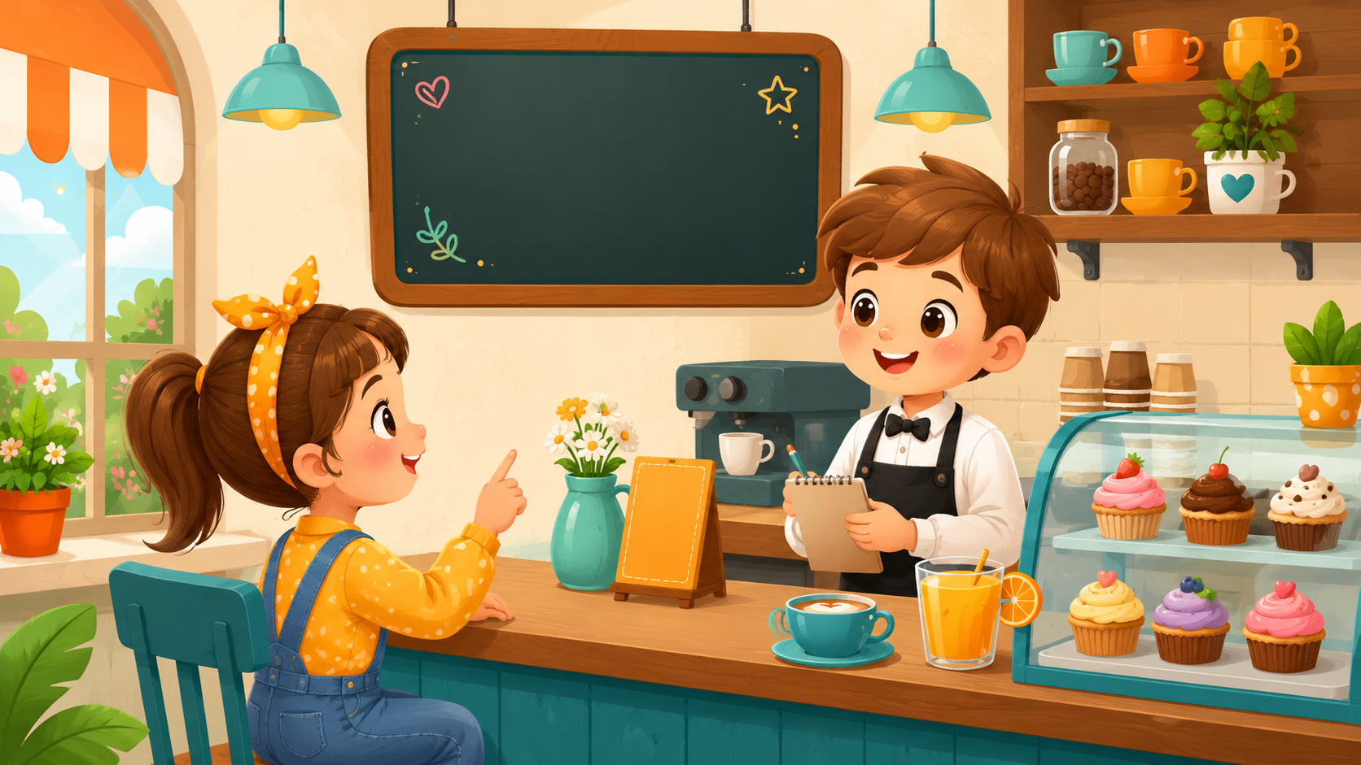
Teacher Quick Assessment
Use this to understand your students after class 7.
Student name
Can say hobby
Can use can/can’t
Support needed
After class, group students by confidence, hobby vocabulary, and can / can’t control.
Hobbies & Abilities · Day 7 · Speaking & Listening
25
Notes:
Use this teacher-only slide to identify who can use hobby words and can/can’t.

Slide 26
Printable Cards: Hobbies
Print this slide and cut into cards.
🎨
draw
🖌️
paint
📚
read
🎤
sing
I like drawing.
I like painting.
I like reading.
I can sing.
💃
dance
🏊
swim
⚽
play soccer
🚲
ride a bike
I can dance.
I can swim.
I can play soccer.
I can ride a bike.
Teacher idea: Give one card to each student. They must ask “Can you…?”
Hobbies & Abilities · Day 7 · Speaking & Listening
26
Notes:
Print and cut. Use for pair interviews, memory games, and hobby conversations.

Slide 27
Printable Cards: Ability Questions
Students pick a card and ask a friend.
👋
Hello.
📋
Art
🎵
Music
⚽
Sports
What do you like?
Can you draw?
Can you sing?
Can you play soccer?
🏊
Swimming
🚲
Bike
❓
Ask again
👏
Encourage
Can you swim?
Can you ride a bike?
Can you say it again?
Great job!
Extension: Students create one new ability question card.
Hobbies & Abilities · Day 7 · Speaking & Listening
27
Notes:
Print and cut. Students match a question card with an answer card to make a dialogue.

Slide 28
Printable Cards: Student Lines
Use for interviews, mingle, or small-group speaking.
🎨
I like _____.
💪
I can _____.
❌
I can’t _____ yet.
❓
Can you _____?
Say your hobby.
Ability sentence
Try-again sentence
Ask a friend
✅
Yes, I can.
❌
No, I can’t.
🙏
Great job!
⭐
I want to try _____.
Positive answer
Negative answer
Kind words
Bonus sentence
Extension: Students create one new student line.
Hobbies & Abilities · Day 7 · Speaking & Listening
28
Notes:
Print and cut. Give each pair four cards. Students ask and answer, then swap cards.

Slide 29
Home Practice
Practice hobbies and abilities at home or with a friend.
Use English with family or a friend.
☕
Question 1
🥪
Question 2
💵
Question 3
What hobby do you like?
Can you _____?
What can you do?
Bring one answer to next class.
Hobbies & Abilities · Day 7 · Speaking & Listening
29
Notes:
Optional homework. Students ask a family member or friend three questions and bring one answer.

