Slide 1
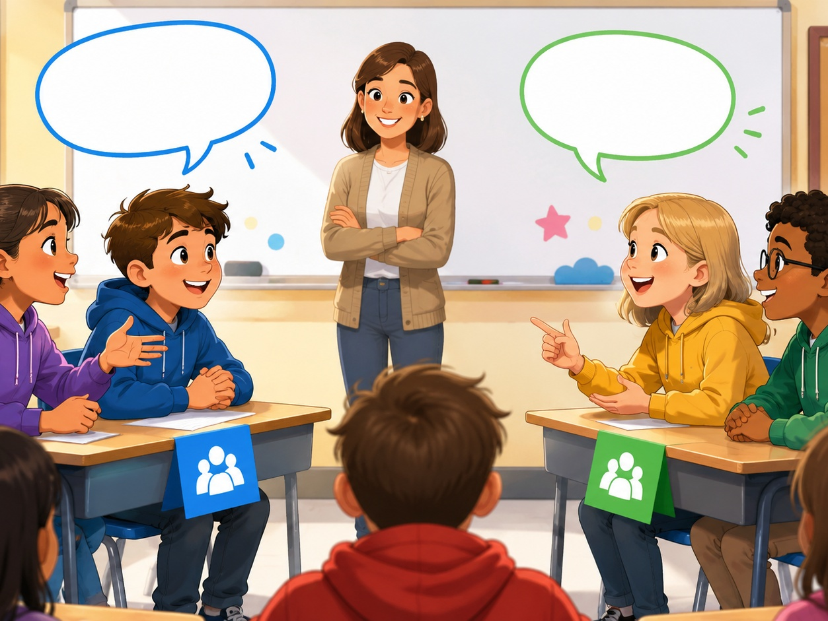
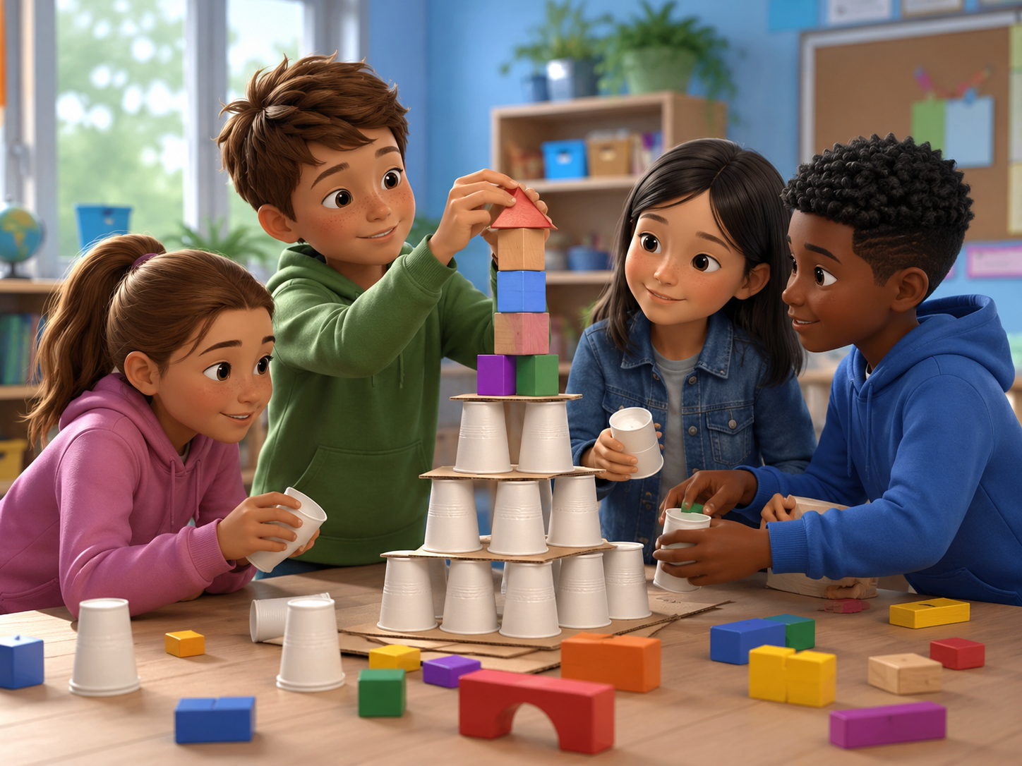
DAY 13 · 90 MINUTES
Mini Debate
Share opinions, listen kindly, and give simple reasons in English.
🗣️
I can speak...
👂
I can listen...
“I think…”
“I hear you.”
💡
I can give a reason...
🤝
I can respect...
“Because…”
“Good point!”
Mini Debate · Day 13 · Speaking & Listening
01
Notes:
Welcome students. Say: Today we will practice teamwork in English. We will ask, plan, help, and celebrate together.

Slide 2
Today’s Mission
Students learn to share opinions, give reasons, listen, and respond in a mini debate.
By the end of class, I can say my opinion and one reason in English.
💬
Opinion
💡
Reason
👂
Listen
🤝
Respect
I can say what I think.
I can say why.
I can hear my friend first.
I can disagree kindly.
Class promise: We think. We listen. We explain. We respect.
A good debate is not a fight. A good debate helps every student speak and listen.
Mini Debate · Day 13 · Speaking & Listening
02
Notes:
Ask students to repeat the mission. Use gestures: hands together for teamwork, finger to head for plan, thumbs up for encouragement.

Slide 3
90-Minute Class Map
Use this slide to tell students what will happen today.
0-10
10-25
25-40
40-60
60-75
75-90
Debate Warm-up
Debate Words
Listen & Notice
Mini Debate Prep
Debate Circles
Show & Reflect
move + choose
agree + disagree
hear opinions
choose reasons
ask + respond
mini debate + exit ticket
Teacher tip: Students should use “I think… because…” many times today.
Mini Debate · Day 13 · Speaking & Listening
03
Notes:
Keep this slide quick. Say: We will warm up, learn team words, solve a challenge, and present our team plan.

Slide 4
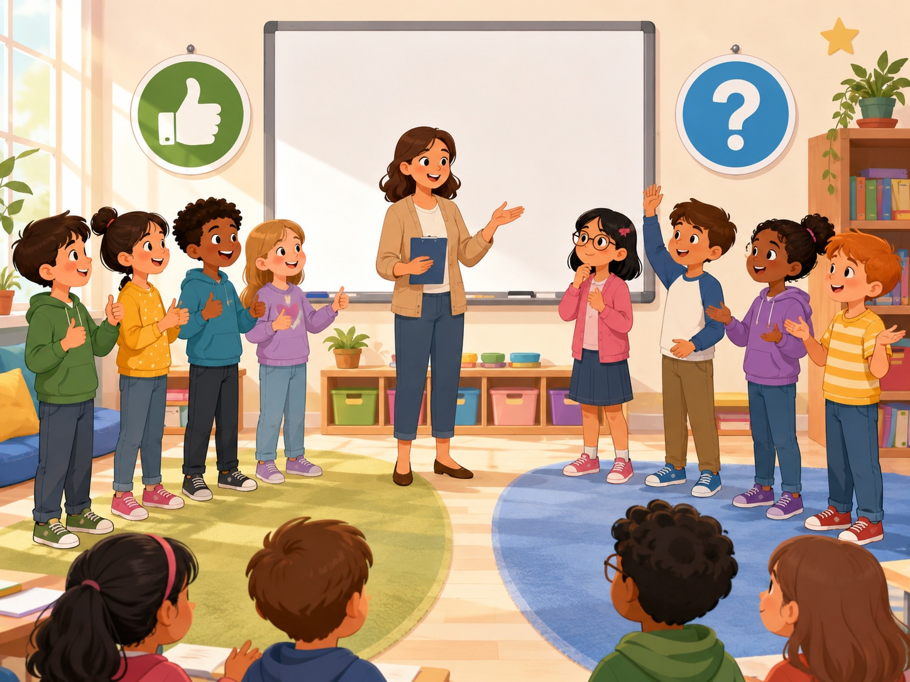
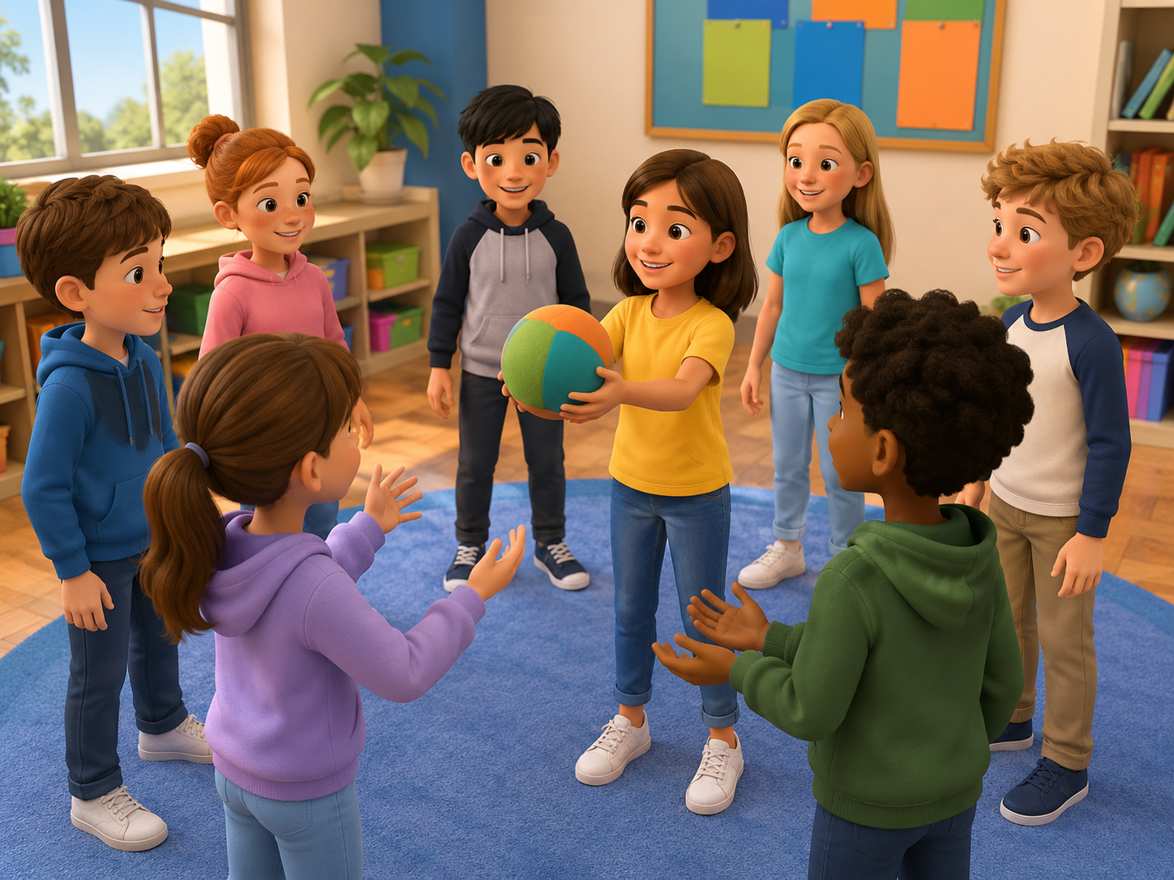
Debate Warm-up: Agree or Disagree
Start speaking in the first 5 minutes.
🧑‍🏫
Teacher
Which side do you choose?
🧒
Student
I agree / I disagree.
🎯
Action
Move to a side and say one reason.
Challenge: no wrong answers. The class wins when everyone speaks kindly.
Mini Debate · Day 13 · Speaking & Listening
04
Notes:
Use the picture. Model with one student. Students stand in a circle and pass an imaginary ball while saying one team word.

Slide 5
Teacher Wants to Know Your Opinion
Ask slowly. Students can answer with one word or a full sentence.
💬
Can you share your opinion?
💡
Do you have a reason?
I think yes.
Because it is fun.
👂
Can you listen first?
🤝
Can you disagree kindly?
Yes. I can listen.
I disagree, but I understand.
❓
Can you ask a friend?
🔁
Can you change your mind?
Why do you think that?
Maybe. I can think again.
Mini Debate · Day 13 · Speaking & Listening
05
Notes:
Ask 2 or 3 students as a model, then students ask partners. Collect team strengths on the board.

Slide 6
8 Useful Debate Words
Use faces, gestures, and quick repetition.
💬
opinion
👍
agree
👎
disagree
💡
reason
what you think
same idea
different idea
why you think it
🌟
example
🔗
because
🤔
maybe
🤝
respect
one real thing
starts a reason
not sure yet
kind words for others
Mini-drill: Teacher says the word -> students do the action.
Mini Debate · Day 13 · Speaking & Listening
06
Notes:
Teach each word with an action. Leader = point gently, listener = ear hand, builder = hands together, reporter = microphone hand.

Slide 7
8 Useful Debate Actions
Students learn simple action words for mini debates.
☑️
choose
🤔
think
📣
say
💡
explain
Pick a side.
Use quiet brain time.
Share your opinion.
Give a reason.
👂
listen
❓
ask
↩️
respond
🗳️
vote
Hear your friend.
Use why or what.
Answer a friend.
Choose after listening.
Say: “I think ____.” or “I agree because ____.”
Mini Debate · Day 13 · Speaking & Listening
07
Notes:
Focus on language, not winning. Model: We need cups. Let’s build. Can you hold this?

Slide 8
Listen & Move
When you hear the sentence, do the action.
👍
I agree.
👎
I disagree.
🤔
I think so.
thumbs up
thumbs down
point to head
🔗
Because...
❓
Can you explain?
👏
Good point!
link hands
question hands
clap three times
Challenge: Can your team do all six actions without using your first language?
Mini Debate · Day 13 · Speaking & Listening
08
Notes:
Teacher reads sentences in random order. Students do the action. Round 2 is faster. Round 3: a student leads.

Slide 9
Mini Debate Phrases
These phrases help students speak longer.
💬
I think _____.
👍
I agree because _____.
👎
I disagree because _____.
Share an opinion.
Support a friend.
Give a different idea.
❓
Can you explain?
🤔
Maybe, but _____.
🌟
Good point!
Ask for more.
Respond politely.
Respect a friend.
Repeat with rhythm: I THINK. BECAUSE. GOOD POINT.
Mini Debate · Day 13 · Speaking & Listening
09
Notes:
Use call and response. Teach stress: LET’S, IDEA, HELP, READY.

Slide 10
Build the Sentence
Students practice three useful patterns.
I think + opinion. I agree/disagree + because. Can you + question?
Opinions
Debate words
Helpful words
dogs are best pets
agree
please
pizza is best
disagree
thank you
homework helps
reason
good point
games are fun
example
my turn
books beat TV
because
your turn
uniforms are good
maybe
I understand
Partner practice: Choose 2 opinions, 2 debate words, and 2 helpful words.
Mini Debate · Day 13 · Speaking & Listening
10
Notes:
Students point to a word and build a sentence. Strong students can add because: Let’s plan because we need an idea.

Slide 11

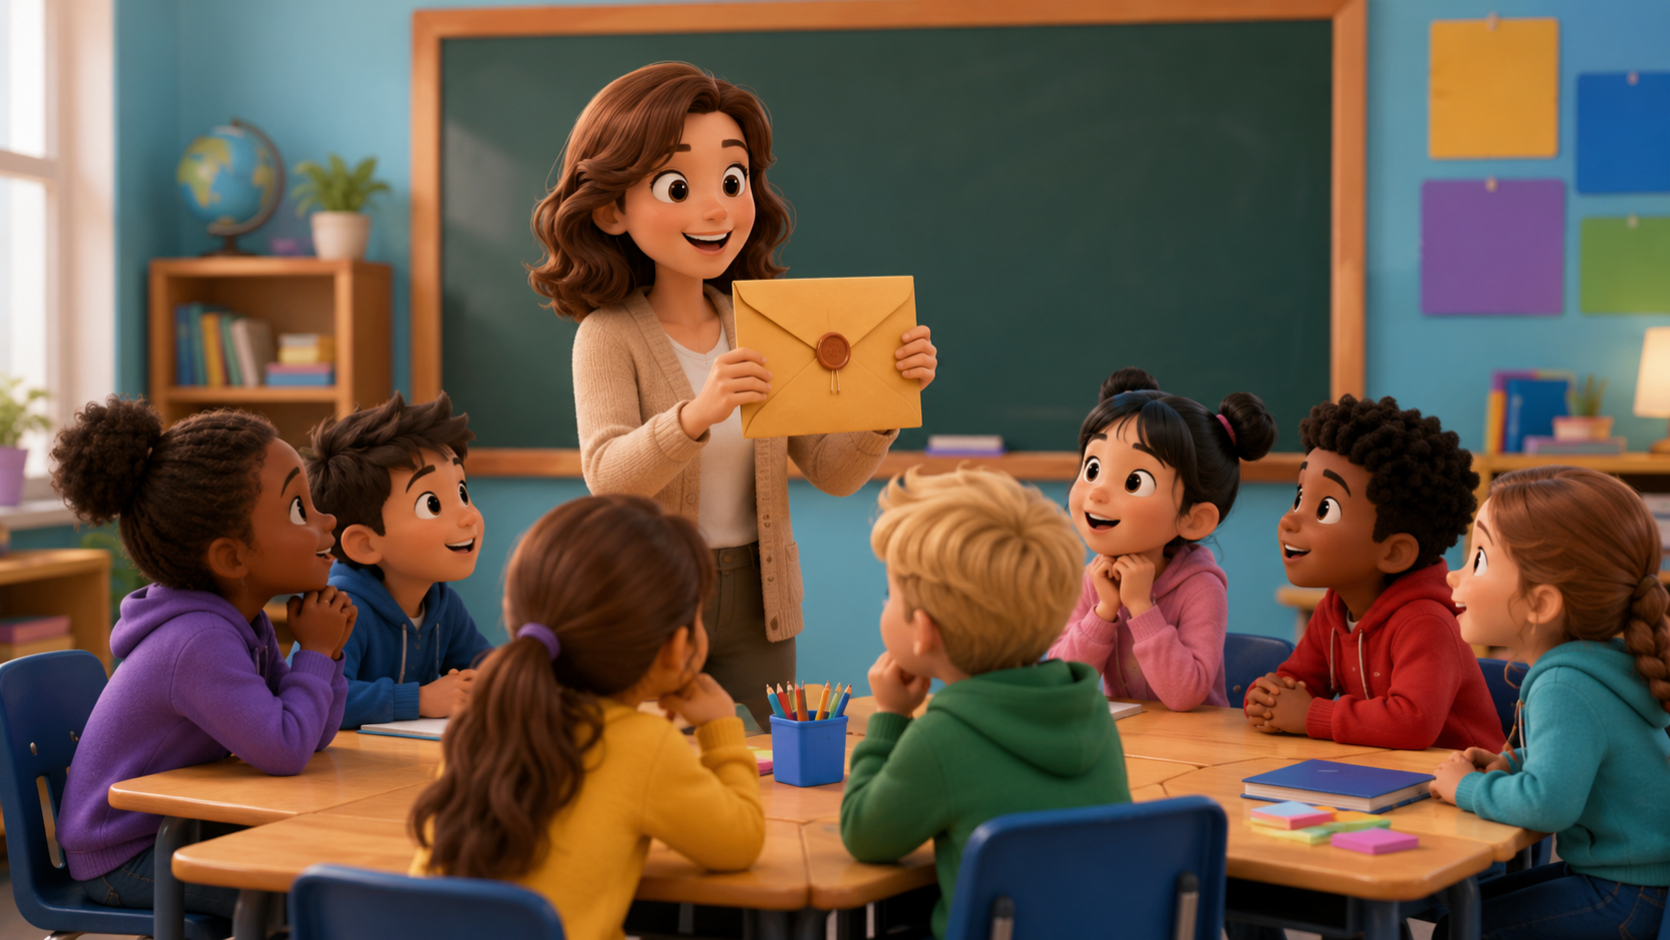
Listening 1: The Mini Debate
Teacher reads. Students listen for opinions and reasons.
❓
Here is the question.
💬
I think dogs are better pets.
👍
I agree because dogs can play.
👎
I disagree because cats are quiet.
🌟
Good point.
Script is in speaker notes for the teacher.
Mini Debate · Day 13 · Speaking & Listening
11
Notes:
Listening script 1. Read twice. First time: students only listen. Second time: students raise their hand when they hear the key phrases. Teacher: Team Blue, here is your secret mission. You must build a bridge. Alex: What should we do? Mina: I have an idea. Let’s use paper. Omar: Can you help me? Lily: Yes. We can try again. Teacher: Good teamwork!

Slide 12
Listening Check
Students answer with fingers: 1, 2, or 3.
👂
What is the question?
👍
Who agrees with dogs?
1 best pet 2 best color 3 fastest animal
1 Leo 2 Maya 3 the teacher
💡
Why does Leo like dogs?
👎
What does Maya say?
1 they play 2 they fly 3 they are purple
1 cats are quiet 2 cats are loud 3 cats are big
Fast correction: Say the full answer together.
Mini Debate · Day 13 · Speaking & Listening
12
Notes:
Students answer with fingers. Then say full answers: They build a bridge. Mina has an idea. Omar asks for help. They try again.

Slide 13
Speaking Game: Opinion Chain
Students build a debate answer together.
1
2
3
4
Pick a card.
Say your opinion.
Give a reason.
Ask a friend.
pet / food / school / game
I think _____.
Because _____.
What do you think?
Use English only. Use gestures if you forget a word!
Mini Debate · Day 13 · Speaking & Listening
13
Notes:
Give each team action cards. Student A says a role. Student B asks a question. Student C gives an idea. Student D cheers. Then rotate roles.

Slide 14
Dialogue Model
Students practice a short, safe debate conversation.
A: What do you think?
B: I think recess should be longer.
A: Why?
B: Because we can play and rest.
A: I agree because exercise is good.
B: Good point! Do you have another reason?
A: Yes. We can make friends.
Practice 3 times: slow voice -> normal voice -> acting voice.
Mini Debate · Day 13 · Speaking & Listening
14
Notes:
Model with one confident student. Then students repeat line by line. Finally teams act it with different actions: build, draw, plan, check.

Slide 15
Choose a Debate Topic
Students use English to choose, prepare, and debate.
🐶
Topic 1 · Pets
🏫
Topic 2 · School
Dogs are the best pets.
Homework is helpful.
🍎
Topic 3 · Food
📚
Topic 4 · Free Time
Fruit is better than candy.
Books are better than TV.
Performance rule: everyone speaks at least one line with “I think” or “because.”
Mini Debate · Day 13 · Speaking & Listening
15
Notes:
Assign each team one challenge. Give 3 minutes to plan and 8 minutes to try. Praise clear English and teamwork, not only the tallest tower.

Slide 16
Debate Rules
A safe, fair mini debate for every team.
⏱️
Use the time.
🗣️
Use English first.
🤝
Be kind.
💡
Give a reason.
Think first, then speak.
One word + gesture is okay.
No laughing at ideas.
Say because.
Class chant: “Think it. Say it. Explain it. Respect it!”
Mini Debate · Day 13 · Speaking & Listening
16
Notes:
Read the rules before students start. Ask for examples of kind teamwork.

Slide 17
Debate Roles
Every student has a job. Every job is important.
🎤
Moderator
🅰️
Speaker A
🅱️
Speaker B
💡
Reason Keeper
📝
Reporter
asks the question
shares one opinion
shares a different opinion
listens for because
shares the result
Role language: “I am the ____.” “My job is to ____.”
Mini Debate · Day 13 · Speaking & Listening
17
Notes:
Give each team role cards. Rotate roles after one round so more students speak.

Slide 18
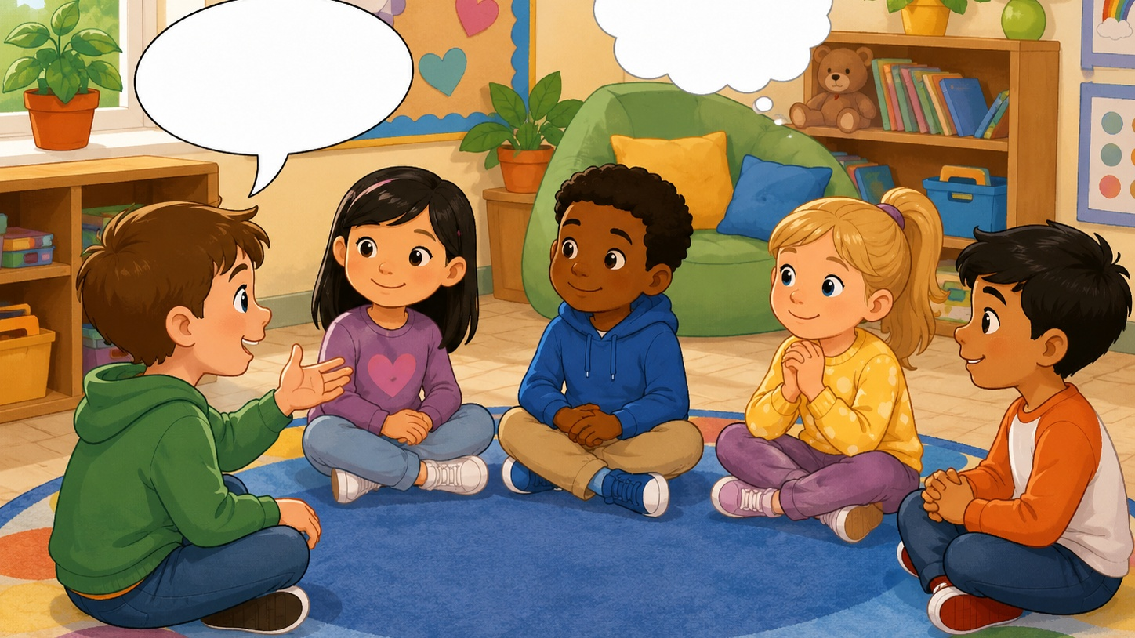
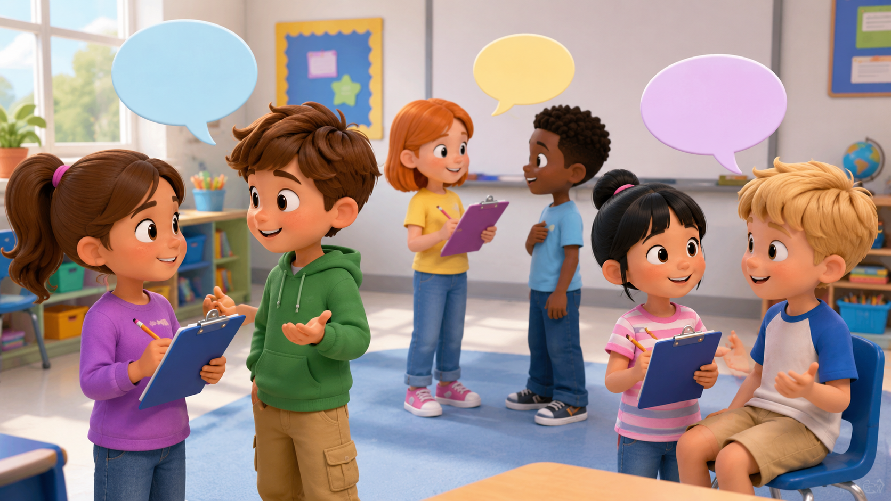
Mingle Survey: Find Opinions
Students ask, answer, and remember friends’ ideas.
Name
Topic
Opinion
Reason
Ask: “What do you think?” -> “Why?” -> “Do you agree or disagree?”
Mini Debate · Day 13 · Speaking & Listening
18
Notes:
Students ask four friends and record short answers. For low-level students, allow drawing in the table. Strong students write full sentences.

Slide 19
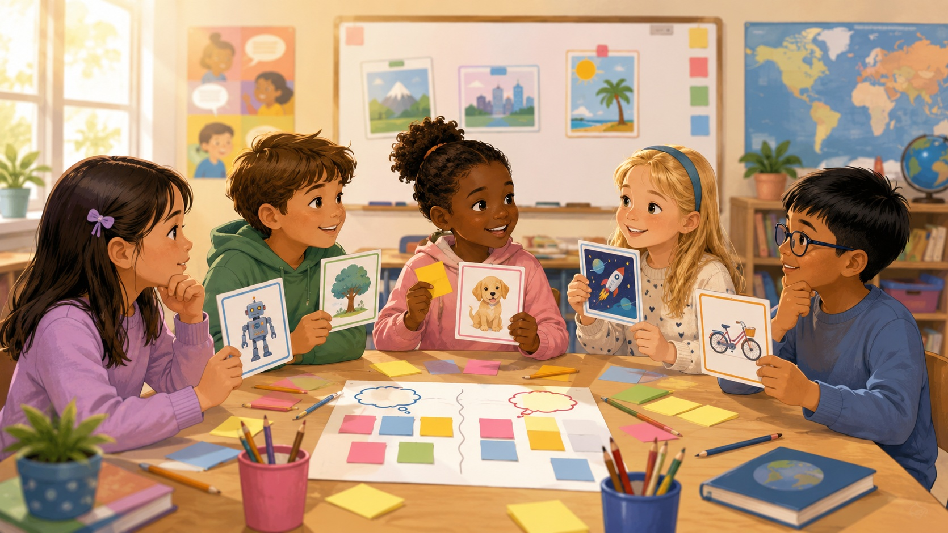
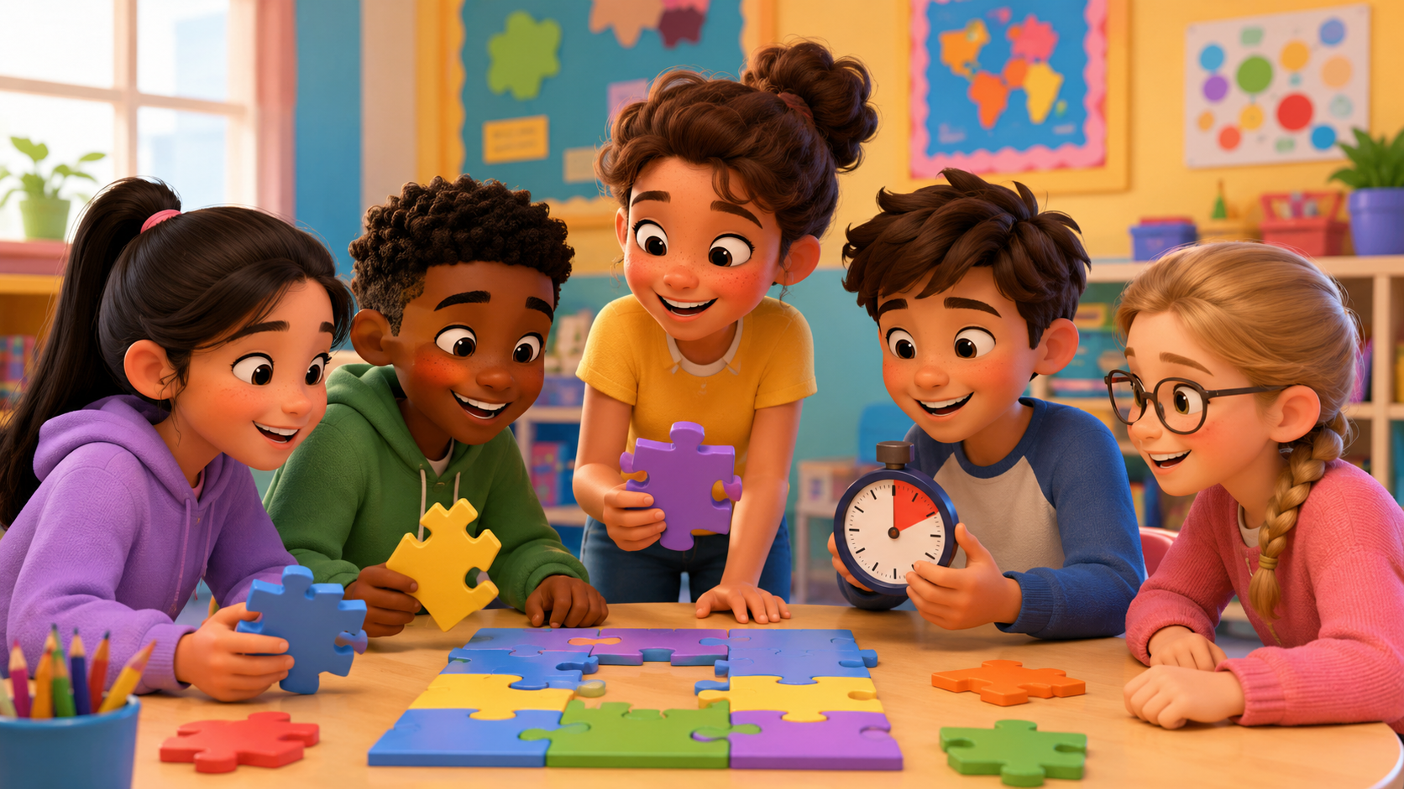
Listening 2: The Debate Club
Students listen for opinions, reasons, and responses.
Name
Opinion
Reason
Agree/Disagree
Listen twice. First: just listen. Second: fill the table.
Mini Debate · Day 13 · Speaking & Listening
19
Notes:
Listening script 2. Read twice. Ben: I am the builder. I can use the cups. Sara: I am the planner. I have an idea. Kim: I am the checker. We need more tape. Omar: I am the reporter. We are ready. Answers: Ben-builder-cups; Sara-planner-idea; Kim-checker-tape; Omar-reporter-ready.

Slide 20
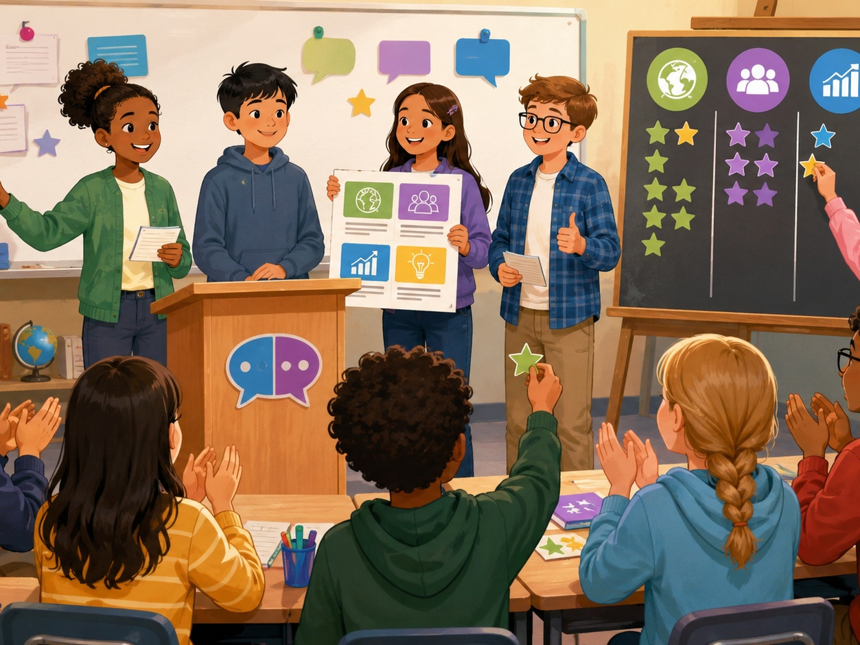
Mini Debate: Topic Sprint
A fast review game before the final speaking task.
🎭
Round 1
Team says: “I think…”
👂
Round 2
Teacher says a topic. Team gives a reason.
💬
Round 3
One student agrees. Another disagrees.
Scoring: 1 point for clear English · 1 point for a reason · 1 point for respect
Mini Debate · Day 13 · Speaking & Listening
20
Notes:
Make 2-4 teams. Keep it light and positive. Award bonus points for students who help shy classmates speak.

Slide 21
Strategy Pause: What Worked?
Teams improve before the final try.
✅
What worked?
🔧
What can we fix?
We used because.
We need louder voices.
🗣️
Who needs to speak?
❓
What will we ask next?
Everyone needs one turn.
Let’s ask why.
Team talk sentence: “Next time, we should _____.”
Mini Debate · Day 13 · Speaking & Listening
21
Notes:
Pause after the first challenge. Teams talk for one minute, then improve their plan.

Slide 22
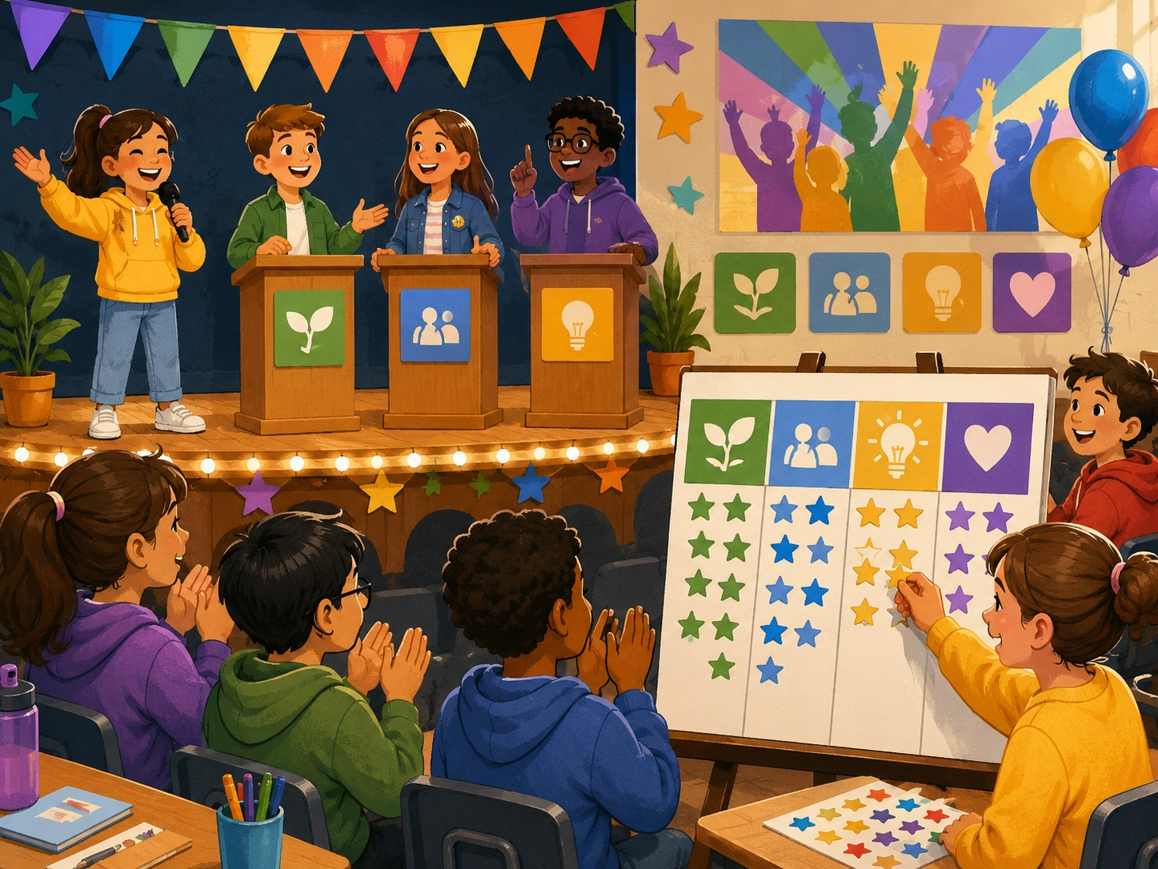
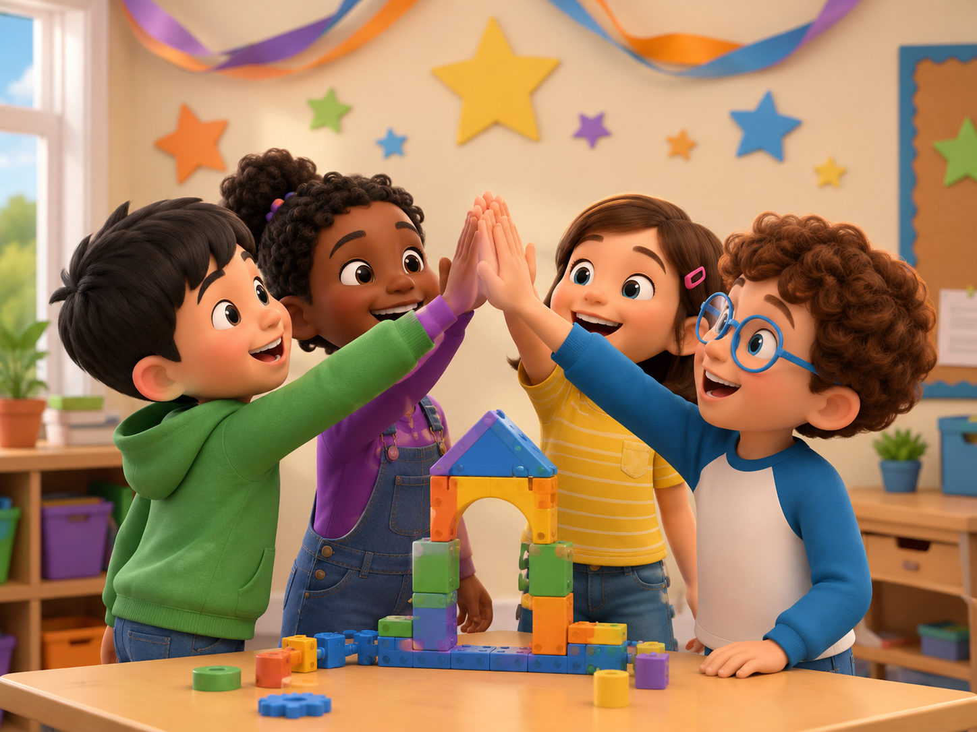
Mini Presentation: Our Debate
Students speak for 30-45 seconds as a team.
Hello. We are Team _____.
Our topic was _____.
Our opinion was _____.
One reason was _____.
We listened to _____.
Next time, we should _____.
Thank you.
Look up · Speak clearly · Use “because” · Respect your team
Mini Debate · Day 13 · Speaking & Listening
22
Notes:
This is the final speaking task. Let students present in teams. Every student says one line.

Slide 23
Our Debate Class Rules
Create a safe classroom for mini debates.
🌱
Use English first.
🤝
Be kind.
👂
Listen carefully.
⭐
Ask an adult.
One word + gesture is okay.
We do not laugh at ideas.
Everyone gets a turn.
For real problems, tell the teacher.
Class chant: “Listen. Think. Reason. Respect.”
Mini Debate · Day 13 · Speaking & Listening
23
Notes:
Have students repeat the class chant. Ask students to show thumbs up if they agree.

Slide 24
Speaking Passport: Day 13 Stamp
Self-check at the end.
Today I can...
💬
share an opinion
💡
give a reason
❓
ask a question
🤝
respect a friend
I think...
because...
Why do you think that?
Good point.
Circle one: 🙂 I can do it 😐 I need practice 🙁 I need help
Mini Debate · Day 13 · Speaking & Listening
24
Notes:
Students self-assess. Ask students to choose one team sentence they can say today.

Slide 25
Exit Ticket
A quick closing routine.
💬
Say one debate word
💡
Say one opinion
opinion / reason / agree
I think dogs are fun.
🔗
Give one reason
🌟
Cheer a friend
Because they can play.
Good point! Thank you.
Teacher says goodbye using each team name when possible.
Mini Debate · Day 13 · Speaking & Listening
25
Notes:
Students must say one thing before leaving. Keep it positive and fast.

Slide 26

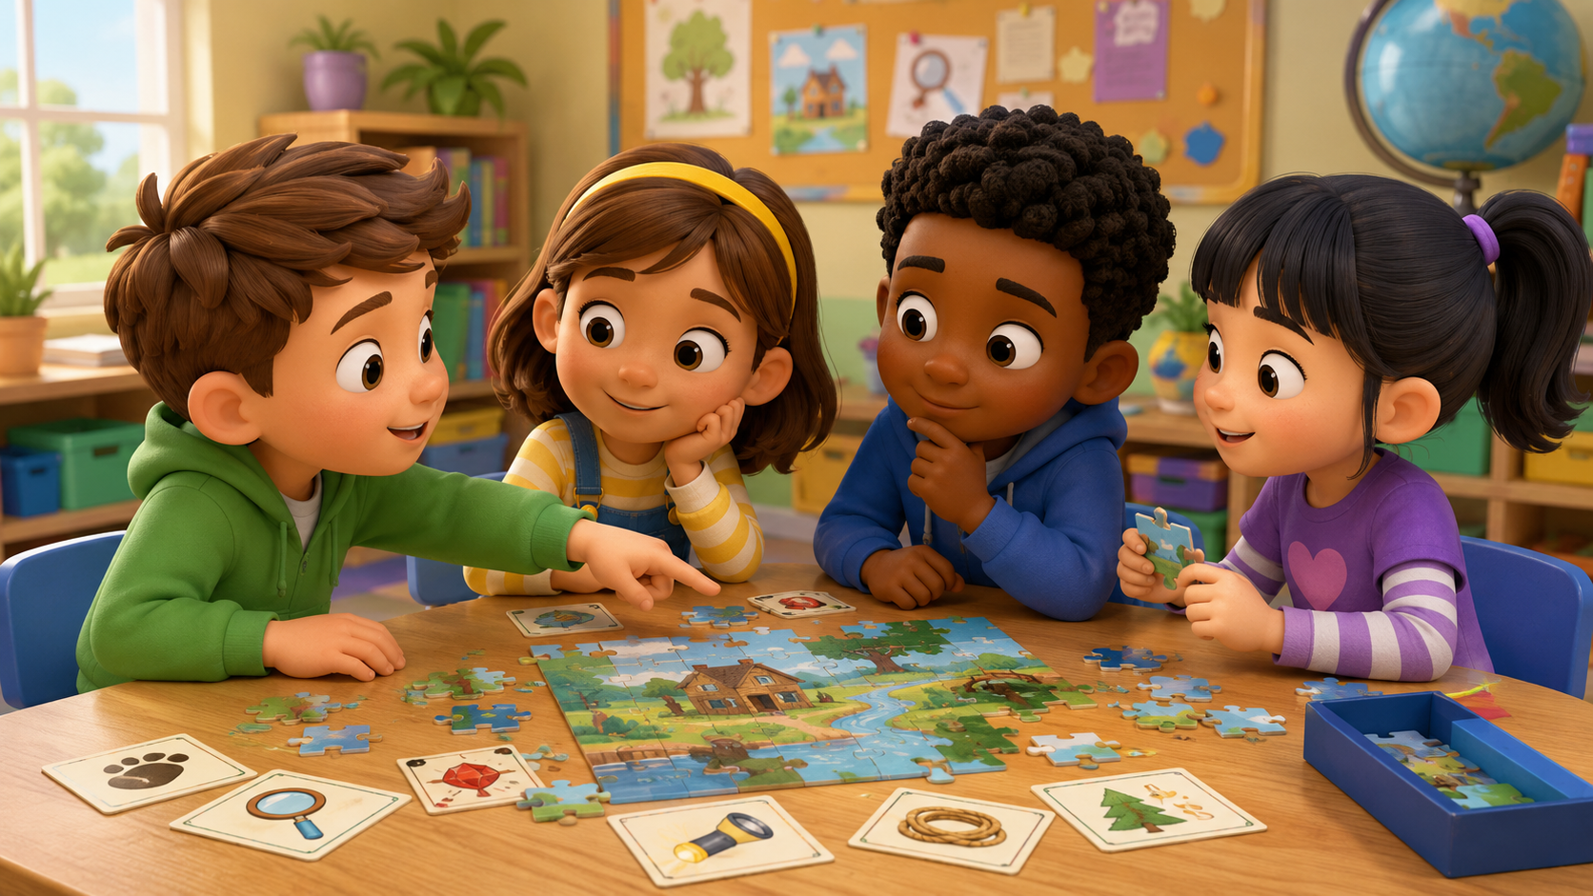
Teacher Quick Assessment
Use this to understand your students after the mini debate.
Student name
Can say opinion
Can give reason
Support needed
After class, group students by confidence and debate language control.
Mini Debate · Day 13 · Speaking & Listening
26
Notes:
Use this as a teacher-only slide. Identify who can speak, who can cooperate, and who needs more support.

Slide 27
Printable Cards: Debate Roles
Print this slide and cut into cards.
🎤
Moderator
🅰️
Speaker A
🅱️
Speaker B
I can ask the question.
I can give my opinion.
I can give another opinion.
💡
Reason Keeper
📝
Reporter
🌟
Kind Listener
I can listen for because.
I can tell the class.
I can say good point.
Teacher idea: Give one card to each student. They ask, “What is your role?”
Mini Debate · Day 13 · Speaking & Listening
27
Notes:
Print and cut. Give one role card to each student. Students must use the sentence on the card during the challenge.

Slide 28
Printable Cards: Debate Actions
Students pick a card and finish the sentence.
💬
I think...
👍
I agree...
👎
I disagree...
🔗
Because...
because ____
because ____
because ____
finish the reason
❓
Can you explain?
🌟
Good point!
❓
What do you think?
💡
Why?
Ask for more
Thank a friend
Answer with an opinion
Answer: Because ____
Extension: Students create one new debate action card.
Mini Debate · Day 13 · Speaking & Listening
28
Notes:
Print and cut. Students match an action card with a role card to make a full sentence.

Slide 29
Home Practice
Ask someone at home 3 questions.
Use English with family or a friend.
🐶
Question 1
👍
Question 2
💡
Question 3
What do you think about pets?
Do you agree or disagree?
Can you give one reason?
Bring one answer to next class.
Mini Debate · Day 13 · Speaking & Listening
29
Notes:
This is optional homework. Students ask a family member or friend three questions and bring one answer. Keep homework oral, not writing-heavy.

