Slide 1
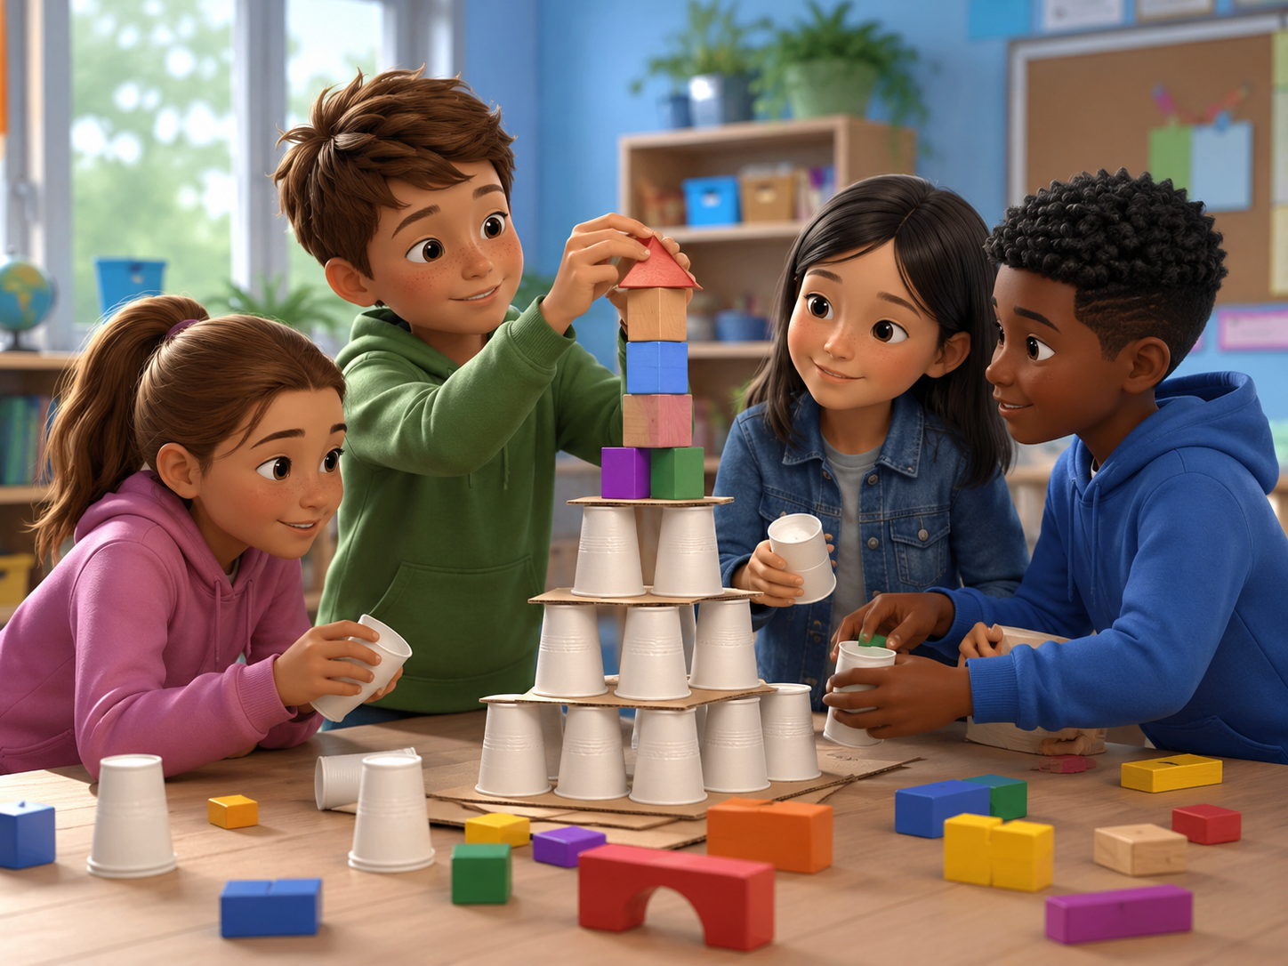
DAY 12 · 90 MINUTES
Team Challenge
Work together, solve problems, and speak English with your team.
🤝
I can work...
🧠
I can plan...
“Let’s help.”
“We need an idea.”
🏁
I can try...
🌟
I can cheer...
“Our team is ready.”
“Good job!”
Team Challenge · Day 12 · Speaking & Listening
01
Notes:
Welcome students. Say: Today we will practice teamwork in English. We will ask, plan, help, and celebrate together.

Slide 2
Today’s Mission
Students learn to plan, listen, and solve a team challenge in English.
By the end of class, I can help my team finish a challenge.
👂
Listen
🗣️
Speak
❓
Ask
🤝
Help
I can listen to my team.
I can say my idea clearly.
I can ask: What should we do?
I can say: Let me help you.
Class promise: We try. We listen. We share. We cheer.
A good team is not always the fastest team. A good team helps every student speak.
Team Challenge · Day 12 · Speaking & Listening
02
Notes:
Ask students to repeat the mission. Use gestures: hands together for teamwork, finger to head for plan, thumbs up for encouragement.

Slide 3
90-Minute Class Map
Use this slide to tell students what will happen today.
0-10
10-25
25-40
40-60
60-75
75-90
Team Warm-up
Team Words
Listen & Plan
Build Challenge
Speak & Survey
Show & Reflect
move + greet
roles + actions
hear the mission
solve with your team
ask friends
mini talk + exit ticket
Teacher tip: Students should use “Let’s…” many times today.
Team Challenge · Day 12 · Speaking & Listening
03
Notes:
Keep this slide quick. Say: We will warm up, learn team words, solve a challenge, and present our team plan.

Slide 4
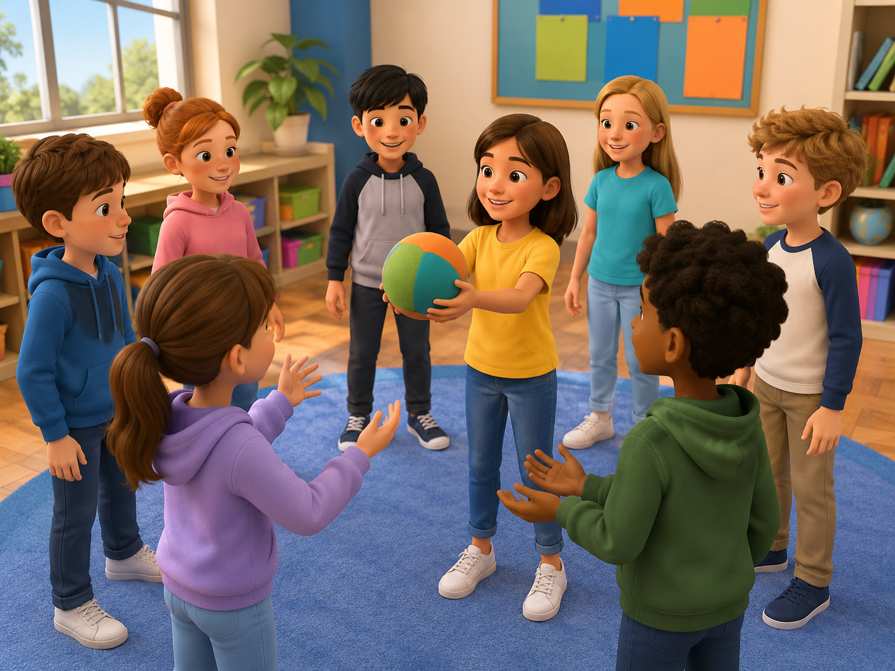
Team Warm-up: Pass the Energy
Start speaking in the first 5 minutes.
🧑‍🏫
Teacher
What makes a good team?
🧒
Student
A good team listens / shares / helps.
🎯
Action
Pass the ball and say one team word.
New picture prompt: cooperative ball circle
Challenge: no one is out. The team wins when everyone speaks.
Team Challenge · Day 12 · Speaking & Listening
04
Notes:
Use the picture. Model with one student. Students stand in a circle and pass an imaginary ball while saying one team word.

Slide 5
Teacher Wants to Know Your Team
Ask slowly. Students can answer with one word or a full sentence.
🤝
Can you work together?
🧠
Do you have an idea?
Yes, we can.
Yes. Let’s build a tower.
👂
Can you listen first?
💬
Can you ask for help?
Yes. I can listen.
Can you help me, please?
⭐
Can you cheer a friend?
🧩
Can you solve a problem?
Good job! Try again!
Maybe. Let’s try.
Team Challenge · Day 12 · Speaking & Listening
05
Notes:
Ask 2 or 3 students as a model, then students ask partners. Collect team strengths on the board.

Slide 6
8 Useful Team Words
Use faces, gestures, and quick repetition.
👑
leader
👂
listener
🧱
builder
🎤
reporter
helps the team start
hears each idea
uses the materials
speaks for the team
💡
idea
🧩
problem
✅
finish
👏
cheer
a plan in your head
something to solve
the task is done
kind words for a friend
Mini-drill: Teacher says the word -> students do the action.
Team Challenge · Day 12 · Speaking & Listening
06
Notes:
Teach each word with an action. Leader = point gently, listener = ear hand, builder = hands together, reporter = microphone hand.

Slide 7
8 Useful Challenge Actions
Students learn simple action words for team tasks.
📣
speak
👂
listen
🤲
share
📐
plan
Say your idea.
Hear your team.
Give materials.
Choose steps.
🧱
build
🔎
check
🔁
try again
🎉
celebrate
Make something.
Look carefully.
Do it one more time.
Say good job.
Say: “Let’s ____.” or “Can you ____?”
Team Challenge · Day 12 · Speaking & Listening
07
Notes:
Focus on language, not winning. Model: We need cups. Let’s build. Can you hold this?

Slide 8
Listen & Move
When you hear the sentence, do the action.
🤝
Work together.
👂
Listen first.
💡
I have an idea.
stand shoulder to shoulder
hand to ear
point to head
🧱
Let’s build.
🔁
Try again.
👏
Good job!
pretend to build
circle hands
clap three times
Challenge: Can your team do all six actions without using your first language?
Team Challenge · Day 12 · Speaking & Listening
08
Notes:
Teacher reads sentences in random order. Students do the action. Round 2 is faster. Round 3: a student leads.

Slide 9
Team Challenge Phrases
These phrases help students speak longer.
💬
Let’s _____.
💡
I have an idea.
❓
What should we do?
Make a suggestion.
Share a plan.
Ask the team.
🤝
Can you help me?
✅
We are ready.
🌟
Good job!
Ask for help.
Tell the teacher.
Cheer a friend.
Repeat with rhythm: LET’S build. I HAVE an idea. CAN you help me?
Team Challenge · Day 12 · Speaking & Listening
09
Notes:
Use call and response. Teach stress: LET’S, IDEA, HELP, READY.

Slide 10
Build the Sentence
Students practice three useful patterns.
Let’s + action. I can + action. We need + noun.
Actions
Team words
Helpful words
listen
leader
please
share
listener
thank you
plan
builder
good job
build
reporter
try again
check
idea
my turn
try again
problem
your turn
Partner practice: Choose 2 actions, 2 team words, and 2 helpful words.
Team Challenge · Day 12 · Speaking & Listening
10
Notes:
Students point to a word and build a sentence. Strong students can add because: Let’s plan because we need an idea.

Slide 11
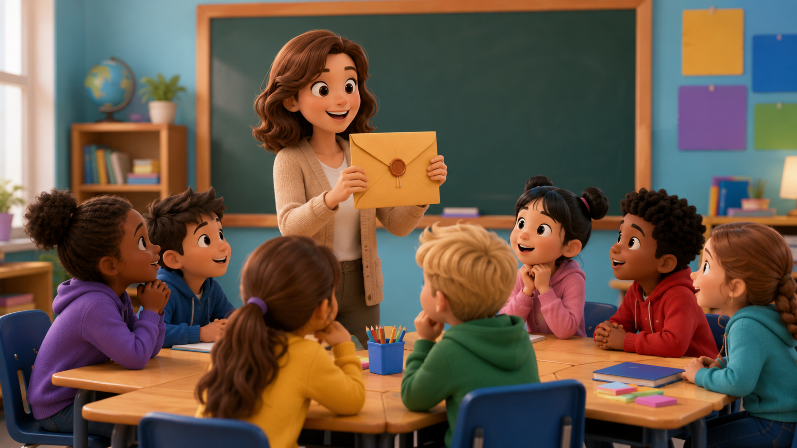
Listening 1: The Secret Mission
Teacher reads. Students listen for team words and actions.
📨
Here is your mission.
❓
What should we do?
💡
I have an idea.
🤝
Can you help me?
New picture prompt: teacher gives a challenge envelope
🔁
Let’s try again.
Script is in speaker notes for the teacher.
Team Challenge · Day 12 · Speaking & Listening
11
Notes:
Listening script 1. Read twice. First time: students only listen. Second time: students raise their hand when they hear the key phrases. Teacher: Team Blue, here is your secret mission. You must build a bridge. Alex: What should we do? Mina: I have an idea. Let’s use paper. Omar: Can you help me? Lily: Yes. We can try again. Teacher: Good teamwork!

Slide 12
Listening Check
Students answer with fingers: 1, 2, or 3.
👂
What is the mission?
💬
Who has an idea?
1 build a bridge
2 draw a cat
3 run fast
1 Alex
2 Mina
3 the teacher
🤝
What does Omar ask?
🔁
What do they do?
1 Can you help me?
2 Are you hungry?
3 What is your name?
1 stop forever
2 try again
3 go home
Fast correction: Say the full answer together.
Team Challenge · Day 12 · Speaking & Listening
12
Notes:
Students answer with fingers. Then say full answers: They build a bridge. Mina has an idea. Omar asks for help. They try again.

Slide 13
Speaking Game: Team Captain Chain
Students build a helpful answer together.
1
2
3
4
Pick a card.
Say your role.
Ask the team.
Give an idea.
leader / builder / reporter
I am the _____.
What should we do?
Let’s _____.
Use English only. Use gestures if you forget a word!
Team Challenge · Day 12 · Speaking & Listening
13
Notes:
Give each team action cards. Student A says a role. Student B asks a question. Student C gives an idea. Student D cheers. Then rotate roles.

Slide 14
Dialogue Model
Students practice a short, safe team conversation.
A: Are we ready?
B: Not yet. We need an idea.
A: What should we do?
B: Let’s build a tall tower.
A: Can you help me?
B: Yes. I can hold the cups.
A: Good job! Let’s try again.
Practice 3 times: slow voice -> normal voice -> acting voice.
Team Challenge · Day 12 · Speaking & Listening
14
Notes:
Model with one confident student. Then students repeat line by line. Finally teams act it with different actions: build, draw, plan, check.

Slide 15
Choose a Team Challenge
Students use English to plan and solve a problem.
🧱
Challenge 1 · Tower
🌉
Challenge 2 · Bridge
Build the tallest paper-cup tower.
Make a bridge from paper.
🧩
Challenge 3 · Puzzle
🎭
Challenge 4 · Team Scene
Solve the picture puzzle together.
Act a 30-second team story.
Performance rule: everyone speaks at least one line with “Let’s” or “Can you…?”
Team Challenge · Day 12 · Speaking & Listening
15
Notes:
Assign each team one challenge. Give 3 minutes to plan and 8 minutes to try. Praise clear English and teamwork, not only the tallest tower.

Slide 16
Challenge Rules
A safe, fair game for every team.
⏱️
Use the time.
🗣️
Use English first.
🤝
Share materials.
🌟
Cheer your team.
Plan first, then build.
One word + gesture is okay.
No grabbing. Ask politely.
Say good job and try again.
Class chant: “Plan it. Try it. Fix it. Cheer!”
Team Challenge · Day 12 · Speaking & Listening
16
Notes:
Read the rules before students start. Ask for examples of kind teamwork.

Slide 17
Team Roles
Every student has a job. Every job is important.
👑
Leader
🧠
Planner
🧱
Builder
🔎
Checker
🎤
Reporter
asks the team to start
chooses one idea
uses the materials
looks for problems
shares the result
Role language: “I am the ____.” “My job is to ____.”
Team Challenge · Day 12 · Speaking & Listening
17
Notes:
Give each team role cards. Rotate roles after one round so more students speak.

Slide 18
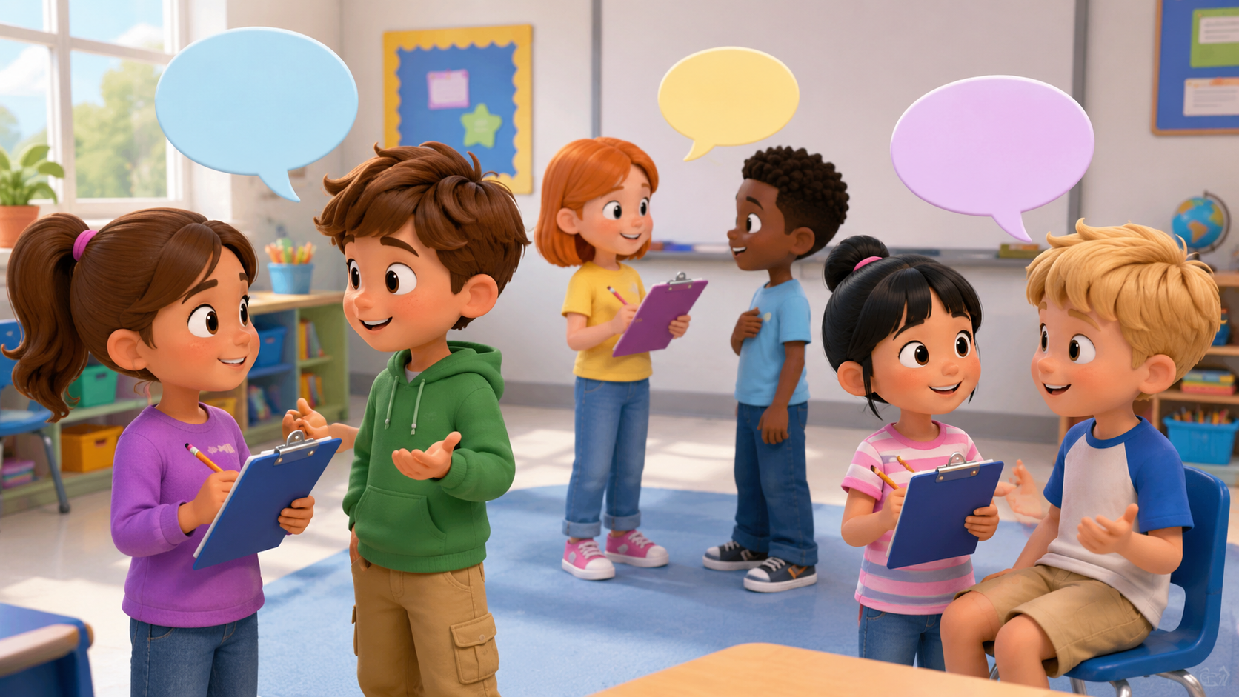
Mingle Survey: Find Teammates
Students ask, answer, and remember team strengths.
Name
Team role
Good at...
Can help?
Ask: “What is your role?” -> “What are you good at?” -> “Can you help our team?”
Team Challenge · Day 12 · Speaking & Listening
18
Notes:
Students ask four friends and record short answers. For low-level students, allow drawing in the table. Strong students write full sentences.

Slide 19
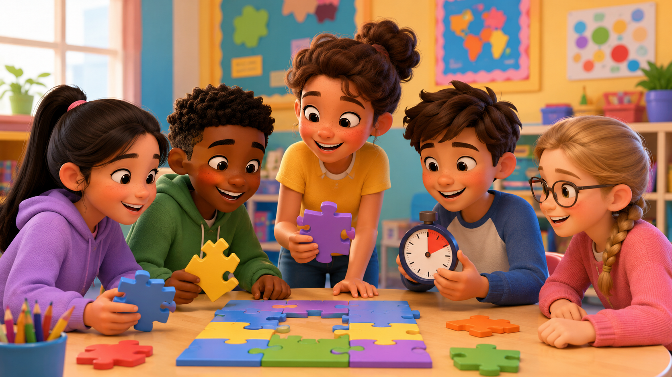
Listening 2: The Team Club
Students listen for roles, strengths, and team needs.
Name
Role
Can do
Team needs
Listen twice. First: just listen. Second: fill the table.
Team Challenge · Day 12 · Speaking & Listening
19
Notes:
Listening script 2. Read twice. Ben: I am the builder. I can use the cups. Sara: I am the planner. I have an idea. Kim: I am the checker. We need more tape. Omar: I am the reporter. We are ready. Answers: Ben-builder-cups; Sara-planner-idea; Kim-checker-tape; Omar-reporter-ready.

Slide 20
Team Challenge: Tower Sprint
A fast review game before the final speaking task.
🎭
Round 1
Team says: “Let’s…”
👂
Round 2
Teacher says a problem. Team gives a plan.
💬
Round 3
One student asks. Another answers.
Scoring: 1 point for clear English · 1 point for a plan · 1 point for teamwork
Team Challenge · Day 12 · Speaking & Listening
20
Notes:
Make 2-4 teams. Keep it light and positive. Award bonus points for students who help shy classmates speak.

Slide 21
Strategy Pause: What Worked?
Teams improve before the final try.
✅
What worked?
🔧
What can we fix?
Our tower was strong.
We need a bigger base.
🗣️
Who needs to speak?
🔁
What will we try next?
The reporter can explain.
Let’s try again slowly.
Team talk sentence: “Next time, we should _____.”
Team Challenge · Day 12 · Speaking & Listening
21
Notes:
Pause after the first challenge. Teams talk for one minute, then improve their plan.

Slide 22
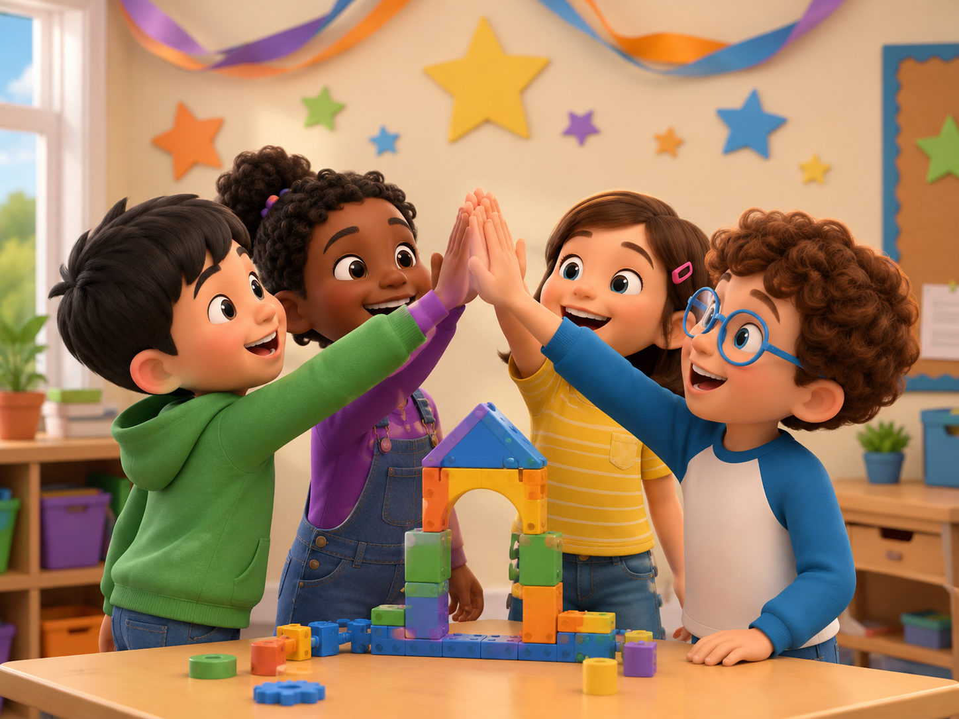
Mini Presentation: Our Team Plan
Students speak for 30-45 seconds as a team.
Hello. We are Team _____.
Our challenge was _____.
Our plan was _____.
My role was _____.
We helped by _____.
Next time, we should _____.
Thank you.
Look up · Speak clearly · Use “we” · Cheer your team
Team Challenge · Day 12 · Speaking & Listening
22
Notes:
This is the final speaking task. Let students present in teams. Every student says one line.

Slide 23
Our Team Class Rules
Create a safe classroom for challenges.
🌱
Use English first.
🤝
Be kind.
👂
Listen carefully.
⭐
Ask an adult.
One word + gesture is okay.
We do not laugh at mistakes.
Everyone gets a turn.
For real problems, tell the teacher.
Class chant: “Plan. Listen. Help. Celebrate.”
Team Challenge · Day 12 · Speaking & Listening
23
Notes:
Have students repeat the class chant. Ask students to show thumbs up if they agree.

Slide 24
Speaking Passport: Day 12 Stamp
Self-check at the end.
Today I can...
🤝
work with a team
💡
share an idea
❓
ask a question
✅
finish a challenge
Let’s help.
I have an idea.
What should we do?
We are ready.
Circle one: 🙂 I can do it 😐 I need practice 🙁 I need help
Team Challenge · Day 12 · Speaking & Listening
24
Notes:
Students self-assess. Ask students to choose one team sentence they can say today.

Slide 25
Exit Ticket
A quick closing routine.
💬
Say one team word
💡
Say one idea
leader / listener / builder
Let’s build a tower.
🤝
Ask for help
🌟
Cheer a friend
Can you help me, please?
Good job! Try again!
Teacher says goodbye using each team name when possible.
Team Challenge · Day 12 · Speaking & Listening
25
Notes:
Students must say one thing before leaving. Keep it positive and fast.

Slide 26
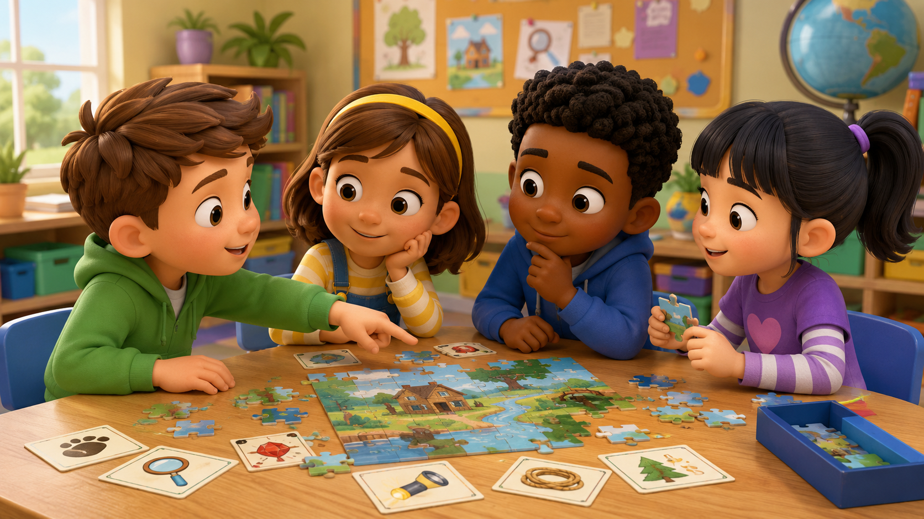
Teacher Quick Assessment
Use this to understand your students after the team challenge.
Student name
Can say idea
Can ask help
Support needed
After class, group students by confidence and teamwork language control.
Team Challenge · Day 12 · Speaking & Listening
26
Notes:
Use this as a teacher-only slide. Identify who can speak, who can cooperate, and who needs more support.

Slide 27
Printable Cards: Team Roles
Print this slide and cut into cards.
👑
Leader
👂
Listener
🧱
Builder
I can start the team.
I can listen first.
I can build carefully.
🔎
Checker
🎤
Reporter
🌟
Cheerleader
I can check the work.
I can tell the class.
I can say good job.
Teacher idea: Give one card to each student. They ask, “What is your role?”
Team Challenge · Day 12 · Speaking & Listening
27
Notes:
Print and cut. Give one role card to each student. Students must use the sentence on the card during the challenge.

Slide 28
Printable Cards: Challenge Actions
Students pick a card and finish the sentence.
👂
Listen.
🤲
Share.
📐
Plan.
🧱
Build.
Let’s ____
Let’s ____
Let’s ____
Let’s ____
🔎
Check.
🔁
Try again.
❓
What should we do?
🤝
Can you help me?
Let’s ____
Let’s ____
Answer with an idea
Answer: Yes, I can.
Extension: Students create one new challenge action card.
Team Challenge · Day 12 · Speaking & Listening
28
Notes:
Print and cut. Students match an action card with a role card to make a full sentence.

Slide 29
Home Practice
Ask someone at home 3 questions.
Use English with family or a friend.
🤝
Question 1
💡
Question 2
❓
Question 3
What makes a good team?
Do you have an idea?
Can you help me?
Bring one answer to next class.
Team Challenge · Day 12 · Speaking & Listening
29
Notes:
This is optional homework. Students ask a family member or friend three questions and bring one answer. Keep homework oral, not writing-heavy.

