Slide 1

DAY 4 · 90 MINUTES
Likes and Reasons
Share what you like and explain it with “because.”
❤️
I can say…
💡
I can explain…
“I like drawing.”
“because it is fun.”
Likes and Reasons · Day 4 · Speaking & Listening
01
Notes:
Welcome students. Say: Today we will talk about things we like and give reasons. The goal is not long answers. The goal is clear English with because.

Slide 2
Today’s Mission
Students learn to give simple opinions with reasons.
By the end of class, I can say what I like and why.
👂
Listen
🗣️
Speak
🤝
Connect
I can hear likes and reasons in a short conversation.
I can say: I like ____ because it is ____.
I can ask a friend: What do you like? Why?
Class promise: Give a reason. Listen kindly. Ask “Why?”
Likes and Reasons · Day 4 · Speaking & Listening
02
Notes:
Ask students to repeat the mission. Use gestures: heart for like, finger to head for reason, and handshake for ask a friend.

Slide 3
90-Minute Class Map
Use this slide to tell students what will happen today.
0–10
10–25
25–40
40–55
55–75
75–90
Quick Likes
Listen & Point
Reason Words
Listening Story
Speak & Survey
Show & Reflect
warm-up + feelings
hear likes / dislikes
fun, easy, delicious
find likes + reasons
ask friends + tally
mini talk + exit ticket
Teacher tip: Students should answer with “because” many times today.
Likes and Reasons · Day 4 · Speaking & Listening
03
Notes:
Keep this slide quick. Say: We will listen, practice reasons, ask many friends, and finish with a small presentation.

Slide 4
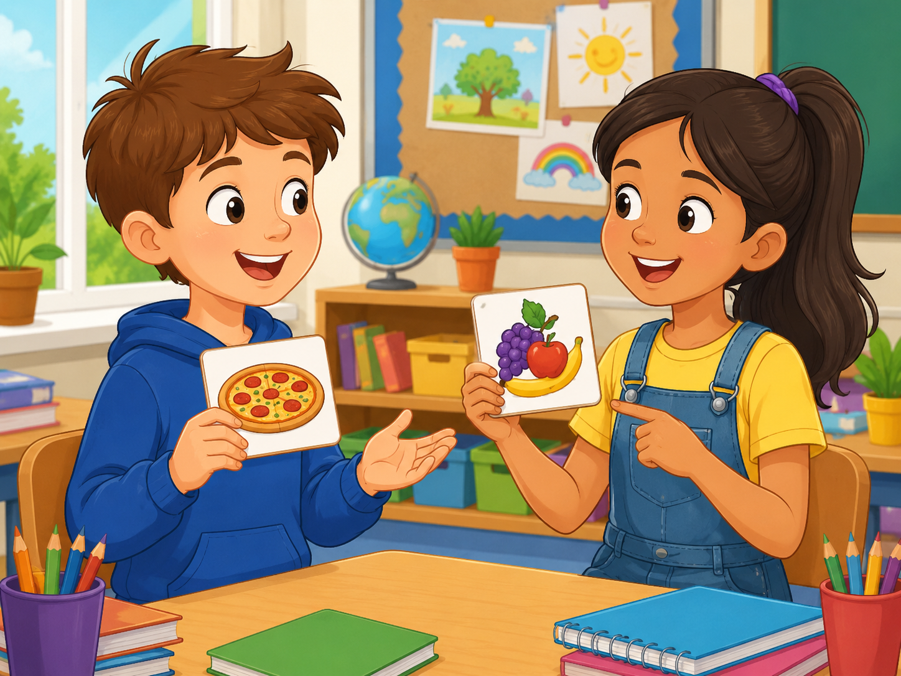
Quick Likes Warm-up
Start speaking in the first 5 minutes.
Teacher: I like pizza. What do you like?
Student: I like _____.
Teacher: Why?
Student: Because it is _____.
🍕
Food
🎮
Fun
New picture prompt: food choices
pizza · fruit · ice cream
games · music · art
Action: ask 2 classmates and remember one answer.
Likes and Reasons · Day 4 · Speaking & Listening
04
Notes:
Use the picture. Model with one student. Students stand and ask two friends. Accept one-word answers first, then push for because.

Slide 5
Teacher Wants to Know You
Ask slowly. Students can answer with one word or a full sentence.
🍕
What food do you like?
🎮
What game do you like?
🎨
What activity do you like?
I like ____ because it is yummy.
I like ____ because it is exciting.
I like ____ because it is fun.
📚
What subject do you like?
🎵
What music do you like?
🐶
What animal do you like?
I like ____ because it is interesting.
I like ____ because it is cool.
I like ____ because it is cute.
Teacher note: Write class favorites on the board.
Likes and Reasons · Day 4 · Speaking & Listening
05
Notes:
Ask 2 or 3 students as a model, then students ask partners. Collect the class favorite foods, games, and activities.

Slide 6
How Much Do You Like It?
Students choose a feeling before giving a reason.
😍
I love it.
🙂
I like it.
😐
It is okay.
🙁
I don’t like it.
😵
I hate it.
I love soccer.
I like drawing.
Math is okay.
I don’t like spiders.
I hate loud noise.
Speak with your partner: “I like / don’t like ____ because ____.”
Likes and Reasons · Day 4 · Speaking & Listening
06
Notes:
Students point to a feeling first. Then they say one sentence. Remind them that polite English is okay even when we do not like something.

Slide 7
8 Useful Reason Words
Use gestures and quick repetition.
🎉
fun
😋
delicious
✨
interesting
😎
cool
makes me happy
tastes good
not boring
great style
🧠
easy
💪
healthy
🎨
creative
🐱
cute
not difficult
good for my body
new ideas
small and sweet
Mini-drill: Teacher says the word → students do the gesture.
Likes and Reasons · Day 4 · Speaking & Listening
07
Notes:
Teach each reason word with an action. Fun = big smile, delicious = rub tummy, interesting = point to head, healthy = muscles.

Slide 8
Listen & Move
When you hear the sentence, do the action.
👍
I like it.
👎
I don’t like it.
❤️
I love it.
thumbs up
thumbs down
heart hands
🤔
Why?
💡
because
🔁
Say it again.
point to head
raise lightbulb finger
circle finger
Challenge: Can your team do all six actions without speaking your first language?
Likes and Reasons · Day 4 · Speaking & Listening
08
Notes:
Teacher reads sentences in random order. Students do the action. Round 2 is faster. Round 3: a student leads.

Slide 9
Likes + Reasons Phrases
These phrases help students speak longer.
❤️
I like _____.
💔
I don’t like _____.
❓
Why?
When I enjoy something.
When I do not enjoy it.
Ask for a reason.
💡
because it is _____.
🙋
Me too!
🤝
Really? I like _____.
Give a simple reason.
I have the same idea.
Different idea politely.
Repeat with rhythm: I LIKE pizza BECAUSE it is DE-li-cious.
Likes and Reasons · Day 4 · Speaking & Listening
09
Notes:
Use call and response. Teach stress: LIKE, BECAUSE, and the reason word.

Slide 10
Build the Sentence
Students practice one useful pattern.
I like + noun + because + it is + adjective.
Noun
Noun
Noun
Noun
Noun
Noun
pizza
soccer
drawing
music
dogs
English
What?
What?
What?
What?
What?
What?
Reason
Reason
Reason
Reason
Reason
Reason
fun
delicious
cool
easy
cute
interesting
Why?
Why?
Why?
Why?
Why?
Why?
Partner practice: Choose 3 nouns and 3 reasons.
Likes and Reasons · Day 4 · Speaking & Listening
10
Notes:
Students point to a noun and reason to build the sentence. Stronger students can add: I like it because it is fun and easy.

Slide 11
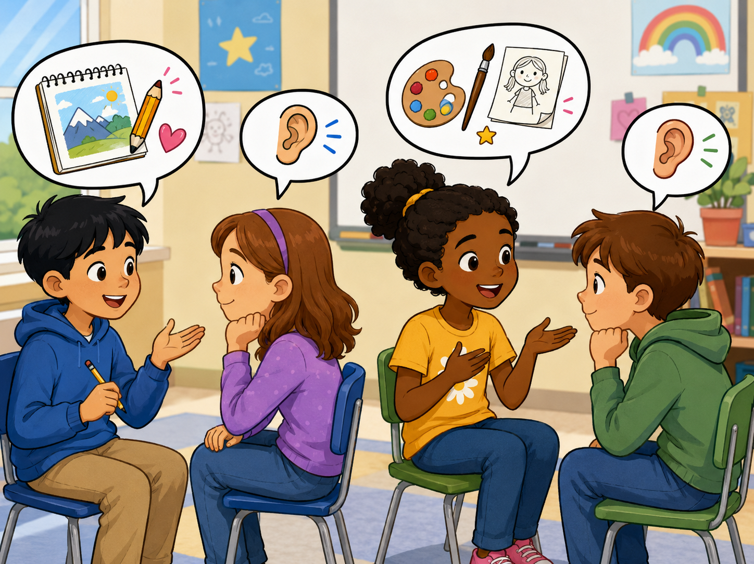
Listening 1: Favorite Things
Teacher reads. Students listen for likes and reasons.
Listen. Put your hand up when you hear:
🎨
I like drawing.
❓
Why?
💡
because it is creative.
🤝
Me too!
New picture prompt: friends sharing favorites
Script is in speaker notes for the teacher.
Likes and Reasons · Day 4 · Speaking & Listening
11
Notes:
Listening script 1. Read twice. First time: students only listen. Second time: students raise their hand when they hear the key phrases.
Mia: What do you like, Omar?
Omar: I like drawing.
Mia: Why?
Omar: Because it is creative. What do you like?
Mia: I like music because it is fun.
Omar: Me too! I like music.

Slide 12
Listening Check
Students answer with fingers: 1, 2, or 3.
👂
What does Omar like?
💬
Why does Omar like it?
1 drawing
2 running
3 cooking
1 creative
2 noisy
3 boring
🎵
What does Mia like?
✅
What does Omar say at the end?
1 music
2 spiders
3 football
1 Me too!
2 Goodbye!
3 I hate it!
Fast correction: Say the full answer together.
Likes and Reasons · Day 4 · Speaking & Listening
12
Notes:
Students answer with fingers. Then say full answers: Omar likes drawing because it is creative. Mia likes music because it is fun.

Slide 13
Speaking Game: Reason Chain
Students build a longer answer together.
1
2
3
4
Pick a card.
Say your like.
Partner asks why.
Give a reason.
pizza / soccer / music
I like _____.
Why?
Because it is _____.
Use English only. Use gestures if you forget a word!
Likes and Reasons · Day 4 · Speaking & Listening
13
Notes:
Give each pair object cards. Student A says a like. Student B asks why. Student A gives a reason. Then switch roles.

Slide 14
Dialogue Model
Students practice a short, safe conversation.
A: What do you like?
B: I like basketball.
A: Why?
B: Because it is exciting.
A: Me too! I like basketball.
Practice 3 times: slow voice → normal voice → acting voice.
Likes and Reasons · Day 4 · Speaking & Listening
14
Notes:
Model with one confident student. Then students repeat line by line. Finally pairs act it with different feelings: excited, shy, sleepy, surprised.

Slide 15
Choose a Role-play
Students make likes and reasons useful in real conversations.
🍽️
Problem 1 · At lunch
🎮
Problem 2 · After school
Say what food you like and why.
Ask about games and give a reason.
📚
Problem 3 · Library
🏃
Problem 4 · Sports club
Talk about books or subjects.
Say what sport you like and why.
Performance rule: everyone speaks at least one line with “because.”
Likes and Reasons · Day 4 · Speaking & Listening
15
Notes:
Assign each pair one role-play. Give 3 minutes to prepare and 5-7 minutes for quick performances. Praise reasons, not only grammar.

Slide 16
Opinion Corners
Students move, choose, and explain.
🍕
Food
⚽
Sports
I like pizza because it is delicious.
I like soccer because it is exciting.
🎨
Art
🎮
Games
I like drawing because it is creative.
I like games because they are fun.
Rule: Move to a corner → tell one friend your reason → change corner.
Likes and Reasons · Day 4 · Speaking & Listening
16
Notes:
Put four picture cards in the classroom corners. Students move to a favorite corner and explain their reason to one friend.

Slide 17
Mingle Survey: Ask 4 Friends
Students ask, answer, and remember reasons.
Name
Likes
Reason
Me too?
New word
Ask: “What do you like?” → “Why?” → Write one reason.
Likes and Reasons · Day 4 · Speaking & Listening
17
Notes:
Students ask four friends and record short answers. For low-level students, allow drawing in the table. Strong students write full reason words.

Slide 18
Listening 2: The Favorite Club
Students listen for personal information and reasons.
Listen and write: name, like, reason, and same/different.
Name
Likes
Reason
Same or different?
Share answers with your partner before teacher feedback.
Likes and Reasons · Day 4 · Speaking & Listening
18
Notes:
Listening script 2. Read twice. First listen: students only listen. Second listen: students fill the table.
Ben: Hi, Lily. What do you like?
Lily: I like animals because they are cute. What about you?
Ben: I like football because it is exciting.
Lily: That is different. Sara likes football too.
Sara: Yes, I like football because it is fast.
Answers: Lily - animals - cute - different from Ben. Ben - football - exciting. Sara - football - fast/same as Ben.

Slide 19
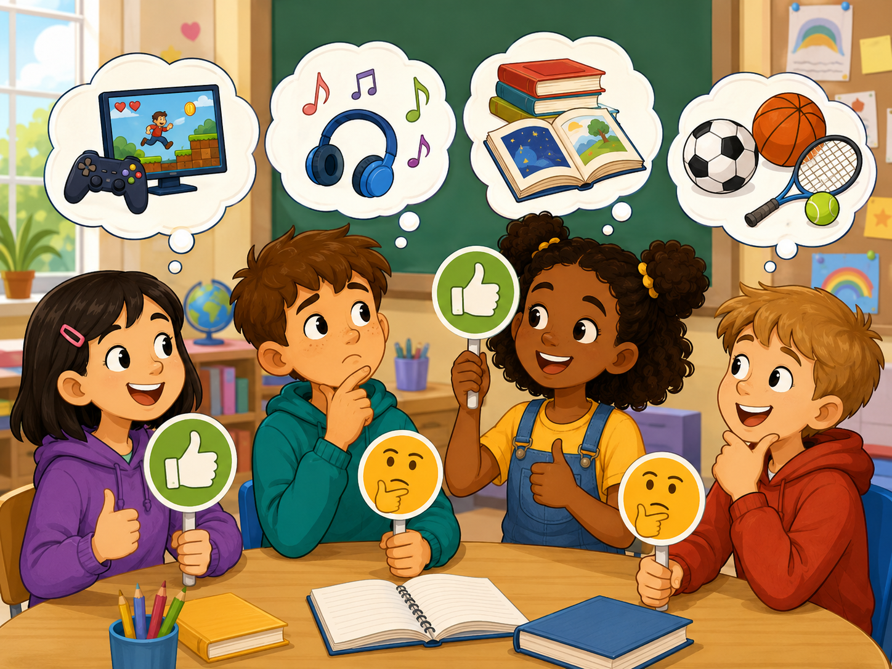
What Do They Like?
Look at the picture. Choose a reason.
Choose one sentence:
🎮
She likes games because they are fun.
🎵
He likes music because it is cool.
📚
She likes books because they are interesting.
⚽
He likes sports because they are exciting.
New picture prompt: students share favorites
Pair talk: “I think she likes… because…”
Likes and Reasons · Day 4 · Speaking & Listening
19
Notes:
Use the picture as a speaking prompt. Students choose one child and make a sentence. Encourage them to point and use because.

Slide 20
Team Challenge: Reason Race
A fast review game before the final speaking task.
🎭
Round 1
👂
Round 2
💬
Round 3
Teacher shows a card. Team says: I like… because…
Teacher says a reason. Team guesses the thing.
One student asks Why? Another gives a reason.
Scoring: 1 point for clear English · 1 point for a reason · 1 point for teamwork
Likes and Reasons · Day 4 · Speaking & Listening
20
Notes:
Make 2-4 teams. Keep it light and positive. Do not overcorrect. Award bonus points for students who help shy classmates speak.

Slide 21
Mini Presentation: My Favorite Thing
Students speak for 20–30 seconds.
Hello. My name is ____.
I like ____ because it is ____.
My friend ____ likes ____ because it is ____.
Thank you.
👀
🗣️
💡
😊
🙏
Look up
Speak clearly
Use because
Smile
Say thank you
Audience listens
Audience listens
Audience listens
Audience listens
Audience listens
Likes and Reasons · Day 4 · Speaking & Listening
21
Notes:
This is the final speaking task. Let students present in pairs or small groups if whole-class speaking is stressful.

Slide 22
Our Speaking Class Rules
Create a safe classroom when sharing opinions.
🌱
Use English first.
🤝
Respect different likes.
Even one word + because is okay.
We do not laugh at opinions.
👂
Ask “Why?” kindly.
⭐
Mistakes help us learn.
Listen to the reason.
Try again with a smile.
Class chant: “Like it. Say why. Listen. Smile.”
Likes and Reasons · Day 4 · Speaking & Listening
22
Notes:
Have students repeat the class chant. Ask students to show thumbs up if they agree.

Slide 23
Speaking Passport: Day 4 Stamp
Self-check at the end.
Today I can…
❤️
say what I like
❓
ask a friend
I like drawing.
What do you like?
💡
ask for a reason
✅
give a reason
Why?
because it is fun.
Circle one: 🙂 I can do it 😐 I need practice 🙁 I need help
Likes and Reasons · Day 4 · Speaking & Listening
23
Notes:
Students self-assess. Ask students to choose one sentence they can say today.

Slide 24
Exit Ticket
A quick closing routine.
💬
Say one like
💡
Give one reason
👥
Tell one friend fact
“I like music.”
“because it is cool.”
“Mina likes art.”
Teacher says goodbye using each student’s name when possible.
Likes and Reasons · Day 4 · Speaking & Listening
24
Notes:
Students must say one thing before leaving. Keep it positive and fast.

Slide 25
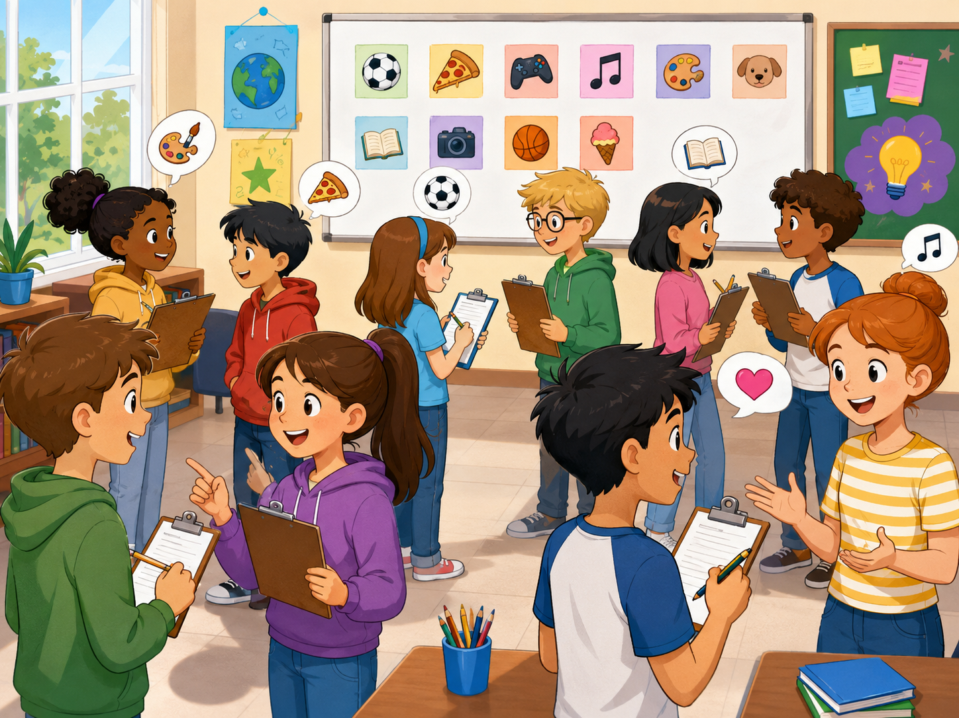
Teacher Quick Assessment
Use this to understand your students after class 4.
Student name
Can say like
Can give reason
Support needed
New image: survey speaking activity
After class, group students by confidence and reason-word control.
Likes and Reasons · Day 4 · Speaking & Listening
25
Notes:
Use this as a teacher-only slide. Identify who can answer with a reason, who only says one word, and who needs more listening support.

Slide 26
Printable Cards: Likes
Print this slide and cut into cards.
🍕
I like pizza.
⚽
I like soccer.
🎮
I like games.
🎵
I like music.
Ask: Why?
Ask: Why?
Ask: Why?
Ask: Why?
📚
I like books.
🎨
I like drawing.
🐶
I like dogs.
🍦
I like ice cream.
Ask: Why?
Ask: Why?
Ask: Why?
Ask: Why?
Teacher idea: Give one card to each student. They must add “because.”
Likes and Reasons · Day 4 · Speaking & Listening
26
Notes:
Print and cut. Use for pair role-plays, memory games, and classroom routines.

Slide 27
Printable Cards: Reason Words
Students pick a reason and finish the sentence.
🎉
fun
😋
delicious
✨
interesting
😎
cool
because it is ____
because it is ____
because it is ____
because it is ____
🧠
easy
💪
healthy
🎨
creative
🐱
cute
because it is ____
because it is ____
because it is ____
because it is ____
Extension: Students create one new reason card.
Likes and Reasons · Day 4 · Speaking & Listening
27
Notes:
Print and cut. Students match a like card with a reason card to make a full sentence.

Slide 28
Printable Cards: Questions
Use for interviews, mingle, or small-group speaking.
🍕
What food do you like?
🎮
What game do you like?
🎨
What activity do you like?
📚
What subject do you like?
Answer + because
Answer + because
Answer + because
Answer + because
🎵
What music do you like?
🐶
What animal do you like?
❓
Why?
🤝
Do you like it too?
Answer + because
Answer + because
Answer + because
Answer + because
Extension: Students create one new question card.
Likes and Reasons · Day 4 · Speaking & Listening
28
Notes:
Print and cut. Give each pair four cards. Students ask and answer, then swap cards with another pair.

Slide 29
Home Practice
Ask someone at home 3 questions.
Use English with family or a friend.
🍽️
Question 1
🎵
Question 2
🎮
Question 3
What food do you like? Why?
What music do you like? Why?
What game do you like? Why?
Bring one answer to next class.
Likes and Reasons · Day 4 · Speaking & Listening
29
Notes:
This is optional homework. Students ask a family member or friend three questions and bring one answer. Keep homework oral, not writing-heavy.

