Slide 1
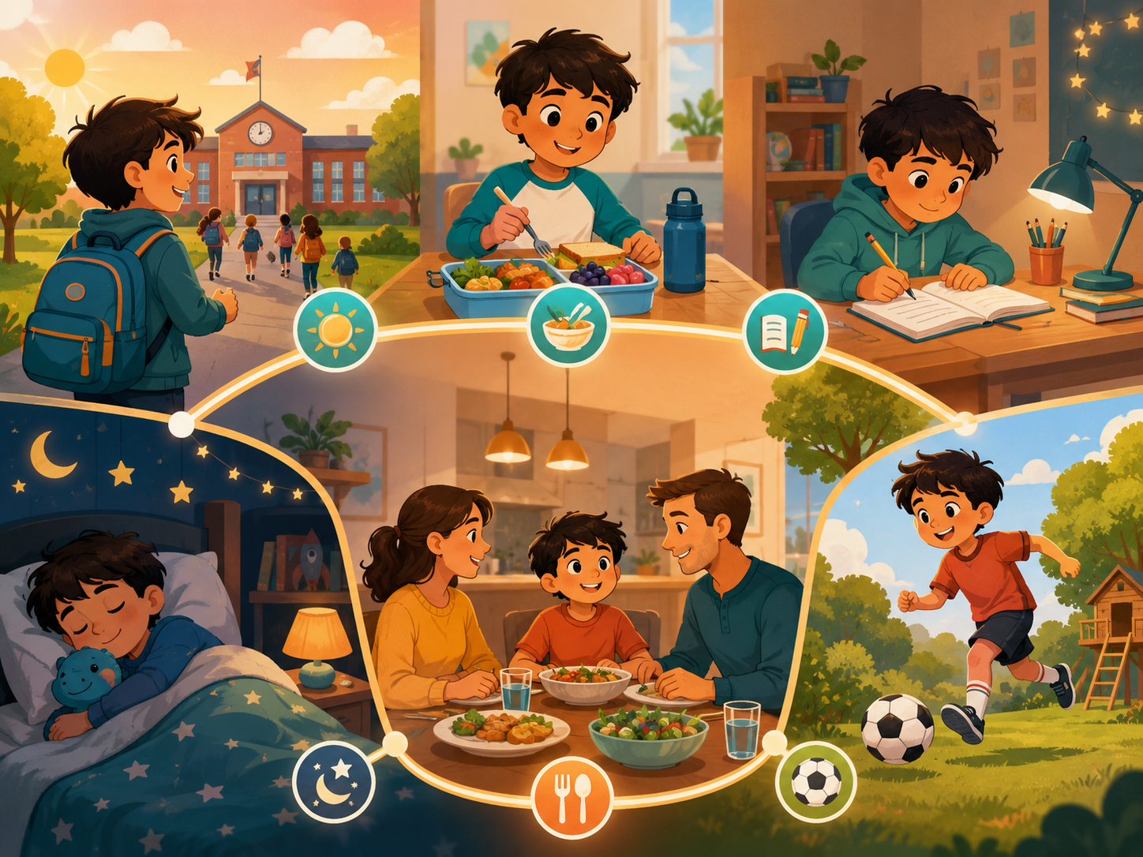
DAY 5 · 90 MINUTES
Daily Routines
Talk about your day in order and tell the time.
⏰
I can say…
➡️
I can order…
“I wake up at seven.”
“First, then, finally.”
Daily Routines · Day 5 · Speaking & Listening
01
Notes:
Welcome students. Say: Today we will talk about daily routines. We will use simple action words, time words, and order words like first, then, after that, and finally.

Slide 2
Today’s Mission
Students learn to describe a normal day in order.
By the end of class, I can talk about my daily routine and tell the time.
👂
Listen
🗣️
Speak
🤝
Connect
I can hear routine words and times in a short conversation.
I can say: I wake up at seven. Then I eat breakfast.
I can ask a friend: What do you do every day?
Class promise: Use English first. Listen carefully. Help friends remember the order.
Daily Routines · Day 5 · Speaking & Listening
02
Notes:
Ask students to repeat the mission. Use gestures: clock for time, walking fingers for routine, and two hands moving forward for order.

Slide 3
90-Minute Class Map
Use this slide to tell students what will happen today.
0–10
10–25
25–40
40–55
55–75
75–90
Quick Routine
Listen & Point
Time Words
Routine Story
Speak & Survey
Show & Reflect
☀️
👂
⏰
📖
📝
⭐
warm-up actions
hear routines
at seven / at night
find order + times
ask friends + tally
mini talk + exit
Teacher tip: Students should say “at” with a time many times today.
Daily Routines · Day 5 · Speaking & Listening
03
Notes:
Keep this slide quick. Say: We will listen, practice routine words, ask many friends, and finish with a small presentation.

Slide 4
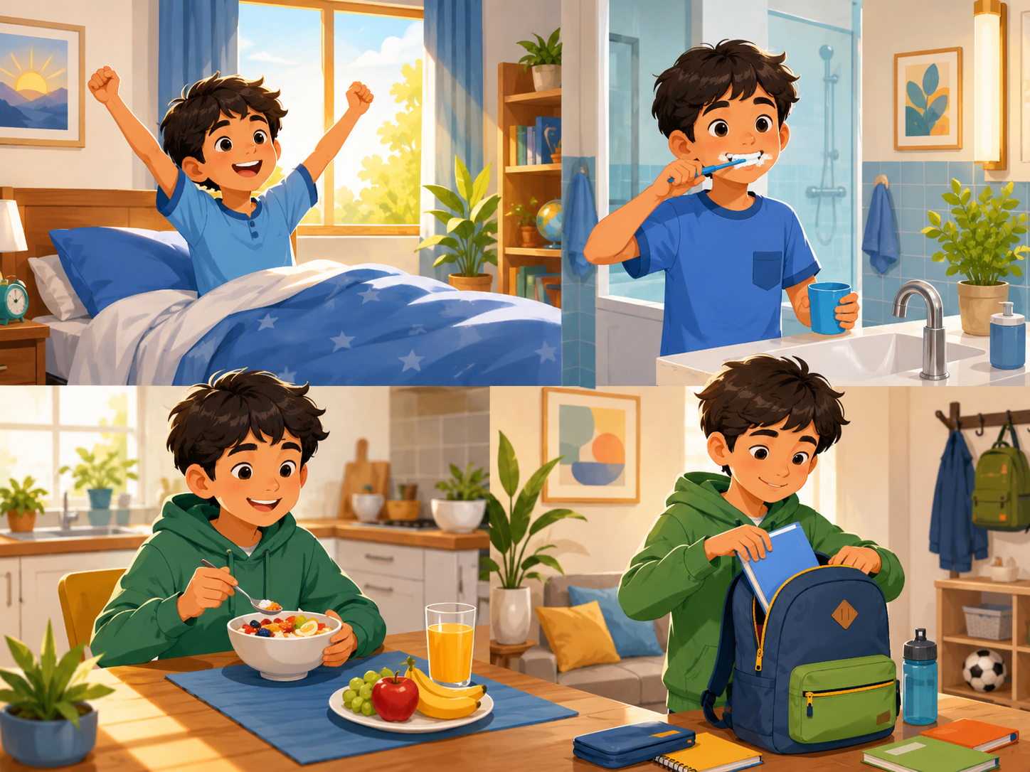
Quick Routine Warm-up
Start speaking in the first 5 minutes.
Teacher: I wake up at seven. What do you do in the morning?
Student: I _____.
Teacher: What time?
Student: At _____.
☀️
Morning
🏫
School
New picture prompt: morning routine
wake up · brush teeth
go to school · study
Action: ask 2 classmates and remember one answer.
Daily Routines · Day 5 · Speaking & Listening
04
Notes:
Use the picture. Model with one student. Students stand and ask two friends. Accept one action first, then push for a time.

Slide 5
Teacher Wants to Know You
Ask slowly. Students can answer with one word or a full sentence.
☀️
What time do you wake up?
🪥
When do you brush your teeth?
🍳
What do you eat for breakfast?
I wake up at _____.
I brush my teeth in the morning.
I eat _____ for breakfast.
🏫
How do you go to school?
📚
When do you do homework?
🌙
What time do you go to bed?
I go to school by _____.
I do homework after school.
I go to bed at _____.
Teacher note: Write one “class routine” sentence on the board.
Daily Routines · Day 5 · Speaking & Listening
05
Notes:
Ask 2 or 3 students as a model, then students ask partners. Collect the class routines on the board.

Slide 6
How Is Your Routine?
Students choose a feeling before saying a routine.
😊
easy
😴
sleepy
⚡
busy
😎
cool
😌
relaxing
I wake up early.
I am sleepy in the morning.
I have many things to do.
After school is cool.
Reading at night is relaxing.
Speak with your partner: “I _____ at _____. It is _____.”
Daily Routines · Day 5 · Speaking & Listening
06
Notes:
Students point to a feeling first. Then they say one sentence. Encourage honest but positive answers.

Slide 7
10 Useful Routine Words
Use gestures and quick repetition.
⏰
wake up
🧥
get dressed
🪥
brush teeth
🍳
eat breakfast
🏫
go to school
open your eyes
put on clothes
clean your teeth
morning food
leave home
🍱
have lunch
📚
do homework
⚽
play outside
🚿
take a shower
🌙
go to bed
midday food
study at home
move and have fun
wash your body
sleep time
Mini-drill: Teacher says the word → students do the gesture.
Daily Routines · Day 5 · Speaking & Listening
07
Notes:
Teach each routine word with an action. Wake up = stretch, brush teeth = brushing gesture, eat breakfast = spoon gesture, go to school = walk fingers.

Slide 8
Listen & Move
When you hear the sentence, do the action.
⏰
I wake up.
🪥
I brush my teeth.
🍳
I eat breakfast.
stretch
brush gesture
spoon gesture
🏫
I go to school.
📚
I do homework.
🌙
I go to bed.
walk fingers
write gesture
sleep pose
Challenge: Can your team do all six actions without speaking your first language?
Daily Routines · Day 5 · Speaking & Listening
08
Notes:
Teacher reads sentences in random order. Students do the action. Round 2 is faster. Round 3: a student leads.

Slide 9
Daily Routine Phrases
These phrases help students speak longer.
☀️
In the morning,
⏰
I wake up at _____.
➡️
Then I _____.
start your day
tell the time
next action
🏫
I go to school.
🌆
After school, I _____.
🌙
Finally, I go to bed.
main school action
afternoon action
last action
Repeat with rhythm: FIRST I wake up. THEN I eat. FINALLY I sleep.
Daily Routines · Day 5 · Speaking & Listening
09
Notes:
Use call and response. Teach stress: I WAKE UP at SEVEN. THEN I eat BREAKFAST.

Slide 10
Build the Sentence
Students practice one useful pattern.
I + routine verb + at + time.
🧩
Action
🧩
Action
🧩
Action
wake up
eat breakfast
go to school
🧩
Action
🧩
Action
🧩
Action
have lunch
do homework
go to bed
⏰
Time
⏰
Time
⏰
Time
six thirty
seven o’clock
eight fifteen
⏰
Time
⏰
Time
⏰
Time
twelve o’clock
four thirty
nine o’clock
Partner practice: Choose 3 actions and 3 times.
Daily Routines · Day 5 · Speaking & Listening
10
Notes:
Students point to an action and a time to build the sentence. Stronger students add: First, then, after that, finally.

Slide 11

Listening 1: Alex’s Morning
Teacher reads. Students listen for actions and times.
Listen. Put your hand up when you hear:
⏰
I wake up at seven.
🪥
I brush my teeth.
🍳
I eat breakfast at seven thirty.
🏫
I go to school at eight.
New picture prompt: routine cards
Script is in speaker notes for the teacher.
Daily Routines · Day 5 · Speaking & Listening
11
Notes:
Listening script 1. Read twice. First time: students only listen. Second time: students raise their hand when they hear the key phrases. Mia: Alex, what do you do in the morning? Alex: I wake up at seven. Mia: What do you do next? Alex: I brush my teeth. Then I eat breakfast at seven thirty. Mia: What time do you go to school? Alex: I go to school at eight. Mia: Great. You have a busy morning!

Slide 12
Listening Check
Students answer with fingers: 1, 2, or 3.
👂
What time does Alex wake up?
🪥
What does Alex do next?
1 seven
2 nine
3 twelve
1 play games
2 brush teeth
3 go to bed
🍳
What time does Alex eat breakfast?
🏫
What time does Alex go to school?
1 seven thirty
2 three o’clock
3 ten fifteen
1 eight
2 six
3 one
Fast correction: Say the full answer together.
Daily Routines · Day 5 · Speaking & Listening
12
Notes:
Students answer with fingers. Then say full answers: Alex wakes up at seven. He eats breakfast at seven thirty. He goes to school at eight.

Slide 13
Speaking Game: Routine Chain
Students build a longer answer together.
1
2
3
4
Pick a card.
Say the routine.
Partner asks time.
Give the time.
wake up / homework / bed
I wake up.
What time?
At seven o’clock.
Use English only. Use gestures if you forget a word!
Daily Routines · Day 5 · Speaking & Listening
13
Notes:
Give each pair routine cards. Student A says an action. Student B asks what time. Student A gives a time. Then switch roles.

Slide 14
Dialogue Model
Students practice a short, safe conversation.
A: What do you do in the morning?
B: I wake up at seven.
A: What do you do next?
B: Then I eat breakfast.
A: What time do you go to school?
B: I go to school at eight.
Practice 3 times: slow voice → normal voice → acting voice.
Daily Routines · Day 5 · Speaking & Listening
14
Notes:
Model with one confident student. Then students repeat line by line. Finally pairs act it with different feelings: sleepy, happy, busy, surprised.

Slide 15
Choose a Role-play
Students make routines useful in real conversations.
🏠
Problem 1 · Morning at home
🏫
Problem 2 · Going to school
Tell your family what you do first.
Say what time you leave home.
📚
Problem 3 · After school
🌙
Problem 4 · Bedtime
Talk about homework, play, and dinner.
Say your evening routine in order.
Performance rule: everyone speaks at least one line with a time.
Daily Routines · Day 5 · Speaking & Listening
15
Notes:
Assign each pair one role-play. Give 3 minutes to prepare and 5-7 minutes for quick performances. Praise order words and clear time.

Slide 16
Routine Corners
Students move, choose, and explain.
☀️
Morning
🏫
School
I wake up at seven.
I go to school at eight.
🌆
After school
🌙
Evening
I do homework at four.
I go to bed at nine.
Rule: Move to a corner → tell one friend your sentence → change corner.
Daily Routines · Day 5 · Speaking & Listening
16
Notes:
Put four picture cards in the classroom corners. Students move to a corner and tell one friend one routine sentence.

Slide 17
Mingle Survey: Ask 4 Friends
Students ask, answer, and remember times.
Name
Morning routine
Time
After-school routine
Time
Ask: “What do you do in the morning?” → “What time?” → Write one time.
Daily Routines · Day 5 · Speaking & Listening
17
Notes:
Students ask four friends and record short answers. For low-level students, allow drawing in the table. Strong students write full routine sentences.

Slide 18
Listening 2: The Busy Day Club
Students listen for names, routines, and times.
Name
Routine 1
Time
Routine 2
Lily
Ben
Sara
Share answers with your partner before teacher feedback.
Daily Routines · Day 5 · Speaking & Listening
18
Notes:
Listening script 2. Read twice. First listen: students only listen. Second listen: students fill the table. Ben: Hi, Lily. What time do you wake up? Lily: I wake up at six thirty. Then I eat breakfast at seven. Ben: I wake up at seven. After school, I play football at four. Sara: I do homework at five. Then I read at eight. Answers: Lily - wake up/six thirty, breakfast/seven. Ben - wake up/seven, play football/four. Sara - homework/five, read/eight.

Slide 19
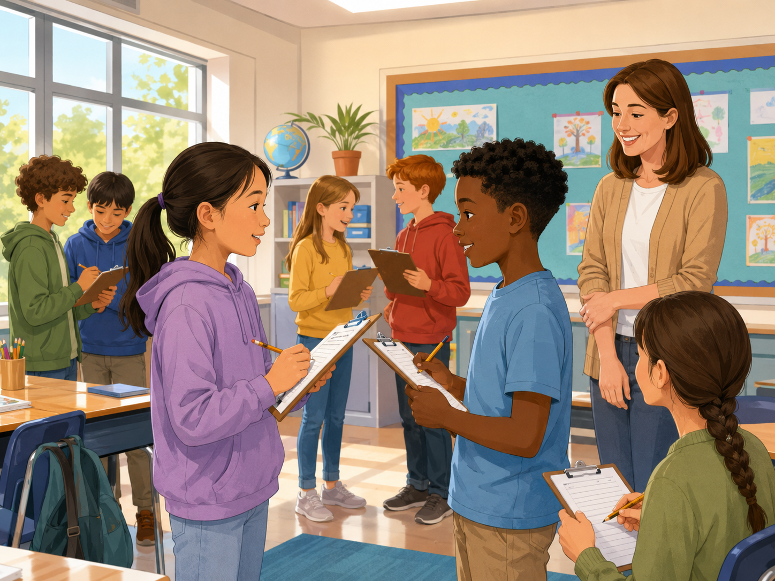
What Do They Do?
Look at the picture. Choose a time and make a sentence.
⏰
He wakes up at seven.
🍳
She eats breakfast at seven thirty.
🏫
He goes to school at eight.
📚
She does homework at five.
New picture prompt: students ask about routines
Pair talk: “I think he / she… at…”
Daily Routines · Day 5 · Speaking & Listening
19
Notes:
Use the picture as a speaking prompt. Students choose one child and make a sentence. Encourage them to point and use at with time.

Slide 20
Team Challenge: Routine Race
A fast review game before the final speaking task.
🎭
Round 1
👂
Round 2
💬
Round 3
Teacher shows a card. Team says: I ____ at _____.
Teacher says a time. Team guesses the routine.
One student asks: What time? Another answers.
Scoring: 1 point for clear English · 1 point for time · 1 point for teamwork
Daily Routines · Day 5 · Speaking & Listening
20
Notes:
Make 2-4 teams. Keep it light and positive. Do not overcorrect. Award bonus points for students who help shy classmates speak.

Slide 21
Mini Presentation: My Daily Routine
Students speak for 20–30 seconds.
Hello. My name is ____.
👀
Look up
In the morning, I ____ at ____.
🗣️
Speak clearly
Then I ____ at ____.
After school, I ____ at ____.
⏰
Say times
Finally, I go to bed at ____.
➡️
Use order words
Thank you.
😊
Smile
Daily Routines · Day 5 · Speaking & Listening
21
Notes:
This is the final speaking task. Let students present in pairs or small groups if whole-class speaking is stressful.

Slide 22
Our Speaking Class Rules
Create a safe classroom when sharing routines.
🌱
Use English first.
🤝
Help your partner.
Even one word + time is okay.
Point, gesture, or whisper a word.
👂
Listen for time.
⭐
Mistakes help us learn.
Hear “at seven” and “after school.”
Try again with a smile.
Class chant: “First. Then. Time. Smile.”
Daily Routines · Day 5 · Speaking & Listening
22
Notes:
Have students repeat the class chant. Ask students to show thumbs up if they agree.

Slide 23
Speaking Passport: Day 5 Stamp
Self-check at the end.
Today I can…
⏰
say a routine
❓
ask a friend
I wake up at seven.
What time do you wake up?
➡️
order my day
✅
tell the time
First, then, finally.
at seven thirty
Circle one: 🙂 I can do it 😐 I need practice 🙁 I need help
Daily Routines · Day 5 · Speaking & Listening
23
Notes:
Students self-assess. Ask students to choose one sentence they can say today.

Slide 24
Exit Ticket
A quick closing routine.
💬
Say one routine
⏰
Add one time
➡️
Add one order word
“I wake up.”
“at seven.”
“Then I eat breakfast.”
Teacher says goodbye using each student’s name when possible.
Daily Routines · Day 5 · Speaking & Listening
24
Notes:
Students must say one routine before leaving. Keep it positive and fast.

Slide 25
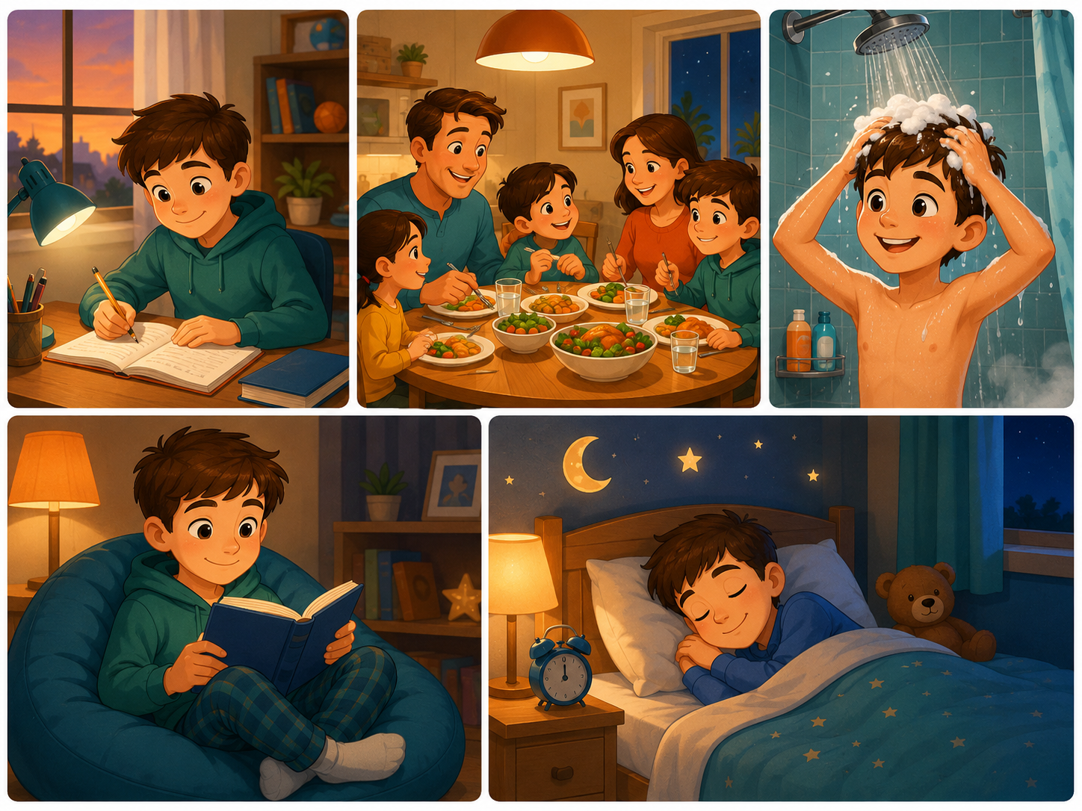
Teacher Quick Assessment
Use this to understand your students after class 5.
Student name
Can say routine
Can tell time
Can order day
Support needed
New image: daily routine speaking activity
After class, group students by confidence, time words, and sequence control.
Daily Routines · Day 5 · Speaking & Listening
25
Notes:
Use this as a teacher-only slide. Identify who can answer with a time, who can order routine sentences, and who needs more listening support.

Slide 26
Printable Cards: Morning Routines
Print this slide and cut into cards.
⏰
I wake up.
🛏️
I get up.
🧥
I get dressed.
🪥
I brush my teeth.
Ask: What time?
Ask: What time?
Ask: What time?
Ask: What time?
🍳
I eat breakfast.
🎒
I pack my bag.
🏫
I go to school.
👋
I say goodbye.
Ask: What time?
Ask: What time?
Ask: What time?
Ask: What time?
Teacher idea: Give one card to each student. They must add “at ____.”
Daily Routines · Day 5 · Speaking & Listening
26
Notes:
Print and cut. Use for pair role-plays, memory games, and classroom routines.

Slide 27
Printable Cards: After-School & Evening
Students pick a card and finish the sentence.
🍱
I have lunch.
⚽
I play outside.
📚
I do homework.
🍽️
I have dinner.
at ____
at ____
at ____
at ____
🚿
I take a shower.
📖
I read a book.
🧸
I relax.
🌙
I go to bed.
at ____
at ____
at ____
at ____
Extension: Students create one new routine card.
Daily Routines · Day 5 · Speaking & Listening
27
Notes:
Print and cut. Students match a routine card with a time card to make a full sentence.

Slide 28
Printable Cards: Questions
Use for interviews, mingle, or small-group speaking.
⏰
What time do you wake up?
🍳
What do you eat for breakfast?
🏫
What time do you go to school?
📚
When do you do homework?
Answer with at ____
Answer with I eat ____
Answer with at ____
Answer with after ____
⚽
What do you do after school?
🍽️
What time do you have dinner?
🌙
What time do you go to bed?
➡️
What do you do next?
Answer with I ____
Answer with at ____
Answer with at ____
Answer with Then I ____
Extension: Students create one new question card.
Daily Routines · Day 5 · Speaking & Listening
28
Notes:
Print and cut. Give each pair four cards. Students ask and answer, then swap cards with another pair.

Slide 29
Home Practice
Ask someone at home 3 questions.
Use English with family or a friend.
☀️
Question 1
🌆
Question 2
🌙
Question 3
What time do you wake up?
What do you do after school or work?
What time do you go to bed?
Bring one answer to next class.
Daily Routines · Day 5 · Speaking & Listening
29
Notes:
This is optional homework. Students ask a family member or friend three questions and bring one answer. Keep homework oral, not writing-heavy.

