Slide 1
credit card fraud detection using support vector machine
Ahmed Sami
April 30, 2020

Slide 2
ML for behavior-based fraud detection
Frequency
Time
Shipping address
Transaction amount
Credit card fraud
2018 $27.85 B
2028 $40.63 B
Source: Annual Fraud Statistics (2018) by The Nilson Report

Slide 3
Dataset: “Credit card fraud detection”
Source: Kaggle
Records: 284,807 transactions
Features: 30
Class: Binary
Class 1 = fraudulent transaction
Class 0 = genuine transaction

Slide 4
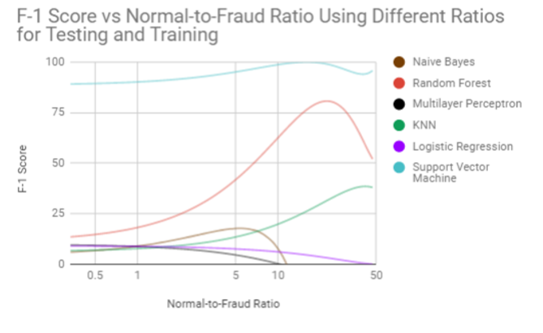
Why SVM??
F-score remains steady as the normal-to-fraud ratio decreases
284,807 Transactions
Fraud 0.17 %
NoFraud 99.83 %
Banerjee, Rishi, et al. "Comparative Analysis of Machine Learning Algorithms through Credit
Card Fraud Detection." New Jersey’s Governor’s School of Engineering and Technology (2018).

Slide 5
Libraries
Data Manipulation | Visualization | Classification
Pandas Numpy Time | Matplotlib Custom modules | Sklearn

Slide 6
Performance Measures
PR curves
F1 Score
“Precision-recall curves (PR curves) are recommended
for highly skewed domains where ROC curves may provide
an excessively optimistic view of the performance.”
Not fraudulent
TN
FP
FN
TP
Source: andLuis Torgo, Paula Branco, and Rita Ribeiro. "A survey of predictive modeling under imbal-anced distributions." ACM Comput. Surv 49.2 (2016): 1-31

Slide 7
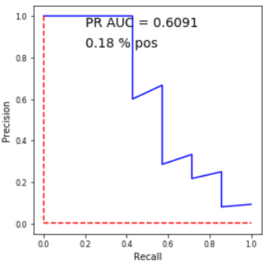
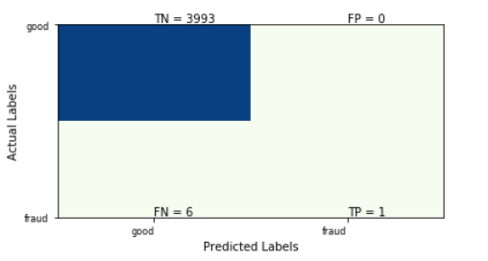
SVM Model
Base_model = SVC(C=5, gamma='scale', kernel='rbf’, probability=True)
F-1 score: 0.2500

Slide 8
Why RBF (Radial Basis Function) ??
“This function is more flexible and majority of the SVM applications used the RBF kernel function” (Dheepa, 2012)
Both articles used RBF
Dheepa, V., and R. Dhanapal. "Behavior based credit card fraud detection using support vector machines." ICTACT Journal on Soft computing 2.07 (2012): 2012.

Slide 9

Finding The Optimal Combination Of “C” And “Gamma”: Gridsearch

Slide 10
Finding The Optimal Combination Of “C” And “Gamma”: Gridsearch
Experiment Hyperparameters:
Cs = [.5, 1, 10, 100, 200]
gammas = np.logspace(-4, 0, num=5, endpoint=True, base=5)

Slide 11
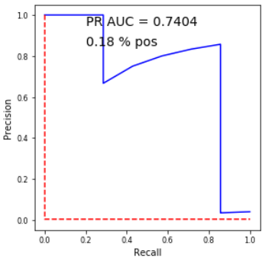
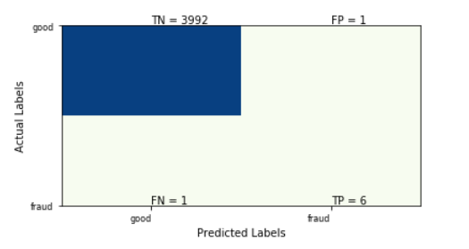
Best SVM Model (after GridsearchCV)
Best_model = SVC(C=10, gamma= 0.0016, probability=True)
F-1 score: 0.8571

Slide 12
SVM Models: Comparison
F-1 score: 0.2500
F-1 score: 0.8571
Before GridsearchCV
After GridsearchCV

Slide 13
Thanks ☺

Slide 14
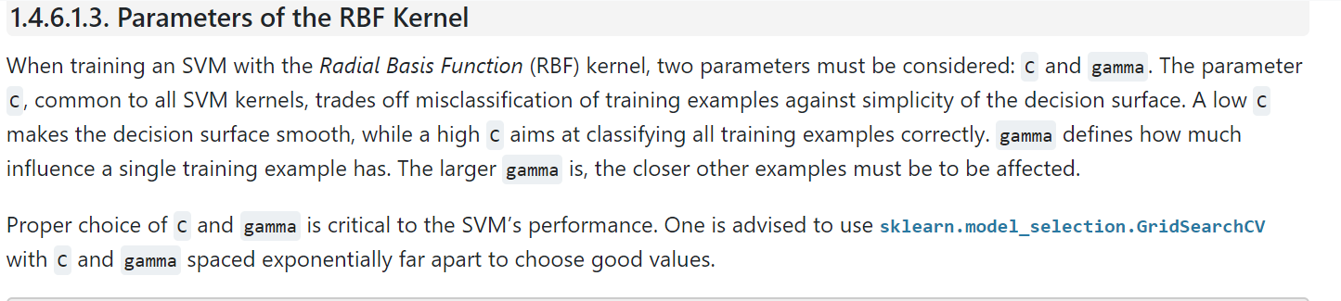
https://scikit-learn.org/stable/modules/svm.html
Why GridSearch??

