Slide 1


Smart OS Simulator
Smart OS Simulator is an interactive educational web application.
Frontend built with Vite + React (TypeScript).
Optional Flask backend for advanced features.
Helps students explore core Operating System concepts visually and interactively.
C223198
C231051
C231053
C231062
Notes:
1

Slide 2

Objectives
CPU Scheduling
Memory Allocation
Simulate CPU scheduling algorithms with Gantt charts and metrics.
Visualize memory allocation strategies and fragmentation.
Page Replacement
Learning Support
Demonstrate page replacement algorithms step by step.
Provide learning support via analysis tools and an OS Q&A assistant.
Notes:
2

Slide 3
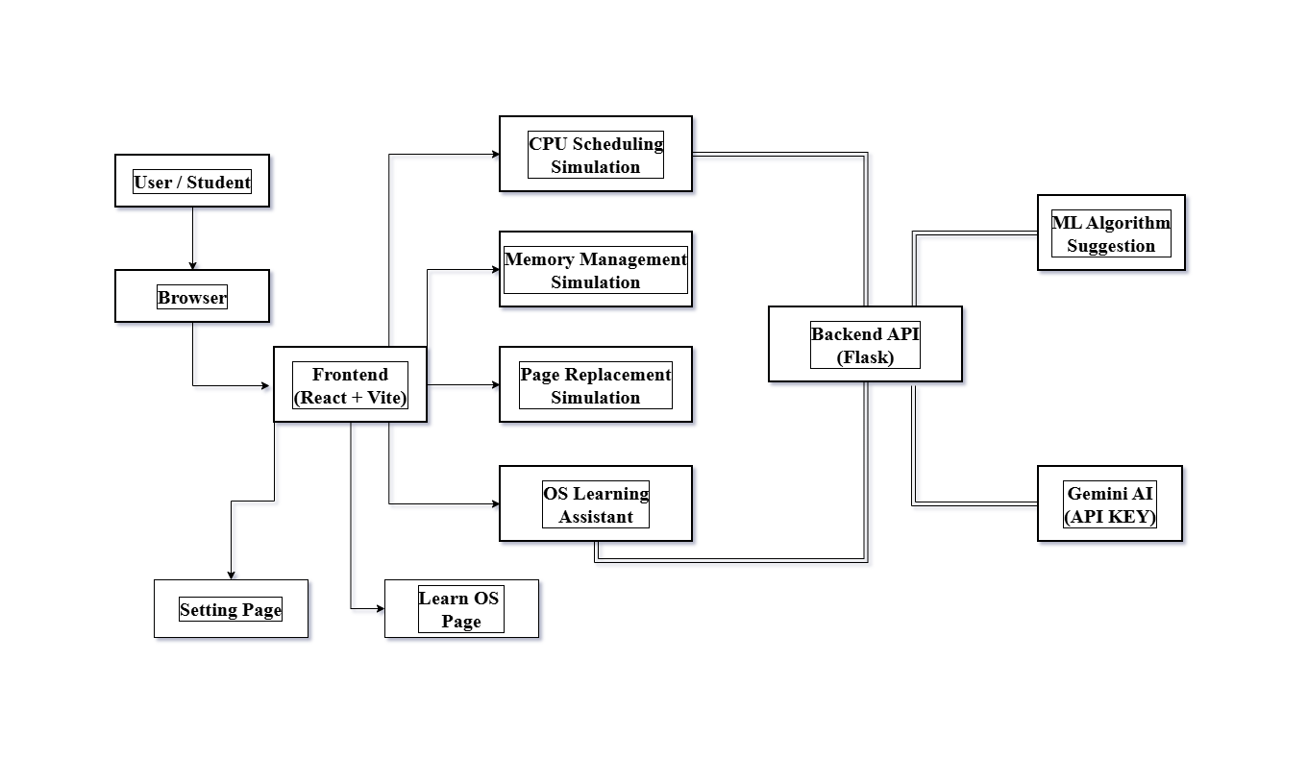
Methodology
Notes:
3

Slide 4
Limitations
Configuration
Security
ML Scheduler
Frontend–backend configuration is tightly coupled to local development.
Security concerns: debug mode enabled and API keys stored in .env.
ML scheduler trained on synthetic data may not generalize well.
User Management
Repository Size
No user authentication, persistence, or rate limiting.
Large repository size due to included node_modules and virtual environments.
Notes:
4

Slide 5







Conclusion
Educational Lab
Clear Visualizations
The project serves as a strong educational lab for OS concepts.
Clear visualizations improve understanding of core algorithms.
AI Assistant
Future Improvements
AI/knowledge-base assistant enhances learning support.
Future improvements should focus on production readiness and security.
Notes:
5

