Slide 1


















CRIME AND PUNISHMENT
by Fyodor Dostoevsky
Ali Amir

Slide 2


Index
1 | Introduction & Hook
2 | Genre
3 | Author’s Biography
4 | Characters & Ideas
5 | Plot Summary
6 | Why You Should Read It
7 | Relevance Today
8 | Conclusions

Slide 3
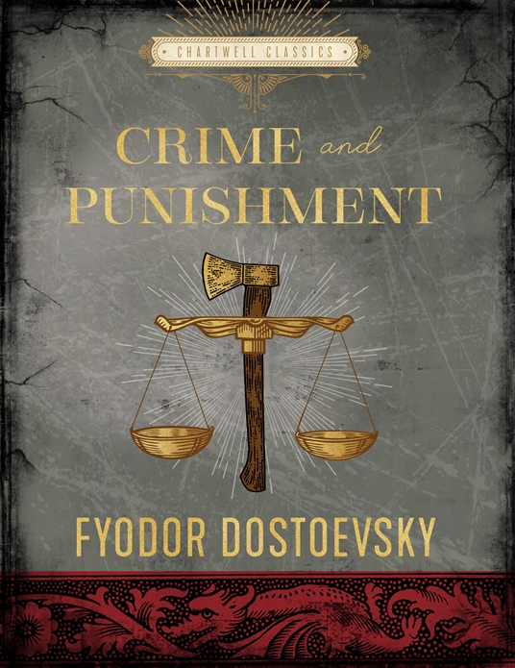


“Your worst sin is that you have destroyed and betrayed yourself…for nothing.” — Fyodor Dostoevsky

Slide 4

Introduction
Imagine holding a scale. On one side, a cruel, greedy person who brings misery to others. On the other, a hundred starving people who could be saved with that one person’s wealth. Cold logic says: eliminate them. But what if picking up the axe shattered your own conscience forever? That is the question at the heart of Crime and Punishment.

Slide 5


19th-Century Realism & Psychological Thriller. Dostoevsky subverts the crime novel: we watch Raskolnikov commit murder in Part One. The suspense shifts from “whodunit” to “whydunit.” The real thriller is the claustrophobic chase inside Raskolnikov’s own fractured mind — a philosophical novel about conscience, guilt, and limits of cold logic.
Genre

Slide 6


Author’s Biography
1
Born 1821 in Moscow to a strict, authoritarian father who was a doctor at a pauper’s hospital. At 16 he left for St. Petersburg to study military engineering.
2
After his father’s murder, he left the military in 1844 to pursue literature. His later imprisonment in Siberia profoundly shaped his worldview.
Dostoevsky’s own suffering breathed life into Raskolnikov’s desperation.
3
He conceived the novel in 1865 in Wiesbaden — penniless, unable to pay his bills, starving in a cheap room. Like Raskolnikov, he was dreaming of escape through desperate action.

Slide 7

CHARACTERS
1
2
3
Raskolnikov
Svidrigailov
  Sonya & Porfiry

Slide 8



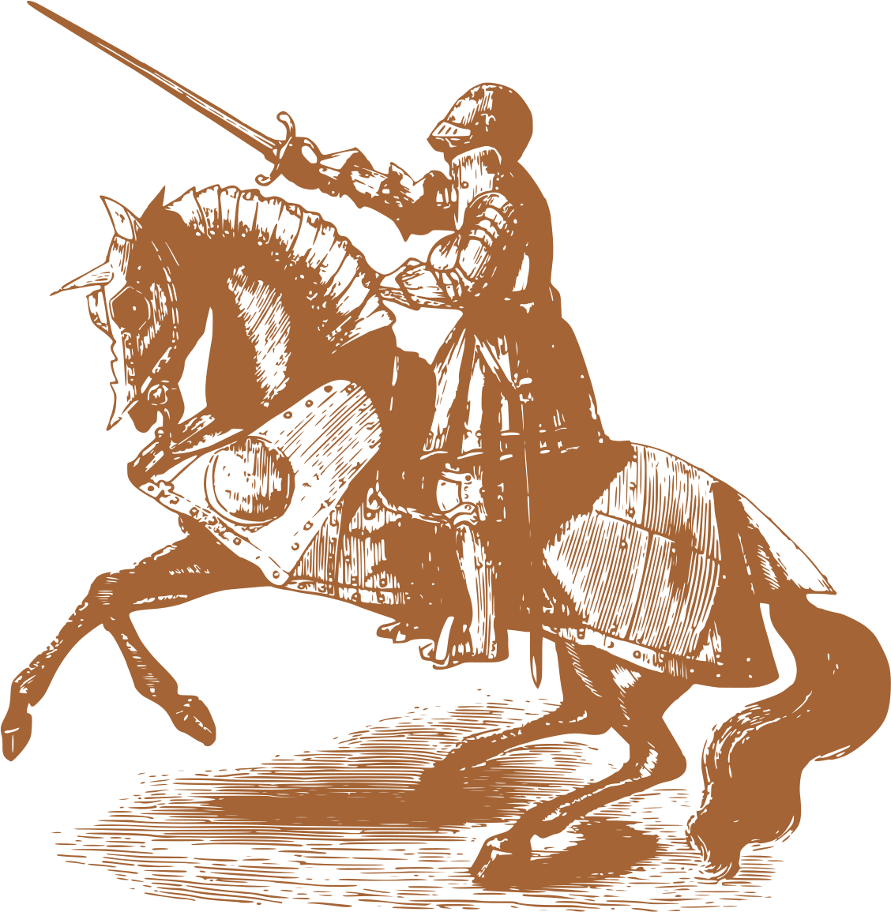

Characters & the Ideas They Represent
Raskolnikov
Svidrigailov
Porfiry Petrovich
Sonya Marmeladova
The Extraordinary Man Theory
An impoverished ex-law student. Represents intellectual arrogance and the “Extraordinary Man” theory — his belief that superior intellect grants the right to step over the law.
A wealthy, corrupt aristocrat. Represents the logical extreme of nihilism. He is Raskolnikov’s dark mirror — showing what life looks like when conscience is completely killed.
The brilliant police detective. Represents psychological reality. He doesn’t chase Raskolnikov with handcuffs — he traps him in agonizing mind games, knowing guilt will break him from within.
Forced into prostitution to feed her family. Represents the opposite of Raskolnikov — self-sacrificing love, empathy, and Christian redemption. The emotional anchor of the novel.
Raskolnikov divides humanity: the “ordinary” masses who must obey the law, and the “extraordinary” few — like Napoleon — who may step over it. His tragedy is believing he belongs to the latter.

Slide 9



Part 1: The Crime
Part 6: Climax
1
4
Parts 2-3: Punishment Begins
Epilogue: Redemption
2
Plot Summary
5
Six Parts + Epilogue
Parts 4-5: Confession
The Pawnbroker
3
6

Slide 10



Plot Summary
1
Part 1 — The Crime: Raskolnikov axes the pawnbroker and her sister. Cold logic shatters immediately.
2
Parts 2–3 — Punishment: Fever, delirium. He hides stolen goods he never uses and isolates from everyone.
  “Did I kill the old crone? I killed myself, not the old crone!” — Raskolnikov
3
Parts 4–5 — Confession: He reads the Lazarus story with Sonya and confesses the murder to her.
4
Part 6 — Climax: Svidrigailov commits suicide. Porfiry confronts Raskolnikov. He confesses to police.
5
Epilogue — Redemption: In Siberia, his arrogance slowly dies. He weeps. His humanity is reborn.

Slide 11
Why You Should Read It
Crime and Punishment is the ultimate cure for intellectual arrogance. We are not machines — we have a conscience. When we believe our intellect places us above human decency, we don’t achieve greatness. We destroy our own peace of mind. True strength comes from empathy, not cold logic.

Slide 12

Relevance Today
Raskolnikov lives in the 21st century. In billionaires who act above moral law. In algorithms that reduce human lives to data points. Dostoevsky’s warning is timeless: true greatness is never built by sacrificing our humanity.

Slide 13















Conclusions
Dostoevsky’s warning is timeless: when we prioritize cold logic over compassion, we step into Raskolnikov’s shoes. True progress can never be built by sacrificing our basic humanity. Salvation comes not from a brilliant mind, but from a compassionate heart.

Slide 14
THANK YOU

