Slide 1
Where open a catering services in Casanearshore ?
Samia N.

Slide 2
Background
Casanearshore park is a service area located in Morocco, dedicated to companies specializing in software development, infrastructure management, back office banking and insurance and customer relationship management
Opening a restaurant is all about location. However, not every restaurant is suitable for every location, and vice versa
If you can define your restaurant type and identify your target demographic and its most populated areas, you’ll be well on your way to choosing a restaurant location that sets your business up for success.

Slide 3
Problem
find the optimal location for a restaurant with the concept of collective catering near to casablanca casanearshore.
The catering services can be dedicated, primarily, to casanearshore employees and students.

Slide 4
Methodology
uses location data of Casablanca neighborhoods to explore and analyses venues categories in casanearshore neighborhood
proposes a clustering of this park (casanearshore) which recommend where a Catering services can be implemented.
Select the appropriate features :
distance to casanearshore park
restaurant concepts: restaurant or catering related words,
Customer type: education and industry related words
distance to other restaurants that provide the same services
distance to catering services
Geography of the region

Slide 5
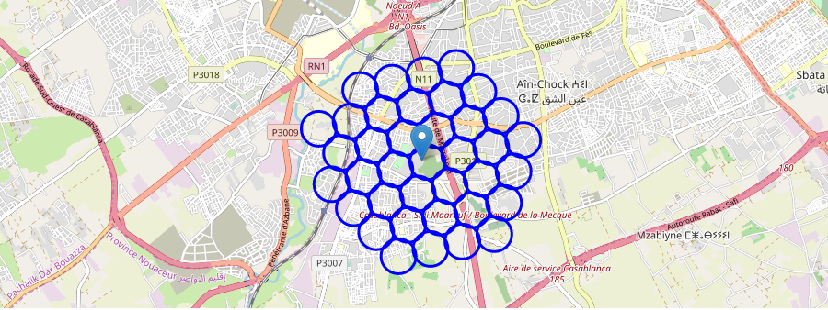
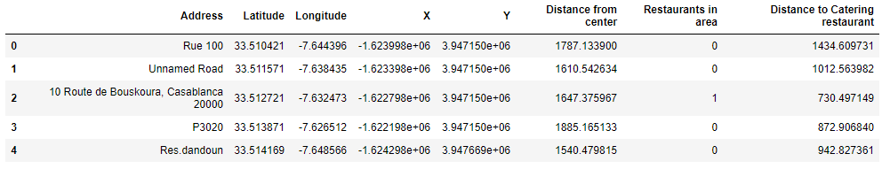
Area of interest
For each cells in the grid, Google Maps Api is used to get for each location latitude and longitude that were calculated automatically using the Cartesian coordinates

Slide 6
Locate Casanearshore venues
Type 1 : business/school typology
Professional & Other Places : 4d4b7105d754a06375d81259
College & University category : 4d4b7105d754a06372d81259
Business Center : 56aa371be4b08b9a8d573517
Business Service : 5453de49498eade8af355881
Office : 4bf58dd8d48988d124941735
Type 2 : restaurant typology :
For generic restaurant, we selected all food category : 4d4b7105d754a06374d81259
For Catering competitors, we selected :
Restaurant : 4bf58dd8d48988d1c4941735
Buffet : 52e81612bcbc57f1066b79f4
Comfort Food Restaurant : 52e81612bcbc57f1066b7a00
Cafeteria : 4bf58dd8d48988d128941735
Food court : 4bf58dd8d48988d120951735
Theme restaurant :56aa371be4b08b9a8d573538

Slide 7
distribution of venues among the selected types
Type | Number of venues
Number of restaurant | 198
Number of Catering restaurants | 21
Number of business (population characteristics) | 179

Slide 8
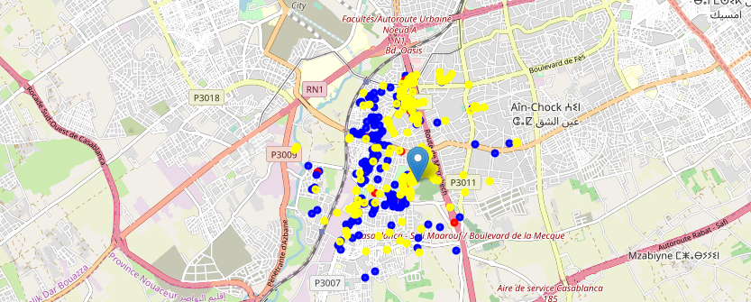
collected venues of Casanearshore in a map
Yellow : how much businesses around our area
The bleu points which present the restaurants that are distributed mainly in the west (from north to south) of the casanearshore center.
catering restaurants with red color are few but presents in our area, they are distributed in the west like the other restaurants except for 2 or 3 ones.

Slide 9
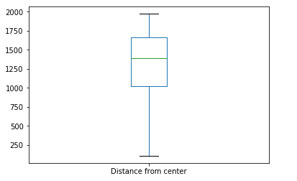
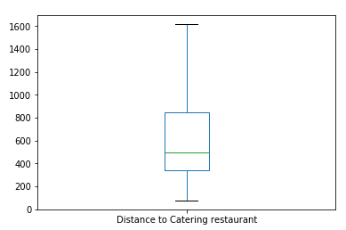
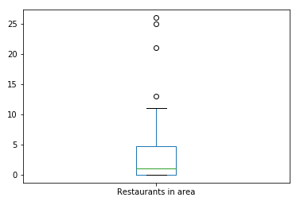
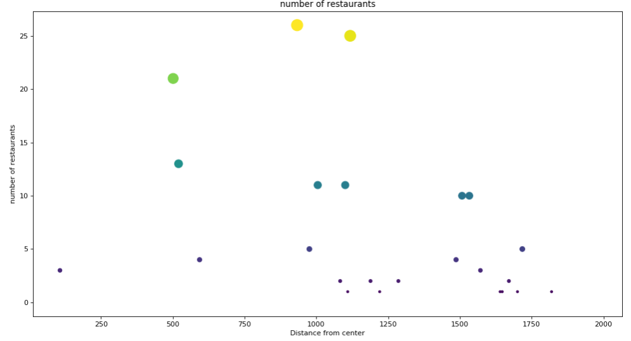
the distributions of distance from center and number of restaurants metrics

Slide 10
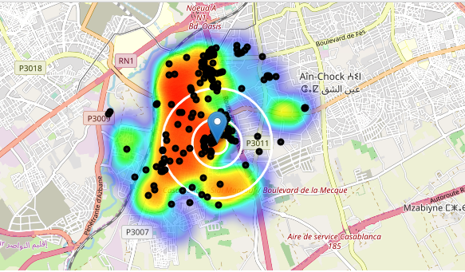
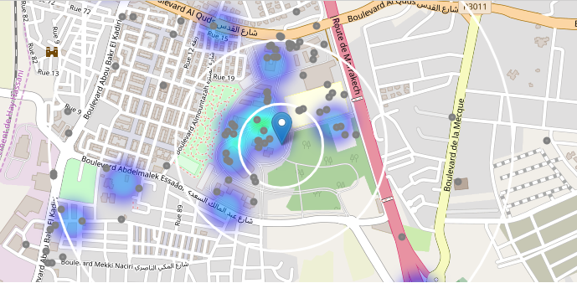
heatmap of restaurants density and catering density

Slide 11
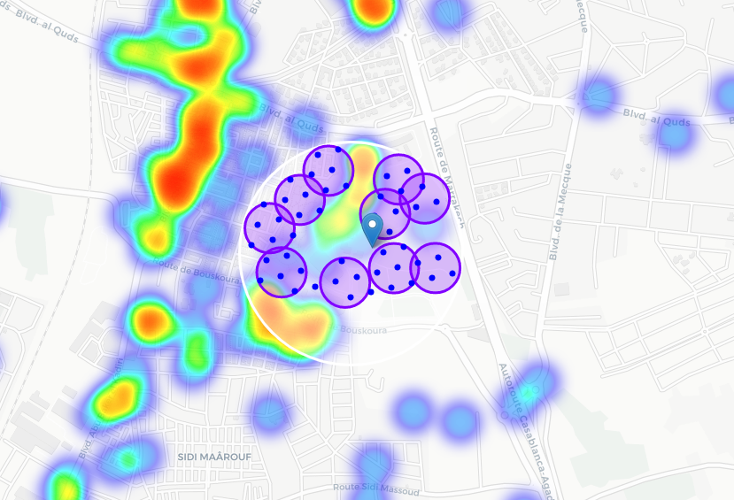
the 10 generated clusters of our area of interest using Kmean

Slide 12
Conclusion
We have created 10 addresses representing centers of zones containing locations with low number of restaurants and no Catering restaurants nearby, all zones being fairly close to Casanearshore center (all less than 500m from casanearshore, ).
zones are shown on map with a radius of ~100 meters (purple circles), their shape is actually very irregular and their centers/addresses should be considered only as a starting point for exploring area neighborhoods in search for potential restaurant locations.
Most of the recommended zones are located in the west of the casanearshore center, which we have identified as interesting due to being accessible for business/student people and also possible to build services in, and well connected by public transport.

