Slide 1






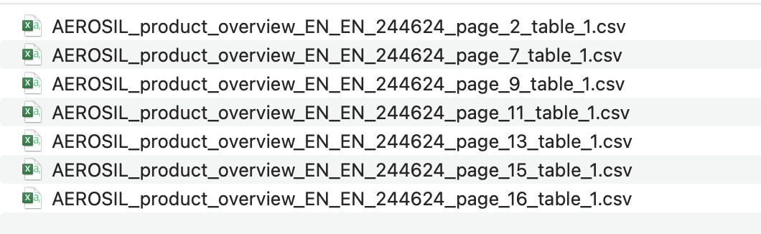
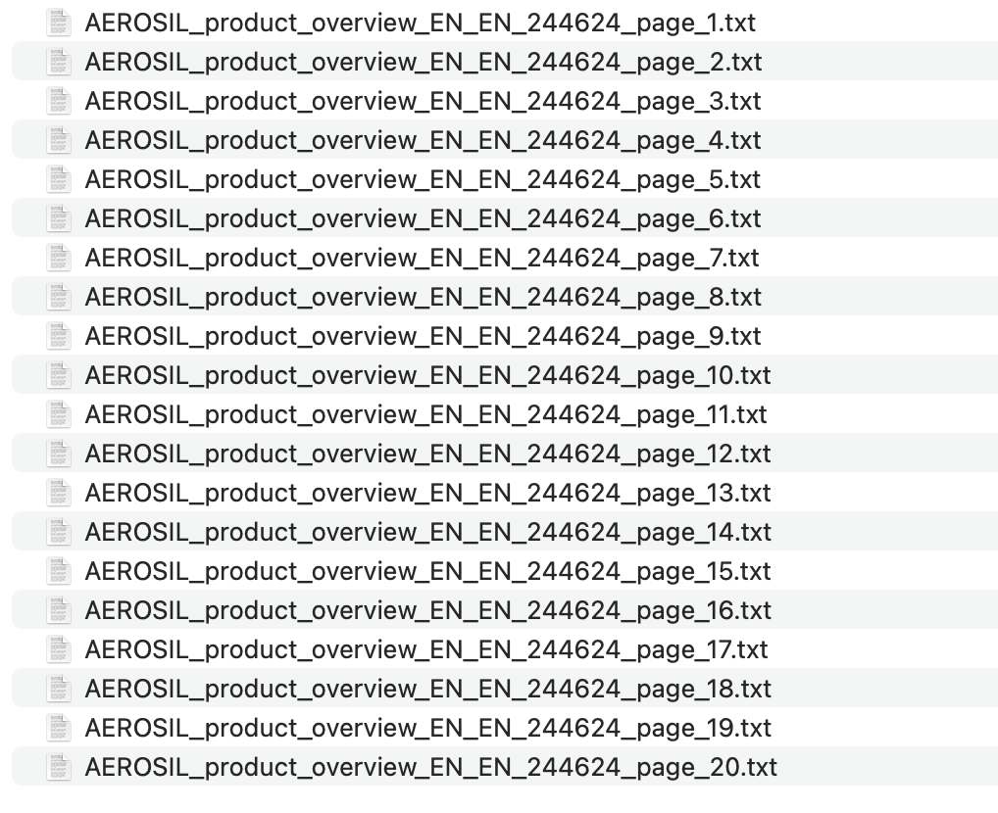
Text Extraction from Text based PDF using Tabula and PDFPlumber:
Text Based Input Files
Tabula
PDFPlumber
Output: CSV
Output: Text

Slide 2



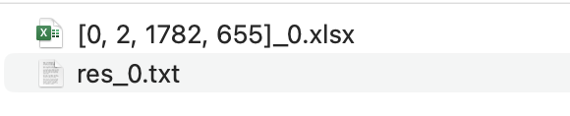
Text Extraction from Image-based PDF using OCR:
Image Based Input Files
OCR
PaddleOCR
PPStructure with PaddleOCR
Output: Text
Output: Excel & Text file
(with coordinates)

