Slide 1

Data Science Case-Study
Sami Ali

Slide 2

Goal
To predict whether the customer will default on their credit card payment next month.
Identify the key drivers that determine this default.

Slide 3
Importance of the Problem
A model like this would be very valuable for Banks who could make use of the information provided.
This would inform the issuer’s decisions on who to give a credit card and what credit limit to provide
A better understanding of their current and potential customers.

Slide 4
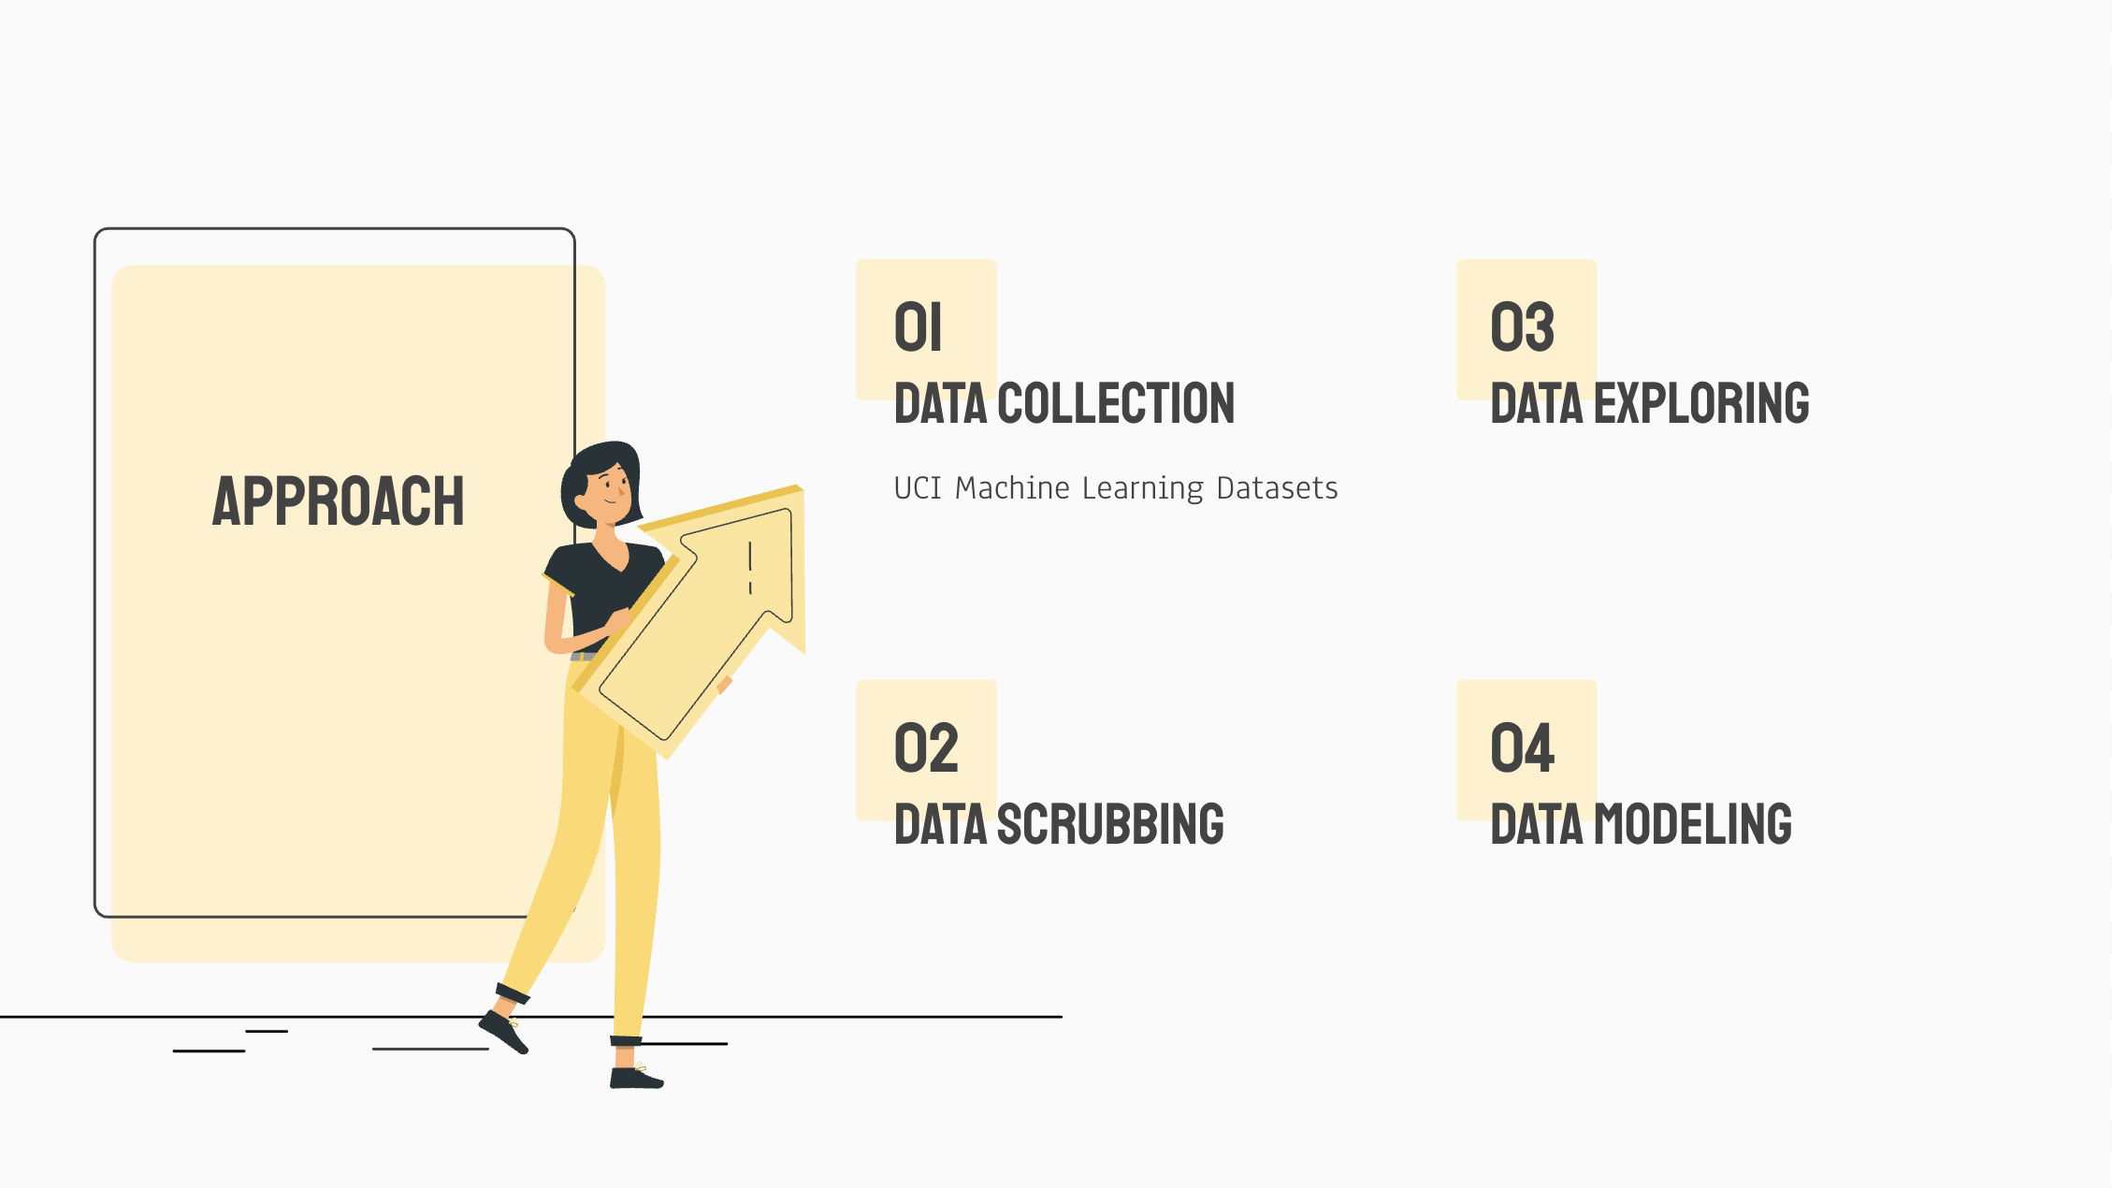
Approach

Slide 5
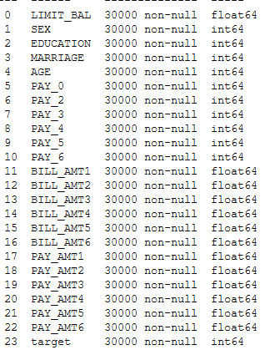
Data Cleaning
Handling missing values
Handling categorical data

Slide 6
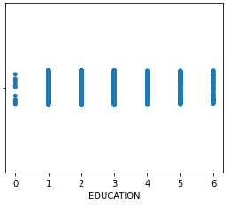
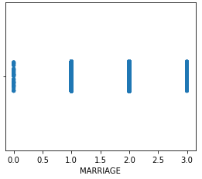
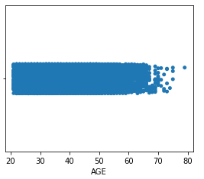
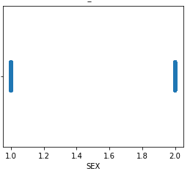
Data Cleaning
Checking outliers
Checking wrong data

Slide 7
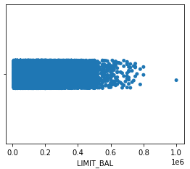
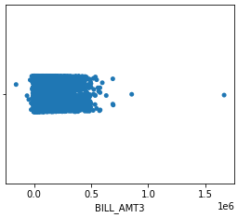
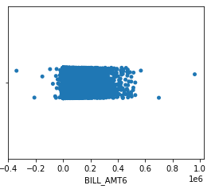
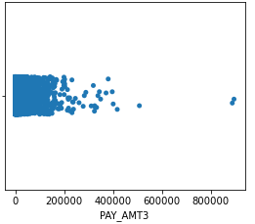
Data Cleaning

Slide 8
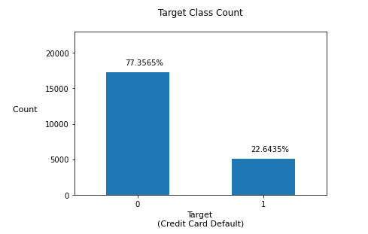
Data Exploring
Checking Data balance

Slide 9
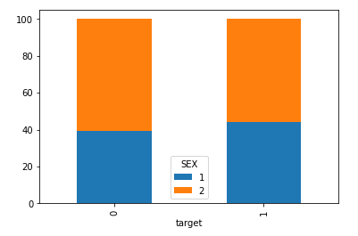
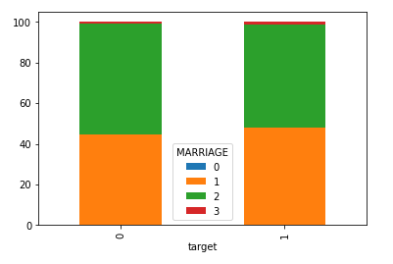
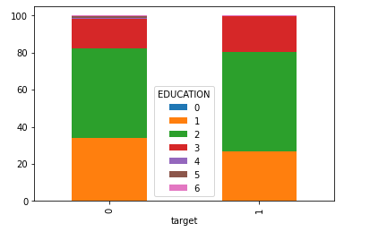
EDA

Slide 10
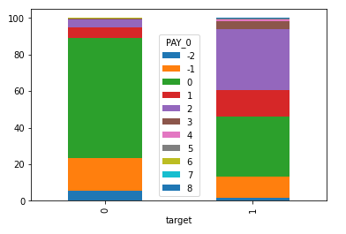
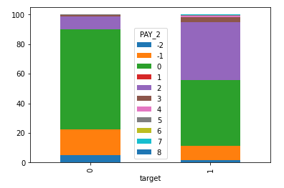
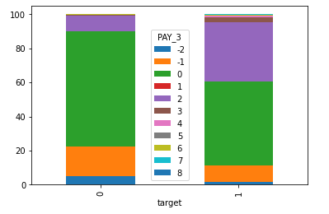
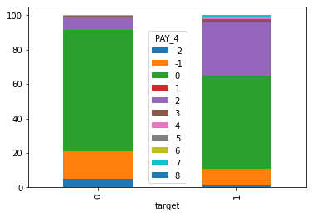
EDA

Slide 11
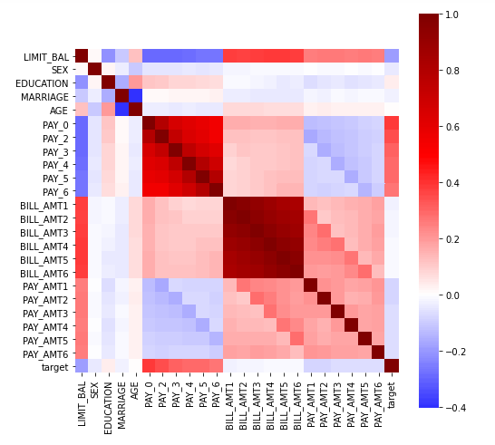
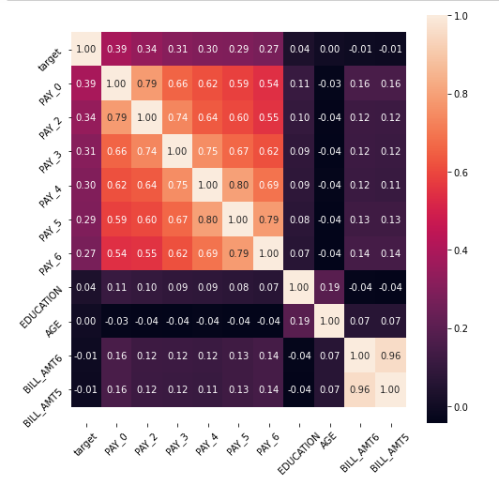
EDA
Correlation heatmap for all features.
Correlation heatmap for top 10 features

Slide 12
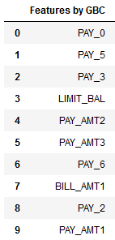

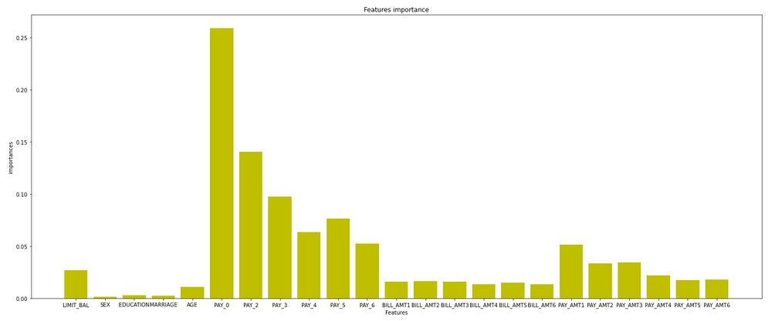
Feature Selection
Gradient Boost Classifier vs Random Forest

Slide 13
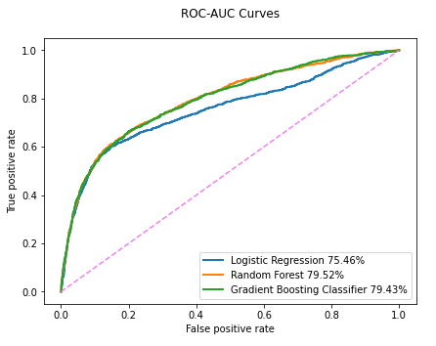
Data Modelling
 | GBR | RF | LR
Training score | 0.833 | 0.841 | 0.818
Accuracy | 0.829 | 0.836 | 0.823
Precision | 0.81 | 0.82 | 0.81
Recall | 0.83 | 0.83 | 0.82
F1-score | 0.82 | 0.82 | 0.80

Slide 14
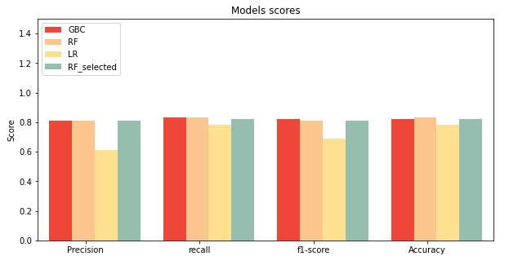
Data Modelling
 | RF after selection | RF
Training score | 0.836 | 0.841
Accuracy | 0.828 | 0.836
Precision | 0.81 | 0.82
Recall | 0.83 | 0.83
F1-score | 0.82 | 0.82

Slide 15

Thank You!

