Slide 1

ME 497R –
Mentored Research
Samuel Nasman
Notes:
Why?
To learn more about aircraft design and optimization
I haven’t had much experience with these sorts of problems, and so it’s been a tremendous learning experience.
What?
2-dimensional airfoils (wing sections; panel method)
Airframe design (vortex lattice method)
Optimizing a wing to minimize induced drag (VLM and an optimizer)
Transition: let’s take a look at 2-dimensional airfoils

Slide 2
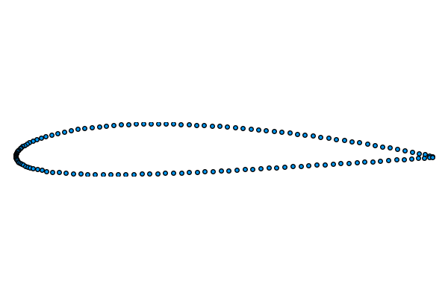
Notes:
We want to figure out the properties of this airfoil
Employ a panel method
make a bunch of panels
Assume inviscid flow and the Kutta condition at the trailing edge, among other important assumptions
Model shape of the airfoil using solutions to the Laplace equation
For Xfoil.jl, we use vortices
Calculate the circulation which is proportional to the lift, drag, etc.

Slide 3
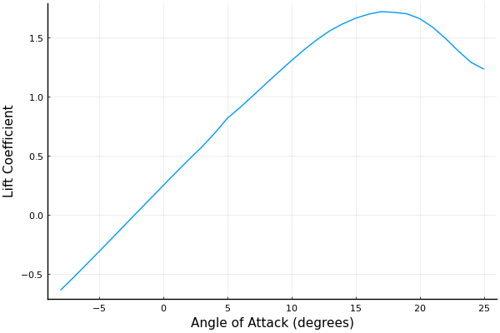
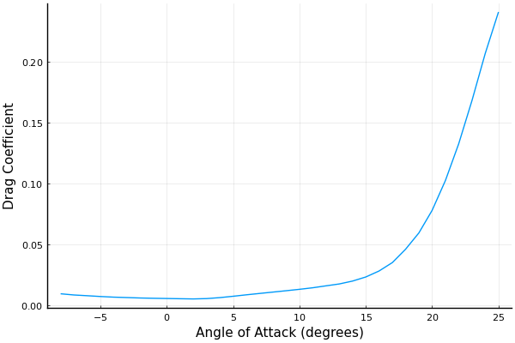
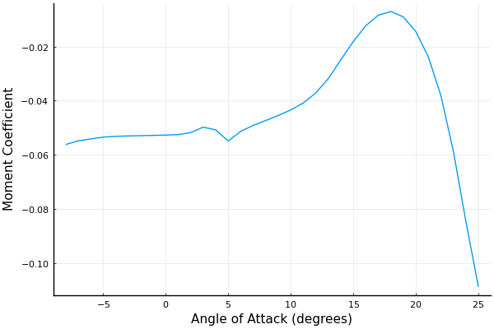
Notes:
Calculate dimensionless coefficients across a range of angles of attack.
Increasing angle of attack increases lift and drag until stall
XFoil actually includes corrections that predict stall to a certain extent
At stall lift decreases
Drag increases sharply
SKIP: at high alpha, r x F may partially explain

Slide 4
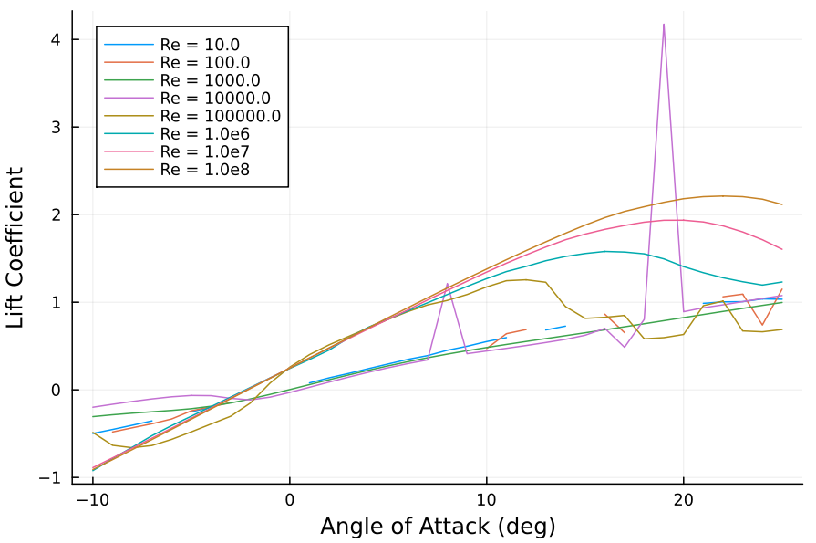
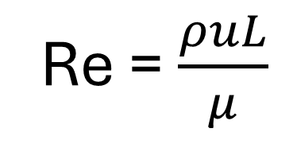
Re = $\frac{ρuL}{μ}$
Notes:
Reynolds number is ratio of inertial forces to viscous forces
For inviscid flows, mu approaches 0 and Re approaches infinity

Slide 5
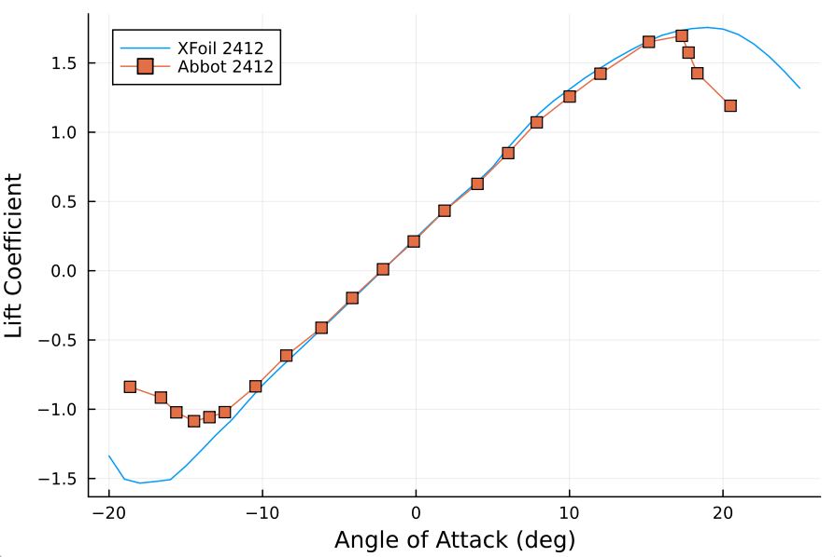
Notes:
Xfoil assumptions
Inviscid irrotational flow / kutta condition
Struggles at accurate predictions for high angle of attack (flow separation)

Slide 6
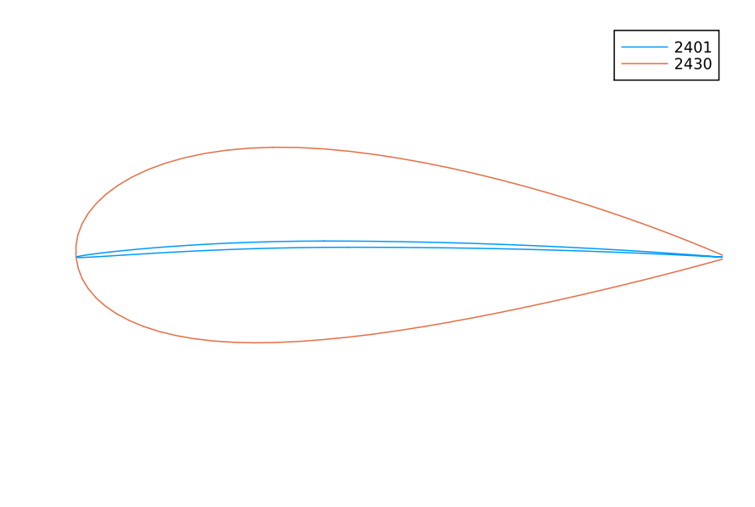
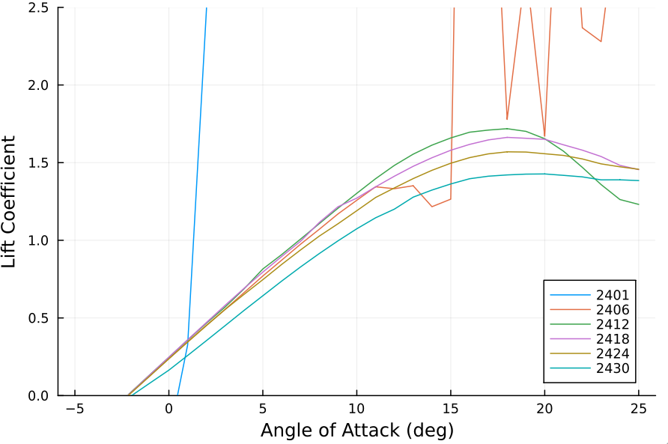
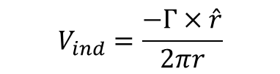
$$V_{ind}=\frac{−Γ×\hat{r}}{2πr}$$
Notes:
Thick airfoils generate smaller lift coefficients, but have softer stall
Extremely thin airfoils have numerical instability. Possible explanations
Leading edge may trip flow separation
Panels so close together may be too close to r=0

Slide 7
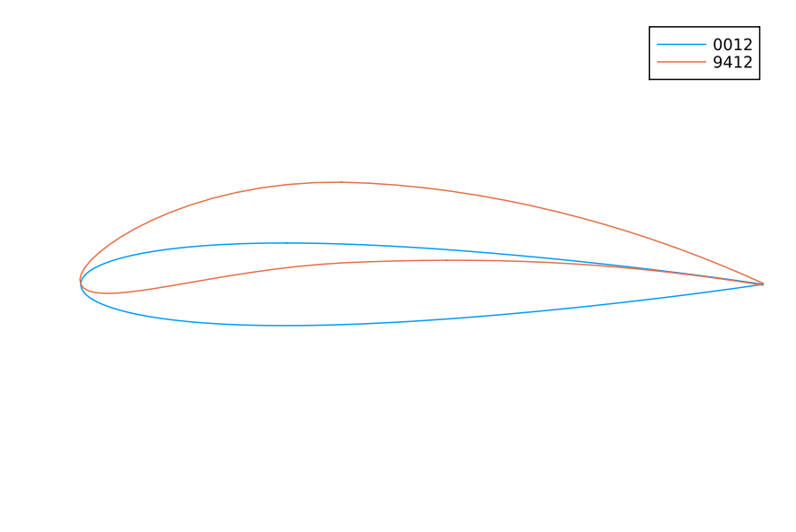
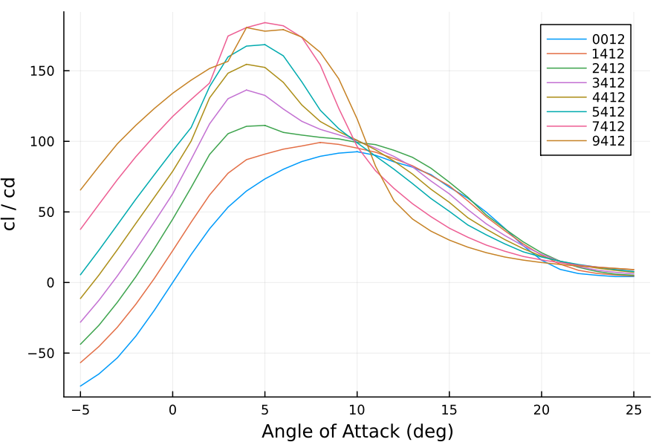
Notes:
Increasing camber shifts airfoil polars
For low angles of attack, cambered airfoils have higher lift/drag ratios
Flaps and slats to increase lift when increasing angle of attack isn’t practical.

Slide 8
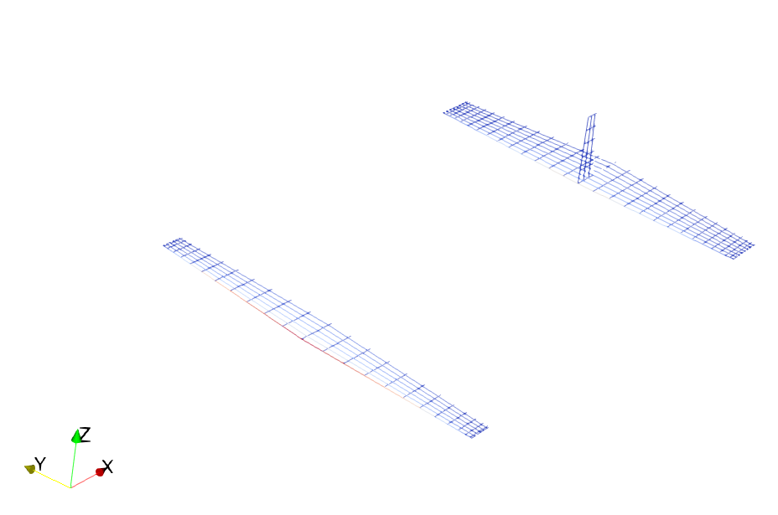
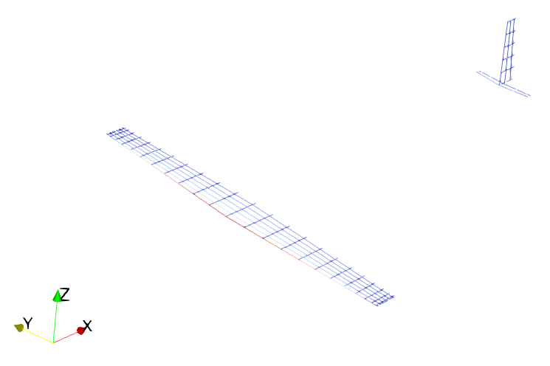
Airframe Analysis
Notes:
Now lets look at an airframe. How do we analyze it?
Vortex Lattice Method
Can’t just use panel method because of wing tip vortices
Vortex filaments for variable circulation
VortexLattice.jl
Aspect ratio
Tail volume and Stability
Note how in this picture we have a large horizontal stabilizer and a small one. How does that affect the aircraft?
limitations

Slide 9
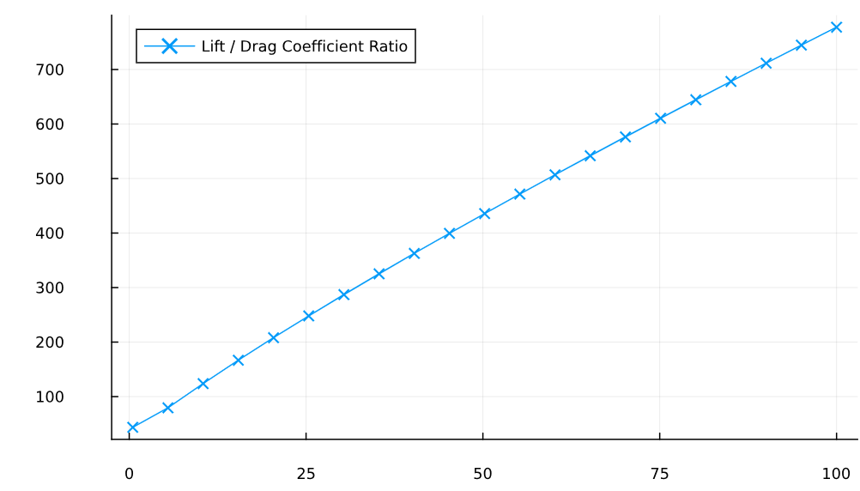
Lift / Drag Coefficient Ratio
Aspect Ratio
Notes:
Increasing the length of the wing increases the lift to drag ratio
Practical considerations often override

Slide 10
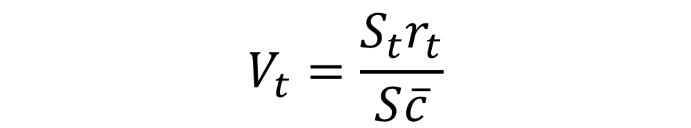
$$V_{t}=\frac{S_{t}r_{t}}{S\overline{c}}$$
Notes:
Tail volume is, roughly speaking, the ratio of the aerodynamic influence of the tail to the influence of the wing.
Tails that are larger or further from the aircraft’s center of gravity have a larger affect on aircraft stability.

Slide 11
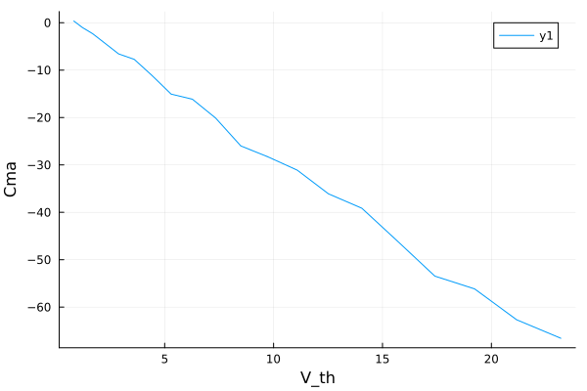
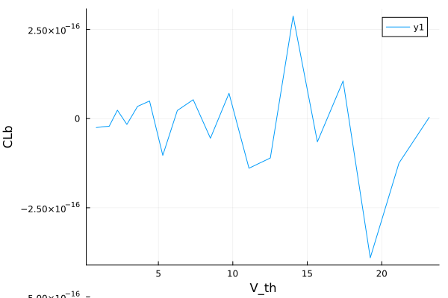
Notes:
Change in moment with respect to alpha
Change in roll with respect to beta

Slide 12
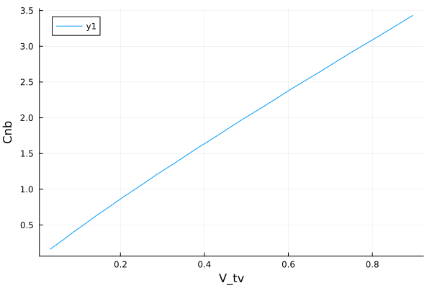
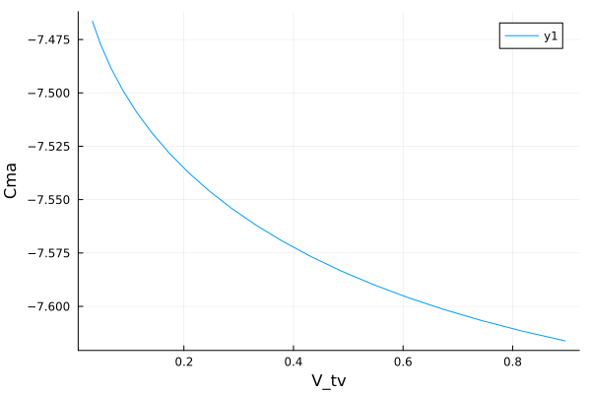
Notes:
Change in yaw with respect to beta
Change in pitching moment with respect to alpha (note the significantly smaller scale)

Slide 13
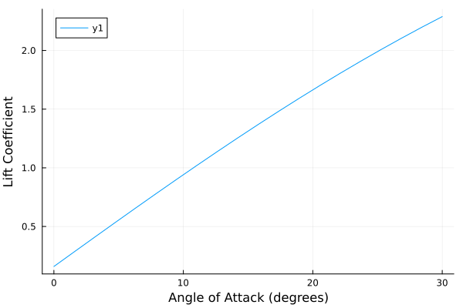
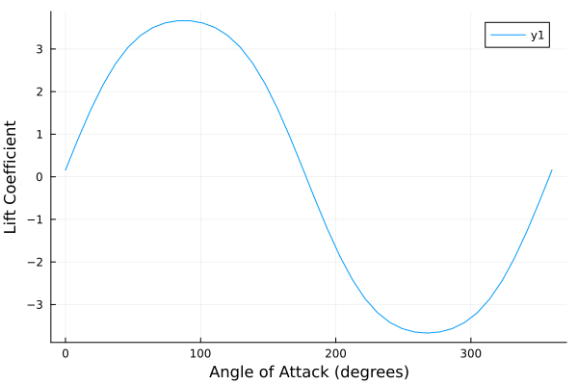
Notes:
Limitations of VLM
Small angles of attack
Flat plate solution (thin wing)

Slide 14

Wing Optimization
Notes:
- Gradient based optimizers calculate numerical derivatives

Slide 15
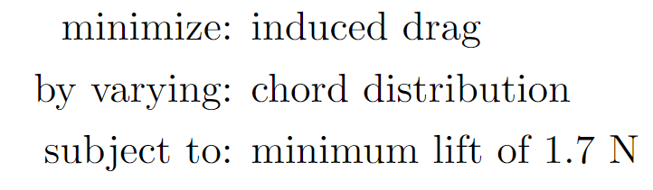

Slide 16
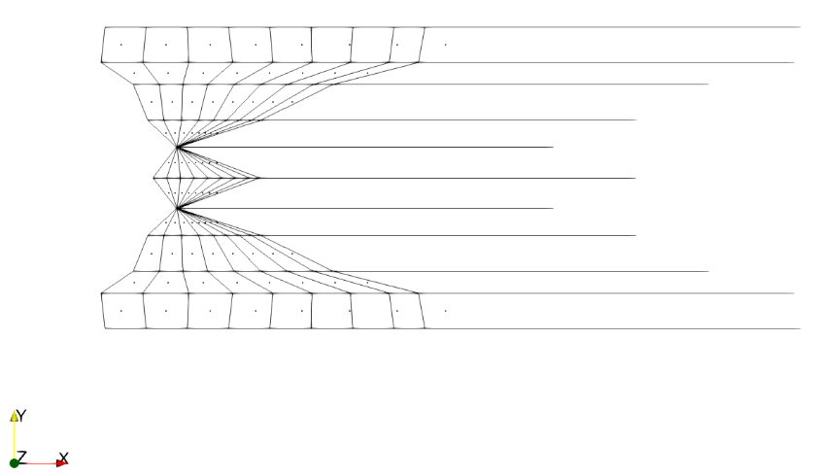
Notes:
Problem: optimizer is struggling to find a practical solution.
Impose monotonicity.

Slide 17
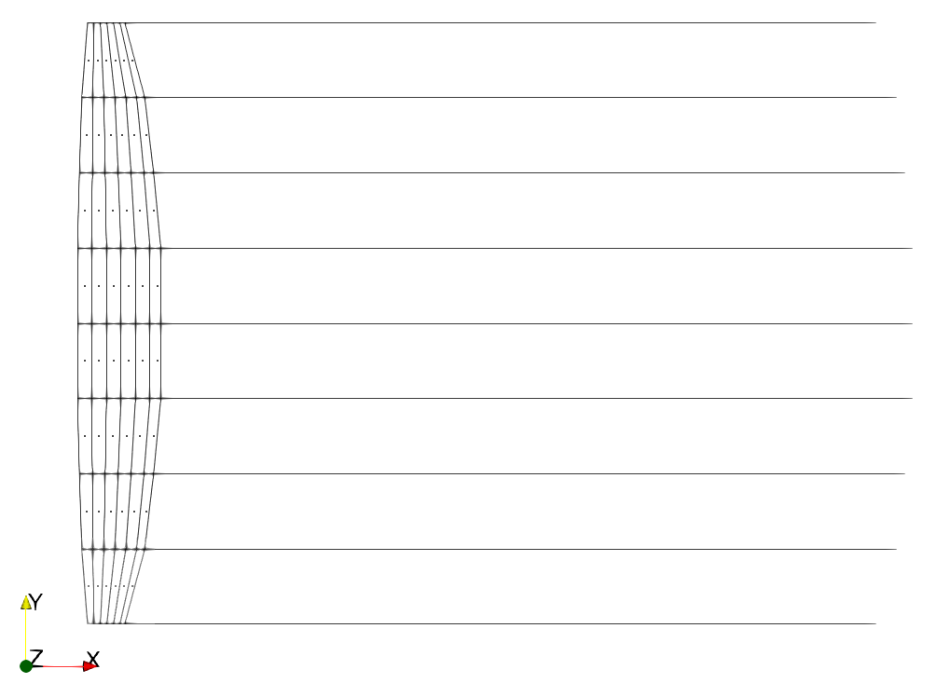
Notes:
Increase number of panels

Slide 18
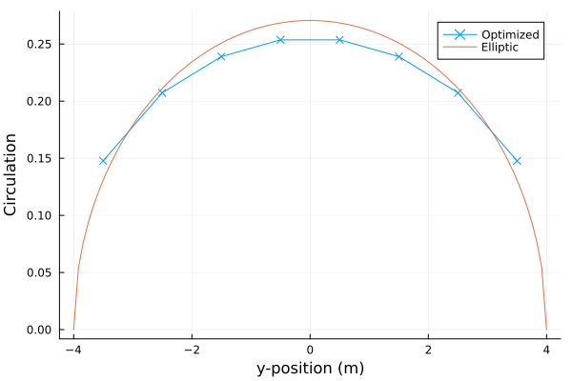
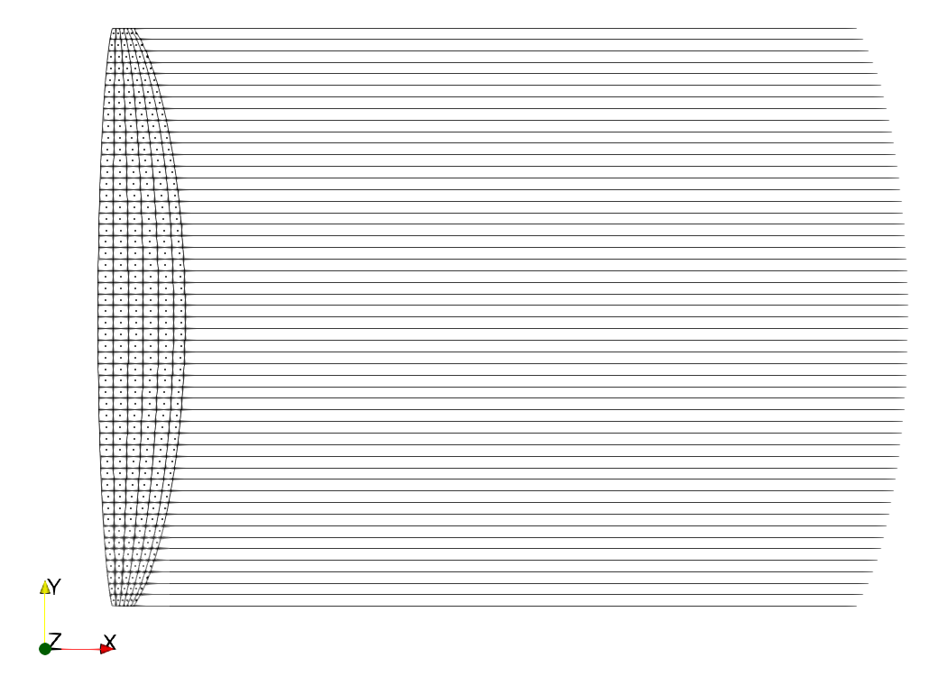
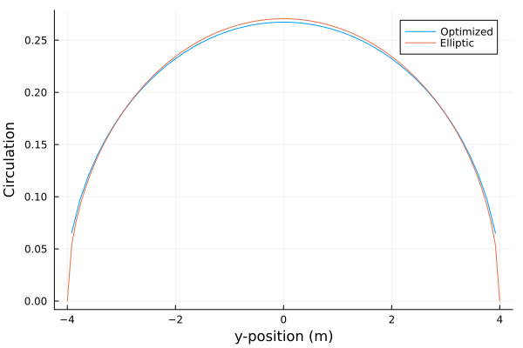
4x6, sd = 0.012817921294912426
25x6, sd = 0.003539906737094895
Notes:
The chord distribution is direction proportional to the circulation
Comparison to the analytical solution looks promising!

Slide 19
Future Work
Optimizer requires ball-park initial chord distribution in order to find analytical solution. Explore better-defining feasible space.
Optimize twist rather than chord.
Look-up table to predict stall.
Splines and Sine-spacing to decrease number of design variables.

Slide 20

THANK YOU

