Slide 1

Codemash Katas – by Telerik
Samidip Basu MS, MCPD, CAPM
Senior Software Trainer | Telerik Inc. | www.telerik.com
E: Sam.Basu@Telerik.com | L: x3179 | C: 507 244 0579
T: @samidip | W: http://samidipbasu.com

Slide 2
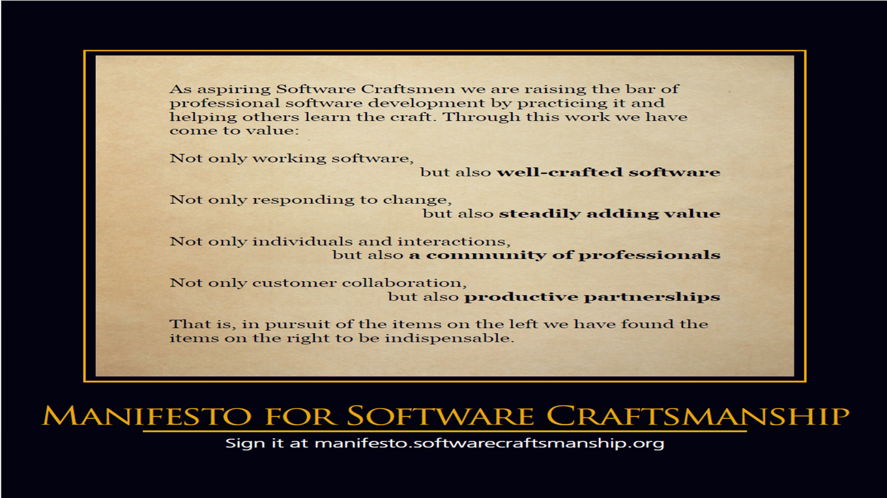
Software Craftsmanship

Slide 3
The pursuit of Craftsmanship …
Why Practice?
I know how to code .. I don’t need practice!
I already practice .. I write code every day!
Practice is the act/learning method of rehearsing a behavior over and over, or engaging in an activity again and again, for the purpose of improving or mastering it, as in the phrase "practice makes it perfect".

Slide 4
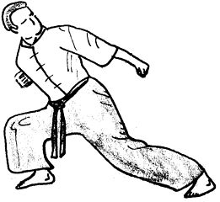
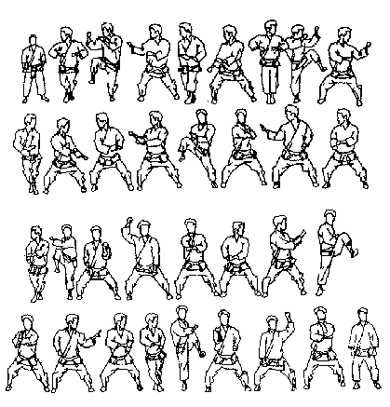
Katas
Kata is a Japanese word describing detailed choreographed patterns of movements practised either solo or in pairs.

Slide 5
Coding Katas
What is it?
It's a small exercise to improve your programming skills - by challenging your abilities and encouraging you to find multiple approaches. Pairing helps you get the most out of it.
Why should I care?
Play with code without fearing any consequences! Also discover & learn new methods, areas, algorithms, languages, libraries ...
How would I know my code works?
By testing, off course. Think TDD.
Let’s Practice!

Slide 6
Few References
Where do I learn more?
http://HudsonSC.com
http://softwarecraftsmanship.org
http://groups.softwarecraftsmanship.org
http://CodingDojo.org
http://codekata.pragprog.com

Slide 7




Telerik Online Resources
All Telerik Products:
www.telerik.com
facebook.com/telerik
Check out the latest from Telerik blogs: blogs.telerik.com
@telerik
Join the community forums:
www.telerik.com/community/forums

