Slide 1

SubNet RWAs

Slide 2
Team 5
Ayomide
Paloma
Richard
Sathya
Sami
2

Slide 3
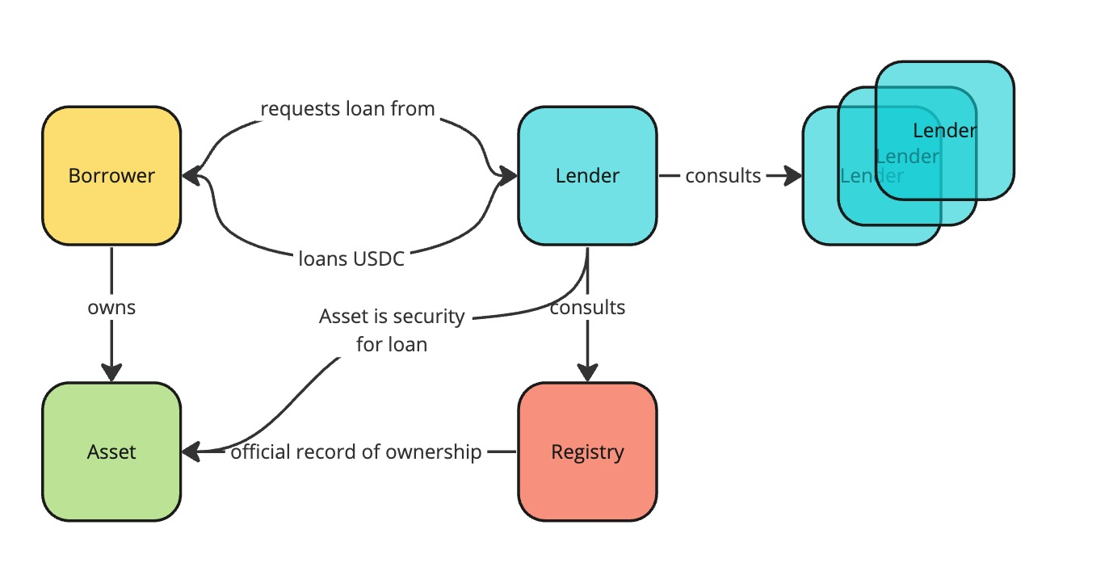
The basic idea – the holy grain of collateralized lending, but on-chain
3

Slide 4
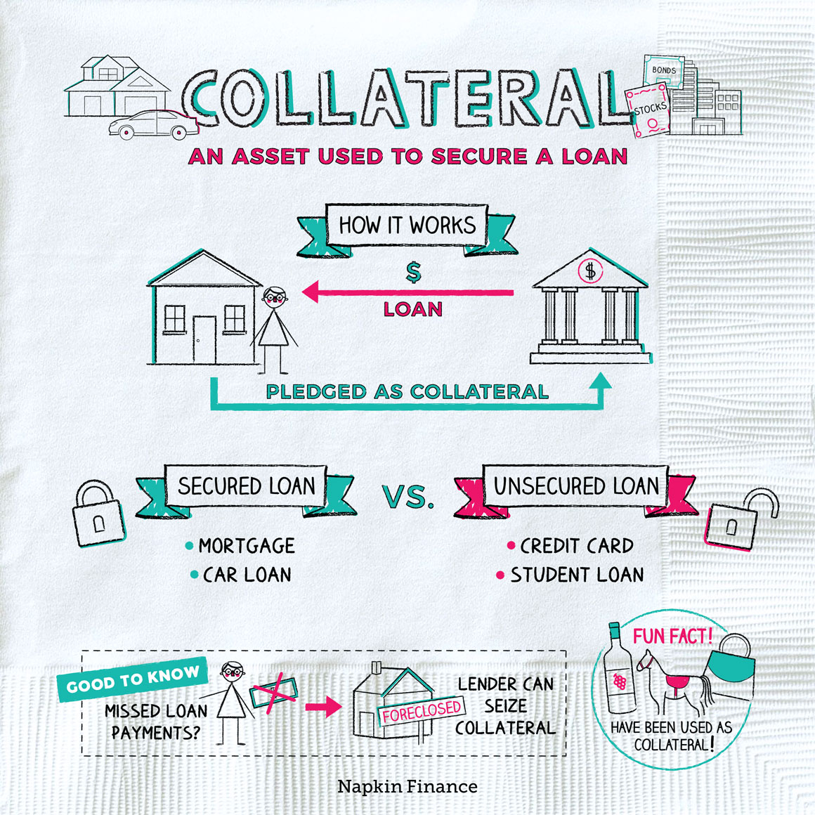
Collateral Fraud
COLLATERAL FRAUD is a type of fraud that affects Lenders
that involves intentional misrepresentation
or deceptive behavior outside of a transaction
or contract, which deprives one party
of informed consent or full participation.
COLLATERAL FRAUD continues to affect lenders across the globe.
Current Defi Loans are OVER COLLATERALIZED crypto native loans
HOWEVER, for larger adoption of blockchain Enterprise Grade Loans need capabilities for
Real World Assets for Property Collaterals for
Authenticity and double-spending
The Institutions would need to operate in SUBNETs
for data privacy, data integrity, and protection

Slide 5
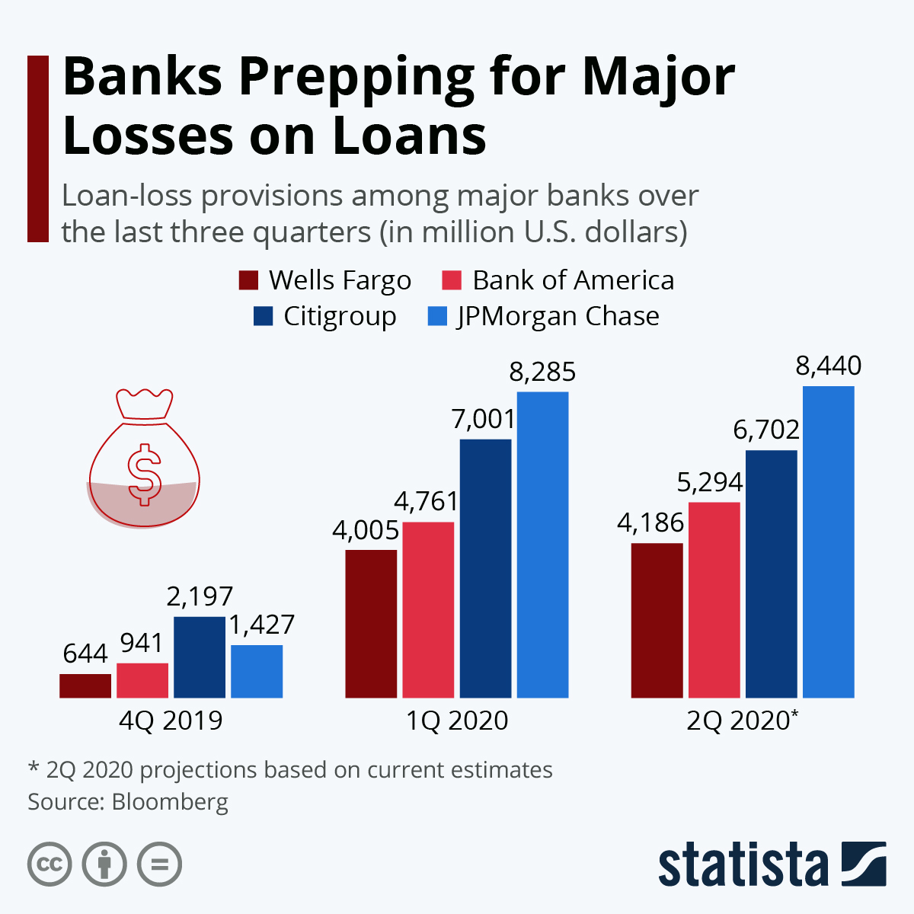
Loan Fraud Trends: A Closer Look
Projected to reach a global market value of more than $12.5B by 2026, lending is one of the largest industries within the financial sector. One study uncovered that small business lending fraud has increased by 6.9% since 2020.
"While small value card/internet frauds contributed the maximum to the number of frauds reported by the private sector banks, the frauds in public sector banks were mainly in the loan portfolio," the RBI
As per the data, 95 percent or Rs 28,792 crore of the total Rs 30,252 crore was reported in cases related to loans (advances).

Slide 6
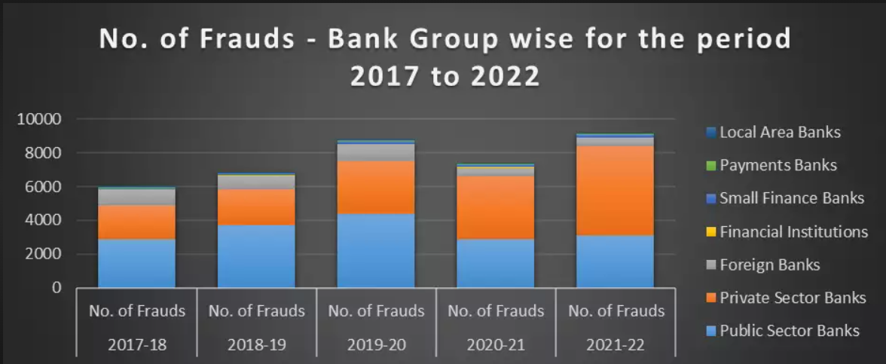
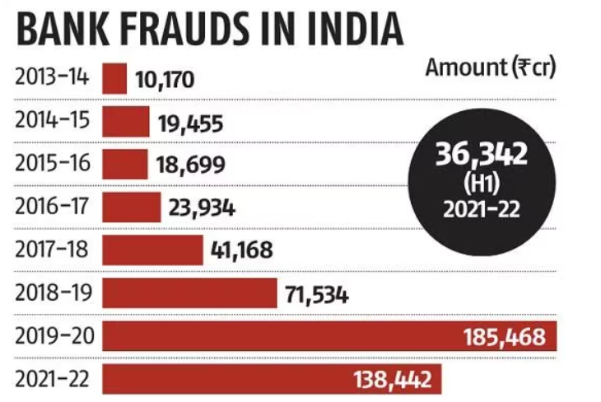
Bank Fraud Statistics in India

Slide 7

We need a highly scalable web3 system to decrease
Fraud affecting Lenders for system integrity
Discrepancies for increased efficiencies
SOLUTION:
Blockchain solution to reduce
Fraud affecting Lenders for system integrity
Discrepancy reduction and reconciliation for increasing efficiencies
Authentic SUBNETs ( Registrars) host Tokenized RWAs, and Inquiries
that verifiers can be used for verifying
Ownership
Double spending

Slide 8
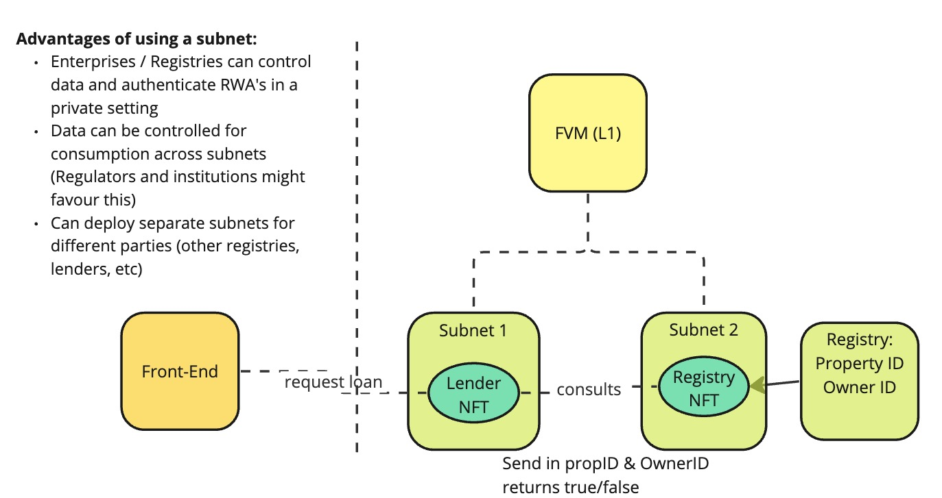
Solution Architecture
8

Slide 9
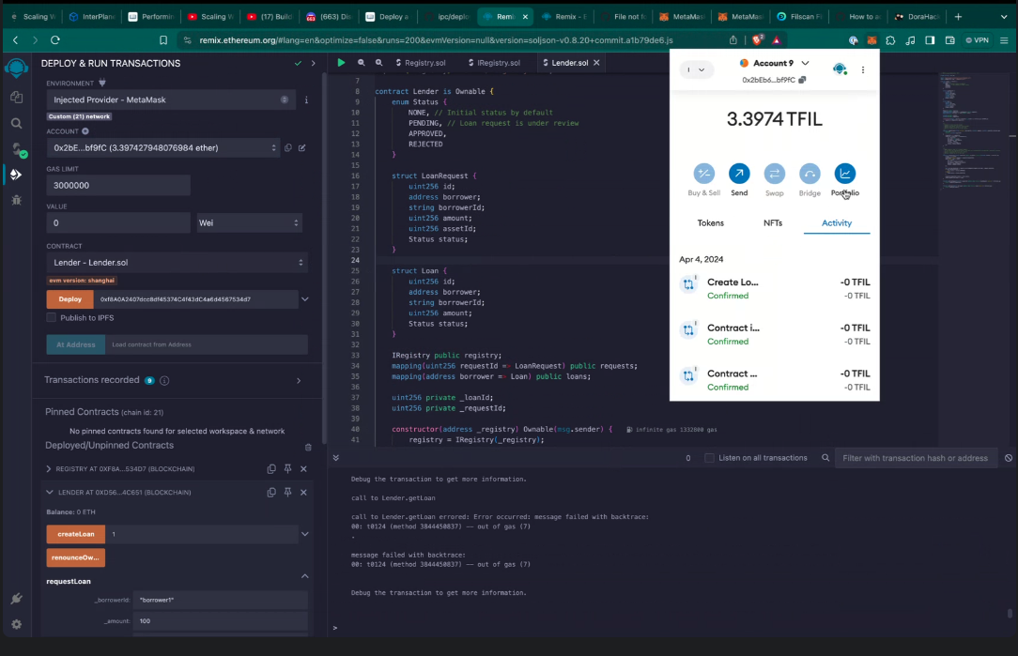
Deployment of subnet and contract

