Slide 1

Get Started

Slide 2
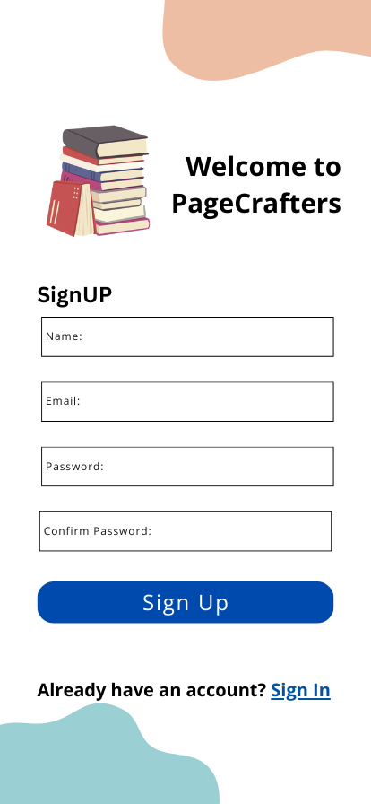
Prompt to Payment for outside users
TU students will get to Sign In without payment

Slide 3
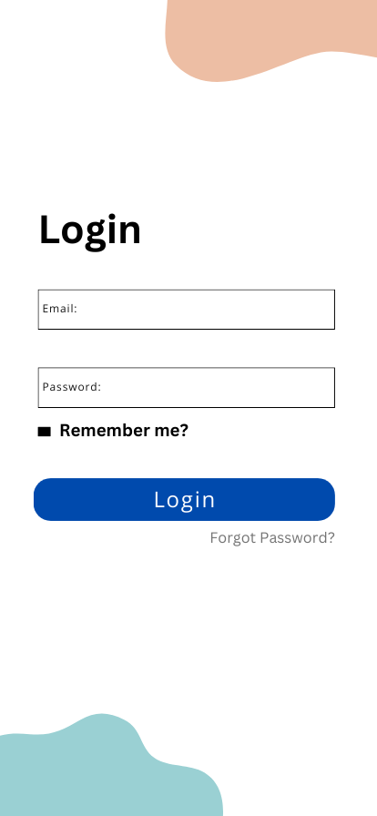
Login will prompt to course list

Slide 4
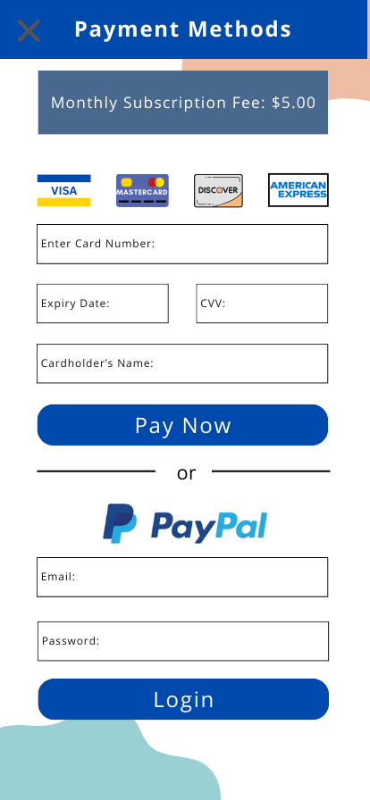
If user is unwilling to pay right away, this cross button will be exit option to signup page
After payment, user will be prompted to login page

Slide 5
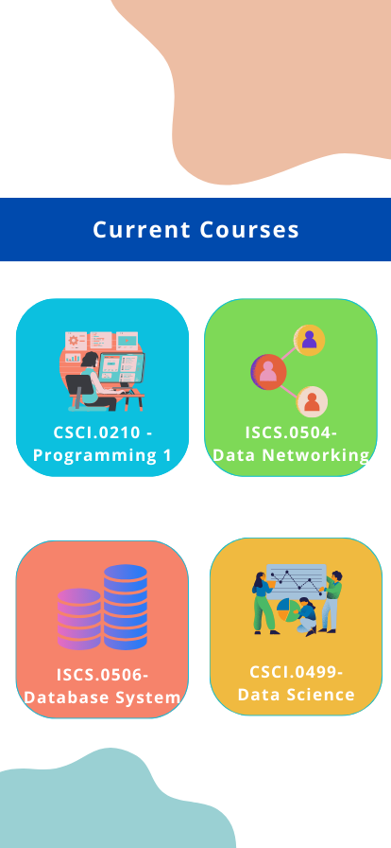
Course buttons will prompt to relevant books, here we only configured this ebook

Slide 6


Slide 7
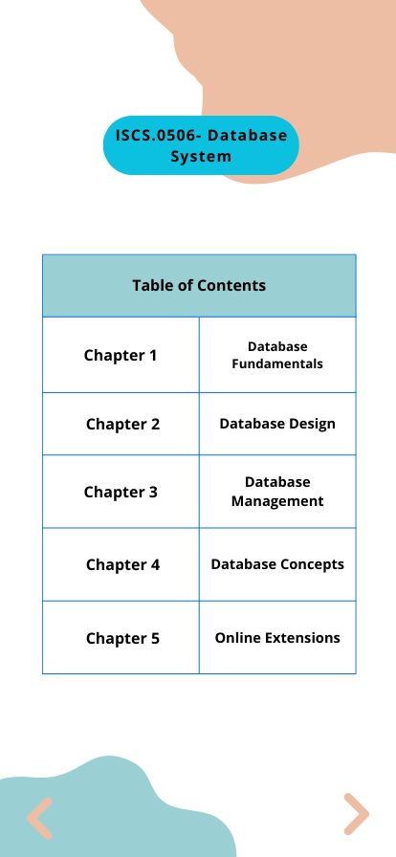
** Only chapter 1 is shown in design, so other chapters are not clickable

Slide 8
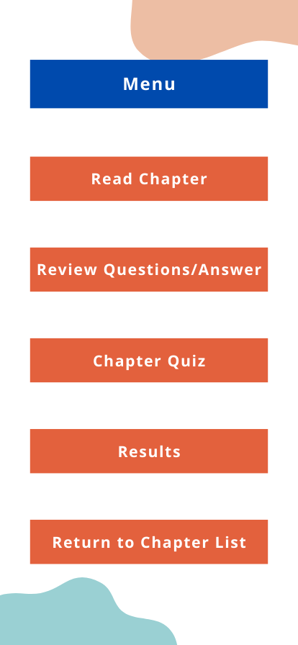
**Buttons lead to relevant pages

Slide 9
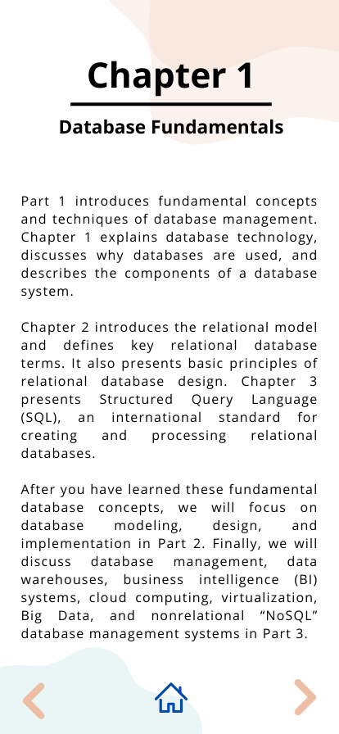
Will lead to next page of chapter, this is not shown in this design. Go to next slide manually
**Home button will lead to the 5 options/return to menu

Slide 10
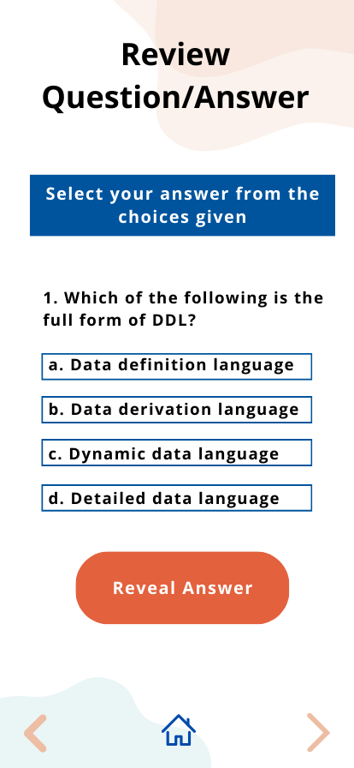
This button will reveal/hide answer
Will lead to next questions, this is not shown in this design. Go to next slide manually
**Buttons are interactive

Slide 11
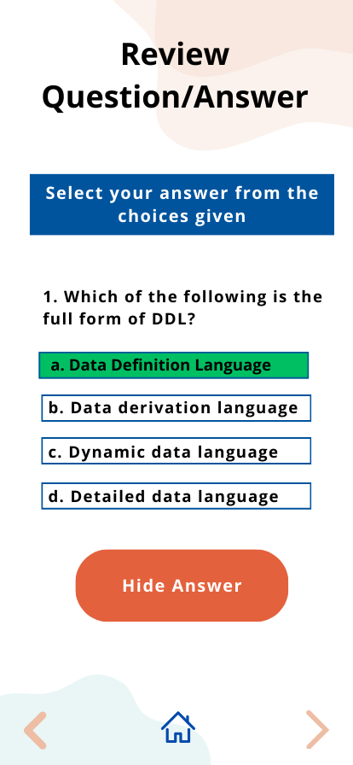
** Home will lead to chapter, if the student wants to review the chapter

Slide 12
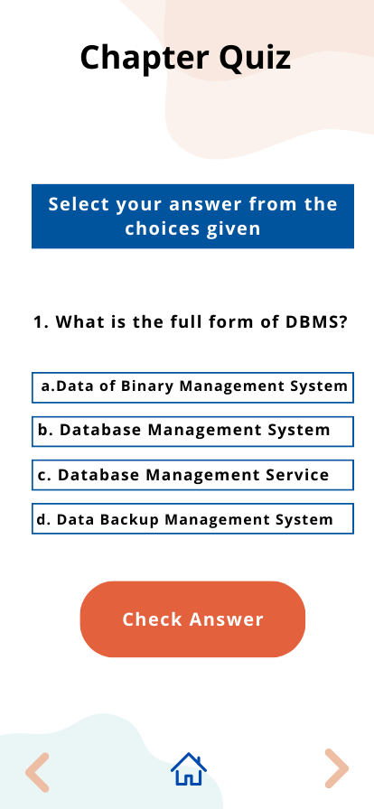
**Check answer will show whether the answer is correct/incorrect

Slide 13
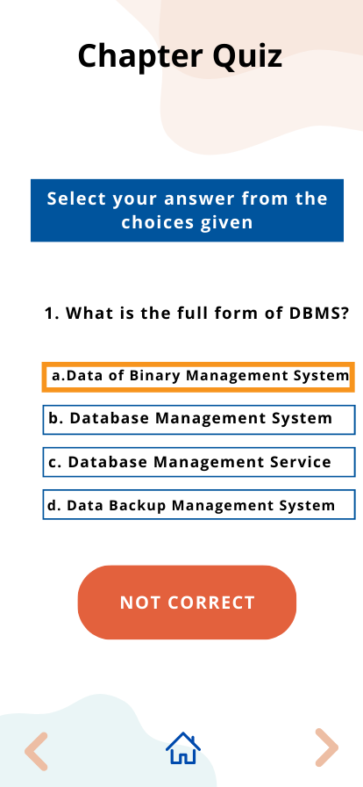

Slide 14
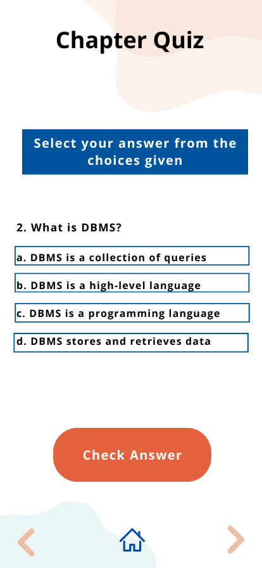

Slide 15
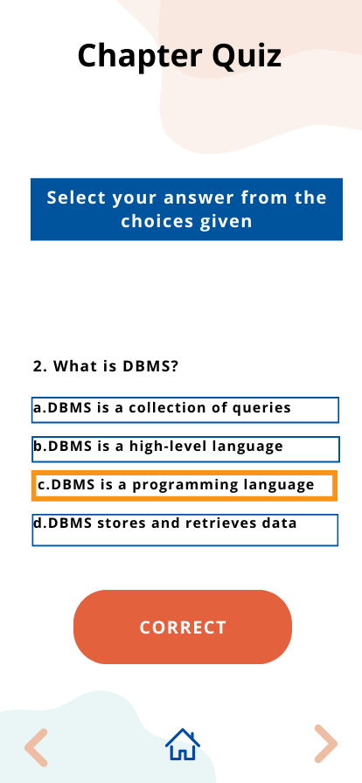
Will lead to next questions, this is not shown in this design. Go to next slide manually

Slide 16
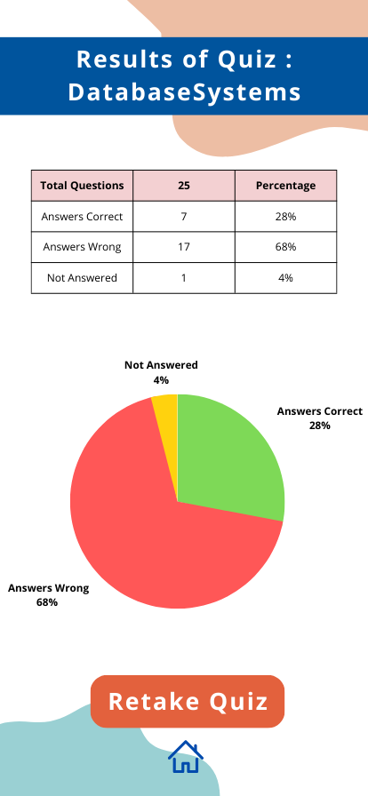
**Retake Quiz button will lead to quiz page
**If student didn’t take quiz, slide 17 (next slide) will show

Slide 17
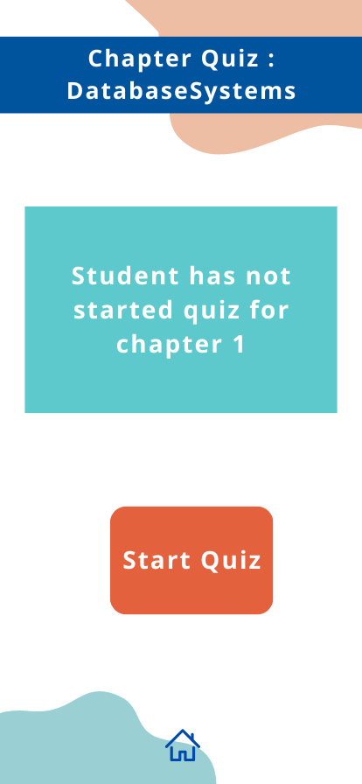
**This page will show if student clicks on results but he hasn’t yet started the quiz

