Slide 1
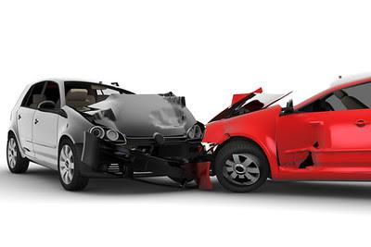
Unveiling NYC's Vehicle Collision Landscape: A Data-Driven Exploration
Presented By Ubaydul H Sami
Course: DAT 310, Spring 2024

Slide 2
Data Description:
This project analyzes traffic accidents in New York City using a comprehensive dataset of police-reported collisions from April 2016 onwards. It provides valuable insights into various aspects of these incidents.
The data, available on the NYC Open Data platform [Motor Vehicle Collisions - Person Data (NYC)]
Key Variables:
Crash Date • Crash Time • Contributing Factor
Driver Gender • Safety Equipment • Body Part Injury

Slide 3
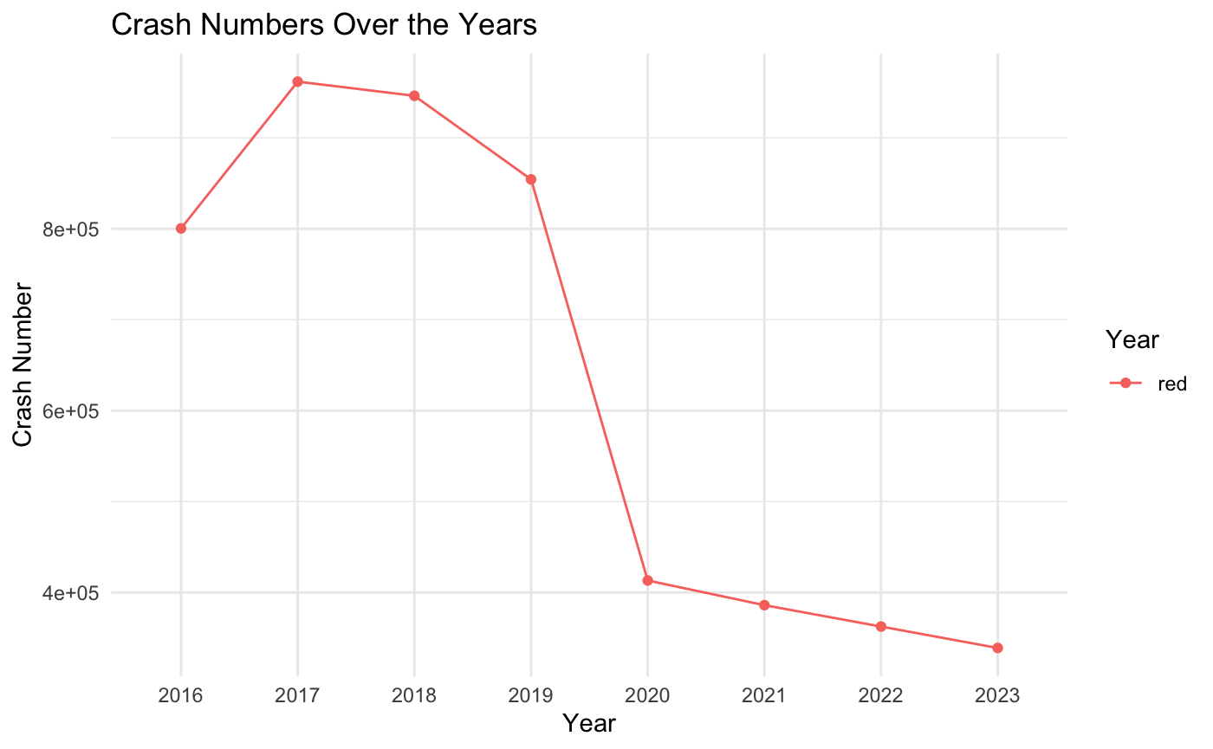
Visualizing Number of Crash over the years
X-axis represents Year from 2016 - 2023
Y-axis represents number of accidents reported per year
The timeline graph shows number of collision was rising from 2016 to 2017 and it starts gradually dropping from 2018 to 2023.

Slide 4
Research Question:
- Why number of Accidents are decreasing over time?
- What are the most prevalent contributing factors associated with motor vehicle collisions in NYC?

Slide 5
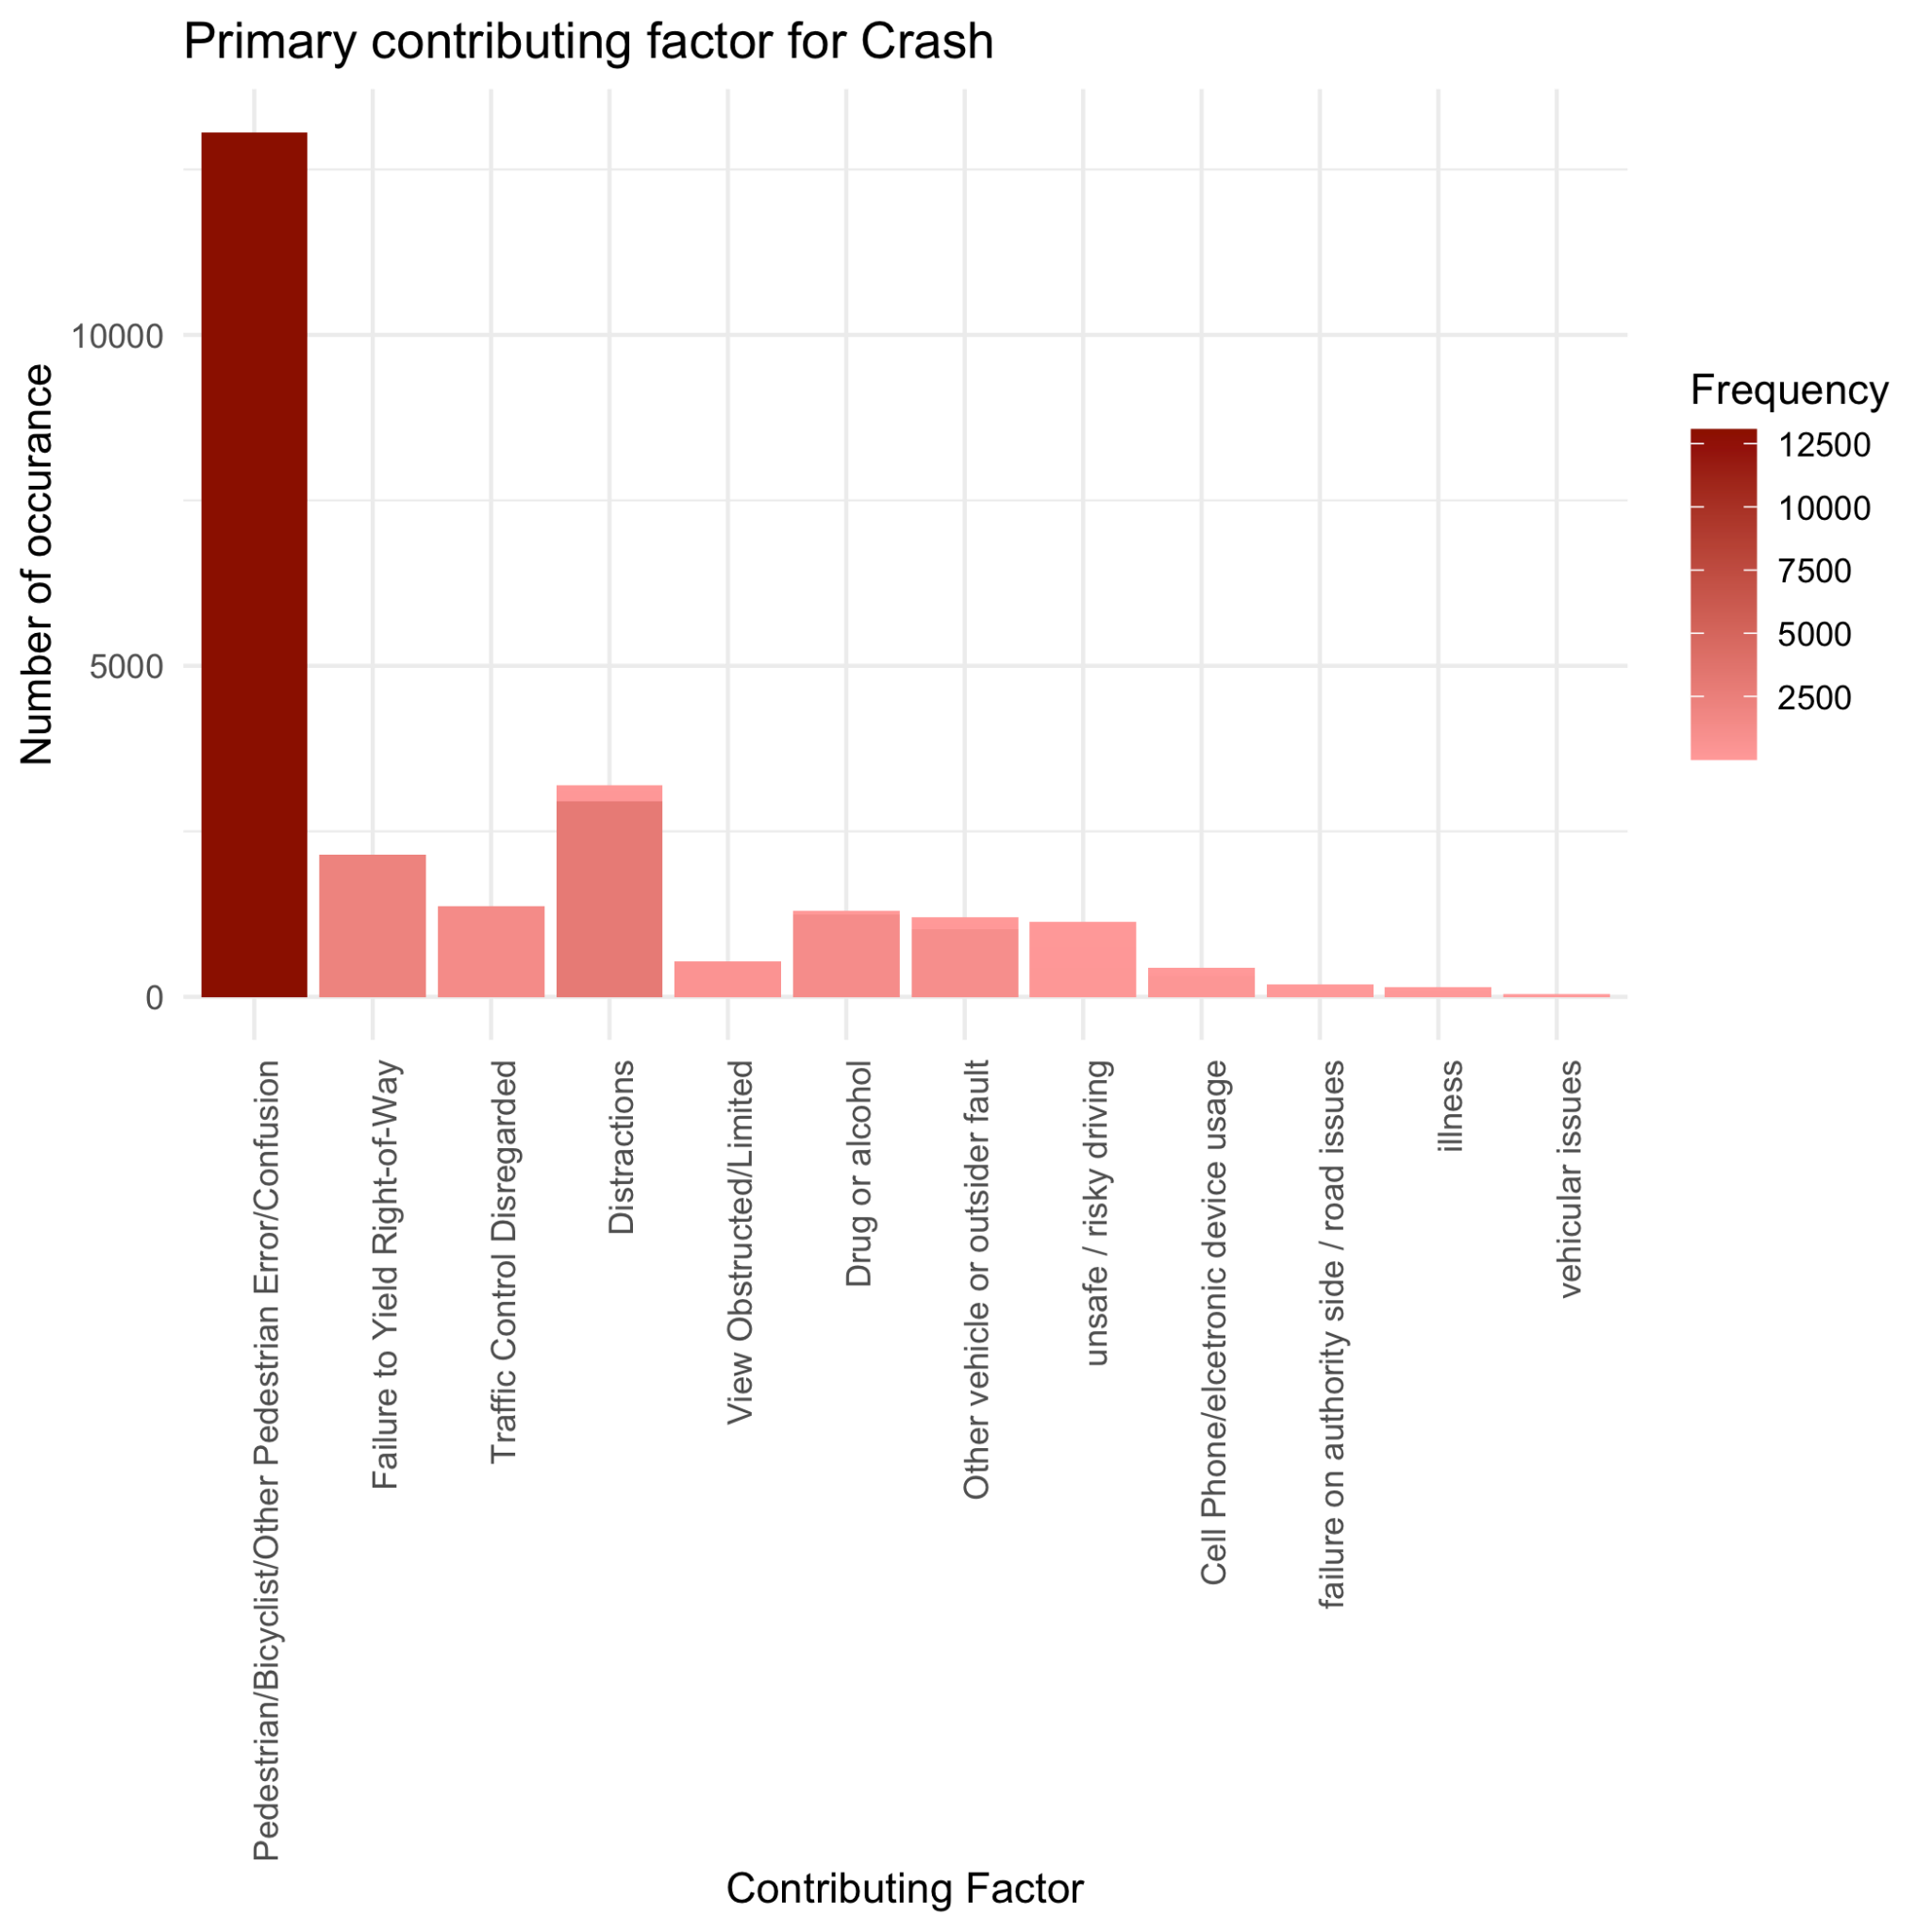
Visualizing The Primary Causes of Accidents
X-axis of this Figure represents Primary causes of vehicle collisions
Y-axis represents number of accidents reported
Highest Number of accident are caused by Pedestrian/Cyclists error
Other major cause of accidents:
Distractions
Failure to Yield Right-of-way
Traffic control disregard
Drug-alcohol influence, and
Risky driving

Slide 6
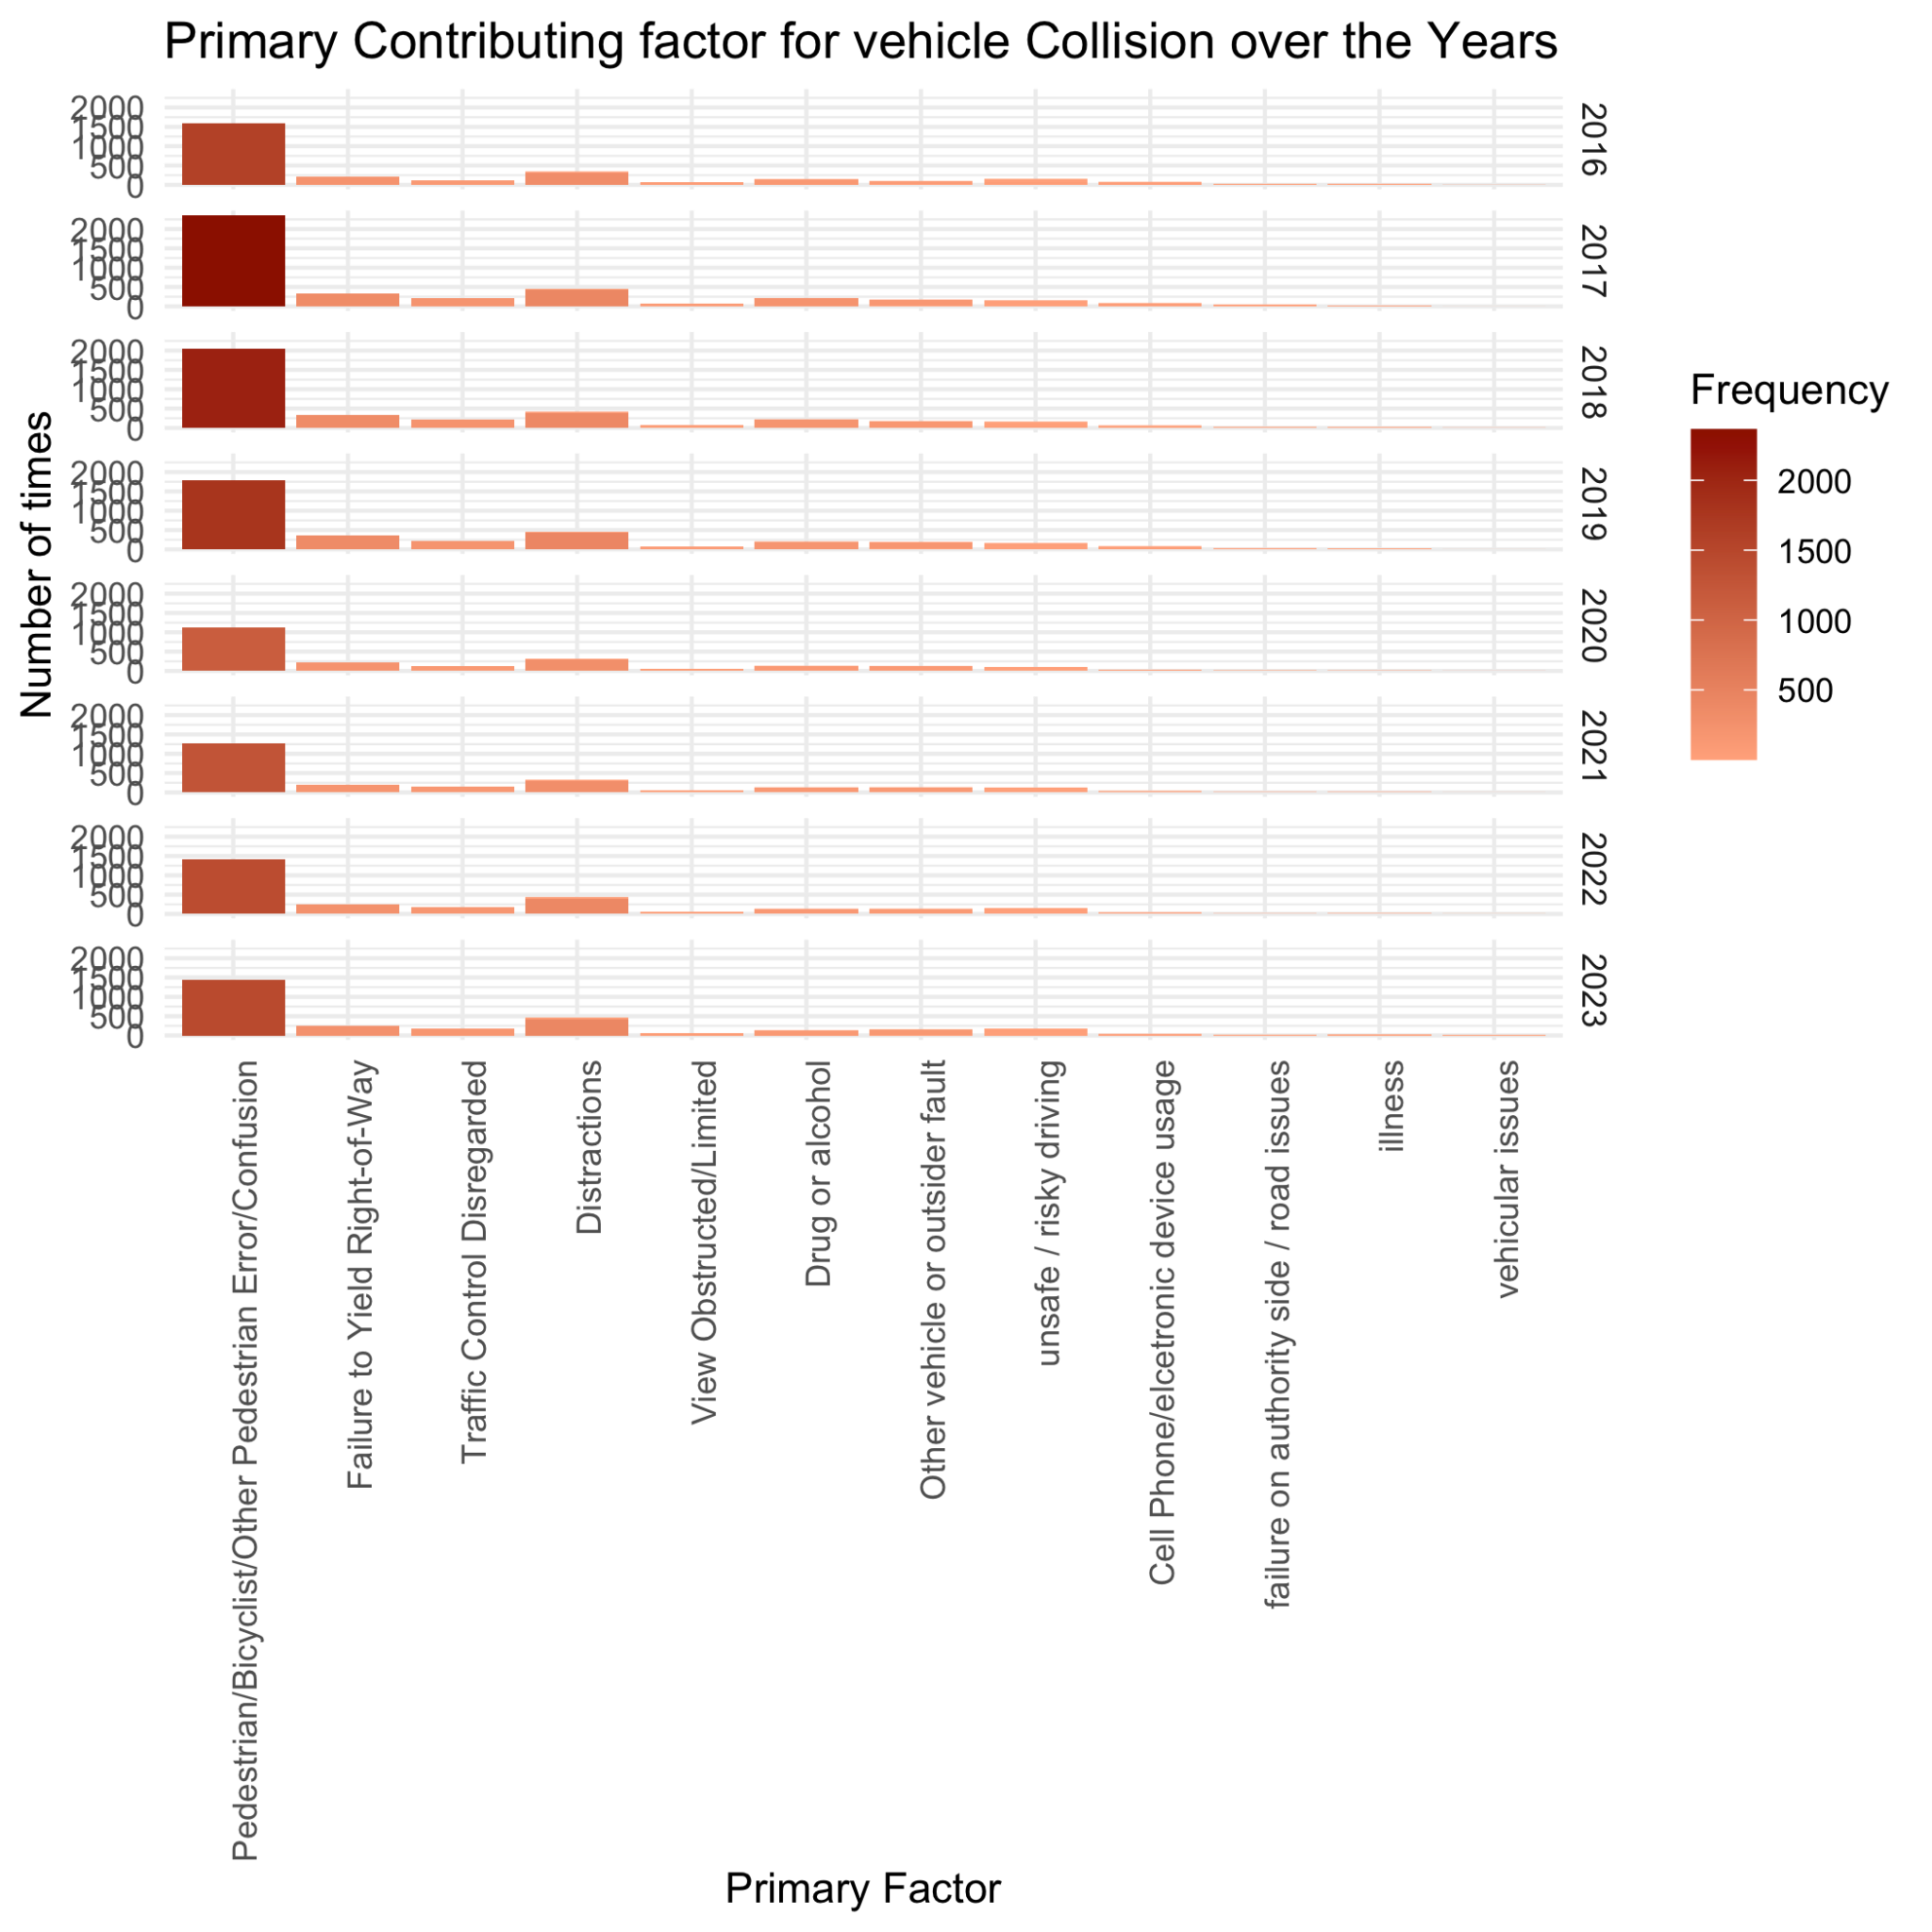
Visualizing The Primary Causes of Accidents Over the Years
X-axis of this Figure represents Primary causes of vehicle collisions
Y-axis represents number of accidents reported By years
Improvement:
Pedestrian or Bicyclist Error
Traffic Control Disregard
Drug-Alcohol Influence
No Changes:
Distractions
Risky Driving

Slide 7
Trends:
Decline in most factors; minimal improvement in distractions and risky driving.
Contributing Factors and Solutions:
Pedestrian or Bicyclist Error:
Additional traffic lights and bike lanes.
Replacement of stop signs with traffic lights.
Extended walk sign times.
Traffic Control Disregard:
Speed and red light cameras.
Increased violation penalties.
Drug-Alcohol Influence:
Awareness campaigns.
Strict law enforcement.
Persistent Challenges:
Distractions:
Widespread phone usage.
Risky Driving:
Ineffective photo enforcement.
Surge in risky driving accidents.
Findings:

Slide 8
Limitation:
Evolution of Vehicle Safety Technology:
Advanced safety features not reflected in dataset.
Features like speed alerts, lane detection, automatic braking, and enhanced brake capacities not considered.
Unclear Dataset Collection Methodology:
Lack of clarity on reporting criteria consistency over time.
Inability to determine if reduction in collision rates solely due to behavioral changes or alterations in reporting standards.

Slide 9
More In Depth Data Exploration
What Time of the day witness Most Number of Accidents?
Which Body Parts are More likely to be injured during a Crash?
What is the most important Safety Equipment for Avoiding Injury During a Crash?
Who is Safer Driver?

Slide 10
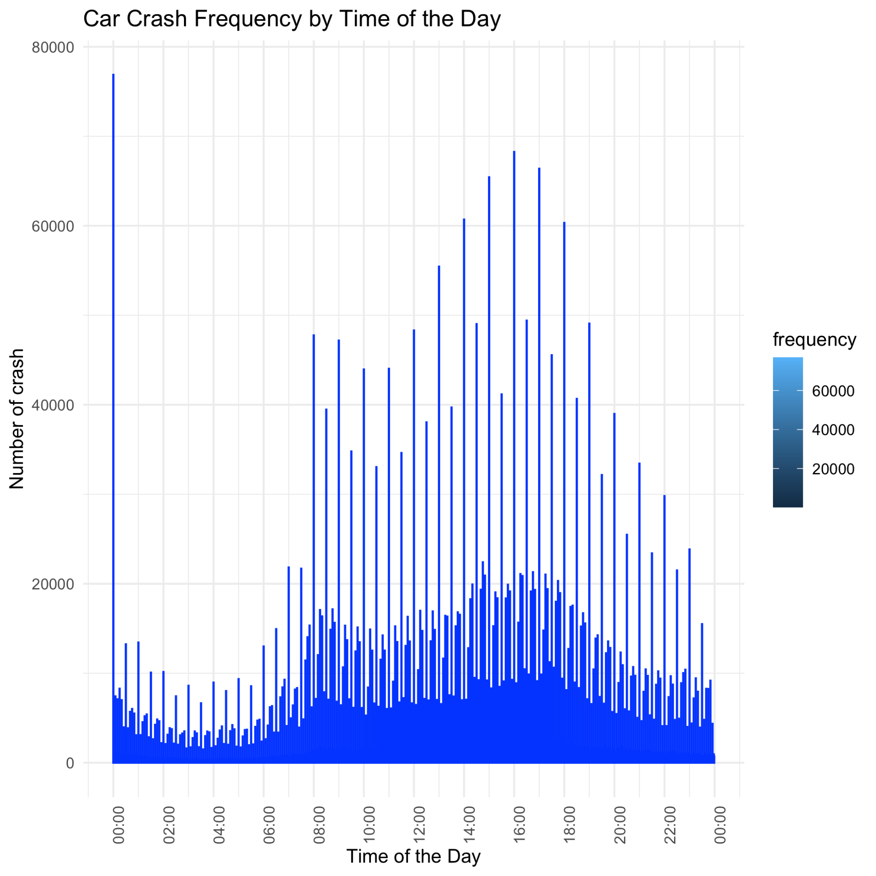
What Time of the day witness Most Number of Accidents?
X-axis of this Figure represents Time of the Day
Y-axis represents number of accidents reported
Highest Number of accident are occured during Rush hours.
8 am to 10 am
4 pm to 6 pm

Slide 11
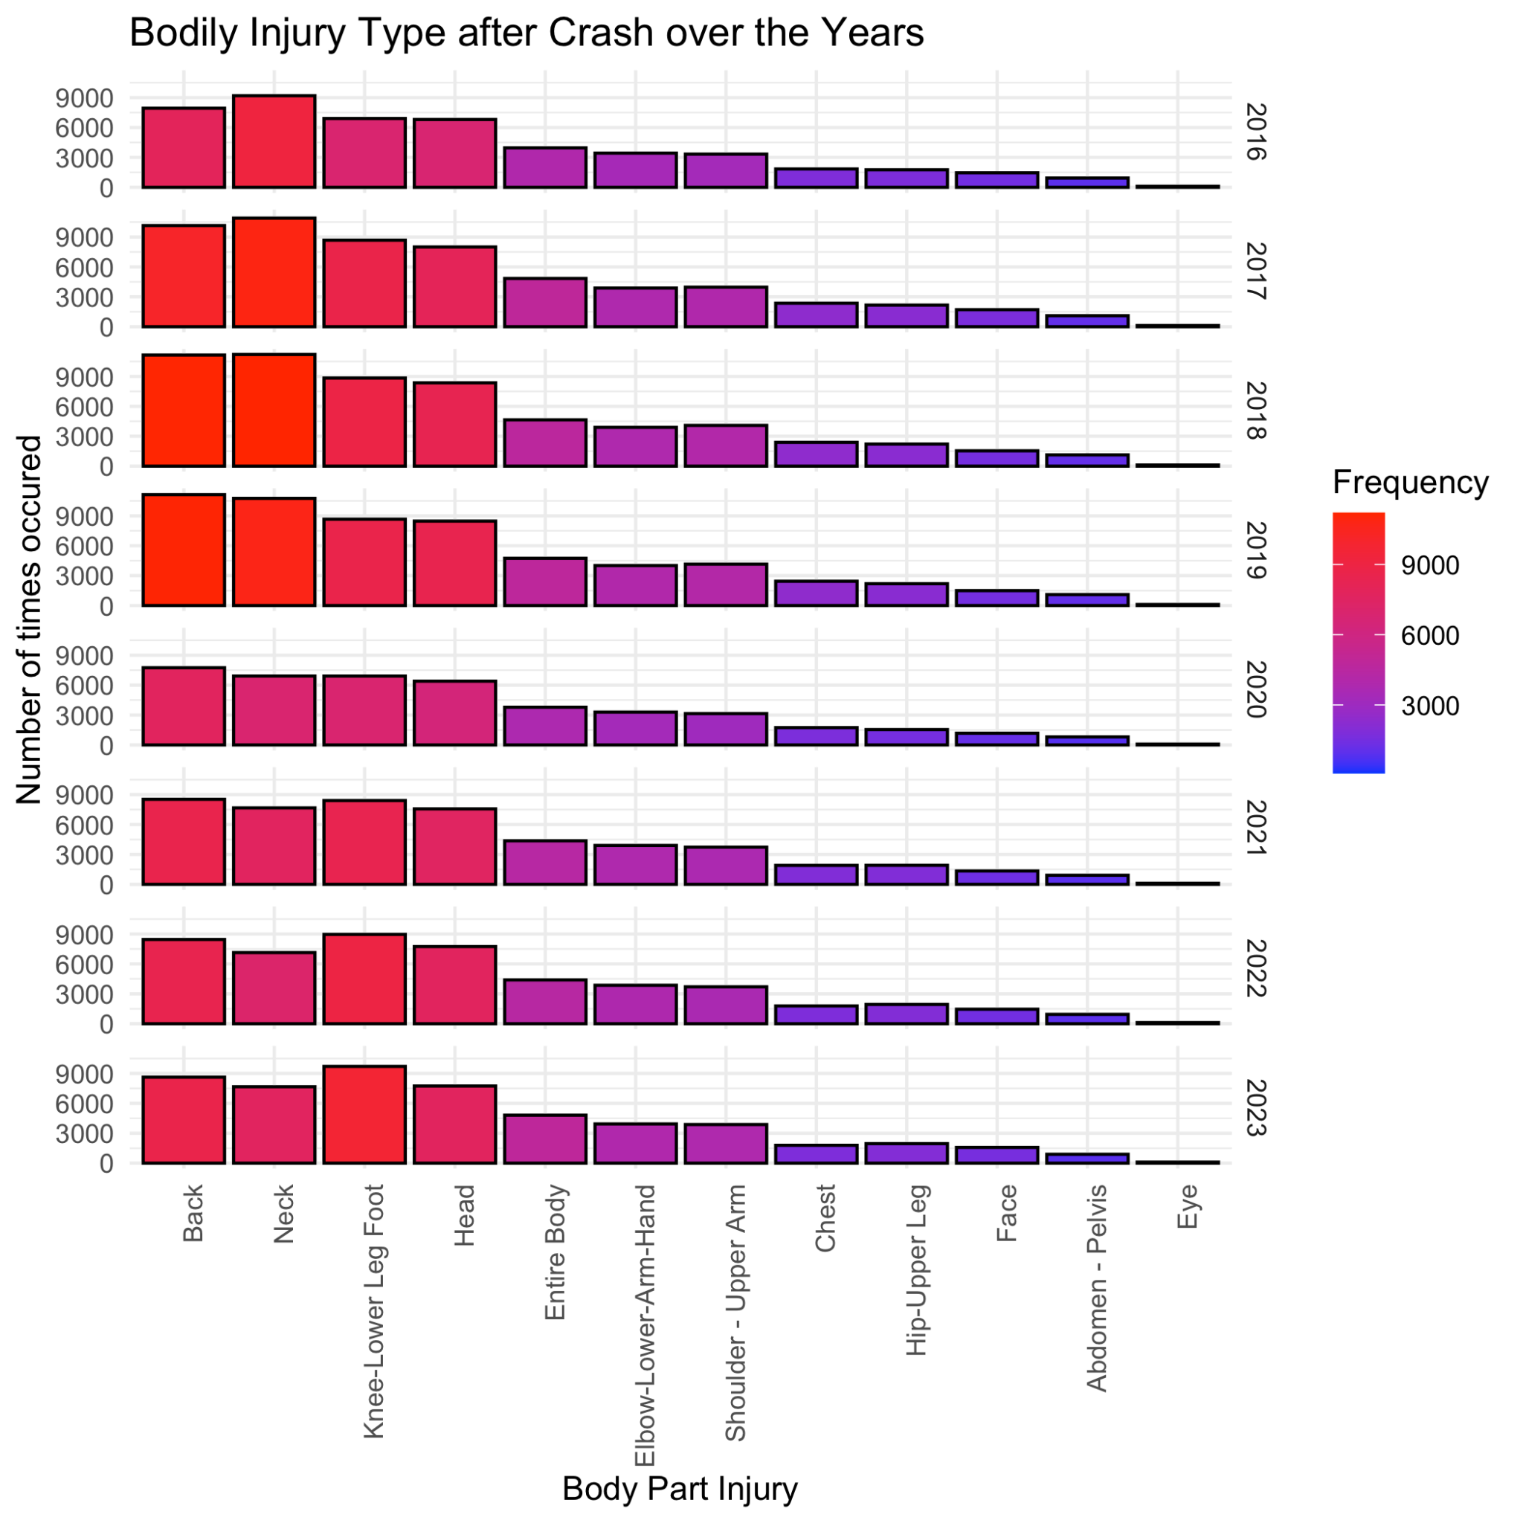
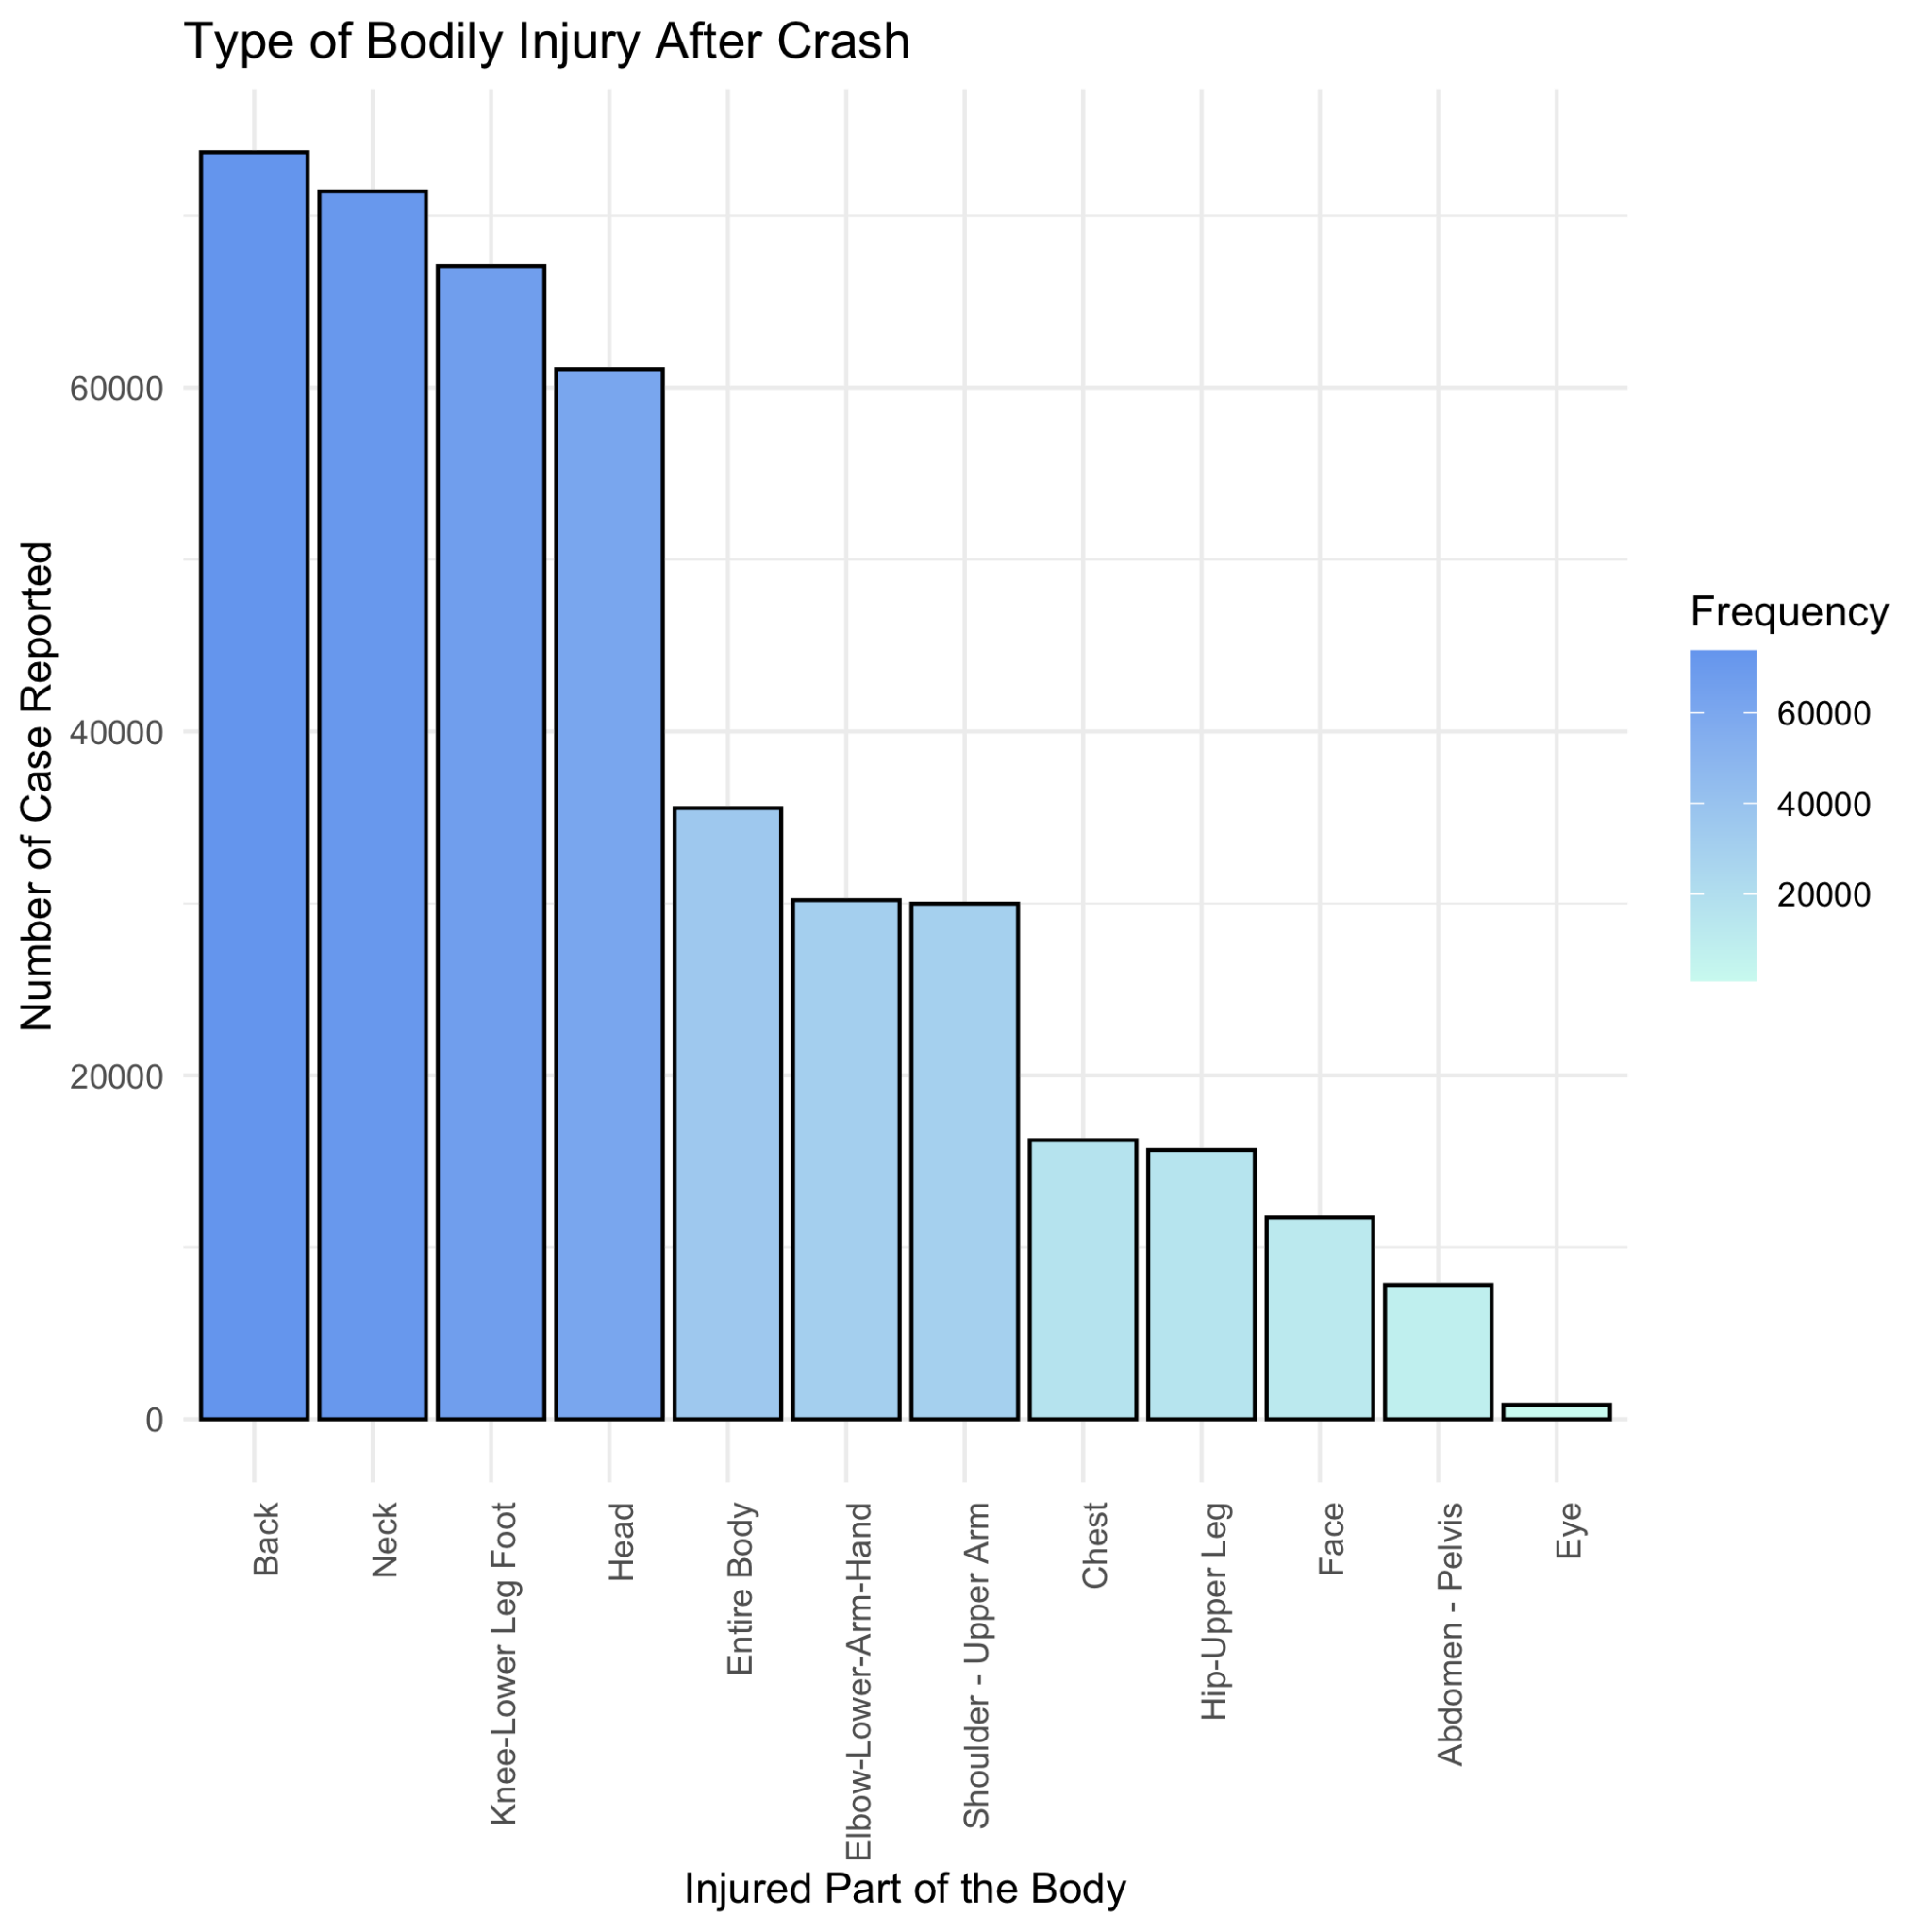
Which Body Parts are More likely to be injured during a Crash?
Back, Neck, Leg and Head are the Most injured part during a Crash
We see on the facet by Year Graph, First few years had maximum injuries related to Neck & Back but later on Neck and Back injury number were Reduced, but Leg Injury increased

Slide 12
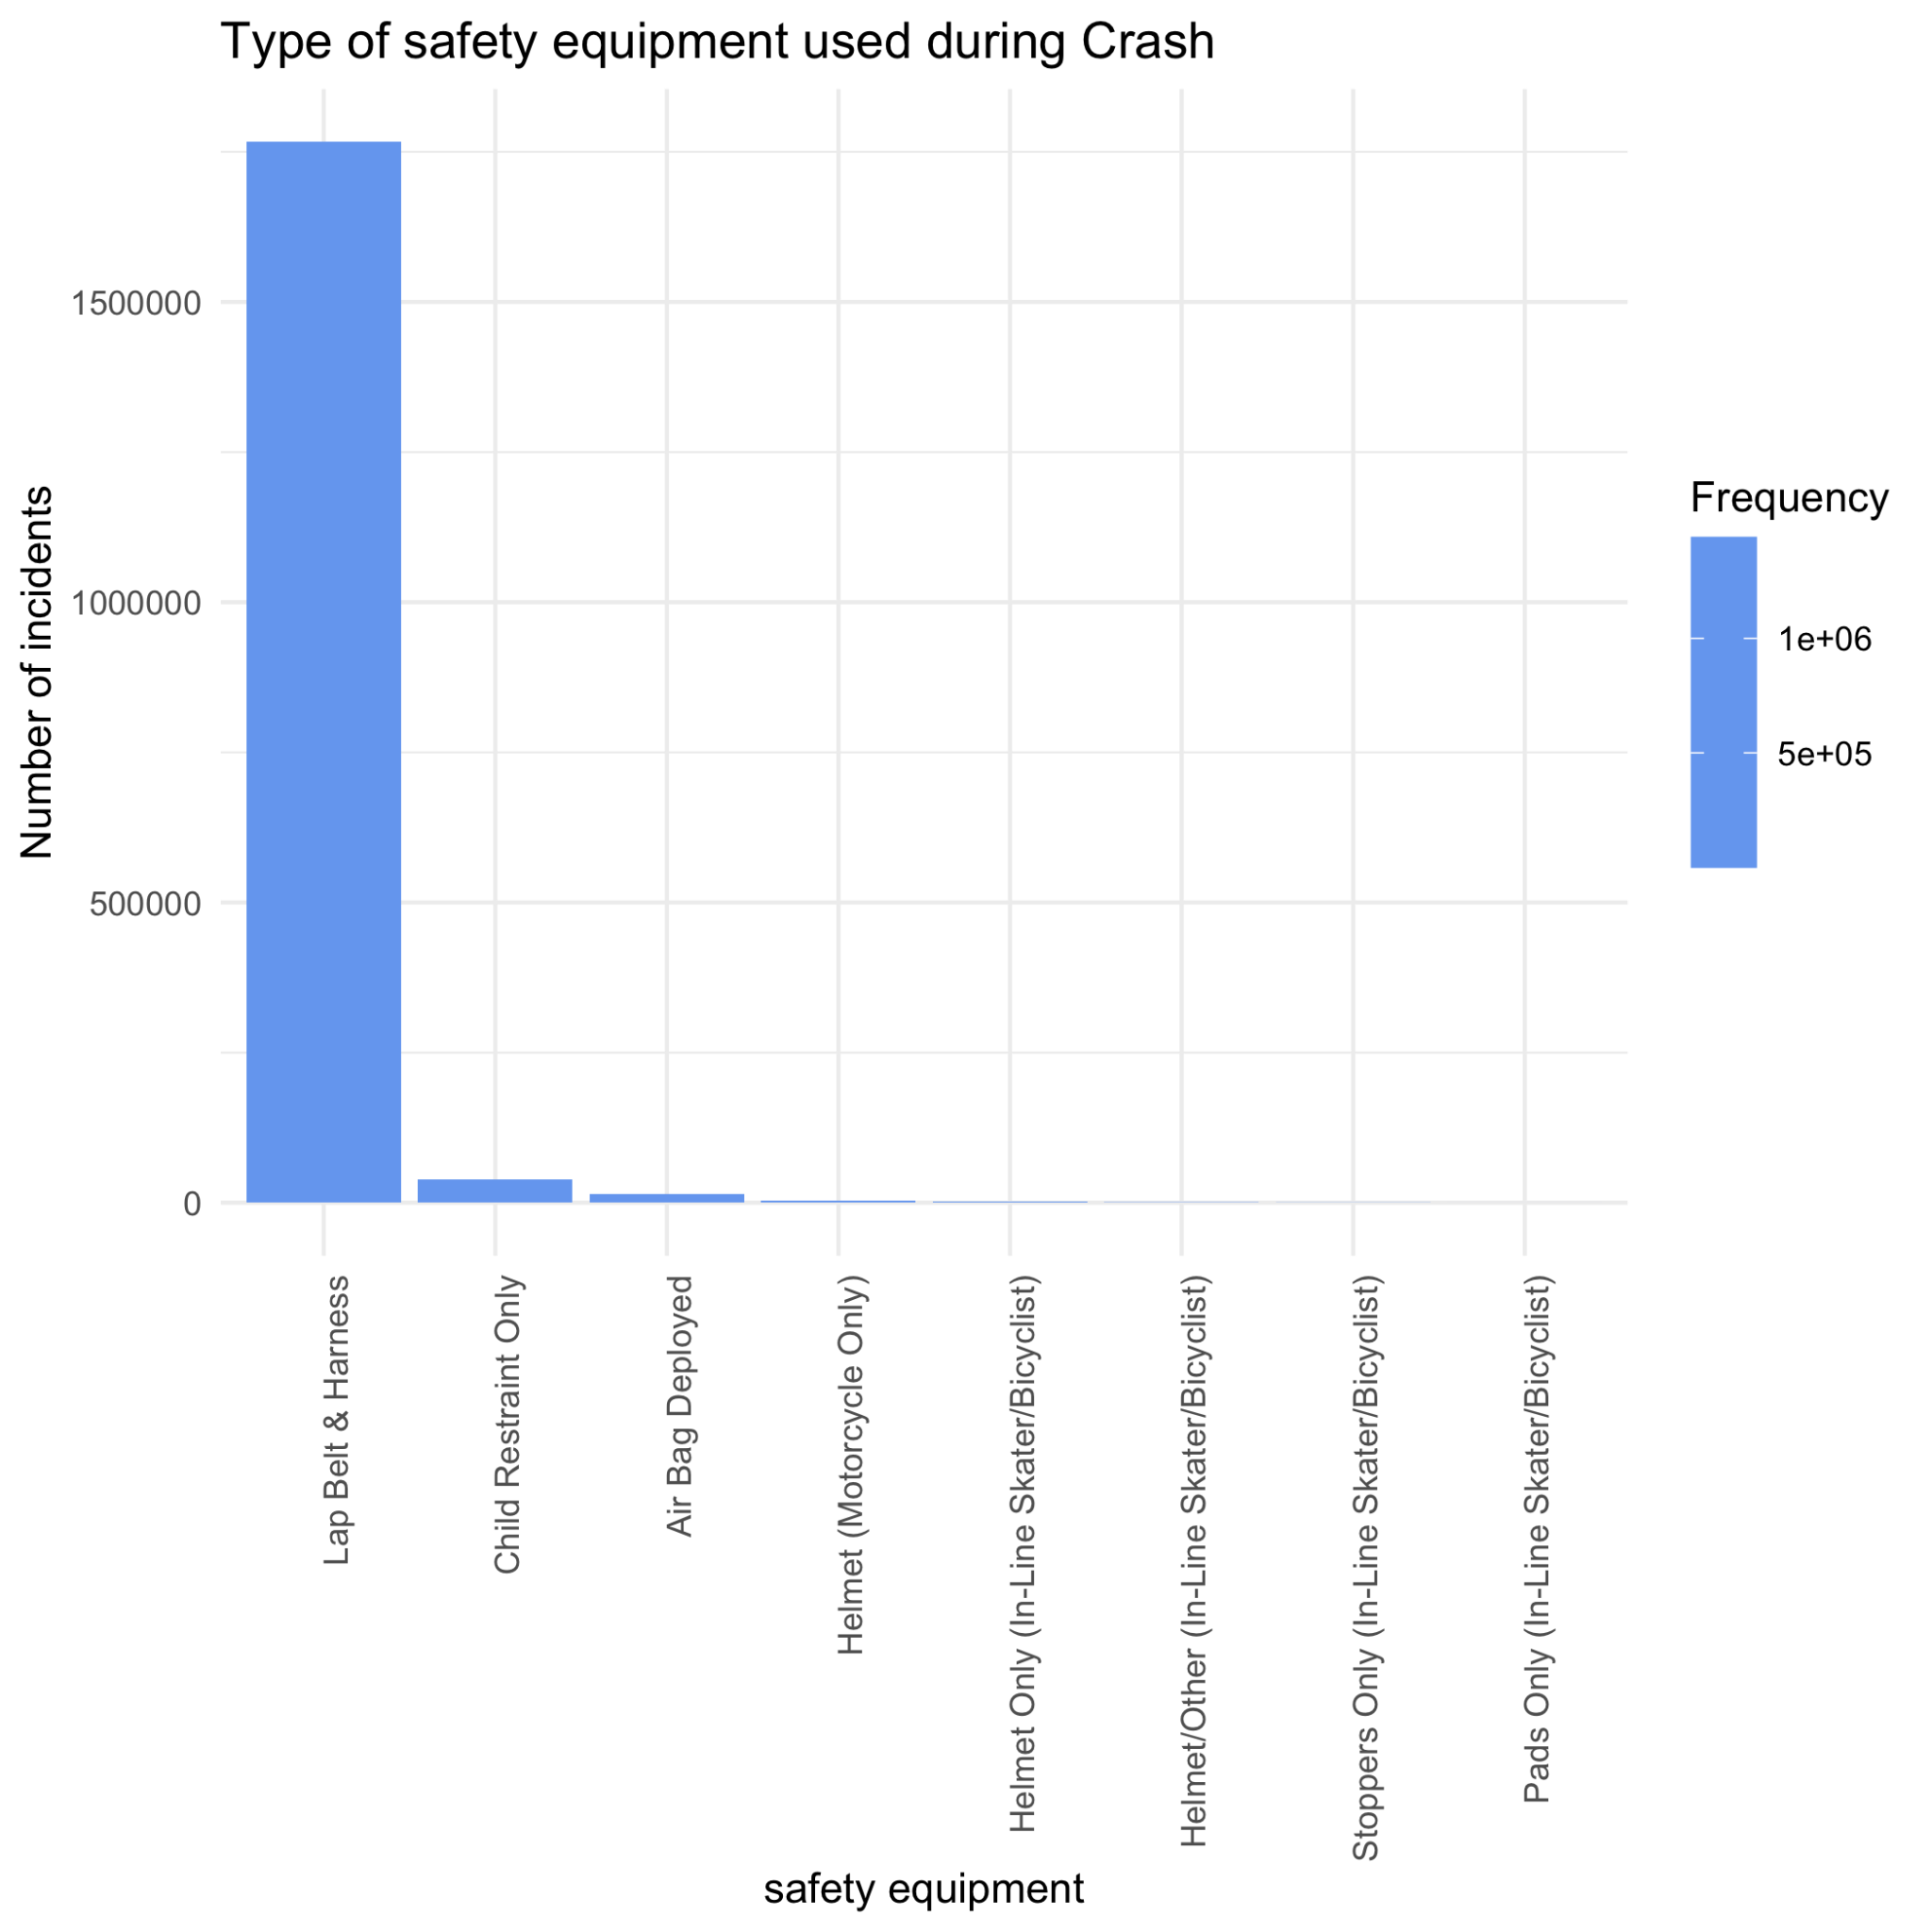
What is the most important Safety Equipment for Avoiding Injury During a Crash? (Using Non-injured Persons)
We Used Data for Non-injured persons during a crash to Find what safety Equipments Helped them Avoid Injury
Lap Belt & Harness is The Most Common Safety Equipment used by all Non-Injured person

Slide 13
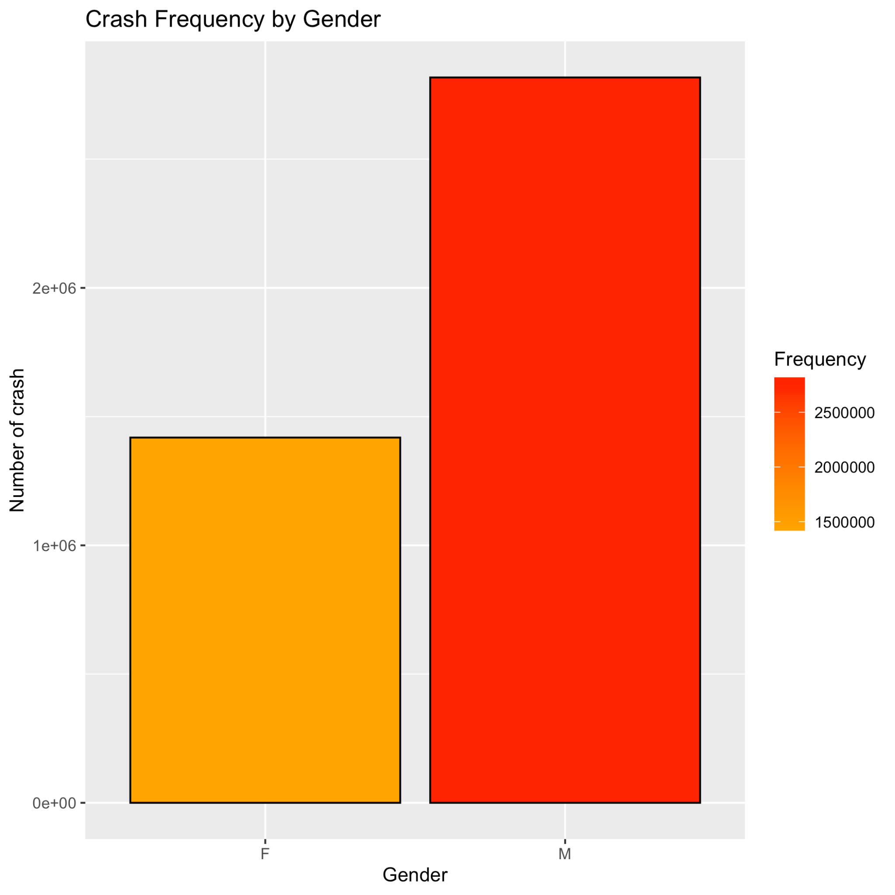
Who is Safer Driver?
Data Shows Number of Male Driver Involved in an Accident is almost Double The number of Female Drivers Involved

Slide 14
Code Explain:
Data Aggregation:
I aggregated crash numbers by collision ID, primary contributing factor, and year using the aggregate() function. This step calculates the frequency of each contributing factor for each year.
Data Cleaning:
Before visualization, I renamed the column containing the count of collisions to "frequency" for clarity. Additionally, I removed rows where the contributing factor is unspecified or blank.
Merging Similar Categories:
To simplify the visualization, similar contributing factors are merged into broader categories. For example, factors related to cell phone usage, vehicle defects, illness, drug/alcohol influence, distractions, unsafe/risky driving, failure on authority side/road issues, and other vehicle/outsider faults are grouped together.
Challenges:
One technical challenge is ensuring that similar contributing factors are correctly identified and merged. This process requires careful examination of the data to avoid overlooking relevant categories or incorrectly merging distinct factors.
Another challenge lies in optimizing the visualization for clarity and interpretability. With numerous contributing factors and multiple years of data, presenting the information in a clear and concise manner can be challenging. Adjustments may be needed in the visualization parameters to enhance readability.

Slide 15
Conclusion
Analysis of the Motor Vehicle Collisions dataset uncovered significant trends and insights into traffic incidents in New York City since April 2016.
The identification of peak accident periods during rush hours underscores the critical need for implementing targeted safety measures during high-traffic times.
Understanding injury patterns from the data informs the development of targeted safety initiatives and enhances medical response protocols.
Encouraging the use of safety equipment, especially among passengers, plays a vital role in improving overall road safety and mitigating the severity of injuries in motor vehicle collisions.

