Slide 1
Samiha Sarker Sweety .
Class Roll:0941
Supervised by:
Prof. Dr. Mohammod Shoyaib.

Slide 2
Project:
Human activity recognation from sensor data using KNN,Decision Tree and Naive Bayes.

Slide 3
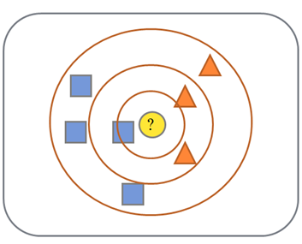
k NEAREST NEIGHBOR
Requires 3 things:
  Feture Space(Training Data)
  Distance metric
    to compute distance between features.
  Euclidean distance(continuos distribution)
  d(p,q) = √∑(p_{i} – q_{i})²
  The value of k
    the number of nearest neighbors to retrieve from which to get majority class and finally calculate distance .
k = 1:
Belongs to square class
k = 3:
Belongs to triangle class
k = 7:
Belongs to square class

Slide 4
        Bubble sort

Slide 5
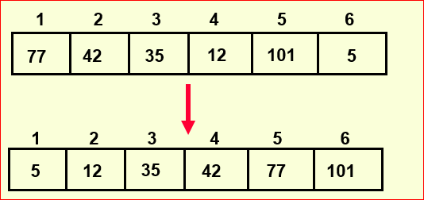
Sorting
Sorting takes an unordered collection and makes it an ordered one.

Slide 6
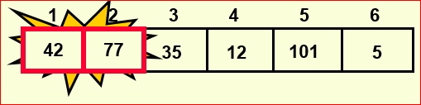
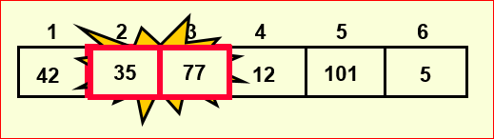
“Bubbling Up” the Largest
Traverse a collection of elements
Move from the front to the end
“Bubble” the largest value to the end using pair-wise comparisons and swapping

Slide 7
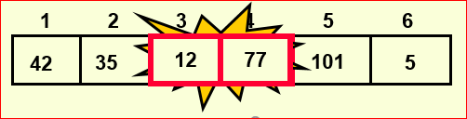
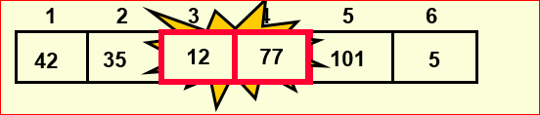
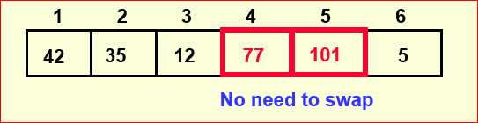
“Bubbling Up” the Largest Element
Traverse a collection of elements
Mov from the front to the end
“Bubblee” the largest value to the end using pair-wise comparisons and swapping

Slide 8
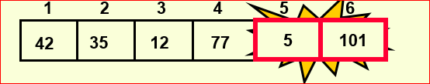
“Bubbling Up” the Largest Element
Traverse a collection of elements
Move from the front to the end
“Bubble” the largest value to the end using pair-wise comparisons and swapping

Slide 9
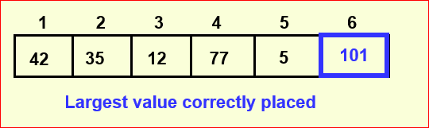
“Bubbling Up” the Largest Element
Traverse a collection of elements
Move from the front to the end
“Bubble” the largest value to the end using pair-wise comparisons and swapping

Slide 10
BubbleRepeat “ Up” How Many Times?
If we have N elements…
And if each time we bubble an element, we place it in its correct location…
Then we repeat the “bubble up”process N – 1 times.

Slide 11
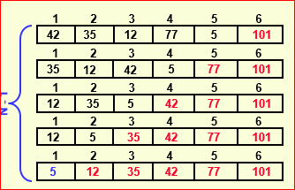
“Bubbling” All the Elements

Slide 12
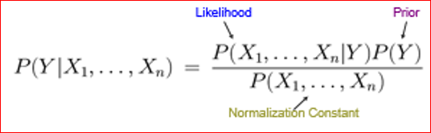
Bayes’ Theorem
P(A|B) = probability of A given that B is true.
P(A|B) = P(B|A)P(A)/P(B)
Using Bayes Rule!

Slide 13
Bayes’ Theorem
P(A/B) = P(B/A)* P(A) /P(B)
P(A/B) = probability of purchasing MacBook after purchasing iphone.
P(B/A) = probability of purchasing iphone after purchasing MacBook.
P(A) = probability of purchasing MacBook.
P(B) = probability of purchasing iphone.

Slide 14
        Decision tree

Slide 15

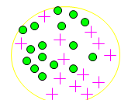
Entropy
Entropy =
  Entropy-(14/30 log2 14/30 )
  -(16/30 log2 16/30)=0.996
  p_{i} is the probability of class i
  Compute it as the proportion of class i in the set.

Slide 16
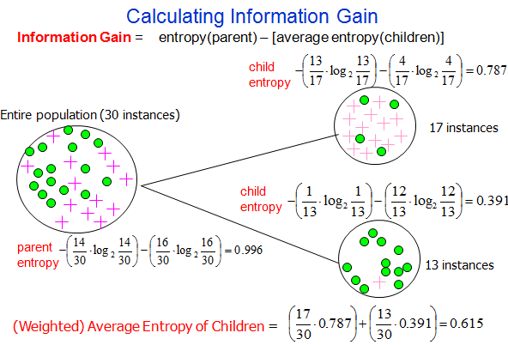
Information Gain= 0.996 - 0.615 = 0.38
Information Gain= 0.996 - 0.615 = 0.38

Slide 17
    Cross-Validation

Slide 18
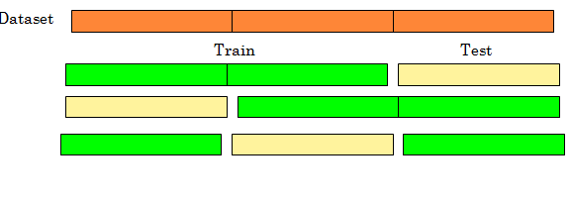
Cross Validation
Common Splitting Strategies
k-fold cross-validation

Slide 19
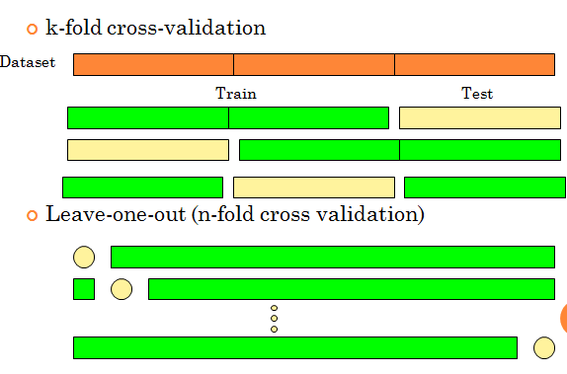
Cross Validation
Common Splitting Strategies

Slide 20
Precision, Recall and F-measure

Slide 21
Precision, Recall and F-measure
Precision: How close are the measurements to each other?
F-measure : A measure that combines precision and recall is the harmonic mean of precision and recall.

Slide 22
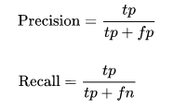
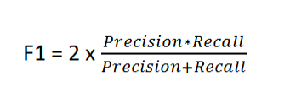
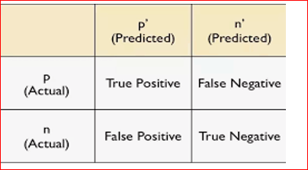
Precision, Recall and F-measure
  tp = true positive, fp = false positive etc.
fn = false negative, tn = true negative.

Slide 23
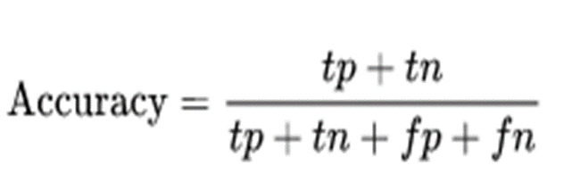
Accuracy
Accuracy: How close is a measurement to the tree value?

Slide 24
My Progress:
    K-Nearest neighbors ( KNN )
    Generic Method for any Dataset .
    10 fold Cross validation .
    Accuracy calculation .
    Decision Tree.
    Precision.
    Recall.
    Fmeasure .
    Naivebayes.

Slide 25
Github link
https://github.com/samihasarker/SPL-1-../blob/master/10cross.py
https://github.com/samihasarker/SPL-1-../blob/master/iris.csv
https://github.com/samihasarker/SPL-1-../blob/master/wine.csv

Slide 26
  THANK YOU

