Slide 1
Linux Assignment
CSE Fundamental
Samik Chugh
CSE Core –B
2501010248
Submitted to: Rajesh Sir

Slide 2
Install WSL & Ubuntu on Windows 10
Open PowerShell as Administrator (search PowerShell → right-click → Run as administrator). Copy & paste the following commands one by one and press Enter.
Enable WSL and Virtual Machine Platform:
dism.exe /online /enable-feature /featurename:Microsoft-Windows-Subsystem-Linux /all /norestart
dism.exe /online /enable-feature /featurename:VirtualMachinePlatform /all /norestart
Restart Windows when prompted (restart your PC).
After restart, open PowerShell (not admin needed now) and install WSL Ubuntu:
wsl --install -d ubuntu
After installation, a new Ubuntu terminal will open. Create your UNIX username and password when prompted.

Slide 3
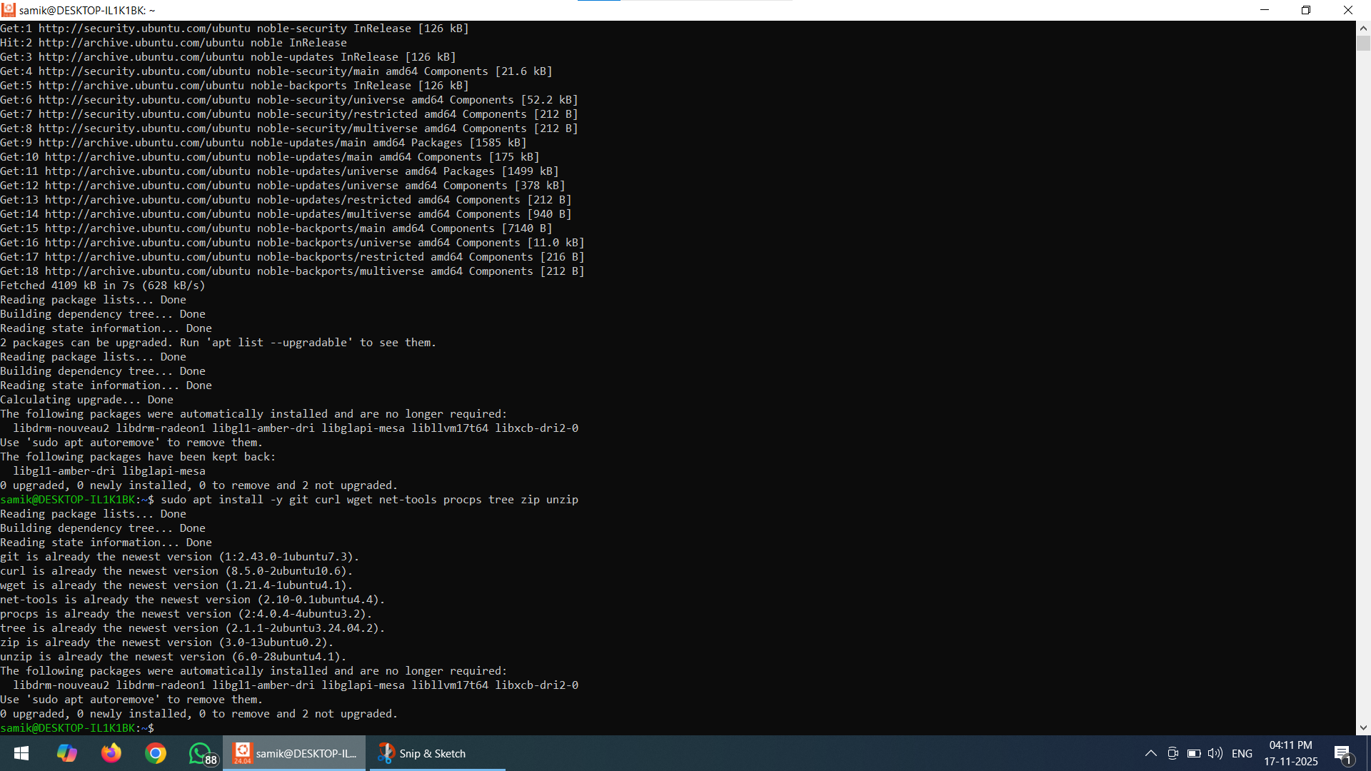
2.Inside Ubuntu: update & install required tools
Open the Ubuntu terminal (from Start menu). Run:
# update packages
sudo apt update && sudo apt upgrade -y
# install common tools
sudo apt install -y git curl wget net-tools procps tree zip unzip
Explanation:
git for version control and GitHub.
curl/wget for downloading files (required by assignment).
net-tools provides ifconfig (if you prefer ip you already have it).
procps includes ps and top.
tree for hierarchical view of directories.

Slide 4
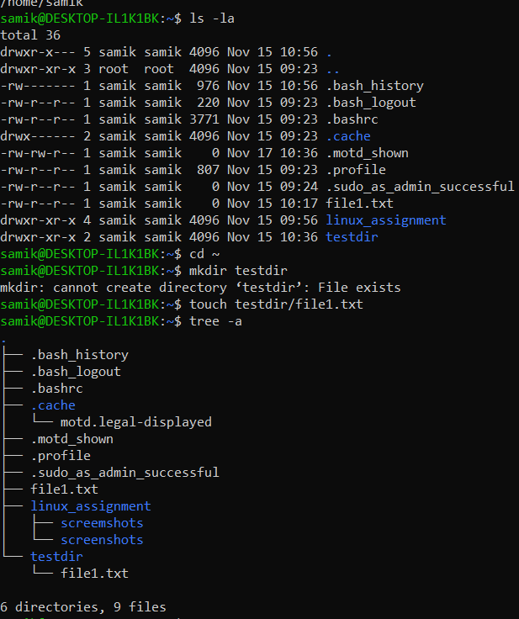
3) 20+ shell commands — with exact commands & what to capture
Run each command in Ubuntu terminal and take a screenshot of the output. Save screenshots in a folder ~/linux_assignment/screenshots
mkdir -p ~/linux_assignment/screenshots
cd ~/linux_assignment
Commands to run (copy-paste). For each command, include syntax, short purpose, and capture screenshot:
File/navigation:
pwd # shows current directory
ls -la # list files with permissions and hidden files
cd ~ # go to home
mkdir testdir # create a directory
touch testdir/file1.txt # create file
tree -a # tree view of current folder

Slide 5
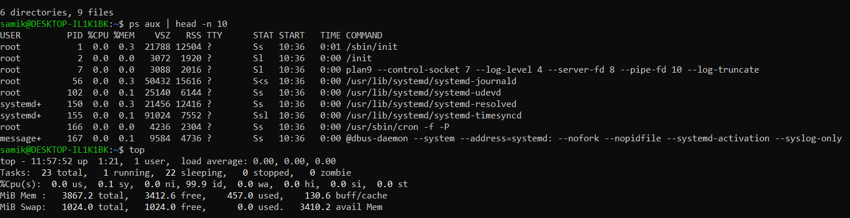
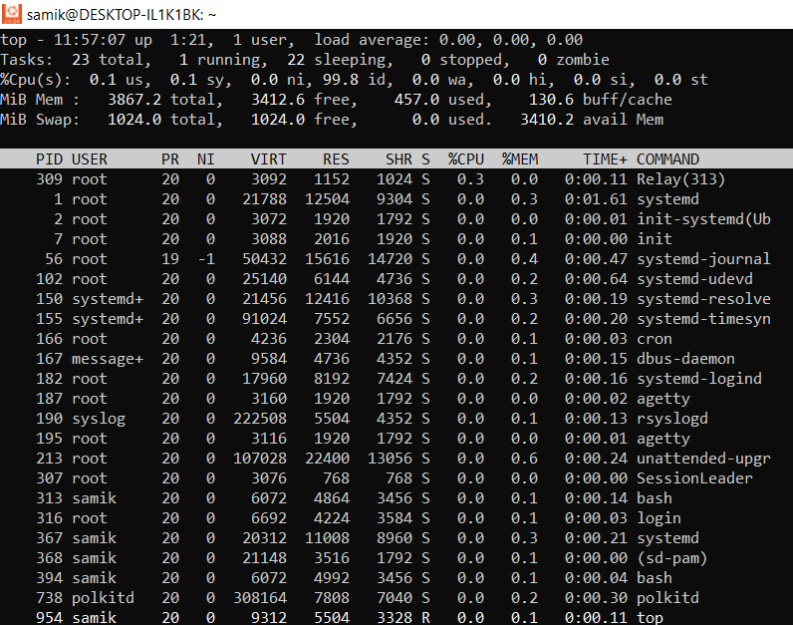
.Process monitoring:
ps aux | head -n 10 # show running processes
top # interactive, press q to quit
# or use htop if installed (sudo apt install -y htop)
Networking:
ping -c 4 8.8.8.8 # ping google DNS
ip a # show IP addresses (modern alternative to ifconfig)
ifconfig || true # ifconfig may be available (net-tools)
netstat -tuln | head -n 10 # active network ports

Slide 6
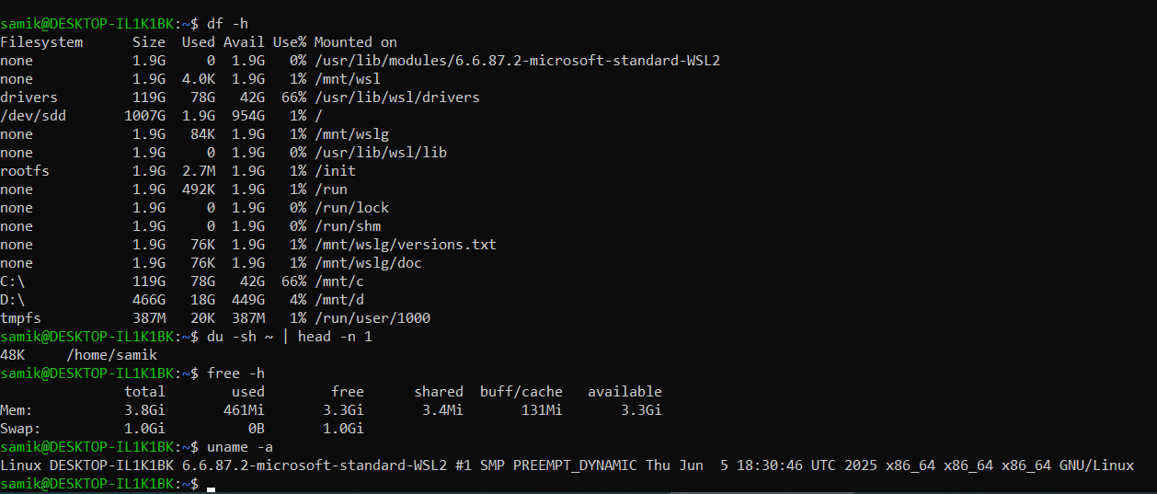
Disk & system info:
df -h # disk usage human-readable
du -sh ~ | head -n 1 # folder size of home
free -h # memory usage
uname -a # kernel and system info

Slide 7
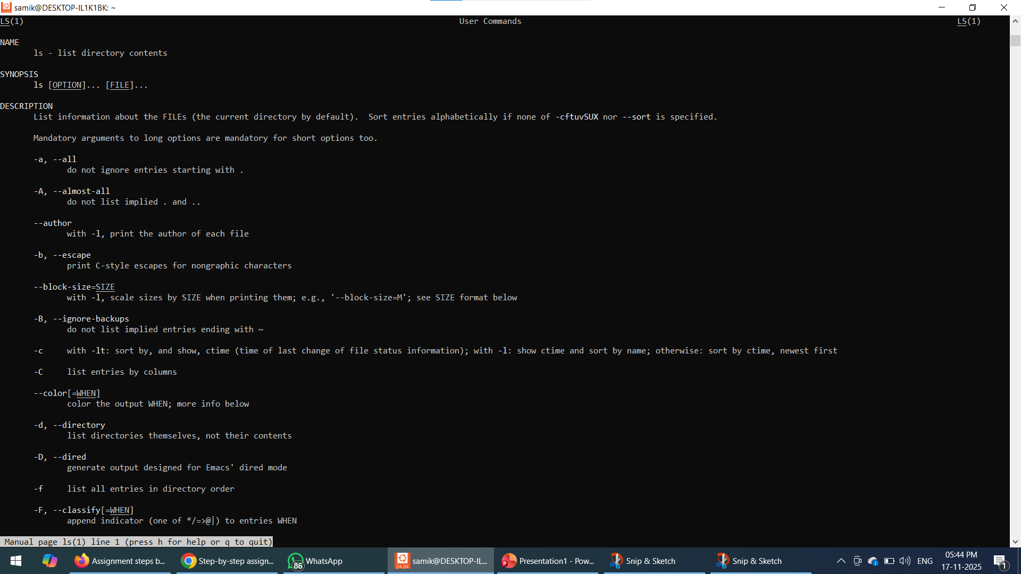
Package & help:
apt list --installed | head -n 20
man ls # open manual page for ls (press q to quit)

Slide 8
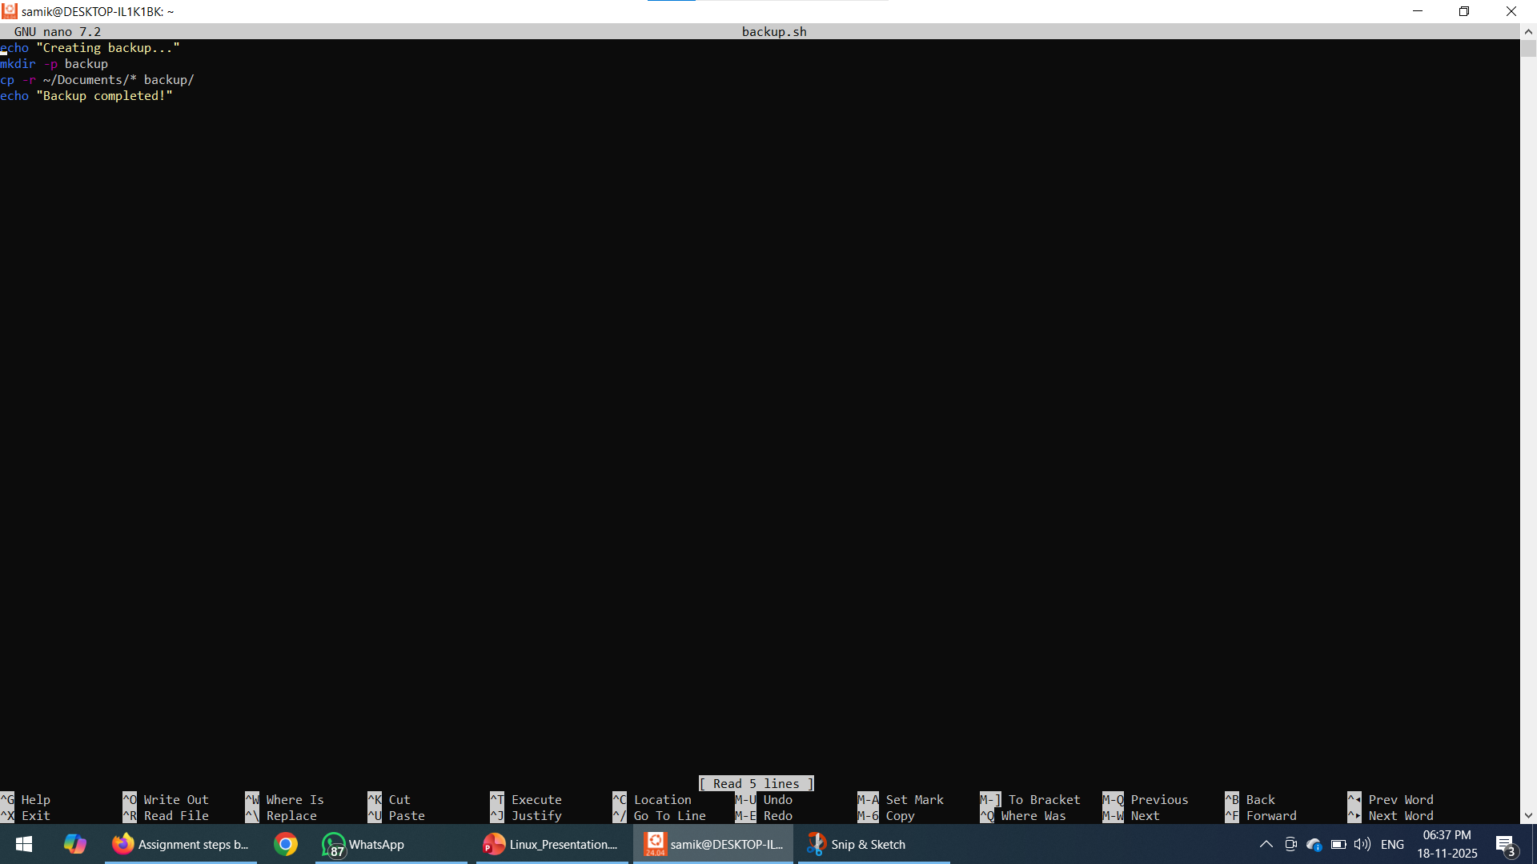
✍️ Step 1: Create and open the script
Run:
nano backup.sh
✍️ Step 2: Paste this code inside nano:
#!/bin/bashmkdir -p backupcp -r ~/Documents/* backup/echo "Backup completed successfully!"
✍️ Step 3: Save the script
In nano:
Press CTRL + O → Enter
Press CTRL + X to exit
✍️ Step 4: Make the script executable
chmod +x backup.sh
✍️ Step 5: Run the script
./backup.sh

Slide 9


