Slide 1

Phishing website detection
Semester Project
Group Members:
Sami ullah khan (02-131192-071)
Saad kamal (02-131192-075)
Course :
Data mining
Course Teacher:
Amina Jameel
Lab Teacher:
Engr.Ramsha Mashood

Slide 2
MOTIVATION:
Phishing is one of the major problems faced by cyber-world and leads to financial losses for both industries and individuals. Detection of phishing attack with high accuracy has always been a challenging issue. At present, visual similarities based techniques are very useful for detecting phishing websites efficiently. Phishing website looks very similar in appearance to its corresponding legitimate website to deceive users into believing that they are browsing the correct website.

Slide 3
INTRODUCTION
A phishing technique was described in detail in a paper and presentation delivered to the 1987 International HP Users Group. Ever since the concept of phishing has been introduced it’s growing so fast. The problem is we do not have enough resources to detect any phishing website in real time. Phishing attempts have grown 65% in the last year and it’s still growing so fast because the average cost of a phishing attack for mid-size companies $1.6 million. The technique for detection for phishing website has been proposed and project has been implemented in this called ‘PHISHING DETECTION THROUGH MACHINE LEARNING’. In this project I have emphasized on the method of detection through the URL also called ‘DECEPTIVE PHISHING’, because it is the most common way people visit the websites and links

Slide 4
TASK DISTRIBUTION
REG. No | MEMBERS NAME | TASKS
65180 | Sami ullah khan | Algorithm implementation and back end development and data collection
65183 | Saad kamal | Front end and compatibility of backend and front end.

Slide 5

TECHNOLOGY
Python. Jupyter notebook.
Pandas
Numpy
Matplotlib
LogisticRegression
train_test_split confusion_matrix
Flask
pickle

Slide 6
TARGET MARKET
Phishing is one of the major problems faced by cyber-world and leads to financial losses for both industries and individuals. Detection of phishing attack with high accuracy has always been a challenging issue. At present, visual similarities based techniques are very useful for detecting phishing websites efficiently. Phishing website looks very similar in appearance to its corresponding legitimate website to deceive users into believing that they are browsing the correct website.

Slide 7
FEATURES
URL domain length of phishing URL.
URL domain length of legitimate URL.
Number of slashes in phishing URL.
Number of slashes in legitimate URL.
Number of dots in phishing URL.
Number of dots in legitimate URL.
Number of terms in the host name of phishing URL.

Slide 8
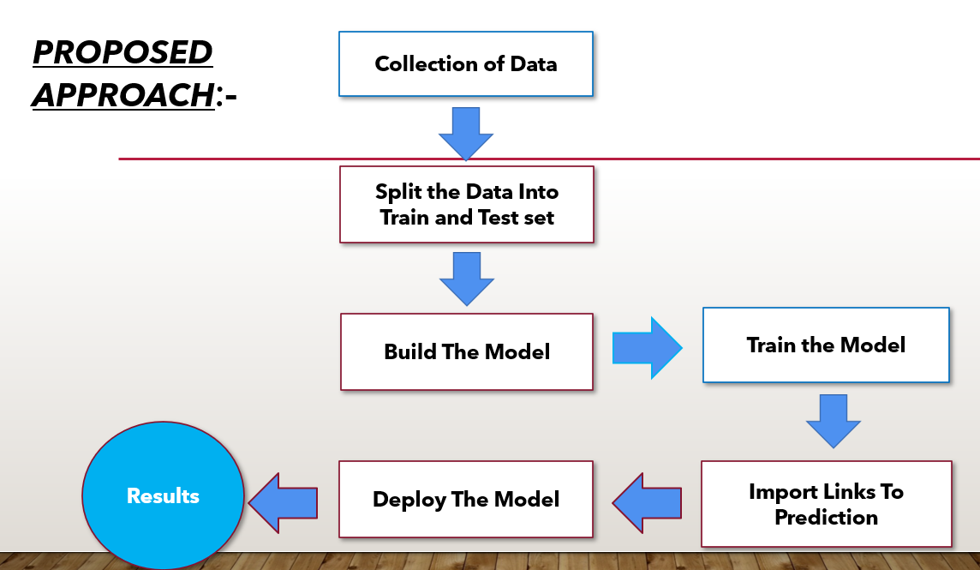
OVERVIEW
(Flow Diagram)
Step 1
Step 1
Step 1

Slide 9
OVERVIEW
(Details)
Background, History, and Statistics section presents the history of phishing attacks, worldwide financial losses due to phishing attacks, the lifecycle of phishing attack, and classification of various types of phishing attacks. This section describes the overall picture of phishing attacks from a high level perspective.(ii)Next, we describe how attacker fools an Internet user and how they bypass the antiphishing system.(iii)Similarly, we present various types of phishing detection techniques, their advantages, and drawbacks.(iv)Also, we provide a comprehensive literature review of visual similarity based phishing detection approaches, which incorporates document object model (DOM), Cascading Style Sheet (CSS), HTML tag, image processing, and hybrid techniques. Moreover, we present a comparison between various visual similarity based antiphishing techniques. It provides a better understanding of the problem, current solution space, and future research scope to efficiently deal with phishing attacks using visual similarity based approach.(v)In addition, we provide several issues and challenges in detection of phishing attacks.

Slide 10
PROS
Measure the degrees of corporate and employee vulnerability.
Eliminate the cyber threat risk level.
Increase user alertness to phishing risks.
Instill a cyber security culture and create cyber security heroes.

Slide 11
ENHANCEMENT
proposed an antiphishing approach based on discriminative keypoint features. This approach considers detection of phishing webpage. This approach will enhance to cyber world. Where multiple attackers tries to hack the system by the user visiting their websites. So if we may know earlier stage that the website is phishing so user will not access the site.

Slide 12
Thank You

