Slide 1
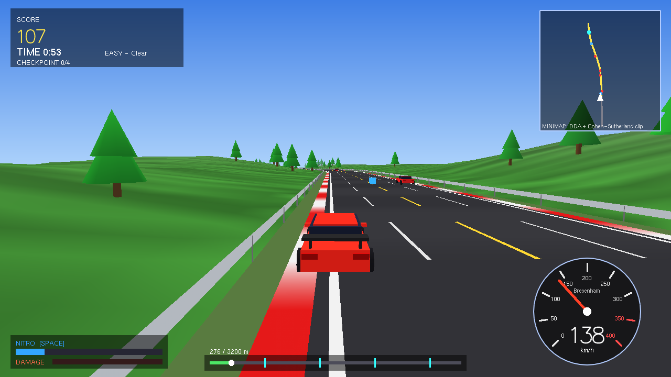
3D TURBO RACER
CG Edition - C++17 / OpenGL racing game with a built-in Computer Graphics Learning Mode
Author: Sami Khan
linkedin.com/in/samikhan07 | github.com/samikhan7507

Slide 2
Project goals
• A playable 3D racing game in modern C++ and OpenGL
• Curved highways, hairpins, mountains, rough terrain, traffic, obstacles
• Realistic steering, collisions, nitro, upgrades, scoring, checkpoints
• 4 difficulty levels - 4 environments and weather types
• Learning Mode wired to the game code: matrices, DDA, Bresenham, clipping, projection, animation
• Free online / phone version + tested, documented source

Slide 3
Architecture
math3d.hpp
Mat3 / Mat4 from scratch: translate, rotate, scale, reflect, shear, perspective, lookAt
cg_algorithms.hpp
DDA, Bresenham, Cohen-Sutherland
game.hpp
Track, physics, traffic, SAT collisions, scoring (no OpenGL - testable headless)
learn_mode.hpp
11 interactive CG pages using the same code
main.cpp
Rendering, HUD, menus, input
web/index.html
JavaScript port for browsers and phones

Slide 4
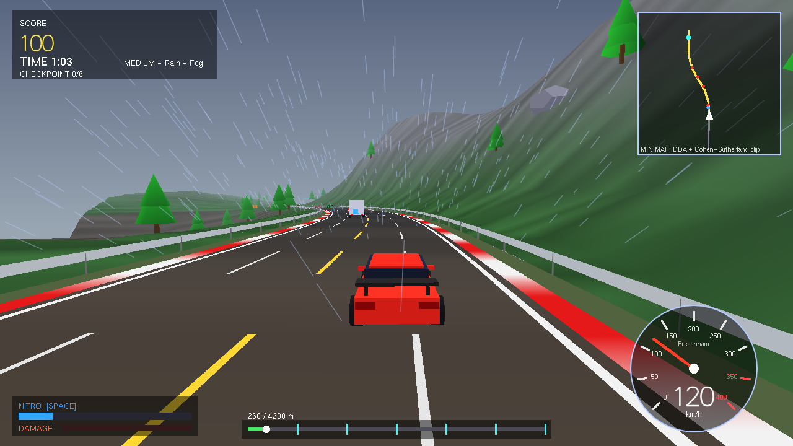
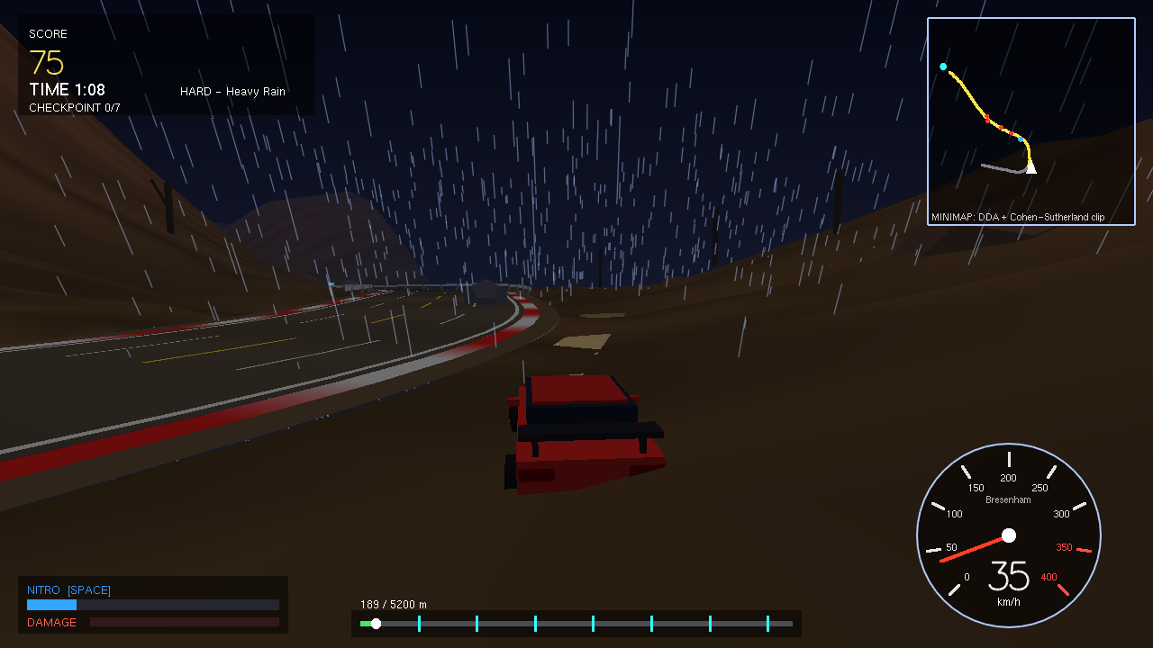
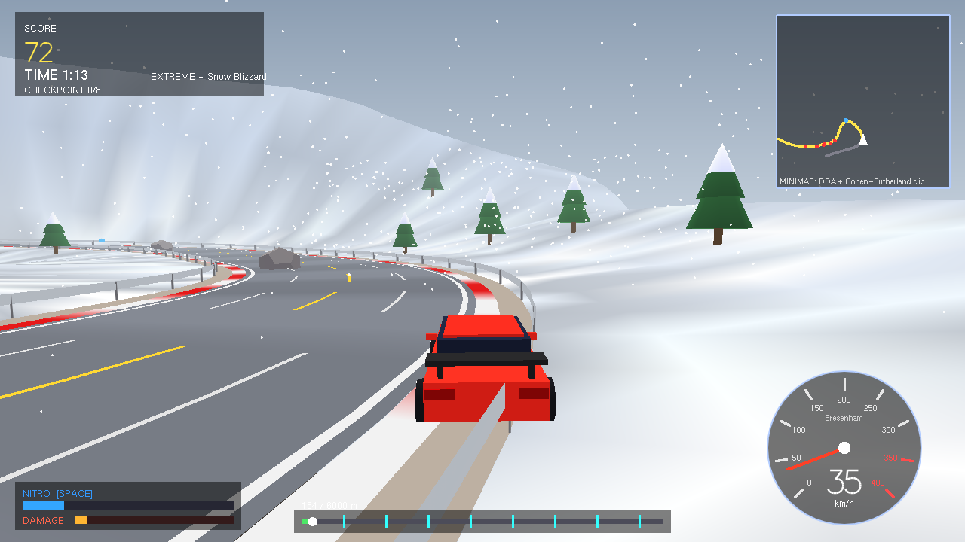
Four difficulty levels
EASY
Sunny Coastal Highway
Clear
MEDIUM
Misty Mountain Pass
Rain + fog
HARD
Night Storm Canyon
Heavy rain, night
EXTREME
Arctic Blizzard Ridge
Snow blizzard

Slide 5
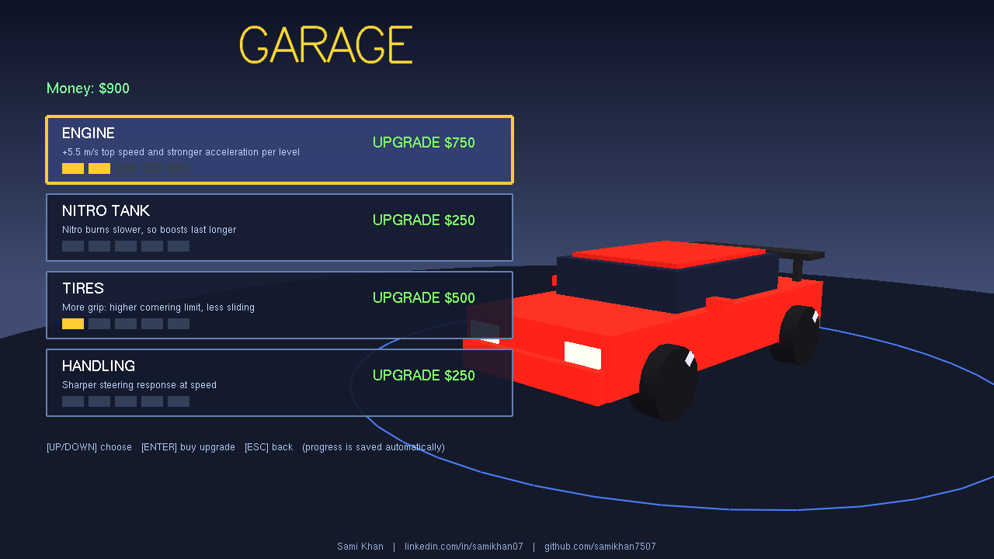
Gameplay systems
• Bicycle-model steering, speed-sensitive, grip-limited
• Slip / drift, handbrake, off-road drag, rough terrain
• Oriented-box (SAT) collisions, damage, near-miss combos
• Nitro gauge + pickups, FOV boost
• Checkpoint arches add time; finish bonus; stars
• Garage: Engine, Nitro, Tires, Handling (saved)

Slide 6
CG theory running inside the game
Translate / Rotate / Scale
Model matrix of every object
Reflection
Left wheels = right wheels, scale(-1,1,1)
Shearing
Body roll in corners
Composite
MVP = P*V*M; minimap T*S*R*T
Projection
Perspective, FOV grows with speed
Bresenham
Speedometer needle + ticks
DDA + Clipping
Minimap road, clipped to its panel
Animation
dt-based camera, wheels, flames, traffic

Slide 7
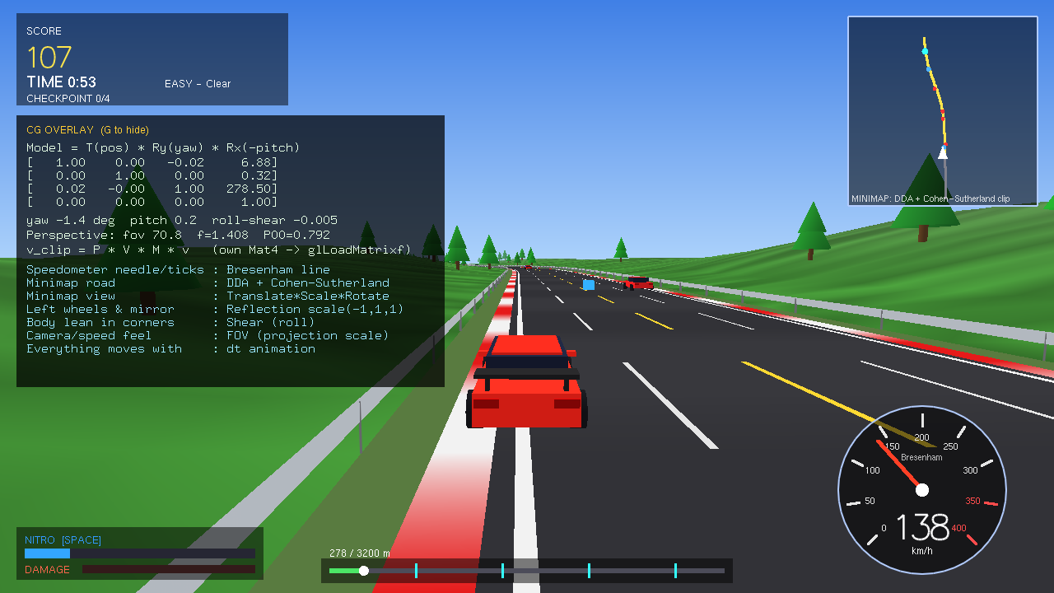
Live CG overlay (press G in a race)
• Real model matrix of the player car
• FOV and projection element
• List of algorithms used by the HUD

Slide 8
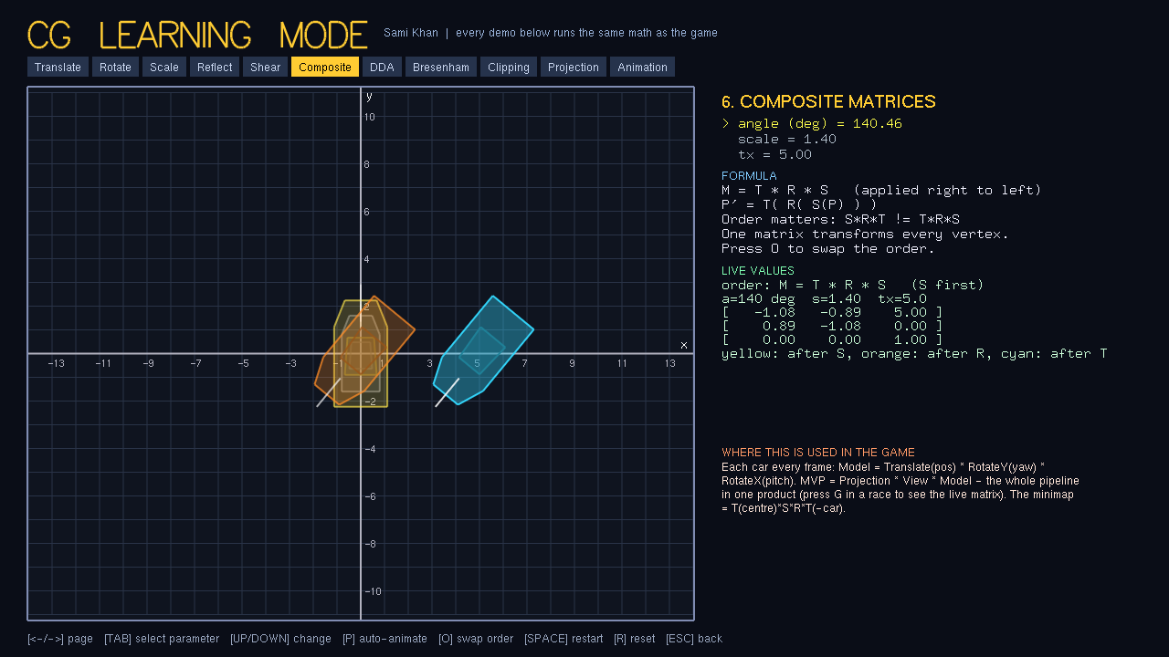
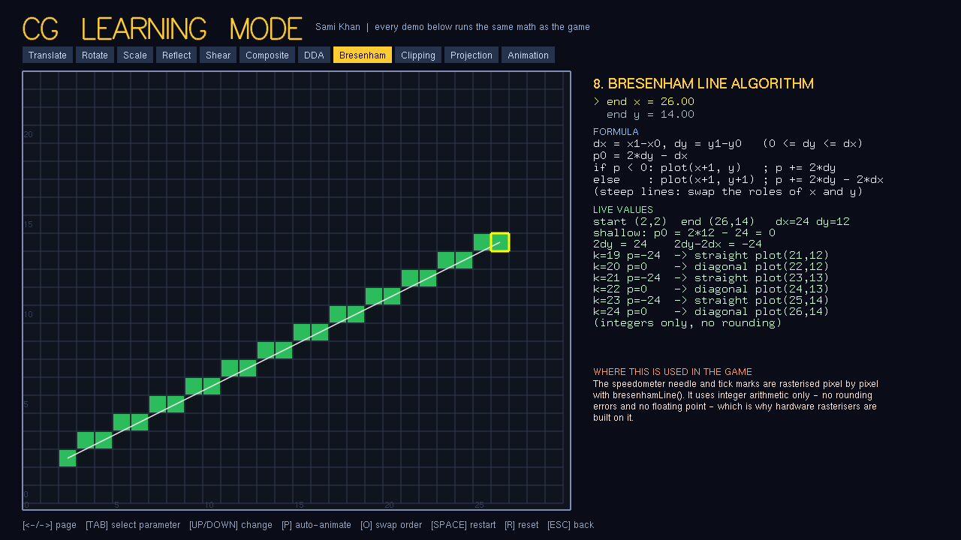
CG Learning Mode - 11 interactive pages
Translation - Rotation - Scaling - Reflection - Shearing - Composite - DDA - Bresenham - Clipping - Projection - Animation
Each page: visual demo, live matrix/values, formula, and "where it is used in the game"

Slide 9
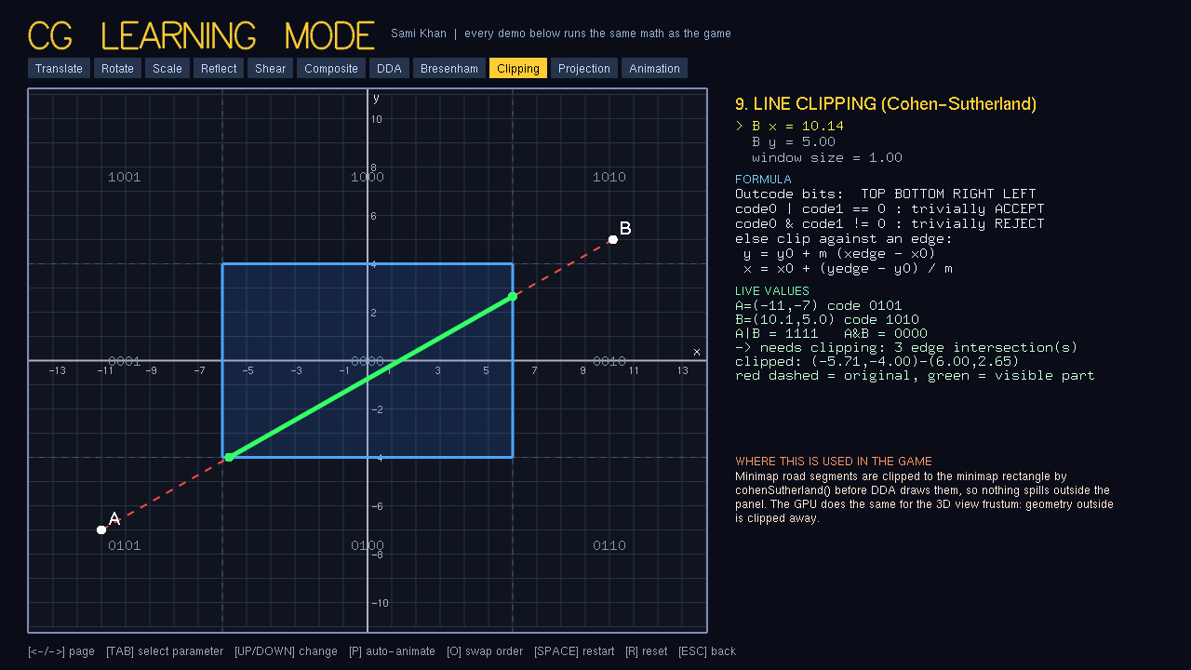
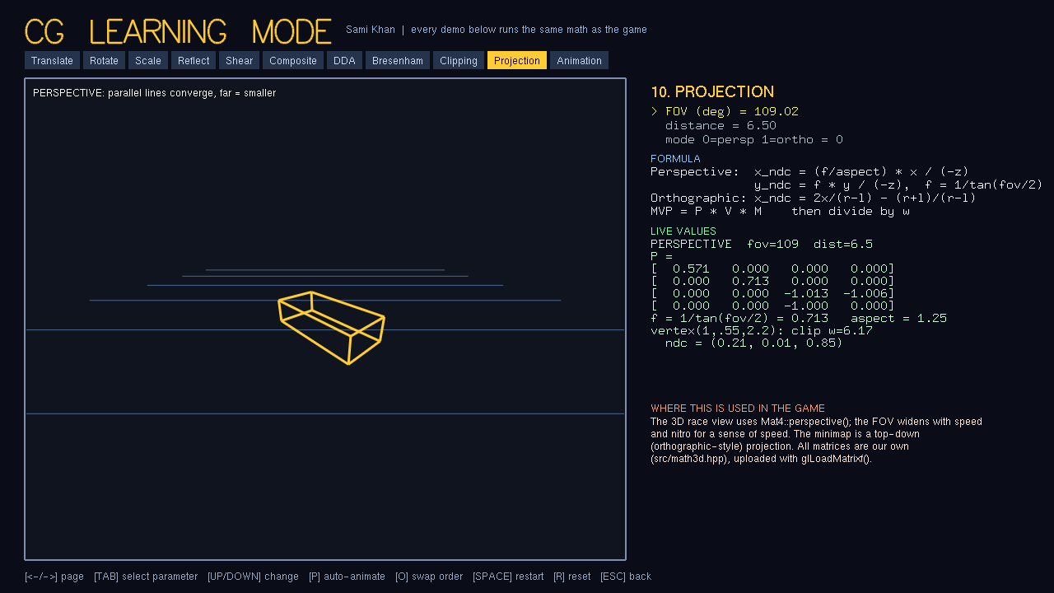
Clipping and projection demos
Cohen-Sutherland outcodes with 9 regions; perspective vs orthographic with the live projection matrix

Slide 10
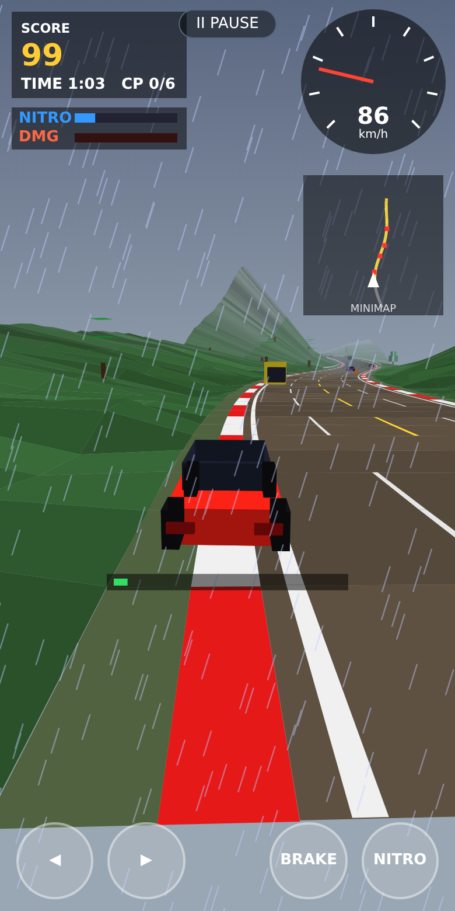
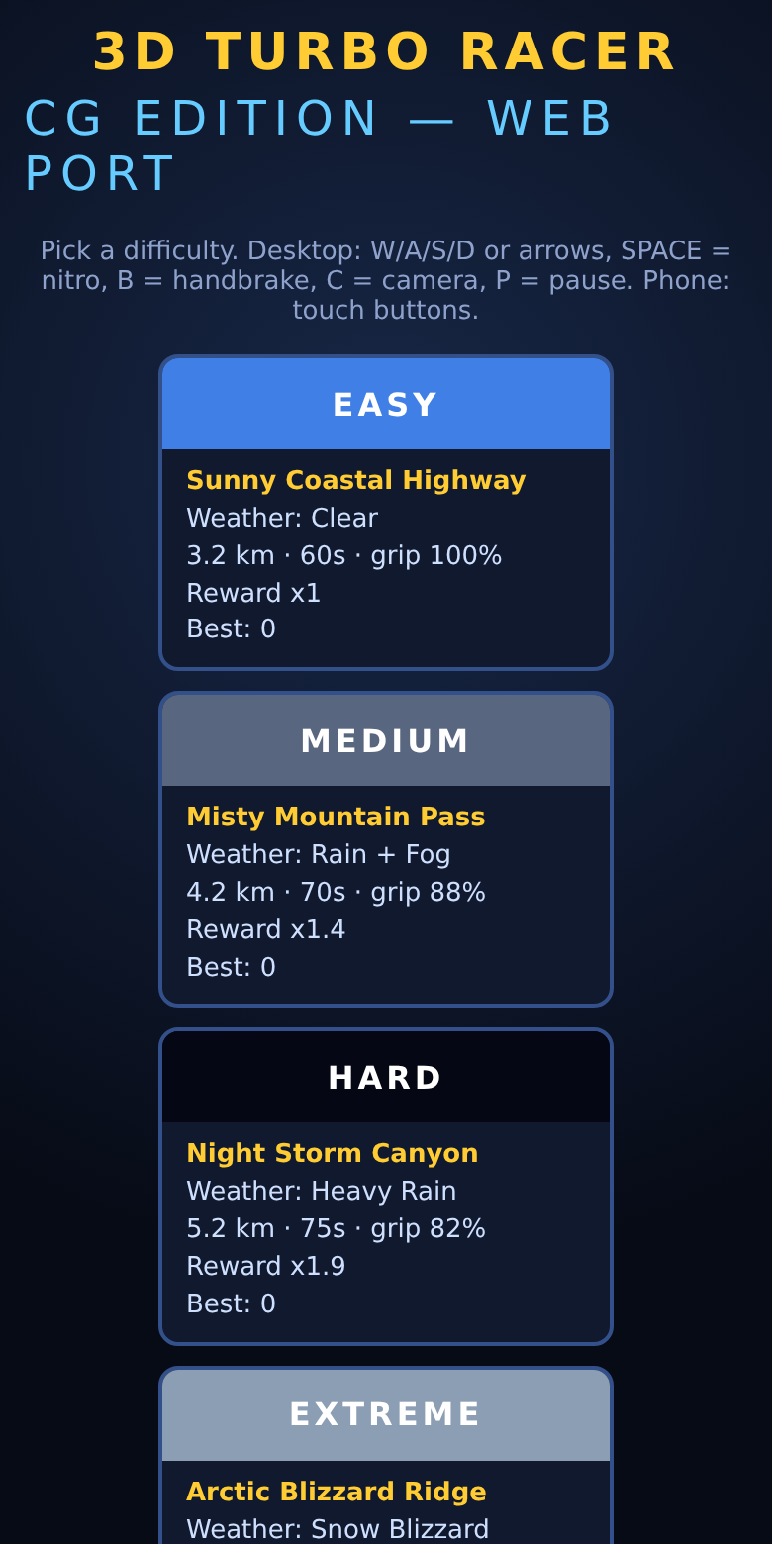
Online and phone version
• Single HTML file, no dependencies
• Touch controls, same difficulties, upgrades, Learning Mode
• Free hosting: GitHub Pages workflow included
• JavaScript re-implementation - NOT the C++ compiled to WebAssembly

Slide 11
Testing
• 35 / 35 headless checks pass (matrix identities, Bresenham vs DDA, clipping vs brute force, collisions, nitro, upgrades)
• Autopilot races on all 4 difficulties - found and fixed 3 real bugs
• Full game run end-to-end under Xvfb (Mesa software GL): 21 screenshots
• Web: headless Chromium desktop + 390x780 touch, zero JS errors
Autopilot: Easy finished (119 s, 4/4 checkpoints); harder levels demanding - difficulty not human-playtested.

Slide 12
Honest limitations
• C++ tested only on Linux (Mesa software rendering); Windows / macOS untested
• Phone version tested by emulation only, not on a physical phone
• C++ game does not run on phones; web port is a simplified JS re-implementation
• Legacy fixed-function OpenGL via GLUT; no audio, no gamepad
• Balance tuned with an autopilot, not human testers

Slide 13
Thank you
Sami Khan
linkedin.com/in/samikhan07
github.com/samikhan7507

