Slide 1




Demystifying Azure Private Endpoints
Raghuram Korukonda
Engineer
Follow me:
@imkraghu
in/raghuramkorukonda
kraghu306@gmail.com

Slide 2
Azure Private Link
Azure Private Link enables you to access Azure PaaS Services (for example, Azure Storage and SQL Database) and Azure hosted customer-owned/partner services over a private endpoint in your virtual network.
Benefits:
Privately access services on the Azure platform
On-premises and peered networks
Protection against data leakage
Global reach
Extend to other services
Service Availability - Link
Logging and monitoring
Integrated with Azure Monitor which allows Archival of log to Storage Account
Streaming of events to Event Hub
Data processed by the Private Endpoint (IN/OUT)

Slide 3
Private-link resource
It is the destination target of a specified private endpoint. The following table lists the available resources that support a private endpoint
Around ~51 resources - Link
Private-link resource name | Resource type | Subresources
Azure App Configuration | Microsoft.Appconfiguration/configurationStores | configurationStores
Azure Automation | Microsoft.Automation/automationAccounts | Webhook, DSCAndHybridWorker
Azure Cosmos DB | Microsoft.AzureCosmosDB/databaseAccounts | SQL, MongoDB, Cassandra, Gremlin, Table
Azure Batch | Microsoft.Batch/batchAccounts | batchAccount, nodeManagement
Azure Cache for Redis | Microsoft.Cache/Redis | redisCache
Azure Key Vault | Microsoft.KeyVault/vaults | vault
Azure Cognitive Services | Microsoft.CognitiveServices/accounts | account
Azure Managed Disks | Microsoft.Compute/diskAccesses | managed disk
Azure Container Registry | Microsoft.ContainerRegistry/registries | registry
Azure SQL Database | Microsoft.Sql/servers | SQL Server (sqlServer)
… | … | …

Slide 4

DNS Configuration Scenarios

Slide 5
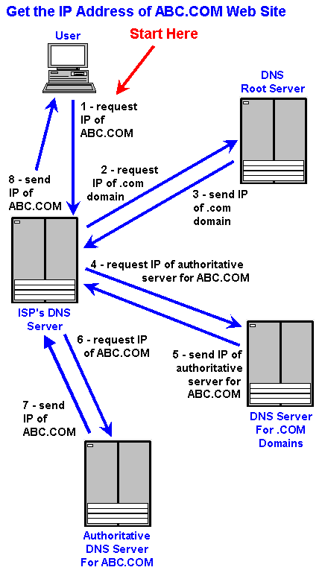
How DNS works?
Source: Internet

Slide 6
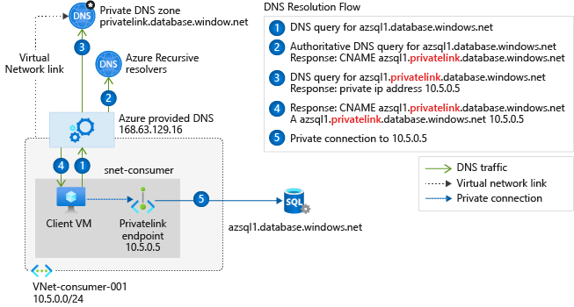
Virtual network workloads without custom DNS server
Reference: MSFT Docs

Slide 7
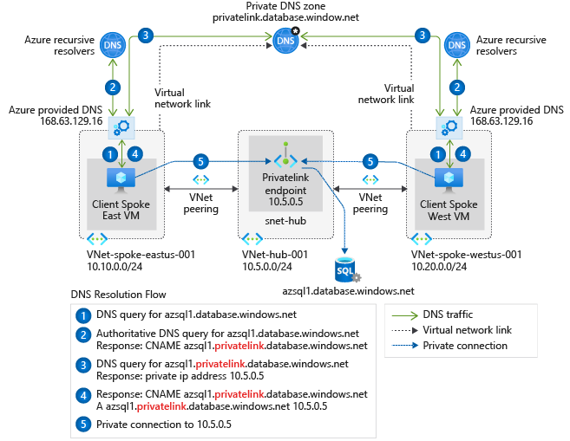
Extended to Peered Network
Reference: MSFT Docs

Slide 8
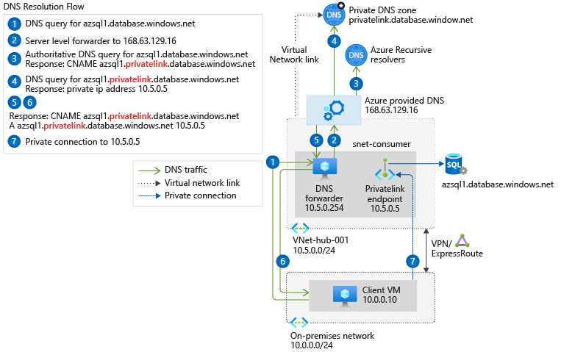
On-premises workloads using a DNS forwarder
Reference: MSFT Docs

Slide 9
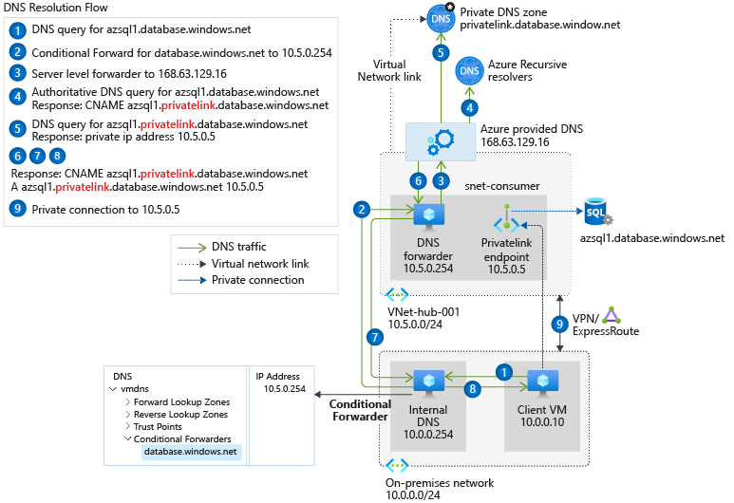
On-premises workloads using a DNS forwarder
Reference: MSFT Docs

Slide 10

Questions?

Slide 11

Thank You!!

