Slide 1

Utilizing Microsoft’s SIEM and EDR for the
implementation of Zero Trust framework.
Keshav Jain Cloud Security Lead

Slide 2

Keshav Jain
https://twitter.com/KeshavJain13 Blogs @ https://www.azuresecmon.com/

Slide 3
Disclaimer!
Views are my own.
Neither I am representing my Employer, nor I am presenting views of my Employer.
Also, I am not presenting my Employer or Clients Security strategies .
Content of this session is prepared by me in my personal capability using the Microsoft Articles, blogs, videos and other resources available publicly.

Slide 4
The Threat Landscape and State of Cybercrime!
Threat actors are adapting sophisticated approaches to disrupt the resources in the organization.
Attackers target the most vulnerable resources in an organization and then traverse laterally to target high-value assets.
Cybercrime is an ongoing and escalating challenge for both the public and private sectors around the globe.

Slide 5
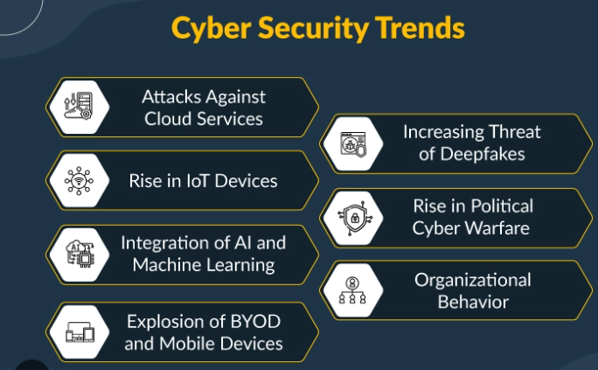
Cyber Security Trends

Slide 6
Zero Trust -- “Never Trust – Always Verify !”
Zero Trust is an information security model that denies access to applications and data by default.
Eliminating implicit trust and continuously validating every stage of a digital interaction.
Every access request is strongly authenticated, authorized within policy constraints and inspected for anomalies before granting access.
No more “Castle and moat approach”.

Slide 7
Why Zero Trust?
Digital Transformation is increasing IT complexity.
Adversaries are becoming more sophisticated and are outmatching current cyber defenses.
The shift to the Cloud is demanding a new approach to securing critical business data.
An increasingly mobile workforce now expect to be able to work from anywhere, on any device.

Slide 8
Zero Trust Principles

Slide 9
Pillars of Zero Trust
Validate users with strong authentication.
Verify user device integrity.
Networks should be segmented.
Removes implicit trust with various components of applications when they talk to each other.
Data should be classified, labeled, and encrypted, and access restricted based on those attributes.

Slide 10
Assume Breach
Assume everything behind the Corporate Firewall comes from the open network.
Adopt an “assume-breach” mindset – to help detect and isolate adversaries before they traverse your network and inflict serious damage.
Having this approach helps us to be more proactive and block threats in advance saving time and energy.

Slide 11
Limit the “blast radius” - Minimize impact if an external or insider breach occurs.
Blast radius in cloud security lets you pre-handle the damage that a particular issue can create.
If a breach does occur, minimizing the impact of the breach is critical. Zero Trust limits the scope of credentials or access paths for an attacker, giving time for systems and people to respond and mitigate the attack.
Verify end-to-end encryption.
Drive threat detection and improve defenses.
Use analytics to get visibility, drive threat detection, and improve defenses.

Slide 12
Visibility
An essential principle of the Zero Trust approach to cybersecurity is to maintain continuous visibility into the activities and behaviors of users and applications within the environment.
Deep visibility is critical, as users constantly interact with applications, data, and resources throughout the course of normal operations.
A well-designed SIEM can provide the level of deep visibility required to ensure that the user remains trustworthy throughout the user’s cycle.

Slide 13
EDR - Endpoint Detection and Response
Endpoint security solution that continuously monitors end-user devices to detect and respond to cyber threats like ransomware and malware.
Detect security incidents.
Contain the incident at the endpoint.
Investigate security incidents.
Provide remediation guidance.

Slide 14
Microsoft Defender for Endpoint
Core Defender Vulnerability Management.
Attack surface reduction.
Next-generation protection.
Endpoint detection and response.
Automated investigation and remediation.
Microsoft Threat Experts.

Slide 15
Microsoft Defender Suite
Microsoft 365 Defender (previously Microsoft Threat Protection).
Microsoft Defender for Endpoint (previously Microsoft Defender Advanced Threat Protection).
Microsoft Defender for Office 365 (previously Office 365 Advanced Threat Protection).
Microsoft Defender for Identity (previously Azure Advanced Threat Protection).
Microsoft Cloud APP Security (MCAS).

Slide 16
Security information and event management (SIEM)
A Zero Trust approach utilizing SIEM and Security Analytics is one of the lone secure approaches to mitigating risk.
Collecting log data and telemetry from key sources of data within and without the environment enables continuous visibility into risk which underpins the principles of zero trust.
Critical data sets include user behaviors, Identity and Access Management (IAM) logs, network behaviors, security posture information, and third-party threat intelligence.
Aggregating these in a SIEM platform enables cross-correlation of data sets and the development of baseline information which helps the security team distinguish between normal and abnormal.
Abnormalities could be the impetus for adjusting the level of trust, and the cybersecurity platforms must be well-integrated to enable the automation of response actions

Slide 17
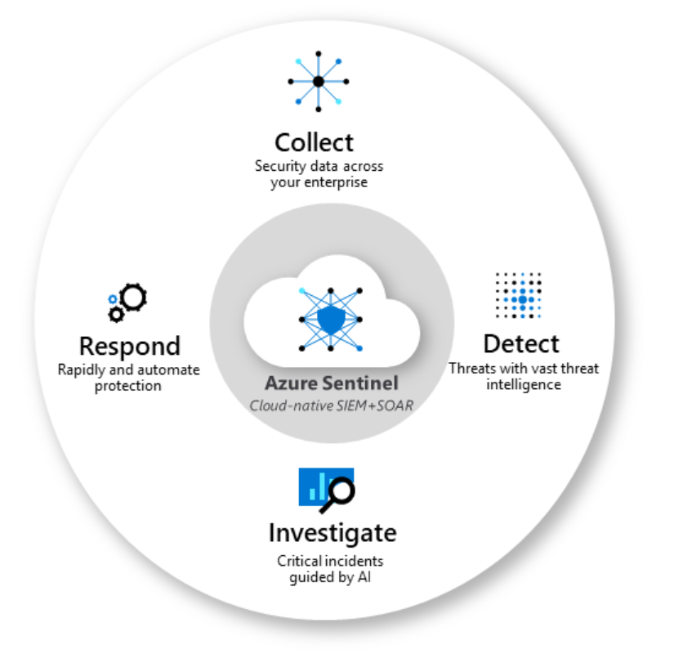
Microsoft Sentinel
Cloud-native Security Information and Event manager (SIEM) platform.
Security Orchestration and Automated Response (SOAR).
Single solution for alert detection, threat visibility, proactive hunting, and threat response.

Slide 18
Microsoft Sentinel Usecases
Impossible travel to an untrusted location.
Sign-in event from an unknown location.
Sign-in event from an infected endpoint.
Explicit MFA Deny.
Brute force attack.
Linux - Failed Login Attempts from Root Account.

Slide 19
Microsoft Zero Trust Tools
Pillars | Products
Identity | Azure AD., Conditional Access policies , Azure active admin center.
Endpoints | Microsoft Endpoint Manager, Intune, Microsoft Defender for Endpoint.
Applications | Microsoft Defender for Cloud Apps. Discover and control the use of shadow IT.
Network | Azure Networking, Virtual Networks and Subnets, Network Security Groups and Application Security Groups, Azure Firewall, Azure DDoS Protection, Azure Web Application Firewall, Azure VPN Gateway, Azure ExpressRoute, Azure Network Watcher
Infrastructure | Azure Blueprints, Azure Policy, Azure Arc, Microsoft Defender for Cloud, Microsoft Sentinel, Azure Resource Manager (ARM) templates
Data | Azure Information Protection with Unified Labeling Client and Scanner.

Slide 20
Quotes on Zero Trust
'We’ve spent years building our zero-trust approach internally at Microsoft. We’ve proven its effectiveness against real-world attacks. We are committed to sharing what we have learned to help every organization accelerate their progress,’ says Microsoft CEO Satya Nadella at the virtual Microsoft Security Summit.
“Our technology needs to be secure by design and promote zero-trust architectural principles. We need to build technology with the design intent to protect the fundamental rights of all people – including privacy – and strengthening these institutions we all depend on for our livelihoods and wellbeing. And we need tech advancements that protect our most finite resource – our planet.”

Slide 21
Thank You!

