Slide 1
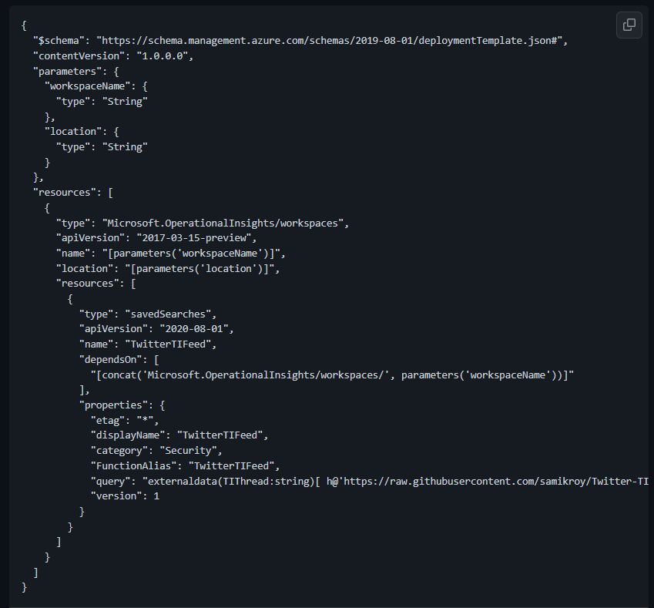
Function Name
Category
Query

Slide 2
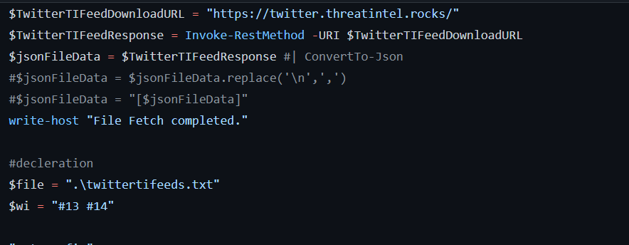
TI feed source
File Path

Slide 3
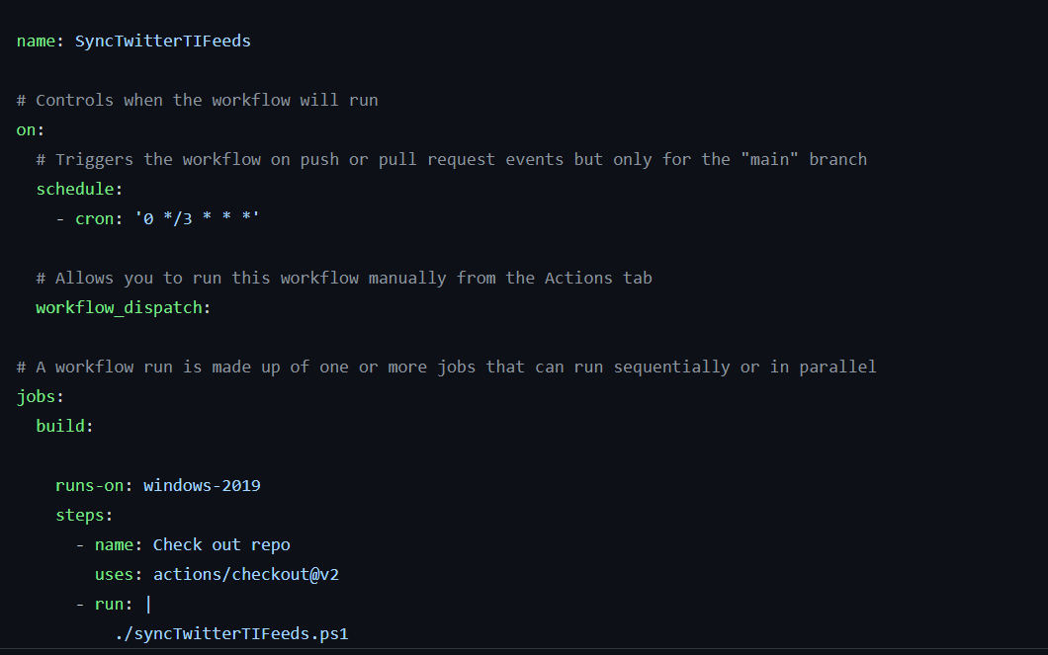
Schedule
Script Call

Slide 4
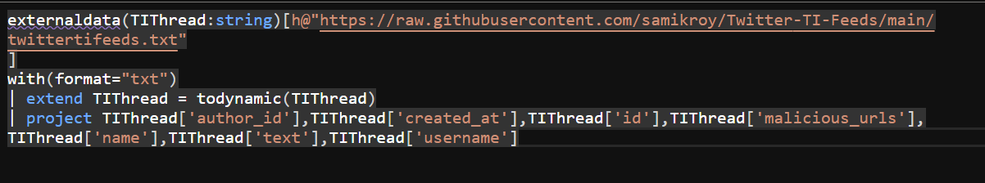
External Operator
Link

