Slide 1

Poshan Abhiyan
BY:
Ajay Kumar : 1602-20-737-002
R.Thirupathi : 1602-20-737-031
C.Samiksha : 1602-20-737-037

Slide 2
Contents :
Motivation
Abstract
Description About Project
Use Case Diagram
Output Screenshots
Technology Used
References

Slide 3
Motivation:
India’s malnutrition rates have dropped dramatically, the govt. of India has approved the centrally sponsored scheme. The main aim is to generate an application that ensures that each student gets the required amount of nutrients. It aims at helping the government aided schools to manage the food served to each student according to each students nutrition factors.

Slide 4
Abstract :
India’s malnutrition rates have dropped dramatically, the govt. of India has approved the centrally sponsored scheme ‘Pradhan mantra poshan Shakti nirman(PM POSHAN)’ for providing one hot cooked meal in government and government aided schools from 2021-22 to 2025-26.
The primary goal of our project is to monitor if the necessary number of calories have been delivered to students in schools. We will also monitor each student's attendance depending on the meals that have been provided for them.
This AI-based tracker captures a picture of the food being consumed and determines how many calories are in it. If the required number of calories are consumed, the child's attendance will be recorded.

Slide 5
Description :
The application provides logins for students and the respective in-charges.
This helps to identify the food items and also to calculate the calories present in the image of food item.
The attendance will be given to students after the food images of food items are uploaded and calories are calculated.
The minimum prerequisite calories has to be matched to give the attendance.
A feedback form regarding the food items which were served is provided, which helps make relative changes in the future.

Slide 6
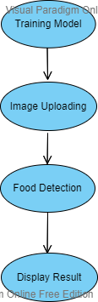
Process Flow

Slide 7
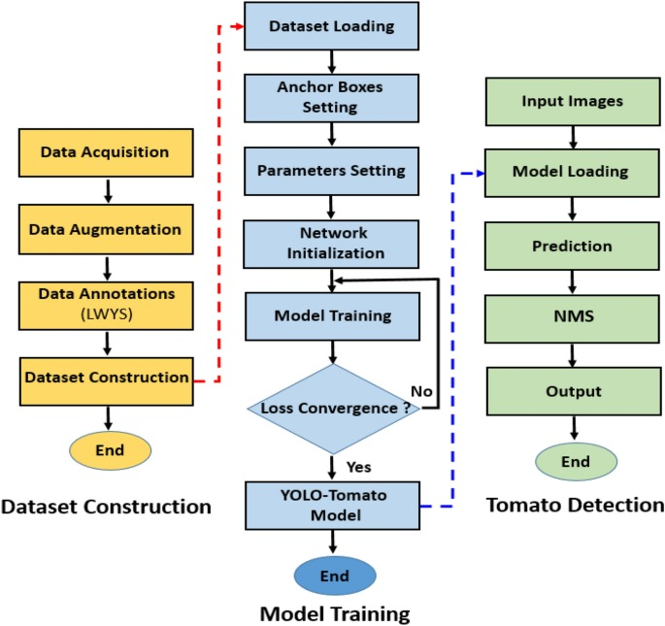
How the model is trained ?

Slide 8
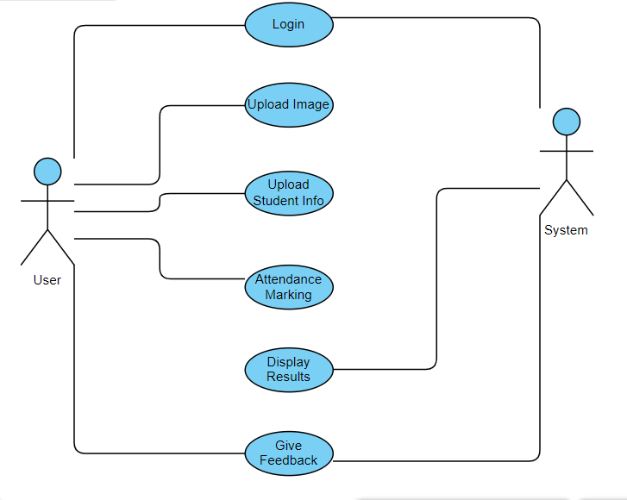
Use Case Diagram

Slide 9
Use Cases :
USE CASE:1
NAME : Login
ACTORS : In-charge
DESCRIPTION : Allows user to login
PRE-CONDITIONS :Enter login credentials
POST-CONDITIONS : Login result
USER | SYSTEM
Enter login credentials
Click Login
 | Verify login credentials
 | Goes to next page if success else displays enter credentials again

Slide 10
USE CASE:2
NAME : Login
ACTORS : Student
DESCRIPTION : Allows user to login
PRE-CONDITIONS :Enter login credentials
POST-CONDITIONS : Login result
USER | SYSTEM
Enter login credentials
Click Login
 | Verify login credentials
 | Goes to next page if success else displays enter credentials again

Slide 11
USE CASE:3
NAME : Attendance Uploading
ACTORS : In-charge
DESCRIPTION : Allows user to take attendance by uploading images
PRE-CONDITIONS : Uploading images, selecting student
POST-CONDITIONS : Attendance taken successfully
USER | SYSTEM
Upload images
Select student
 | Identify food item
 | Return result

Slide 12
USE CASE:4
NAME : Display Results
ACTORS : System
DESCRIPTION : Gives the predicted amount of calories and the detected food item
PRE-CONDITIONS : Uploading images, selecting student
POST-CONDITIONS : Predicted output
USER | SYSTEM
Upload images
Select student
 | Identify food item
 | Return result

Slide 13
USE CASE:5
NAME : Feedback
ACTORS : Student
DESCRIPTION : Allows student to give feedback
PRE-CONDITIONS : Feedback description
POST-CONDITIONS : Feedback given successfully
USER | SYSTEM
Enter feedback
Submit feedback
 | Feedback submitted

Slide 14
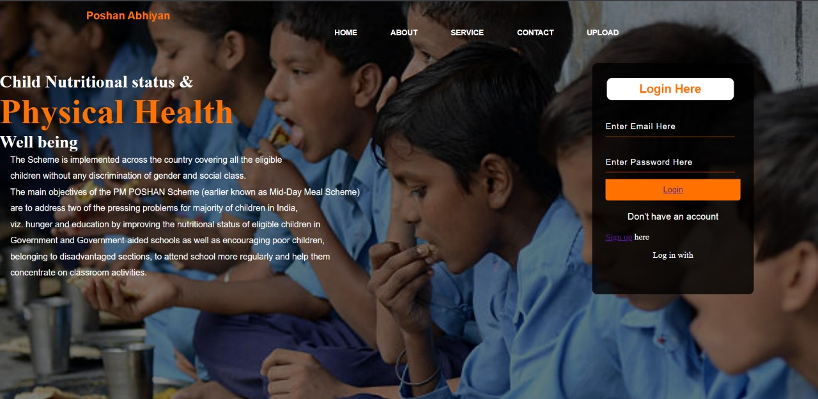
Output Screenshots:

Slide 15
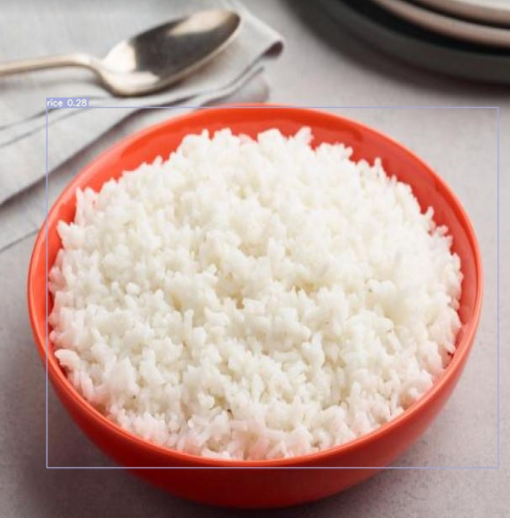

Slide 16
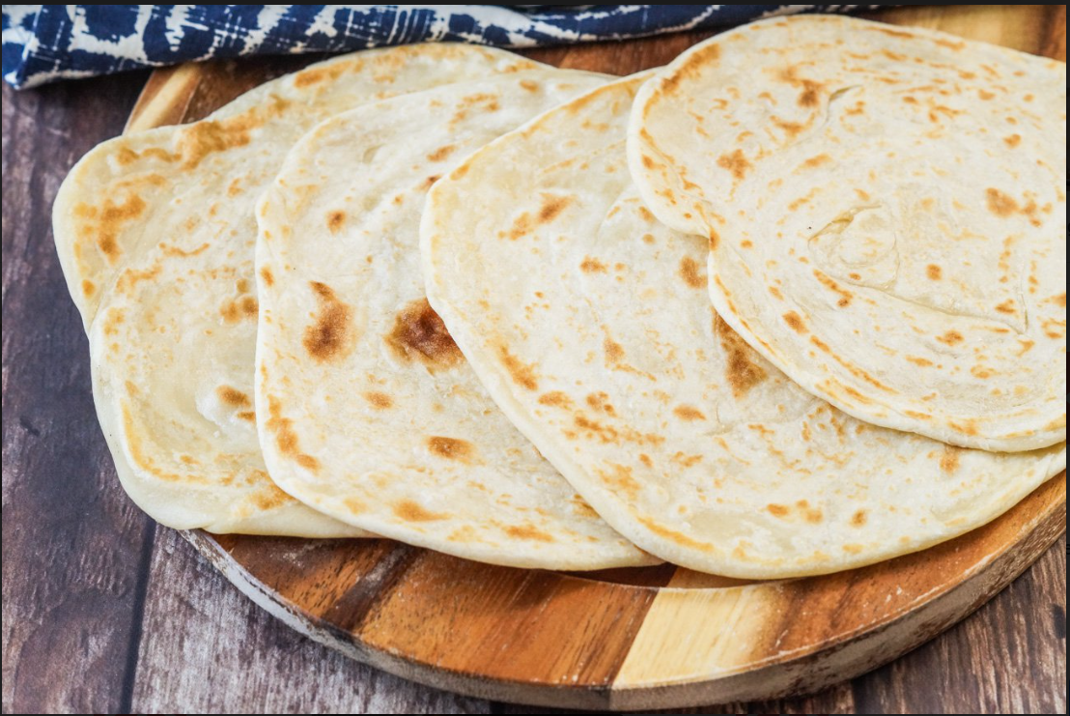

Slide 17
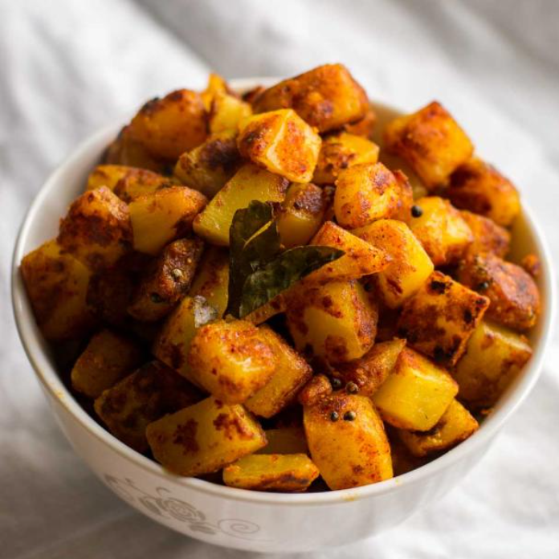


Slide 18
Requirements & Technology Used :
HARDWARE REQUIRED:
PC/Laptop
Stable Internet Connection
SOFTWARE REQUIRED:
YoloV7
VS Code
TECHNOLOGIES USED:
-HTML, CSS, JAVASCRIPT, ROBOFLOW

Slide 19
Future Scope :
We will improv calorie estimation using instance segmentation, which will help calculate the precise amount of calories present.
We will include image based BMI index calculation which will help automatic calculation of the height and weight
We will implement it as an android application

Slide 20
References :
https://www.w3schools.com/html/
https://www.w3schools.com/css/default.asp
https://www.w3schools.com/js/default.asp
https://www.w3schools.com/python/default.asp
https://roboflow.com/
https://www.kaggle.com/

Slide 21
Thank You

