Slide 1

ROBOTICS
Potential Field-Based Mobile Robot Navigation
Prepared By
Christina Esther Taniya Renjarla Nandini Yedelli Samiksha Chavan Jagruti Thotam

Slide 2

PROJECT DESCRIPTION
Introduction: Autonomous mobile robots need to navigate through an environment, reach a target location, and avoid obstacles along the way.
Problem statement: Navigation becomes more challenging when the environment contains both stationary obstacles and moving obstacles whose positions change over time.
Proposed solution: This project uses the Artificial Potential Field algorithm to guide a simulated robot toward its goal while generating avoidance forces around nearby obstacles.
Objectives:
  Develop a MATLAB-based robot navigation simulation.
  Implement attractive, repulsive, and tangential forces.
  Simulate three static and two moving obstacles.
  Predict the future positions of moving obstacles.
  Perform collision checking before robot movement.
  Visualize the robot trajectory and analyze navigation performance.

Slide 3
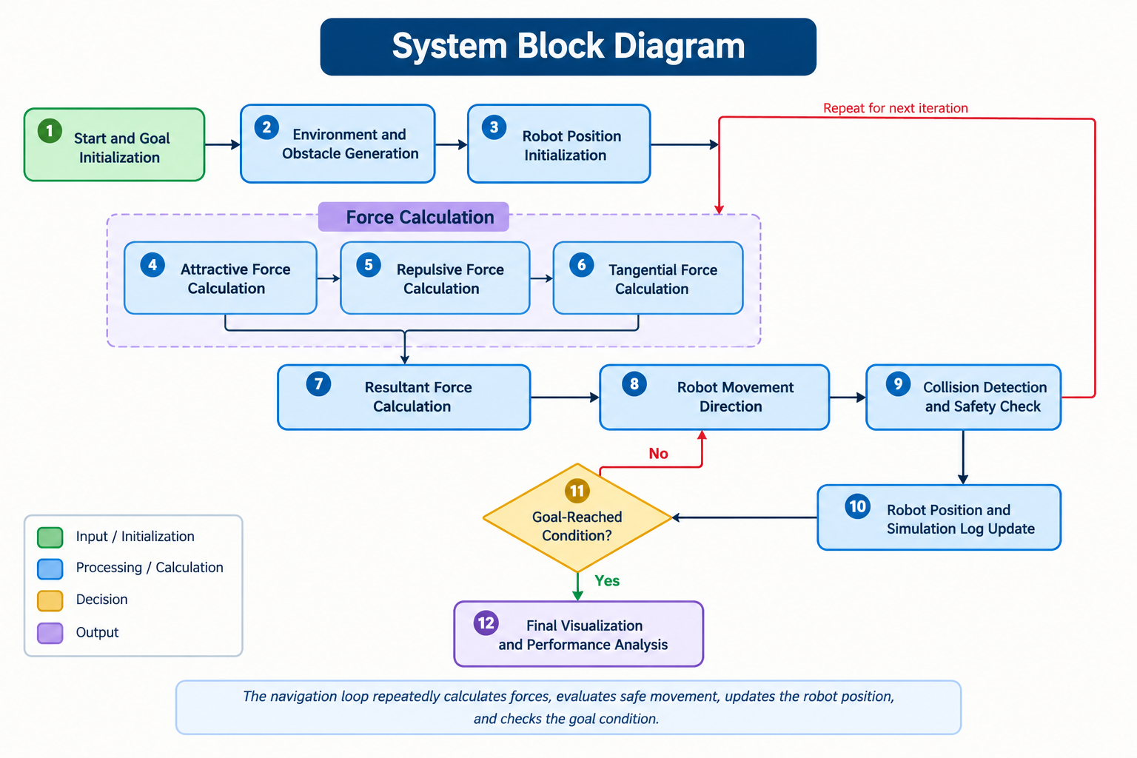
BLOCK DIAGRAM

Slide 4
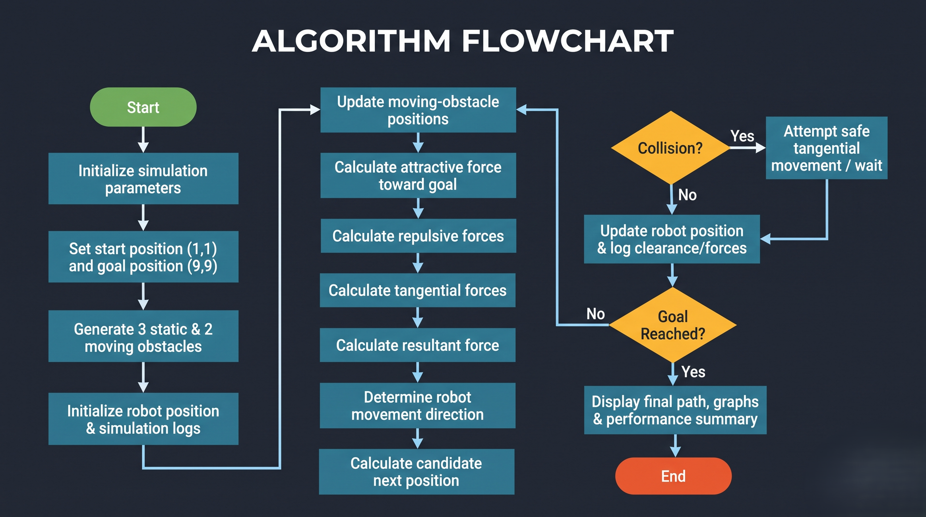
FLOW DIAGRAM

Slide 5

COMPONENTS USED AND THEIR IMPORTANCE
  MATLAB: programming, numerical computation, simulation, and visualization.
  Artificial Potential Field algorithm: guides the robot toward the goal and away from obstacles.
  Attractive force: pulls the robot toward the target.
  Repulsive force: pushes the robot away from nearby obstacles.
  Tangential force: helps the robot move around obstacles.
  Moving-obstacle prediction: estimates future obstacle positions using velocity and a look-ahead time.
  Collision detection: checks whether the proposed robot position is safe.
  Graphical visualization: displays the robot path, obstacles, force vectors, and performance graphs.

Slide 6
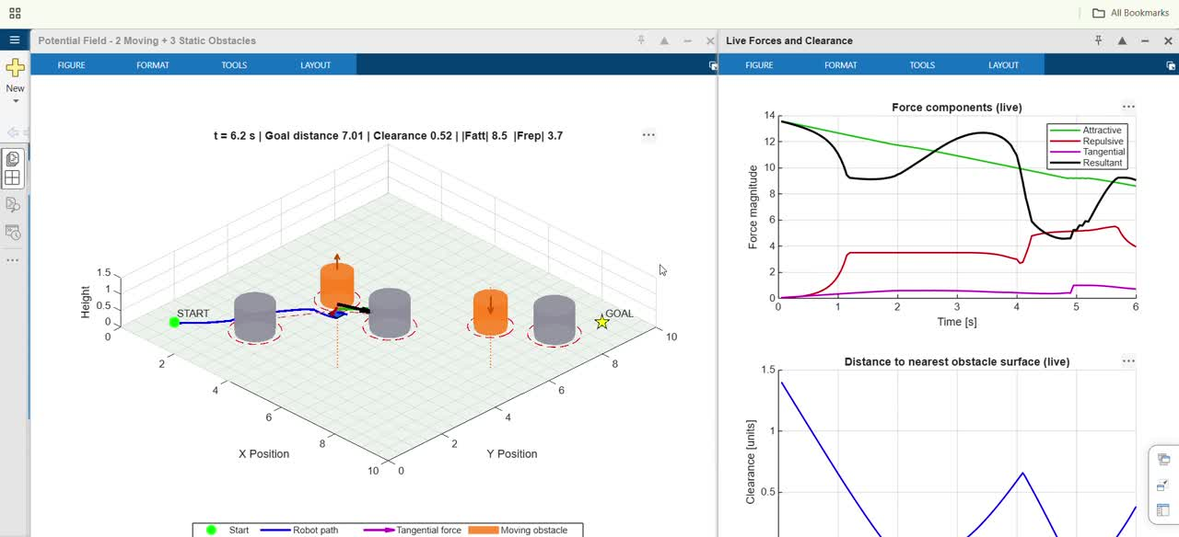
WORKING PROJECT PROTOTYPE

Slide 7
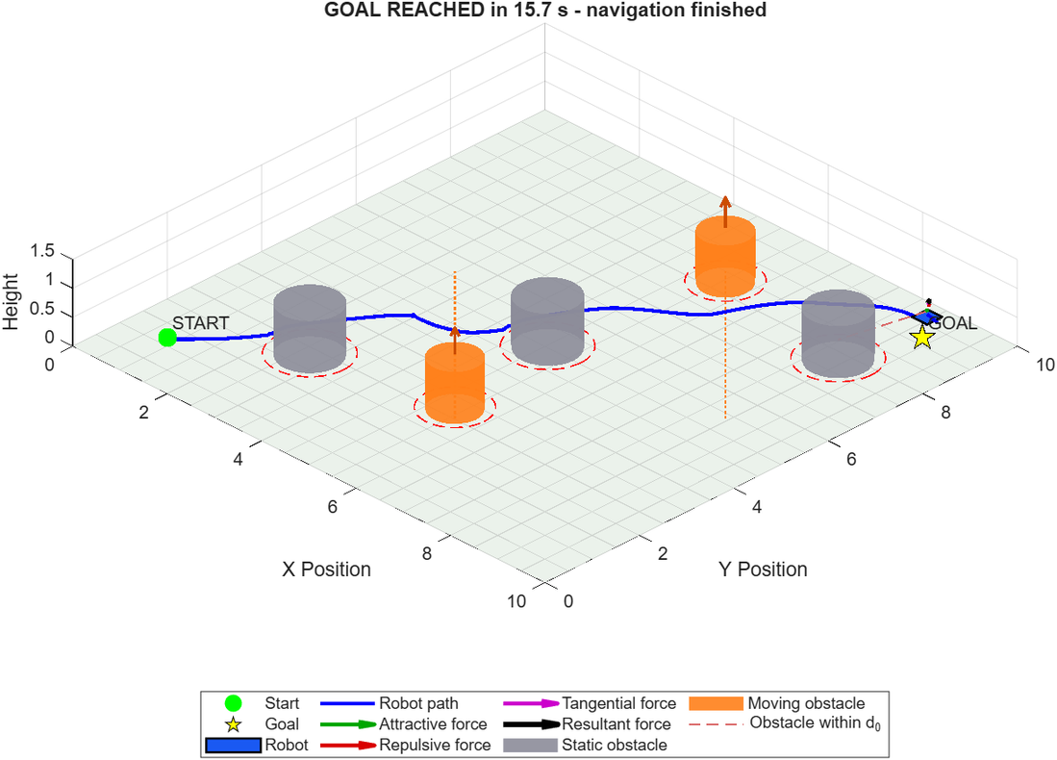
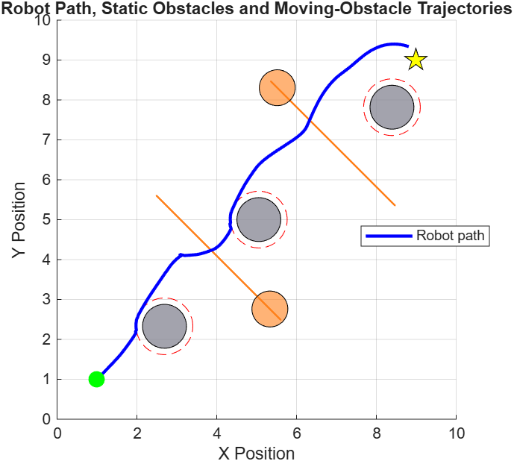
OUTPUT

Slide 8
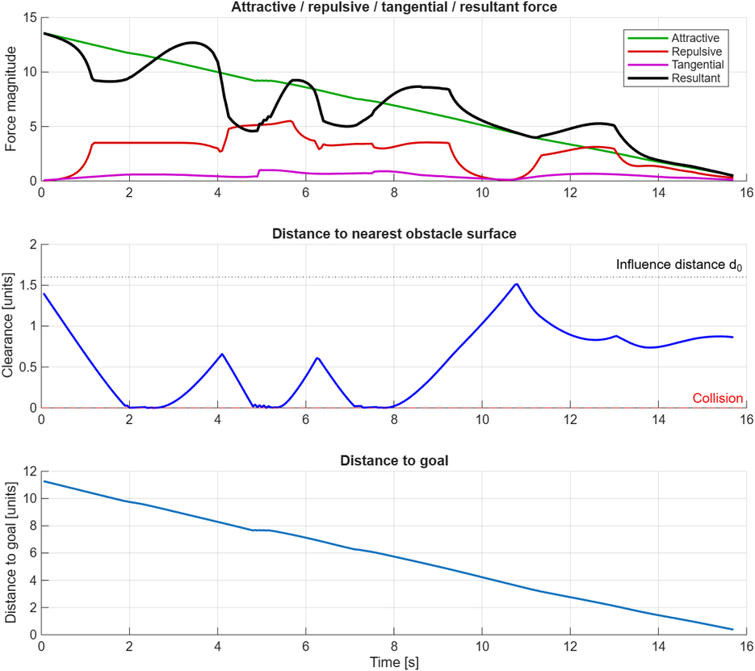
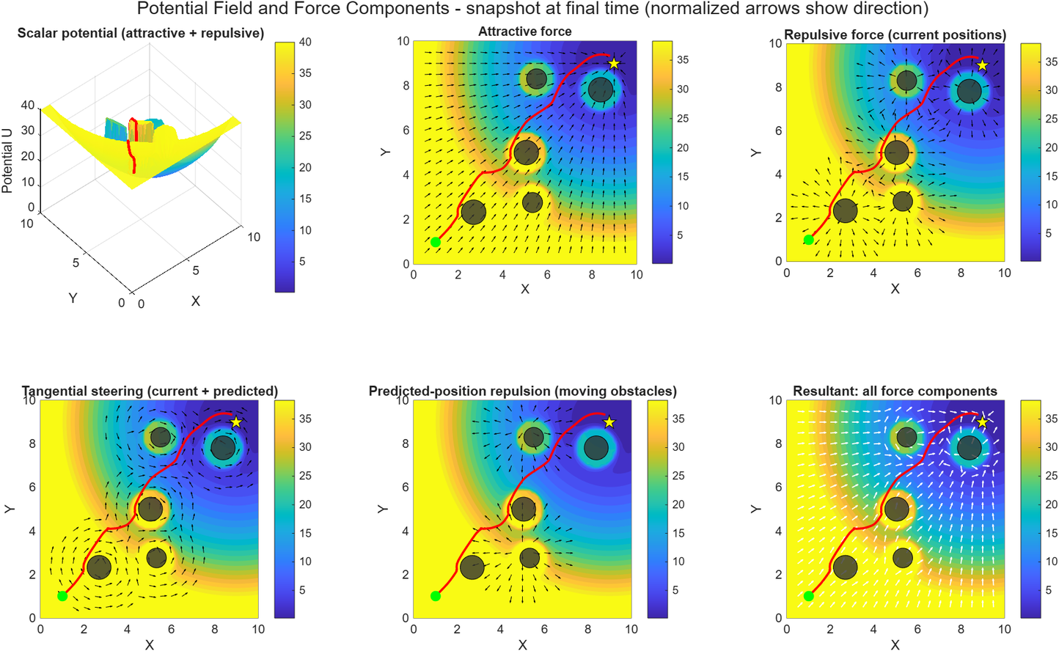
OUTPUT

Slide 9
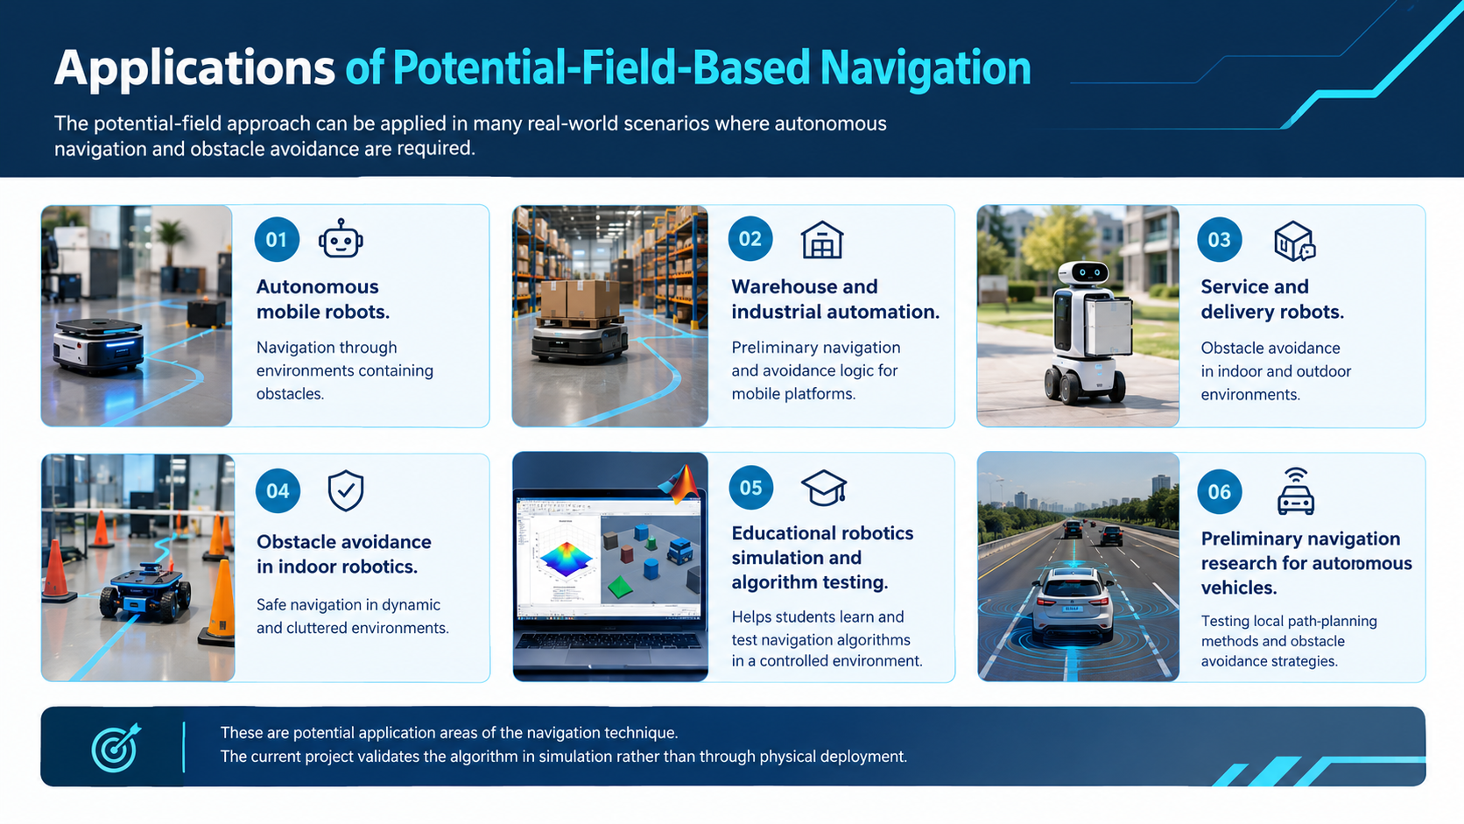

Slide 10
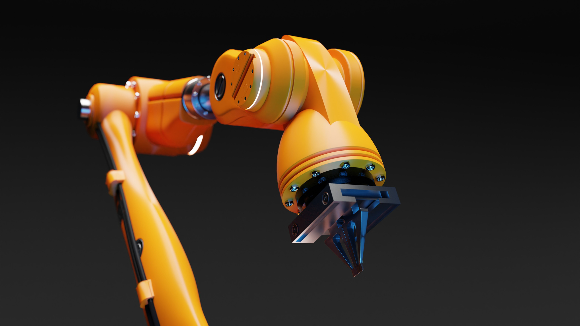
THANK YOU!

