Slide 1
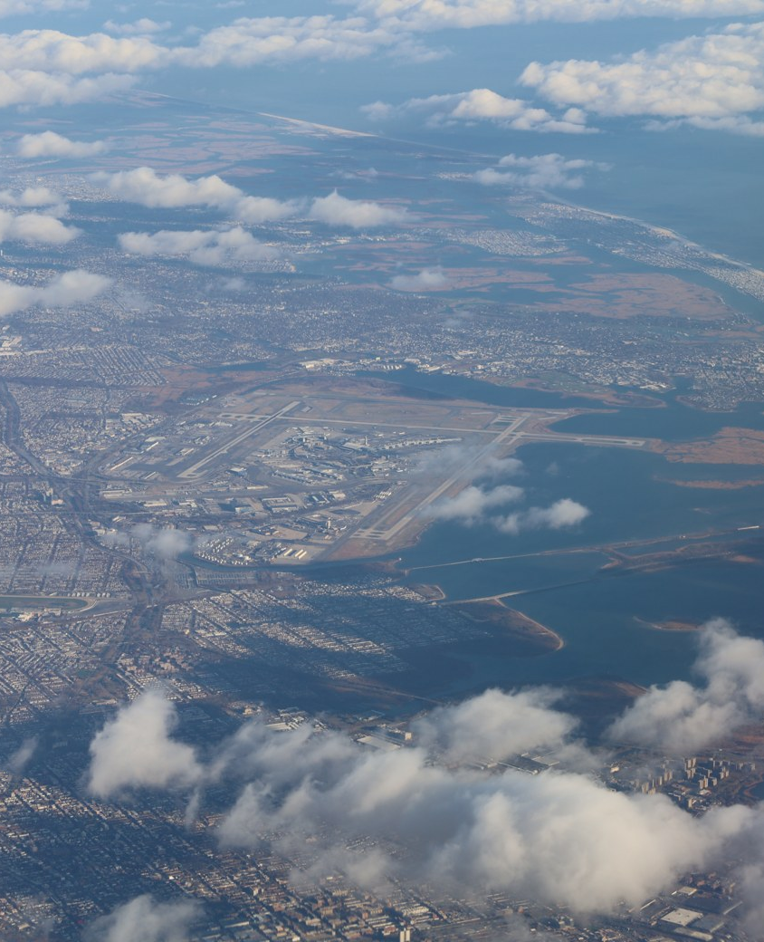
PROJECT 21 / TEAM T022 / SECTION C
Flight Delay Prediction
and Rescheduling
Gradient boosting, an embedding MLP,
and an offline decision analysis
CSAI / Phase 1 and Phase 2
Notes:
Introduce the team and the decision point. The photo illustrates JFK in 2021. Model records are from 2013. Photo: Antony-22, CC BY-SA 4.0, resized and cropped.
Source: https://commons.wikimedia.org/wiki/File:John_F._Kennedy_Airport_2021c.jpg
Source: https://creativecommons.org/licenses/by-sa/4.0/
Source: https://github.com/samiksha-jangid27/flight-delay-prediction

Slide 2
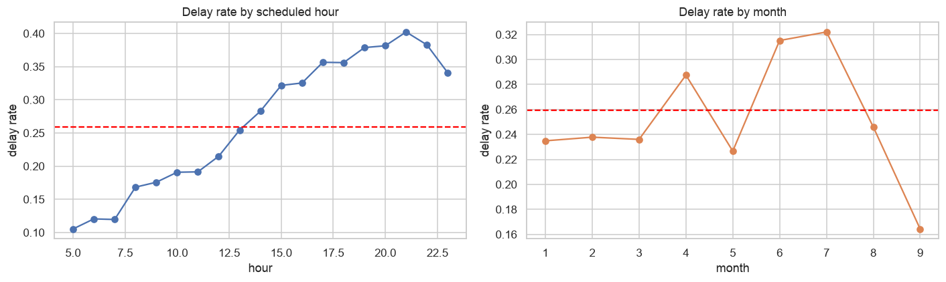
Prediction target and flight data
Before scheduled departure, estimate the chance that arrival will be at least 15 minutes late.
336,776
327,346
EWR · JFK · LGA
raw flight records
flights with a defined outcome
origin airports in 2013
PROJECT 21 / TEAM T022
02
Notes:
The 9,430 rows with undefined arrival outcomes are excluded from the supervised task. These training-period charts show the fraction of arrivals at least 15 minutes late by scheduled hour and month.
Source: https://www.kaggle.com/datasets/matinsajadi/flights
Source: https://github.com/samiksha-jangid27/flight-delay-prediction/blob/de0d2ea/README.md#dataset
Source: https://github.com/samiksha-jangid27/flight-delay-prediction/blob/de0d2ea/reports/figures/delay_by_hour_and_month.png

Slide 3
Chronological evaluation protocol
All model comparisons align flight ID, flight date, and label.
Window | 2013 dates | Flights | Purpose
Early training | Jan 1 – Jul 23 | 181,405 | Fit base models and preprocessing
Calibration | Jul 24 – Sep 12 | 46,894 | Fit calibration maps and the stack
Validation | Sep 13 – Nov 6 | 50,466 | Select settings and compare models
Phase 1 test | Nov 7 – Dec 31 | 48,581 | Score the frozen AML baselines
Phase 2 results in this deck use the validation window.
PROJECT 21 / TEAM T022
03
Notes:
Explain why a random split would mix future and past. Validation was used to select settings, so the Phase 2 numbers are development results. The Phase 1 test history is disclosed in the manifest.
Source: https://github.com/samiksha-jangid27/flight-delay-prediction/blob/de0d2ea/docs/dl_data_contract.md
Source: https://github.com/samiksha-jangid27/flight-delay-prediction/blob/de0d2ea/docs/canonical_evaluation.json

Slide 4
Pre-departure feature availability
The prediction timestamp and the feature allowlist define what the model can use.
Inputs from the timetable
Prior-date outcome history
Carrier, origin, destination, distance, scheduled clock times, and cyclic calendar features.
The 31-feature experiment uses earlier dates. The CSV does not record when those outcomes became available.
Excluded prediction fields
Schedule and route control
Actual departure and arrival times and delays are excluded from the input. Arrival delay supplies the label.
The 23-feature control removes all eight outcome-history predictors and compares the same four models on aligned flights.
PROJECT 21 / TEAM T022
04
Notes:
Exact real-time availability cannot be established for every previous-date outcome. The control uses schedule and route features. The two congestion proxies were evaluated in a separate 33-feature variant.
Source: https://github.com/samiksha-jangid27/flight-delay-prediction/blob/de0d2ea/docs/historical_features.md
Source: https://github.com/samiksha-jangid27/flight-delay-prediction/blob/de0d2ea/docs/feature_policy.md
Source: https://github.com/samiksha-jangid27/flight-delay-prediction/blob/de0d2ea/reports/dl/schedule_only_metrics.csv

Slide 5
AML baselines, embedding MLP and hybrid
The baselines and the MLP use the same target and chronological training dates.
AML baselines
Balanced Logistic Regression provides a linear baseline. XGBoost models nonlinear interactions in the engineered inputs.
Embedding MLP
Carrier, origin and destination IDs → embeddings → concatenate dense features → ReLU and dropout layers → one delay logit.
XGBoost + MLP stack
Base-model probabilities → Logistic Regression fitted on calibration flights → hybrid delay probability on validation.
PROJECT 21 / TEAM T022
05
Notes:
The MLP uses 254 dense inputs on the main data and three embedding fields. Its unknown embedding is frozen at zero. An unseen route or distance band maps to an all-zero one-hot block. Stacking tests whether the two base models provide complementary scores. Cyclic time features encode the schedule, and each flight is a separate row.
Source: https://github.com/samiksha-jangid27/flight-delay-prediction/blob/de0d2ea/docs/dl_architecture.md
Source: https://github.com/samiksha-jangid27/flight-delay-prediction/blob/de0d2ea/docs/hybrid_approach.md
Source: https://arxiv.org/abs/1604.06737

Slide 6
MLP training and matched-seed ablation
AdamW and BCE with logits train the model. Early stopping monitors validation AP.
One change from the baseline | Mean paired AP change
Lower learning rate to 0.0005 | +0.004759
Reduce batch size to 512 | −0.004602
Use hidden widths [64, 32] | +0.001489
Increase dropout to 0.3 | +0.002135
Increase weight decay to 0.001 | +0.000027
All six configurations ran at seeds 42, 46 and 50.
PROJECT 21 / TEAM T022
06
Notes:
Each difference subtracts the baseline score at the same seed. The published checkpoint was selected by the original six-trial search. The ablation separately checks sensitivity to settings and seed. The largest mean AP gain in these runs came from lowering the learning rate.
Source: https://github.com/samiksha-jangid27/flight-delay-prediction/blob/de0d2ea/docs/dl_ablation.md
Source: https://github.com/samiksha-jangid27/flight-delay-prediction/blob/de0d2ea/reports/dl/controlled_ablation.csv
Source: https://github.com/samiksha-jangid27/flight-delay-prediction/blob/de0d2ea/configs/dl_config.yaml

Slide 7
AML and DL validation results
Same 50,466 flights. AP and trapezoidal PR AUC are reported separately.
Model | AP ↑ | PR AUC ↑ | ROC-AUC ↑ | Brier ↓
Logistic Regression · isotonic | 0.2233 | 0.2641 | 0.6360 | 0.150899
XGBoost · isotonic | 0.2129 | 0.2114 | 0.6279 | 0.137199
Embedding MLP · isotonic | 0.2082 | 0.2039 | 0.6207 | 0.137476
XGBoost + MLP hybrid | 0.2093 | 0.2092 | 0.6255 | 0.137145
The hybrid’s Brier score was 0.000054 lower than calibrated XGBoost’s, with lower AP.
PROJECT 21 / TEAM T022
07
Notes:
This table focuses on calibrated candidates. Raw Logistic Regression leads raw ranking at AP 0.2532, while its Brier score is 0.5219. The calibrated XGBoost and hybrid Brier gap is small. XGBoost and MLP residual correlation is 0.968 on this window.
Source: https://github.com/samiksha-jangid27/flight-delay-prediction/blob/de0d2ea/reports/dl/metrics.csv
Source: https://github.com/samiksha-jangid27/flight-delay-prediction/blob/de0d2ea/reports/dl/hybrid_comparison.json
Source: https://github.com/samiksha-jangid27/flight-delay-prediction/blob/de0d2ea/docs/dl_evaluation.md

Slide 8
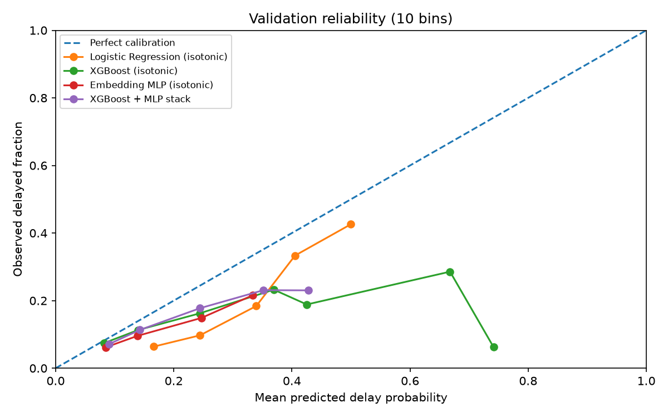
Calibration and operating thresholds
Reliable probabilities and the ability to flag delayed flights are separate outcomes.
25% minimum precision
Calibrated Logistic Regression reached 5.56% recall. Calibrated XGBoost, MLP and hybrid fell short of the floor.
Maximum F1 on validation
Calibrated XGBoost used threshold 0.2500 and reached F1 0.3169.
PROJECT 21 / TEAM T022
08
Notes:
The reliability plot compares mean predicted probability with observed fraction. The 25% precision floor and the maximum-F1 threshold answer different questions. Neither is an independently validated policy. Calibration is fitted on late training.
Source: https://github.com/samiksha-jangid27/flight-delay-prediction/blob/de0d2ea/reports/dl/figures/reliability.png
Source: https://github.com/samiksha-jangid27/flight-delay-prediction/blob/de0d2ea/reports/dl/metrics.csv
Source: https://proceedings.mlr.press/v70/guo17a.html

Slide 9
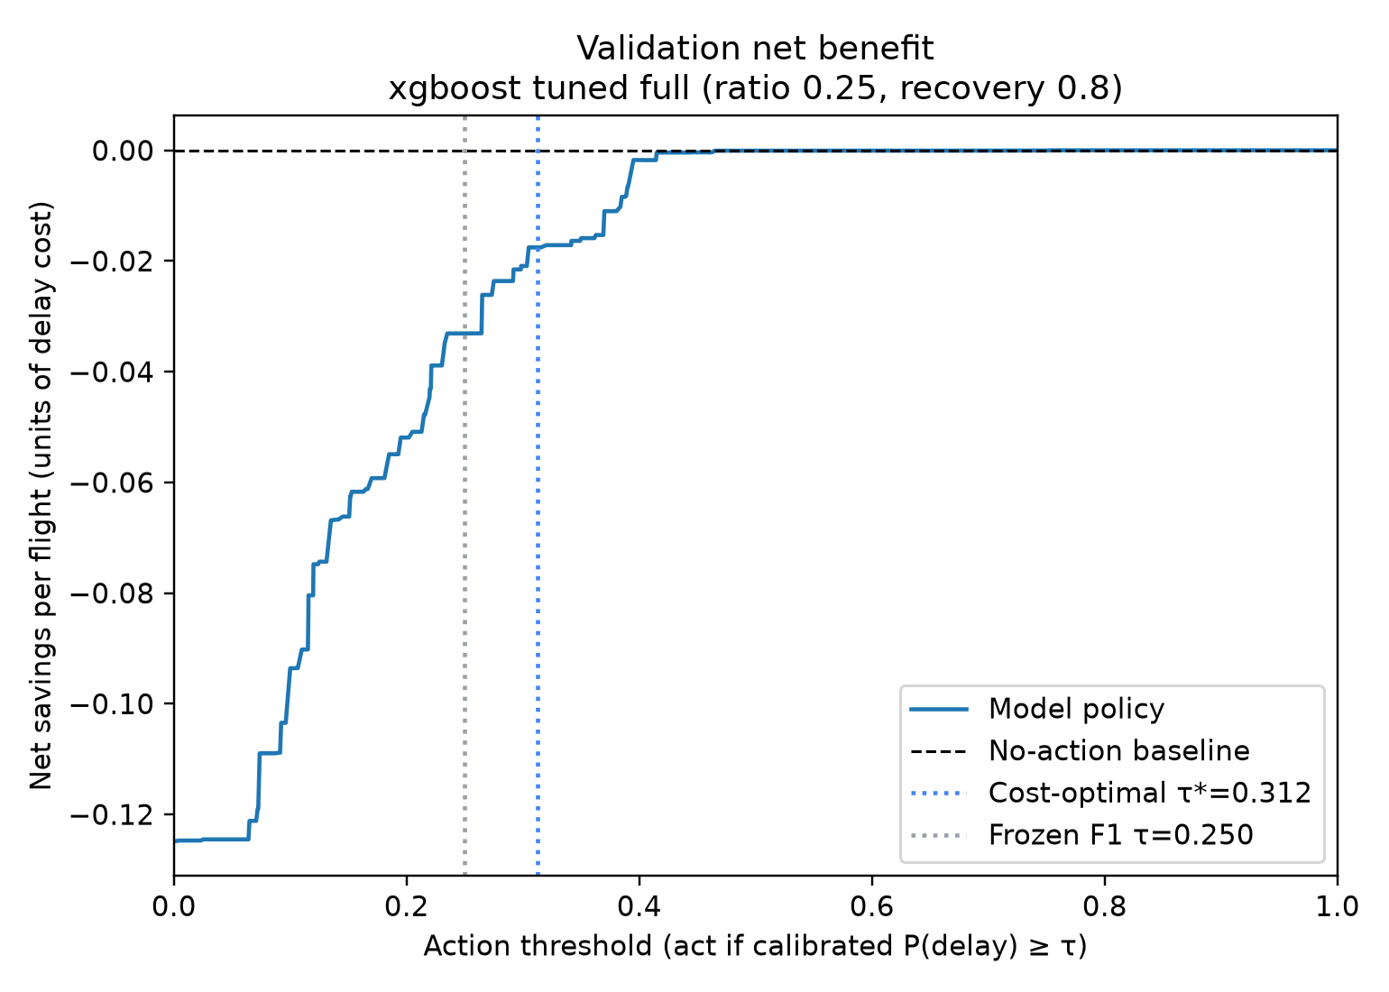
Offline rescheduling what-if
Act when calibrated delay risk exceeds action cost divided by recoverable delay cost.
Headline assumptions
Action cost = 0.25 × delay cost
Recovery fraction = 0.8
Risk threshold = 0.3125
Inaction had the lowest cost
Calibrated XGBoost: −0.0175
Calibrated Logistic Regression: −0.0564
Net savings per flight, in delay-cost units.
PROJECT 21 / TEAM T022
09
Notes:
The formula is action cost divided by recovery times delay cost. Both guided policies increased simulated cost at the headline setting. These results replay a hypothetical intervention model with homogeneous costs and recovery.
Source: https://github.com/samiksha-jangid27/flight-delay-prediction/blob/de0d2ea/docs/rescheduling_analysis.md
Source: https://github.com/samiksha-jangid27/flight-delay-prediction/blob/de0d2ea/paper/figures/xgb-netbenefit.png

Slide 10
Results and reproducibility
The calibrated AML models remain the basis for the rescheduling analysis.
Phase 1 held-out scores
XGBoost: AP 0.337, ROC-AUC 0.599. Logistic Regression: AP 0.294, ROC-AUC 0.544.
Phase 2 checkpoint replay
The published MLP weights reproduced 50,466 validation probabilities exactly in the verification environment.
Evidence limits
The dataset covers NYC-origin flights in 2013. Prior-date outcome availability remains conditional, and the Phase 2 results describe validation.
PROJECT 21 / TEAM T022
10
Notes:
The Phase 1 held-out window was also used in an earlier pre-congestion experiment. The repo documents that reuse. Live demo command: python scripts/verify_dl_checkpoint.py. Then run the Phase 2 comparison in a separate output directory.
Source: https://github.com/samiksha-jangid27/flight-delay-prediction/blob/de0d2ea/docs/canonical_evaluation.json
Source: https://github.com/samiksha-jangid27/flight-delay-prediction/blob/de0d2ea/scripts/verify_dl_checkpoint.py
Source: https://github.com/samiksha-jangid27/flight-delay-prediction/blob/de0d2ea/docs/historical_features.md

Slide 11
Team contributions
Project 21 · Team T022 · Section C
Member | Phase 2 contribution
Lakshya | Dataset integration and availability audit
Ankit Raj Singh | Categorical encoding and embedding tables
Samiksha Jangid | PyTorch MLP architecture and tests
Rashmi Anand | Training, tuning and checkpoint export
Shubhaang Kataruka | AML–DL evaluation and checkpoint verification
github.com/samiksha-jangid27/flight-delay-prediction
PROJECT 21 / TEAM T022
11
Notes:
Each member should explain their own contribution, the complete workflow, and one limitation. Use the submission guide to rehearse the handoffs.
Source: https://github.com/samiksha-jangid27/flight-delay-prediction/blob/de0d2ea/README.md#team
Source: https://github.com/samiksha-jangid27/flight-delay-prediction

