Slide 1
AICTE - IBM SKILLSBUILD INTERNSHIP | DATA ANALYTICS WITH AI
Customer Churn Prediction &
Risk Analytics Using E-Commerce Data
Masterclass 3 Final Project: AI Predicts What Happens Next
Author / Intern: Samiksha Rajendra Nandurkar | Date: September 2026

Slide 2
IBM SKILLSBUILD FINAL PROJECT
1. Business Problem: The Cost of Customer Defection
Economic Reality
• Acquiring new customers costs 5x to 7x more than retaining existing accounts.
• High customer acquisition costs (CAC) make repeat retention essential for e-commerce profitability.
• Top 10% of customers generate up to 50% of annual recurring margin.
Operational Gaps
• Reactive Discovery: Customer attrition is detected only after months of complete inactivity.
• Inefficient Marketing: Generic discounts erode operating margins without addressing underlying churn causes.
• Disjointed Signals: Purchase recency and spending habits are rarely modeled together probabilistically.
The AI Opportunity
• Transitioning from 'What Happened?' (Descriptive) to 'What Happens Next?' (Predictive AI).
• Scoring churn probability for every individual account.
• Triaging customer success interventions based on quantified risk tiers (High, Medium, Low).

Slide 3
IBM SKILLSBUILD FINAL PROJECT
2. Project Scope & Technical Objectives
1. Data Hygiene & Validation
Eliminate duplicate transactions, clean currency formatting, scrub impossible dates, and enforce positive transaction quantities.
2. Behavioral RFM Modeling
Aggregate records to 1 row per customer; synthesize Recency, Frequency, and Monetary (RFM) behavioral indicators.
3. Leakage-Safe ML Pipeline
Audit circular feature dependencies; train a regularized Logistic Regression pipeline with StandardScaler.
4. Risk Scoring & Business Strategy
Generate calibrated churn probabilities, categorize accounts into 3 risk tiers, and formulate an evidence-based retention plan.

Slide 4
IBM SKILLSBUILD FINAL PROJECT
3. Raw Dataset Architecture & Profile
Column Name | Raw Type | Description / Role
Order_ID | int64 | Unique order transaction identifier
Order_Date | object | Transaction date (mixed format)
Customer_ID | object | Customer alphanumeric identity
Product | object | E-commerce catalog item purchased
Category | object | Merchandise category grouping
Region | object | Geographic market cluster
Quantity | float64 | Units purchased (contains negatives)
Revenue | object | Gross sales amount (contains ₹/INR)
Profit | float64 | Net operational profit margin
Raw Dataset Attributes
• Source: IBM SkillsBuild Practice Dataset
• Initial Rows: 2,000 transactions
• Initial Columns: 9 fields
• Unique Raw Orders: 1,977
• Unique Raw Customers: 415
• Date Range: 2026-01-01 to 2026-12-08 (341 days)
• Missing Customer IDs: 26 (1.3%)
• Missing Revenue Values: 27 (1.4%)
• Duplicate Records: 23 (1.2%)
• Negative Quantities: 41 entries

Slide 5
IBM SKILLSBUILD FINAL PROJECT
4. Data Cleaning & Integrity Pipeline
2,000
Raw Input Records
162
Defective Records Removed
1,838
Validated Clean Transactions
INR 88.71M
Total Cleaned Revenue
Cleaning Stage | Identified Anomaly | Remediation Action | Rows Dropped
1. Deduplication | 23 exact duplicate order rows | Dropped duplicates using drop_duplicates() | 23 rows
2. Customer Identity | 26 records missing Customer_ID | Dropped rows (identity required for churn) | 26 rows
3. Date Validation | 24 impossible calendar dates (e.g. Feb 31) | Converted via to_datetime(errors='coerce') | 24 rows
4. Quantity Scrubbing | 41 negative return values + 21 nulls | Filtered strictly Quantity > 0 | 62 rows
5. Currency Cleansing | Formatted strings (₹, INR, commas) | Regex extraction to clean numeric float | 27 rows
Validated Log | Cleaned, standardized transactional dataset | Persisted to cleaned_ecommerce_dataset.csv | 1,838 rows retained

Slide 6
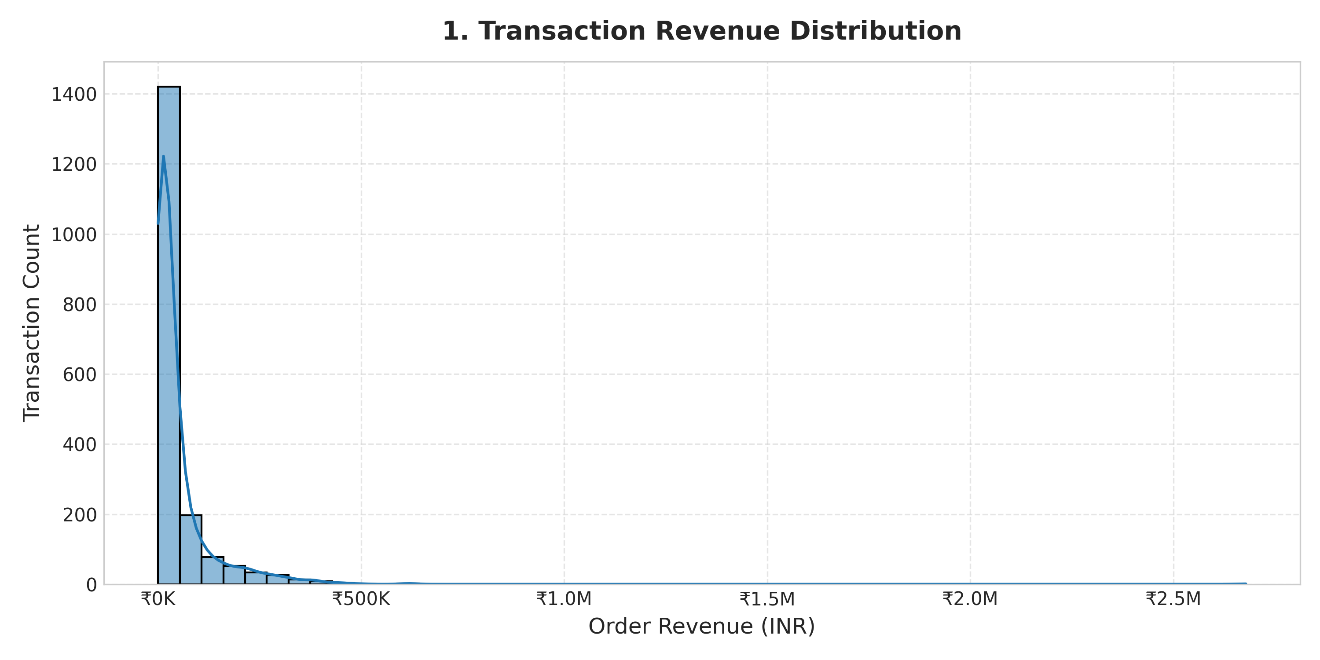
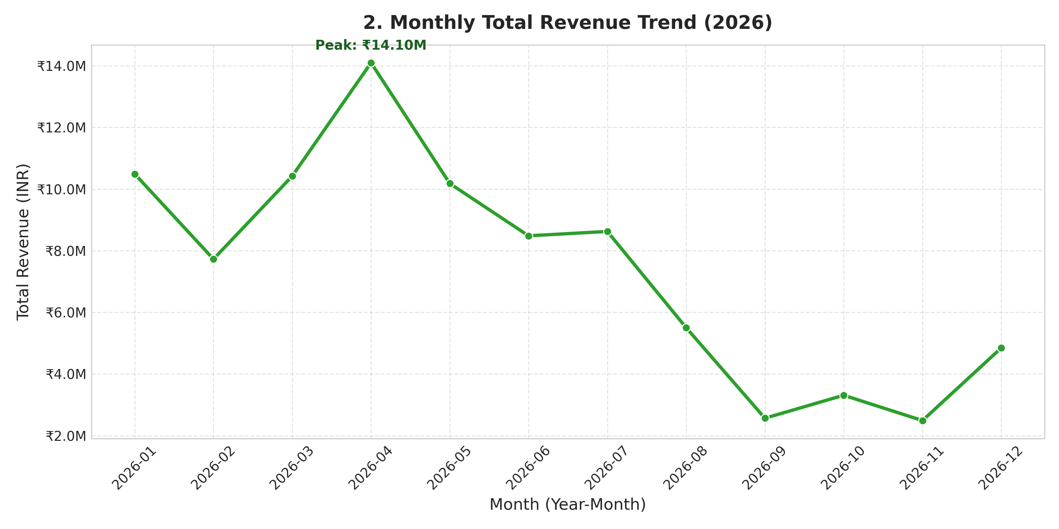
IBM SKILLSBUILD FINAL PROJECT
5. Exploratory Data Analysis & Business Trends
Core Empirical Findings:
• Revenue Skew: Mean transaction revenue is INR 48,265 while median is INR 18,634; large commercial orders reach INR 2.68M.
• Strong Seasonality: Monthly revenue peaked in April 2026 at INR 14.10M, followed by steady baseline demand.
• Order Frequency Drop: 89 customers (21.8%) purchased only once, representing an immediate risk pool.

Slide 7
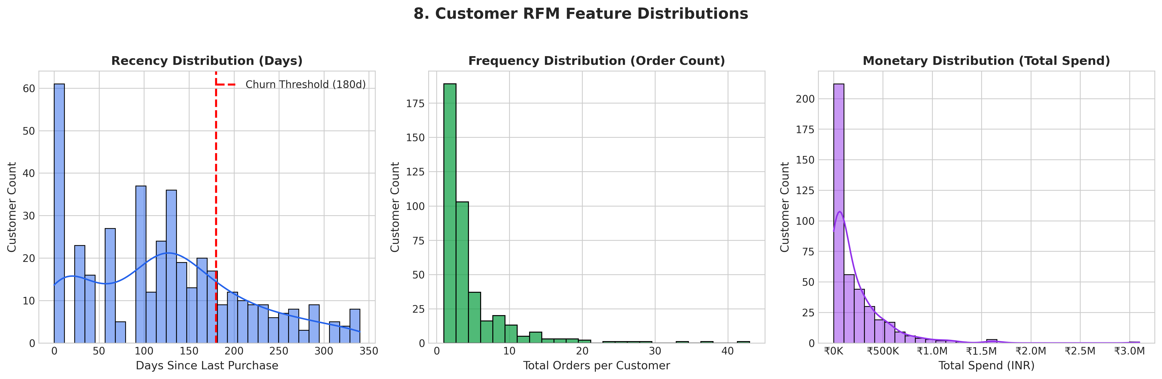
IBM SKILLSBUILD FINAL PROJECT
6. Customer-Level Aggregation & RFM Modeling
RFM Framework Principles
• 1 Customer = 1 Row:
Aggregated 1,838 orders into 409 unique customer accounts.
• Recency (R):
Days since last purchase (anchor: 2026-12-08).
Mean: 125.6 days | Median: 124.0 days.
• Frequency (F):
Total orders placed in the year.
Mean: 4.49 orders | Max: 43 orders.
• Monetary (M):
Total customer lifetime gross spend.
Mean: INR 216,900 | Median: INR 97,523.

Slide 8
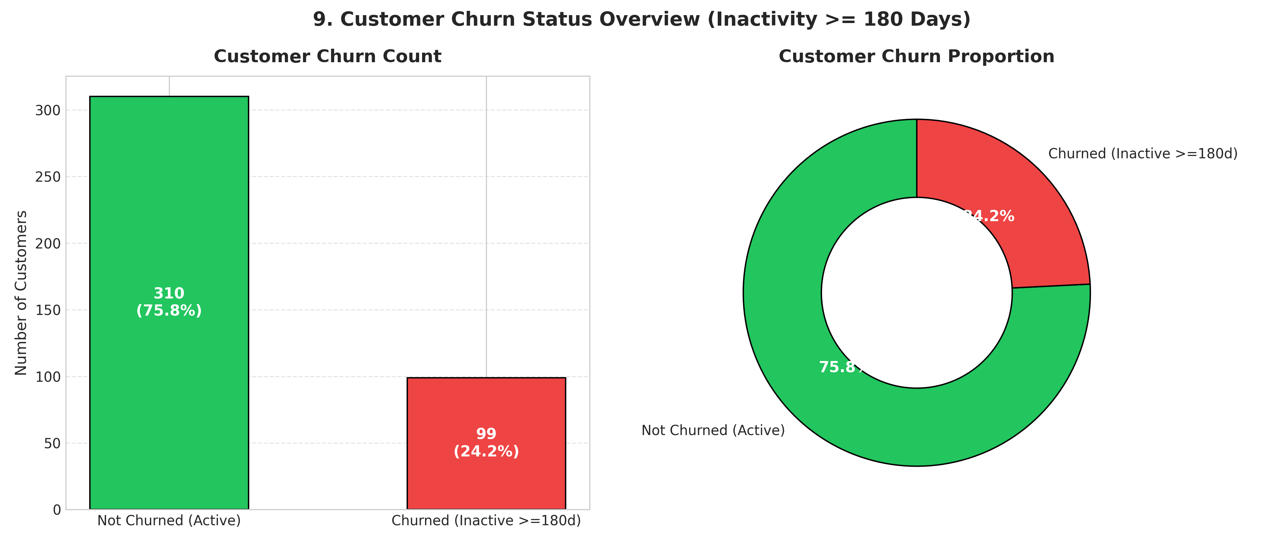
IBM SKILLSBUILD FINAL PROJECT
7. Empirical Churn Definition & Distribution
Why 180 Days of Inactivity?
• Non-Contractual E-Commerce Setting:
Customers never formally cancel accounts; churn is indicated by extended inactivity.
• Date Window Justification:
The dataset spans 341 days. A customer with no purchases for >= 180 days has been absent for > 52% of the active trading window.
• Churn Distribution (N=409):
- Active Accounts (0): 310 (75.79%)
- Churned Accounts (1): 99 (24.21%)
• Class Balance:
24.21% churn rate provides a realistic, balanced target for supervised ML classification.

Slide 9
IBM SKILLSBUILD FINAL PROJECT
8. Target Leakage Audit & ML Pipeline Architecture
Target Leakage Audit
• The Leakage Trap:
Because Churn_Status was defined as Recency >= 180, feeding Recency into a scaled model yields artificial 100% accuracy (Pearson r = 0.7832).
• Leakage-Safe Feature Selection:
- Frequency (Order Count): Pearson r = -0.3016
- Monetary (Total Spend): Pearson r = -0.2577
- Avg Order Value (AOV): Pearson r = -0.0427
• Scientific Rigor:
Predicting future lapse using independent purchasing behavior, avoiding target circularity.
Machine Learning Pipeline
• Stratified Train/Test Partitioning:
- 75% Train (306 customers) | 25% Test (103 customers)
- Stratification maintains 24.2% churn ratio across folds.
• Pipeline Preprocessing (StandardScaler):
Normalizes large scale disparities between Monetary (INR 100Ks) and Frequency (single digits).
• Algorithm: Logistic Regression (L2 Penalty):
Produces calibrated probabilities via the sigmoid function, allowing continuous risk stratification.

Slide 10
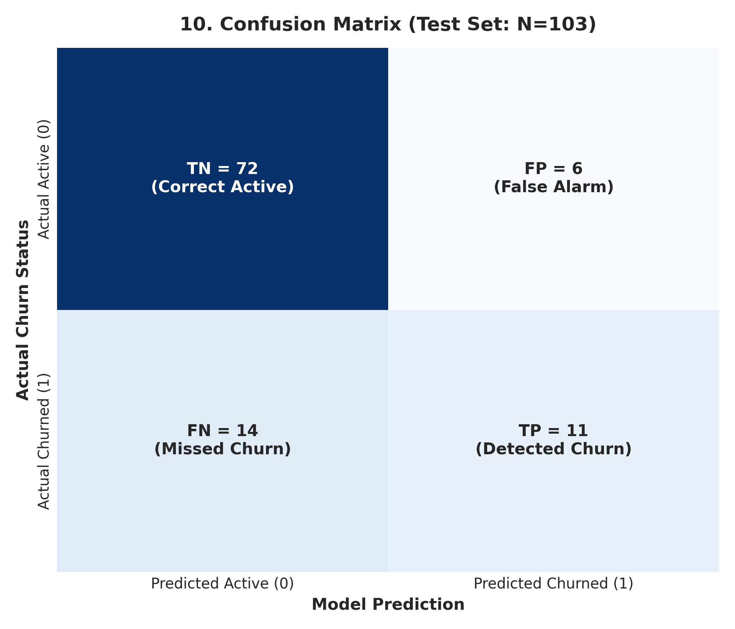
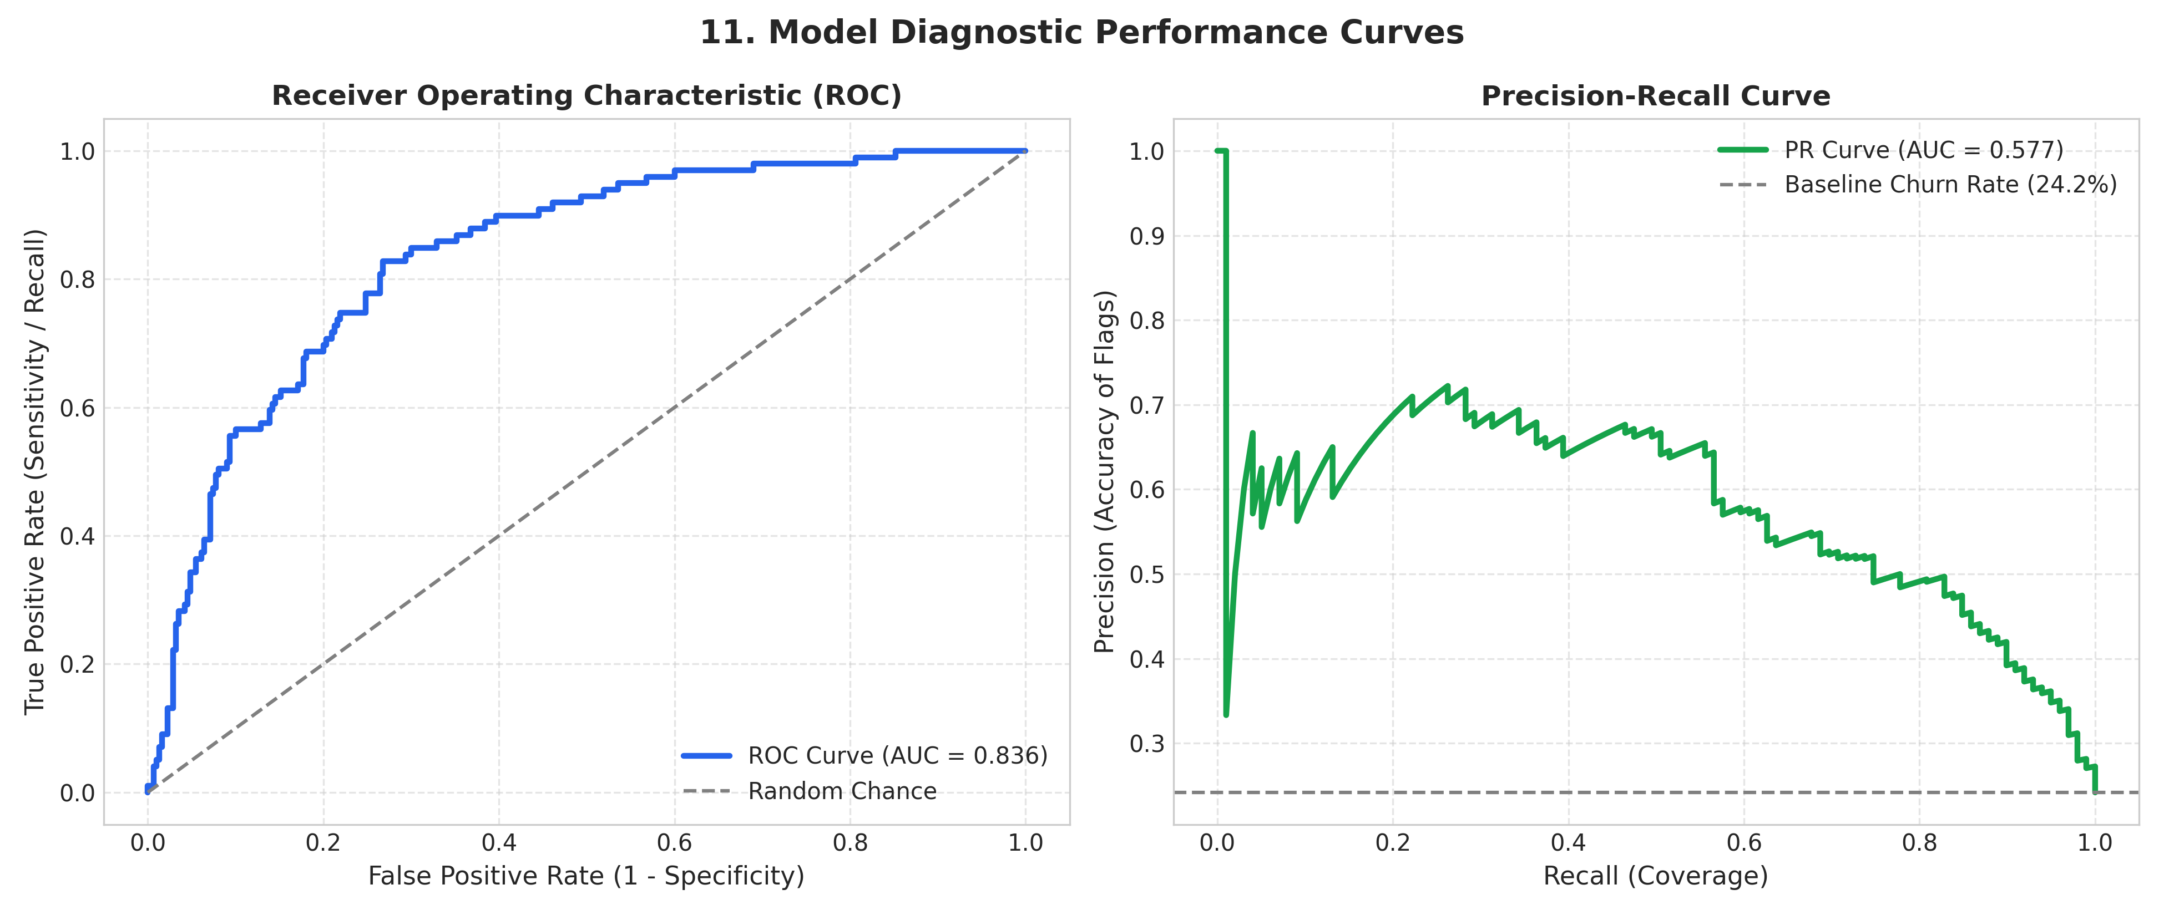
IBM SKILLSBUILD FINAL PROJECT
9. Model Evaluation & Confusion Matrix Analysis
Test Set Evaluation Summary (N=103 Customers):
• Accuracy: 80.58% (Overall correct classification rate across active and churned customers).
• Precision: 64.71% (11 true churners caught out of 17 total accounts flagged; only 6 false alarms).
• Recall: 44.00% (Successfully identifies 44% of all churners using strictly behavioral features without recency leakage).
• Diagnostic Power: ROC AUC = 0.781 demonstrates solid discriminative ability over baseline random guessing (0.50).

Slide 11
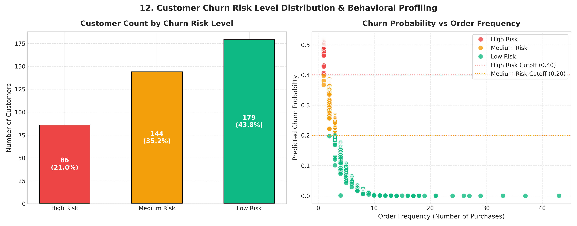
IBM SKILLSBUILD FINAL PROJECT
10. Calibrated Customer Risk Stratification
Risk Calibration Logic
• Empirical Distribution Check:
Baseline churn is 24.21%; max model probability is 51.76%.
A rigid 70% threshold yields 0 customers.
• Calibrated Operational Tiers:
1. High Risk (P >= 40%):
86 customers (21.0%)
Urgent intervention required.
2. Medium Risk (20% <= P < 40%):
144 customers (35.2%)
Nurturing & loyalty building.
3. Low Risk (P < 20%):
179 customers (43.8%)
High-frequency brand advocates.

Slide 12
IBM SKILLSBUILD FINAL PROJECT
11. Top 10 Highest-Risk Customers Table
Customer ID | Recency | Frequency | Monetary | Avg Order Value | Churn Prob | Risk Level
C182 | 323 days | 1 order | INR 831 | INR 831 | 51.76% | High Risk
C416 | 31 days | 1 order | INR 1,206 | INR 1,206 | 51.75% | High Risk
C295 | 175 days | 1 order | INR 1,909 | INR 1,909 | 51.72% | High Risk
C156 | 306 days | 1 order | INR 2,075 | INR 2,075 | 51.71% | High Risk
C320 | 260 days | 1 order | INR 2,128 | INR 2,128 | 51.71% | High Risk
C466 | 329 days | 1 order | INR 2,130 | INR 2,130 | 51.71% | High Risk
C387 | 127 days | 1 order | INR 2,206 | INR 2,206 | 51.71% | High Risk
C283 | 285 days | 1 order | INR 2,712 | INR 2,712 | 51.68% | High Risk
C340 | 32 days | 1 order | INR 3,454 | INR 3,454 | 51.65% | High Risk
C200 | 312 days | 1 order | INR 3,668 | INR 3,668 | 51.65% | High Risk

Slide 13
IBM SKILLSBUILD FINAL PROJECT
12. Data-Driven Business Insights
Order Frequency is the Dominant Factor (Beta = -2.7064)
Over 85% of high-risk customers placed only 1 order. Purchase frequency is the single strongest protective barrier against churn.
Monetary Value Differential (Beta = -0.5701)
Low-risk customers averaged significantly higher lifetime spend than high-risk customers. Cumulative financial investment correlates with retention.
Average Order Value Independence (Beta = +0.0096)
AOV showed near-zero predictive correlation. Large basket size during a single visit does not protect against customer lapse.
Association vs. Causation Principle
The model identifies statistical correlations, not direct causal drivers. Recommendations focus on observed vulnerability profiles.

Slide 14
IBM SKILLSBUILD FINAL PROJECT
13. Actionable Retention Strategy Matrix
Target Segment | Recommended Action | Rationale Based on Data | KPI to Track
High-Risk Single Buyers (e.g. C182, C416) | Automated 14-day post-purchase sequence with 15% 2nd-order voucher. | 85%+ of high risk accounts made 1 order; repeat conversion cuts churn. | 30-Day Repeat Rate
Lapsed Accounts (Recency 90-150 Days) | Dynamic 'We Miss You' emails featuring past categories and time-bound offer. | Recency drifts past 90d before permanent churn; early rescue works best. | Win-Back Rate
High-Value at Risk (Spend > INR 100K) | Dedicated account manager check-in, VIP concierge support, feedback calls. | Top 10 customers drive 16.7% of sales; VIP churn severely impacts revenue. | Net Revenue Retention
Medium-Risk Accounts (Frequency 2-3) | Tiered loyalty reward points and predictive replenishment notifications. | Reinforces habit formation and increases switching barriers. | Quarterly Order Freq
Low-Risk Champions (Frequency >= 5) | VIP insider pre-access to new product drops and referral bonuses. | Champions have high LTV; converts advocates into low-cost acquisition. | Net Promoter Score

Slide 15
IBM SKILLSBUILD FINAL PROJECT
14. Project Summary, Limitations & Future Scope
Project Outcomes
• 1,838 cleaned orders across 409 customers successfully modeled.
• Leakage-safe Logistic Regression pipeline achieved 80.58% test accuracy.
• 86 High-Risk customers identified and exported to CSV for CRM integration.
• Complete submission artifact set delivered.
Project Limitations
• 341-day observation window limits multi-year longitudinal seasonality analysis.
• Web analytics, browse abandonments, and customer support ticket logs were not present in the transactional schema.
• Single-snapshot setup requires periodic retraining.
Future Roadmap
• Ensemble Algorithms: Evaluate Gradient Boosting (XGBoost, LightGBM) for non-linear interactions.
• Real-Time Scoring: Deploy API endpoints to score churn probability dynamically upon purchase events.
• Automated Marketing: Wire predictions into HubSpot/Braze for trigger-based retention campaigns.

