Slide 1

Inheritance
Inheritance in Java is a mechanism in which one object acquires all the properties and behaviors of a parent object. It is an important part of OOPs (Object Oriented programming system).
Inheritance represents the IS-A relationship which is also known as a parent-child relationship.

Slide 2
Subclass
Super Class
extends keyword
Key Points
Sub Class/Child Class: Subclass is a class which inherits the other class. It is also called a derived class, extended class, or child class.
Super Class/Parent Class: Superclass is the class from where a subclass inherits the features. It is also called a base class or a parent class.
The extends keyword indicates that you are making a new class that derives from an existing class. The meaning of "extends" is to increase the functionality.

Slide 3
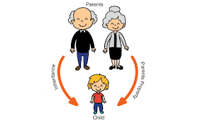
Why use inheritance in java?
For Method Overriding (so runtime polymorphism can be achieved).
For Code Reusability.

Slide 4
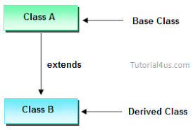
The syntax of Java Inheritance
class Subclass-name extends Superclass-name
{
//methods and fields
}

Slide 5
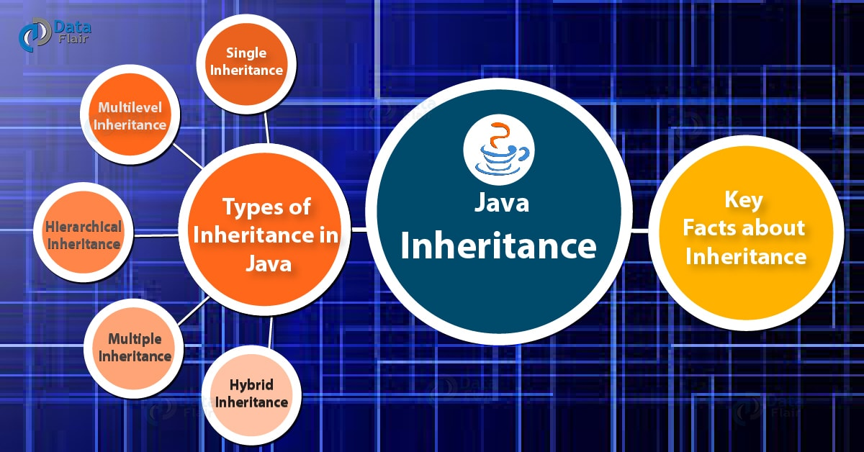
Types of inheritance in java

Slide 6
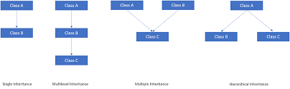

Slide 7
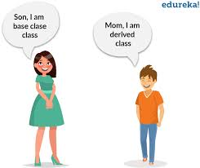
Single inheritance

Slide 8

Multilevel Inheritance

Slide 9

Hierarichal Inheritance

Slide 10
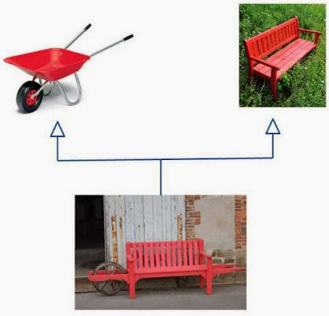
Why multiple Inheritance is not supported in Java ?

Slide 11
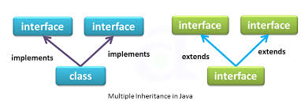

Slide 12


