Slide 1
Report on - AbDb: Antibody structure database — A database of PDB derived antibody structures - Saba Ferdous - Andrew C.R. Martin
Samiksha Shrimali
1911048
A3

Slide 2
Introduction
This database simplifies the process of analyzing structures of proteins of a particular class. These need to be extracted from the Protein Data Bank (PDB).
In the case of antibodies, there are a number of special considerations and it can turn to be tedious because:
They may be crystallized with or without antigen; for analysis purposes, one is normally only interested in the Fv region of the antibody; structural analysis requires individual antibody-antigen complexes from a PDB file which may contain multiple copies of the same, or different, antibodies.
Consequently, there is a need for a specialist resource containing pre-numbered non-redundant antibody Fv structures with their cognate antigens.

Slide 3
In particular they wished their resource to:
• Correctly identify proteins and not treat them as antigens.
• Provide downloadable isolated Fv (variable) fragments
• Provide multiple numbering schemes (Kabat , Chothia and Martin)
• Split PDB files containing multiple antibodies into separate files, each containing antigen chains as appropriate.
• Deal with instances of anti-idiotypic antibodies where each antibody is
treated both as antibody and as antigen.
• Provide information on redundancy (representative antibodies and lists of
non-redundant antibodies and redundant sets)

Slide 4
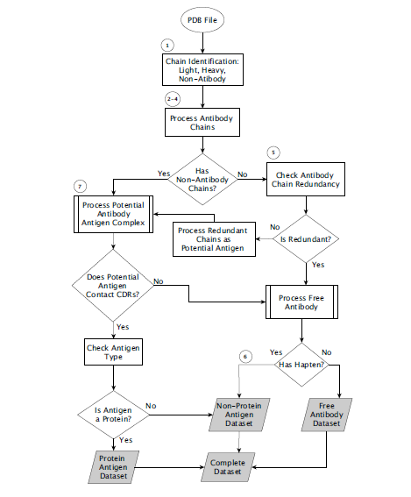

Slide 5
Step 1: Identify Chain Types. Each PDB file is processed to identify the chain types present: light, heavy or antigen. An in-house program aligns the sequence of each PDB chain with consensus light and heavy chain variable domain sequences.
Each chain is provisionally assigned as light or heavy depending on their scores against a sequence value alloted within the program.
Each chain that was provisionally identified as light in the previous step is then reassigned as antigen if it does not have the highest score for a match against the light chain sequence and its score is less than 80%

Slide 6
Step 2: Assign antibody type. A decision is then made as to whether the antibody is ‘complete’ (containing both light and heavy chains), light-chain only or heavy-chain only. Complete antibodies and antibodies containing a single chain type are then processed differently to deal with correct chain pairing.
Step 3: Splitting and Numbering. In a PDB file, peptide, protein, DNA, and RNA antigens are present with distinct chain labels The file is then split such that each chain (as defined by the chain label in the PDB file) is placed in its own file. The files containing the antibody chains are then numbered according to different numbering skills.

Slide 7
Step 4: Antibody Reassembly.
Most PDB files containing ‘complete’ antibodies have either duplets of light and heavy chains, or triplets of light, heavy and antigen chains which appear in that order (i.e. light, heavy or light, heavy, antigen).
However, this is by no means always the case. Even the presence of L and H chain labels does not always indicate a pair of light and heavy chains forming an antibody.
It is therefore necessary to determine the correct pairs of light and heavy chains from the chain type assignments in the split chains.

Slide 8
Step 5: Assigning Antibody/Antibody Complexes.
Initially antibodies in PDB files containing no non-antibody chains are assigned as free antibodies. However, if the PDB file contains more than one antibody, it is possible that one is acting as an antigen for the other. (If the sequences of the two antibodies are identical then this will not be the case, but if the sequences are different then they will be forming antibody antigen pairs .)
All such antibodies are placed in the protein antigen set.

Slide 9
Step 6 and 7 : Assigning Free/Complexed Antibodies
All the antibodies currently assigned as uncomplexed, are checked for the presence of non-protein antigens including haptens, lipids and carbohydrates. All such antibody complexes are placed in the non-protein antigen set.
Step 8: Annotating the PDB files.
All the files are annotated according to certain rules.
During numbering of the antibody chains, the chain
labels are indicated and mapped as L and H chains to their original chain labels in the source PDB file.

Slide 10
Redundancy processing
Each antibody pair (both light and heavy chains) is compared on the basis of the residue labels that are present in both sequences. For example, if residue L24 is present in both sequences and the amino acid is different, then the two antibodies would not be regarded as redundant.
This process is repeated across all pairs of antibodies in order to identify redundant clusters.
In order to select a representative from each cluster, if there were differences in lengths, then the shorter sequences are discarded.
From the remaining structures, the highest resolution structure is selected.
The non-redundancy processing is performed across each dataset described previously such that a non-redundant dataset is produced for each of the redundant sets.

Slide 11
Strategy to implement
With a similar database wherein structures of proteins can be analysed and they can be assigned different types using mysql and python.
Incorporate different numbering schemes.

Slide 12
Conclusion
AbDb provides a regularly updated resource with processed antibody structures
and has a number of features not provided by other antibody structure
resources. In particular, it provides:
• Processed PDB files containing only the variable domains and split into
individual antibodies with cognate antigens (including multi-chain and non protein
antigens),
• PDB files numbered with three numbering schemes
• 36 simply classified downloadable datasets: complete antibodies, lightchain-
only and heavy-chain-only also split into free antibodies, complexes
with protein antigens and complexes with non-protein antigens (all numbered
with all three numbering schemes)
• Non-redundant versions of each of the 36 datasets, information files describing redundant clusters
• Information on redundancy when searching by PDB code: a list of all processed
PDB files containing redundant antibodies is provided.
• Files describing antibodies available (both complexed and uncomplexed)

Slide 13
Bibliography
https://www.engpaper.com/database-2018.htm
Database URL: www.bioinf.org.uk/abs/abdb/
https://www.rcsb.org
https://bio.libretexts.org/Bookshelves/Microbiology/Book%3A_Microbiology_(Boundless)/

Slide 14
THANK YOU!

