Slide 1
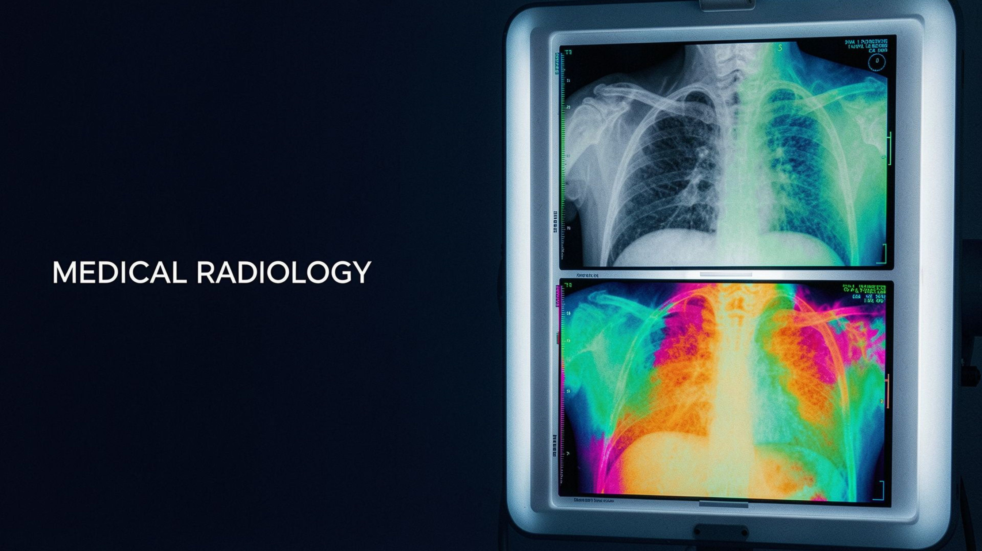
CUDA C · MEDICAL IMAGE PROCESSING
Image Colour Inversion
Using CUDA C Programming
Parallel implementation of image inversion and pseudocolour mapping for medical radiology.
Every pixel, its own thread: turning grayscale X-rays into enhanced colour views in parallel.
Notes:
1

Slide 2



THE PROBLEM
What problem does this project solve?
It turns grayscale intensity into visual contrast that is easier to inspect.
Grayscale input
Invert intensity
X-rays store intensity from 0 = black to 255 = white.
Each pixel becomes 255 - input.
CUDA workflow
Pseudocolour
cudaMalloc(), cudaMemcpy(), cudaFree(), cudaEventRecord(), and cudaEventSynchronize().
Intensity values map into RGB colours to reveal differences.
Notes:
2

Slide 3
THE TRANSFORMATION
How the image transformation works
01
02
03
04
Read
Launch
Transform
Compare
Read the grayscale image as pixel intensity values.
Launch a CUDA kernel so threads process pixels independently.
Create inverted and pseudocolor outputs from the same input.
Save multiple visualizations for side-by-side comparison.
CPU LOOP
GPU KERNEL
One pixel after another
Many pixels at once
Pixels are handled sequentially.
Independent pixels are processed in parallel.
Notes:
3

Slide 4
WHY CUDA C
Why CUDA C is useful here
Each pixel in a medical image, such as a chest X-ray, holds brightness from 0 (black) to 255 (white). CUDA gives each pixel its own GPU thread.
SERIAL CPU WORK
PARALLEL GPU WORK
One by one
All together
Inversion and colourization wait for each pixel to finish before the next begins.
Independent pixels are processed simultaneously across the image.
Invert
Colorize
Combine
255 - input creates a negative view.
Turn brightness into a blue → green → red heatmap.
Create a combined visualization. The eye distinguishes more colours than shades of gray, helping radiologists see subtle density differences.
Notes:
4

Slide 5
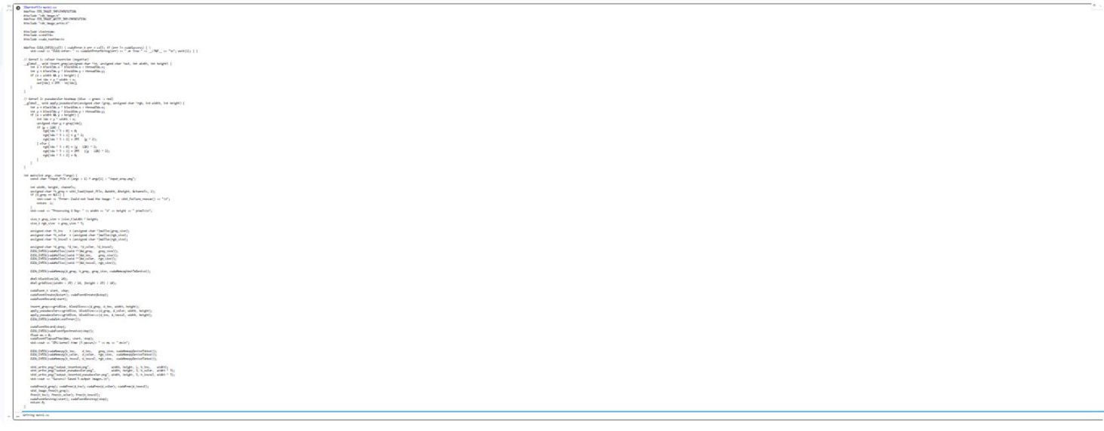
IMPLEMENTATION
Notes:
5

Slide 6
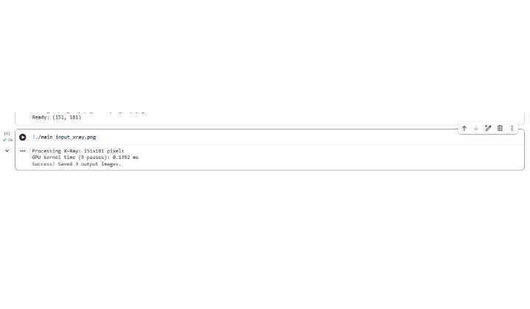
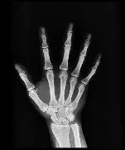
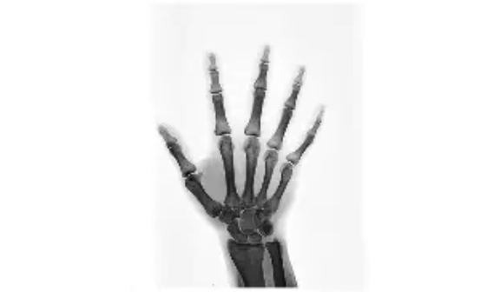
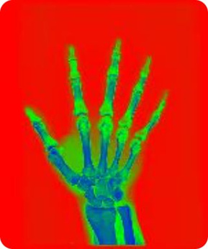

VERIFICATION
Output verification and four visual results
OUTPUT IMAGES
Input X-ray
Inverted
Inverted pseudocolour
Pseudocolour
Notes:
6

