Slide 1
JDBC (Java Database Connectivity)
From Classic JDBC to Modern, Production-Ready JDBC
Samiksha Suhas Asodekar
Java Database Connectivity Deep Dive

Slide 2

Why Learn JDBC?
Core skill for backend + full‑stack developers
Used in real projects, interviews & enterprise systems
Direct control over SQL logic
Builds foundation for ORM tools

Slide 3
Prerequisite – SQL Basics
SQL = Structured Query Language
Tables → rows → columns
Key operations:
CREATE TABLE Customers (
CustomerID INT PRIMARY KEY,
Name VARCHAR(50),
City VARCHAR(50)
);

Slide 4
Joins, Subqueries & Aggregations
Joins: Combine data from multiple tables
(INNER, LEFT, RIGHT)
Subqueries: Query inside another query
Aggregations: SUM, COUNT, AVG, MIN, MAX
SELECT Name, Department, Salary
FROM Employees e
WHERE Salary > (
SELECT AVG(Salary)
FROM Employees
WHERE Department = e.Department
);

Slide 5
Prerequisite – Performance & Indexing
Indexes → speed up queries (B‑Tree structures)
Normalization vs Denormalization → balance storage vs speed
Transactions → ensure consistency (Commit / Rollback)

Slide 6
What is JDBC?
JDBC = Java Database Connectivity API
Provides standard classes & interfaces to interact with databases
Allows:
Opening / closing connections
Sending SQL statements
Reading / writing data

Slide 7
JDBC Architecture
Flow: Application → JDBC API → DriverManager / DataSource → Driver → Database
Key Components:
DriverManager → Manages drivers
Connection → Link to DB
Statement → Executes SQL
ResultSet → Holds query results

Slide 8
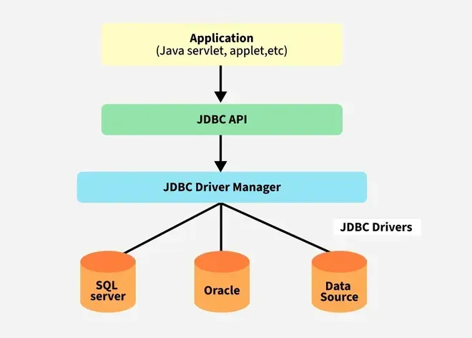
JDBC Driver Types
Type | Name | Description | Status
1 | JDBC‑ODBC Bridge | Uses OS‑level ODBC driver | ❌ Removed (JDK 8)
2 | Native API | Calls database native C/C++ libs | Legacy
3 | Network Protocol | Middleware server converts requests | Rare
4 | Thin Driver | Pure Java, communicates directly DB | ✅ Standard choice

Slide 9
JDBC Evolution (Old → New)
Pre Java 6 (≤ JDBC 3.0) ➡️ Manual driver loading (Class.forName()), manual resource closing
JDBC 4.0 (Java 6) ➡️ Auto‑load driver, new SQL types (RowId, SQLXML, NClob)
JDBC 4.1 (Java 7) ➡️ try‑with‑resources → auto close
JDBC 4.2 (Java 8) ➡️ java.time API support, large updates, JDBCType, REF CURSOR
JDBC 4.3 (Java 9 +) ➡️ beginRequest(), endRequest(), ShardingKey, ConnectionBuilder

Slide 10
Core Interfaces
Connection → Establish link, start / commit / rollback transactions
Statement → Execute SQL queries directly
PreparedStatement → Parameterized + secure queries
CallableStatement → Call stored procedures

Slide 11
ResultSet & RowSet
ResultSet (java.sql)
Holds query results row by row
Connected → requires active DB link
Retrieve data via getString() or getObject()
RowSet (javax.sql)
Extends ResultSet
Disconnected → can work without active connection
Scrollable, updatable, serializable (can be sent over network)

Slide 12
Modern JDBC (Java 8+ Style)
Driver auto‑loaded (JDBC 4.0 +)
try‑with‑resources → automatic closing
DataSource pooling → efficient connections
java.time API support
// Driver auto-loaded (JDBC 4.0 +)
try (Connection con = dataSource.getConnection();
PreparedStatement ps = con.prepareStatement(
"INSERT INTO audit(ts, who) VALUES (?, ?)")) {
ps.setObject(1, java.time.Instant.now());
ps.setString(2, userId);
ps.executeUpdate();
}

Slide 13
Transactions
Group multiple SQL statements into one logical unit
Methods: commit(), rollback()
Ensures ACID properties:
Atomicity → All or nothing
Consistency → DB remains valid
Isolation → Transactions don’t interfere
Durability → Data saved permanently after commit
con.setAutoCommit(false); // Start transaction
try {
psTransfer.executeUpdate(); // Debit
psReceive.executeUpdate(); // Credit
con.commit(); // Success
} catch (SQLException e) {
con.rollback(); // Failure → Undo
}

Slide 14
Batch Processing
Execute many SQL statements at once
Reduces network calls → boosts
performance for bulk inserts/updates
Use addBatch() to queue statements
Use executeBatch() or executeLargeBatch()
(JDBC 4.2 +) to run them together
try (PreparedStatement ps = con.prepareStatement(
"INSERT INTO emp VALUES (?, ?)")) {
ps.setInt(1,1); ps.setString(2,"Alice"); ps.addBatch();
ps.setInt(1,2); ps.setString(2,"Bob"); ps.addBatch();
ps.setInt(1,3); ps.setString(2,"Charlie"); ps.addBatch();
ps.executeLargeBatch(); // JDBC 4.2 +
}

Slide 15
Handling Large Data (LOBs)
LOB = Large Objects (BLOB, CLOB, NCLOB, SQLXML)
Used for storing images, audio, video, documents
Access via getBlob(), getClob(), getNClob(),
getSQLXML()
Stream APIs → handle data efficiently
try (PreparedStatement ps = con.prepareStatement(
"INSERT INTO files(name, data) VALUES (?, ?)")) {
ps.setString(1, "report.pdf");
ps.setBlob(2, new FileInputStream("report.pdf"));
ps.executeUpdate();
}

Slide 16
Connection Pooling
Reuses database connections instead of creating
new ones each time
Improves performance & scalability in multi‑user
applications
Managed by DataSource objects (instead of
DriverManager)
Popular libraries: HikariCP, Apache DBCP, C3P0
// Using DataSource for pooling
DataSource ds = getDataSource();
try (Connection con = ds.getConnection();
PreparedStatement ps = con.prepareStatement(
"SELECT * FROM users WHERE active=?")) {
ps.setBoolean(1, true);
ResultSet rs = ps.executeQuery();
}

Slide 17
Best Practices
Always use PreparedStatement → prevents SQL injection
Close resources with try‑with‑resources → avoids leaks
Prefer DataSource over DriverManager → enables pooling
Use batch updates for bulk operations → improves performance
Handle transactions carefully → commit or rollback explicitly
Log SQL exceptions → easier debugging

Slide 18
Common Pitfalls in JDBC
❌ Forgetting to close connections → memory leaks
❌ Using Statement instead of PreparedStatement → SQL injection risk
❌ Hardcoding DB credentials → security issues
❌ Not handling exceptions properly → unstable apps
❌ Ignoring transactions → inconsistent data

Slide 19
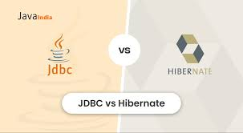
JDBC vs ORM Tools
Aspect | JDBC | ORM (e.g., Hibernate, JPA)
Control | Full SQL control | Abstracted, less SQL visibility
Complexity | Manual coding, verbose | Simplified, declarative mappings
Performance | Fine‑tuned, but manual | Optimized internally, may add overhead
Learning Curve | Easier if you know SQL | Steeper, requires ORM concepts
Use Case | Small apps, performance‑critical | Large apps, rapid development

Slide 20
JDBC in Real Projects
Bullets (Content):
Used in enterprise apps for direct DB access
Common in banking, retail, logistics systems
Often combined with connection pooling for scalability
Forms the base layer for ORM tools (Hibernate, JPA)
Still relevant for performance‑critical modules
Example Use Case:
Banking system → JDBC for transaction layer (fast, reliable, ACID)
Reporting system → ORM for higher‑level queries

Slide 21
Summary & Key Takeaways
JDBC = Java Database Connectivity API → bridges Java apps with databases
Core interfaces: Connection, Statement, PreparedStatement, CallableStatement
Advanced features: Transactions, Batch Processing, LOBs, Connection Pooling
Evolution: modern JDBC (Java 8+) → cleaner, safer, more efficient
Best practices: use PreparedStatement, manage resources, handle transactions, prefer DataSource

Slide 22
Thank You!

