Slide 1
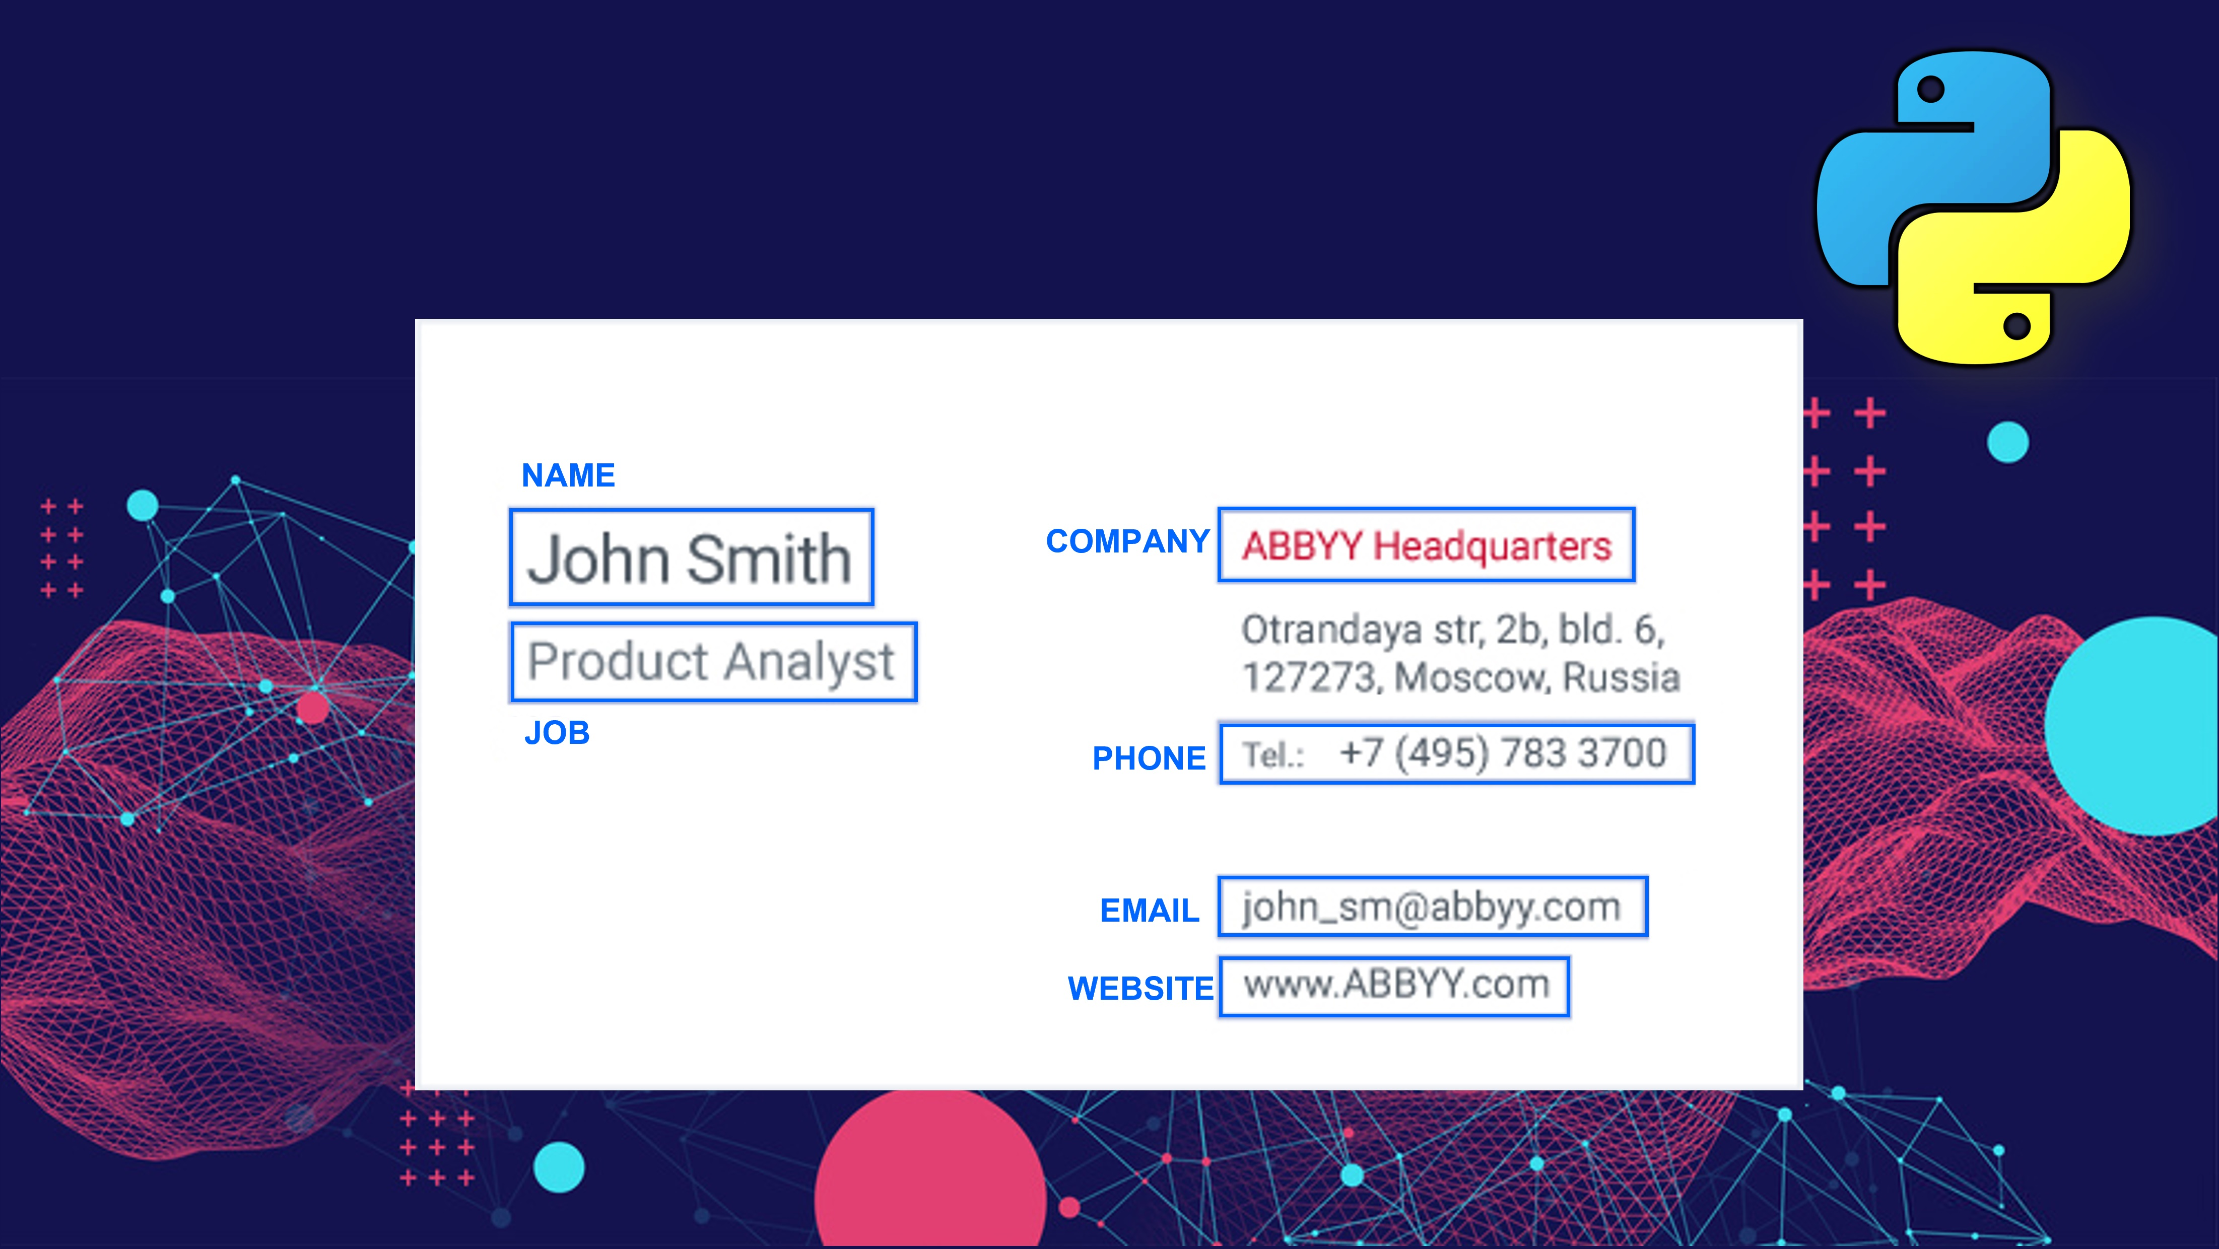

Slide 2

Intelligently Extract Text & Data From Documents with
OCR
Named Entity Recognition (NER)

Slide 3
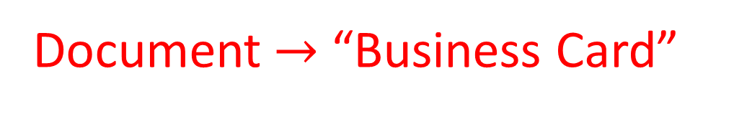
Intelligently Extract Text & Data from Documents Project
Document $→$ “Business Card”
However, you can use same technique explained in the course with any Financial Document (invoice, Bill of Lading etc)

Slide 4
Intelligently Extract Text & Data from Documents Project
Project Features:
Extract Entities (text & data) from Business Card (Image).
Eg: Name, Organisation, Phone, Email and Web

Slide 5
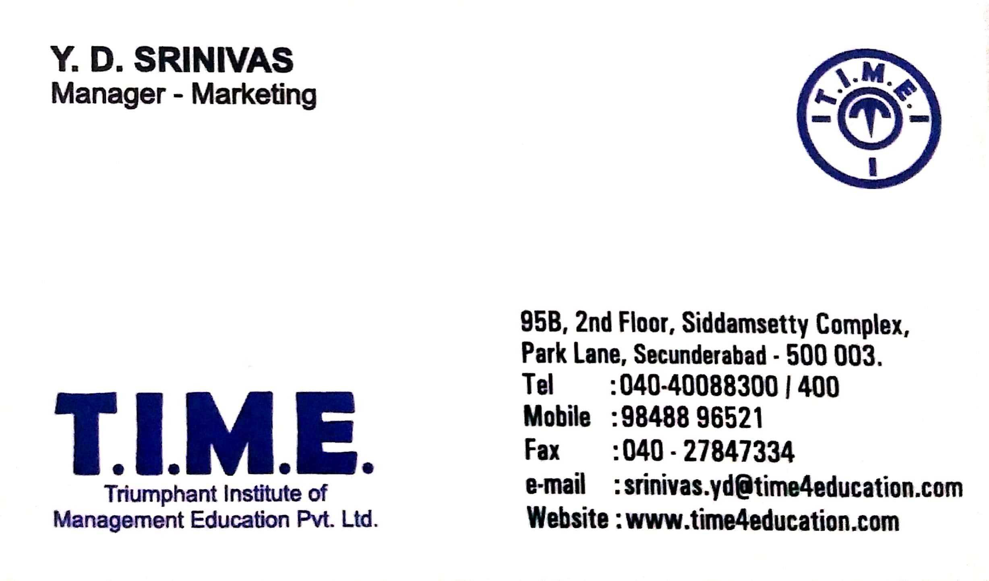
Intelligently Extract Text & Data from Documents Project
Project Features:
Extract Entities (text & data) from Business Card (Image).
Eg: Name, Organisation, Phone, Email and Web
Task
Location of Entity Text of Corresponding Entity

Slide 6
Intelligently Extract Text & Data from Documents Project
Project Features:
Extract Entities (text & data) from Business Card (Image).
Eg: Name, Organisation, Phone, Email and Web
Name | Y.D Srinivas
Designation | Manger - Marketing
Organisation | Triumphant Institute of Management Education Pvt Ltd
Phone | 040-40088300/400, 9848896521
Email | srinivas.yd@time4.education.com
Web | www.time4education.com
Scanned Business Cad

Slide 7








Technologies
Computer Vision
Natural Language Processing
Extract Entities from Text
Identify Location of Text
Extract Text from Image
Scanning Document
Cleaning and Parsing

Slide 8
Stages of Development
Setting up Project
Data Preparation
Labelling
Data
Pre-processing
Training Named Entity Recognition
Prediction
Document Scanner App
Installation
Extract text and Location from Business Card
BIO Tagging
Text Cleaning & Processing
Train Machine Learning Model
Parsing and Bounding Box
Automatic Document Scanning App

Slide 9
let's start the project

