Slide 1
Business Card Named Entity Recognition

Slide 2
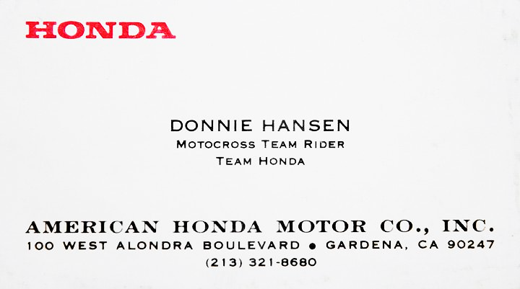
IDEA
Scanned Business Cad

Slide 3
IDEA
Name | Donnie Hansen
Designation | Motocross Team Rider
Organization | American Honda Motor Co. Inc
Phone | 213 321 8680
Email
Website
Scanned Business Cad

Slide 4
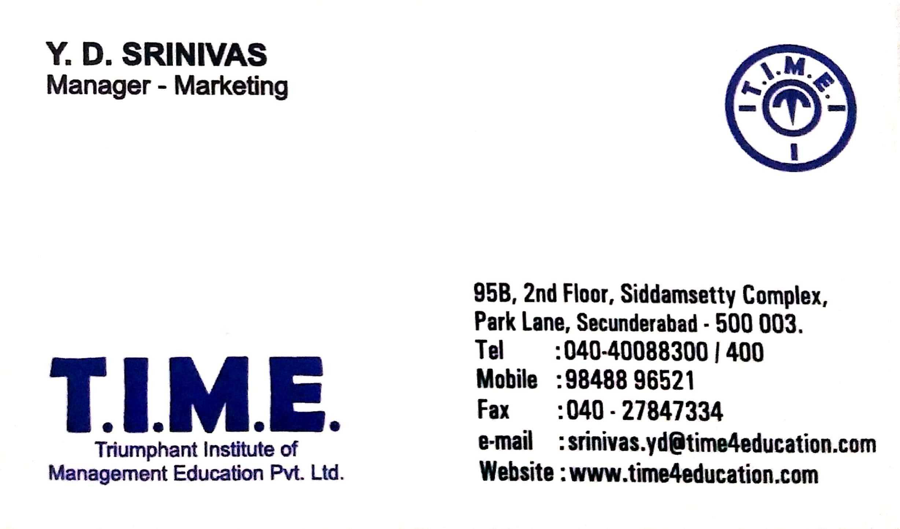
IDEA
Name | Y.D Srinivas
Designation | Manager – Marketing
Organization | Triumphant Institute of Management Education Pvt Ltd
Phone | 040-40088300/400, 9848896521
Email | srinivas.yd@time4.education.com
Website | www.time4education.com
Scanned Business Cad

Slide 5

Architecture
A
Text Cleaning
Entities
text
NLP
Extract Text from Image
Using OCR
Deep Learning Model
Trained in SpaCy
For NER
Name | Donnie Hansen
Designation | Motocross Team Rider
Organization | American Honda Motor Co. Inc
Phone | 213 321 8680
Email
Website

Slide 6






Training Architecture
A
Labeling
Text Cleaning
text
ner
Extract Text from Image
Using OCR
Train NER Model in spaCy

Slide 7
next
Collecting Data

